Slide 1
Finite Elasticity

Slide 2
Arrangements
Twelve lectures on seismology and Earth structure
Two linked problem sets – solutions online immediately
Supervisions in the weeks of 17th November and 1st December – sign up information to come
Change in lecture style – fewer topics, more detail
Lecture content builds directly on each other

Slide 3
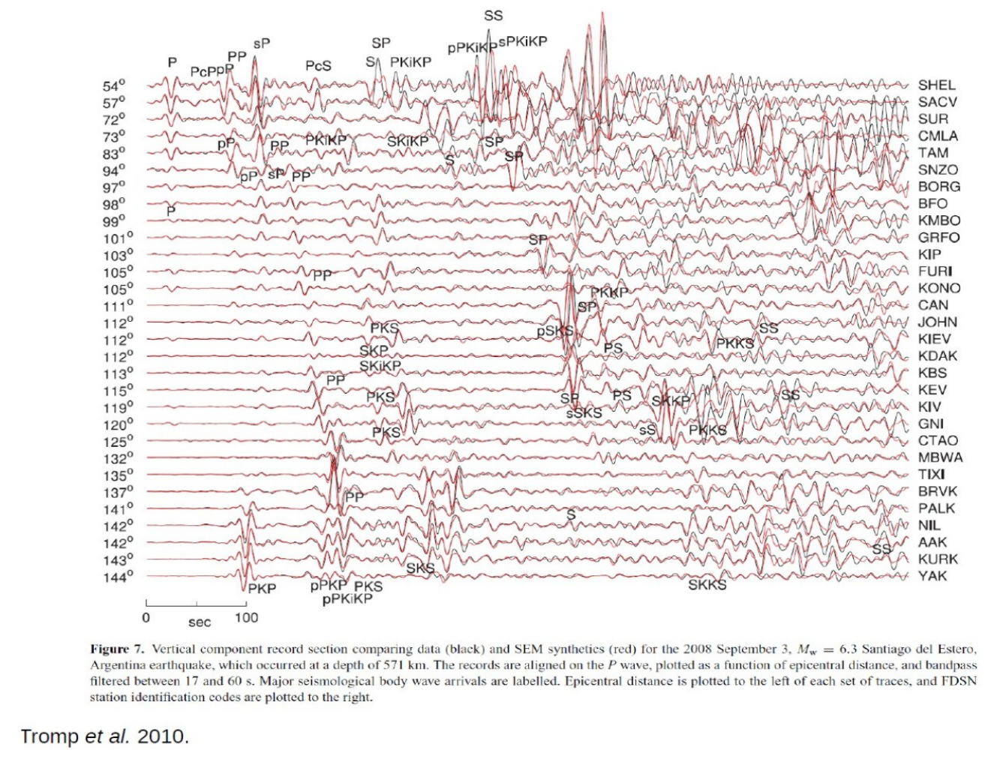

Slide 4
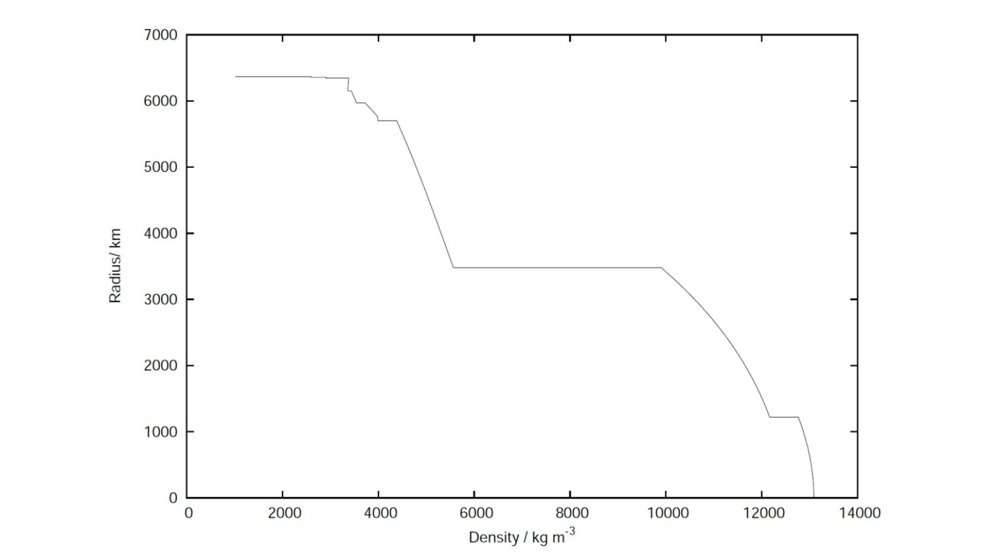
Model of Earth’s interior density structure. Believed to be accurate enough to conclude that the outer core is less dense than would be expected for an iron-nickel alloy. Suggests there is a “light element” in the core. Tells us something about planetary formation and differentiation.

Slide 5
Kinematics

Slide 6
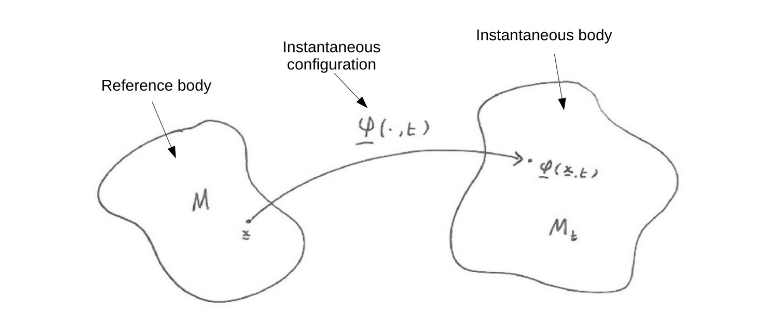

Motion of a body

Slide 7
Referential vs spatial descriptions
Referential quantities are functions of position within the reference body
Spatial quantities are functions of position within physical space
In either case, functions might also depend on time
In fluid mechanics, spatial (or Eulerian) descriptions most common
In solid mechanics, referential (or Lagrangian) descriptions most common
These conventions follow ultimately from the constitutive relations involved

Slide 8
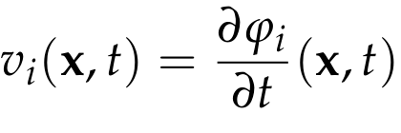
Referential velocity
Referential velocity is the velocity of fixed particles:
Can be related to the spatial velocity using the motion
We will always use the referential velocity, and typically just call it the velocity

Slide 9
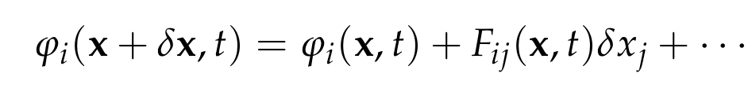

Deformation gradient
First-order Taylor expansion of the motion about a fixed point:
Deformation gradient has components:
Related to the strain tensor – more details in the next lecture

Slide 10

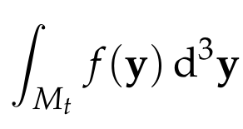
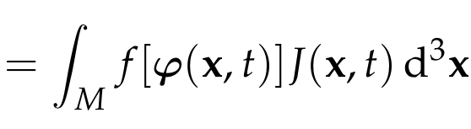
Jacobian
The Jacobian of the motion is defined by:
Must be non-zero if the instantaneous configurations are invertible. We can assume it is always positive so that the motion is orientation preserving
Can be used to transform spatial integrations to the reference body:

Slide 11
Conservation of mass

Slide 12
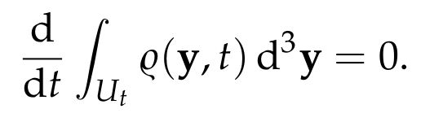
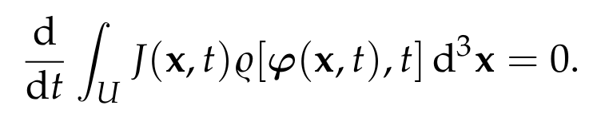
Integral conservation laws
For an arbitrary sub-body, we must have:
Transforming the integral to the reference body, we find:

Slide 13
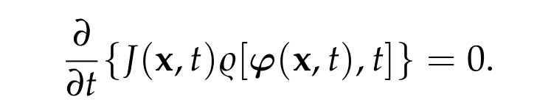
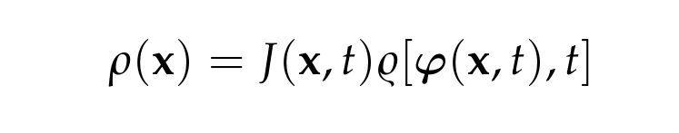
Local conservation laws
Because the sub-body was arbitrary, we must have:
This leads us to define the referential density:
Note slight notation change between printed handouts
Referential density is just the density within the reference configuration

Slide 14
Kinetic and potential energies

Slide 15

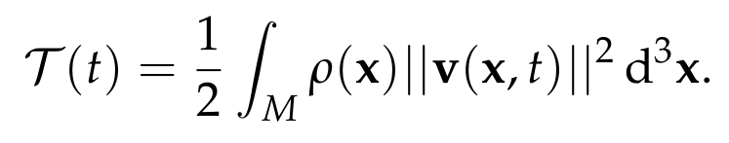
Kinetic energy
Kinetic energy density is defined by analogy with particle mechanics:
Note this definition is per unit volume in the reference body
Kinetic energy of the body at an instance in time is given by:

Slide 16
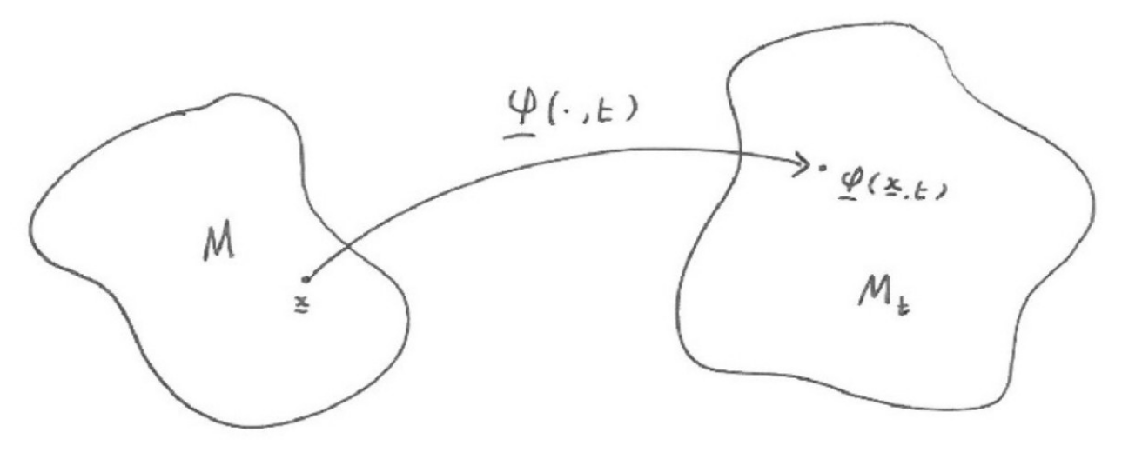
Hyperelastic bodies
Elastic bodies have a preferred shape and/or volume, with work being necessary to deform them away from this preferred state
If the work required depends only on the final configuration, there is a well-defined potential energy. Such bodies are said to be hyperelastic

Slide 17
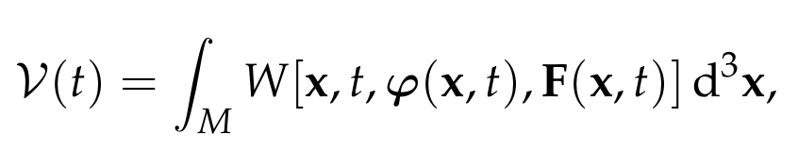
Elastic potential energy
We assume that the potential energy takes the form:
This choice defines a simple hyperelastic body
The term simple means that the potential energy density at a point depends only on the motion and its first spatial derivative at the same point
It’s possible to consider dependence on higher-order spatial derivatives at a point, or a non-local form for the potential energy density, but this is not obviously needed within real materials
The form of the potential energy can be simplified using symmetry arguments – this is an application of the principle of material frame indifference

Slide 18

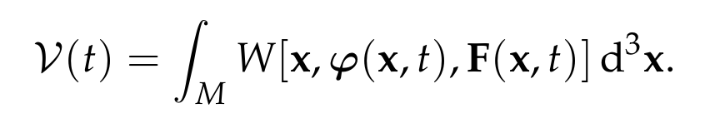
Time-translation invariance
If two motions differ only by a time-translation, we require that:
This condition is met if and only if the potential energy density simplifies:
No explicit time-dependence of the potential energy density

Slide 19
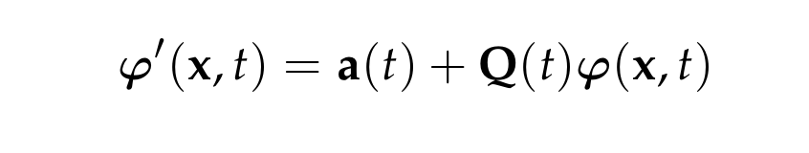
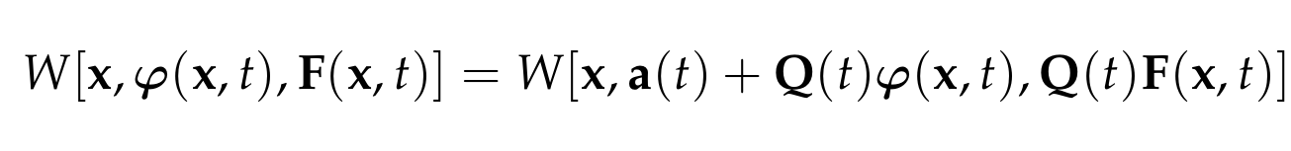
Super-imposed rigid body motions
Two motions differing by a rigid body motion can be related by:
We require the motions to have the same potential energy
A sufficient condition is that:
This can also be shown to be a necessary condition

Slide 20


Super-imposed rigid body motions
Focusing first on spatial translations, we conclude that
No explicit dependence on the particle’s position in space
Potential energy now reduced to:
The potential energy density is conventionally called the strain energy function

Slide 21
Hamilton’s principle

Slide 22
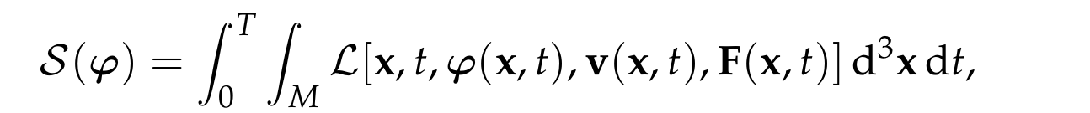

Action and Lagrangian
Variational arguments covered from first-principles and in full detail in the handout – please ask if you need any additional help
Action for the for a motion is defined by:
Where the Lagrangian takes the conventional form:
To each possible motion of the body, the action returns a single real number – it defines a functional of the body’s motion

Slide 23


Hamilton’s principle
Functional derivative of the action must vanish at the true motion:
so long as the variations to the motion have fixed-endpoints
This is Hamilton’s principle, and it is equivalent to Newton’s laws of motion for systems in which a potential energy is defined

Slide 24
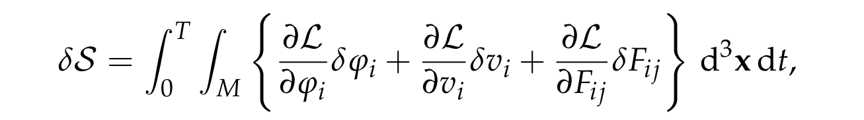

Variation of the action
To first-order in the perturbed motion, we have:
This can be simplified by relating variations in velocity and deformation gradient to the underlying motion:

Slide 25
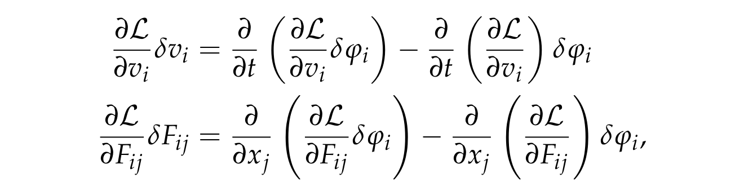
Variation of the action
Using the product rule, we see that:
We can then integrate by parts in time, and use the divergence theorem to simplify the expression:

Slide 26
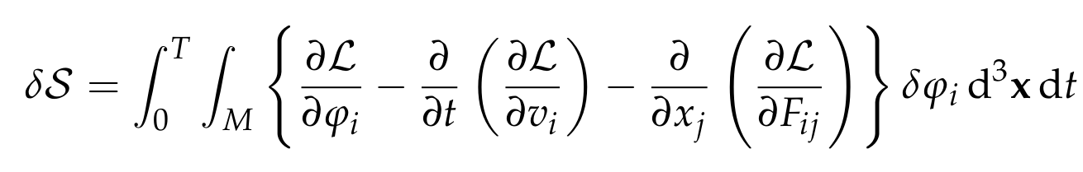
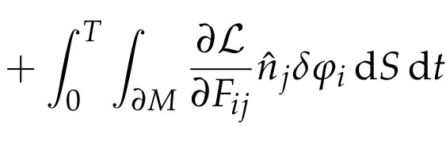
Variation of the action
Following this effort, the first order change in the action is:
Fixed-endpoint conditions have been used
We need the above expression to vanish for all such variations of the motion

Slide 27
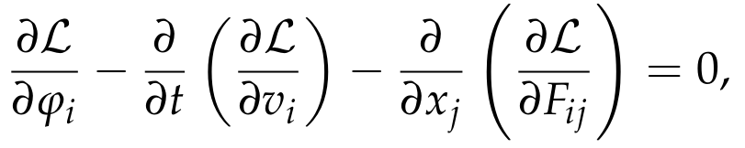

Euler-Lagrange equations
From Hamilton’s principle, we have obtained the Euler-Lagrange equation:
along with the natural boundary condition
These equations govern the motion of a simple hyperelastic body

Slide 28
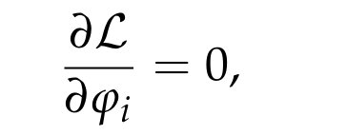
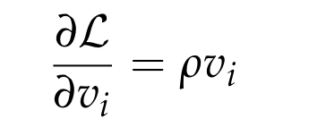
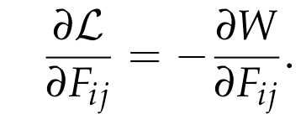
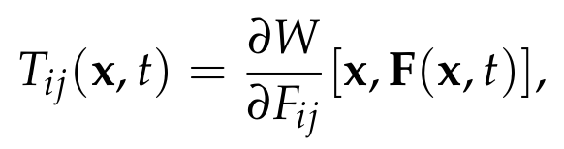
First Piola-Kirchhoff stress
For our Lagrangian, we see that
We define the first Piola-Kirchhoff stress tensor to be

Slide 29
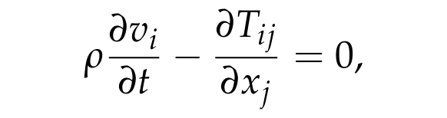

Conservation of linear momentum
Euler-Lagrange equations can now be written:
subject to the boundary conditions
In the third problem set, you will show these equations are equivalent to the conservation of linear momentum
You will also learn about the physical meaning of this new stress tensor

