Slide 1
Constitutive theory

Slide 2
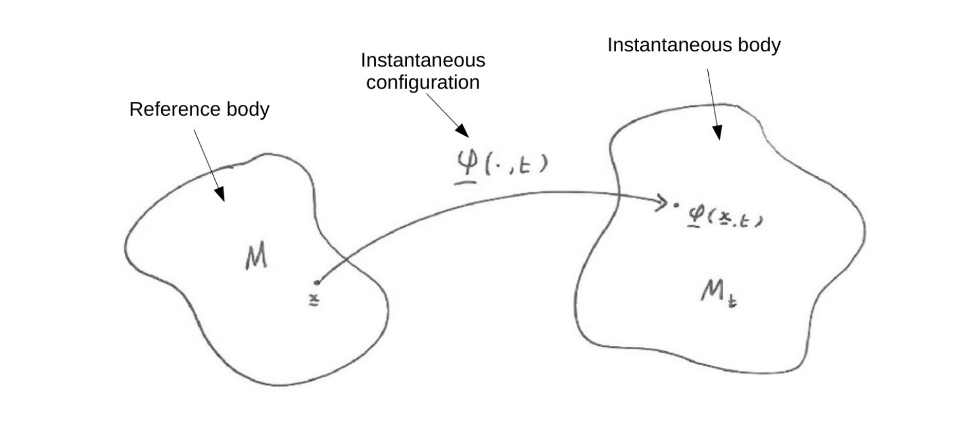


From last time

Slide 3
Material frame indifference

Slide 4
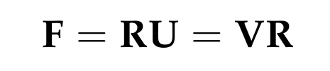
Polar decomposition theorem
For any invertible matrix with a positive determinant, we can write:
Rotation matrix
Symmetric positive-definite matrices
U and V have the same eigenvalues – same magnitude of stretching about rotated principal axes
Proof is non-examinable

Slide 5
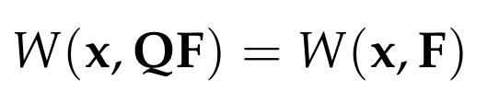
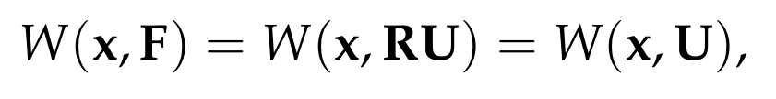
Rotational invariance of strain energy
We require the invariance property:
Writing F = RU, it follows that:
This shows that strain energy is only affected by the stretching part of the deformation gradient

Slide 6



Reduced strain energy function
We have shown that the strain energy must take the form:
where we have introduced the right Cauchy-Green deformation tensor:
Note that U is the square-root of C. We use C in practice because its simpler
Equivalently, we could use the finite strain tensor:

Slide 7

Consequences of the result
Recall the first Piola-Kirchhoff stress tensor defined by:
Using the chain rule, we can then write:
From a careful application of index-notation

Slide 8
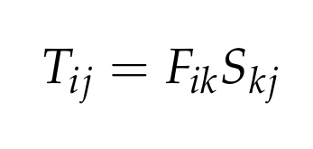
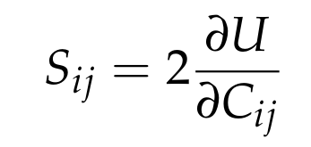
Consequences of the result
We have now shown that:
Where we have defined the second Piola-Kirchhoff stress tensor:
Note that S is a symmetric tensor – in the third problem set you will see that this symmetry is equivalent to the conservation of angular momentum

Slide 9
Equilibria and linearisation

Slide 10
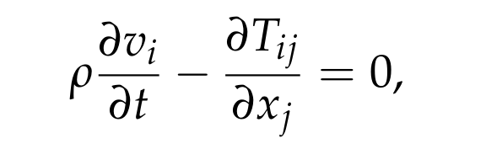
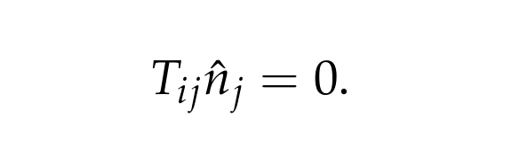
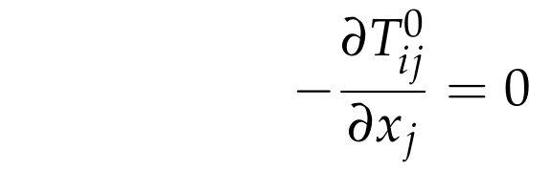
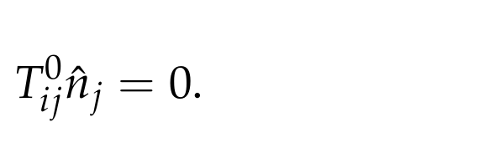
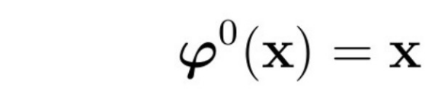
Equilibrium configurations
Equations of motion and boundary conditions:
Equilibrium conditions:
Stress-free equilibrium configurations are a possible solution!

Slide 11
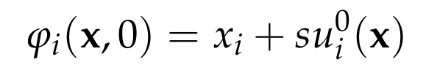
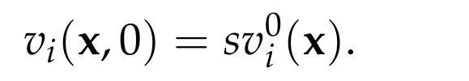
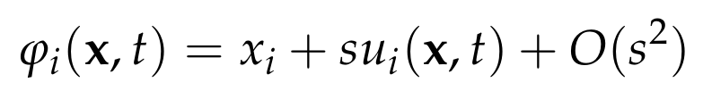
Linearisation about equilibrium
We consider an initial disturbance about a stress-free equilibrium:
Here “s” is a perturbation parameter that is used for book-keeping. The case s=0 corresponds to equilibrium
We expand the motion in powers of s:
The first-order coefficient, u, is known as the displacement vector

Slide 12
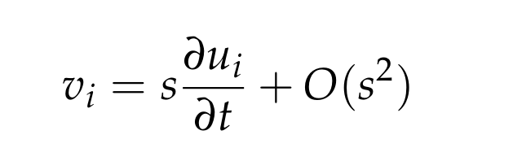
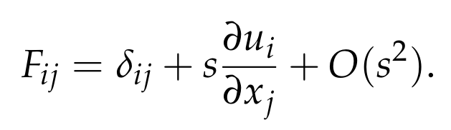
First order expansions
First-order expansions of the velocity and deformation gradient:

Slide 13

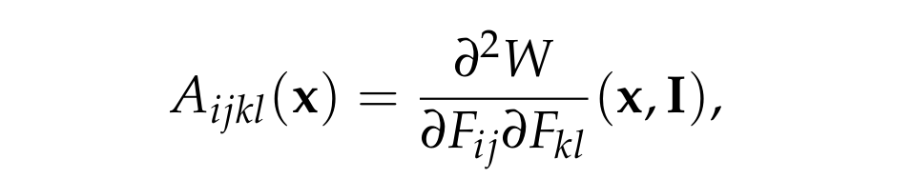

First order expansions
From the definition of the first Piola-Kirchhoff stress, we find:
where we have defined the elastic tensor:
This is Hooke’s law, but its nothing more than the result of linearisation
Note the hyperelastic symmetry which will be important:

Slide 14
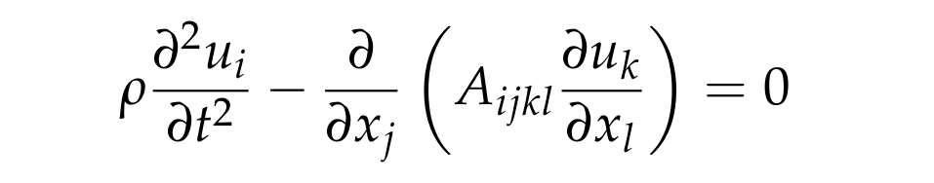

Linearised equations of motion
Linearised equation of motion:
Linearised boundary condition:
These linearised equations are sufficient for describing most aspects of seismic wave propagation within the Earth

Slide 15

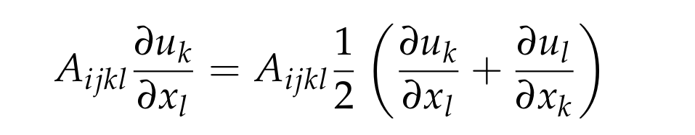
Additional symmetries
About a stress-free equilibrium, the elastic tensor possess additional symmetries:
You will show this in the third problem set
The allows us to write the linearised first Piola-Kirchhoff stress tensor:
where on the right we see the linearised strain tensor, which is often called the strain tensor in elementary (but inaccurate) discussions of elasticity

Slide 16
Material symmetries

Slide 17

The material symmetry group
Recall the invariance property under super-imposed rotations:
What happens if we do the rotation first?
This condition does not hold in general for all rotation matrices, Q
When it does, we say that Q is in the material symmetry group at this point
This reflects an invariance of the strain energy with respect to orientation of stretching. Physically, in reflects lattices symmetries in crystalline materials

Slide 18

Isotropic materials
An elastic body is isotropic at a point if the corresponding material symmetry group comprises all rotation matrices
Otherwise, the body is anisotropic at this point
Making use of material frame indifference, isotropy requires:
for all rotation matrices
It follows that the strain energy depends only on the eigenvalues of the right Cauchy-Green deformation tensor

Slide 19
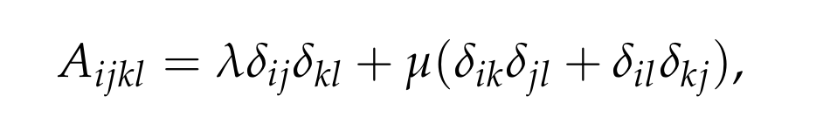
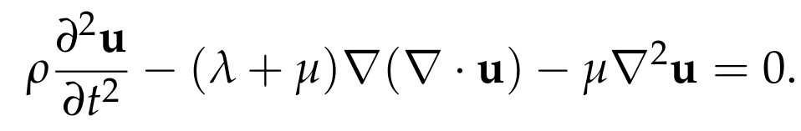
Isotropic materials
It is only a matter of tedious algebra to show that:
Specification of the full elastic tensor requires only the two Lame parameters
If the material is also homogeneous, the linearised equations reduce to:
This is the form presented in 1B dynamics, but there are a lot of assumptions necessary to get here, most of which don’t hold in the Earth

Slide 20


Elastic fluids
In an elastic fluid, there is no preferred shape, only a preferred volume
The strain energy depends only on the Jacobian of the motion:
Equivalently, the material symmetry group comprises all matrices with determinant equal to one (the special linear group)
In this case, the elastic tensor takes the simple form:

