Slide 1
Ray theory

Slide 2



From last lecture
Plane wave ansatz
Christoffel equation for plane waves:
Definition of the slowness surface:

Slide 3
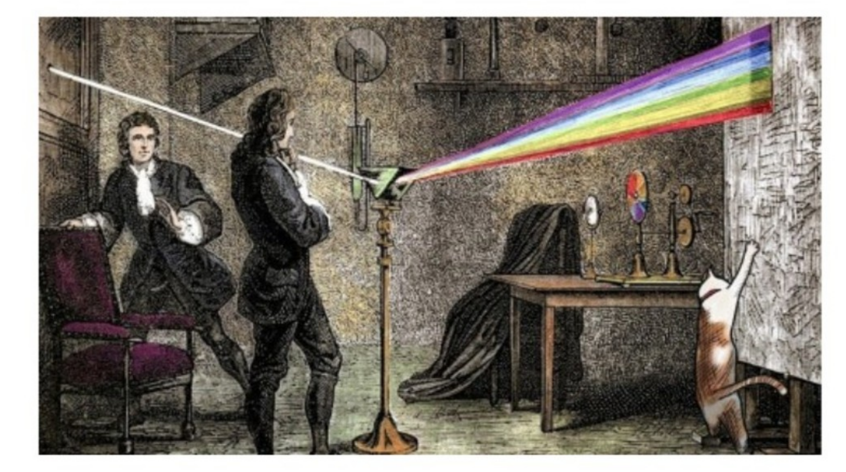
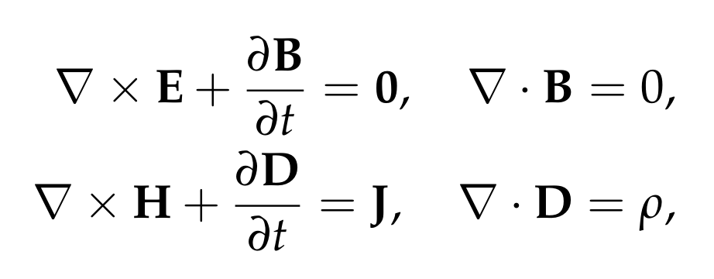

Slide 4
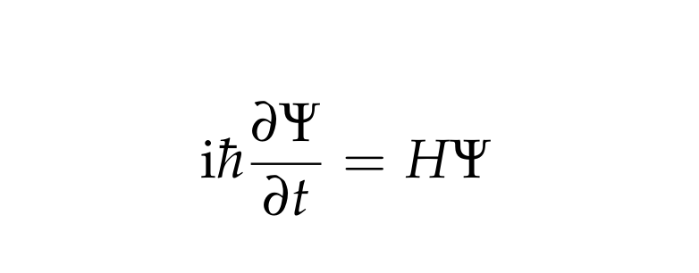
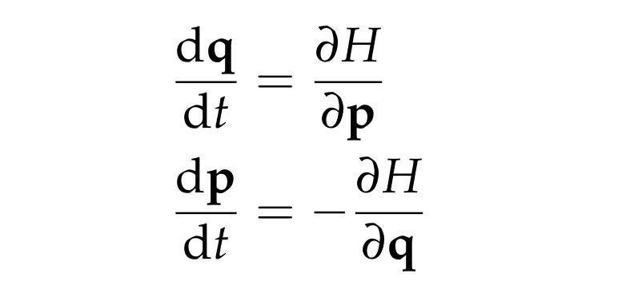
Quantum mechanics
Classical mechanics

Slide 5
Length scales of heterogeneity

Slide 6
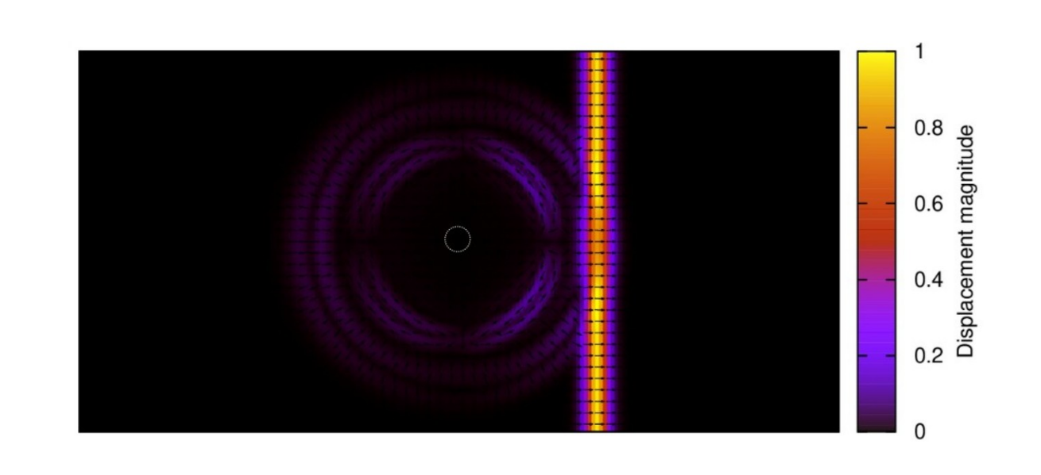

Scattering regime:

Slide 7
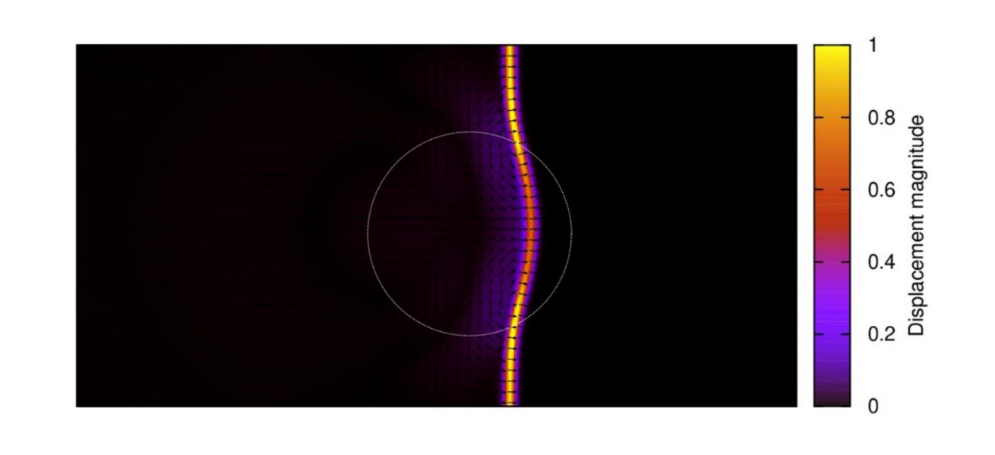
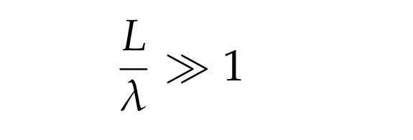
Geometric optics regime:

Slide 8
Ray series ansatz

Slide 9
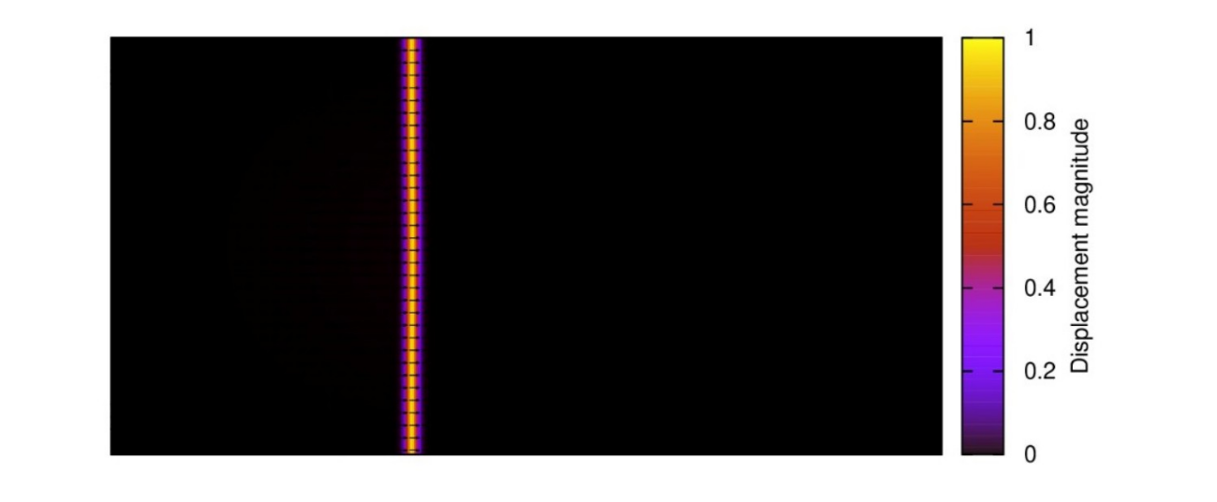

Canonical problem
Start with a plane wave within the homogeneous left half plane:
Can we extend this solution into the heterogeneous right half plane?

Slide 10
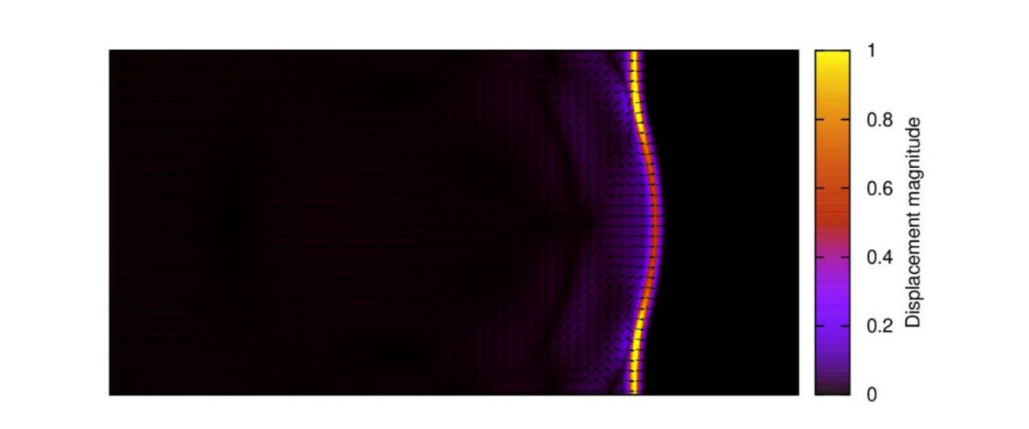

Initial ansatz
As an initial guess, we look for a solution of the form:

Slide 11

Travel time and local slowness
Assumed solution takes the form:
Introduction of the travel time function allows for curved wavefronts:
The local slowness vector is orthogonal to the wavefronts:
Polarisation vector allowed to vary with position – accounts for focusing effects and for variations in anisotropic properties with position

Slide 12
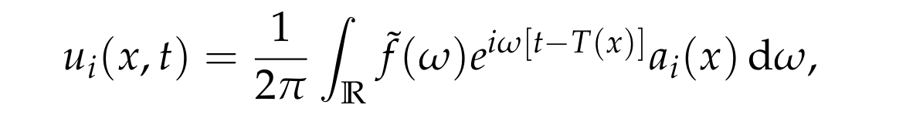

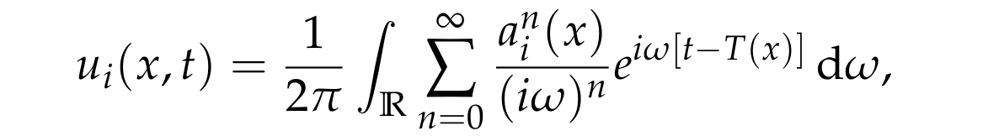
The ray series
Harmonic decomposition solution:
This is a convolution of f with the singular solution:
Experience has shown that we should generalise the singular part to:
First term (n=0) in the ray series is the singular one, while successive ones become smoother and smoother

Slide 13
The eikonal equation

Slide 14



Frequency-domain equations
Linearised equations with no force term:
Transforming to the frequency-domain:
Ray series in the frequency-domain:
We can now substitute in our ansatz and see what happens!

Slide 15

Lots of differentiation...
Example step from the calculation:
Factor of frequency is added each time we differentiate the phase term

Slide 16
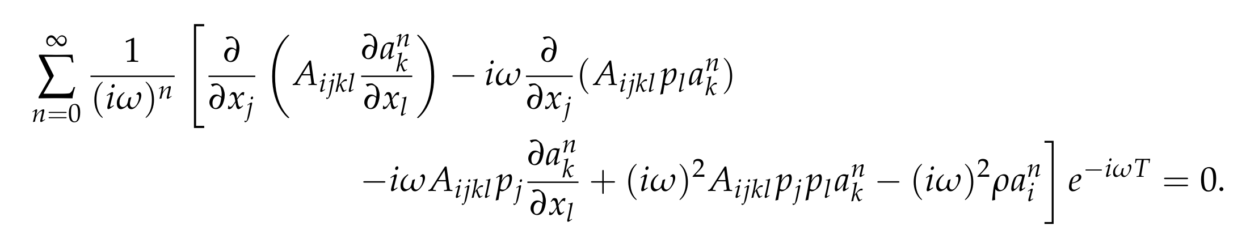
Result of the calculation
Equations of motion imply:
Common phase term cancels
These equations must hold for all frequencies – this implies that the coefficients of each power of frequency must separately vanish
Compare with power series solution of ODEs

Slide 17
Results of the calculation
From the highest order coefficient, we have:
At the next order:
For the general term with n > 1:
First equation determines p, while the later ones successively determine the polarisation vectors at different orders
Where have we made an approximation?

Slide 18
A short cut
In this course we will consider only the equation derived from the highest-order term in the expansion
If that is all that we required, we can systematically drop all but the highest order terms within the previous derivation:
This saves a lot of time!
You can practice these steps in Example sheet 3

Slide 19
Highest order condition
From the highest order coefficient, we have:
This motivates the definition of a local Christoffel matrix:
And so write the above condition as:
Locally, things look identical to plane waves!

Slide 20
The eikonal equation
The equation
has non-trivial solutions for the zeroth-order polarisation vector if and only if:
This is a non-linear first order PDE for the travel time called the eikonal equation
If the local slowness surfaces are everywhere non-degenerate:

Slide 21
The method of characteristic

Slide 22
Ray Hamiltonian
Recall the eikonal equation is:
If we defined the ray Hamiltonian for the kth sheet of the slowness surface:
We can write the eikonal equation in the form:

Slide 23
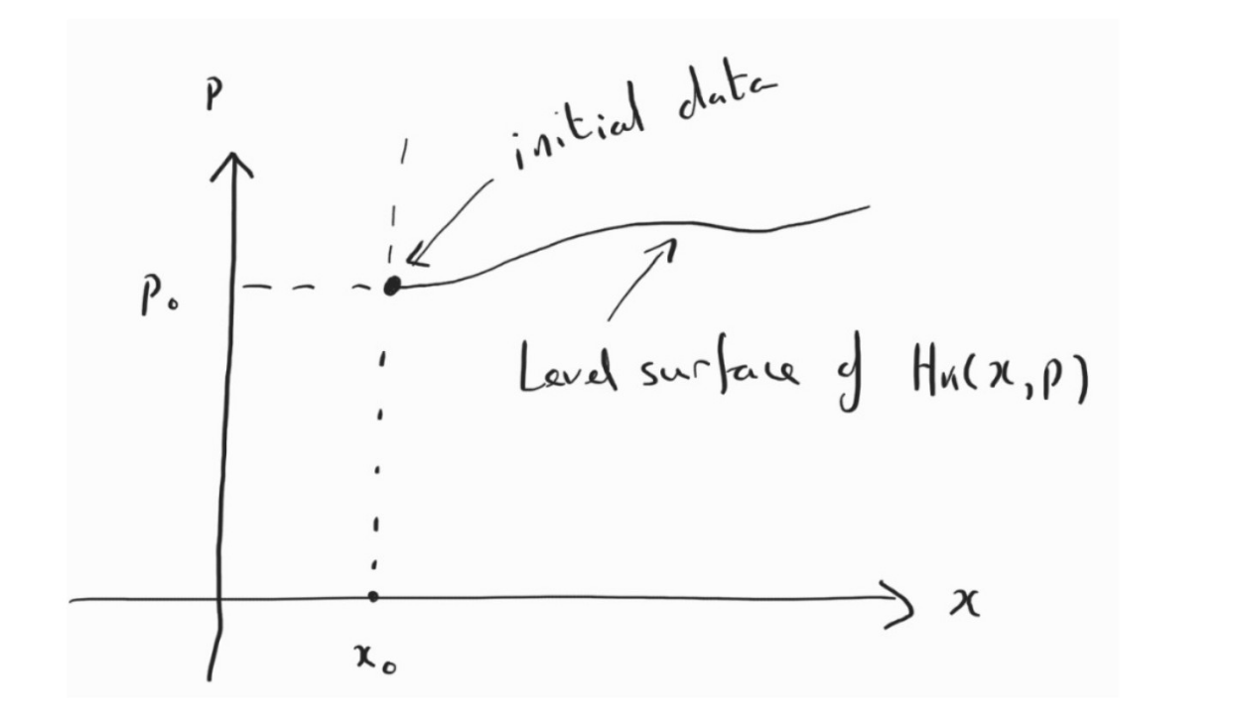
Geometric interpretation
Solution of eikonal equation is a 3D level surface of the Hamiltonian in a 6D phase space
Initial data specifies a 2D level surface in the phase space
The problem is how to extend this 2D surface into the appropriate 3D level surface
This is where Hamilton’s equations enter into the method

Slide 24

Hamilton’s equations
Initial data extended through integration of Hamilton’s equations:
This works because the Hamiltonian is constant along the integral curves:
There are a few subtler points to the method that are being ignored

Slide 25
Recovering the travel time
Rays are the projection of integral curves into the position-domain
Rate of change of the travel time along a ray:
Right hand side simplified using Euler’s homogeneous function theorem;
The generating parameter along the ray is equal to the travel time

Slide 26
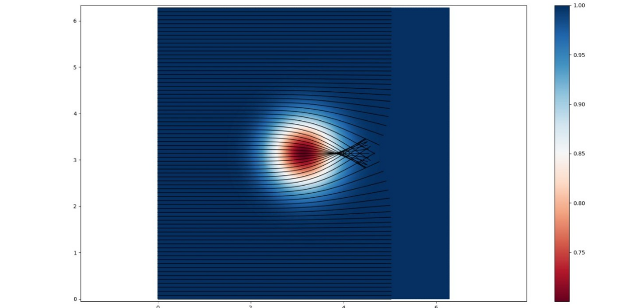
Caustics
If rays for two different integral curves touch, then the travel time need not be well-defined. These points are known as caustics. The ray theoretic amplitude is infinite at such points, while the true amplitude is large but finite

Slide 27
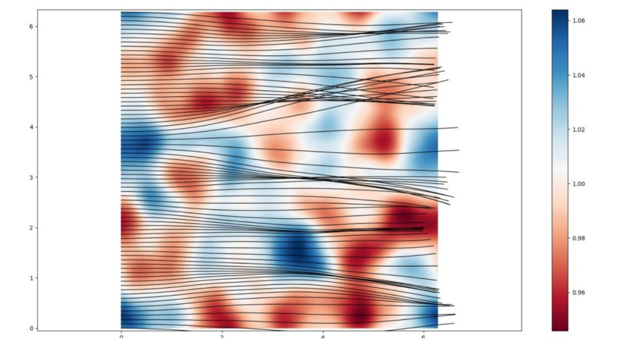
Caustics
Within heterogeneous materials, caustics occur frequently – c.f. Penrose Hawking singularity theorems in general relativity

