Slide 1

Feedback form for the course
Please do fill this in before the end of term
We do take comments seriously, and they help to make the course better over time
https://cambridge.eu.qualtrics.com/jfe/form/SV_3z0oG7tq3O9xtpc

Slide 2
Waveform tomography

Slide 3


From last time
Using Fermat’s principle, we find that:
Expand the velocity in a finite-dimensional basis:
Formulation as a regularised least squares problem:

Slide 4
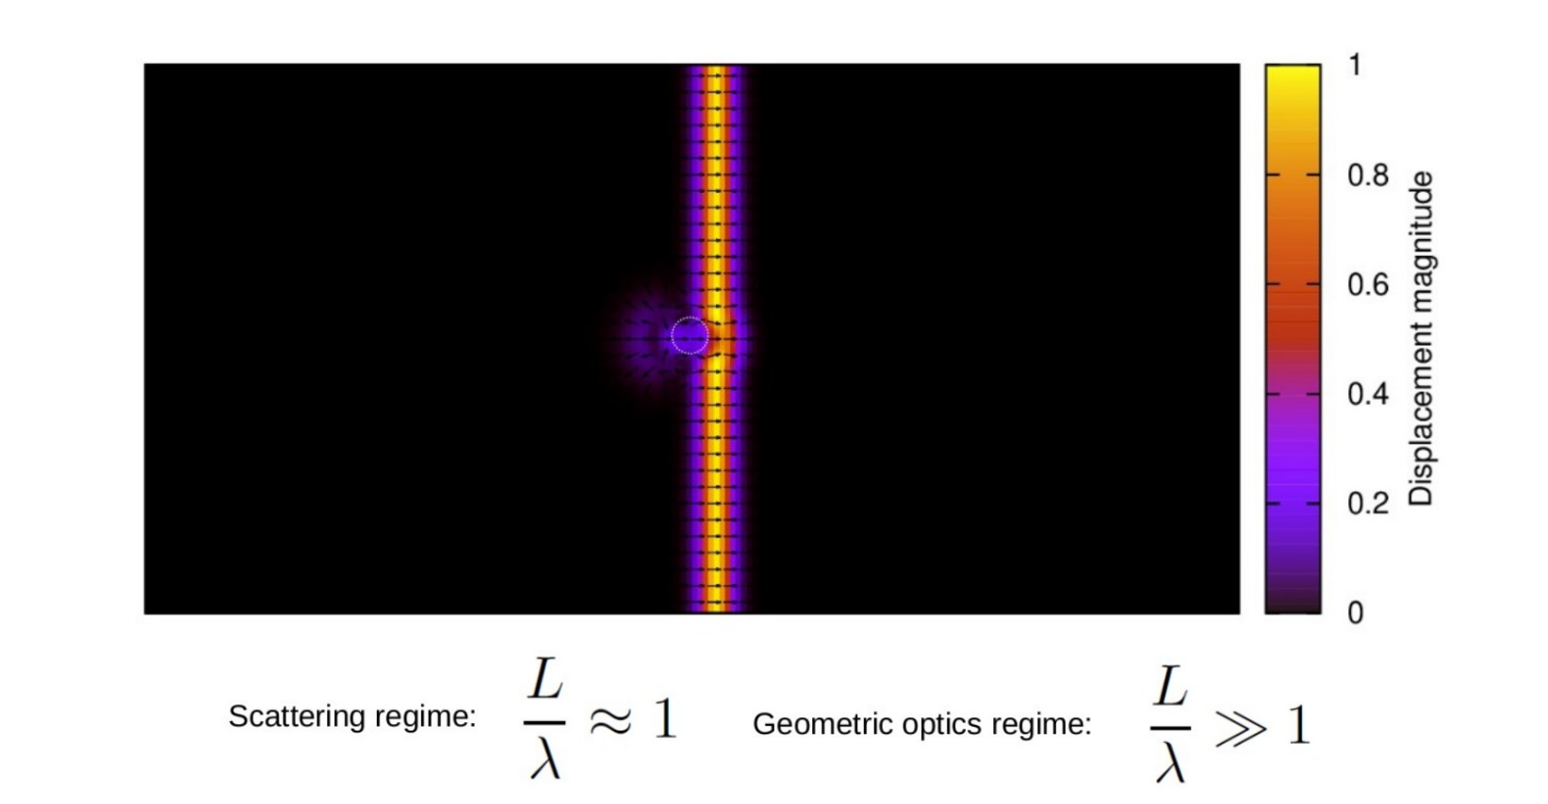
Wavefront healing

Slide 5
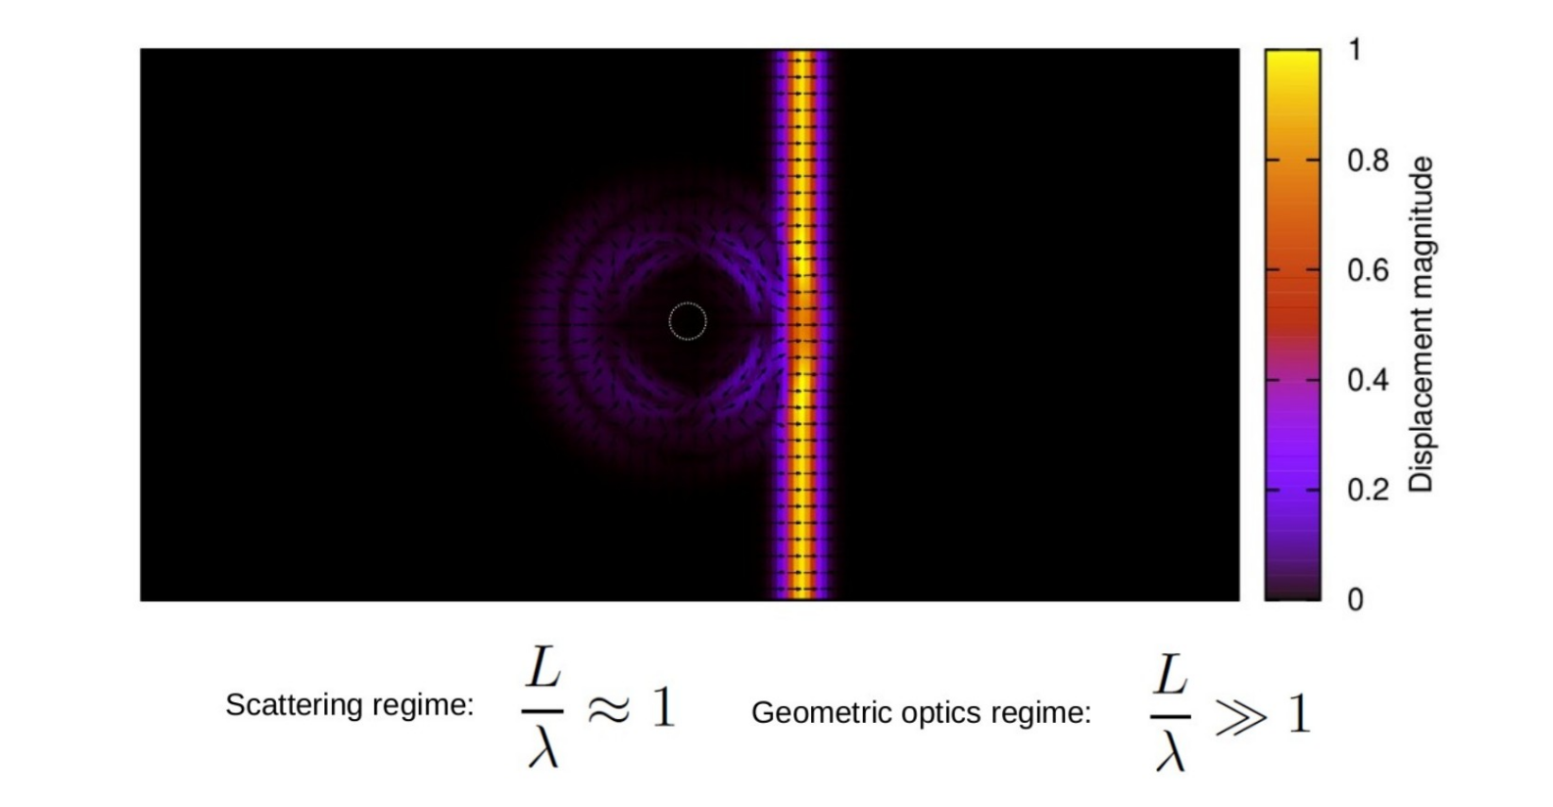
Wavefront healing

Slide 6
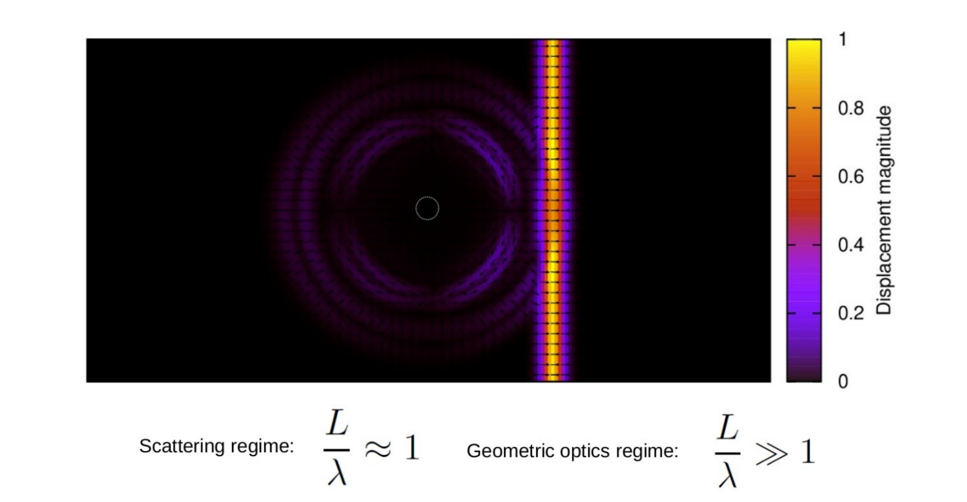
Wavefront healing

Slide 7
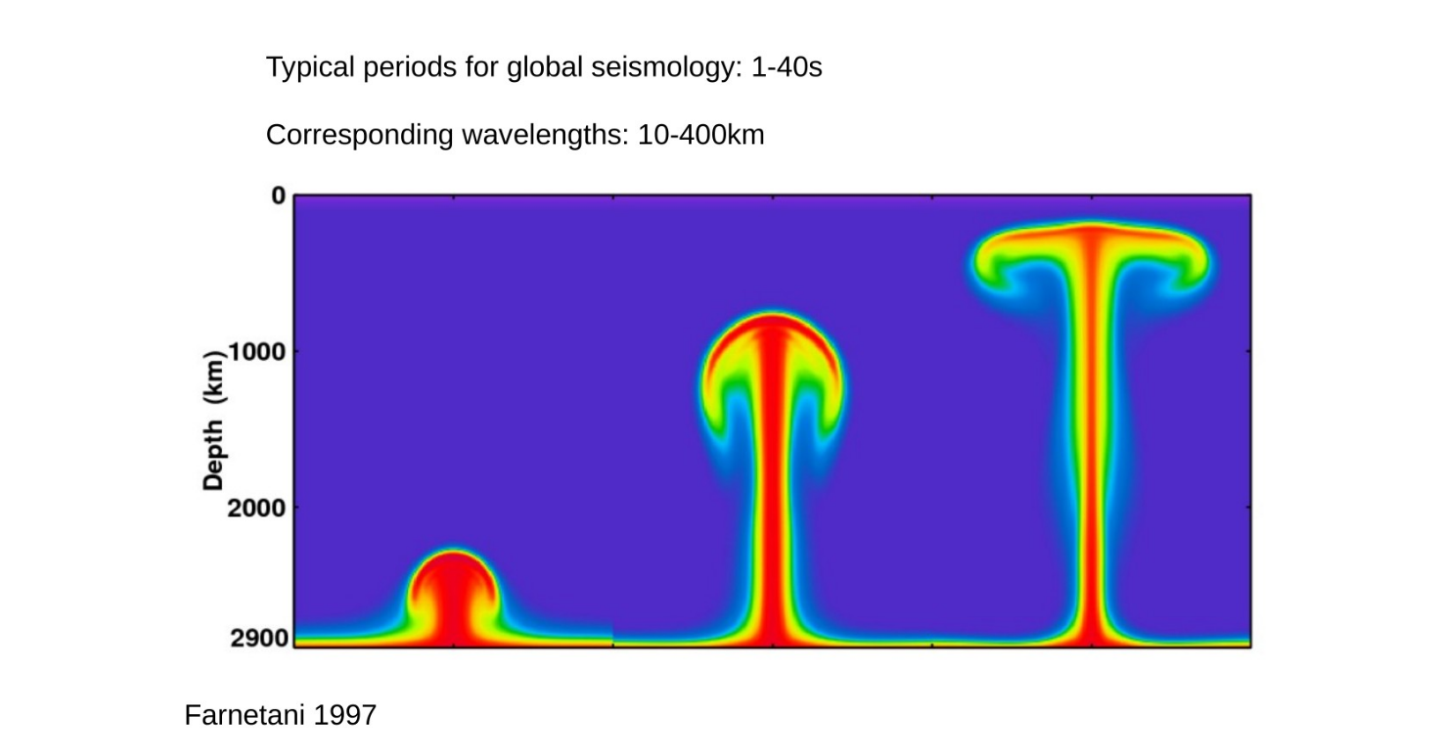
Lengths scales in the mantle

Slide 8
Waveform inversion

Slide 9


Equations of motion
Equations of motion:
These can be solved numerically in realistic laterally heterogeneous earth models using techniques like the finite element methods
These are demanding calculations, run on HPC systems using parallel computing over hundreds or thousands of cores. Applications of GPU computing is common
Each simulation take tens of minutes to hours depending on resources

Slide 10
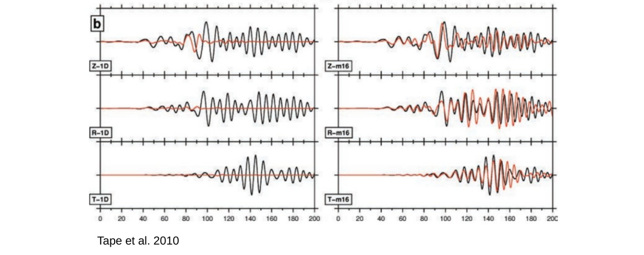

Waveform misfits

Slide 11

Formulation of the problem
Misfit is an implicit function of the parameters in the elastic wave equation:
Density – piecewise constant function
Elastic tensor – piecewise constant tensor field (21 independent components)
Stress glut – space and time dependent tensor field
Geometry of the model (e.g., topography on internal boundaries)
Relation can be condensed to:
The aim is to minimise this functional
Strictly defined on an infinite-dimensional space. In practice reduced to a finite but high-dimensional space linked to the numerical discretisation of the equations of motion
Millions or billions of degrees of freedom would be typical

Slide 12
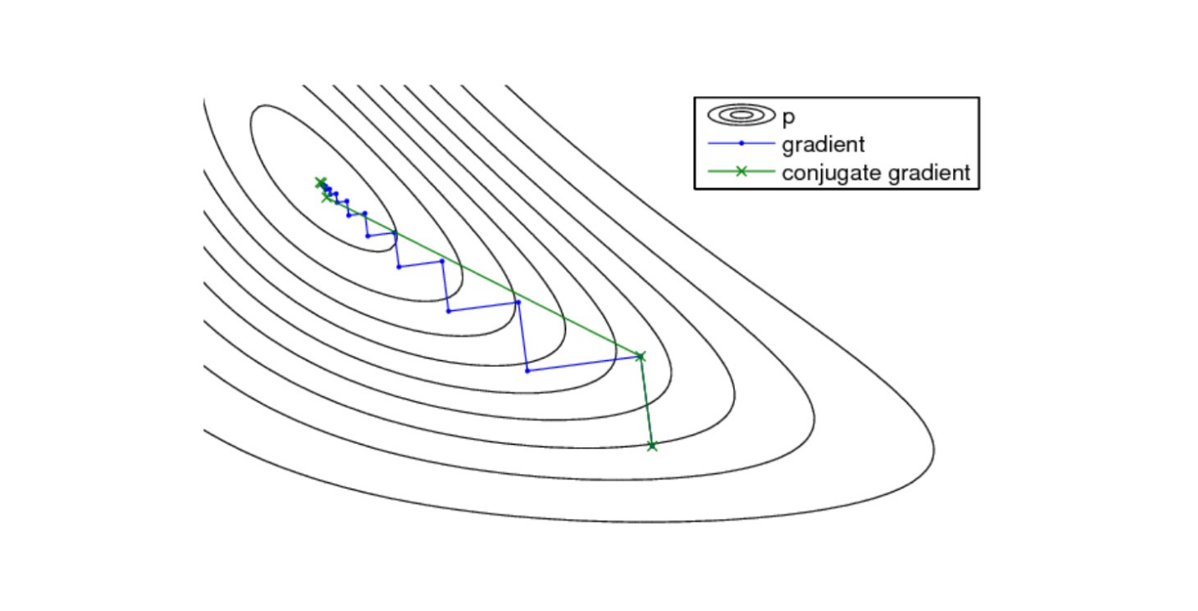
Gradient based optimisation
Iterative reduction of the misfit using the local gradient to take steps downhill
For large-scale optimisation problems, this is often the only viable approach
Bayesian sampling methods are not typically an option, though this is activate research topic
To proceed, we need a way of evaluating the gradients

Slide 13
Functional derivatives
Functional derivative defined through a first-order Taylor expansion:
The terms gradient and sensitivity kernel are equivalent and widely used
Focusing on S-wave velocity variations alone, we can write to first order:
Methods for calculation will be discussed later

Slide 14
Gradient based optimisation
Condition for a minimum – global and then local:
Starting an an initial point, we consider the update:
Step length determined by approximately solving a 1D minimisation problem
Process is repeated until convergence or the misfit is sufficiently small

Slide 15
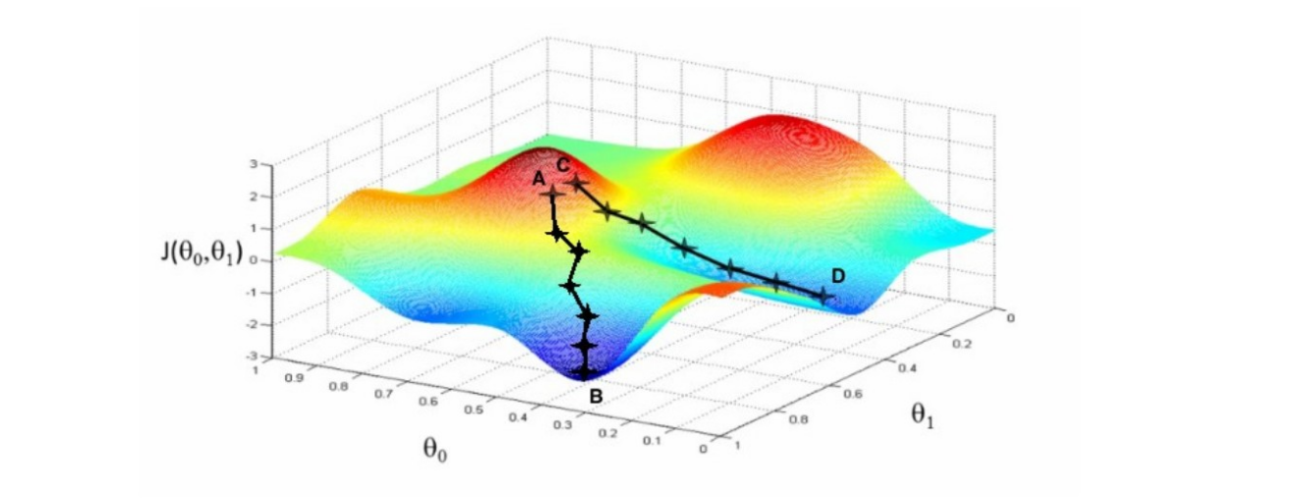
Local minima
Gradient based methods produce only local minima
Uncertainty quantification possible to a limit extent, but adds significantly to the cost

Slide 16
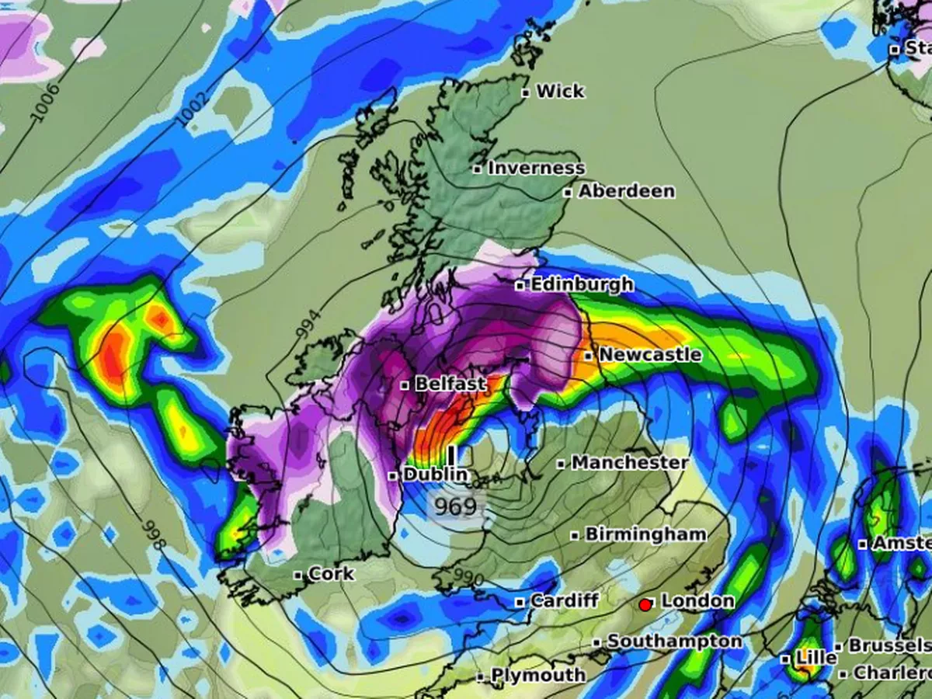
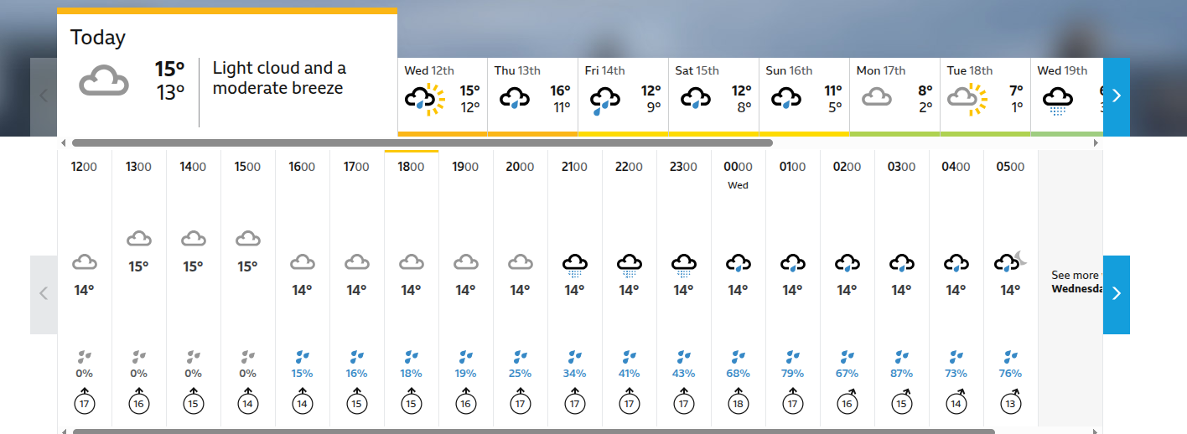
Essentially the same methods underlie weather forecasting along with a host of other important applications

Slide 17
Calculating the gradients

Slide 18
How not to do it
Finite difference approximation:
Approximation of derivative relative to an n-dimensional model parametrisation requires n+1 forward calculations
One gradient calculation using this method for a realistic problem would take of order hundreds of years on a massive HPC system!
The adjoint method provides the exact gradient at a cost of two forward simulations

Slide 19
PDE constrained optimisation
We want to minimise:
subject to the constraints:
This can be done using the method of Lagrange multipliers

Slide 20
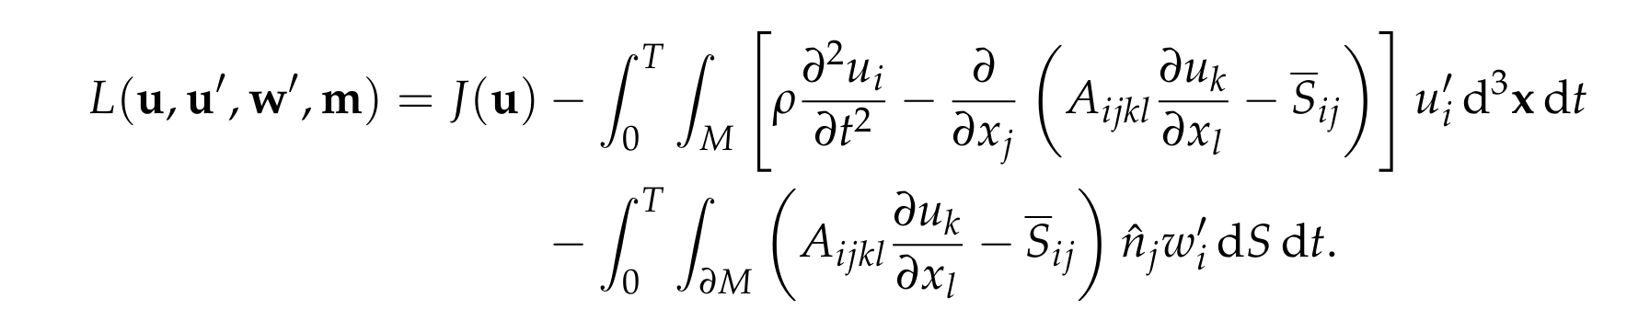
PDE constrained optimisation
We start by defining the Lagrangian:
Each constraint is associated with a Lagrange multiplier field
Zero initial conditions on displacement and velocity are being imposed directly
Within the Lagrangian, all fields are regarded as being independent

Slide 21

Lagrange multiplier theorem
The following equality holds:
so long as the following conditions are met:
Subscripts used for partial functional derivatives
You only need to know how to apply this method not to prove that it works – details provided in an appendix to the handout for anyone interested

Slide 22
The forward problem
Recall that the Lagrangian is:
Stationarity condition wrt to u’ gives the equations of motion
Stationary conditoins wrt to w’ give the boundary conditions
This is how the forward problem emerges within the method

Slide 23
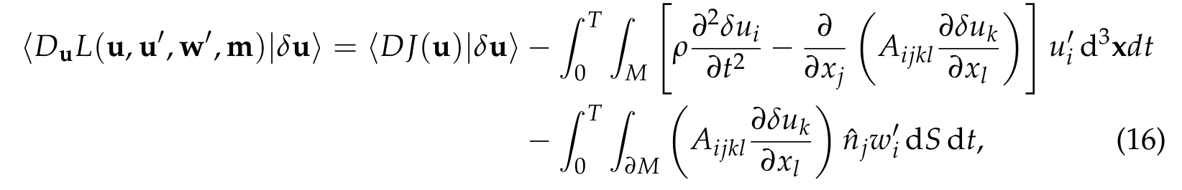


The adjoint problem
Varying wrt to u gives:
From the chosen form for J we can write:

Slide 24
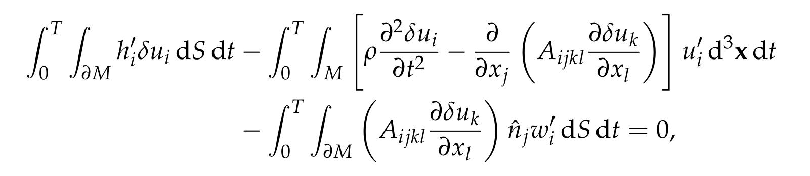
The adjoint problem
We need the following condition to hold:
For all variations of the displacement vector
To see the consequence, we need to pass all the derivatives to the other terms using integration by parts in time and the divergence theorem spatially
Full details are in the handout

Slide 25
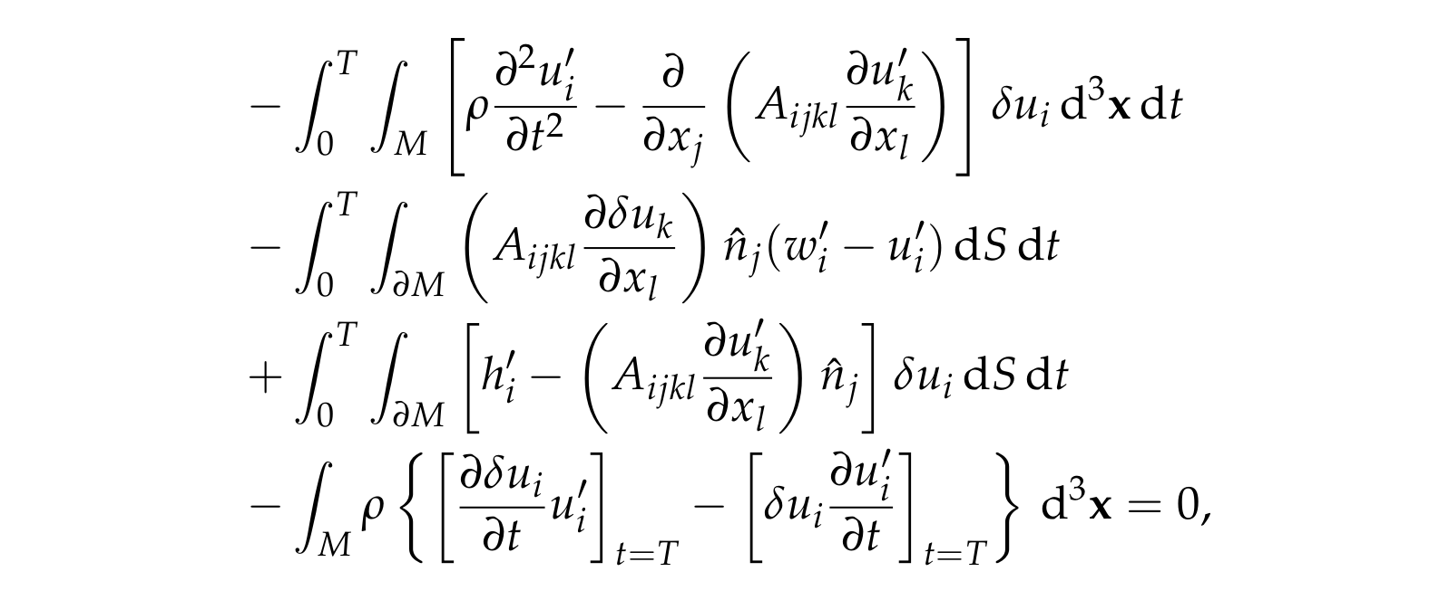
The adjoint problem
The result of the long calculation is that:
From this we can read off the necessary adjoint equations

Slide 26

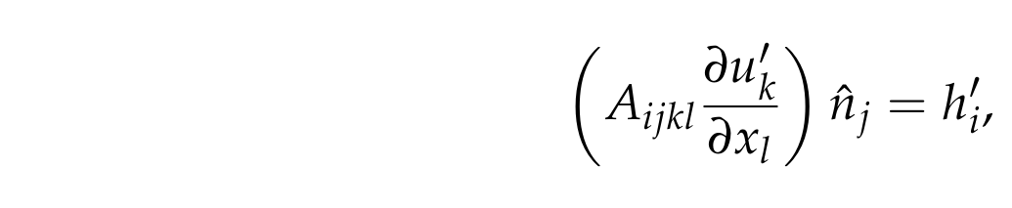
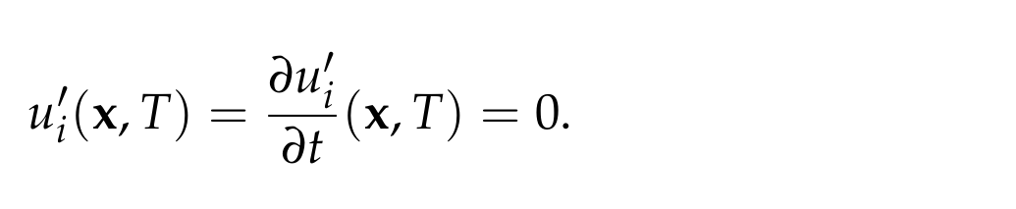
The adjoint problem
We have shown that the Lagrange multipliers must satisfy the equations:
along with the equality u’ = w’ on the boundary
This is a terminal-value problem for u’ driven by the boundary traction h’:

Slide 27
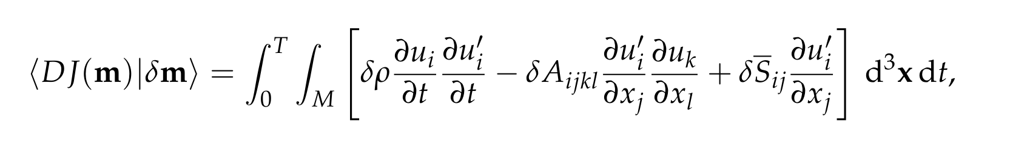
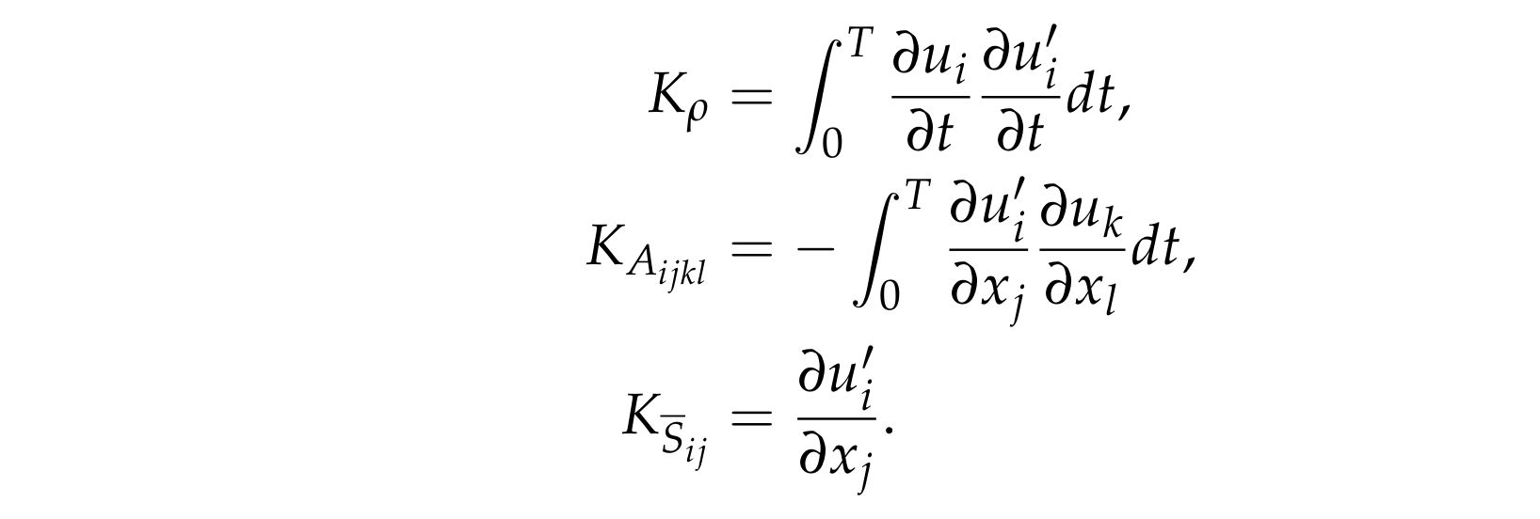
Sensitivity kernels
Using the multiplier theorem and integrating by parts, we find that:
We can then read-off the sensitivity kernels:

Slide 28
Summary of the adjoint method
For each gradient calculation we must:
Solve the forward problem for u
From this solution, compute J, and form the adjoint traction h’
Solve the adjoint problem for u’
Combine the forward and adjoint fields to form the sensitivity kernels
Such a calculation has the cost of two forward calculations
Adjoint equation near identical to the forward one, and so the same numerical code can be used with only minor modification
Choice of misfit enters into the problem only through the form of the adjoint traction
Calculations that would take hundred of years reduced to a minutes or hours

Slide 29
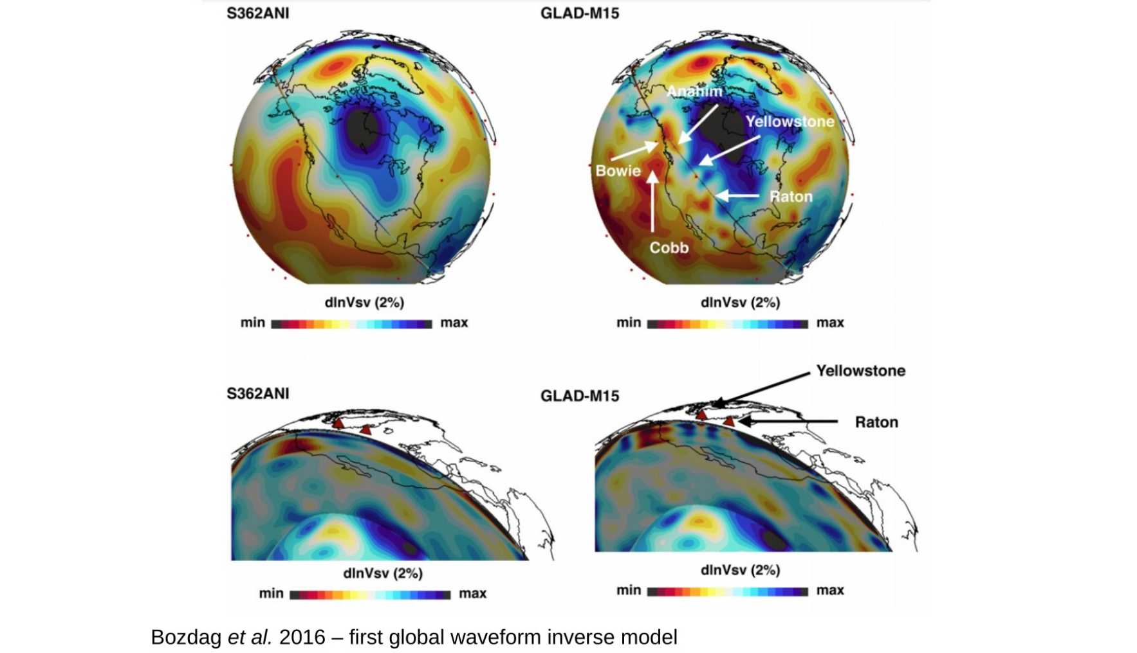

Slide 30

Banana doughnut kernels
In practice, delay times are measured using cross-correlations:
Time-shift than maximises the cross-correlation taken as the delay time
This defines a functional of the synthetic waveform, and hence we can derive the associated sensitivity kernels using the adjoint method
The only step we haven’t covered is determining the adjoint traction for this choice of functional – this is an easy calculation, but not one you need to know

Slide 31
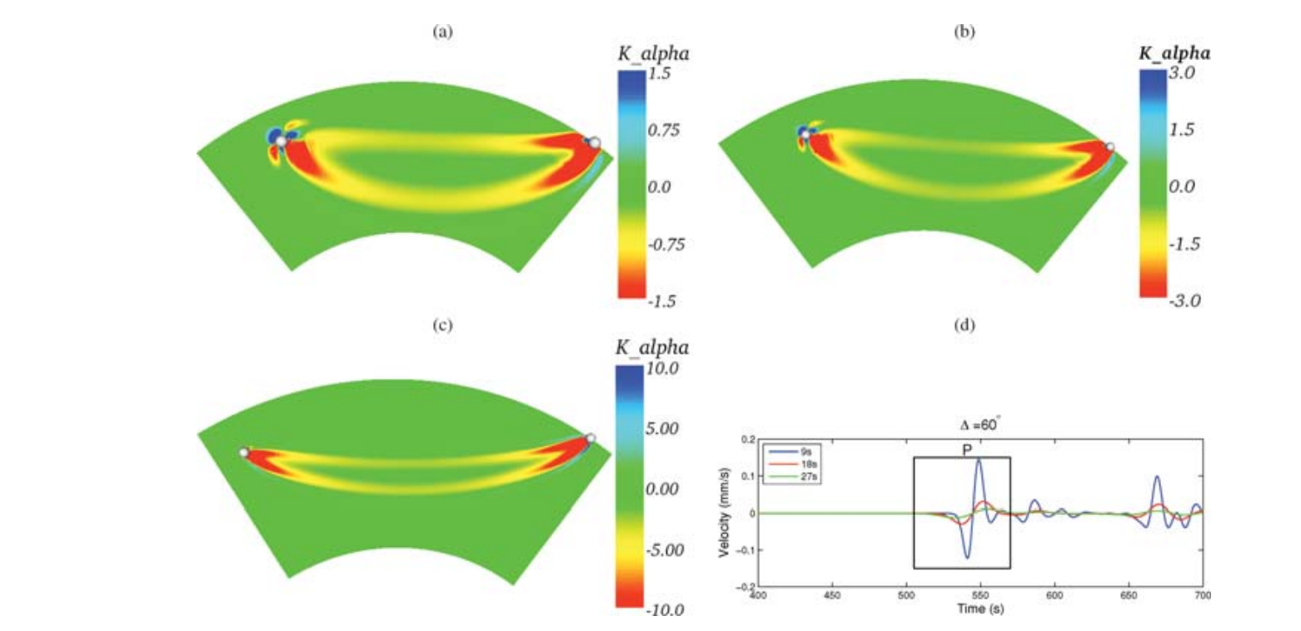
Liu & Tromp 2008

Slide 32
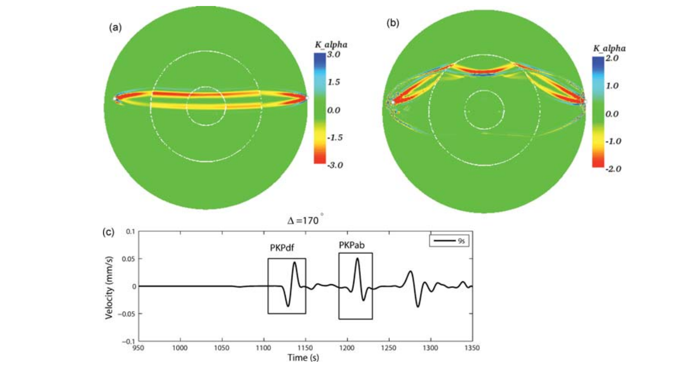
Liu & Tromp 2008

