Slide 1
Seismic sources

Slide 2
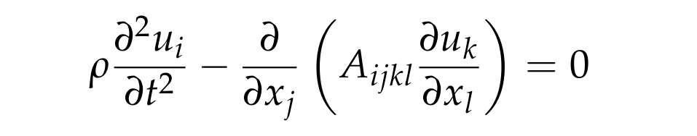

From last time
Linearised equations of motion:
subject to boundary conditions:
Along with initial conditions on the displacement vector and its time-derivative
But where to earthquakes enter into the theory?

Slide 3
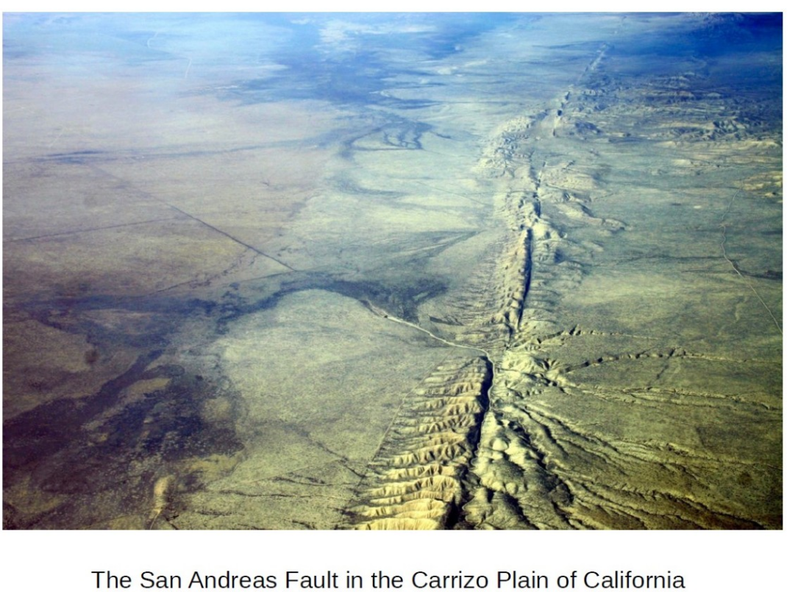
Earthquakes and tectonics

Slide 4
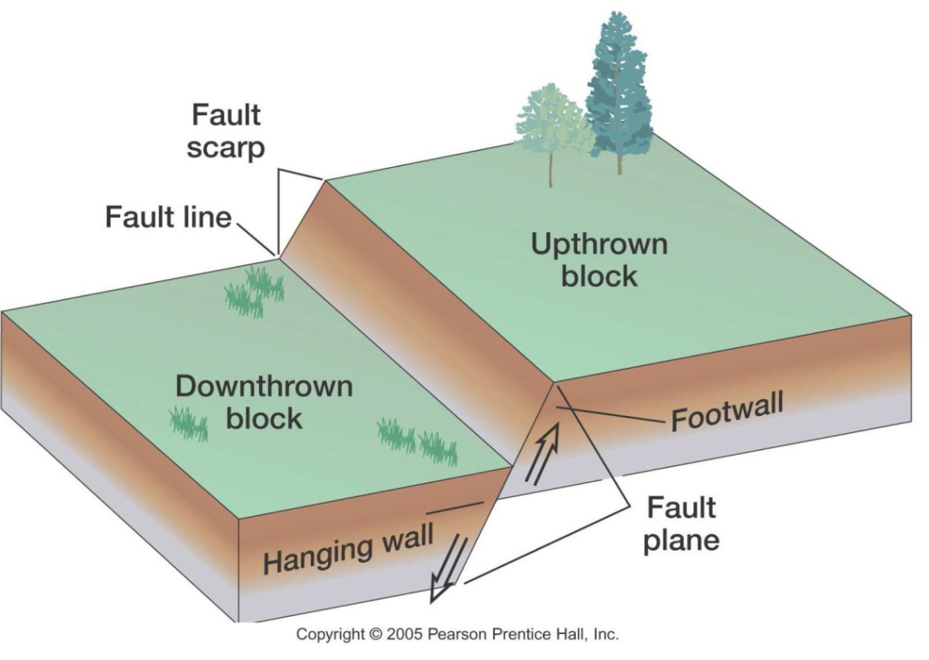
Idealised fault planes
You don’t need to learn all this terminology

Slide 5
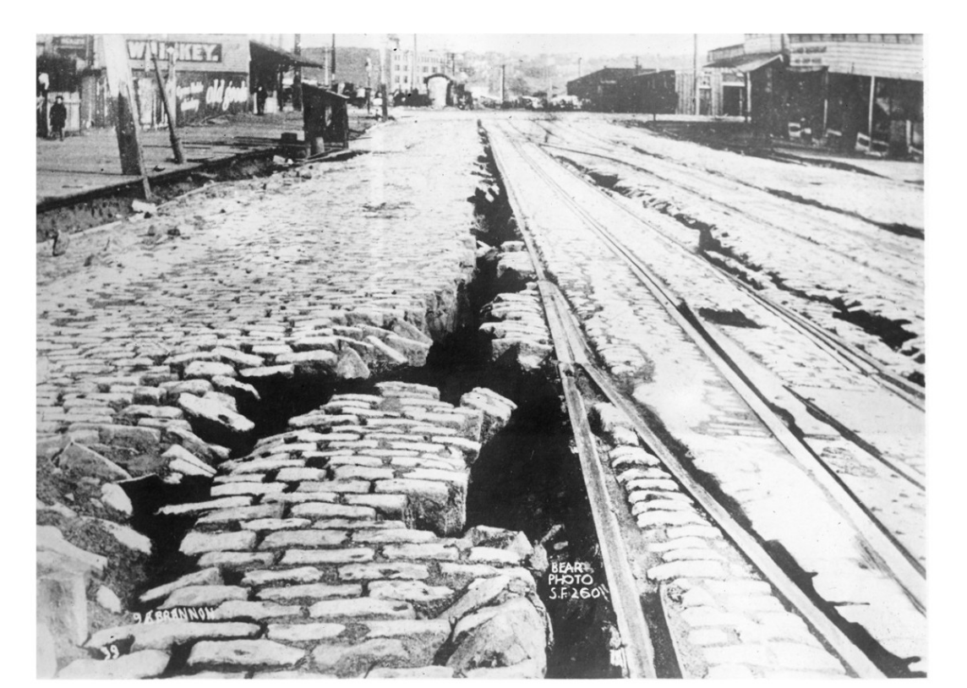
San Francisco 1906

Slide 6
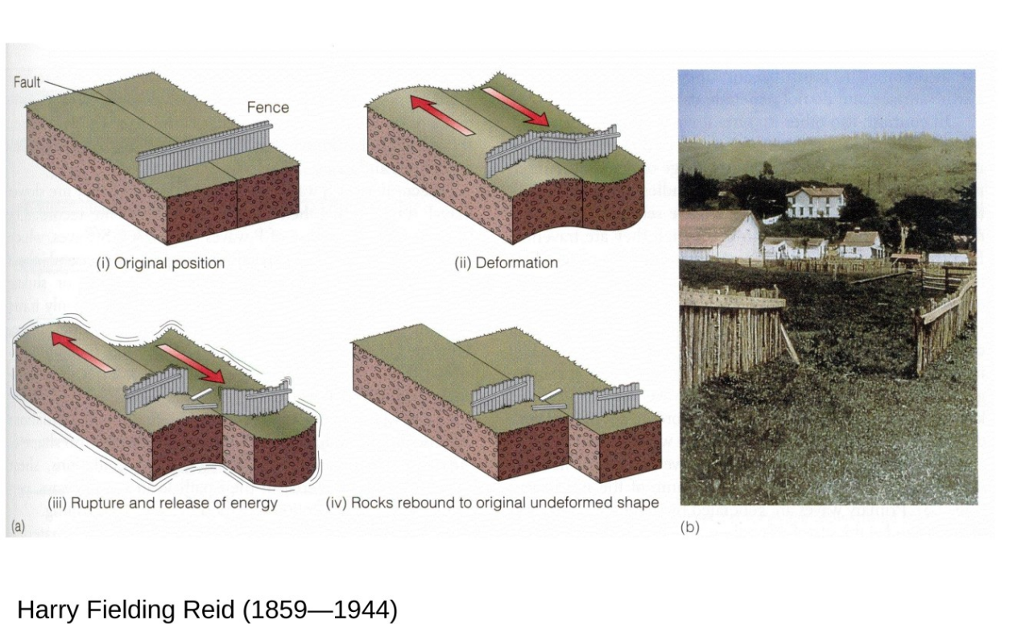
Elastic rebound theory

Slide 7
Kinematic source approximation

Slide 8
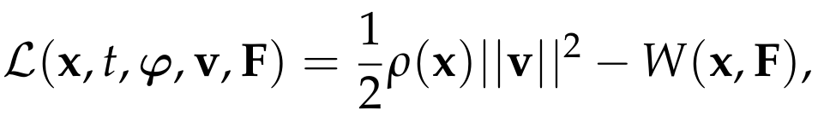

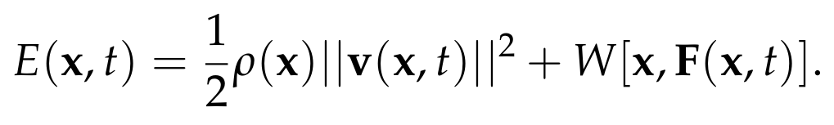
Conservation of energy
Lagrangian density for finite elasticity:
Motion of the body satisfies conservation of energy:
A body in a stable equilibrium configuration will remain in it – no earthquakes!

Slide 9
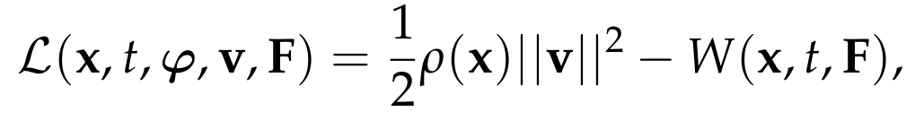

Breaking the time-translation symmetry
To model an earthquake phenomenologically, we just add an explicit time-dependence to the strain energy function:
Equations of motion are unchanged
Constitutive equation now has an explicit time-dependence:

Slide 10
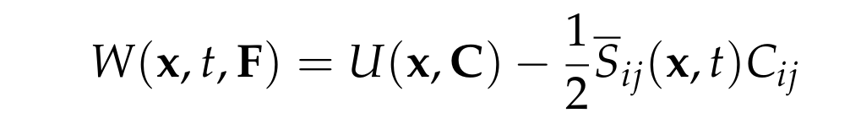
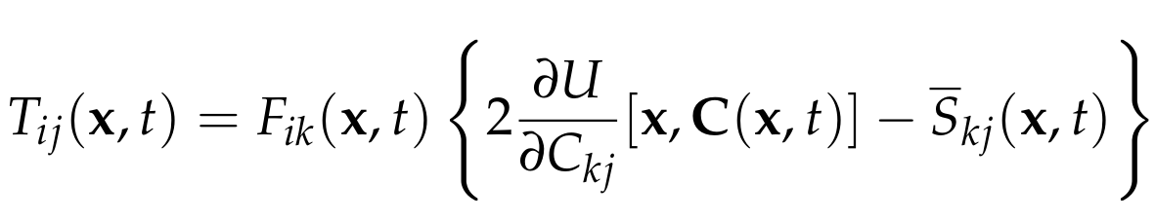
Stress glut
We assume that the time-dependent strain energy function can be written:
The corresponding first Piola-Kirchhoff stress tensor is
First term on right hand side is the stress predicted by elasticity, but this differs from the true stress due to the the second term

Slide 11
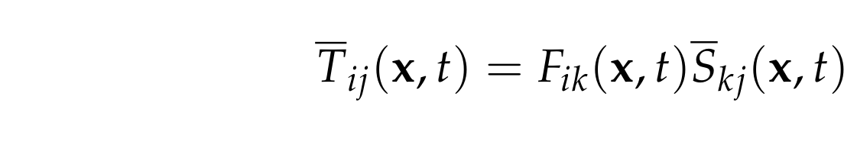
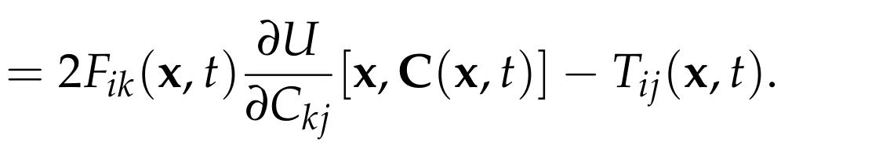
Stress glut
The stress glut is defined by:
This term quantifies the failure of elasticity to correctly predict stresses in the body
By definition, the stress glut is non-zero within the source region
In the full problem, the stress glut would be determined dynamically
Under the kinematic source approximation, the stress glut is reduced to a parameter

Slide 12
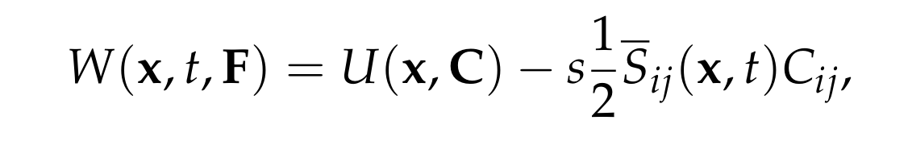
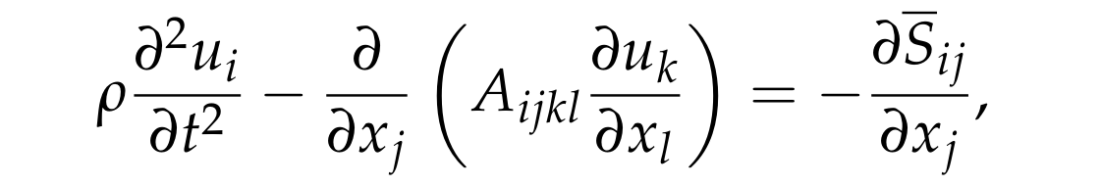

Linearised equations of motion
We add a stress glut as a perturbation to a stress-free equilibrium configuration:
Linearisation proceeds almost identically to yield:
Seismic source associated with an effective body force and effective traction (force per unit area) on the boundary

Slide 13
Model for an ideal fault

Slide 14
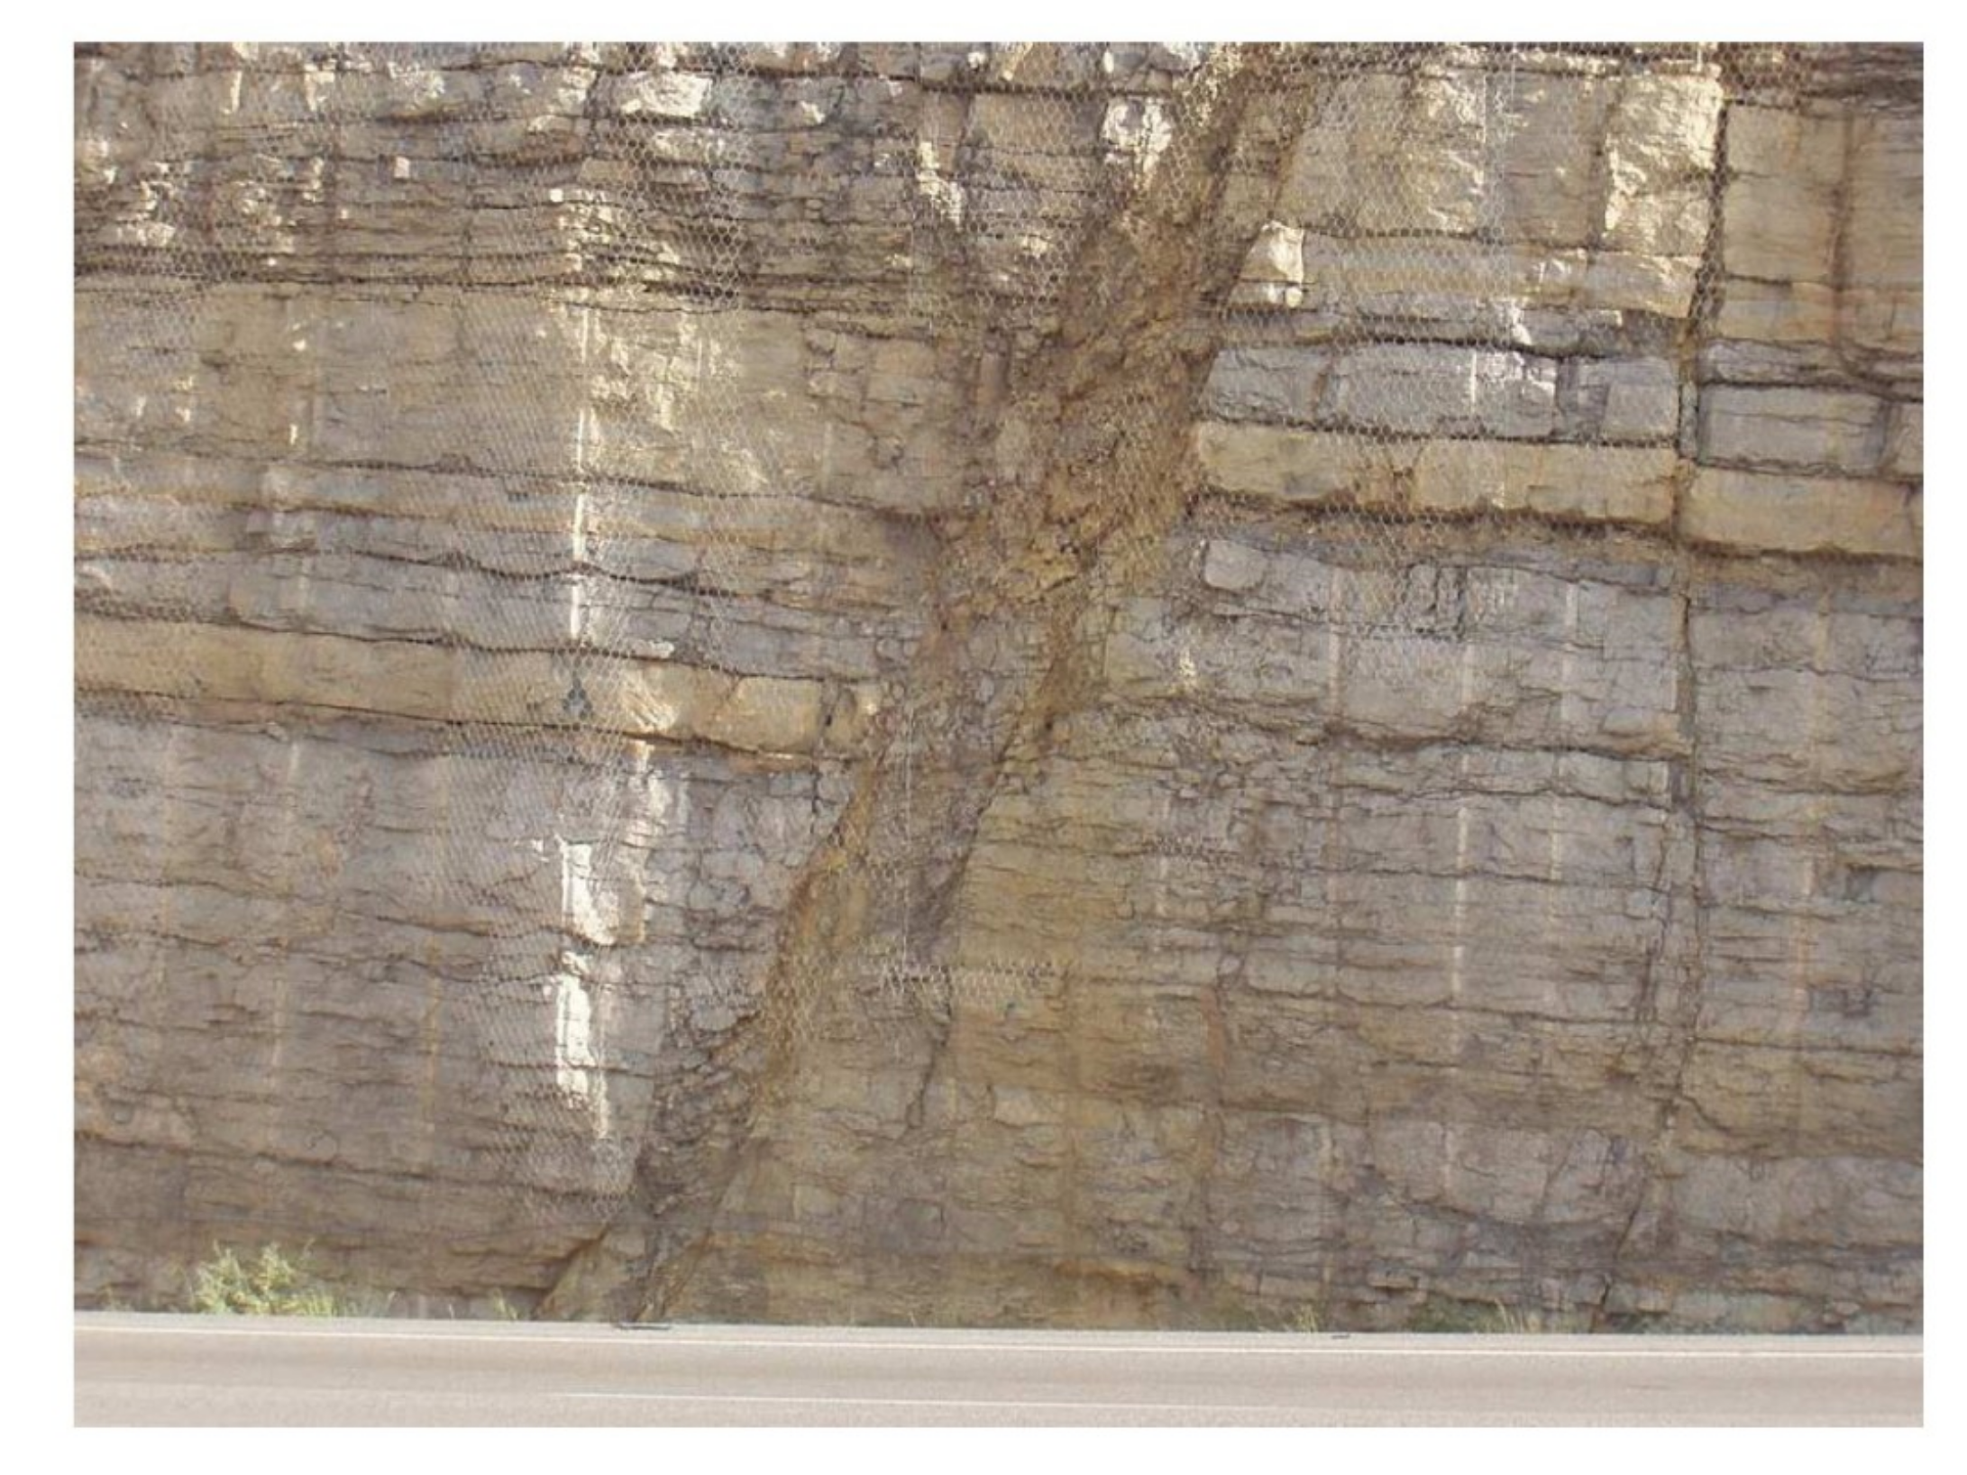
Real and ideal faults
Real faults involve strong non-elastic deformation across a finite fault zone

Slide 15
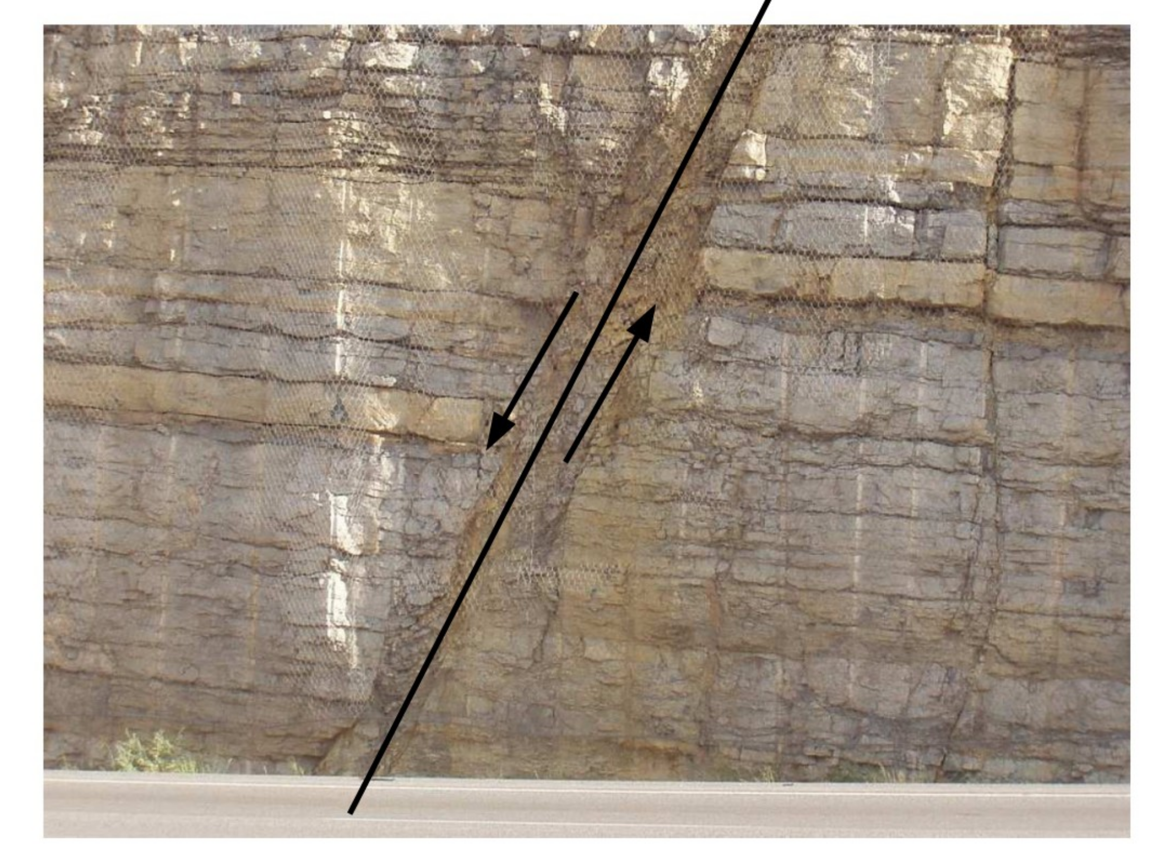
Real and ideal faults
For an ideal fault we collapse the fault zone to a surface across which displacement is discontinuous

Slide 16
Stress glut for an ideal fault
We consider a planar fault and adapt our coordinates suitably
x3=0
Displacement takes the form:
The displacement discontinuity vector, w, is tangential to the fault plane

Slide 17

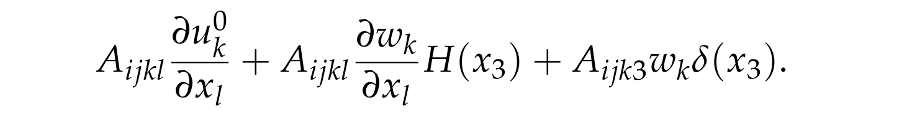

Stress glut for an ideal fault
Spatial derivative of the displacement vector:
Resulting linearised stress predicted by elasticity:
Motivates the definition of the stress glut:
Simple generalisation to non-planar faults

Slide 18



Equations of motion
Equations of motion with an idealised fault:
Parameters in these equations:
Geometry of the Earth model
Density and the elastic tensor
Geometry of the fault plane and the displacement discontinuity vector

Slide 19
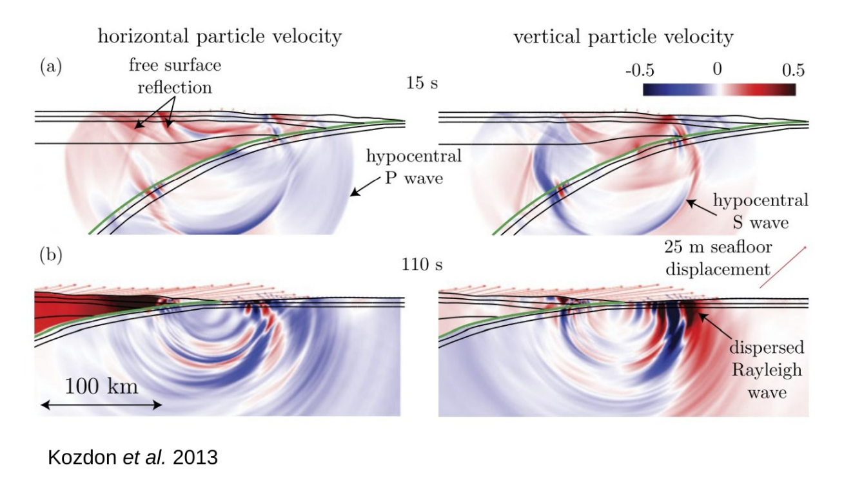
Numerical simulations

Slide 20
Inverse problems

Slide 21
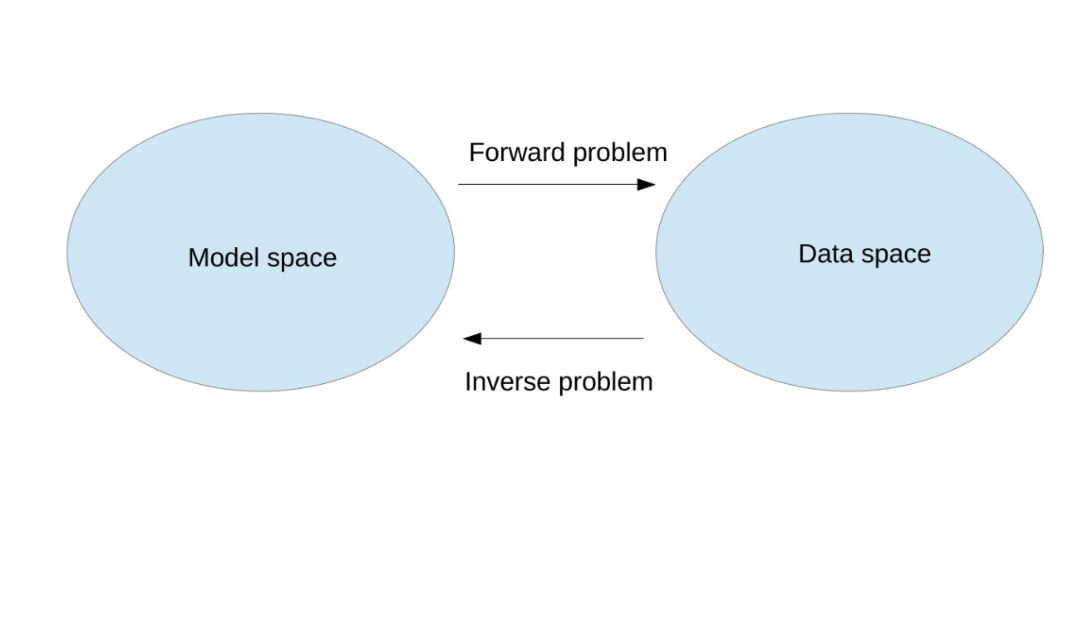
Common structure
This graphical representation suggests a symmetry between forward and inverse problems – this is not the case!

Slide 22
Well-posed and ill-posed problems
A mathematical problem can be viewed as mapping between inputs and outputs
Such a problem is said to be well-posed if:
For each input there exists an output
For each input there exists a unique output
The output depends continuously on the input
A problem that is not well-posed is said to be ill-posed
The equations of mathematical physics are well-posed (or thought/hoped to be)
Inverse problems are almost always ill-posed

