Slide 1
Plane wave propagation

Slide 2
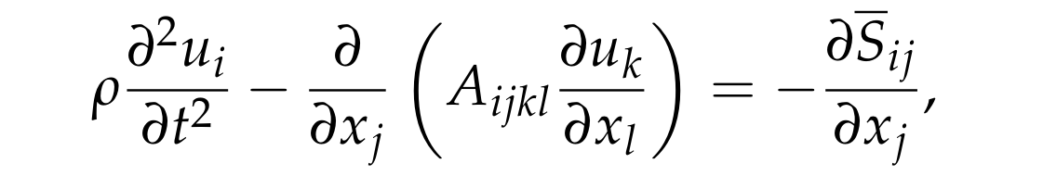

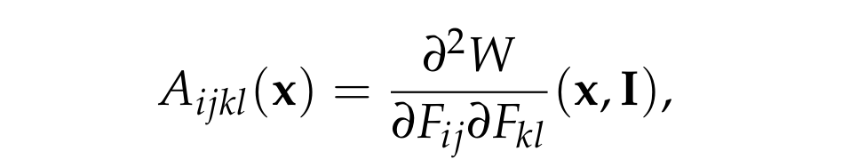
Previously...
Linearised equations of motion including a stress glut:
Definition of the elastic tensor:

Slide 3
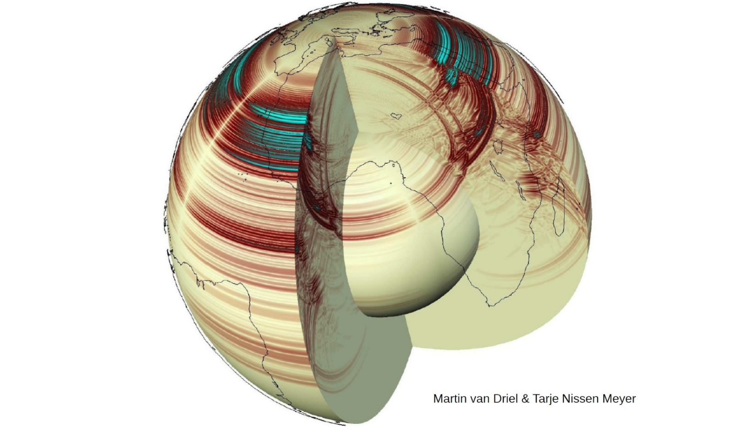

Slide 4
The Christoffel equation

Slide 5

Plane wave ansatz
We consider an infinite and homogeneous body
Look for a plane wave solution of the form:
The slowness vector, p, sets the orientation and speed of the wavefronts
The polarisation vector, a, sets the direction of particle motion
The pulse shape set by f, and does not vary as the wave propagates – in this sense the waves are non-dispersive (but...)

Slide 6
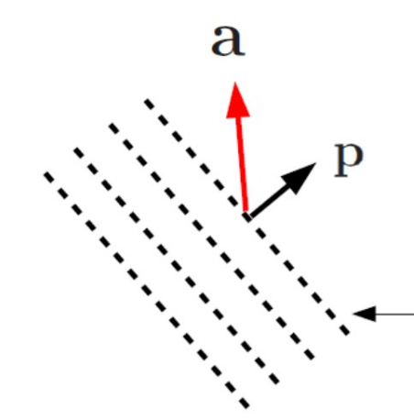

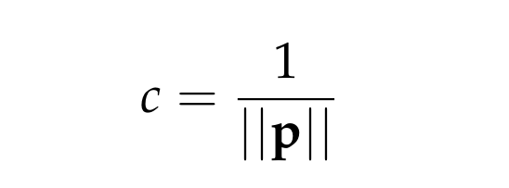
Plane wave ansatz
wavefronts
Phase speed

Slide 7

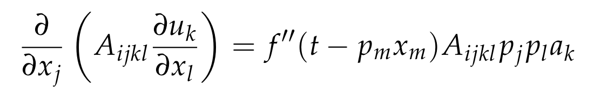
The Christoffel equation
For the plane wave ansatz:
A non-trivial plane wave solution exists if and only if:
This is known as the Christoffel equation – it places a constraint on both the slowness and polarisation vectors

Slide 8



The Christoffel matrix
It will be useful to define the Christoffel matrix, which is a function of p:
The Christoffel equation can then be written:
This is a homogeneous linear equation for a, that can have non-trivial solutions if and only if:
The roots of this equation define the slowness surface

Slide 9
Reduction to an eigenvalue problem

Slide 10

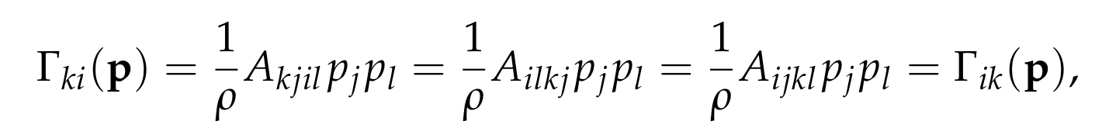
Two useful properties
From the definition of the Christoffel matrix, we have:
It is a homogeneous function of order two
The hyperelastic symmetry implies that the Christoffel matrix is symmetric:

Slide 11


Plane waves in a fixed direction
Fixing the orientation of the slowness vector, we can write:
and hence the Christoffel equation reduces to:
This is a symmetric eigenvalue problem:
Squared phase speeds are real, generally three distinct values
Polarisation vectors for distinct squares phase speeds are orthogonal
Degenerate squared phase speeds are possible

Slide 12
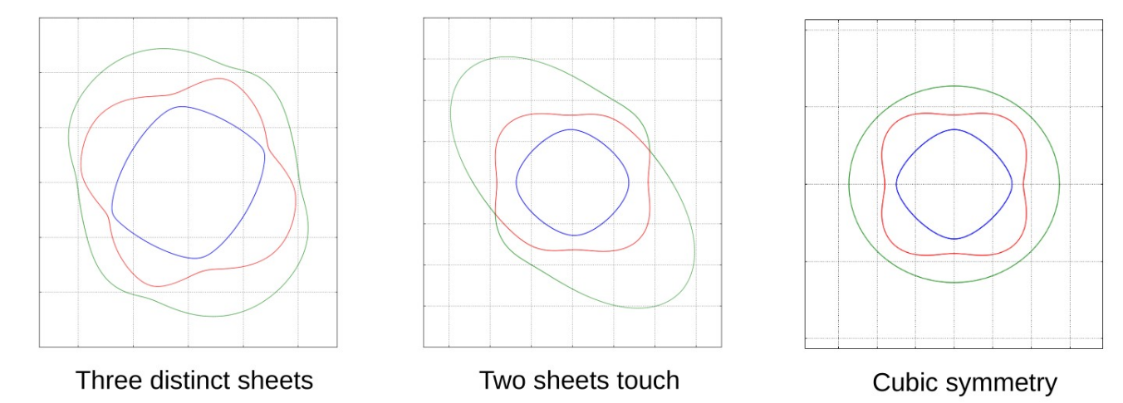
The slowness surface

Slide 13
Isotropic media

Slide 14
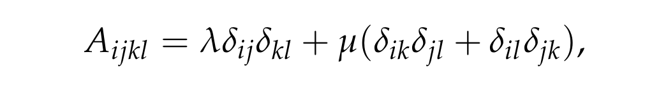

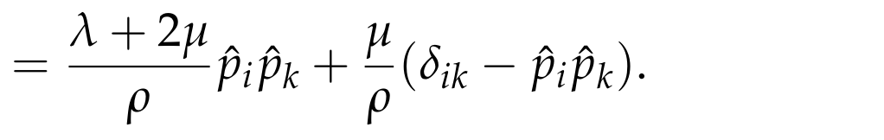
Isotropic Christoffel matrix
We have seen that the elastic tensor in an isotropic solid takes the form:
Putting into the definition of the Christoffel matrix, we arrive at:
In the final expression, note orthogonal projections parallel and perpendicular to the direction of the slowness vector

Slide 15
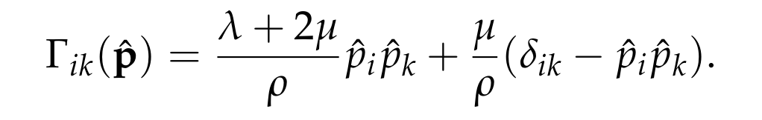
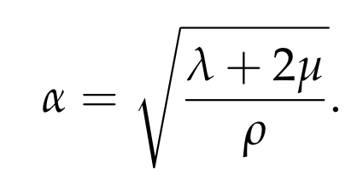

P-waves
Isotropic Christoffel matrix:
By inspection we identify an eigenvector and eigenvalue:
These plane waves are known as P-waves:
Particle motion along the propagation direction
Phase speed the same in all directions
Associated with a non-degenerate eigenspace

Slide 16
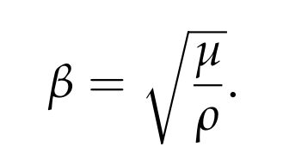

S-waves
Isotropic Christoffel matrix:
By inspection we identify an eigenvector and eigenvalue:
These plane waves are known as S-waves:
Particle motion perpendicular to the propagation direction
Phase speed the same in all directions
Associated with a two-fold degenerate eigenspace

Slide 17
Slightly anisotropic media

Slide 18
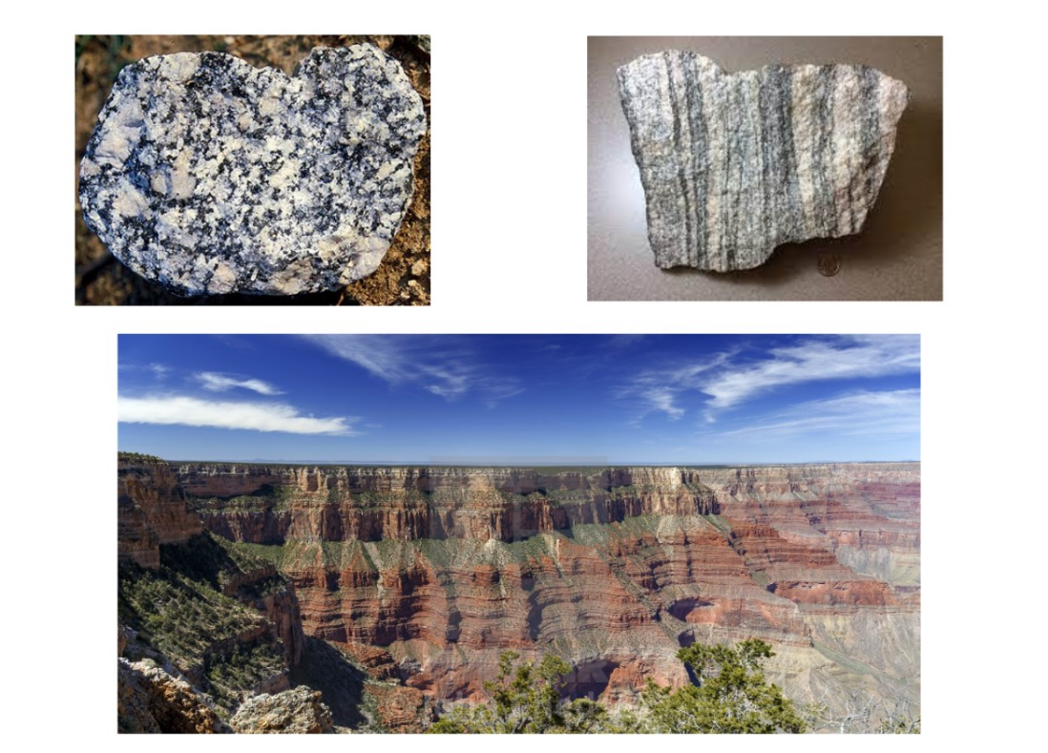
Anisotropy in the Earth

Slide 19
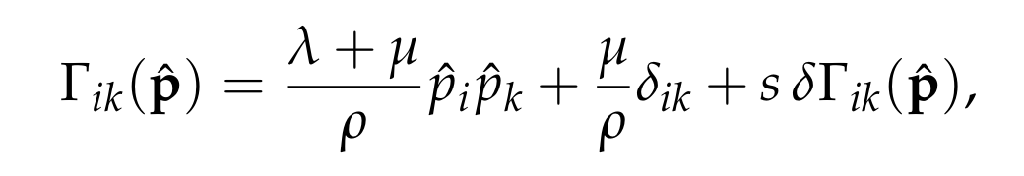

Perturbed eigenvalue problem
We consider a slightly anisotropic elastic tensor:
Resulting Christoffel matrix:
Eigenvalue problem to be solved:

Slide 20


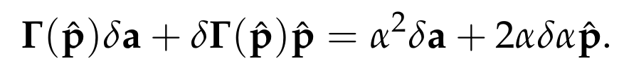

Quasi P-waves
Apply non-degenerate perturbation theory:
First-order term in eigenvalue problem:
Through a standard argument, we arrive at:
Polarisation almost aligned with propagation direction, phase speed now varies with the orientation

Slide 21

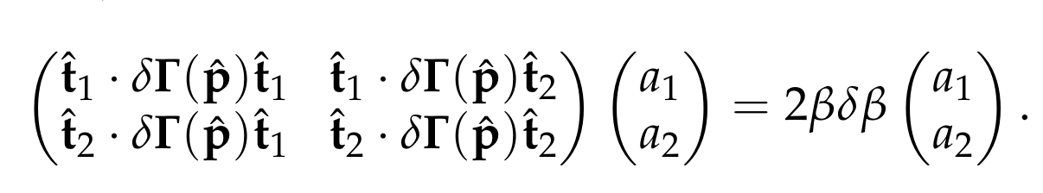
Quasi S-waves
Apply degenerate perturbation theory:
Leads to 2D eigenvalue problem:
Solution gives two perturbed phase speeds which are usually distinct – the initial degeneracy is split
Zeroth-order eigenvectors orthogonal to each other and propagation direction, first order correction will have a component along propagation direction
This behaviour is known as shear wave splitting

Slide 22
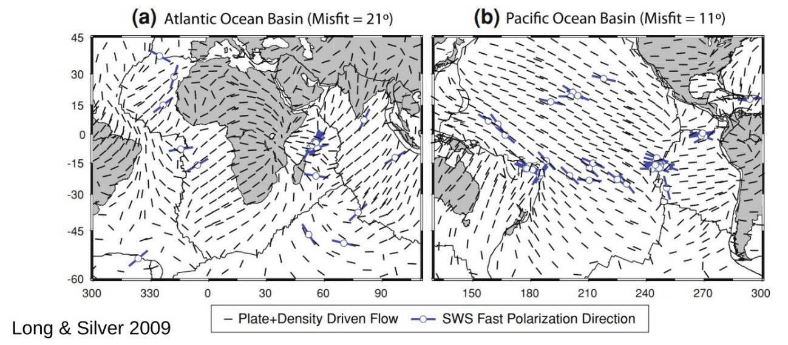
Shear wave splitting and mantle flow
Convection in the mantle creates large-scale alignment of anisotropic mineral grains with the flow direction – produces an effective seismic anisotropy. Example here shows the relation between shallow anisotropy and plate motion

Slide 23
Interaction of plane waves with boundaries
Topic covered quantitatively in previous years but never examined
Quantitative details now removed from the course for reasons of time
The usual reflections and transmissions of waves occur when a plane elastic wave interacts with a boundary.
The only interesting feature is the conversion between different wave types. For example, in an isotropic medium, an incident P-wave can produced reflected and transmitted P- and S- waves

Slide 24


Slide 25
