Slide 1
Delay time tomography

Slide 2
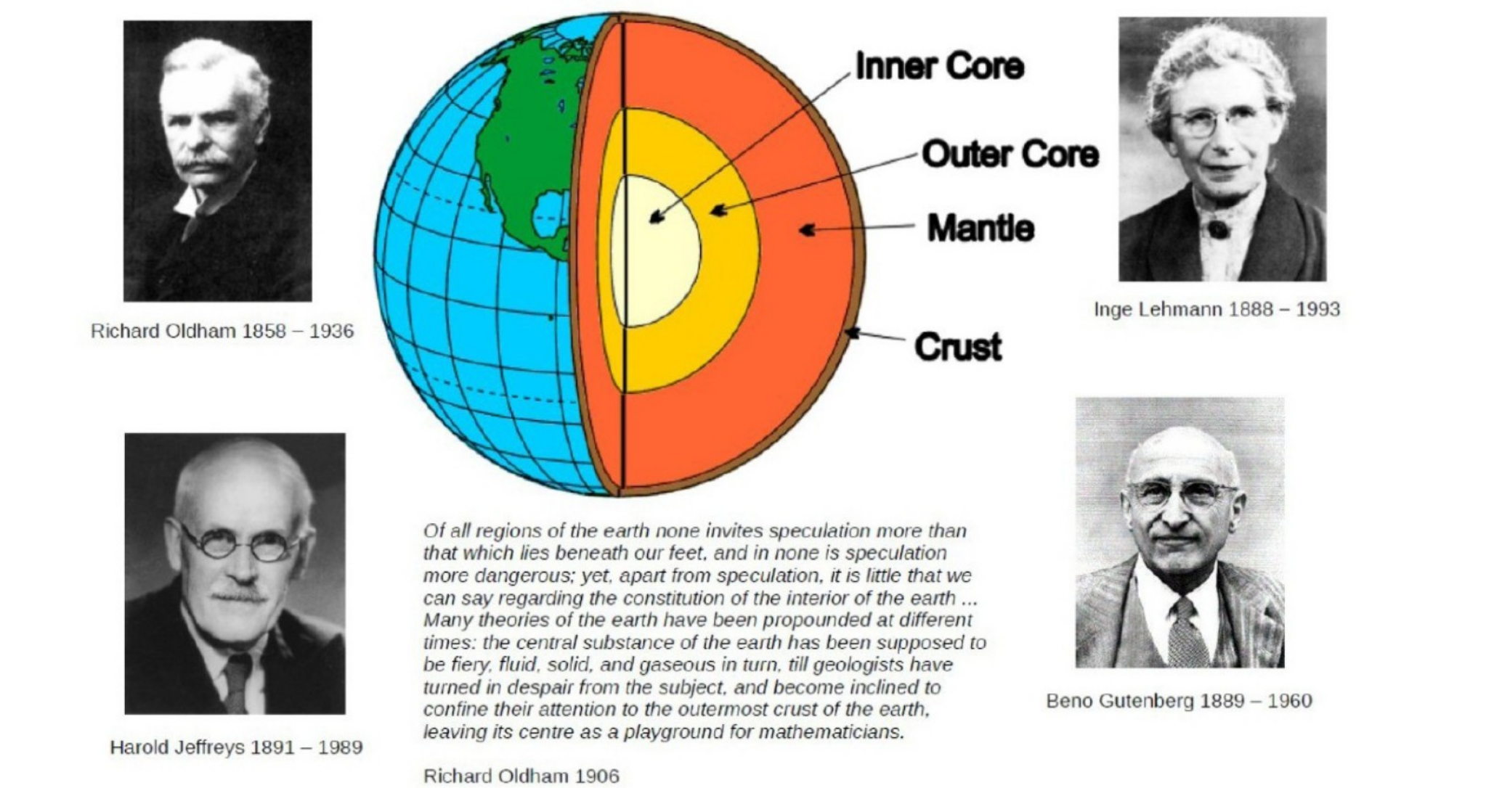
From last lecture

Slide 3
Lateral velocity variations

Slide 4
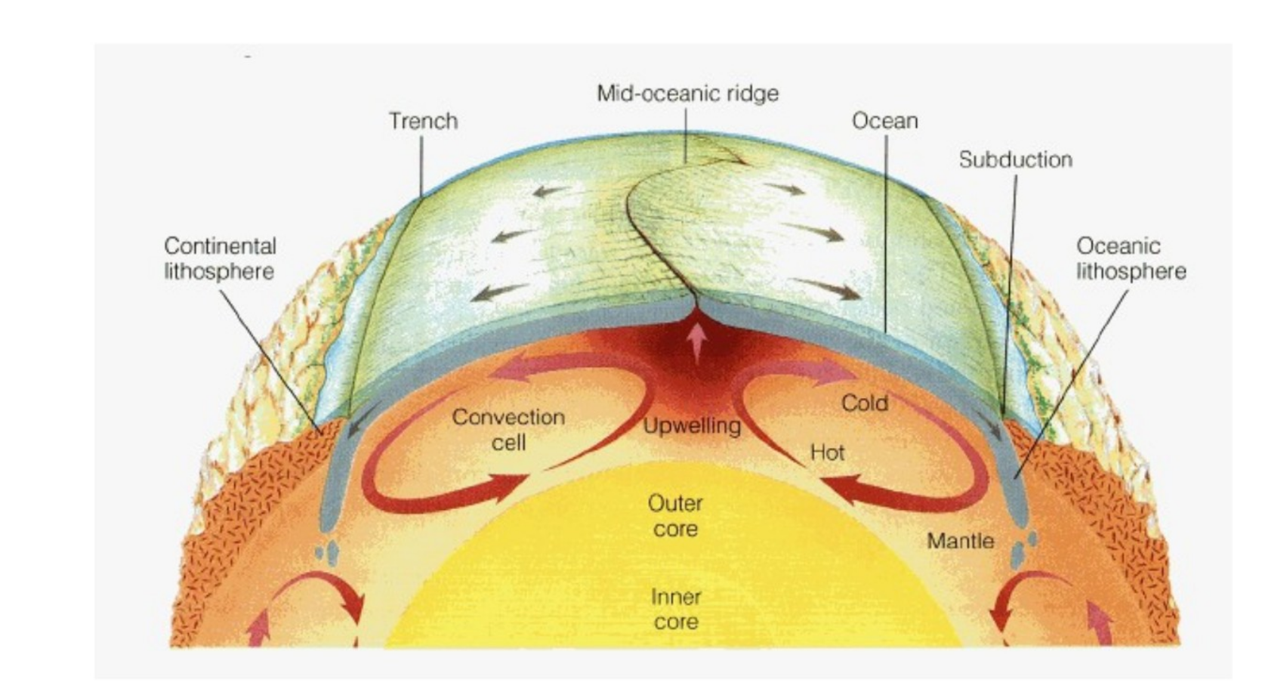
Mantle convection

Slide 5
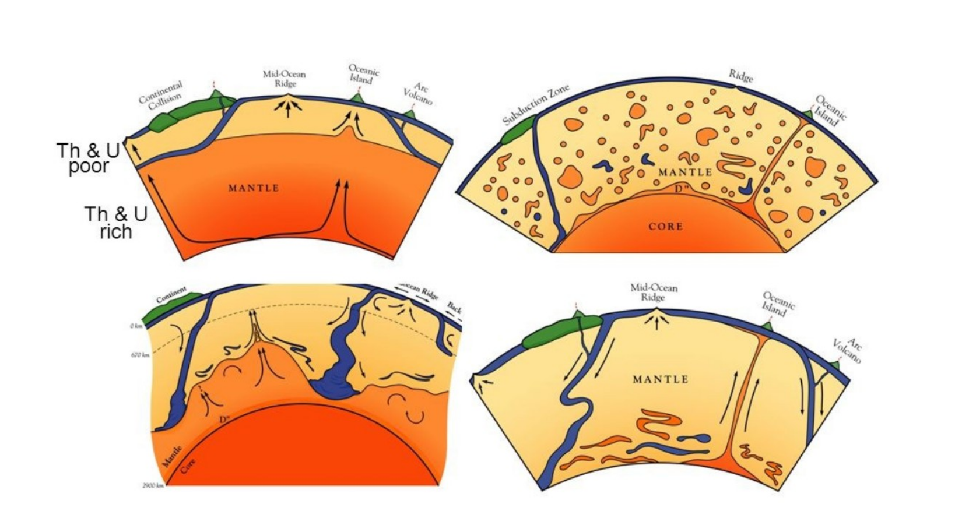
Mantle convection
Can we do better than drawing cartoons?

Slide 6
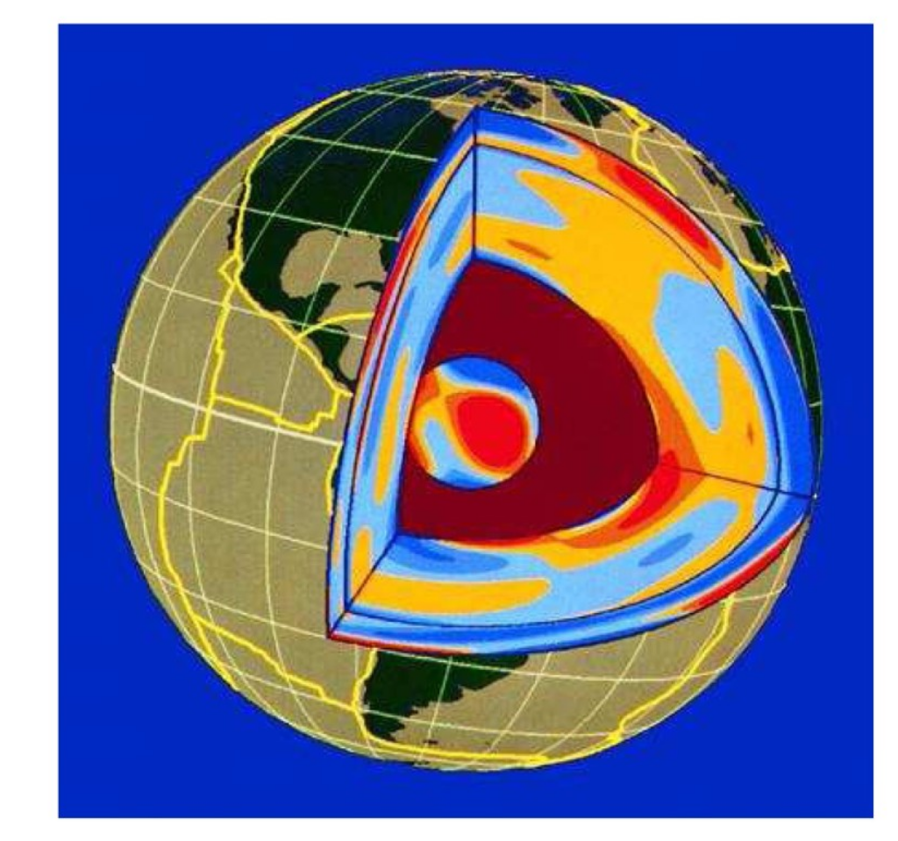
Seismic tomography
Quantitative models for lateral variations within the Earth derived from seismological observations
Most models show perturbations in elastic wave speeds relative to a spherically symmetric reference model
Other parameters, (e.g., density, attenuation can be sought with more difficulty)
Simple interpretation:
Red = slow = hot
Blue = fast = cold
Dziewonski & Woodhouse (1989)

Slide 7
Setting up the inverse problem

Slide 8
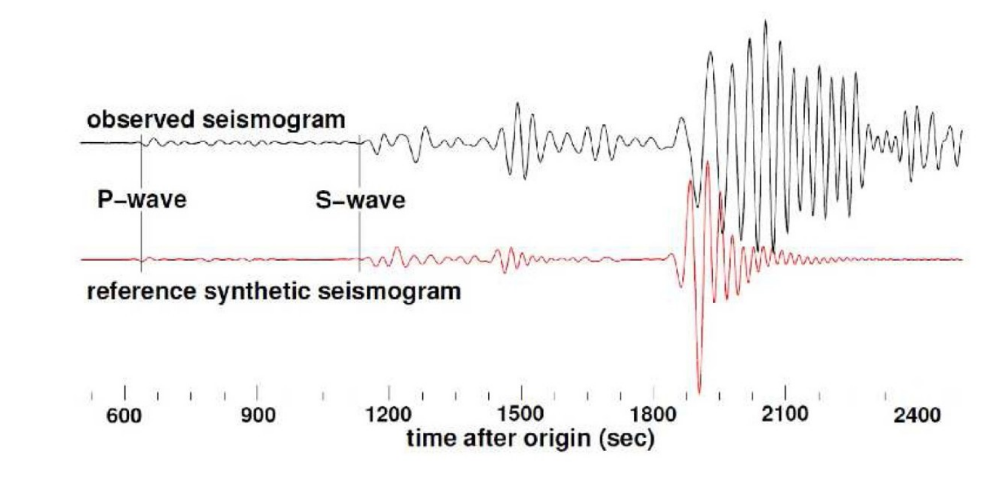

Delay time measurements

Slide 9

Ray theoretic delay times
Rays determined through integration of Hamilton’s equations:
Once the ray path is known, the travel time can be written:
If velocity variations are sufficiently small, we can seek to linearise:

Slide 10


Ray theoretic delay times
Using Fermat’s principle, we find that:
First-order contribution from varying ray geometry vanishes, and so we need only integrate the velocity perturbation along the reference ray path
Functional derivative identified by using the standard inner product:
Note that the functional derivative is singular on the ray path and zero elsewhere

Slide 11


Finite-dimensional parametrisation
For the ith delay time measurement:
Expand the velocity in a finite-dimensional basis:
Choice of basis functions determined by assumptions about the Earth and the potential resolution of the data as set by its dominant frequencies

Slide 12



Reduction to linear algebra
Using the model parametrisation, we now have:
We can now use a familiar matrix-vector notation:
where we have set:

Slide 13
Solving the inverse problem

Slide 14


The null space
Tomographic problem with perfect data:
Is there unique model that solves this problem?
The null space for the matrix A comprises those vectors satisfying:
This is a linear subspace. If non-trivial (not just the zero-vector), then the linear system cannot have unique solutions
The null space is always non-trivial for under-determined problems M > N

Slide 15
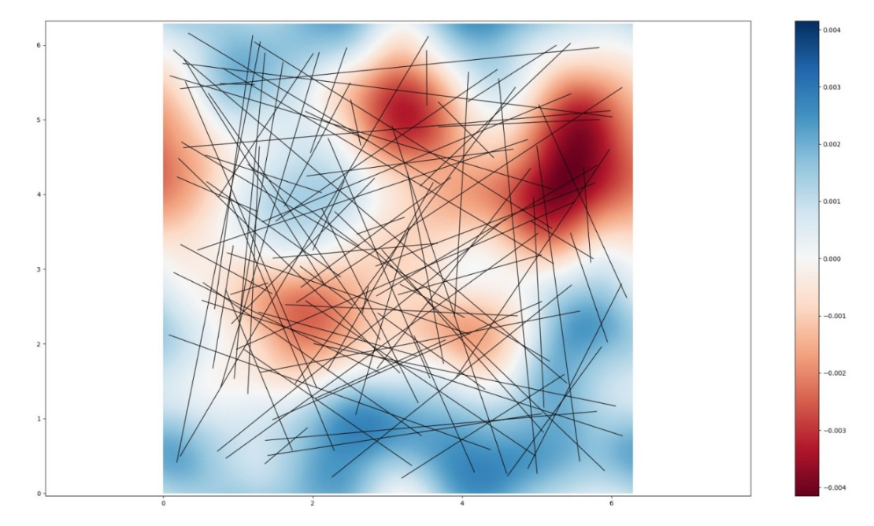
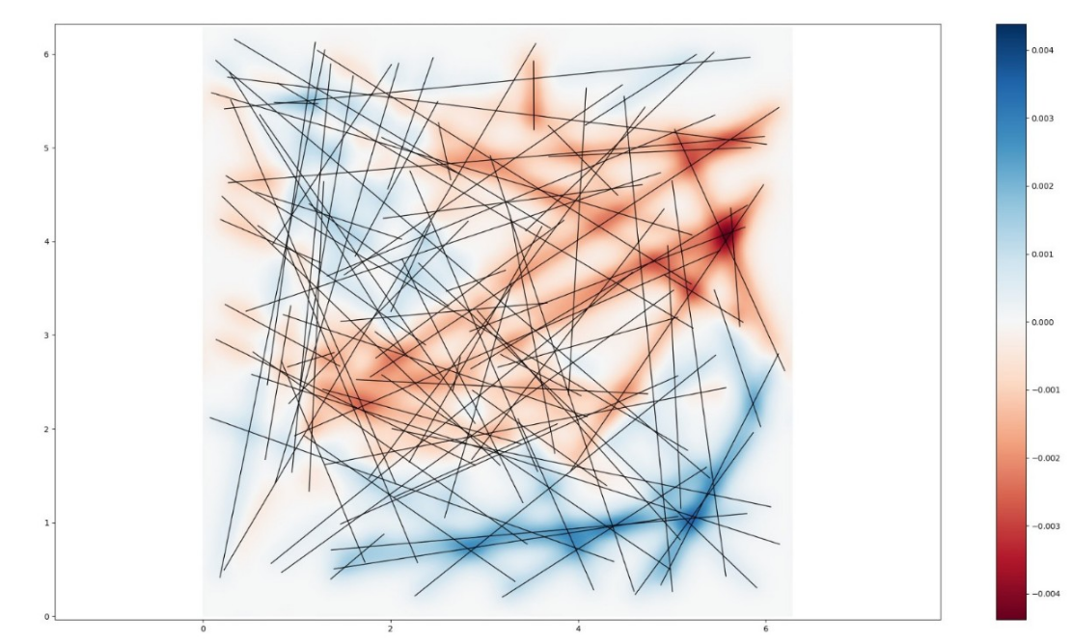
The null space
Lack of ray coverage is the most obvious ray null spaces are generated

Slide 16


Least squares solutions
An obvious way to proceed is through a least-squares solution
We define the least-squares misfit through:
In matrix notation, this becomes:
If there is a non-trivial null-space there is no unique minimum!

Slide 17



Regularisation
The idea is to penalise models with undesirable properties within the inversion
Suppose we prefer models with a small norm:
Relative to our model parametrisation, this becomes:

Slide 18

Regularised least squares
We modify the least squares misfit to incorporate regularisation:
Models with a small value of J now represent a balance between fitting the data well and keeping the chosen model property small
This balance is reflected in the choice of the trade-off parameter
Many choices of regularisation possible such as norm or gradient damping

Slide 19


Solving the optimisation problem
Misfit is quadratic, and so has at most one minimum value when:
Through a calculation (detailed in the handout) this implies:
If the matrix on the LHS is invertible, there is a unique solution to the problem

Slide 20
Uniqueness of the solution
Consider the associated eigenvalue problem:
If the eigenvalues are all non-zero, then the matrix is invertible
Take inner product with a normalised eigenvector:
The LHS is positive so long as the trade-off parameter is positive
Regularised least squares is a means of calculating solutions to the inverse problem that also have desirable physical properties. But there are a lot of arbitrary choices

Slide 21
Generalised regularisation
We can also ask that the model stays “close” to a preferred point:
For positive trade-off parameter, we obtain the unique solution:

Slide 22
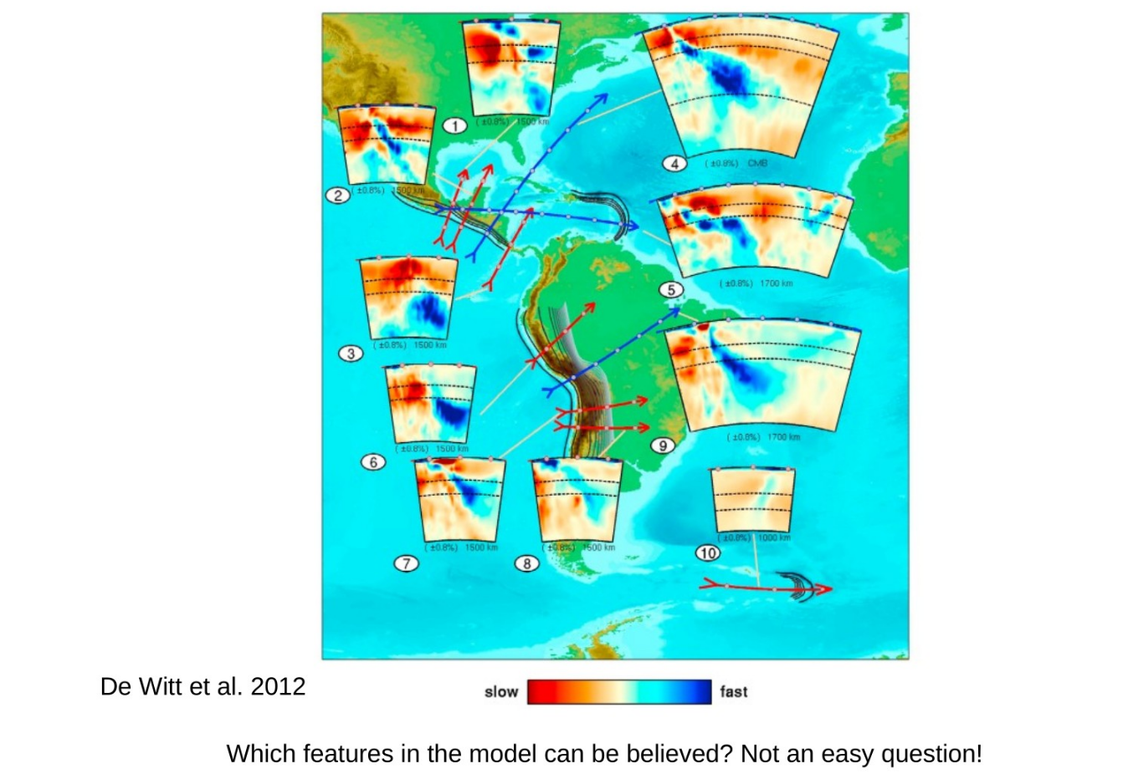

Slide 23
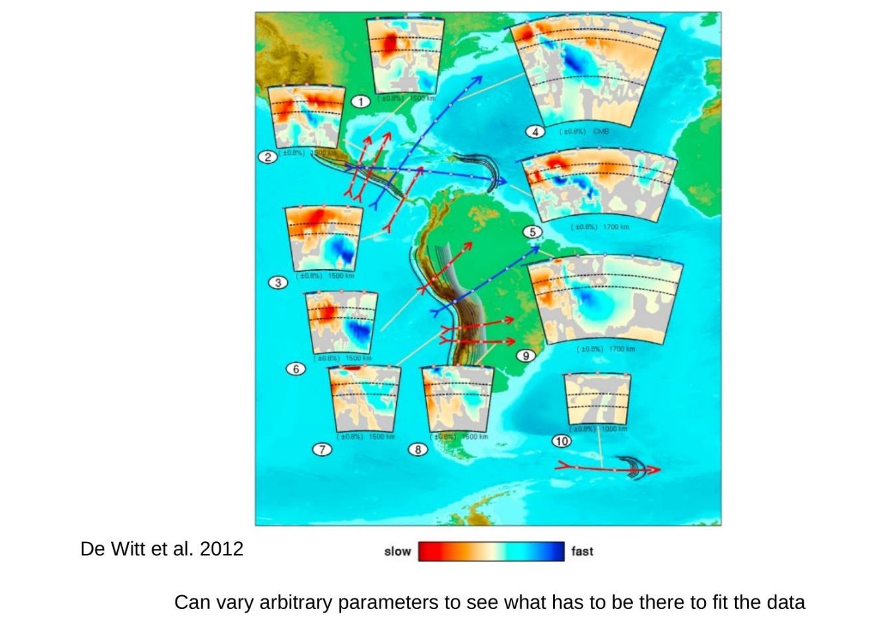

Slide 24
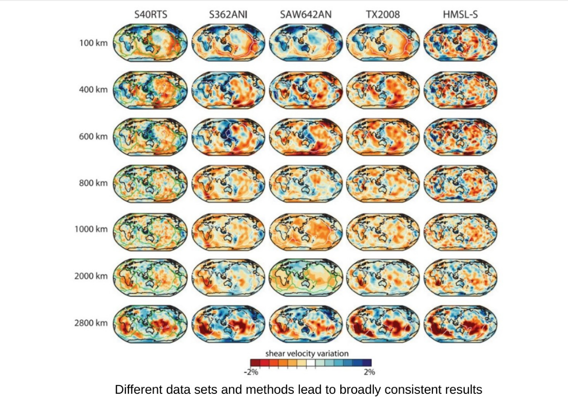

Slide 25
A Bayesian perspective

Slide 26

Bayes theorem
Bayes theorem expressed in terms of conditional probability density functions:
This is a complete recipe to update prior beliefs given data
But what do probabilities mean in this context?
And how do you arrive at the “correct prior”

Slide 27
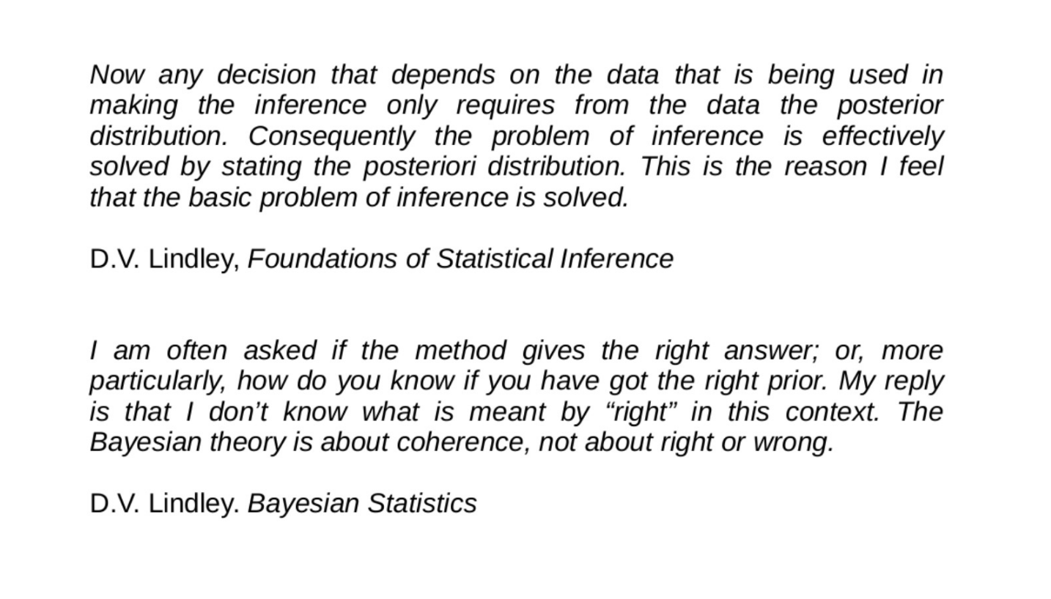

Slide 28
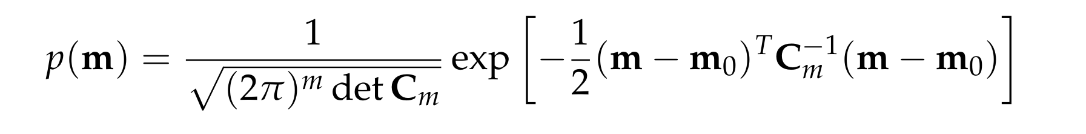
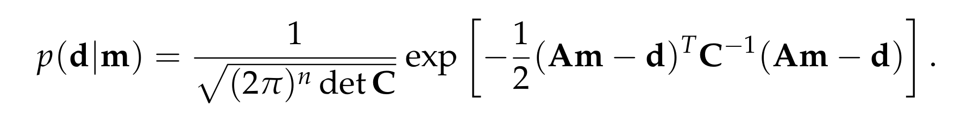
Linear problems with Gaussian priors
Prior and likelihood take the form:
Bayes theorem results in a posterior PDF that is also Gaussian

Slide 29


Posterior mean and covariance
Posterior mean has the same form as a regularised least-squares solution:
Method also provides the posterior covariance:
Crucially, this quantifies uncertainty on the model – a combination of propagated data errors and the limitations imposed by the physics of the problem
Bayesian methods have a lot going for them, but they are only as good as the prior

