Slide 1

Feedback form for the course
Please do fill this in before the end of term
We do take comments seriously, and they help to make the course better over time
https://cambridge.eu.qualtrics.com/jfe/form/SV_3z0oG7tq3O9xtpc

Slide 2
Equilibrium figures

Slide 3

From last lecture
Lagrangian in a self-gravitating planet:
Decomposition of the motion relative to an approximately rotating frame:
Equilibrium equations:

Slide 4
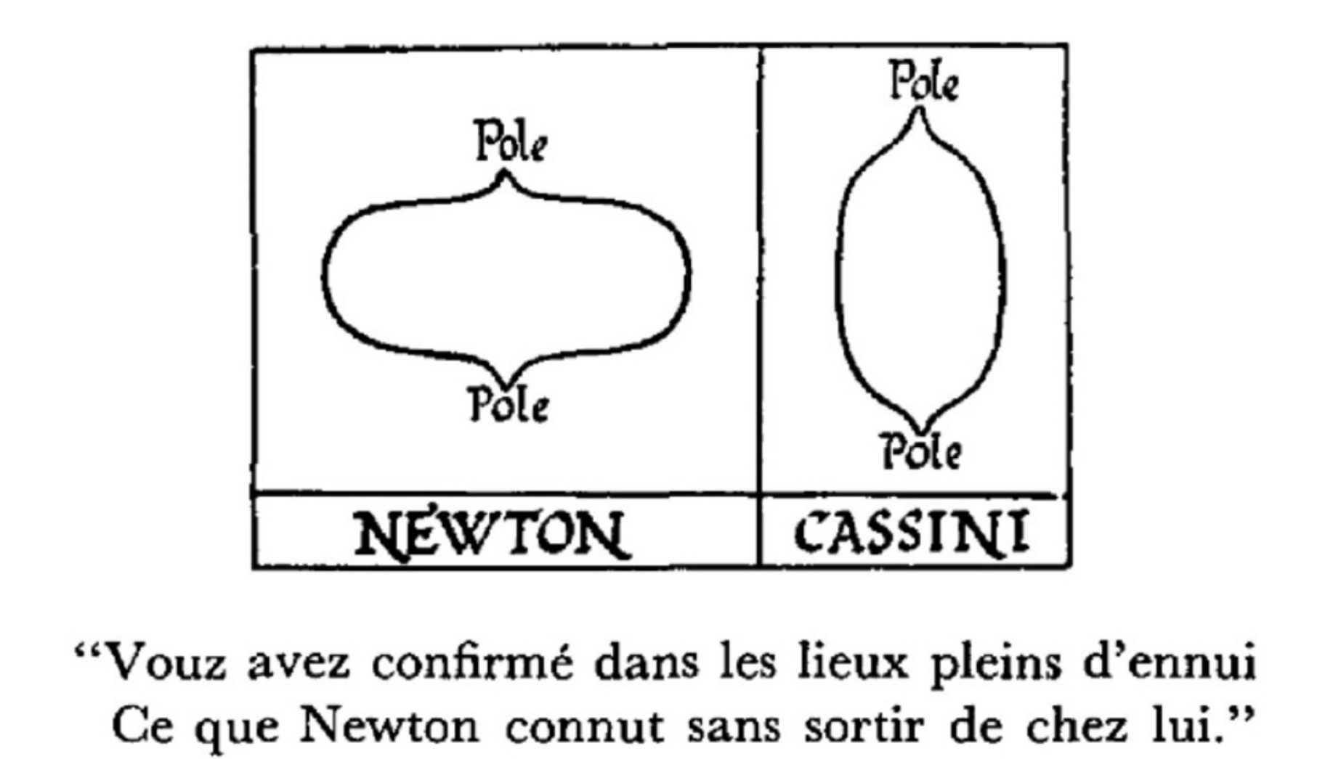
Chandrasekhar (1969)

Slide 5
Solutions of the equilibrium equations

Slide 6


Simplified notations
Notation from last lecture:
To simplify things we now write:
At equilibrium referential and spatial quantities coincide
The stress tensor is symmetric and so has six independent components

Slide 7
Under-determined system
Suppose the planet’s shape and density are known
We then have three equations for the six components of stress:
This is an under-determined system and so we cannot expect unique solutions
More formally, there exists non-trivial divergence-free symmetric second order tensor fields that satisfy the correct boundary conditions
Compare with the existence of divergence-free vector fields

Slide 8
Hydrostatic equilibrium

Slide 9


Stress in a viscous fluid
The (Cauchy) stress in a compressible Newtonian fluid:
At equilibrium, the stress is hydrostatic:
The same result holds in more general viscous fluids
Scaling estimate for deviatoric stress associated with convection:
Pressures in the Earth’s interior are of order 1e10 Pa – deviation from hydrostatic state in Earth-like planets represents only a small perturbation

Slide 10

Hydrostatic equilibrium equations
Given the hydrostatic approximation, we have:
This is now an over-determined set of equations – three equations for one unknown
Helpful to switch to a vector-calculus notation:
Here we have introduced the gravity-potential, this being the sum of the gravitational and centrifugal potentials

Slide 11
Consequences of the equations
Hydrostatic equilibrium equation:
Gradients of pressure and gravity potential are parallel, and so a level surface of one field is a level surface of the other
Ignoring the atmosphere, the pressure vanishes at the planet’s surface, and hence this must be a level surface of the gravity potential
Taking the curl of the equation, we find:
This shows that level surfaces of density are also coincident with the other two fields

Slide 12
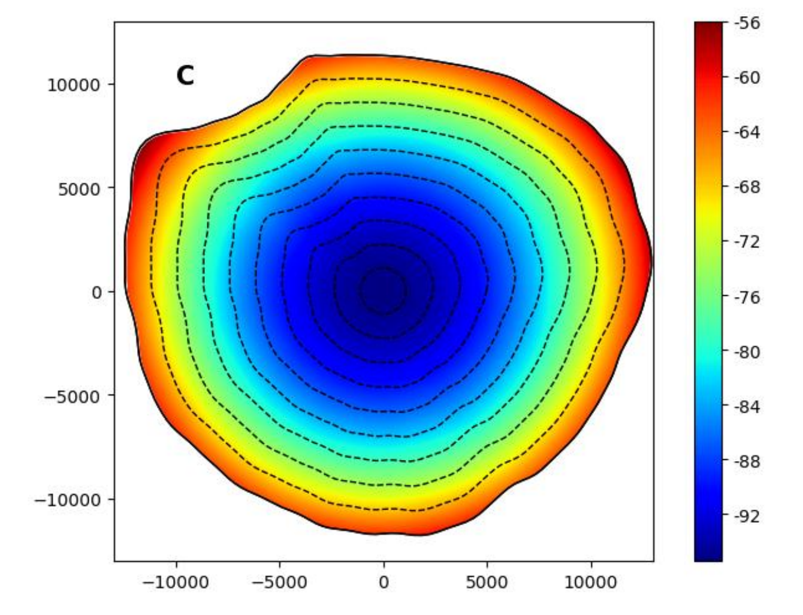
Gravitational potential for Phobos
Equatorial slice through the gravitational potential for Phobos calculated assuming a constant interior density
The potential field is non constant on the moon’s surface, and hence this cannot be a hydrostatic equilibrium state
In general, the hydrostatic equilibrium condition imposes very strong conditions on a planet’s shape, density, and rotation
Myhill et al. (2025)

Slide 13

Non-rotating planets
In the non-rotating case, suppose the planet is spherically symmetric
Equilibrium equation reduces to:
There is just one non-trivial equation here, and so we can find an equilibrium solution
It can be shown that this is the only solution in the non-rotating case

Slide 14
Slowly rotating planets
By definition, slowly rotating means that the centrifugal potential is small relative to the gravitational potential:
For the Earth, we find:
In such cases, we can apply first-order perturbation theory
Higher-order theories exist and are sometimes necessary

Slide 15

Perturbation expansions
Expand about the non-rotating solution:
Similarly, the free-surface radius is expanded as:
Topography on internal boundaries expanded similarly, but we neglect this detail for simplicity in what follows

Slide 16
First-order equilibrium equations
First-order perturbation of the equilibrium equation:
Exact boundary condition on the perturbed planetary surface:
Expanded to first-order, this reduces to:

Slide 17
Analysis of the equations
First-order perturbation of the equilibrium equation:
Take cross-product with radial unit vector:
From this, we conclude that:

Slide 18


Analysis of the equations
First-order perturbation of the equilibrium equation:
Taking the curl of this equation, we arrive at:
And hence, we see that:

Slide 19

Analysis of the equations
We have now shown that the following identities hold for the first-order perturbations:
All other terms can be expressed through the gravity potential perturbation

Slide 20

Linearised Poisson equation
Linearisation of Poisson’s equation is trivial:
Linearisation of continuity conditions requires more work:
Derivation done within the final example sheet

Slide 21


Modified Poisson equation
Expressing other perturbations in terms of the gravity potential:
Expressing other perturbations in terms of the gravity potential:
Linear boundary value problem for the perturbed gravitational potential, with the centrifugal potential providing the “force terms”
Theory applies also to equilibrium tides in gaseous planets

Slide 22


Ellipticity function
Separation of variables shows that:
which serves to define the ellipticity function
This function has the property:
at the planets mean surface (and at internal ones too)
Surface ellipticity of the Earth is around 1/300

Slide 23
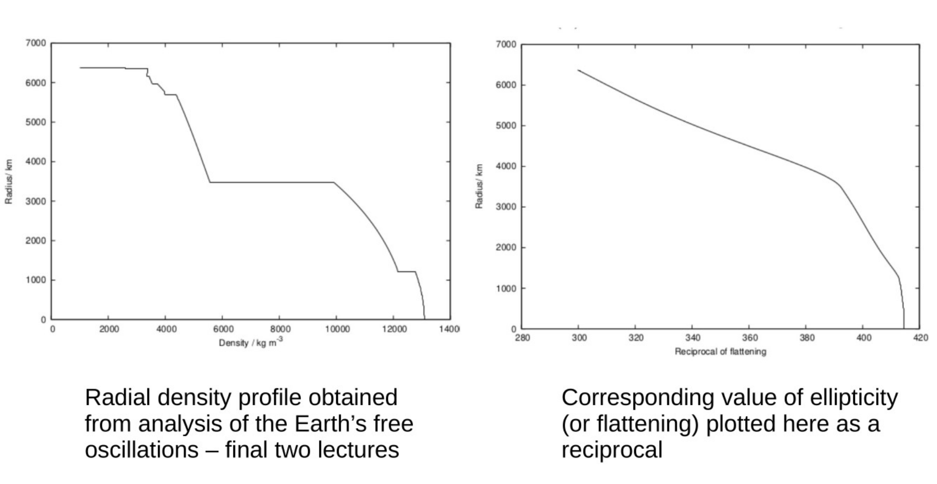
Numerical calculation for the Earth

Slide 24
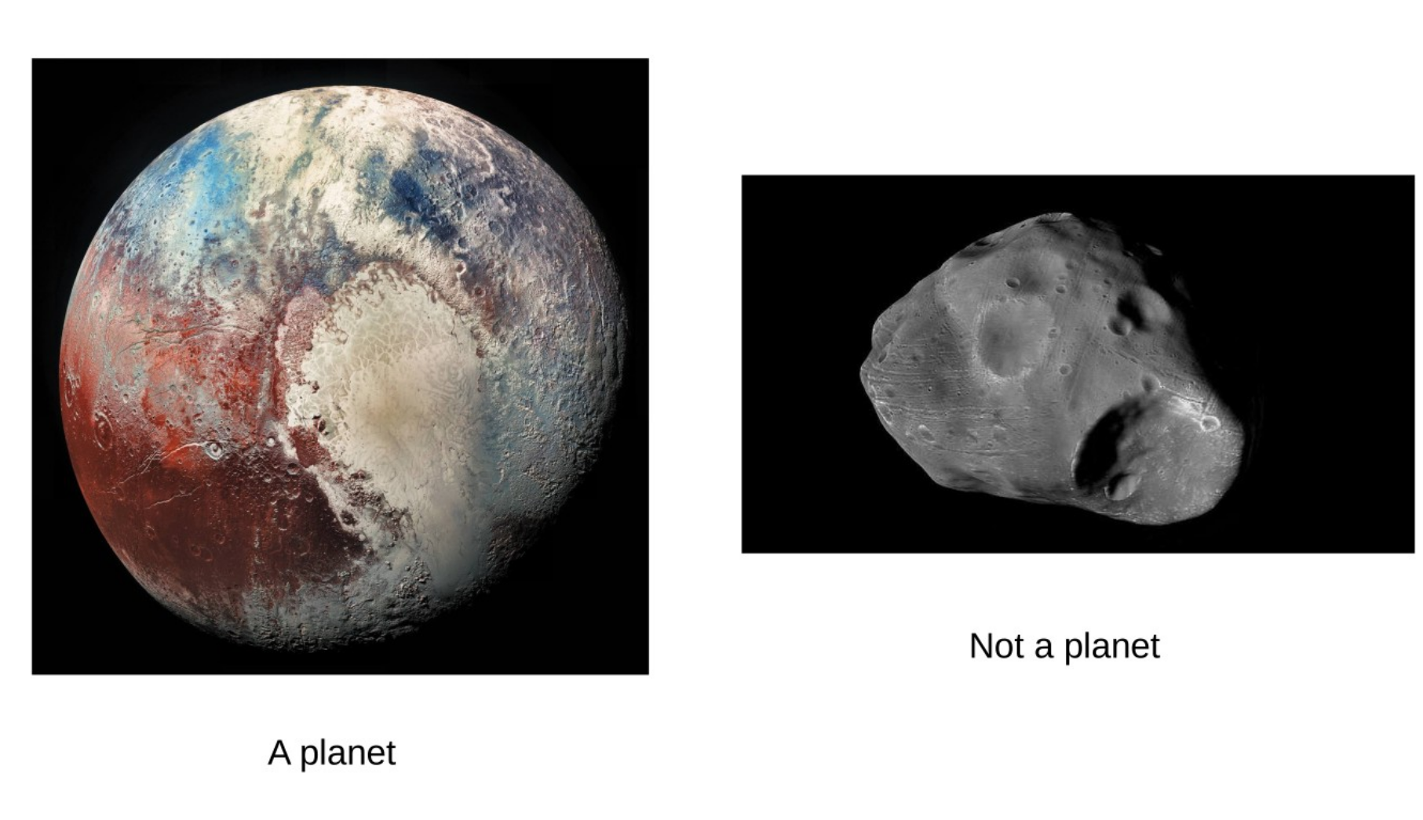
What is a planet?

Slide 25
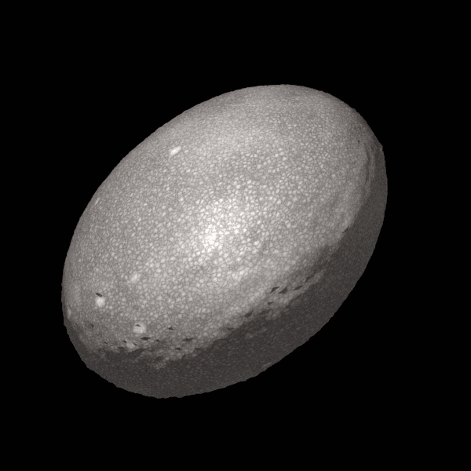
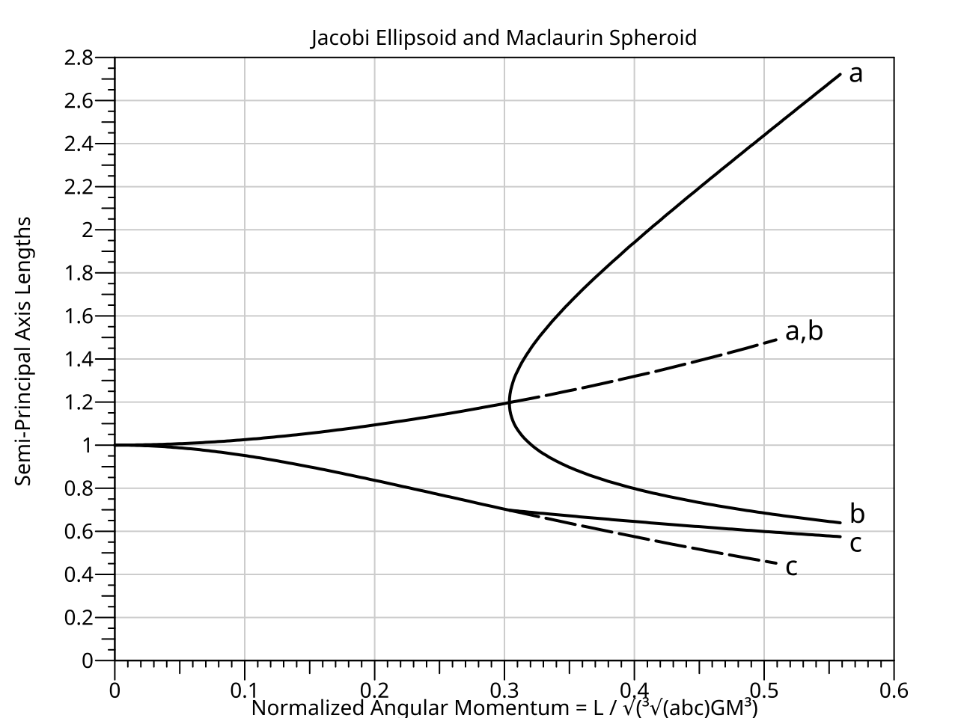
Equilibrium figures do not have to be axisymmetric
Haumea is a dwarf planet with rotation period of 4 hours and a triaxial figure

Slide 26
