Slide 1
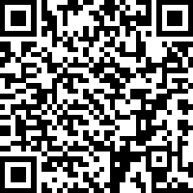
Feedback form for the course
Please do fill this in before the end of term
We do take comments seriously, and they help to make the course better over time
https://cambridge.eu.qualtrics.com/jfe/form/SV_3z0oG7tq3O9xtpc

Slide 2
Free oscillations of the Earth

Slide 3
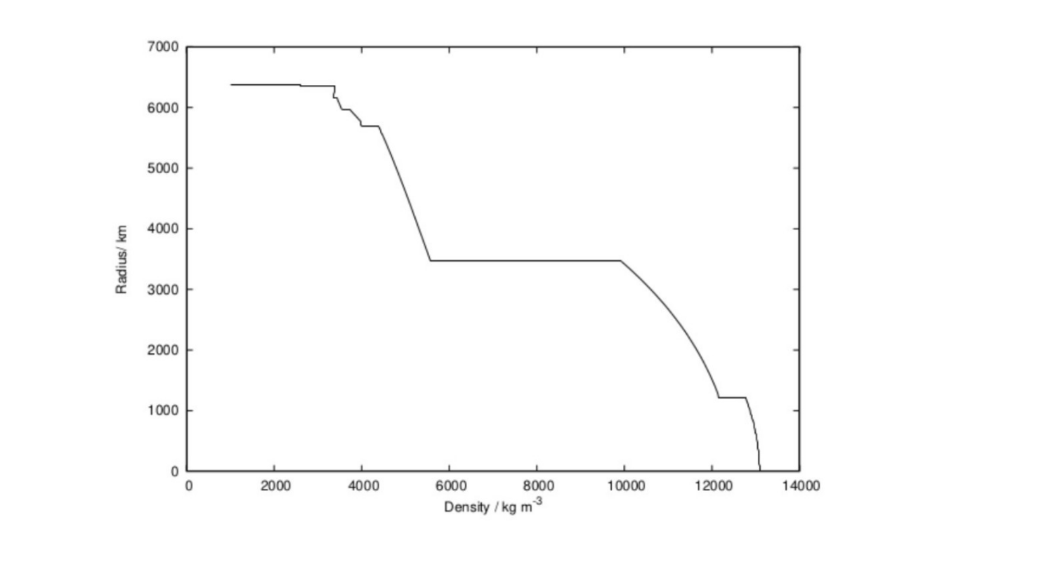
From last lecture
Dziewonski & Anderson (1981)

Slide 4
Operator formalism

Slide 5
Equations of motion
Linearised equations with self-gravitation and rotation:
Linearised equations with self-gravitation and rotation:
Simplifying notations will help a lot!

Slide 6

Weak form of the equations
For an arbitrary test function, we have:
Integrating by parts and using the boundary conditions:
If the latter identity holds for all test functions, then we can recover both the equations of motion and the boundary conditions
This is the weak formulation of the problem
Weak and strong formulations are equivalent up to technicalities

Slide 7

Kinetic energy form
We define the kinetic energy form:
Acceleration term in the weak form can then be written:
This sesqui-linear form is associated with the linear operator:

Slide 8

Coriolis form
We define the Coriolis form:
Associated with the linear operator:

Slide 9
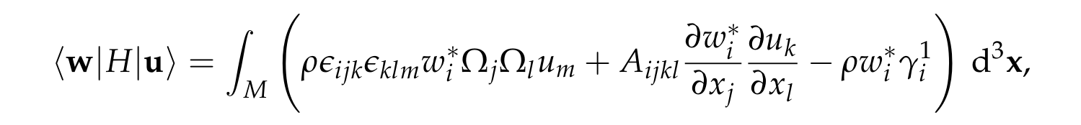
Potential energy form
We define the potential energy form:
Along with the linear form linked to the stress glut:
These two terms incorporate both the equations of motion and the boundary conditions

Slide 10
Equations of motion
The weak form of the equations of motion can now be written:
which is to hold for all test functions, w
We can formally think of the problem as
but the boundary conditions are then left implicit

Slide 11
Properties of the forms
The kinetic energy form is self-adjoint:
The Coriolis form is anti-self-adjoint:

Slide 12
Properties of the forms
The potential energy form is self-adjoint:
Elastic term is clear due to hyperelastic symmetric
Centrifugal term follows by a simple calculation – details in handout
Gravitational potential term takes more work but proceeds in the same manner – details are not in handout and are not examinable

Slide 13
Non-rotating eigenvalue problem

Slide 14
Free oscillations
For long-period seismology, rotation is a relatively small term that is often handled through perturbation theory
Weak form in a non-rotating planet:
Free oscillations are time-harmonic solutions with no force term:
This is an eigenvalue problem, with squared eigenfrequency as the eigenvalue

Slide 15
Standard properties
You need to know how to show that:
Squared eigenfrequencies are real
Eigenfunctions in distinct eigenspaces are orthogonal:
Further properties to know but without proof:
Eigenspaces are all finite dimensional
Eigenfunctions form a complete basis for vector fields satisfying the traction-free boundary conditions

Slide 16
Eigenfunction expansions
We use k to label the eigenspaces, and m the eigenfunctions in each eigenspace
Within each eigenspace, we can choose an orthonormal basis, and hence:
Completeness of the eigenfunctions means that we can write:
This is the eigenfunction expansion of the vector field

Slide 17
Eigenfunction expansions
Equations of motion in the frequency-domain:
Expanding the solution in the eigenfunction basis:
Frequency-domain solution readily derived:
Time-domain solution obtained by an inverse Fourier transformation – but details are not covered and not examinable

Slide 18
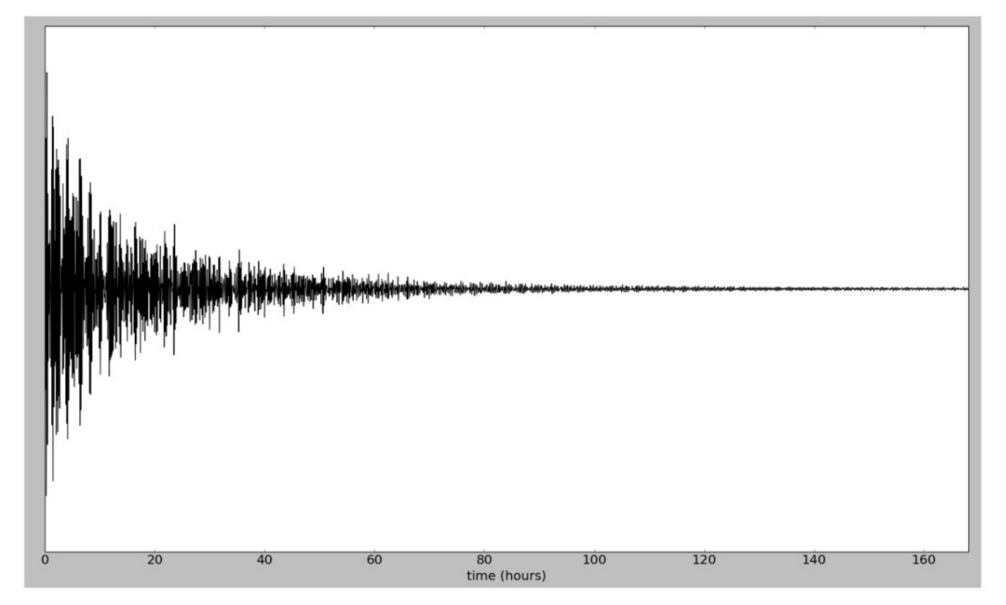
Long time-series
Several day long time-series following a large earthquake (Bolivia 1994)
The effects of attenuation are clearly seen within real data

Slide 19
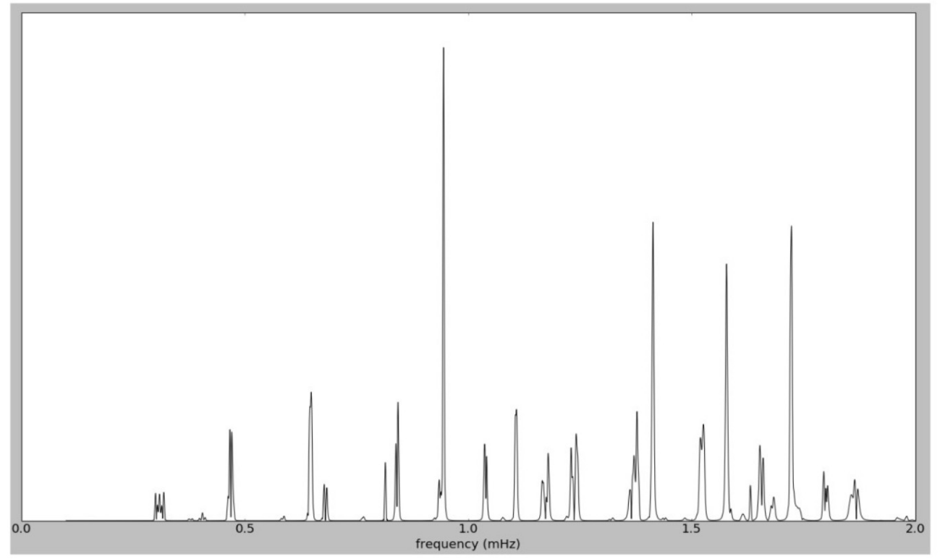
Corresponding amplitude spectra
Resonance peaks (or poles) associated with each eigenfrequency
For good resolution in the frequency-domain, we need long time series

Slide 20
Gravitational stability

Slide 21
Rayleigh quotient
The non-rotating eigenvalue problem:
Taking the test function to equal the eigenfunction:
Sign of the squared eigenfrequency determined by the potential energy form
Positive values imply stable oscillations about equilibrium
Negative values imply unstable, exponentially growing perturbations
Zero values correspond to linear growth in time (double pole at the origin)

Slide 22

Non-gravitating case
Potential energy form simplifies such that:
Potential energy form simplifies such that:
Vanishes for linearised rigid body motions:
Six-dimensional eigenspace at zero-frequency, but not excited by earthquakes:

Slide 23
Non-gravitating case
Potential energy form simplifies such that:
Non-negative values so long as we have uniform pointwise stability:
Implies elastic wave speeds are all positive
In isotropic case, implies P-wave speed greater than for S-waves

Slide 24
Gravitational contribution
Quantitative treatment possible, but difficult
This shows that there can be a finite number of eigenspaces with negative squared eigenfrequencies
Existence depends on interplay between gravitational and elastic forces
Elastic forces always resist further deformation
Gravitational forces can encourage it
A spherically symmetric compression would lower the (always negative) gravitational binding energy, while raises the elastic potential energy

