Slide 1
JAVASCRIPT STRINGS
By Davyd Manzhula

Slide 2
AGENDA
String literals
Template literals
String object and its methods

Slide 3
STRING LITERALS

Slide 4
STRING LITERALS
'string text'
"string text"
String(something)
`hello world`
`hello ${who}`
escape `<a>${who}</a>`

Slide 5
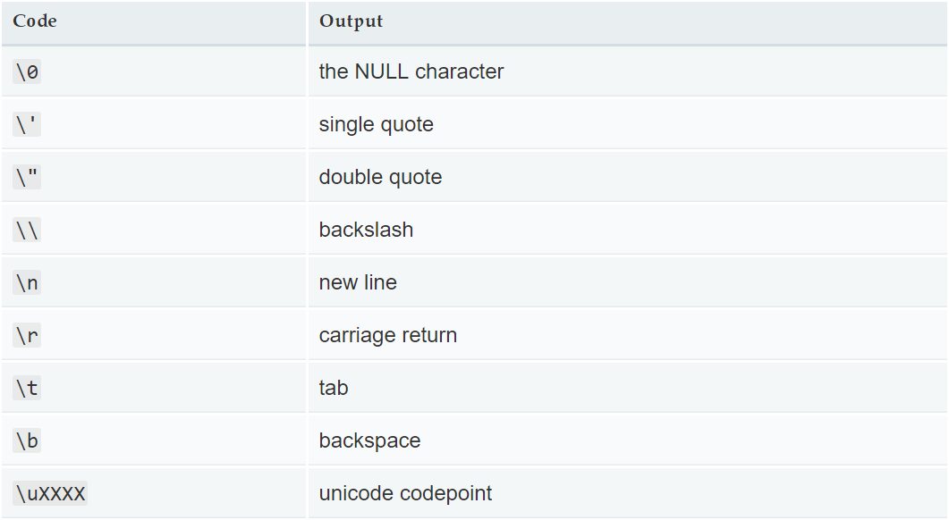
STRING LITERALS

Slide 6
STRING LITERALS
'string text'
"string text"
String(something)

Slide 7
STRING LITERALS
'cat'.charAt(1) // a
'cat'[1] // a

Slide 8
It's possible to use String as a "safer" toString() alternative, although it still normally calls the underlying toString(). It also works for null, undefined, and for symbols.
let something = null;
something.toString() //Uncaught TypeError
String(something) //"null"

Slide 9
let s1 = '2 + 2';
let s2 = new String('2 + 2');
eval(s1); // 4
eval(s2); // "2 + 2"
eval(s2.valueOf()); // 4

Slide 10
TEMPLATE LITERALS

Slide 11
STRING LITERALS
let a = 5;
let b = 10;
'a = ' + a + ', b = ' + b + ', a + b = ' + (a + b);
`a = ${a}, b = ${b}, a + b = ${a + b}`
// a = 5, b = 10, a + b = 15

Slide 12
var classes = 'header'
classes += (isLargeScreen() ?
'' : item.isCollapsed ?
' icon-expander' : ' icon-collapser');
let classes = `header ${ isLargeScreen() ? '' :
`icon-${item.isCollapsed ? 'expander' : 'collapser'}` }`;

Slide 13
let person = 'David';
let age = 19;
function myTag(strings, name, age) {
let str0 = strings[0]; // "My name is "
let str1 = strings[1]; // " and I am "
let str2 = strings[2]; // ""
ley ageStr;
if (age >= 18){
ageStr = 'old fart';
} else {
ageStr = 'young fart';
}
return `${str0}${name}${str1}${ageStr}`;
}
myTag`My name is ${person} and I am ${age}`;
// "My name is David and I am old fart"

Slide 14
STRING LITERALS
`\r\n\u1234\t\ta` // " ↵↵ሴ a"
String.raw`\r\n\u1234\t\ta` // "\r\n\u1234\t\ta"

Slide 15
STRING OBJECT AND ITS METHODS

Slide 16
let s_prim = 'foo';
let s_obj = new String(s_prim);
console.log(typeof s_prim); // Logs "string"
console.log(typeof s_obj); // Logs "object"

Slide 17
STRING METHODS
String.prototype.charAt() Returns the character (exactly one UTF-16 code unit) at the specified index.
String.prototype.charCodeAt() Returns a number that is the UTF-16 code unit value at the given index.
String.prototype.codePointAt() Returns a nonnegative integer Number that is the code point value of the UTF-16 encoded code point starting at the specified index.
String.prototype.concat() Combines the text of two strings and returns a new string.
String.prototype.includes() Determines whether one string may be found within another string.

Slide 18
String.prototype.endsWith() Determines whether a string ends with the characters of another string.
String.prototype.indexOf() Returns the index within the calling String object of the first occurrence of the specified value, or -1 if not found.
String.prototype.lastIndexOf() Returns the index within the calling String object of the last occurrence of the specified value, or -1 if not found.
String.prototype.localeCompare() Returns a number indicating whether a reference string comes before or after or is the same as the given string in sort order.
String.prototype.match() Used to match a regular expression against a string.

Slide 19
String.prototype.matchAll() Returns an iterator of all matches.
String.prototype.normalize() Returns the Unicode Normalization Form of the calling string value.
String.prototype.padEnd() Pads the current string from the end with a given string to create a new string from a given length.
String.prototype.padStart() Pads the current string from the start with a given string to create a new string from a given length.
String.prototype.repeat() Returns a string consisting of the elements of the object repeated the given times.

Slide 20
String.prototype.replace() Used to find a match between a regular expression and a string, and to replace the matched substring with a new substring.
String.prototype.search() Executes the search for a match between a regular expression and a specified string.
String.prototype.slice() Extracts a section of a string and returns a new string.
String.prototype.split() Splits a String object into an array of strings by separating the string into substrings.
String.prototype.startsWith() Determines whether a string begins with the characters of another string.

Slide 21
String.prototype.substr() Returns the characters in a string beginning at the specified location through the specified number of characters.
String.prototype.substring() Returns the characters in a string between two indexes into the string.
String.prototype.toLocaleLowerCase() The characters within a string are converted to lower case while respecting the current locale. For most languages, this will return the same as toLowerCase().
String.prototype.toLocaleUpperCase() The characters within a string are converted to upper case while respecting the current locale. For most languages, this will return the same as toUpperCase().
String.prototype.toLowerCase() Returns the calling string value converted to lower case.

Slide 22
String.prototype.toSource() Returns an object literal representing the specified object; you can use this value to create a new object. Overrides the Object.prototype.toSource() method.
String.prototype.toString() Returns a string representing the specified object. Overrides the Object.prototype.toString() method.
String.prototype.toUpperCase() Returns the calling string value converted to uppercase.
String.prototype.valueOf() Returns the primitive value of the specified object. Overrides the Object.prototype.valueOf() method.

Slide 23
String.prototype.trim() Trims whitespace from the beginning and end of the string. Part of the ECMAScript 5 standard.
String.prototype.trimStart() String.prototype.trimLeft() Trims whitespace from the beginning of the string.
String.prototype.trimEnd() String.prototype.trimRight() Trims whitespace from the end of the string.

Slide 24
USEFUL LINKS
https://developer.mozilla.org/uk/docs/Web/JavaScript/Reference/Global_Objects/String
https://developer.mozilla.org/en-US/docs/Web/JavaScript/Reference/Template_literals
https://habr.com/ru/post/262679/

