Slide 1
Big Mountain Resort
Plan to increase revenue

Slide 2
The Problem
350,000 guests per season
New chair lift increases operating costs by $1,540,000
Current ticket price only $81

Slide 3
The Problem
We need to:
Cut costs
and/or
Increase ticket price

Slide 4
Recommendation / Key Findings
We are among top resorts for all key features that customers value
Machine model suggests ticket price: $95.87
Machine model mean absolute error: $10.39
We should increase our price!

Slide 5
Modeling Results / Analysis
Linear regression model
Vertical drop
Snow making area
Chairs
Fast quads
Runs
Longest run
Skiable terrain
Trams
Random forest regressor
Fast quads
Runs
Snow making area
Vertical drop

Slide 6
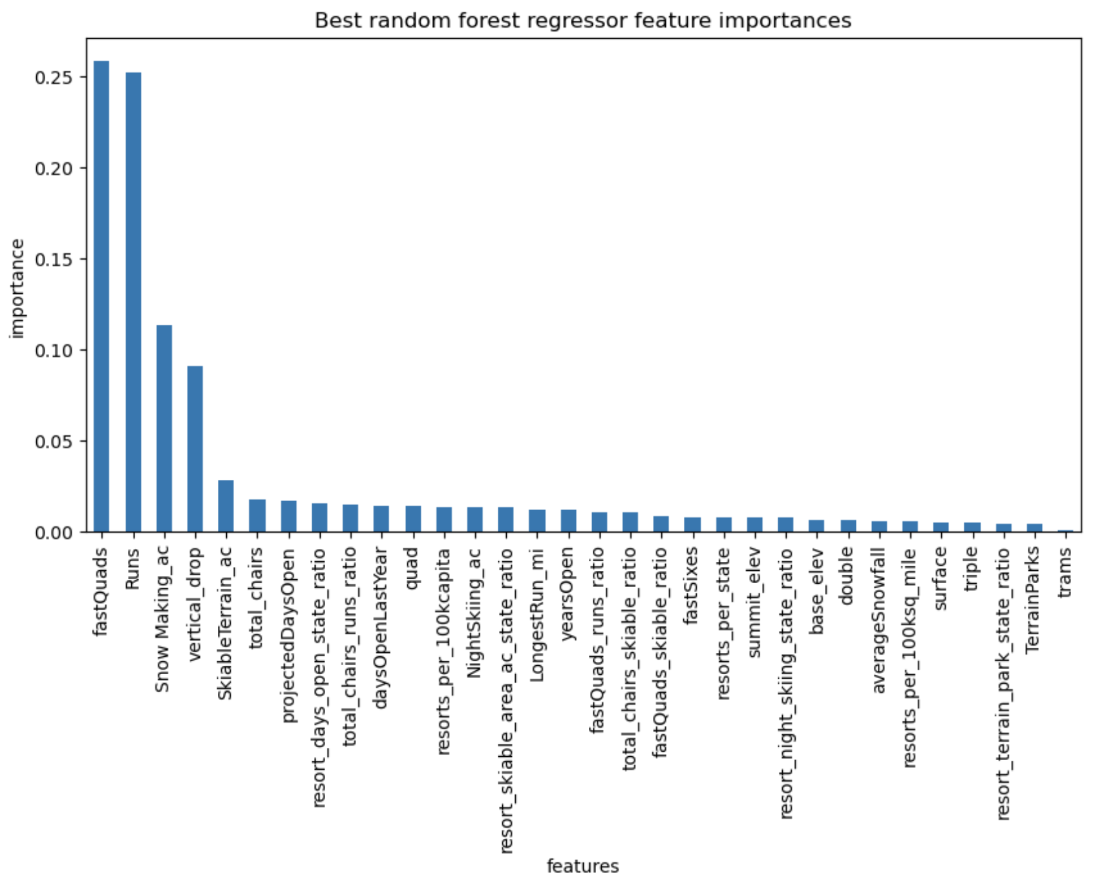

Slide 7
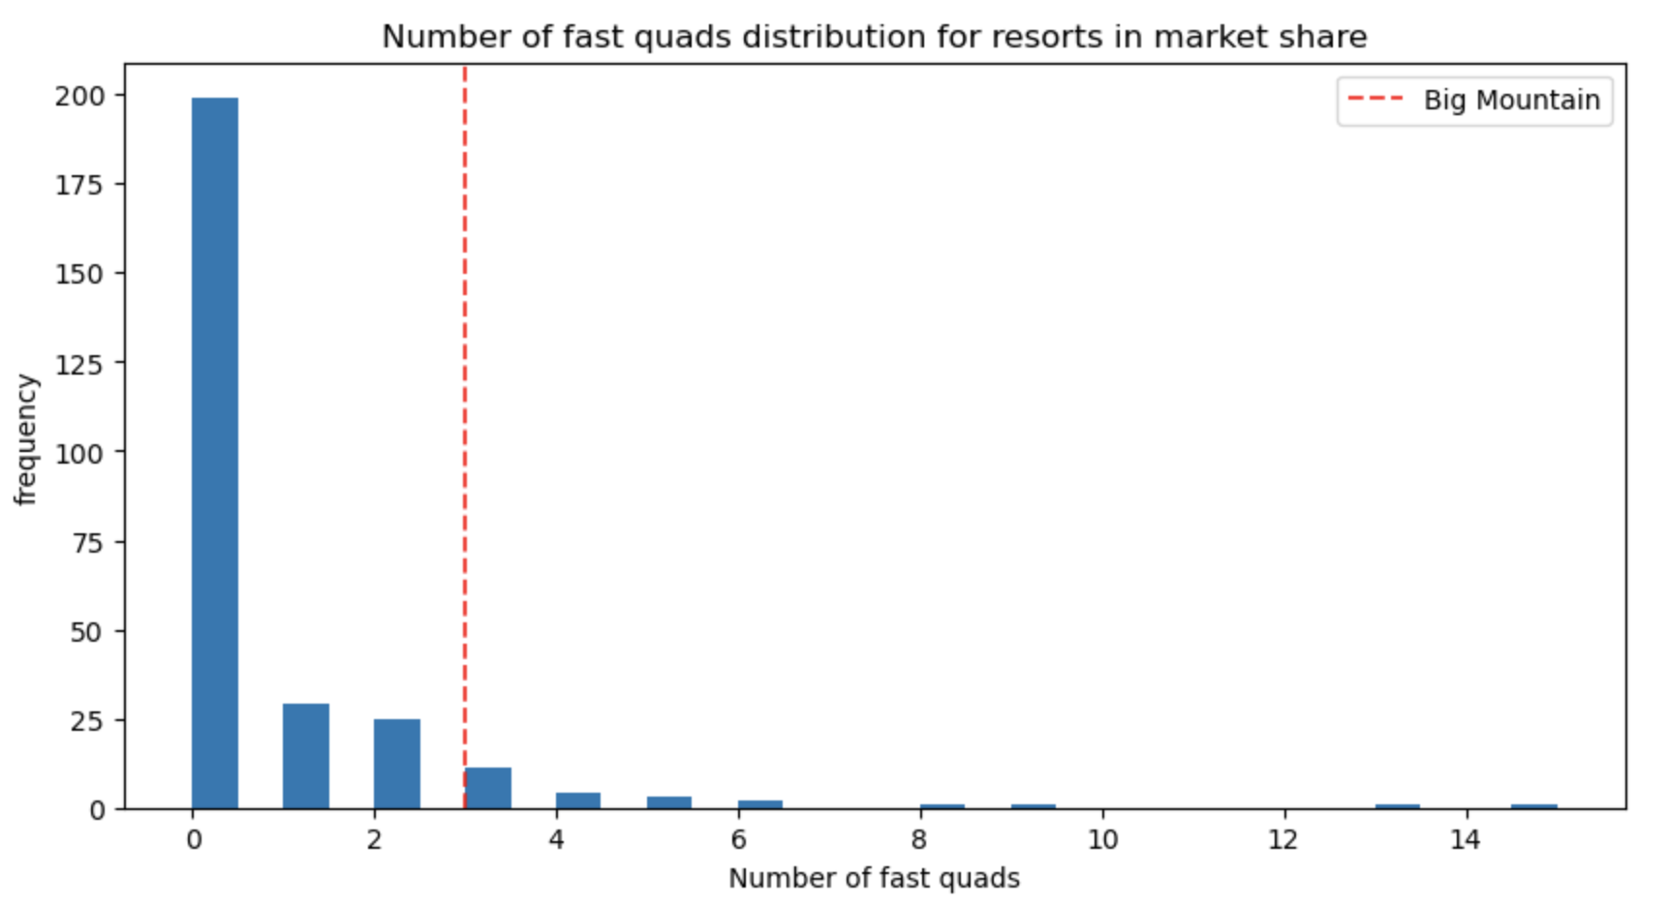
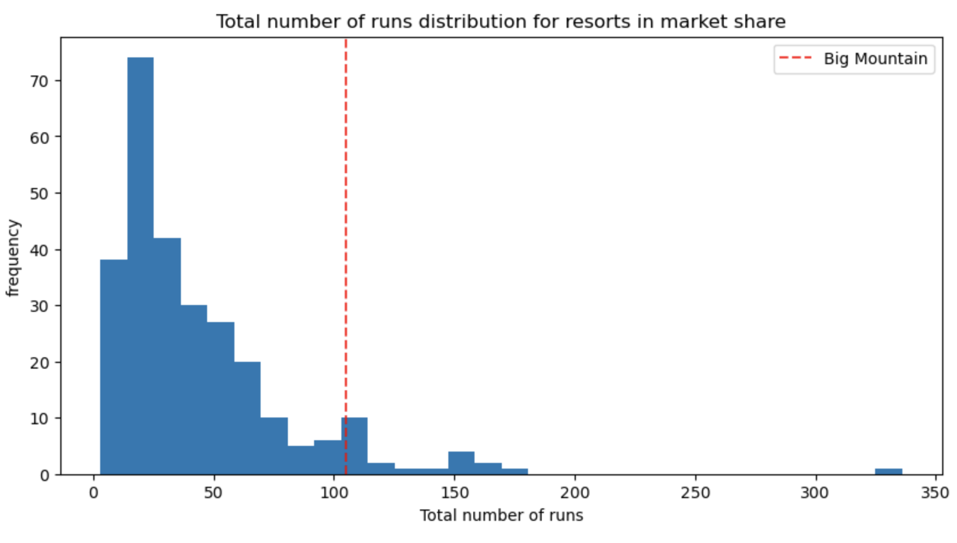
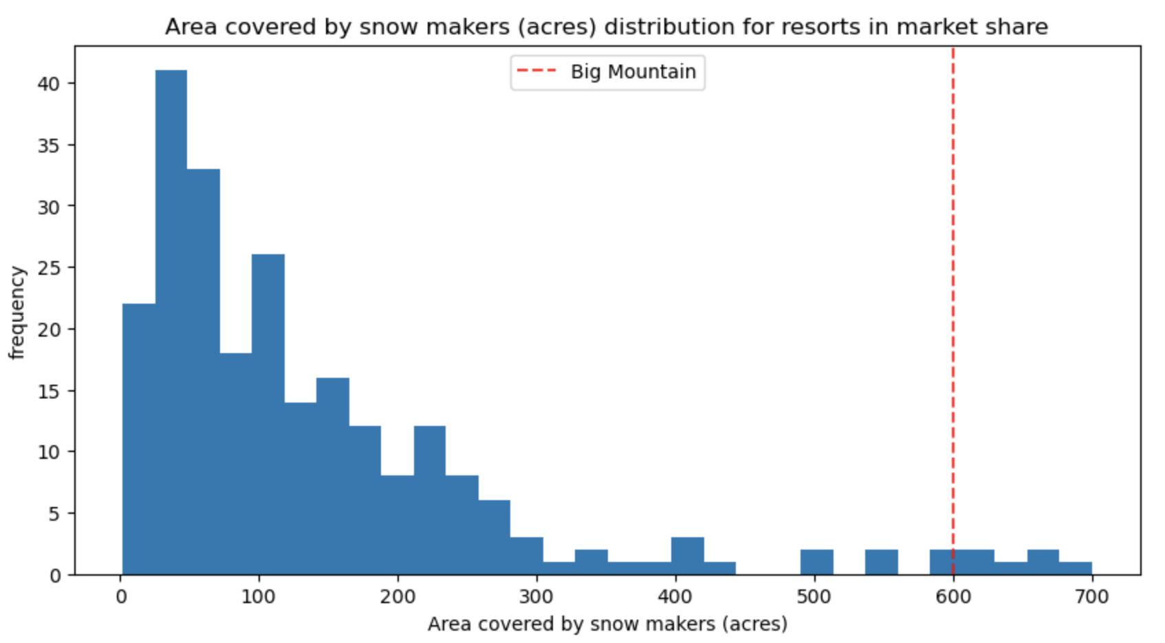
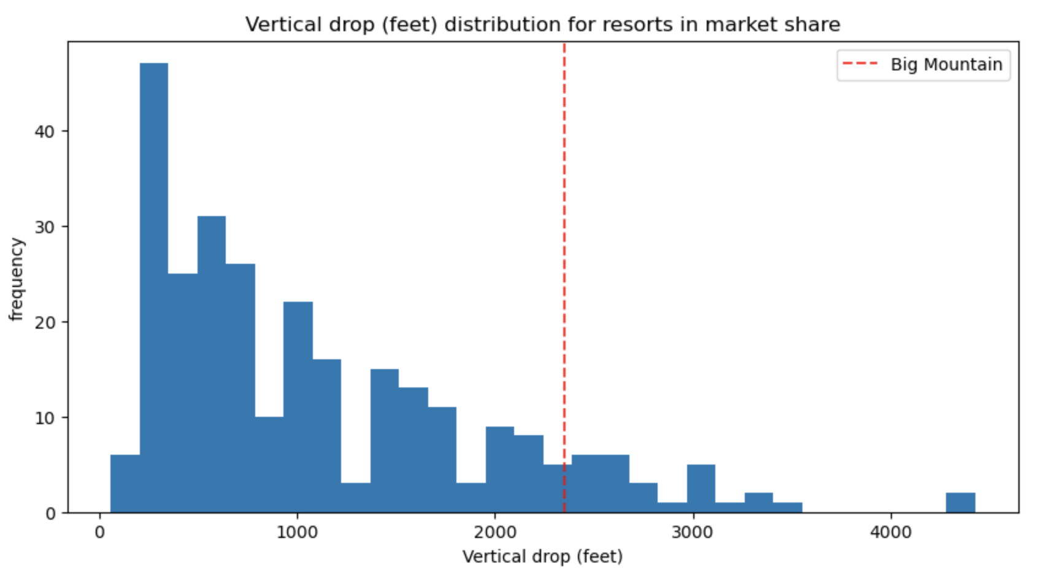

Slide 8
Modeling Results / Analysis
Business Scenario #1:
Run closures
Close 5 runs:
- $1,116,667
Close 8 runs:
- $2,206,521
How much will this save?
Business Scenario #2:
Increase vertical drop
Ticket value + $1.99
Seasonal ticket revenue + $3,474,638
Additional chair lift cost - $1,540,000

Slide 9
Summary / Conclusion
Current price of $81 is undervalued
Big Mountain Resort top of class for most valuable features
Recommend ticket price increase of at least $3.99
Random forest regressor available to explore additional feature / pricing options

