Slide 1

Honeytoken IDS rules + ET INFO Suricata rules for anomaly detection
Tony Robinson, Proofpoint Emerging Threats

Slide 2

Before we Begin…
Super huge thanks to Jason Ish (@ish) + Victor Julien (@inliniac)
For telling me to submit something for Suricon. I might not have been able to attend, but I’m here because you believed in me.
Slide deck is available at:
https://github.com/da667/Contalks/tree/main/Suricon2024
So if you gotta get moving…
Or you missed one of the URLs / References today… help yourself!

Slide 3

#WHOAMI
Tony Robinson – Proofpoint Emerging Threats
Intel goes in, rules come out (Snort 2.9, Suricata 4-7)
Sr. Threat Researcher, 3 years
10+ years experience in cybersecurity
Mainly NSM, SOC, + DFIR
Chesterfield, MI, United States
Happily Married
Two Bassett Hounds
Likes: Good Food, Video Games, Anime/Manga Nerd
Errata: Self-published author – Building Virtual Machine Labs: A Hands-On Guide

Slide 4

Part 1
Making better use of ET INFO

Slide 5

ET INFO
[...] for signatures to help provide audit level events that are useful for correlation and identifying interesting activity which may not be inherently malicious but is often observed in malware and other threats
https://community.emergingthreats.net/t/suricata-5-6-7-rule-categories/
TL;DR: These rules could trigger on bog standard activity, but in the right context, they could indicate anomalous activity

Slide 6

ET_INFO Category Forks (Suricata 7.0.3+)
New Rule Categories:
Forked From ET_INFO:
FILE_SHARING
DYN_DNS
REMOTE_ACCESS
TA_ABUSED_SERVICES
Deprecated Rule Categories:
Merged into ET_INFO:
ET_POLICY

Slide 7
ET_INFO Rules That Do Hard Work
DNS Over HTTPS (DoH)
Wraps DNS queries in TLS and HTTP2
Slightly better for privacy, terrible for network visibility
Difficult to block
Yet another Protocol that can’t be bothered to define its own TCP/UDP port
Tools/Malware Utilizing DoH:
ChamelGang (2023) - https://www.bleepingcomputer.com/news/security/chinese-hackers-use-dns-over-https-for-linux-malware-communication/
Godlua (2019) - https://www.trendmicro.com/vinfo/us/security/news/cybercrime-and-digital-threats/new-godlua-backdoor-found-abusing-dns-over-https-doh-protocol
Dnstt - https://www.bamsoftware.com/software/dnstt/
Godoh - https://github.com/sensepost/godoh
https://detect.fyi/detecting-dns-over-https-30fddb55ac78
https://github.com/curl/curl/wiki/DNS-over-HTTPS#publicly-available-servers
Where most DNS Over HTTPS Rules in ET OPEN/PRO come from

Slide 8
ET_INFO Rules That Do Hard Work
External IP Lookup Services
Remote server returns the External/Public IP address of the client
Often used with commodity malware for network connectivity checks, anti-sandboxing, Geofencing, system identification, etc:
https://isc.sans.edu/diary/APIs+Used+by+Bots+to+Detect+Public+IP+address/29516/OpenSSH
Agent Tesla - https://blogs.blackberry.com/en/2021/06/threat-thursday-agent-tesla-infostealer-malware
Remcos RAT - https://www.cyfirma.com/research/the-persistent-danger-of-remcos-rat/
Snake Keylogger - https://www.splunk.com/en_us/blog/security/under-the-hood-of-snakekeylogger-analyzing-its-loader-and-its-tactics-techniques-and-procedures.html
Sometimes used with legitimate software for telemetry purposes
We sig them when we see them

Slide 9
ET_INFO Rules That Do Hard Work
Pastebin-like Services
Web (HTTP/HTTPS) services used to host text documents
Sometimes anonymously, sometimes not
Legitimately used to share configuration files, output of log files, other text-based information for troubleshooting, but very commonly abused
Host malicious phishing links (and other very objectionable content)
Host malicious scripts in different programming languages (bash, powershell, etc.) encoded/encrypted payloads (base64, etc.)
https://socradar.io/top-5-paste-sites-used-by-threat-actors/
https://www.bleepingcomputer.com/news/security/malware-campaigns-deliver-payloads-via-obscure-paste-service/

Slide 10
ET_INFO Rules That Do Hard Work
URL Shorteners
Web (HTTP/HTTPS) services that turn urls into shorter urls.
Also obfuscates the original URL
Adversaries often use URL shorteners in combination with phishing:
“Silent Librarian” https://www.proofpoint.com/us/threat-insight/post/threat-actor-profile-ta407-silent-librarian
https://www.kaspersky.com/blog/malicious-redirect-methods/50045/

Slide 11
ET_INFO Rules That Do Hard Work
Dotted Quad Host file downloads
IP address specified as the destination in the HTTP host header
Most normal HTTP/HTTPS traffic specifies a hostname in the host header
In some cases, loaders or stage 1 malicious payloads will perform a GET request for a payload (.ps1, .zip, .rar, .exe, .dll, etc.) directly to an IP address
Several families of information stealers (Vidar, Arkei, Mars, Stealc, etc.) will download several DLL files (mozglue.dll, freebl3.dll, sqlite3.dll, nss3.dll, softokn3.dll, etc.)
Honorable mentions:
2003179 - exe download without User-Agent
2020202 - ET HUNTING Terse Named Filename EXE Download
ET HUNTING Possible EXE Download From Suspicious TLD
ET HUNTING Terse Request for [file extension]

Slide 12
ET_INFO Rules That Do Hard Work
Specific Services
Enable rules for anything that touches Discord, Telegram, Anonfiles, and/or gofile.io/gofile.cc
Discord/Telegram - The new IRC bots
Tons of malware variants using both services for C2 and data exfiltration
You can likely throw a dart at a wall of known infostealer variants, and find a variant that uses either service for C2.
Anonfiles/gofile.io/gofile.cc
Independent filesharing services very frequently used with information stealers for data exfiltration.
Honorable Mentions:
Just about anything in the TA_ABUSED_SERVICES category
Just about anything in the FILE_SHARING category

Slide 13
Using suricata-update with ET_INFO
Suricata-Update
Rule management tool provided by OISF
Ships with Suricata source tarball
wget www.openinfosecfoundation.org/download/suricata-current.tar.gz
suricata-update directory in tarball (with requirements.txt, and setup.py for installation)
Can also be installed via make install-full alongside Suricata.
Also available via pip
pip install suricata-update
If you’re familiar with pulledpork (Snort) it’s basically that. But better.

Slide 14
Using suricata-update with ET_INFO
Configuration files
update.yaml
Master configuration file
Can be used to specify location of disable, enable, modify, and drop.conf files
Disable.conf
Used to disable rules
Can manually specify location via --disable-conf
Enable.conf
Enables select rules
Manually specify location via --enable-conf
Drop.conf
Changes select rules from alert to drop
Only applies to inline sensors
Use --drop-conf to specify conf file location
Modify.conf
Can specify changes to rule header, body and/or metadata to matching rules
--modify-conf to specify conf file location
Will not be using this today

Slide 15
Enabling only specific ET_INFO rules
Order of operations
Suricata-update processes instructions in enable/disable/drop/modify.conf in a certain order:
disable.conf
enable.conf
drop.conf
modify.conf
Supported Rule Matching operations:
signature ID
regular expression
rule group
filename
We only need disable.conf and enable.conf

Slide 16

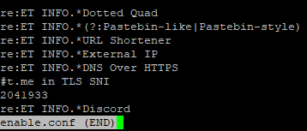
Enabling only specific ET_INFO rules
Disable.conf:
group:info.rules (etpro) group:emerging-info.rules (etopen) group:*info.rules (catches both, but may interfere with non ET rulesets)
Enable.conf:
re:ET INFO.*Dotted Quad
re:ET INFO.*(?:Pastebin-like|Pastebin-style)
re:ET INFO.*URL Shortener
re:ET INFO.*External IP
re:ET INFO.*DNS Over HTTPS
#t.me in TLS SNI
2041933
re:ET INFO.*Discord

Slide 17
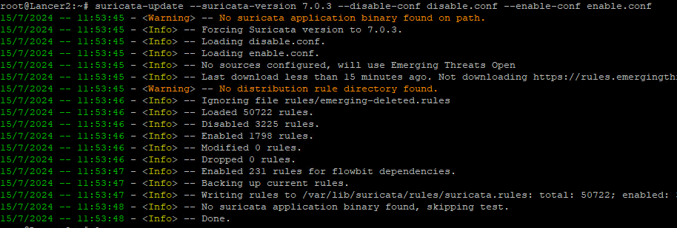
Enabling only specific ET_INFO rules

Slide 18

Part 2
Honeytoken IDS Rules

Slide 19
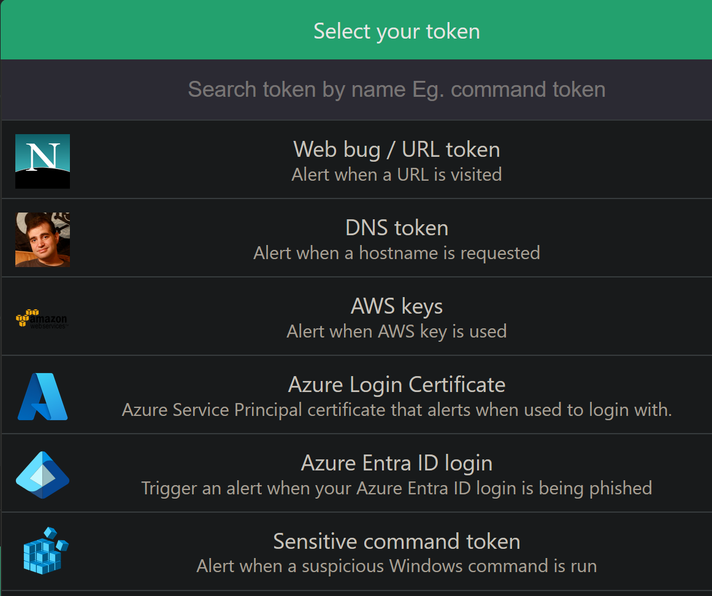
What is a Honeytoken?
Fake or misleading data, that when observed serves as an indicator of malicious activity
https://en.wikipedia.org/wiki/Honeytoken
Exist in a multitude of forms
Fake login credentials
Email addresses
“Sensitive Files”
Systems and System Artifacts
Related: “Canary Tokens”
Most popular: Thinkst Canary Tokens
https://canary.tools
https://canarytokens.org/generate

Slide 20
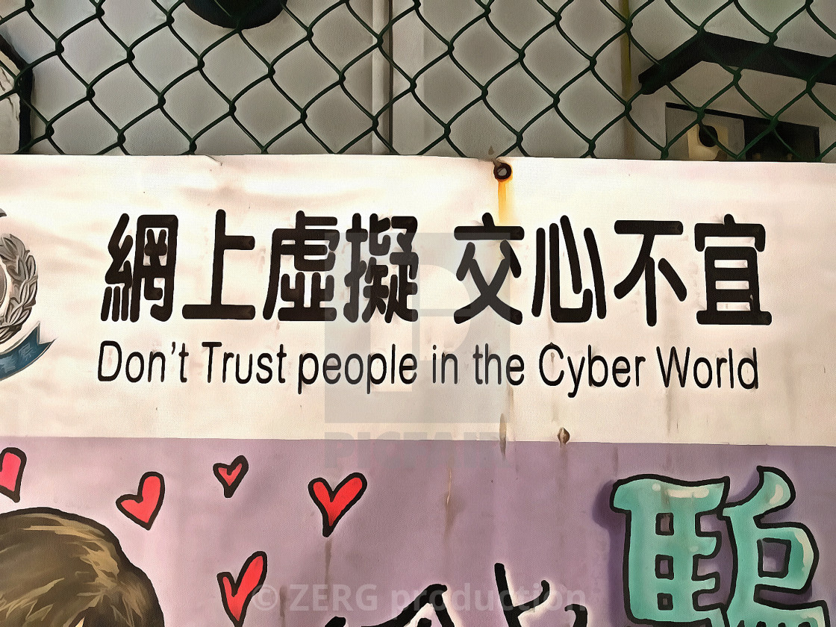
IDS Honeytokens
Creating IDS Rules to track the exfiltration of unique host artifacts
Hostname
DNS Suffix
Username
MAC Address
HWID/UUID
Etc.

Slide 21
System Specific Data - Windows
Where to find this information - Windows
Msinfo32.exe
Systeminfo.exe
Registry Editor
HKLM\SOFTWARE\Microsoft\Cryptography\MachineGuid
Whoami
Ipconfig /all
Wmic (requires UAC elevation)
diskdrive get description, pnpdeviceid /format:list
path win32_VideoController get name
baseboard list /format:list
SerialNumber, Manufacturer, Product, Description

Slide 22

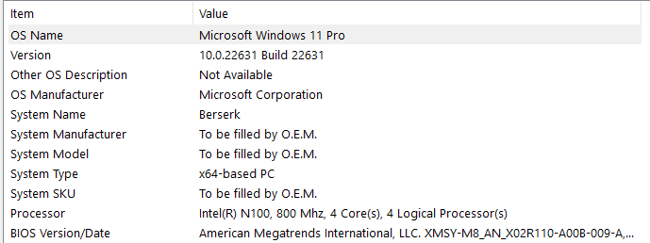
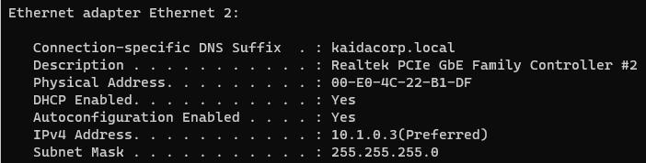


System-specific Data - Windows

Slide 23
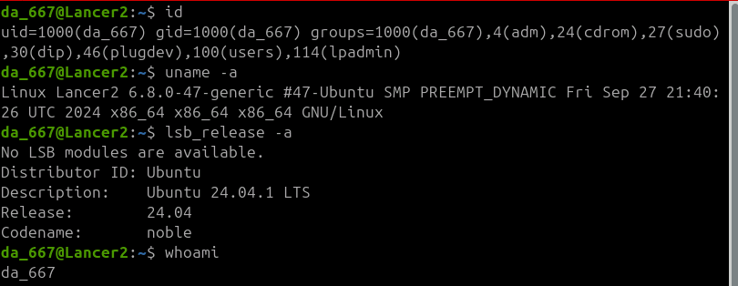
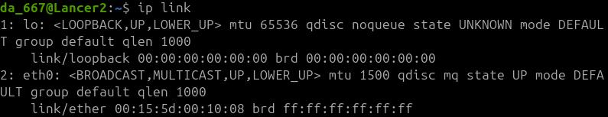
System Specific Data - Linux
Where to find this information - Linux
id
uname -a
lsb_release -a
/proc/cpuinfo
lscpu/lspci/lsusb
ip addr
ip link
/etc/*release
/etc/*version

Slide 24
So, what now?
We got all of this data, let’s make some rules out of it
Most common data exfiltration traffic is going to be HTTP/HTTPS
Consider creating http (GET/POST), udp, and/or generic TCP/UDP rules

Slide 25
Examples - HTTP POST/GET Requests
alert http $HOME_NET any -> $EXTERNAL_NET any (msg:”Host Berserk GUID Observed in HTTP POST Body”; flow:to_server,established, http.method; content:”POST”; http.request_body; content:”e7d3a778-6465-49f0-a711-7d5673993858”; fast_pattern; sid:1000000; rev:1;
alert http $HOME_NET any -> $EXTERNAL_NET any (msg:”Host Berserk GUID Observe in HTTP GET Request”; flow:established,to_server; http.method; content:”GET”; http.uri; content: :”e7d3a778-6465-49f0-a711-7d5673993858”; fast_pattern; sid:1000001; rev:1;)
alert http $HOME_NET any -> $EXTERNAL_NET any (msg:”Host Berserk MAC address Observed in HTTP GET Request”; flow:established,to_server; http.method; content:”GET”; http.uri; content:”00-E0-4C-22-B1-DF”; fast_pattern; sid:1000002; rev:1;)
alert http $HOME_NET any -> $EXTERNAL_NET any (msg:”Host Berserk MAC address Observed in HTTP POST Body”; flow:established,to_server; http.method; content:”POST”; http.request_body; content:”00-E0-4C-22-B1-DF”; fast_pattern; sid:1000003; rev:1;)

Slide 26
So, what now? (Part 2)
Data Transformations
Take those host-specific artifacts, and encode/transform them like the bad guys would!
Use Cyberchef (https://gchq.github.io/CyberChef/) and try encoding the artifact strings using various transformations:
Hex-encoding
Decimal-encoding
Base64
Base32
Base58
Uuencoding
Single-byte XOR

Slide 27
Examples - Part 2
alert tcp $HOME_NET any -> $EXTERNAL_NET any (msg:”Berserk Hex-Encoded (no spaces) MAC Address Outbound”; flow:established,to_server; content:”303045303443323242314446”; fast_pattern; sid:1000004; rev:1;)
alert tcp $HOME_NET any -> $EXTERNAL_NET any (msg:”Berserk Decimal-Encoded (no spaces) MAC Address Outbound”; flow:established,to_server; content:”48 48 69 48 52 67 50 50 66 49 68 70”; fast_pattern; sid:1000005; rev:1;)
alert tcp $HOME_NET any -> $EXTERNAL_NET any (msg:”Berserk Base58-Encoded (no spaces) MAC Address Outbound”; flow:established,to_server; content:”uk5xhWRSdfmhJhGR”; fast_pattern; sid:1000006; rev:1;)
alert tcp $HOME_NET any -> $EXTERNAL_NET any (msg:”Berserk Base32-Encoded (no spaces) MAC Address Outbound”; flow:established,to_server; content:”GAYEKMBUIMZDEQRRIRDA====”; fast_pattern; sid:1000007; rev:1;)
alert tcp $HOME_NET any -> $EXTERNAL_NET any (msg:”Berserk UU-Encoded (no spaces) MAC Address Outbound”; flow:established,to_server; content:”|2c 2c 23 21 25 2c 23|1|23 2c|C|29 22 2c|41|26|”; fast_pattern; sid:1000008; rev:1;)

Slide 28
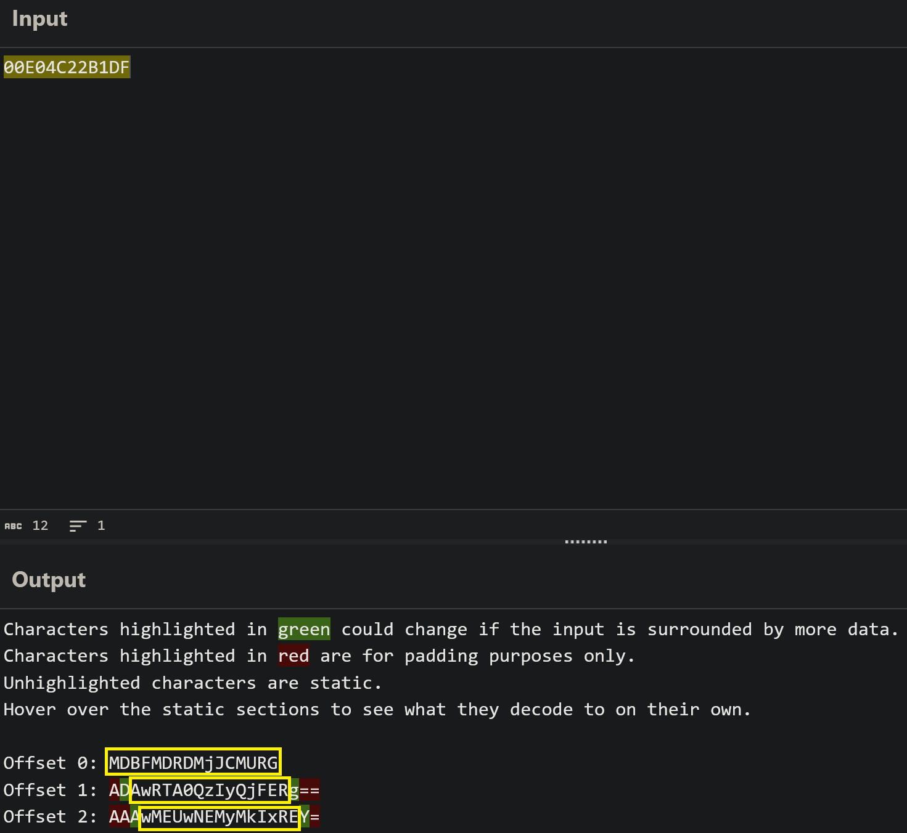
Bonus Round - Base64
Use Cyberchef “Show Base64 Offsets”
Results for “00E04C22B1DF” →
alert tcp $HOME_NET any -> $EXTERNAL_NET any (msg:”Host Berserk MAC Address Base64 Offset 1”; flow:established,to_server; content:”MDBFMDRDMjJCMURG”; fast_pattern; sid:1000009; rev:1;)
alert tcp $HOME_NET any -> $EXTERNAL_NET any (msg:”Host Berserk MAC Address Base64 Offset 2”; flow:established,to_server; content:” AwRTA0QzIyQjFER”; fast_pattern; sid:1000010; rev:1;)
alert tcp $HOME_NET any -> $EXTERNAL_NET any (msg:”Host Berserk MAC Address Base64 Offset 3”; flow:established,to_server; content:” wMEUwNEMyMkIxRE”; fast_pattern; sid:1000011; rev:1;)

Slide 29
Bonus Bonus Round: XOR Rainbow Table
XOR:
Do some bitwise math, to obfuscate data
Rainbow table
Take a known value (e.g. system artifacts) transform it via (single or multi-byte XOR)
Create rules to search for the transformed values
Can very easily be done with a cyberchef recipe + some simple scripting to increment the sid number for the rules
Cyberchef recipe + script for sid numbering available in github repository for this talk

Slide 30
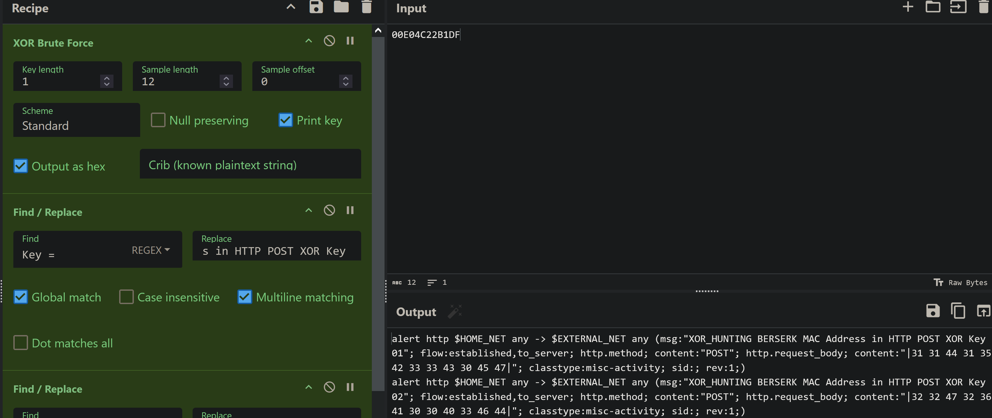
Bonus Bonus Round: XOR Rainbow Table
Notes:
Cyberchef Recipe: Step 1: XOR Brute Force - Key Length: 1 or 2, Check “Print Key”, Check “Output as Hex” Step 2: Find and Replace - Find:’Key = ‘, Replace:’alert http $HOME_NET any -> $EXTERNAL_NET any (msg:"XOR_HUNTING BERSERK MAC Address in HTTP POST XOR Key ’ Step 3: Find and Replace - Find:’: ‘, Replace:’"; flow:established,to_server; http.method; content:"POST"; http.request_body; content:"|’ Step 4: Find and Replace - Find:’$’, Replace:’|"; classtype:misc-activity; sid:; rev:1;)’ Notes: - Key Length 1 produces 255 rules 256 - 1 (key 0x00 is effectively worthless) - Key Length 2 produces 65535 rules 256^2 -1 (key 0x0000 is worthless) - the first find/replace can be modified to change the header and rule message to change protocols, network vars, port vars, etc. - the second find/replace can be modified to change the flow option (to _or_ from HOME_NET, or removed entirely for UDP rules), and/or change sticky buffers for the network protocols in question - the third find/replace can be modified to change the classtype, add additional metadata tags (e.g. reference or metadata) - Typically, user-created rules are placed in a local.rules file. Locally created rules are typically assigned sids from 1000000 through 1999999 (see also: sidallocation.org) - Users will need to either user a script, or one-liner to replace the blank sid number with a sid in the allocation range. Users with existing local rules will need to determine the next available sid number to begin assigning these sids. I three simple scripts (perl, python, and bash) that can do this. That will be included in the github repo for this slide deck. -Either suricata.yaml will need to be modified to include the use of this new .rules file generated, or the new .rules file will need to have all of its rules appended to the existing local.rules file https://gchq.github.io/CyberChef/#recipe=XOR_Brute_Force(1,12,0,'Standard',false,true,true,'')Find_/_Replace(%7B'option':'Regex','string':'Key%20%3D%20'%7D,'alert%20http%20$HOME_NET%20any%20-%3E%20$EXTERNAL_NET%20any%20(msg:%22XOR_HUNTING%20BERSERK%20MAC%20Address%20in%20HTTP%20POST%20XOR%20Key%20',true,false,true,false)Find_/_Replace(%7B'option':'Regex','string':':%20'%7D,'%22;%20flow:established,to_server;%20http.method;%20content:%22POST%22;%20http.request_body;%20content:%22%7C',true,false,true,false)Find_/_Replace(%7B'option':'Regex','string':'$'%7D,'%7C%22;%20classtype:misc-activity;%20sid:;%20rev:1;)',true,false,true,false)&input=MDBFMDRDMjJCMURG

Slide 31
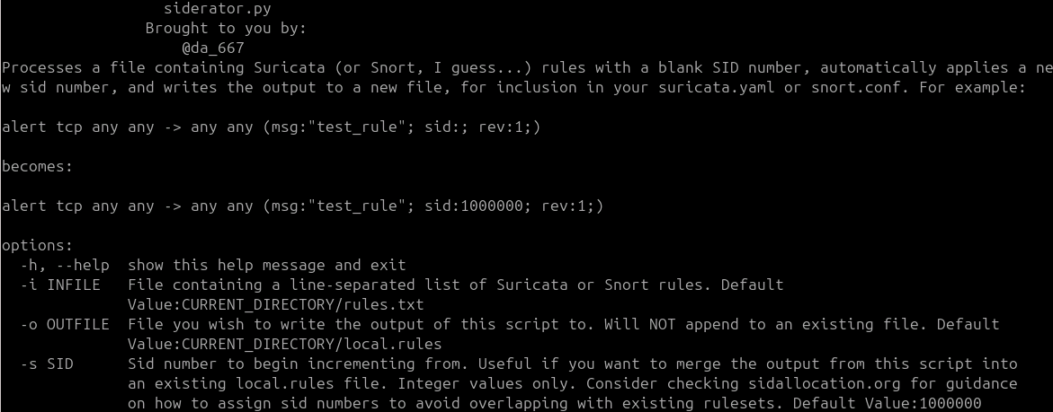
Bonus Bonus Round: XOR Rainbow Table
Notes:
Cyberchef Recipe: Step 1: XOR Brute Force - Key Length: 1 or 2, Check “Print Key”, Check “Output as Hex” Step 2: Find and Replace - Find:’Key = ‘, Replace:’alert http $HOME_NET any -> $EXTERNAL_NET any (msg:"XOR_HUNTING BERSERK MAC Address in HTTP POST XOR Key’ Step 3: Find and Replace - Find:’: ‘, Replace:’"; flow:established,to_server; http.method; content:"POST"; http.request_body; content:"|’ Step 4: Find and Replace - Find:’$’, Replace:’|"; classtype:misc-activity; sid:; rev:1;)’ Notes: - Key Length 1 produces 255 rules 256 - 1 (key 0x00 is effectively worthless) - Key Length 2 produces 65535 rules 256^2 -1 (key 0x0000 is worthless) - the first find/replace can be modified to change the header and rule message to change protocols, network vars, port vars, etc. - the second find/replace can be modified to change the flow option (to _or_ from HOME_NET, or removed entirely for UDP rules), and/or change sticky buffers for the network protocols in question - the third find/replace can be modified to change the classtype, add additional metadata tags (e.g. reference or metadata) - Typically, user-created rules are placed in a local.rules file. Locally created rules are typically assigned sids from 1000000 through 1999999 (see also: sidallocation.org) - Users will need to either user a script, or one-liner to replace the blank sid number with a sid in the allocation range. Users with existing local rules will need to determine the next available sid number to begin assigning these sids. I three simple scripts (perl, python, and bash) that can do this. That will be included in the github repo for this slide deck. -Either suricata.yaml will need to be modified to include the use of this new .rules file generated, or the new .rules file will need to have all of its rules appended to the existing local.rules file https://gchq.github.io/CyberChef/#recipe=XOR_Brute_Force(1,12,0,'Standard',false,true,true,'')Find_/_Replace(%7B'option':'Regex','string':'Key%20%3D%20'%7D,'alert%20http%20$HOME_NET%20any%20-%3E%20$EXTERNAL_NET%20any%20(msg:%22XOR_HUNTING%20BERSERK%20MAC%20Address%20in%20HTTP%20POST%20XOR%20Key%20',true,false,true,false)Find_/_Replace(%7B'option':'Regex','string':':%20'%7D,'%22;%20flow:established,to_server;%20http.method;%20content:%22POST%22;%20http.request_body;%20content:%22%7C',true,false,true,false)Find_/_Replace(%7B'option':'Regex','string':'$'%7D,'%7C%22;%20classtype:misc-activity;%20sid:;%20rev:1;)',true,false,true,false)&input=MDBFMDRDMjJCMURG

Slide 32
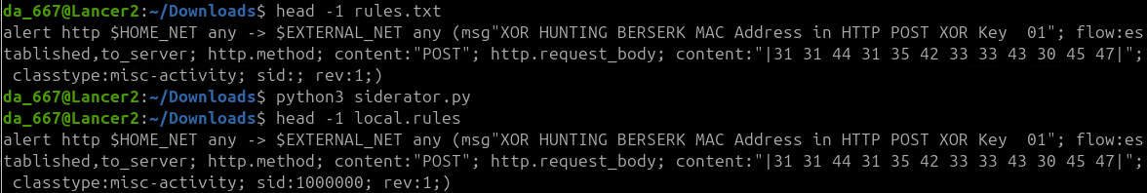
Bonus Bonus Round: XOR Rainbow Table
Notes:
Cyberchef Recipe: Step 1: XOR Brute Force - Key Length: 1 or 2, Check “Print Key”, Check “Output as Hex” Step 2: Find and Replace - Find:’Key = ‘, Replace:’alert http $HOME_NET any -> $EXTERNAL_NET any (msg:"XOR_HUNTING BERSERK MAC Address in HTTP POST XOR Key’ Step 3: Find and Replace - Find:’: ‘, Replace:’"; flow:established,to_server; http.method; content:"POST"; http.request_body; content:"|’ Step 4: Find and Replace - Find:’$’, Replace:’|"; classtype:misc-activity; sid:; rev:1;)’ Notes: - Key Length 1 produces 255 rules 256 - 1 (key 0x00 is effectively worthless) - Key Length 2 produces 65535 rules 256^2 -1 (key 0x0000 is worthless) - the first find/replace can be modified to change the header and rule message to change protocols, network vars, port vars, etc. - the second find/replace can be modified to change the flow option (to _or_ from HOME_NET, or removed entirely for UDP rules), and/or change sticky buffers for the network protocols in question - the third find/replace can be modified to change the classtype, add additional metadata tags (e.g. reference or metadata) - Typically, user-created rules are placed in a local.rules file. Locally created rules are typically assigned sids from 1000000 through 1999999 (see also: sidallocation.org) - Users will need to either user a script, or one-liner to replace the blank sid number with a sid in the allocation range. Users with existing local rules will need to determine the next available sid number to begin assigning these sids. I three simple scripts (perl, python, and bash) that can do this. That will be included in the github repo for this slide deck. -Either suricata.yaml will need to be modified to include the use of this new .rules file generated, or the new .rules file will need to have all of its rules appended to the existing local.rules file https://gchq.github.io/CyberChef/#recipe=XOR_Brute_Force(1,12,0,'Standard',false,true,true,'')Find_/_Replace(%7B'option':'Regex','string':'Key%20%3D%20'%7D,'alert%20http%20$HOME_NET%20any%20-%3E%20$EXTERNAL_NET%20any%20(msg:%22XOR_HUNTING%20BERSERK%20MAC%20Address%20in%20HTTP%20POST%20XOR%20Key%20',true,false,true,false)Find_/_Replace(%7B'option':'Regex','string':':%20'%7D,'%22;%20flow:established,to_server;%20http.method;%20content:%22POST%22;%20http.request_body;%20content:%22%7C',true,false,true,false)Find_/_Replace(%7B'option':'Regex','string':'$'%7D,'%7C%22;%20classtype:misc-activity;%20sid:;%20rev:1;)',true,false,true,false)&input=MDBFMDRDMjJCMURG

Slide 33
Thanks for Attending my Talk!
Get in touch with the ET team
https://community.emergingthreats.net
Community forum. Come talk shop with us, share rules, post questions, etc.
Discord
Yeah, I just finished talking smack about Discord, but we _do_ have a Discord community as well.
https://discord.gg/8ZGA6mtfYT
Slide deck, Cyberchef recipe, siderator.py, and other materials available at:
https://github.com/da667/Contalks/tree/main/Suricon2024

