Slide 1


Domain-specific adaptation of a large language model for the German administration
Master Thesis
David Wolpers
15.03.2024

Slide 2
Agenda
Intention
Background
Training Setup
Results
Evaluation
Conclusion

Slide 3
Intention
AI models are everywhere (GPT-4, LLama2, DALL·E 3)
Everyday use cases try to exploit the advantages of these models
One common use case is switching from a key-based search to using a large language model (LLM) that has access to the knowledge of the domain
But most domains aren’t available in public and models like GPT-4 don’t know about it
How to teach LLMs about these domains?

Slide 4
Current approaches
Pass the required documents to state-of-the-art generic LLM as a reading comprehension
  Requires a generic LLM
  Requires a setup to retrieve the required documents
Define question-answer pairs to fine-tune a generic LLM
  Requires manual labour to define the question-answer pairs
Just train a generic LLM with huge amounts of data
  Very expensive
  Huge amount of domain-specific data necessary

Slide 5
Goal of this thesis
Train two new small non-generic LLM with domain-specific data using an existing training setup
  One from scratch
  One uses an available trained model
Use the German administration data during training
Training should be relatively cheap to ensure viability for small use cases
Evaluate the effect of fine-tuning on the result
Evaluate closed-book question answering
Evaluate open-book question answering

Slide 6
Large language models (LLM)
Take a text input and produce a text output
Large amount of data necessary to train these models
How do they work?:
  Different architectures exist, but the transformer architecture dominates
  This thesis used T5 an implementation of the transformer architecture

Slide 7
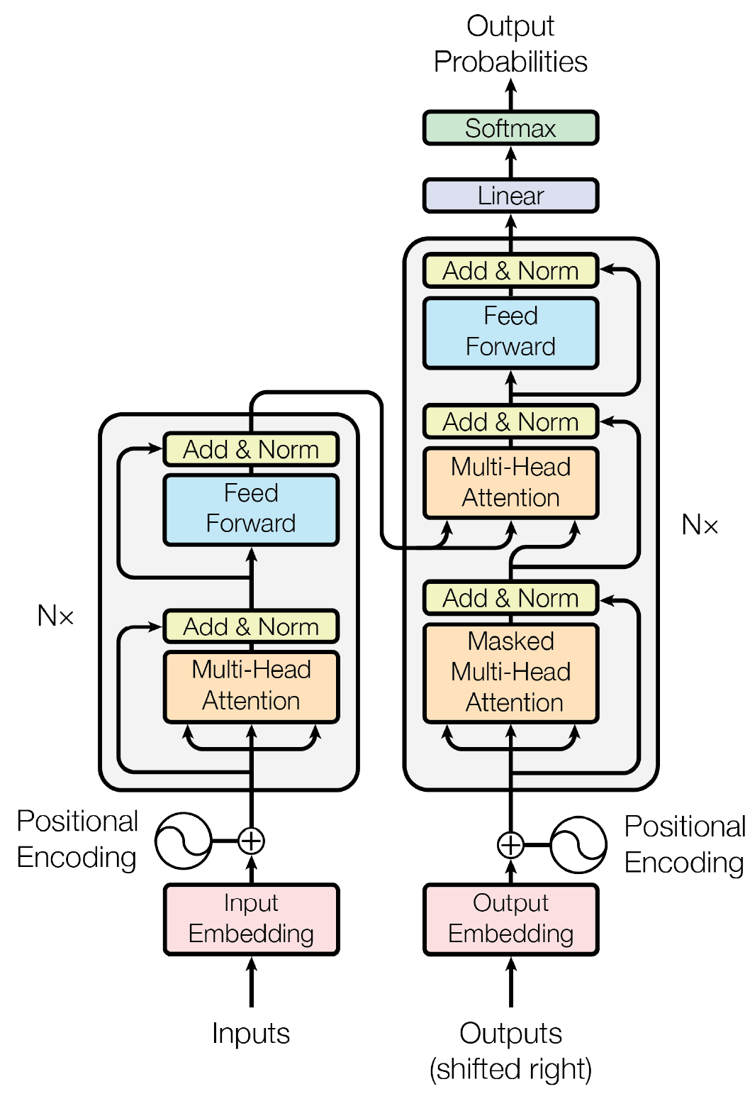
Transformer architecture
Input query is converted to tokens
Tokens are converted to embedding vectors
Multiple encoder blocks extract the features of query
Multiple decoder blocks than generate the output one token at a time
Subsequent generated tokens use all previously generated tokens as additional inputs for the decoder
Source: 1: Attention is all you need

Slide 8
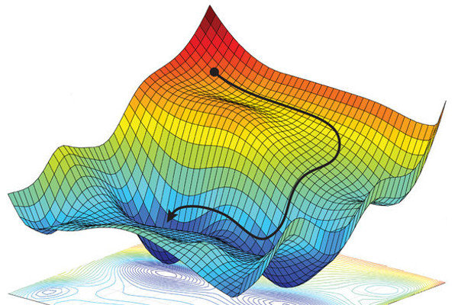
Training
Multiple trainable parameters in a transformer:
  Matrices to create the embedding vectors
  Matrices of all attention heads
  Parameters in the neural network
Training is the process of tuning these parameters using Stochastic Gradient Descend (SGD)
Training requires large amounts of data
Source: 4: https://towardsdatascience.com/coding-deep-learning-for-beginners-linear-regression-gradient-descent-fcd5e0fc077d

Slide 9
Pretraining
Pretraining is the process of training the parameters to gain a general understanding of languages (or a language) and some basic facts
Pretraining doesn‘t require any labelled data
Pretraining uses the most amount of data
Pretraining requires the most training duration
Uses Masked Language Modelling (MLM) to automatically generate the goal for the model

Slide 10
Fine-tuning
Teach the model specific tasks
Requires labelled data
Common tasks include:
  Open-book Question Answering
  Closed-book Question Answering
  Classification
T5 ads a different prefix for every task

Slide 11
Infrastructure
Tensor Processing Units (TPU) were designed for training AI models
Google Cloud Project (GCP) provides access to TPU-VMs
TPU Research Programme (TRC) provided free access to certain TPUs
Hugging Face platform provides access to models and datasets
Hugging Face Transformer library provides training scripts and compatibility with different AI frameworks
Flax was used to train the models on TPUs

Slide 12
Training data
Pretraining
  OSCAR - German split of the Common Crawl corpus
  Wikipedia – German Wikipedia dump
  German administration for Baden-Württemberg
    Service
    Living situation
    https://www.service-bw.de/zufi
    An error removed all commas from the dataset
Fine-tuning
  Deepset/GermanQuAD : Question answering
  Deepset/GermanDPR : Question answering
  Philschmid/germeval18 : Classification

Slide 13
Models

Slide 14
Infrastructure Training Setup

Slide 15
Training
All training scripts can be found on https://github.com/da721wol/Domain-specific-LLM
Tokenizer-script
Pretraining-script
Different fine-tuning-scripts

Slide 16
Results – Training duration
Pretraining T5_{BASE} took about 8 days for 823,100 steps
Pretraining T5_{LARGE} originally took about 5 days for 524,288 steps
The additional 26,700 steps took 10 hours
Fastest fine-tuning was Closed-book QA with GermanDPR
  T5_{BASE} with 2 hours
  T5_{LARGE} with 4 hours
Slowest fine-tuning was Open-book QA with GermanDPR
  T5_{BASE} with 13 hours
  T5_{LARGE} with 26 hours

Slide 17
Results – Training costs
Pretraining costs:
  T5_{BASE} cost about 1536$ (TPUv3-8, 8.00$/h)
  T5_{LARGE} cost about 60$ (TPUv2-8, 6.00$/h)
Fine-tuning costs:
  T5_{BASE} would cost about 35$ (CPU, 1.59$/h)
  T5_{LARGE} would cost about 64$ (CPU, 1.59$/h)
Total costs:
  T5_{BASE} cost about 1571$
  T5_{LARGE} would cost about 124$
Other costs can be ignored for most use cases

Slide 18
NLP-benchmarks
Based on the ROUGE-Score
Compares words or word-sequences between the generated answer and the expected answer (multiple answers are possible)
A score of 0 has not a single matching word a score of 1 has 100% matching words
ROUGE1, ROUGE2 and ROUGEL were used
All variants fine-tuned on the specific task were tested

Slide 19
NLP-benchmarks
Open-book QA:
  ROUGE1 and ROUGEL similar with about 0.5 for GermanQuAD and 0.6 for GermanDPR
  ROUGE2 was lower with about 0.4 and 0.5 respectively
  Classification models were terrible
Closed-book QA:
  Low to very low scores across the board
  GermanDPR again performed better with about 0.2
  GermanQuad had all scores lower than 0.1
  Classification models were again terrible

Slide 20
Evaluation of domain-specific questions
ROUGE-score requires existing answers
The score depends on the answers provided
  It’s free
  There’s no charge
Instead, QA pairs were evaluated by humans
The questions were defined beforehand
The answers were generated by the models from the thesis and external models using a combination of closed- and open-book QA

Slide 21
Evaluation score
0: The answer didn't fit the question at all.
1: The answer fits the question, but it's obviously wrong.
2: The answer fits the question, but it's not obviously wrong.
3: The answer is either partly correct or misses some relevant information.
4: The answer is fully correct and includes most or all necessary information.

Slide 22
Questions
In total 30 questions were defined
Likely questions somebody might ask
Question types:
  Time or money-related question
  Location or source
  Yes/No-Questions
  Explanations

Slide 23
Candidates
Closed-book QA:
  T5_{BASE_CLOSED}
  T5_{LARGE_CLOSED}
Open-book QA:
  T5_{BASE_OPEN}
  T5_{LARGE_OPEN}
  GPT-4
  Luminous-base-control (Aleph Alpha)

Slide 24
Evaluation scores

Slide 25
Conclusions
Using an available pretrained models is considerably cheaper than a model trained from scratch
TPUs are cost-efficient compared to CPUs
Closed-book QA doesn’t show much promise
Open-book QA might work
Small domain-specific dataset
Fine-tuning should focus on the required tasks

Slide 26
Questions?

Slide 27
Sources
1: Ashish Vaswani et al. “Attention is All you Need”. In: Advances in Neural In-
formation Processing Systems. Ed. by I. Guyon et al. Vol. 30. Curran Asso-
ciates, Inc., 2017. URL: https://proceedings.neurips.cc/paper_files/
paper/2017/file/3f5ee243547dee91fbd053c1c4a845aa-Paper.pdf
2: Colin Raffel et al. Exploring the Limits of Transfer Learning with a Unified
Text-to-Text Transformer. 2019. eprint: arXiv:1910.10683
3: Murat Sazli. “A brief review of feed-forward neural networks”. In: Commu-
nications Faculty Of Science University of Ankara 50 (2006-01), pp. 11–17.
DOI: 10.1501/commua1-2_0000000026.
4: https://towardsdatascience.com/coding-deep-learning-for-beginners-linear-regression-gradient-descent-fcd5e0fc077d
All other sources can be found in the script at https://github.com/da721wol/Domain-specific-LLM

