Slide 1
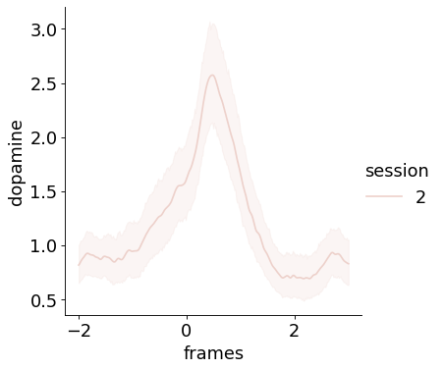
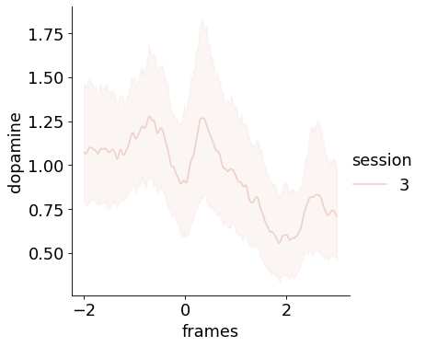
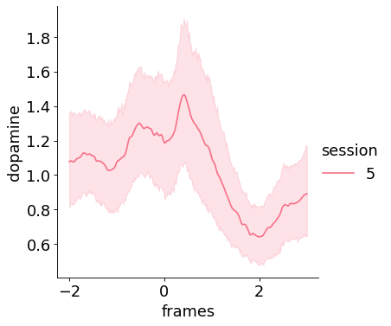
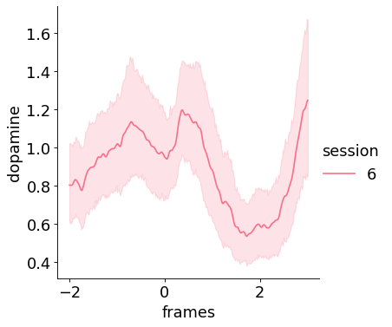
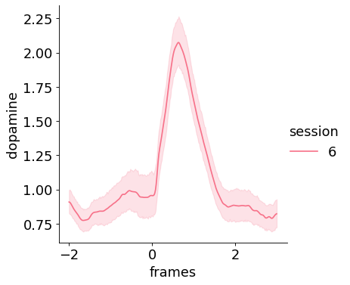
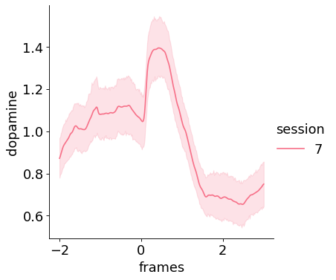
PBSNR-01LH
Exendin-4 Injection on session3, 5, 6 (10ug/kg)
saline
30 min after inj.
10 min after inj.
1h after inj.
PBSNR-02LH
saline
10 min after inj.
Exendin-4 Injection on session 7 (20ug/kg)

Slide 2
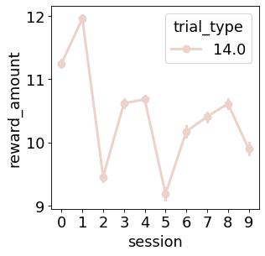
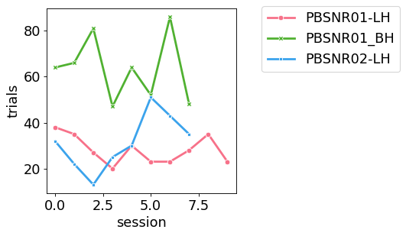
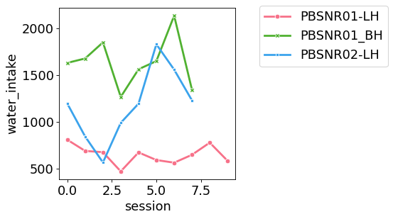
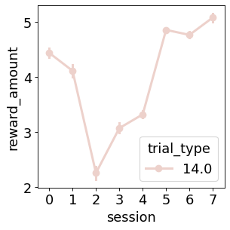
PBSNR-01LH
PBSNR-02LH
Agonist injection

Slide 3
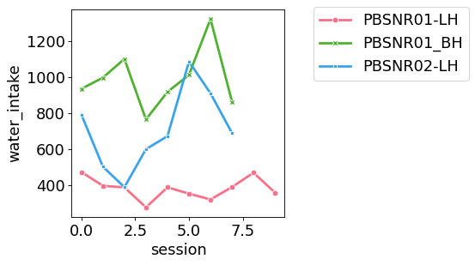
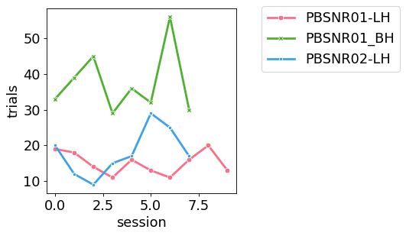
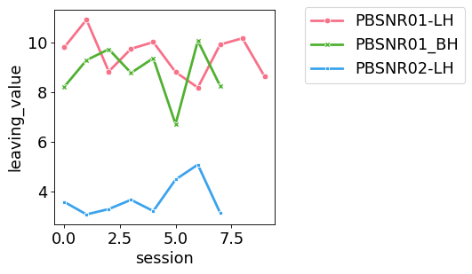
first 60% trials

Slide 4
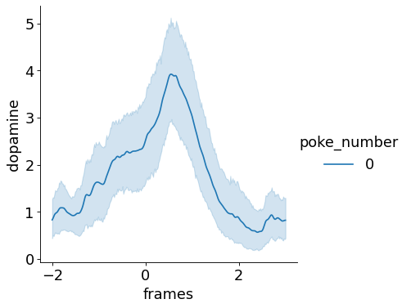
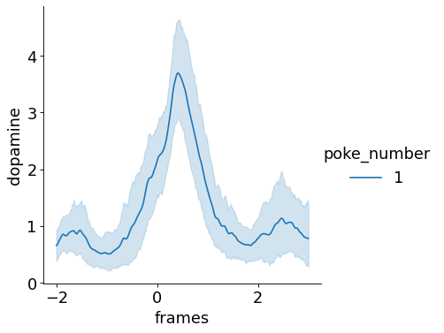
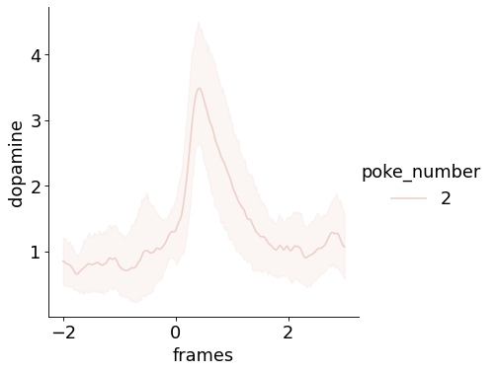
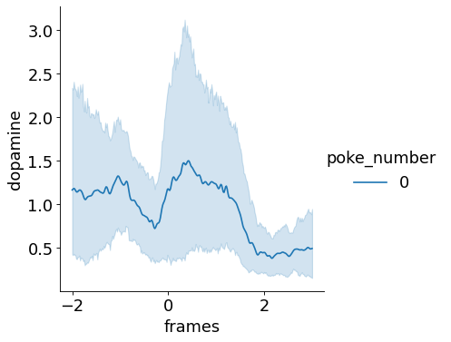
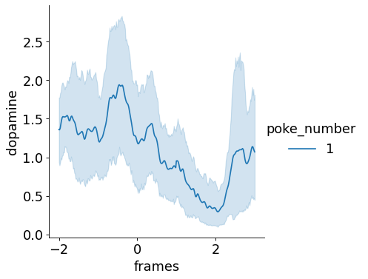
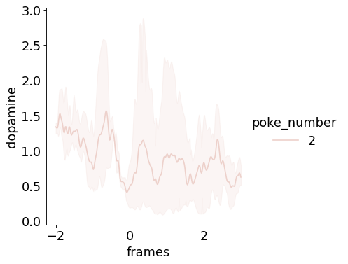
PBSNR-01LH, only 60% trials
Saline, session2
14ul
9.8ul
6.9ul
Exendin-4, session3, 10 min after inj

Slide 5
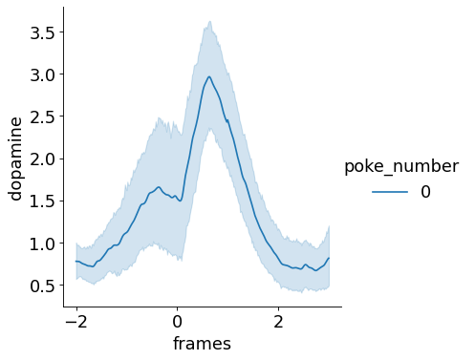
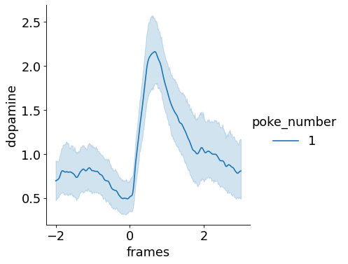
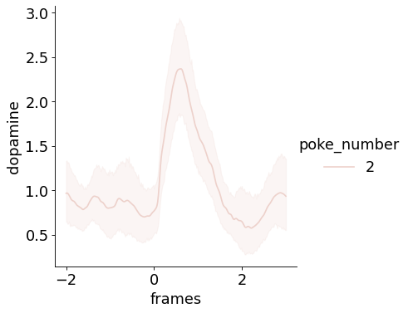
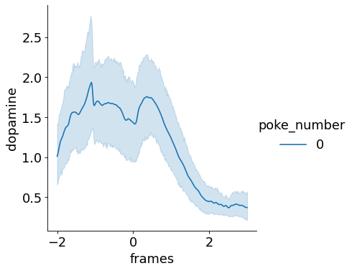
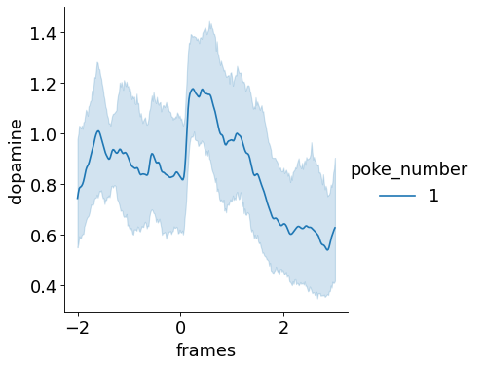
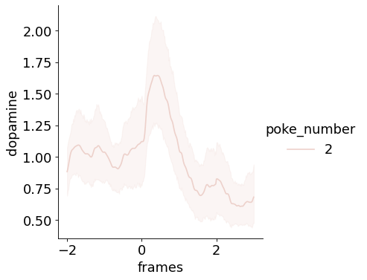
PBSNR-02LH, 60% trials
Saline, session6
14ul
9.8ul
6.9ul
Exendin-4, session7

Slide 6
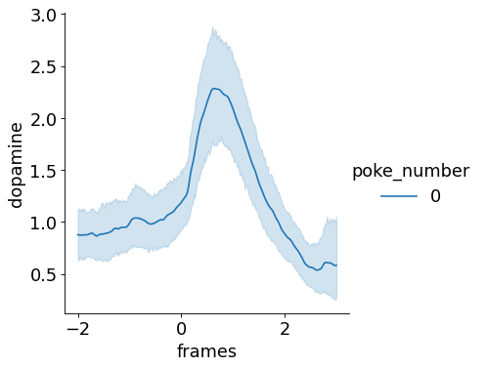
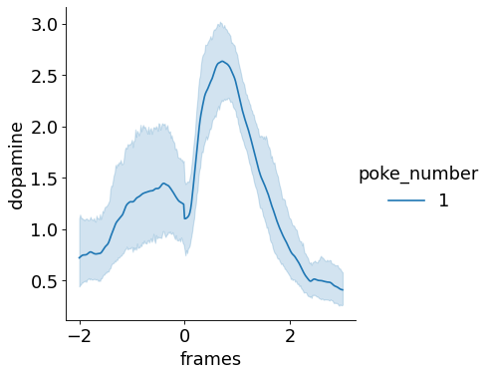
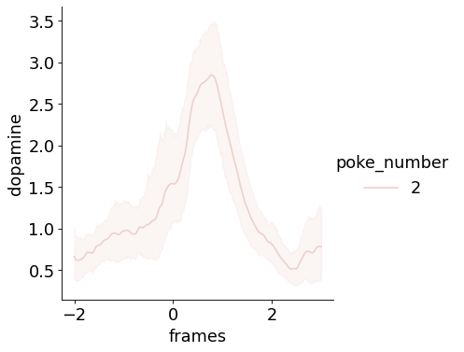
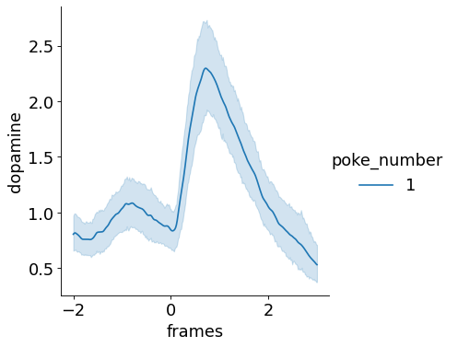
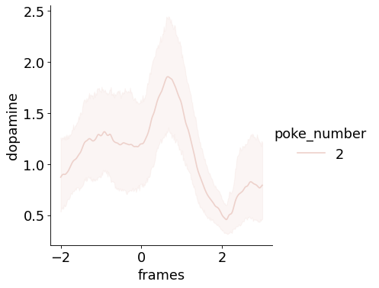
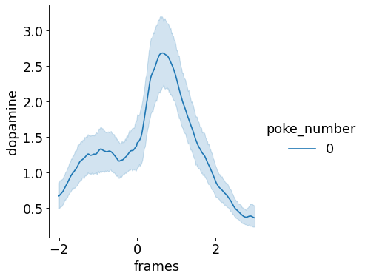
PBSNR-01BH, 60% trials
Saline, session2
Exendin-4, session7

Slide 7
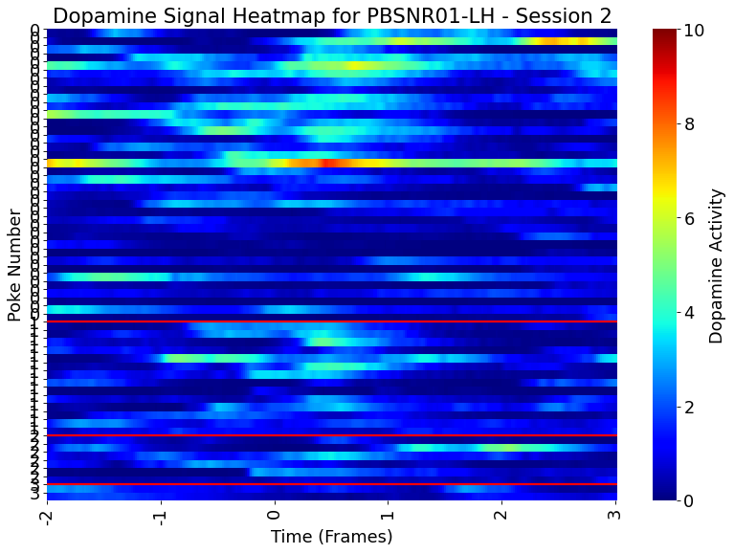
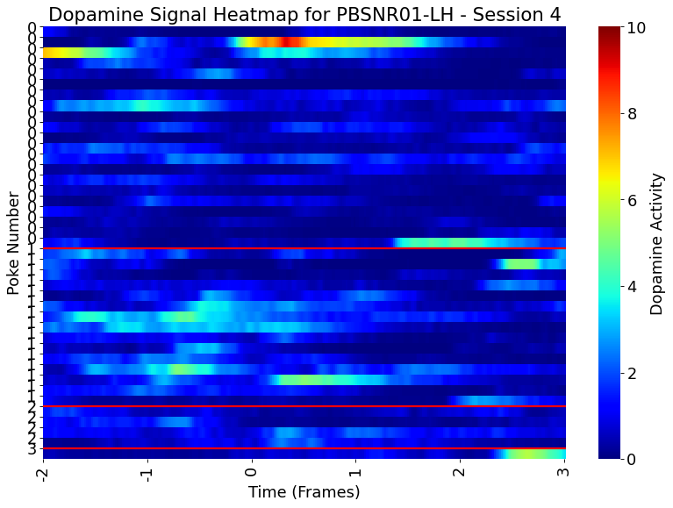
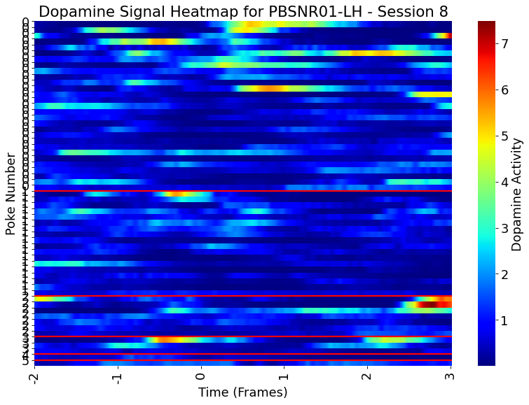
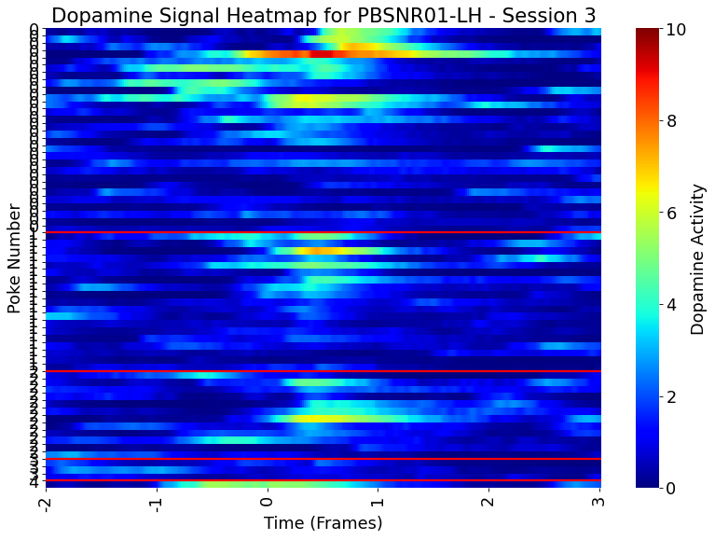
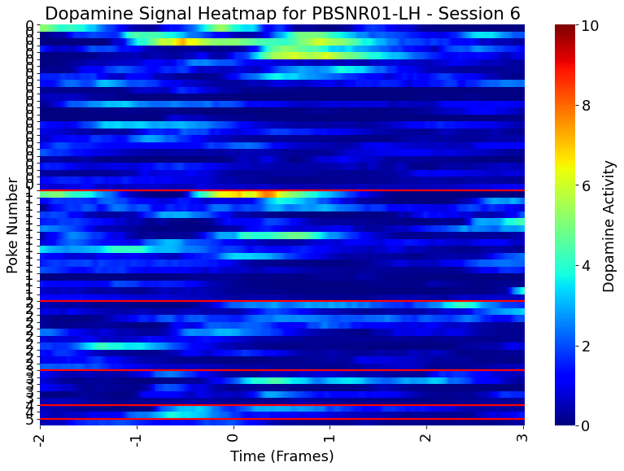
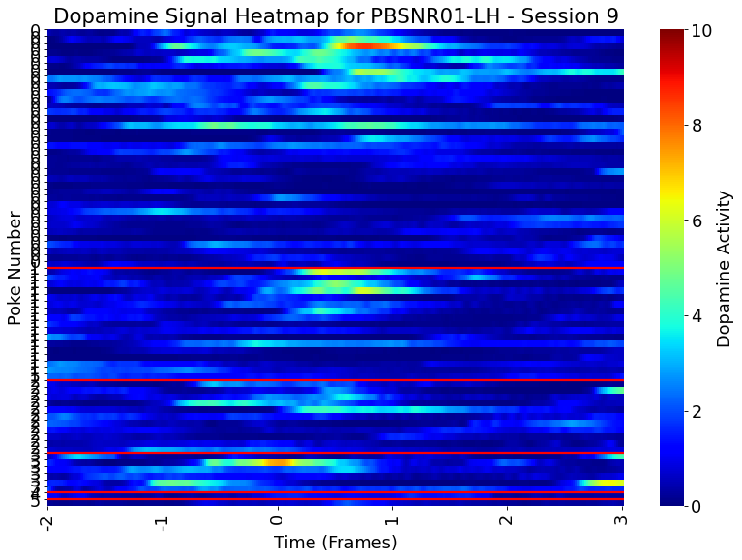
PBSNR-01LH
Saline injection
Exendin-4 injection
Notes:
Session 4 is the day right after exendin-4 injection; session 8 is 2 days after exendin-4 injection

Slide 8
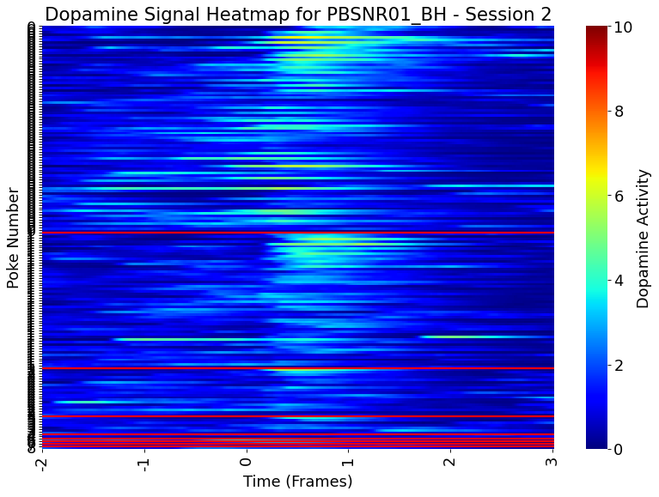
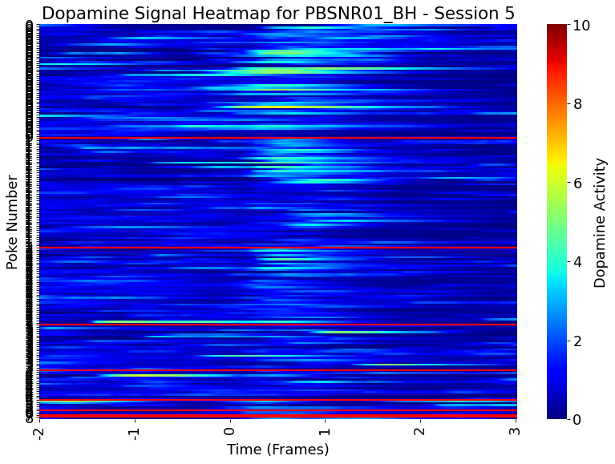
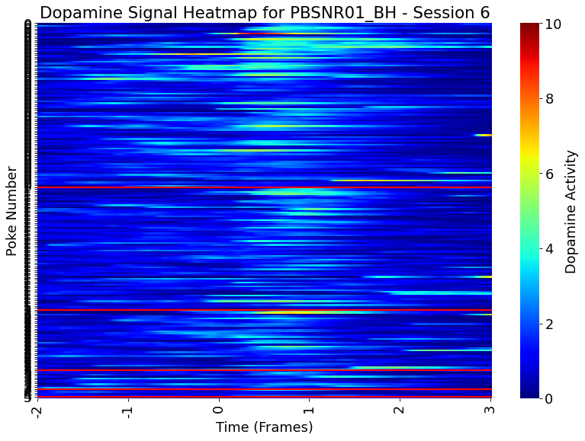
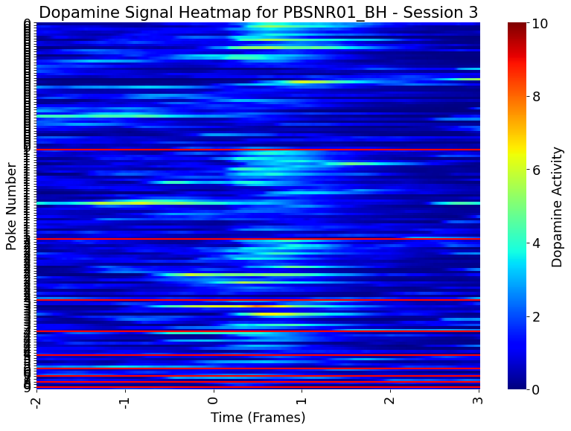
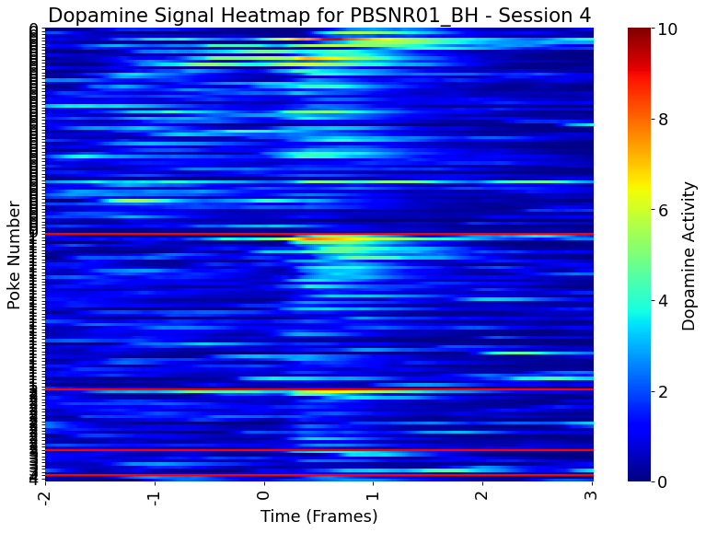
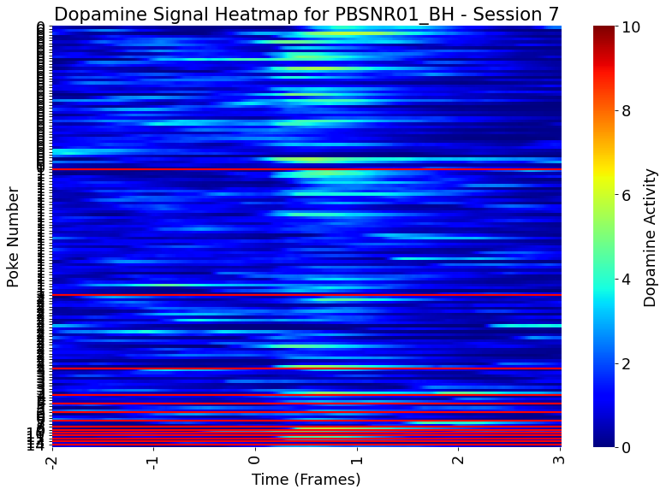
PBSNR-01BH
Saline injection
Exendin-4 injection
Notes:
Session 5 is the day right after exendin-4 injection

Slide 9
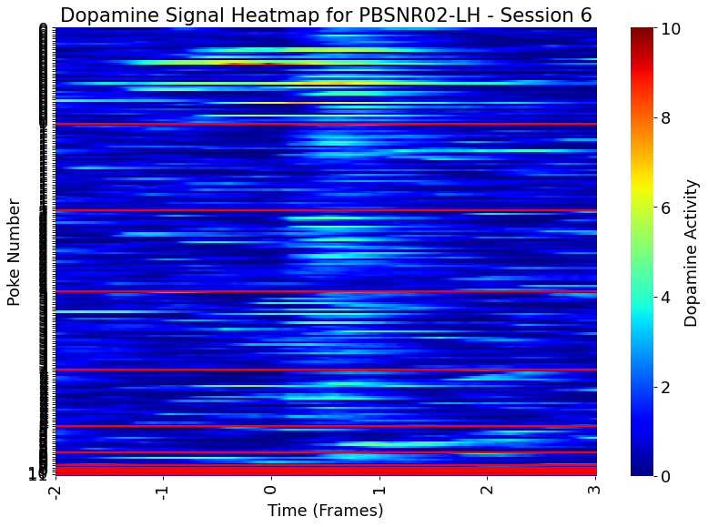
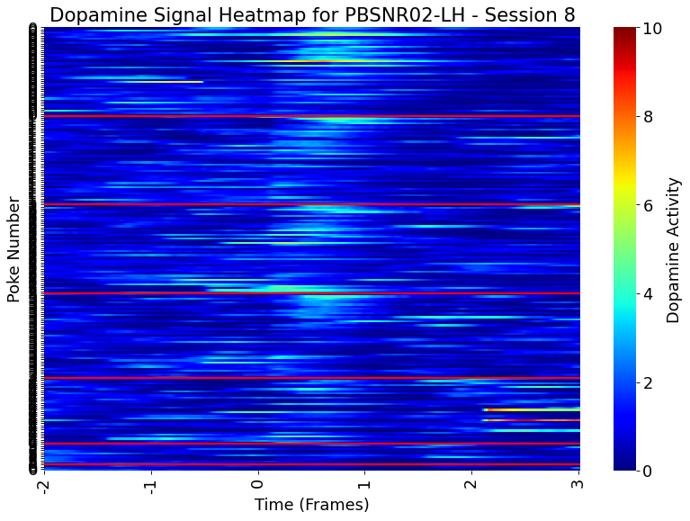
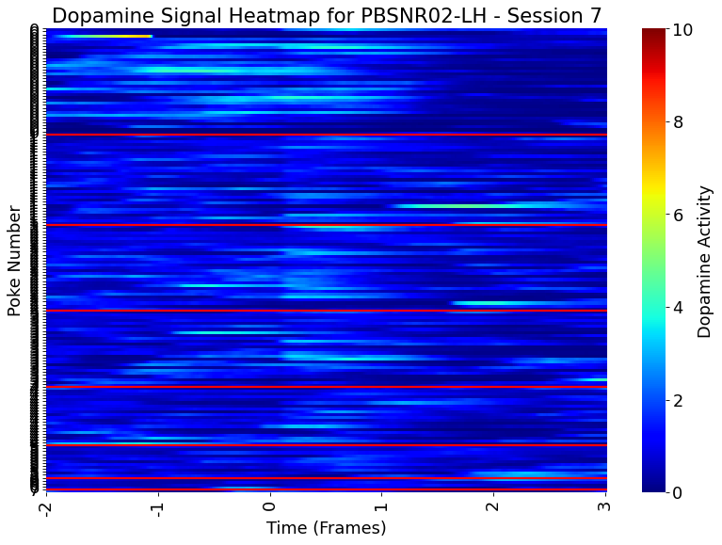
PBSNR-02LH
Saline injection
Exendin-4 injection
Notes:
Session 5 is the day right after exendin-4 injection

Slide 10
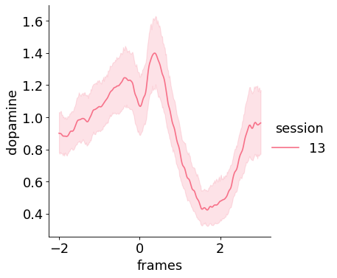
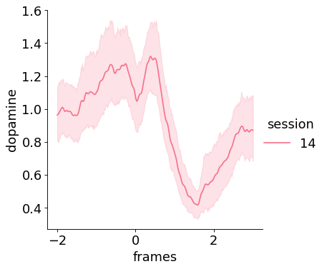
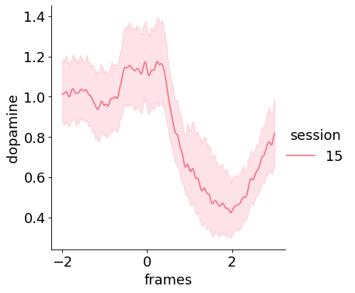
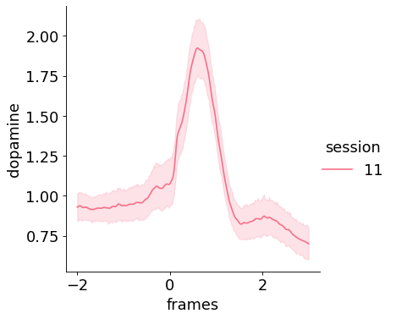

Liraglutide injection (0.2mg/kg)
PBSNR-01LH
Saline session 13
Liraglutide session 14
Saline session 15
PBSNR-02LH
saline
liraglutide

Slide 11



Liraglutide injection (0.2mg/kg)
PBSNR-01BH
saline
liraglutide

Slide 12

Liraglutide injection (0.2mg/kg)
PBSNR-02LH
saline
liraglutide

Slide 13









PBSNR-01LH, only 50% trials
Saline session 15, 50% trials
Saline session 13
Liraglutide 0.2mg/kg sc. session 14

Slide 14









PBSNR-01BH, all trials
Saline session 13, all trials
Saline session 11
Liraglutide 0.2mg/kg sc. session 12

Slide 15









PBSNR-02LH
Saline session 13, all trials
Saline session 11, all trials
liraglutide session 12, all trials

Slide 16



PBSNR01-NH
PBSNR01-RH
PBSNR02-RH

Slide 17



First 60% trials analyzed, same in following slides
Liraglutide 0.4mg/ml s.c. (arrow)
Session 0-2 baseline (saline inj)

Slide 18






PBSNR01-LH
Saline (session 0)
14ul
9.8ul
6.9ul
Liraglutide 0.4mg/ml s.c. (session 3)

Slide 19






PBSNR01_BH
Saline (session 0)
14ul
9.8ul
6.9ul
Liraglutide 0.4mg/ml s.c. (session 3)

Slide 20






PBSNR02-LH
Saline (session 0)
14ul
9.8ul
6.9ul
Liraglutide 0.4mg/ml s.c. (session 3)

Slide 21






PBSNR01-LH
PBSNR01_BH
PBSNR02-LH
Saline (session 0)
Liraglutide 0.4mg/ml s.c. (session 3)

