Slide 1
CAN Bus Protocol Stack Part-II: Exploring the Controller Area Network Software Architecture

Slide 2
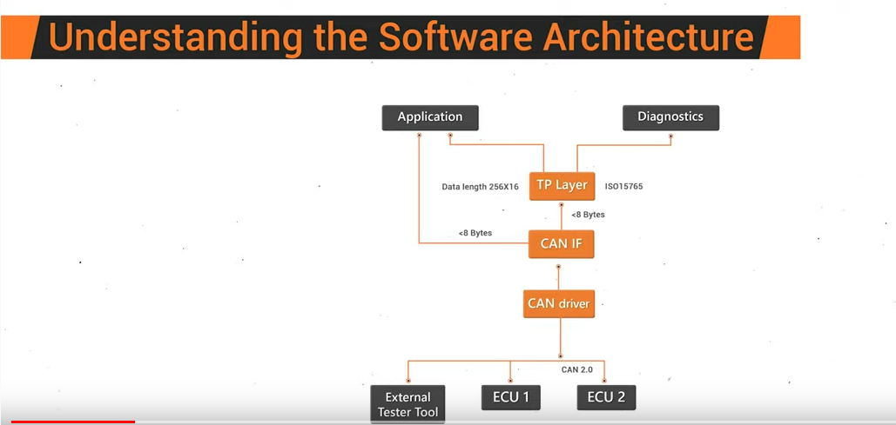

Slide 3
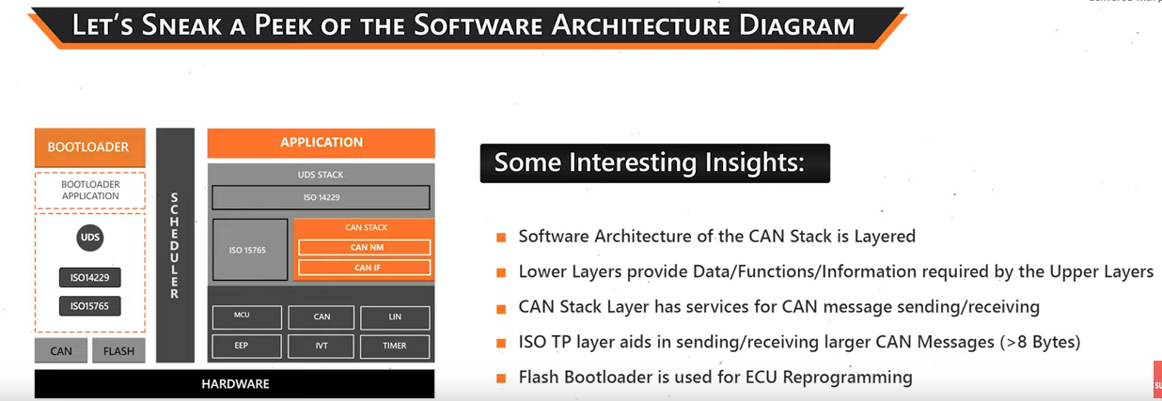

Slide 4
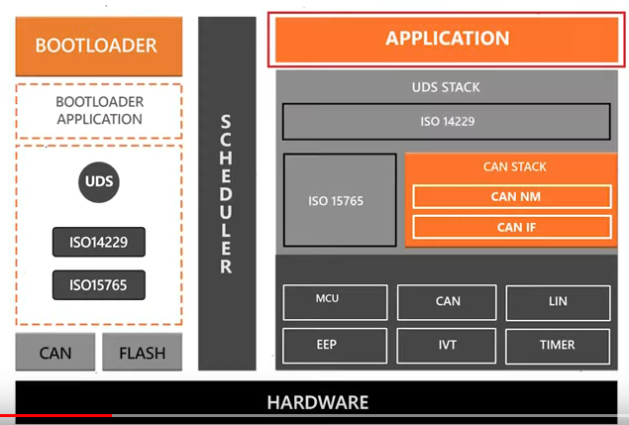

Slide 5


Slide 6
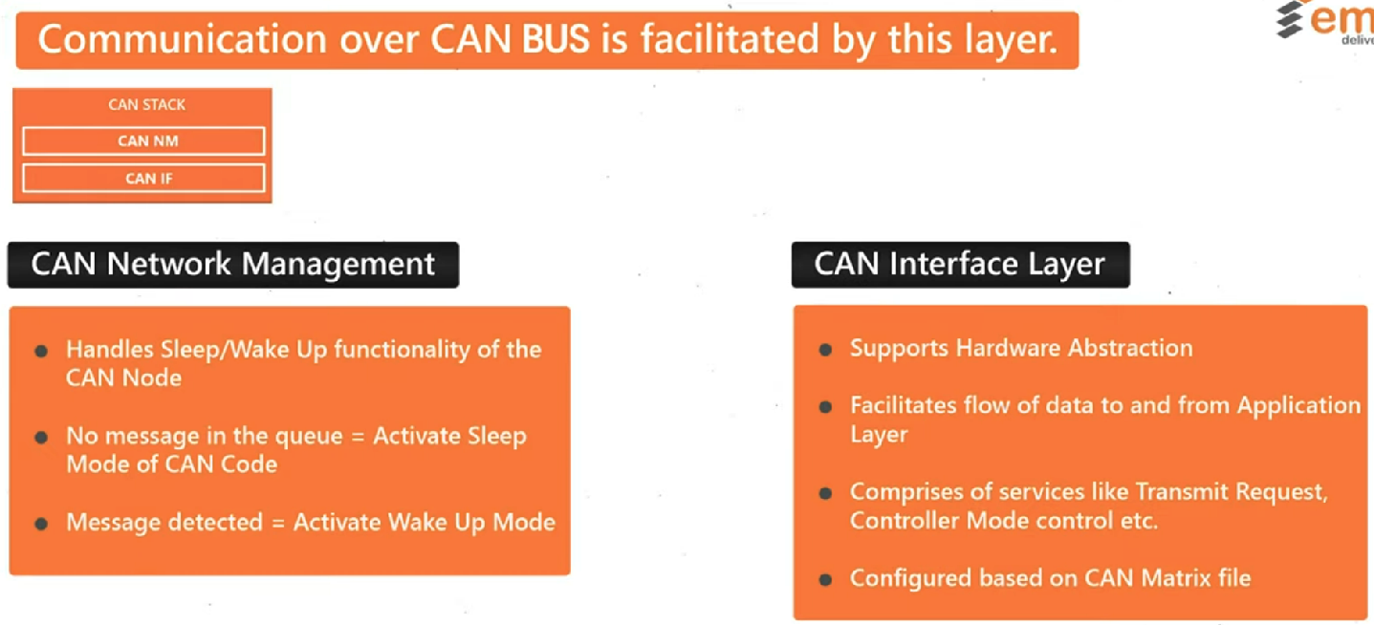

Slide 7
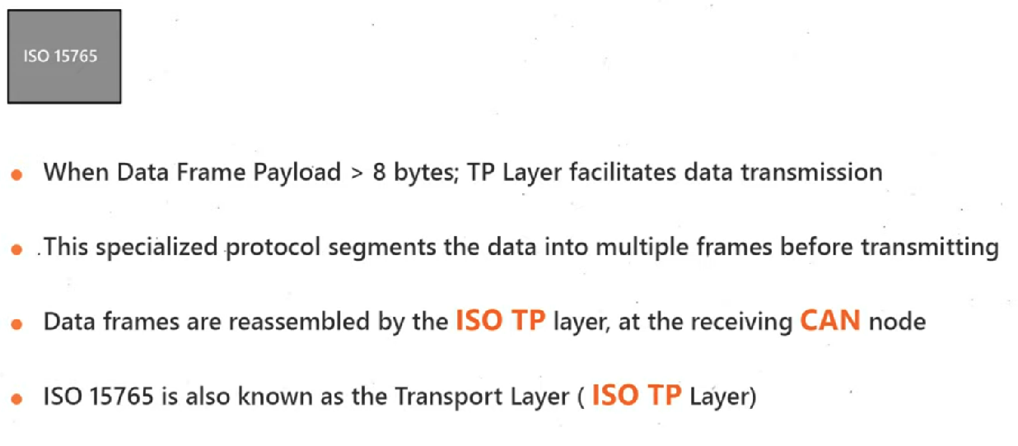

Slide 8
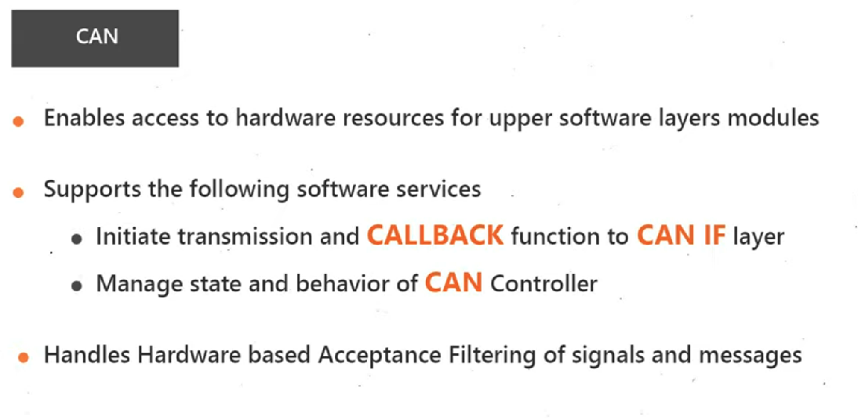

Slide 9


