Slide 1
COMBATING RURAL EXODUS IN AFRICA
Using Starlink WAN Technology to Keep Communities Together
A Network Simulation & Implementation Project
Demonstrating Technology's Role in Rural Development
Realized by: BAGNAWE Emmanuel

Slide 2
The Rural Exodus Crisis in Africa: Understanding the Challenge
60% of African youth migrate to cities seeking opportunities
🏚️ No Economic Opportunities: Youth leave villages for urban jobs
🏥 Limited Healthcare: Medical facilities concentrated in cities
🎓 Poor Education Access: Quality schools only in urban areas
📡 No Internet Connectivity: Rural areas lack digital infrastructure
👨‍👩‍👧‍👦 Family Separation: Communities break apart as young people leave

Slide 3
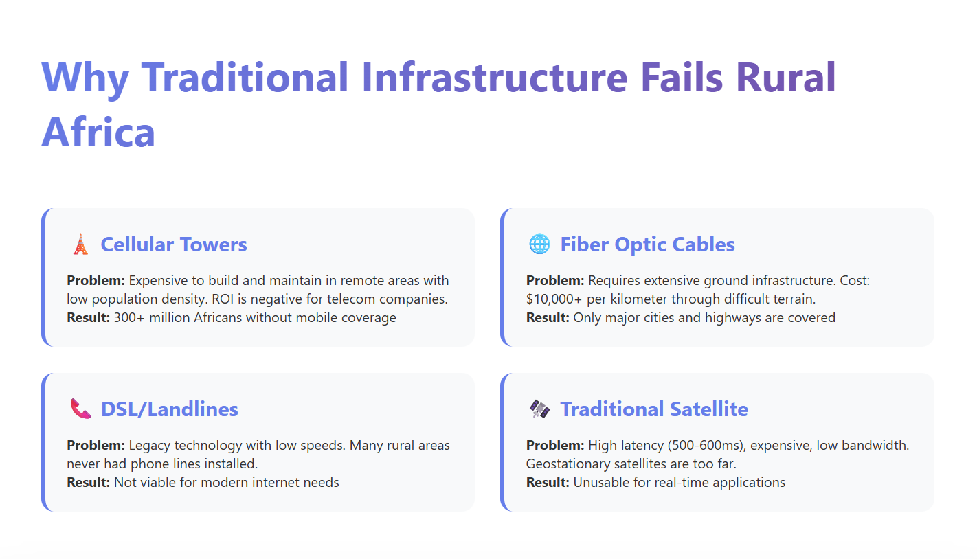

Slide 4
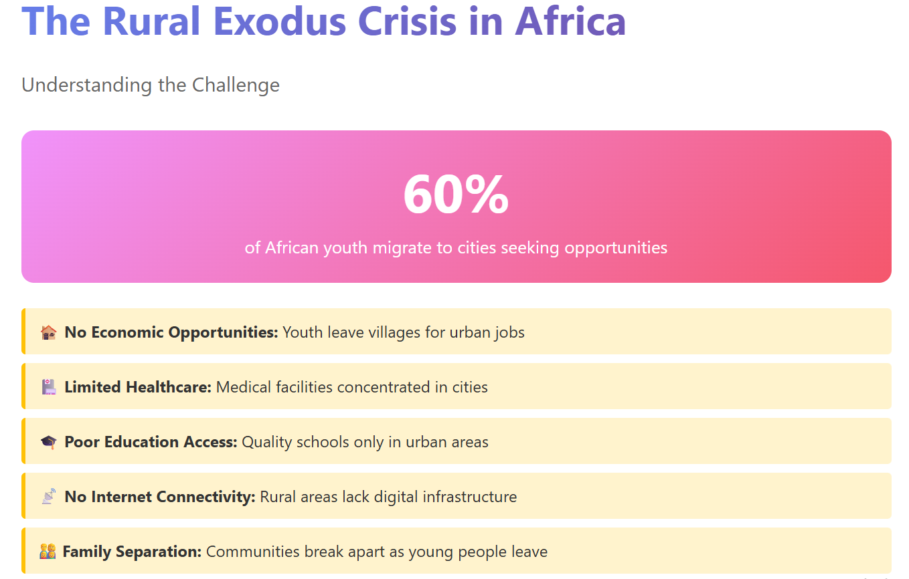

Slide 5
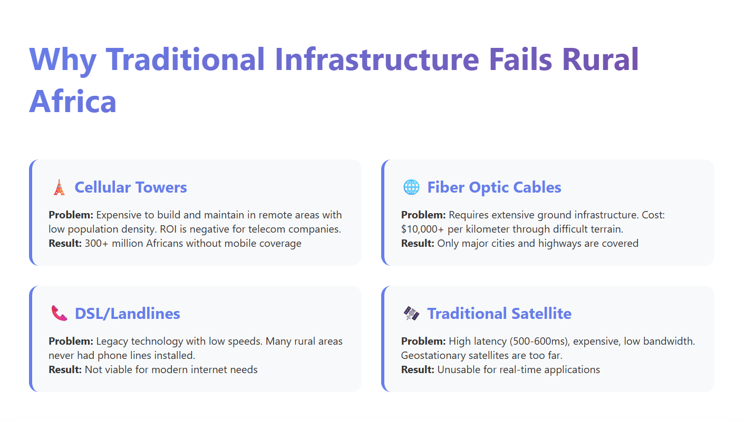

Slide 6
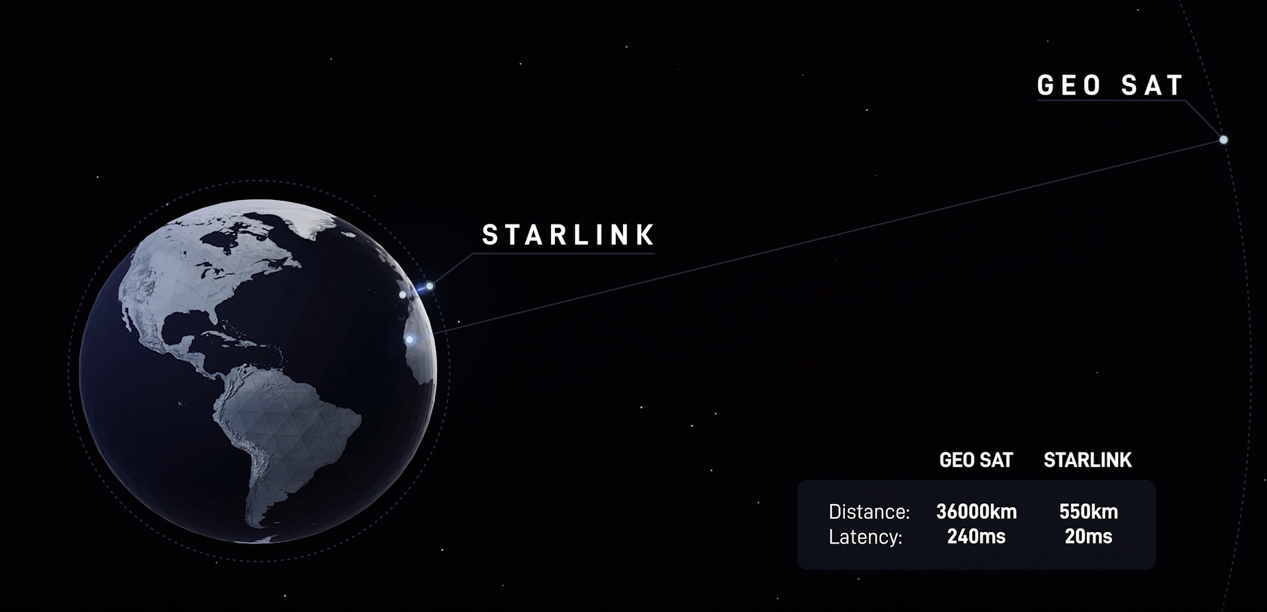
The Starlink Solution
Low Earth Orbit (LEO) Satellite Constellation
🚀 What Makes Starlink Different?
LEO Satellites at 550km altitude (vs. +36,000km for traditional satellites)
Result: 20-40ms latency instead of 600ms - making real-time applications possible
150 Mbps Download Speed
20 Mbps Upload Speed
20-40ms Latency (Low!)
99.9% Global Coverage

Slide 7
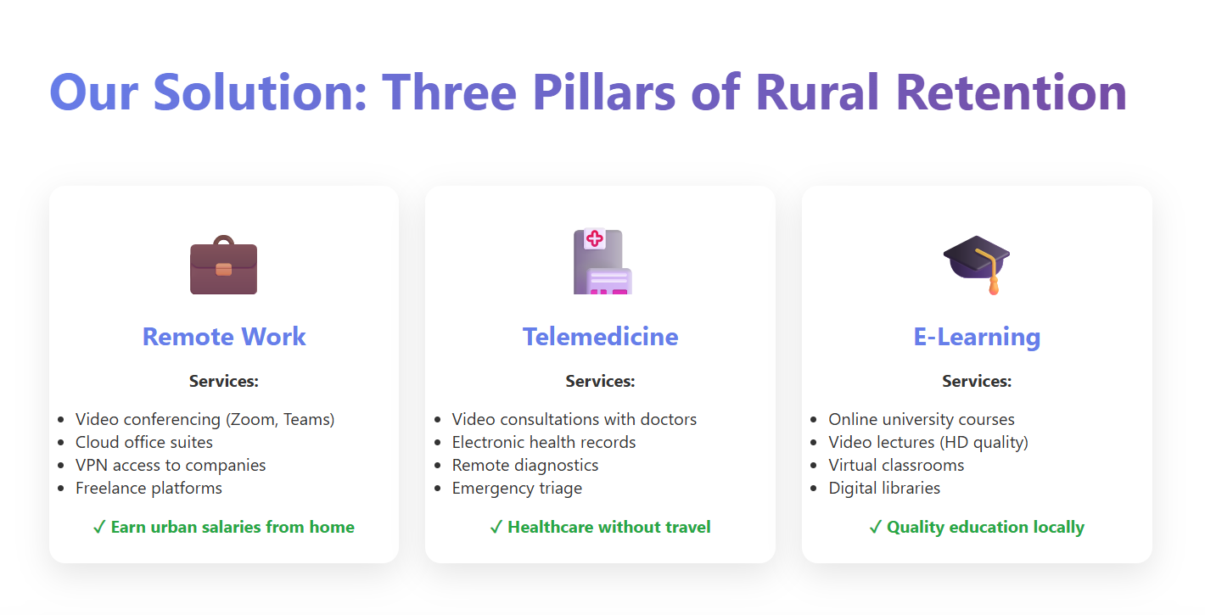

Slide 8
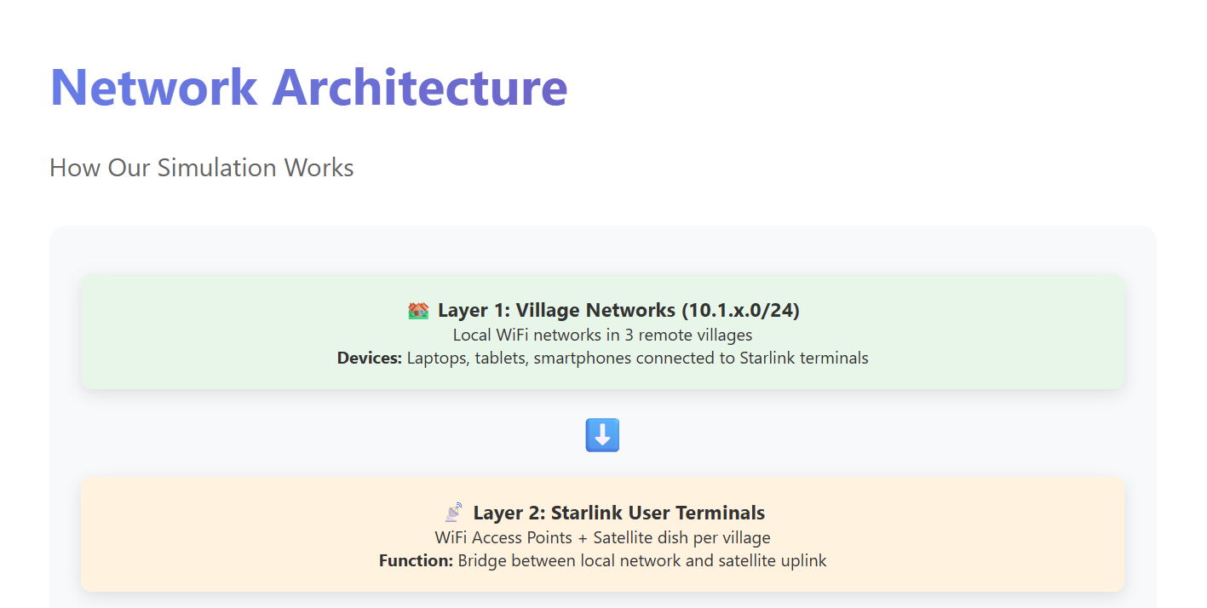

Slide 9
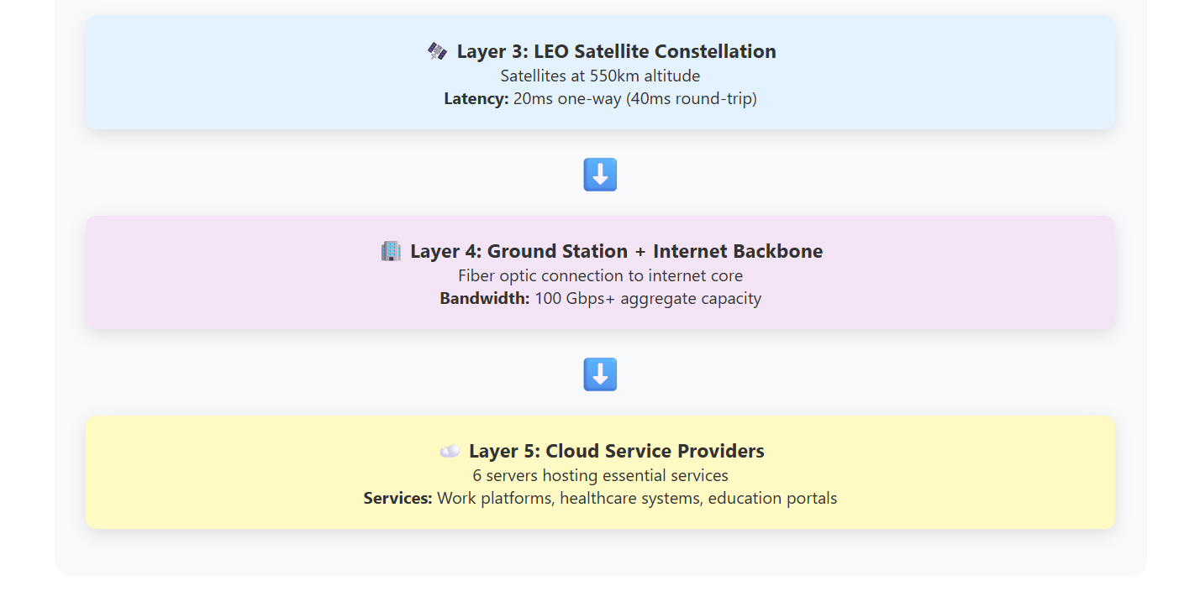

Slide 10
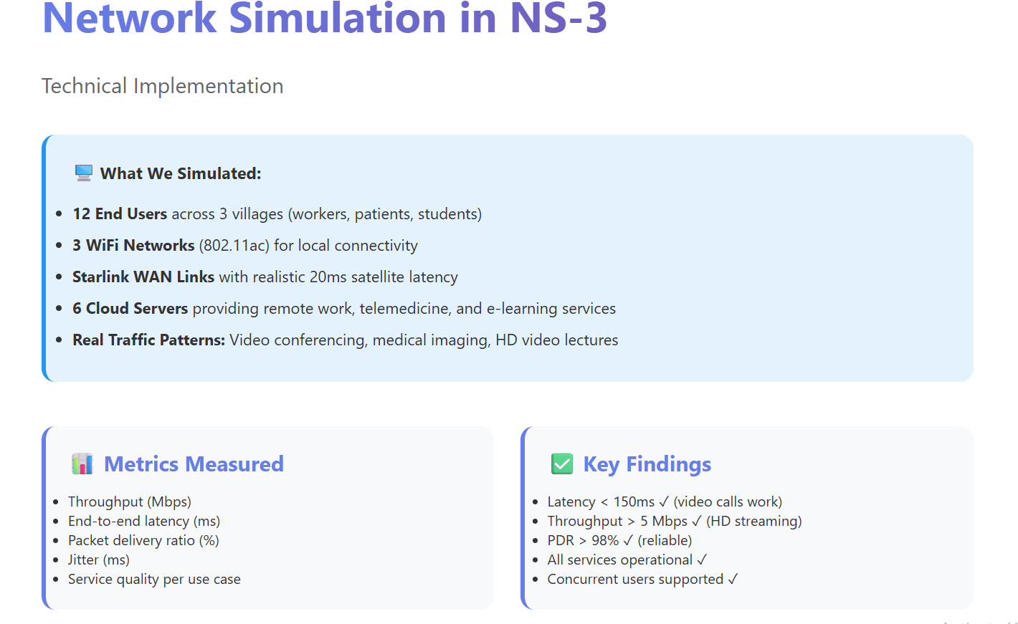

Slide 11
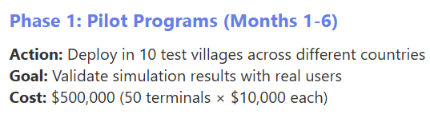
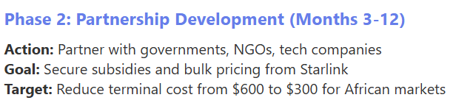
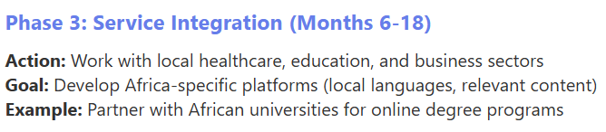
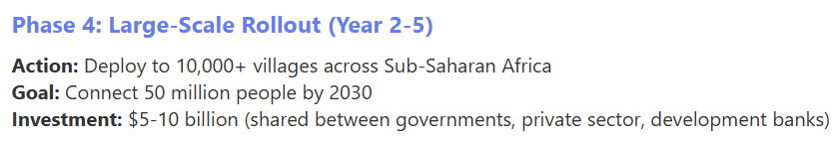
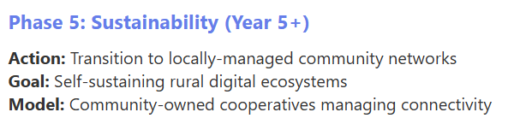
Implementation Roadmap for Africa
From Simulation to Reality

Slide 12
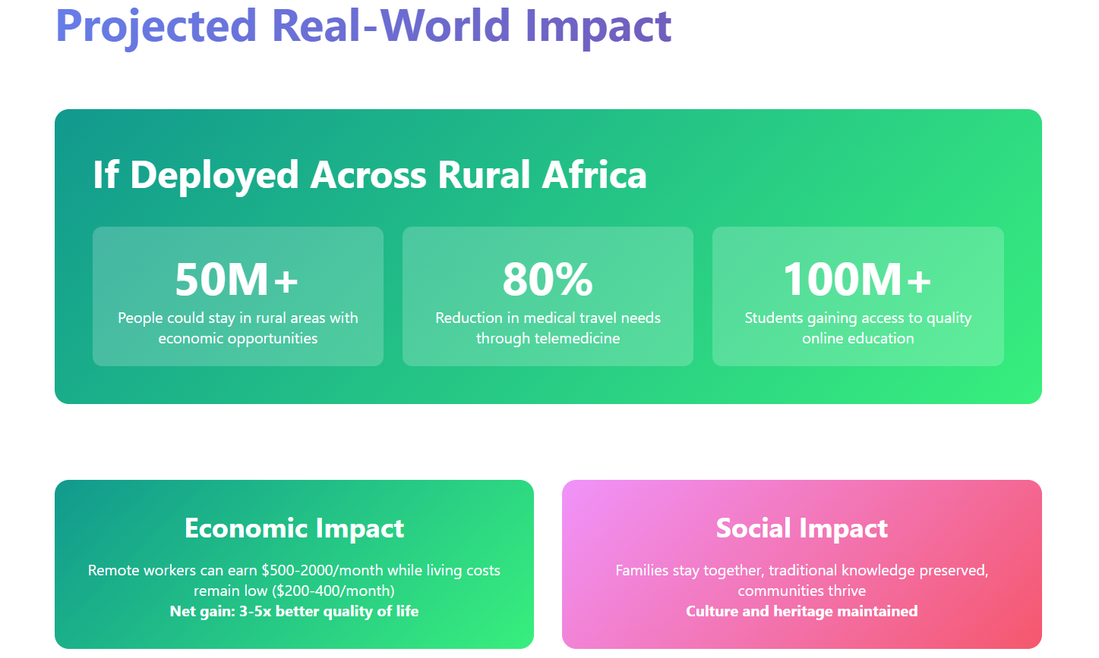

Slide 13
