Slide 1
JOB-TRACKER
A Full-Stack Job Board & Applicant Tracking System
Advanced Java — Final Project Submission
Harun Mohamud Ahmed · Sabirin Abdukadir Salad · Jabir Abdi Hassan Sahal · Yasin Farah Igale

Slide 2
OVERVIEW
What Job-Tracker Does
Three roles
Applicant, Employer, and Admin, each with distinct permissions enforced by JWT + Spring Security.
Full hiring lifecycle
Employers create companies and post jobs; applicants search, save, and apply; admins moderate everything.
Admin-gated companies
New company profiles start PENDING and only post publicly visible jobs once an admin approves them.
Containerized stack
Spring Boot 3 + PostgreSQL run via Docker Compose; React 19/Vite frontend consumes the REST API.
2

Slide 3
TECHNOLOGY
Tech Stack
Backend
Database
Frontend
Spring Boot 3 · Java 21
PostgreSQL 16
React 19 + Vite
Spring Security + JWT
Dockerized
Axios
Spring Data JPA / Hibernate
6 relational tables
Tailwind CSS
Maven
React Router
3

Slide 4
ARCHITECTURE
Request Flow
Controller
→
Service
→
Repository
→
Hibernate
→
PostgreSQL
Every REST resource (Users, Companies, Jobs, Applications, Categories, SavedJobs) follows this same layered path — keeping request handling, business rules, and persistence cleanly separated.
Security: a stateless JwtAuthenticationFilter validates every request's Authorization header, loads the user via CustomUserDetailsService, and populates the Spring Security context — no server-side sessions. @PreAuthorize enforces role checks (e.g. hasRole('ADMIN')) at the controller layer.
4

Slide 5
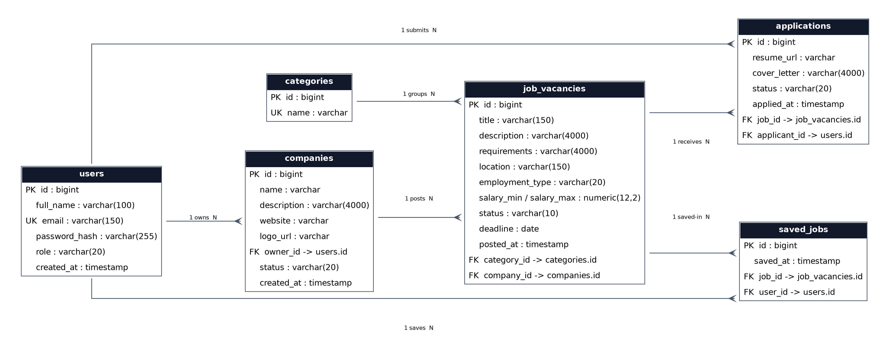
DATABASE DESIGN
Entity-Relationship Diagram
5

Slide 6
FEATURES
What's Built
JWT auth & registration across 3 roles
Employer company profiles + admin approval workflow
Job posting, editing, closing, deletion
Public job search with category/location/keyword filters
Applications with an ATS-style status pipeline
Saved jobs (bookmarking) for applicants
Full admin dashboard: users, companies, jobs, applications
6

Slide 7
DEBUGGING
Challenges & Fixes
lower(bytea) does not exist
Null search filters were sent untyped; Postgres guessed bytea. Fixed with explicit CAST(:param AS string) in JPQL.
LazyInitializationException
List endpoints read lazy relations after the Hibernate session closed. Fixed by adding @Transactional(readOnly = true).
Missing /api/users backend
No UserController existed at all. Built the full module: list, view, change role, delete.
Privilege escalation on register
Registration accepted role=ADMIN from the client. Blocked; admins are now promoted only by an existing admin.
7

Slide 8
TEAM
Individual Contributions
Member | Module | Contribution
Harun Mohamud Ahmed | Team Lead · Categories · Security | Led the team, owns Categories, built JWT security & role-based access, integrated all modules and fixed production bugs across the codebase.
Sabirin Abdukadir Salad | Companies | Company entity, CRUD, and the admin approval workflow (PENDING/APPROVED/REJECTED).
Jabir Abdi Hassan Sahal | Users | User entity, registration/auth DTOs, and admin user-management endpoints.
Yasin Farah Igale | Jobs & Saved Jobs | Job entity, search/filter queries, job lifecycle, and the saved-jobs bookmarking feature.
8

Slide 9
Acknowledgement of GenAI Tool Use
Purpose of Use:
Understanding Advanced Java and Spring Boot concepts
Debugging and resolving coding issues
Designing the PostgreSQL database schema and relationships
Improving frontend ideas and user interface suggestions
Generating documentation, README, and project report drafts
Assisting with testing and troubleshooting
9

Slide 10
Thank You
Questions?
Job-Tracker — Advanced Java Final Project

