Slide 1
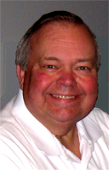
Dave Ackmann
Retired
BS Mechanical Engineering
MS Computer Science
Classical Baritone, Woodworker

Slide 2
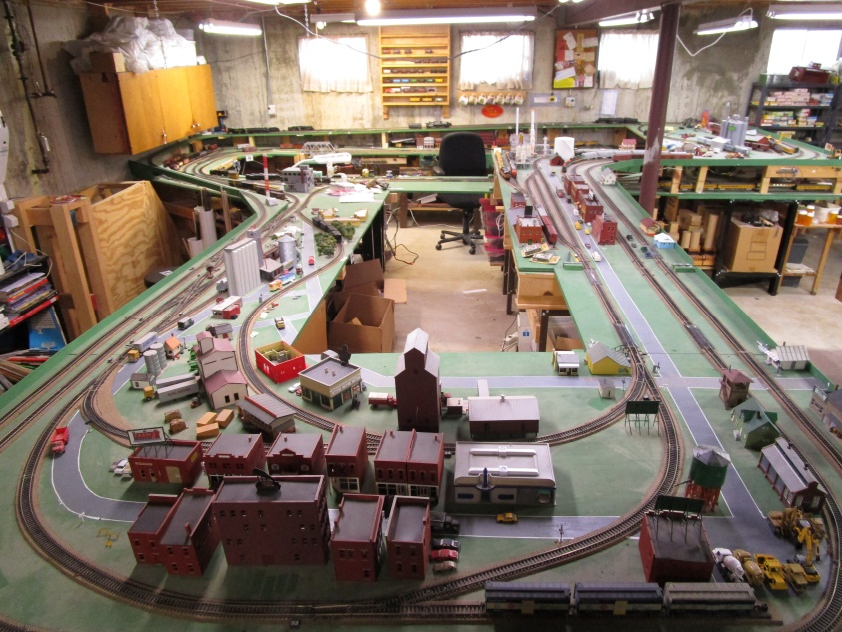
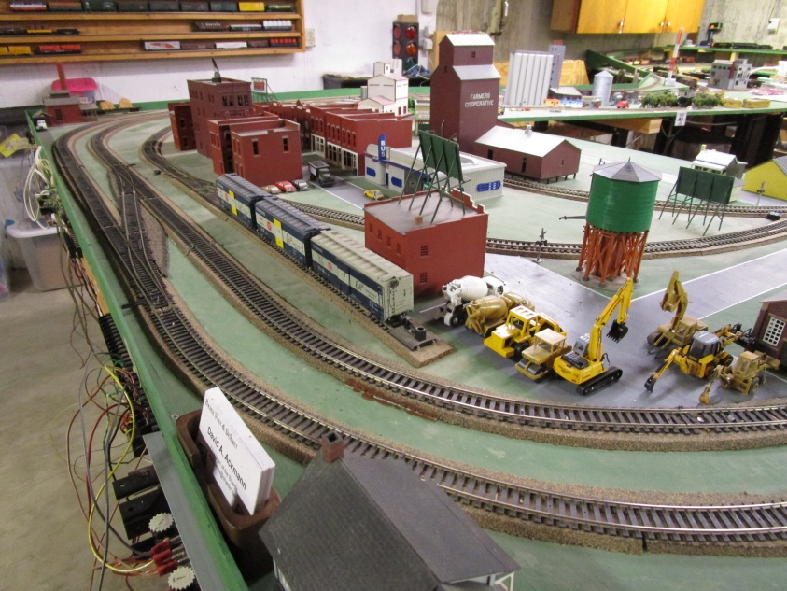
Baden, Vogt & DeSmet
HO, DCC, Freelance (UP), 250 ft², T Shape

Slide 3
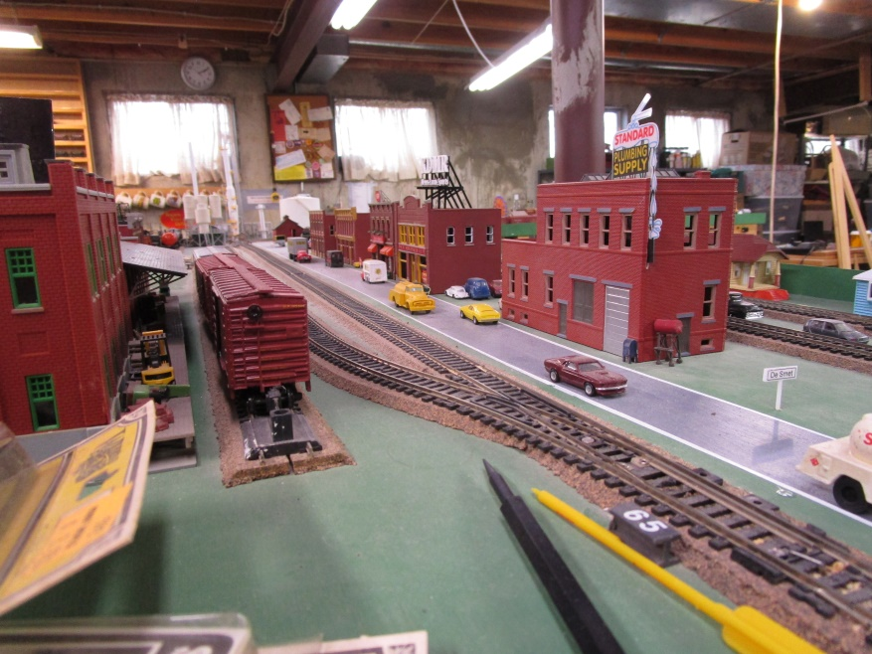
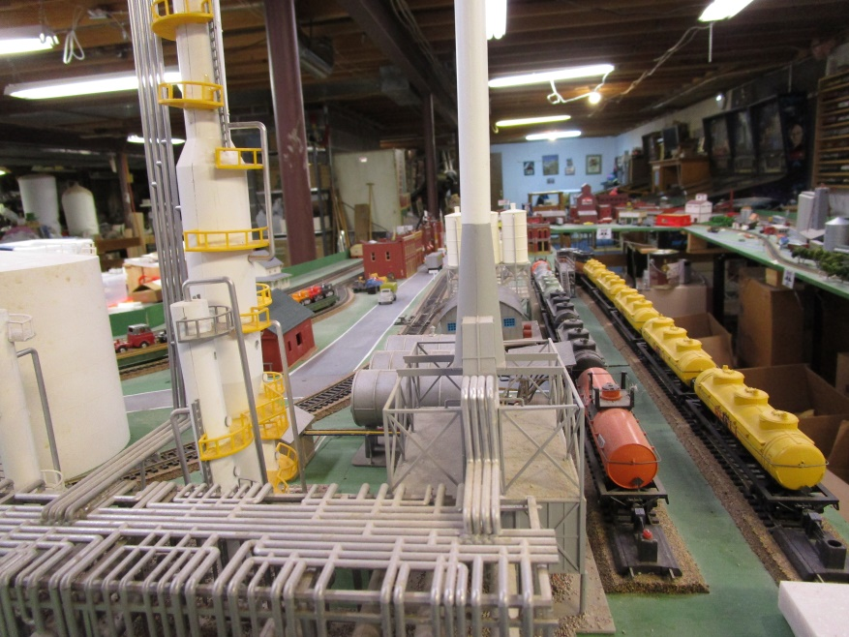
Baden, Vogt & DeSmet
HO, DCC, Freelance (UP), 250 ft², T Shape,
Two Lift Gates, Continuous Loops, 35 Years Old

Slide 4
http://daackm.github.io

Slide 5
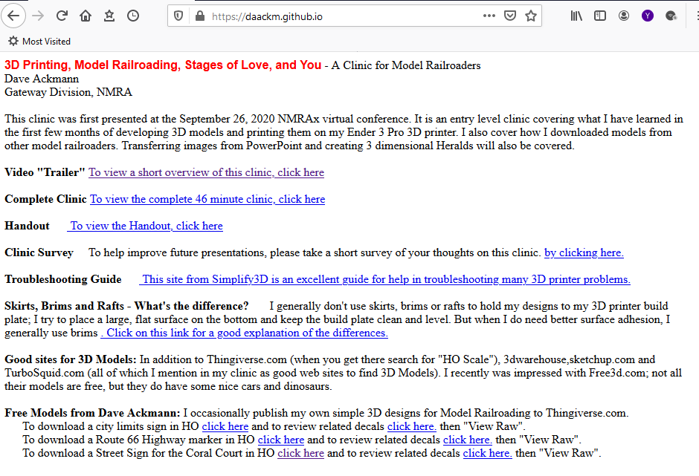

Slide 6
Signage, Custom Decals,
Arduino Micro-Processors,
3D Printing

