Slide 1
Judging the National Model Contest
by
Bill Brown , MMR
NMRA National Model Contest chairman
Jim Zinser, MMR
Coordinator of Judges/Judging

Slide 2
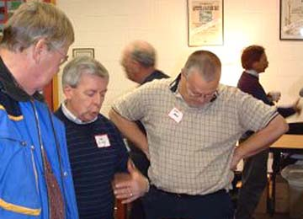
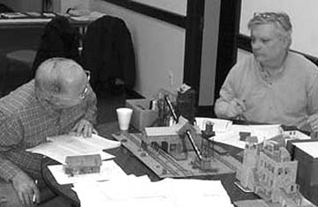
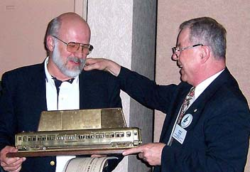
Judging National Model Contest
WHY WOULD ANYONE IN HIS RIGHT MIND
WANT TO JUDGE THE MODEL CONTEST?
It’s a lot of fun.
Great way to improve your modeling skills, even better than entering.
Opportunity to earn AP points toward Association volunteer.

Slide 3

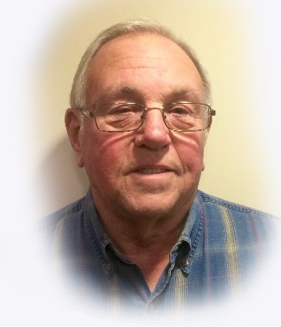





Judging National Model Contest
Your Celebration Room Staff
Bill Brown, MMR Jim Zinser, MMR Tom Oxnard, MMR Carl Smeigh
Bob Verkuyl Ken May Paul Voelker

Slide 4
Judging National Model Contest
Celebration Room Timeline
- Monday and Tuesday (8am to 6pm) – Drop off of models, photos, and displays, and the room is open to convention attendees.
- Monday (1pm) – Judging Clinic
- Tuesday (1pm to 6pm) – Meet the Modeler, Photographer and Crafter Afternoon
- Tuesday (8am to 6pm) and Wednesday (8am to noon) – Balloting for The People’s Choice Awards.
- Wednesday (8:30am to 4pm) – Judging takes place. All convention attendees are welcome to observe…but NO TALKING please!
- Thursday (9am to 11am) – Contest Score Review - Entrants stop in to review THEIR OWN score sheet.
- Thursday (9am to 2pm) – The room is open to the public.
- Thursday (2pm) – Awards Ceremony
- Thursday (4pm) – The Celebration Room will be closed for the rest of the day for award photos.
- Friday (8am to Noon) – All models must be picked up.

Slide 5
Judging National Model Contest
Who & what kind of entries will I be judging?
Eligibility
Member eligibility
NMRA membership
Cannot be professional model builder
Model eligibility
Must be built (90% min.) by entrant
1st place National models cannot re-compete (region 1st placers can compete at national)
Entries can be brought through a proxy
Kinds & Numbers of entries
All types & scales of locos, cars, structures & scenes
Typically 60 to 80 models are judged

Slide 6
Judging National Model Contest
How & when is the judging done?
Judging is done in teams of 3 people
The team leader is an experienced judge & modeler. He or she guides the others through the process
New or inexperienced judges are placed with experienced judges to be given training and guidance and are welcome Each team is responsible for judging one of five aspects or factors (more on this later) Judging schedule
Judging starts on Wednesday morning – Report by 8:00am
It usually takes five to six hours depending on the number of models (typ. 60 to 80 models)

Slide 7
Judging National Model Contest
How are the models evaluated?
The models are judged on two key aspects.
What did the modeler intend to build?
How well did he or she achieve that goal?
Scoring system: Max pts. – 125
Place Awards (Generally 1st, 2nd, 3rd) are given in each category (structure, car, loco, etc. )
Overall score determines eligibility for a Merit Award
One of the most important aspects of judging is to
score models fairly & uniformly with respect to the
Merit Award level (87.5 pts. of the 125 total)

Slide 8
Judging National Model Contest
So what are the five factors?
Each of the five factors looks at a different aspect of the model & has specific point allotments.
Construction 40 pts
Conformity 25 pts
Detail 20 pts
Appearance 25 pts
Scratchbuilding 15 pts
Total 125 pts
We will carefully examine each factor later

Slide 9
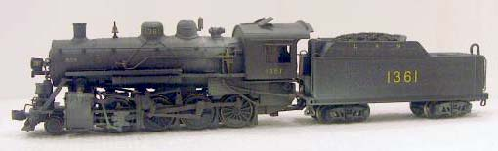
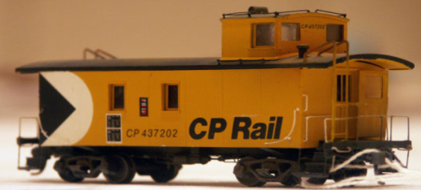
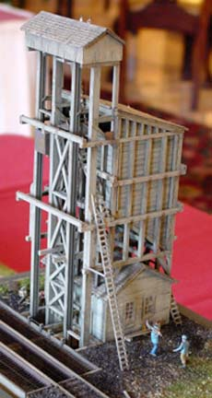
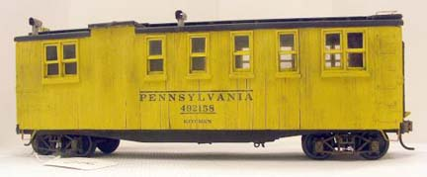
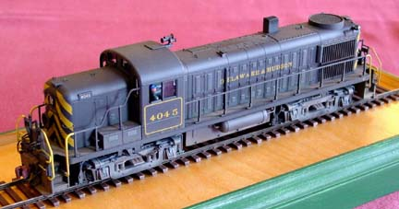
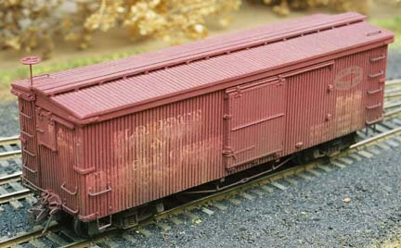
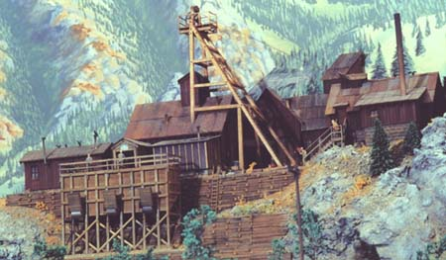
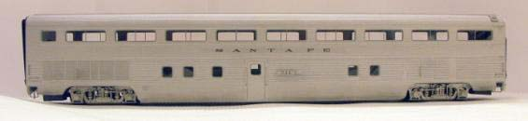
Judging National Model Contest
And, what are the model categories?
Nine categories group models by type
Structures
Cabooses
Locomotive - Steam
Non-Revenue Cars
Locomotives – Diesel & Other
Traction
Freight Cars
Dioramas
Passenger Cars

Slide 10
Judging National Model Contest
Are there any written guidelines?
Yes, we use the - Achievement Program Judging Guidelines which provides
Two dimensional judging matrices to combine
Complexity and scope of the intended model &
How well was the intention achieved (quality/quantity)
Specific descriptions of what to look for, what to emphasize and other tips We also depend on the Judging form (901) filled out by the entrant which provides…
Model specific information telling us things like:
What he or she intended to build
How much was scratch-built vs. kit or commercial parts

Slide 11
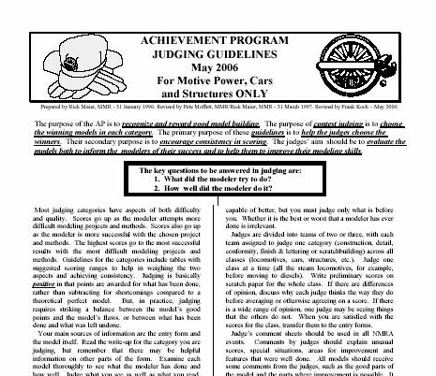
Judging National Model Contest
Achievement Program Judging Guidelines
The “Judging
Guidelines” is the bible for contest judging
Covers all factors in all categories
Includes both matrices, tips & step-by-step guidance
Available on NMRA website
q

Slide 12
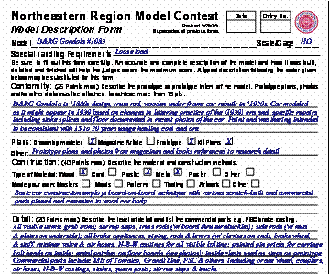
Judging National Model Contest
Judging Form (902)
Details by factor
q
Basis of model – kit, kit-bash or scratch-built
Intended proto- type & condition
How model was built & finished
What parts built by modeler vs. Commercial parts

Slide 13
Judging National Model Contest
How does the Judging Matrix work ?
Each of five factors are judged based on a matrix which strikes a balance between complexity & quality or quantity
For example,
Construction Factor (40 pts. Total – 28 pts. Merit)
Quality & Craftsmanship
Poor
Good
Exceptional
Simple
Complexity
Merit Level
Very Complex

Slide 14
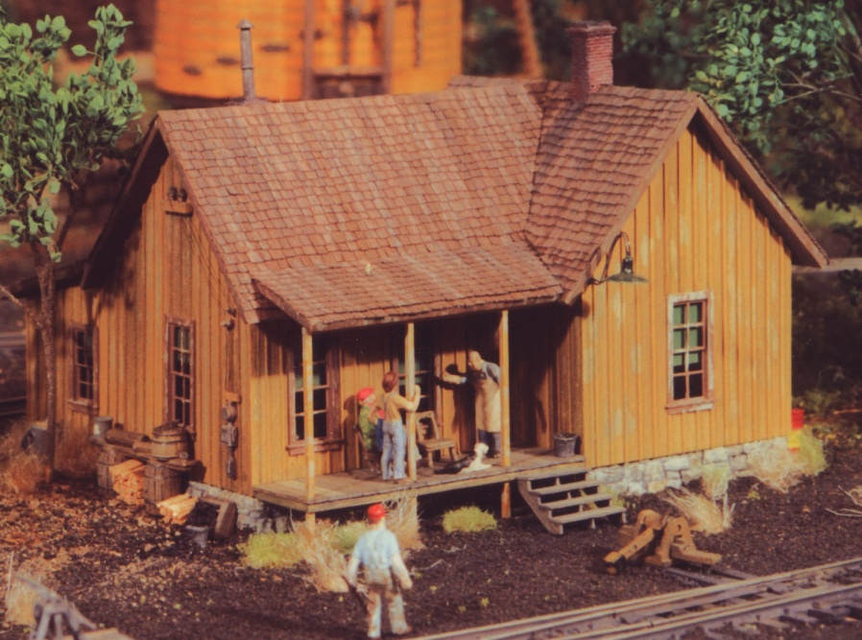
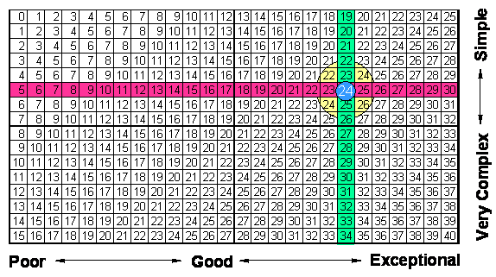
Judging National Model Contest
How Did This Small Section House Do?
(40 pts. Total – 28 pts. Merit)
Quality & Craftsmanship
Very good to excellent
Complexity
Relatively small
simple structure

Slide 15
Judging National Model Contest
Back to the Factors…
Construction (40 pts. Total – 28 pts. Merit)
Focus - quality, craftsmanship, modeling skill and execution, proper handling of materials
Method of fabrication or choice of materials not important
Work done by modeler very important and dependent on type or basis of model
Scratchbuilt high range scores
Modified kits mid to high range scores
Modified R-t-R mid to high range scores
Stick kits high mid range scores
Plastic kits low mid range scores
Ready-to-run low range scores
Complexity or scope of model also important (see matrix)

Slide 16
Judging National Model Contest
Quality aspects to look for…
Overall quality of assembly
Neatness of glued parts, absence of any visible glue
Fit of parts, no open joints, no bowing or warpage
Square corners, straight lines
Evenness,matching ends
Unsanded or fuzzy wood
Even spacing of grab irons, windows, etc.
Excess glue or solder, fingerprints, etc.

Slide 17
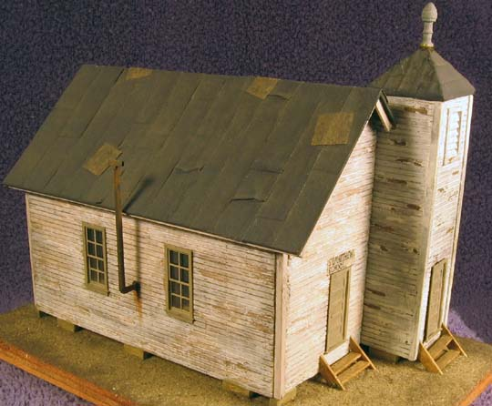
Judging National Model Contest
Here Are Some Examples Where
Quality Could Be Improved…
Neat little church; not a contest model. Lot’s of charm,
But some classic construction errors. Let’s zoom in…

Slide 18
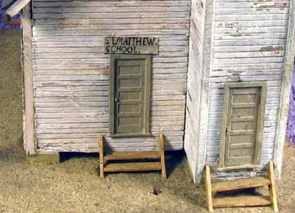
Judging National Model Contest
The Neat Little Church
Uneven Siding
Open Joint
Crooked Step
(error or intended?)

Slide 19
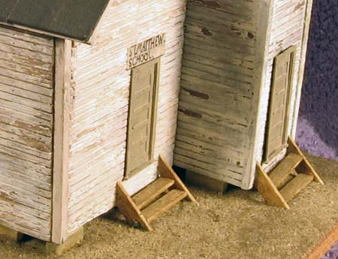
Judging National Model Contest
The Neat Little Church
Uneven Siding
Poor Fit Door

Slide 20
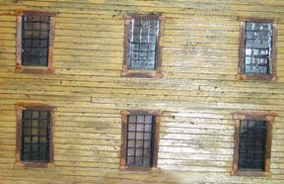
Judging National Model Contest
Here is another example. This time it’s glue…
Glue spots
Scratchbuilt wall with lots of glue spots around
the windows and quite a sheen on the siding.

