Slide 1
Judging National Model Contest
Complexity aspects to consider…
Amount of time and effort to fit multiple parts
Difficulty of model and construction techniques
Numbers of attributes such as walls, rooflines, windows and doors
Example, a 4-6-6-4 is more complex than an 0-6-0
Example, a center flow hopper is more complex than a flatcar.
Example, grand central station is more complex than a tool shed

Slide 2
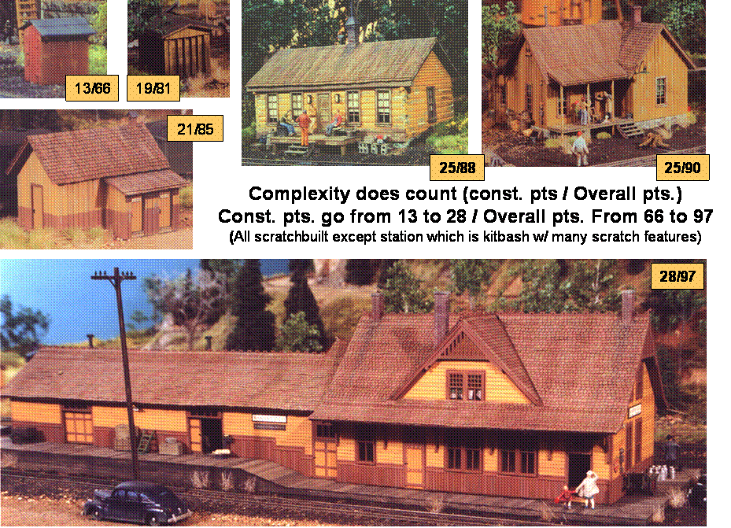
Judging National Model Contest
Here’s are some Examples of How Scoring
Can Increase with Complexity

Slide 3
Judging National Model Contest
Conformity (25 pts. Total – 17.5 pts. Merit)
Focus - Conformity to prototype or prototype intent
Replication of prototype features, dimensions, components, simulation of construction materials, and arrangement of detail
Make it look like the prototype
For selectively compressed models consider how well model captures important features and balance of prototype
Freelanced models also need to follow prototype practice
Is it logical
Would it do the job
Would it take the intended loads
Does it conform to normal construction practice.
If not why?
Documentation important; show plans, photos, or other items to substantiate your model (15 pts. max. if none provided)

Slide 4
Judging National Model Contest
Conformity Matrix (25 pts. Total – 17.5 pts. Merit)
Merit Level

Slide 5
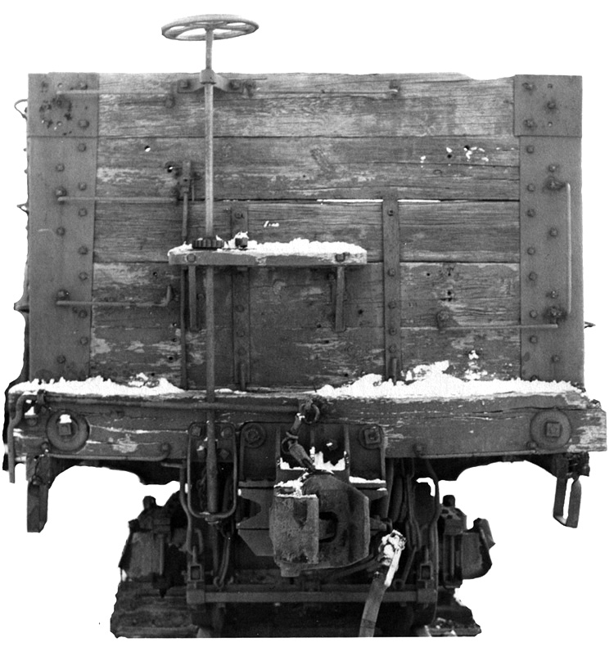
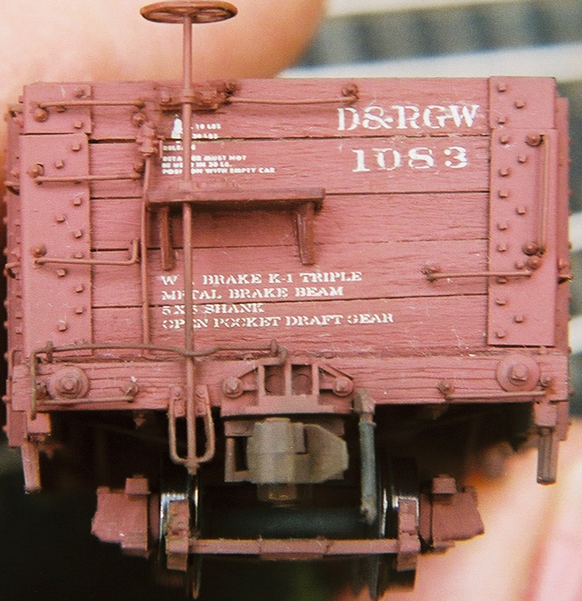
Judging National Model Contest
Example -
Detail Conformance
“B” End of D&RGW Gondola #1083
Can you see the differences?

Slide 6
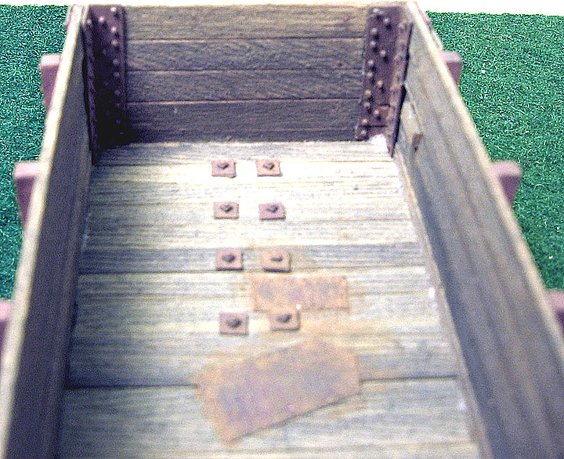
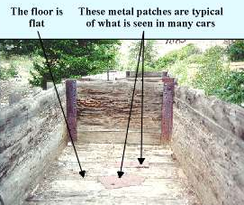
Judging National Model Contest
Example – Conformance to Specific Car
Floor patches D&RGW Gondola #1083

Slide 7
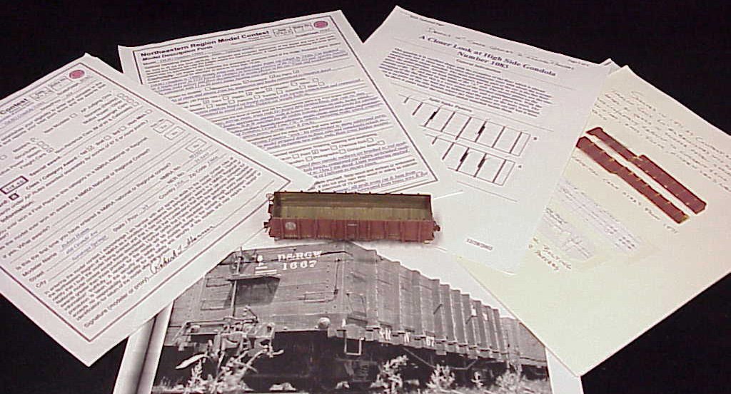
Judging National Model Contest
Example –
Conformance Documentation
Overall Package – D&RGW Gondola #1083

Slide 8
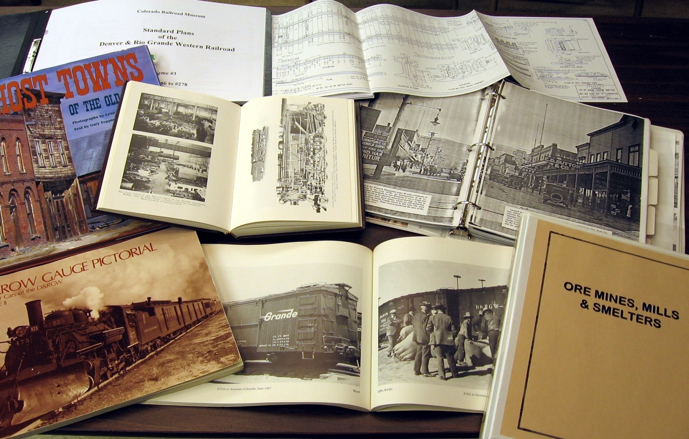
Judging National Model Contest
General References for Free Lance Models

Slide 9
Judging National Model Contest
Detail (20 pts. Total – 14 pts. Merit)
Focus – Quantity and Refinement of Detail
Detail has to be added; cast on detail doesn’t count
Cast-on detail can be filed off and replaced with more refined separate parts
Detail that is integral to operation of model is more important than incidental detail
Working detail is more important than non-working detail
Completeness is important; add everything you can see on model.
Refined of detail is better than simple parts; a brake cylinder made up of several well made parts is probably better than a single piece filed to shape.

Slide 10
Judging National Model Contest
Detail Matrix (20 pts. Total – 14 pts. Merit)
Quantity & Refinement
Extensive &
Little added
Moderate Detail
Complete
0
1
2
3
4
5
6
7
8
9
10
11
12
13
14
15
Simple
1
2
3
4
5
6
7
8
9
10
11
12
13
14
15
16
2
3
4
5
6
7
8
9
10
11
12
13
14
15
16
17
Complexity
3
4
5
6
7
8
9
10
11
12
13
14
15
16
17
18
Merit Level
4
5
6
7
8
9
10
11
12
13
14
15
16
17
18
19
Complex
5
6
7
8
9
10
11
12
13
14
15
16
17
18
19
20

Slide 11
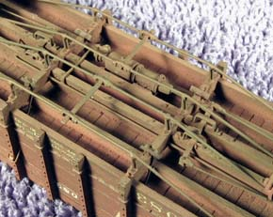
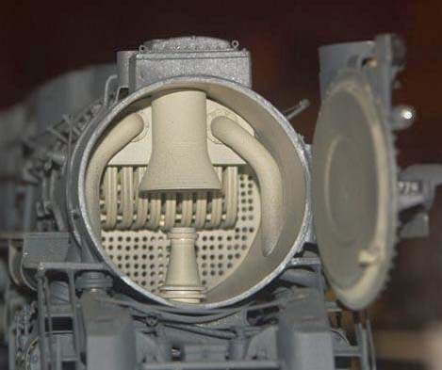
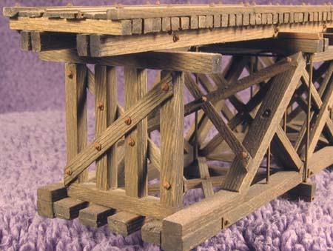
Judging National Model Contest
Detail Examples …

Slide 12
Judging National Model Contest
Appearance (25 pts. Total – 17.5 pts. Merit)
Focus – Quality and skill of finish
Paint quality - smoothness, opacity & evenness,crisp transitions form color to color,correctness of color, and
appropriateness of shine or dullness of finish
Lettering quality – spacing, straightness, evenness, visibility of film (decals), air bubbles
Important to describe (model description form) state of finish; old/new, weathered/clean, if weathered what it might look like source or circumstances leading to appearance
Weathering not necessary, but if included appropriateness to usage; is underside weathered, tracks, coupler (everything you can see)

Slide 13
Judging National Model Contest
Appearance Matrix (25 pts. Total – 17.5 pts. Merit)
Merit Level

Slide 14
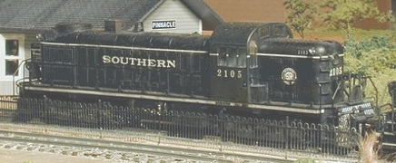
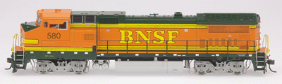
Judging National Model Contest
Complexity of Finish Counts
Multi-color paint schemes are more difficult and done equally well
will score higher than single color paint jobs.

Slide 15
Judging National Model Contest
Scratchbuilding (15 pts. Total – 10.5 pts. Merit)
Focus – Amount of model built from scratch
Specifically aspects and parts of model built form raw materials such as strip stock (wood, plastic, metal), sheet stock, (scribed siding, embossed, etc.) and other forms of basic materials ( casting compounds, plaster, wire, etc.
Casting and photo etching parts is considered scratchbuilding
Drawing plans is part of scratchbuilding process.
Complexity aspect refers to complexity of parts that are scratchbuilt.
Typically trucks, couplers, motors, light bulbs, nut and bolt castings are exempted from scratchbuilding requirements

Slide 16
Judging National Model Contest
Scratchbuilding Matrix
(15 pts. Total – 10.5 pts. Merit)
Merit Level

Slide 17
Judging National Model Contest
Scratchbuilding Subschedule
Nut/Bolt Castings
Building exempted parts may result
in higher construction scores

Slide 18
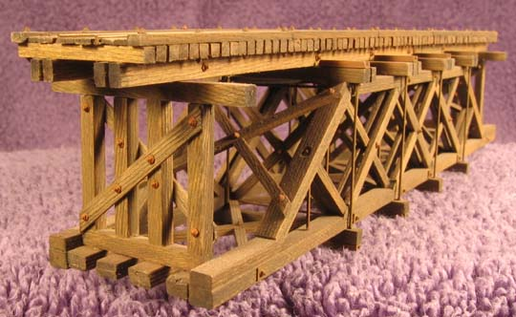
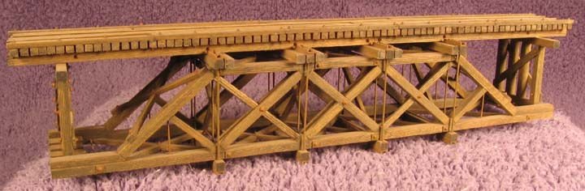
Judging National Model Contest
Scratchbuilding Examples…
Howe deck truss based on an old Jack Work article (It’s for a 24” gauge mine tram), and though fairly small garnered a 99 points!

Slide 19
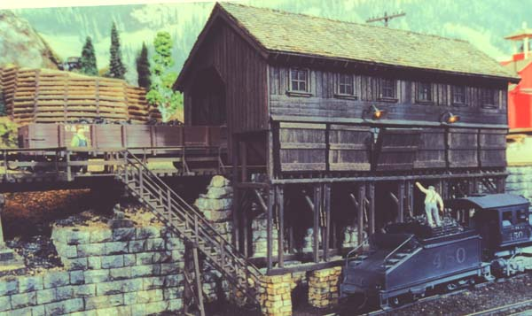
Judging National Model Contest
Scratchbuilding Examples…
This structure was a lot more complex and was completely
scratch-built including windows, individual shingles, interior detail and lighting taking 110 pts at the Denver national in ‘91
Burnett Clifton Coal Pocket Typical of the D&RGW & unavailable as a kit

Slide 20
Judging National Model Contest
The Matrices all look very subjective. How do
you achieve consistent & uniform scores?
It is difficult. Some think we add up points or subtract points. Neither! Because the value of a point cannot established.
The answer is CALIBRATION! We calibrate around the Merit Level score, 87.5 pts. This the most important scoring range and why I show the green merit level lines on the matrices.
To become calibrated takes experience achieved by working with experienced judges in contest and/or at-home judging.
This is the primary job of the Team Leader: to teach, to guide, to show, to CALIBRATE newer judges, so merit level models are properly rewarded.

