Slide 1
00: Introduction

Slide 2
Content
Mesh Representation & Data Structures
Differential Geometry of Curves & Surfaces
Higher-Order Curves & Surfaces
Simplification & Smoothing
Texture Parameterisation & Synthesis
Mesh Repair & Improvement
Mesh Processing Pipeline

Slide 3
Assessment
4 Assignments @ 25% each
I: Mesh Data Structures
II: Higher Order Surfaces
III: Texture Parameterisation
IV: Simplification & Smoothing
No exam

Slide 4
Textbooks
There is no single textbook we can use
But all of the core material is in this one:
Hardback: £18.99
Kindle: £48.44
Notes:
50.99

Slide 5
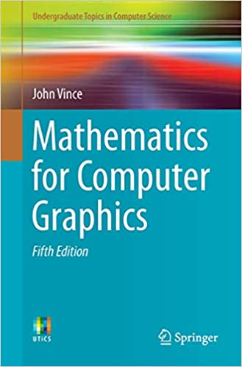
Maths Refresher
Basic linear algebra / geometry / calculus:
Hardback: £40.54
Kindle: £12.34

Slide 6
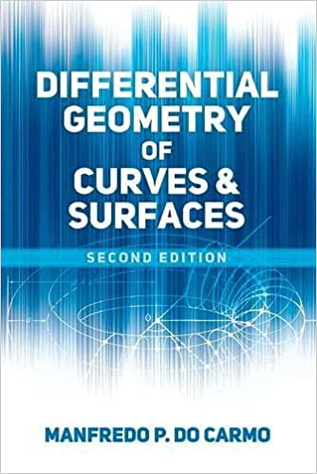

Differential Geometry
Botsch & Kobbelt assume you know it
So we will supplement from these two
Paperback: £18.99
Kindle: £14.92
Paperback: £12.99
Kindle: £8.96
Notes:
50.99

Slide 7

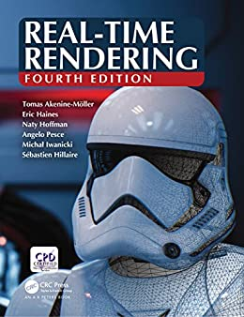
Texts From 5812/5822
Both of these have some of this material
And you'll need them anyway
Hardback: £78.66
ACM: $20.00
Hardback: £59.86
Kindle: £51.27
ACM: $20.00

Slide 8
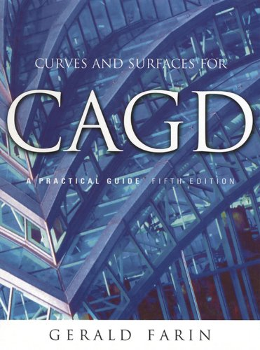
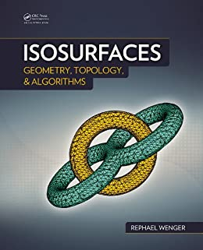
Secondary References
None of these is necessary
All of them are useful
Hardback: £70.22
Kindle: £66.71
Hardback: £37.59
Kindle: £35.71
Hardback: £85.00
Kindle: £34.99

Slide 9
Detailed Plan

Slide 10
Chapter Equivalence

Slide 11
Lab Sessions
2 hour lab shared with Rafael in COMP 5812M
This week, it will be online
We will break it into 4 groups:
Group A will meet me at 1500, Rafael at 1530
Group B will meet Rafael at 1500, me at 1530
Group C will meet me at 1600, Rafael at 1630
Group D will meet Rafael at 1600, me at 1630

Slide 12
Group A - 1500 HC, 1530 RK
M. Eng.
Matthew Cumber
Siyuan Fan
Isaiah Fergile-Leybourne
Alexander Goose
Jason (Zecheng) Hu
M. Sci.
Sharo Hama Karim
Niall Horn
Chaoshan Huang
Jason Kharmawphlang
Yichen Xiao

Slide 13
Group B - 1500 RK, 1530 HC
M. Eng.
John Barbone
Sven Buckland
Vincent (Chan) Lou
Natasha Newland
M. Sci.
Nikhil Bharadwaj
Jiaxing Cai
Zekun Cai
Yiu Ho
Eleanor Mills
Shihua Wu

Slide 14
Group C - 1600 HC, 1630 RK
M. Eng.
Ciaran Brennan
Lewis Hadley
Parmvir Grewal
Tomas Martinek
M. Sci.
Yizhou Hu
Huayang Jiang
Wei Pan
Tianyi Yan
Jingyuan Zhang
Zhiyang Zhang

Slide 15
Group D - 1600 RK, 1630 HC
M. Eng.
Domantas Dilys
Mario Ivanov
Ramal Cooray
Usama Usman
M. Sci.
Jacob Bennett
Zechen Geng
Sharjeel Qaiser
Yuxuan Wen
Xiaoyuan Yang
Jinyun Zhu

