Slide 1
07. Higher-Order Surfaces
Dr. Hamish Carr

Slide 2
Motivation
We built Bézier curves in 2-D:
Because not everything is straight
So curves need a separate representation
And we built them using polynomials
We can do much the same thing in 3-D
Higher-order surfaces:
Bézier Patches, Subdivision Surfaces, &c.

Slide 3
Bézier Curve
Repeated linear interpolation
based on control polygon
actually a polyline
Recursively defined (de Casteljau)
Note barycentric indices

Slide 4

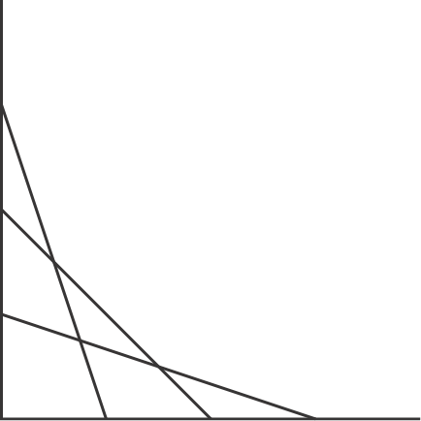
Construction
t=1
t=0.75
t=0.5
t=0.75
t=0.25
t=0.5
t=0.25
t=0
t=1
t=0.75
t=0.5
t=0.25
t=0

Slide 5
Bézier Triangle
Generalisation of triangles
Repeated linear interpolation
based on control net
Recursively defined (de Casteljau)

Slide 6



Construction
p₃₀₀
p₂₀₀
p₂₀₁
p₂₁₀
p₀₀₁
p₁₀₁
p₁₁₀
p₁₀₂
p₁₁₁
p₁₂₀
p₀₀₀
p₀₀₁
p₀₁₀
p₀₀₂
p₀₁₁
p₀₂₀
p₀₀₃
p₀₁₂
p₀₂₁
p₀₃₀

Slide 7
Properties
Control edges generate Bézier curves
Bézier patch is cubic polynomial
Hermite patches also exist
& can be converted to/from Bézier
Bounded by convex hull of control net
Local control

Slide 8
de Casteljau Patches
int N_PTS = 4;
Point bezPoints[N_PTS][N_PTS][N_PTS];
void DrawBezier()
{ // DrawBezier()
for (float alpha = 0.0f; alpha <= 1.0f; alpha += 0.01f)
{ // parameter loop
for (float beta = 0.0f; beta <= 1.0f; beta += 0.01f)
{ // parameter loop
float gamma = 1.0f - alpha - beta;
for (int diag = N_PTS-1; diag >= 0; diag--)
{ // diagonal loop
for (int i = 0; i <= diag; i++)
{ // i loop
for (int j = 0; j <= diag - i; j++)
{ // i loop
int k = diag - i - j;
bezPoints[i][j][k] = alpha*bezPoints[i+1][j ][k ]
+ beta *bezPoints[i ][j+1][k ];
+ gamma*bezPoints[i ][j ][k+1];
} // j loop
} // i loop
} // diagonal loop
// draw the point
DrawPoint(bezPoints[0][0][0]);
} // parameter loop
} // parameter loop
} // DrawBezier()

Slide 9
Example

Slide 10
Bézier Tensor Patches
Triangles are not always best
quadrilaterals are often easier
easier to construct large surfaces
easier to texture
So how can we do this with squares?
Iterate bilinear interpolation

Slide 11
Bilinear Béziers
p₃₀₃
p₃₁₃
p₃₂₃
p₃₃₃
p₂₀₂
p₂₁₂
p₂₂₂
p₁₀₁
p₁₁₁
p₀₀₀
p₃₀₂
p₃₁₂
p₃₂₂
p₃₃₂
p₂₀₁
p₂₁₁
p₂₂₁
p₁₀₀
p₁₁₀
p₃₀₁
p₃₁₁
p₃₂₁
p₃₃₁
p₂₀₀
p₂₁₀
p₂₂₀
p₃₀₀
p₃₁₀
p₃₂₀
p₃₃₀

Slide 12
Computation
The individual terms are Bézier curves
And we can compute direction vectors
Then compute normal vectors

Slide 13
Example

Slide 14
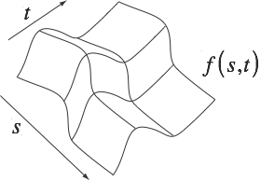


Direction Vectors

Slide 15
Normal Vectors
Take crossproduct of two vectors
tangent to the surface
direction vectors
partial derivatives
from the separated Bézier curves

Slide 16
Normal Vectors

Slide 17
Shortcut
Bézier patches are very common
so they are often built into libraries
E.g. OpenGL’s Evaluators
Now the basis of geometry shaders
GLfloat ctrlpoints[4][4][3];
glMap2f(GL_MAP2_VERTEX_3, 0, 1, 3, 4, 0, 1, 2, 12, 4, &ctrlpoints[0][0][0]);
glEnable(GL_MAP2_VERTEX_3);
glMapGrid2f(20, 0,0, 1,0, 20, 0.0, 1.0);
glEvalCoord2f(i/30.0, j/30.0);

Slide 18
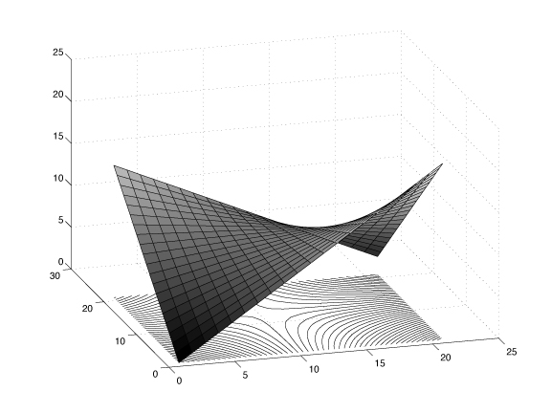
Evaluators
Essentially, a loop through (s,t)
Computes a set of smaller patches
Which are rendered as triangles / quads
I.e. details are stored algorithmically

Slide 19
Surface Construction
Glue these patches together like triangles
Make sure tangents match at edges
Back to artistic control

Slide 20
Subdivision Surfaces
Another algorithm for smooth surfaces
Start with a rough description
Compute a finer resolution version
Surface defined by limit of the computation
in practice, stop when quads < 1 pixel

Slide 21
Loop Subdivision
Uses triangles
Equivalent to quartic box spline
Insert one point along each edge
Each triangle becomes 4
Then choose the geometric positions of:
new vertices
old vertices

Slide 22
Mesh Topology Changes
Old Vertex
Added Vertex
Add vertex to each edge
Divide face in 4
But this gives us 4 coplanar triangles
Which means the surface doesn't change

Slide 23
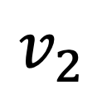
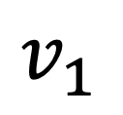
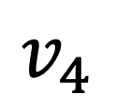
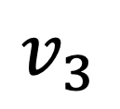
Adjacent Faces
$$v_{2}$$
$$v_{3}$$
$$v_{4}$$
$$v_{1}$$
Look at the two faces adjacent to the edge
Their vertices affect how sharp the edge is
Take weighted average of all four vertices
Neighbours account for 25% weight

Slide 24
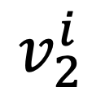
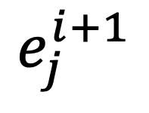
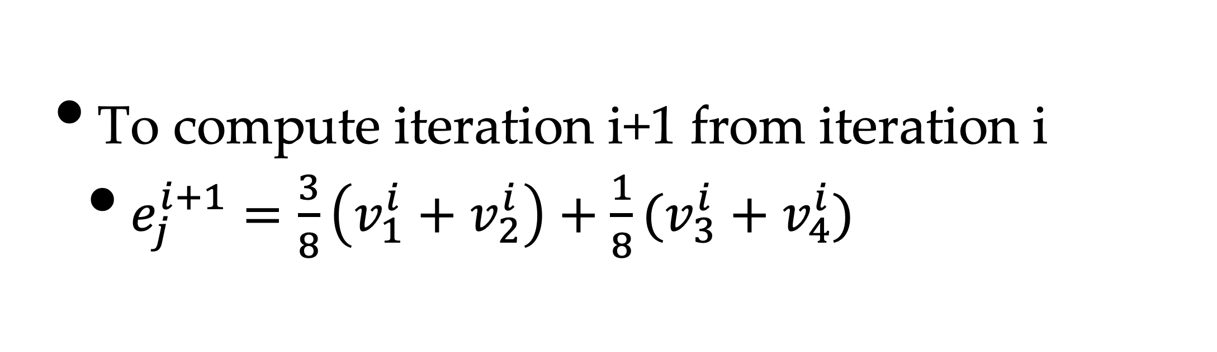
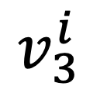
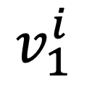
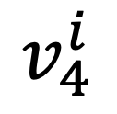
Edge Vertex Computation
$$v_{2}^{i}$$
$$v_{3}^{i}$$
$$v_{4}^{i}$$
$$e_{j}^{i+1}$$
$$v_{1}^{i}$$
To compute iteration i+1 from iteration i
$e_{j}^{i+1}=\frac{3}{8}\left(v_{1}^{i}+v_{2}^{i}\right)+\frac{1}{8}(v_{3}^{i}+v_{4}^{i})$

Slide 25
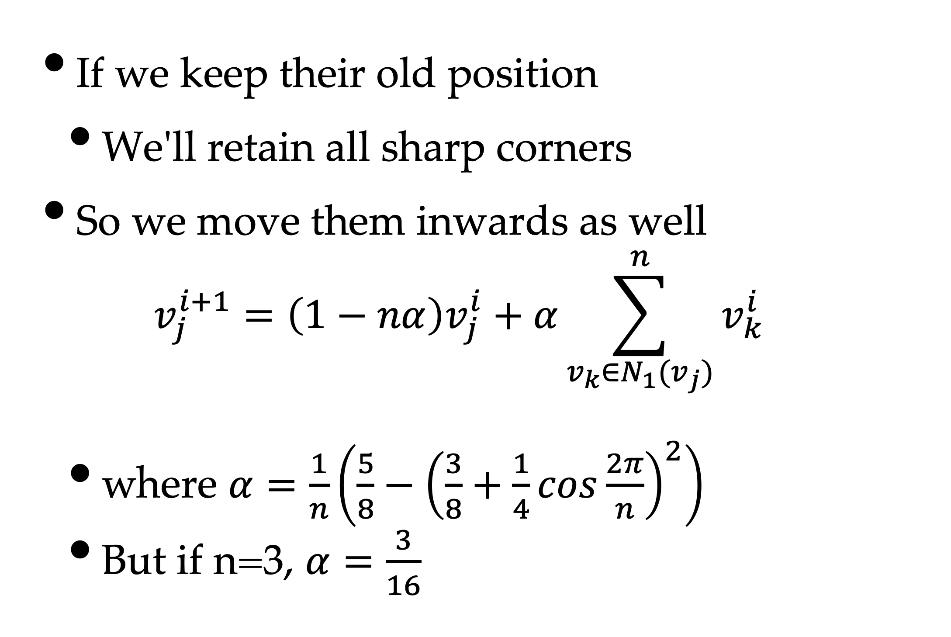
Original Vertices
If we keep their old position
We'll retain all sharp corners
So we move them inwards as well
$$v_{j}^{i+1}=\left(1−nα\right)v_{j}^{i}+α\sum_{v_{k}∈N_{1}(v_{j})}^{n}{v_{k}^{i}}$$
where $α=\frac{1}{n}\left(\frac{5}{8}−{\left(\frac{3}{8}+\frac{1}{4}cos\frac{2π}{n}\right)}^{2}\right)$
But if n=3, $α=\frac{3}{16}$

Slide 26
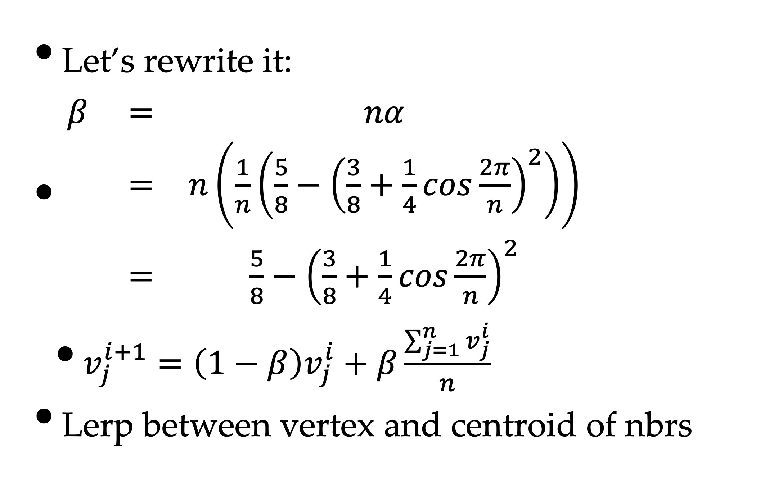
Why This Formula?
Let’s rewrite it:
$\begin{matrix}β & = & nα \\ & = & n\left(\frac{1}{n}\left(\frac{5}{8}−{\left(\frac{3}{8}+\frac{1}{4}cos\frac{2π}{n}\right)}^{2}\right)\right) \\ & = & \frac{5}{8}−{\left(\frac{3}{8}+\frac{1}{4}cos\frac{2π}{n}\right)}^{2}\end{matrix}$
$v_{j}^{i+1}=\left(1−β\right)v_{j}^{i}+β\frac{\sum_{j=1}^{n}{v_{j}^{i}}}{n}$
Lerp between vertex and centroid of nbrs

Slide 27
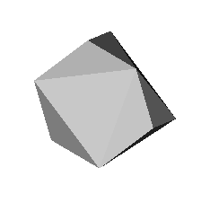
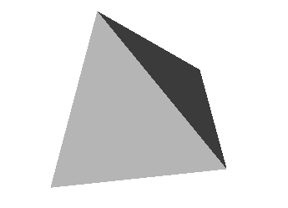
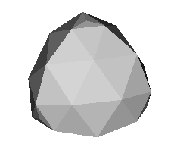
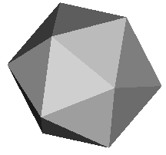
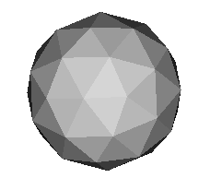
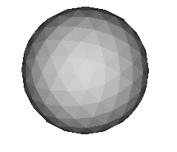
Results

Slide 28
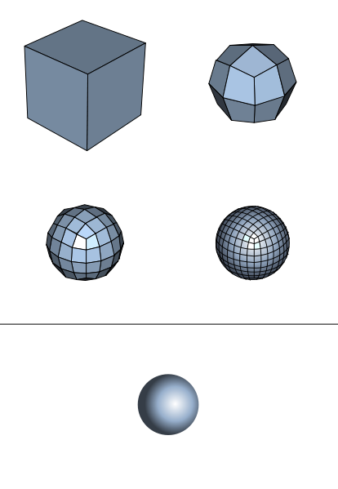
Catmull-Clark Subdivision
Start with polyhedron
Add face & edge points
fp = centroid of face
ep = midpoint of edge
Move original points in
to “average” of fp/ep
Repeat until done
(From wikipedia)

Slide 29
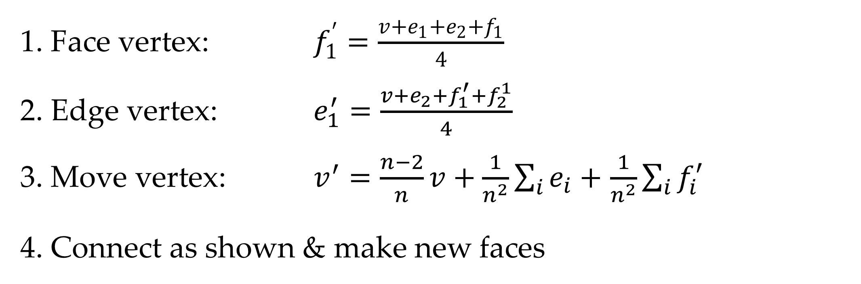
Subdivision Construction
Before
After
1. Face vertex: $f_{1}^{′}=\frac{v+e_{1}+e_{2}+f_{1}}{4}$
2. Edge vertex: $e_{1}^{′}=\frac{v+e_{2}+f_{1}^{′}+f_{2}^{1}}{4}$
3. Move vertex: $v^{′}=\frac{n−2}{n}v+\frac{1}{n^{2}}\sum_{i}^{ }{e_{i}}+$ $\frac{1}{n^{2}}\sum_{i}^{ }{f_{i}^{′}}$
4. Connect as shown & make new faces

Slide 30
Subdivision Properties
After one subdivision, it’s a quad mesh
New vertices are degree 4
Quads are divided into 4 smaller quads
Limit surface is a cubic B-spline patch
At least near vertices of degree 4
Other vertices are extraordinary
We can edit mesh at each level

Slide 31
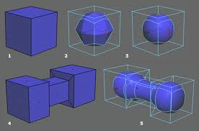
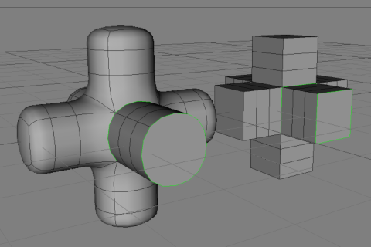
General Subdivisions
Many ways of doing this
All basically the same
Start with coarse version
Refine with extra points
Adjust point locations
End with limit surface
blendernewbies.com
madsie.com

