Slide 1
01: Calculus & Linear Algebra
Dr. Hamish Carr

Slide 2
Contents
Functions
Differentiation
Integration
Vector Spaces
Matrix Multiplication

Slide 3
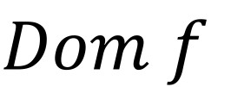
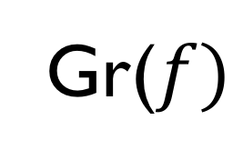

Graph of a Function
Gr($f)$
Ran$f$
$$Dom f$$
$$Gr\left(f\right)=\{\left(x,y\right):x∈Dom f, y=f(x)∈Ran f\}$$
Set of points defined by the function
Notice we are now in 2-D
The embedding space of the graph

Slide 4
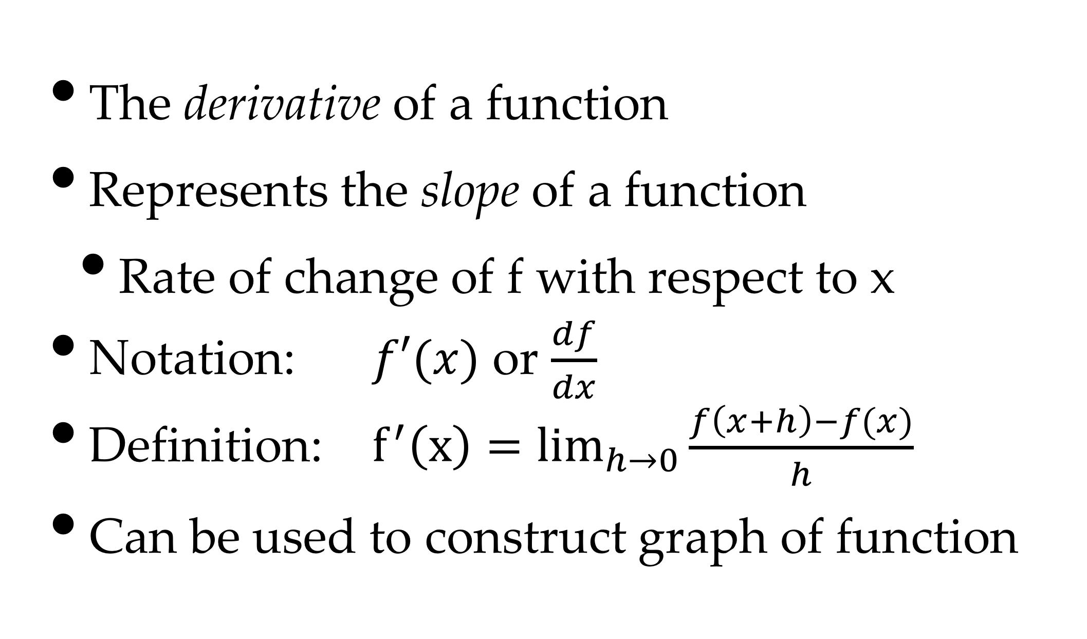
Differential Calculus
The derivative of a function
Represents the slope of a function
Rate of change of f with respect to x
Notation: $f′(x)$ or $\frac{df}{dx}$
Definition: $f^{′}\left(x\right)=\lim_{h→0}{\frac{f\left(x+h\right)−f(x)}{h}}$
Can be used to construct graph of function

Slide 5
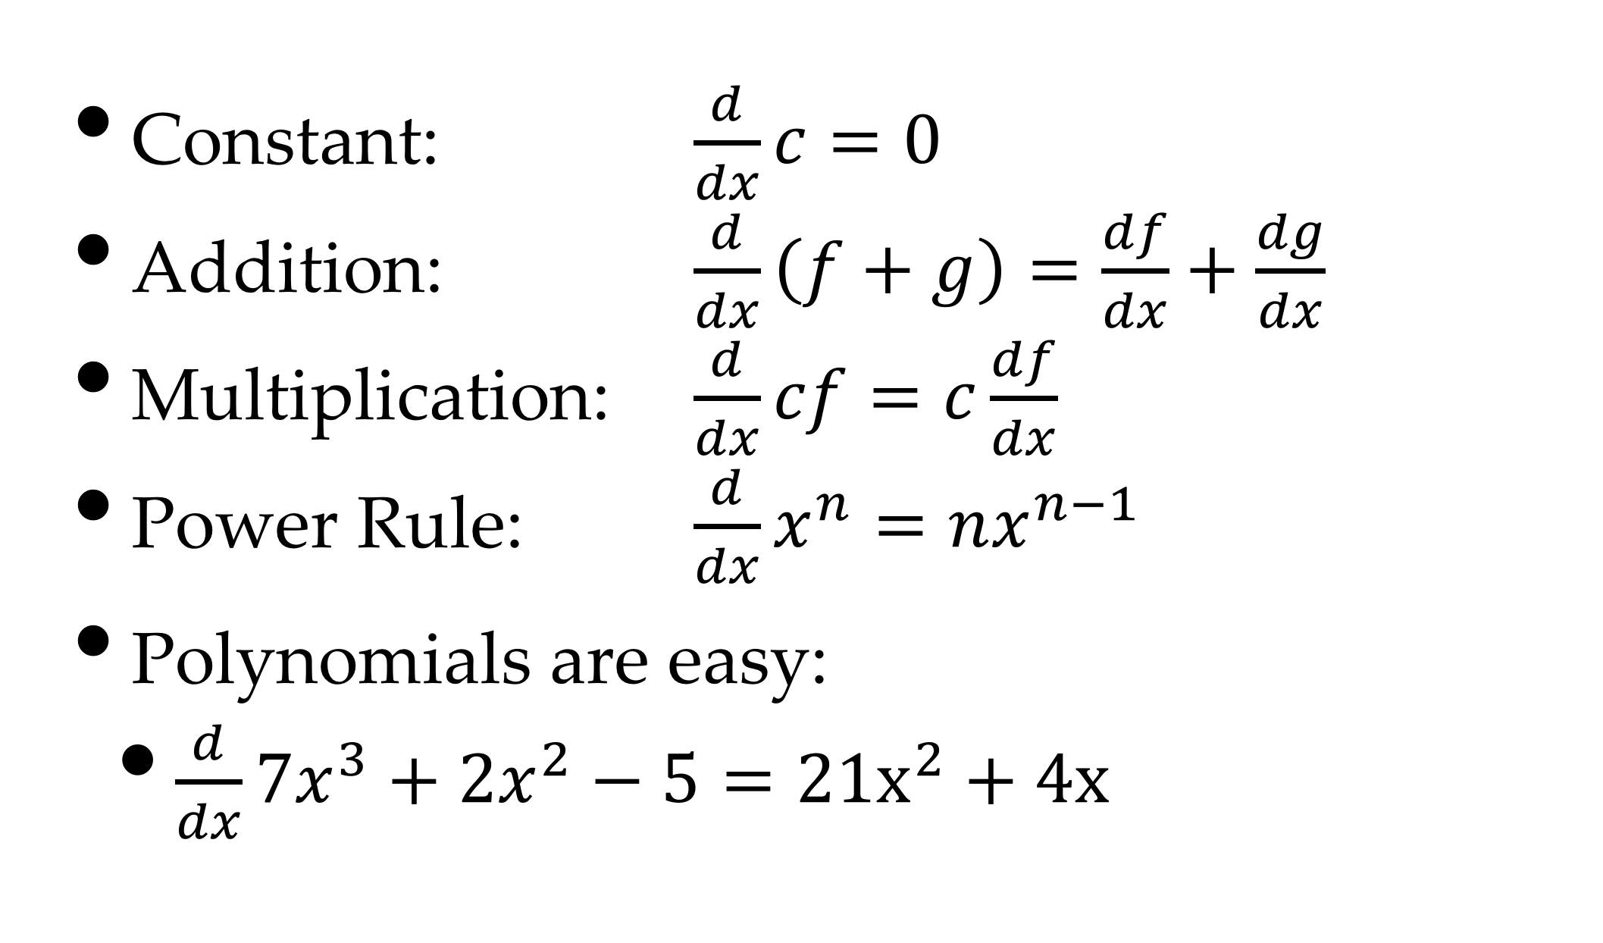
Rules of Differentiation
Constant: $\frac{d}{dx}c=0$
Addition: $\frac{d}{dx}\left(f+g\right)=\frac{df}{dx}+\frac{dg}{dx}$
Multiplication: $\frac{d}{dx}cf=c\frac{df}{dx}$
Power Rule: $\frac{d}{dx}x^{n}=nx^{n−1}$
Polynomials are easy:
$\frac{d}{dx}7x^{3}+2x^{2}−5=21x^{2}+4x$

Slide 6
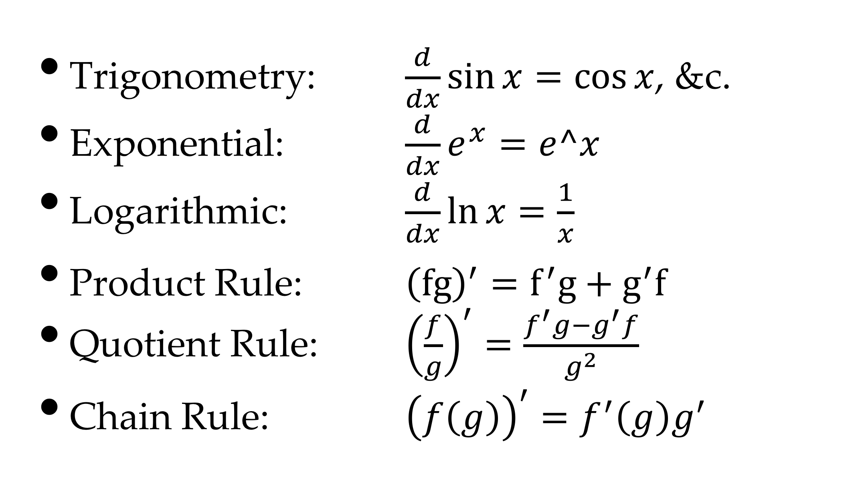
More Rules
Trigonometry: $\frac{d}{dx}\sin{x}=cos⁡x$, &c.
Exponential: $\frac{d}{dx}e^{x}=e^x$
Logarithmic: $\frac{d}{dx}\ln{x}=\frac{1}{x}$
Product Rule: ${\left(fg\right)}^{′}=f^{′}g+g^{′}f$
Quotient Rule: ${\left(\frac{f}{g}\right)}^{′}=\frac{f^{′}g−g^{′}f}{g^{2}}$
Chain Rule: ${\left(f\left(g\right)\right)}^{′}=f^{′}\left(g\right)g^{′}$

Slide 7
Sketching A Function
<
>
Partition graph into segments
Defined by roots of derivatives
Where derivative is 0 – critical points

Slide 8
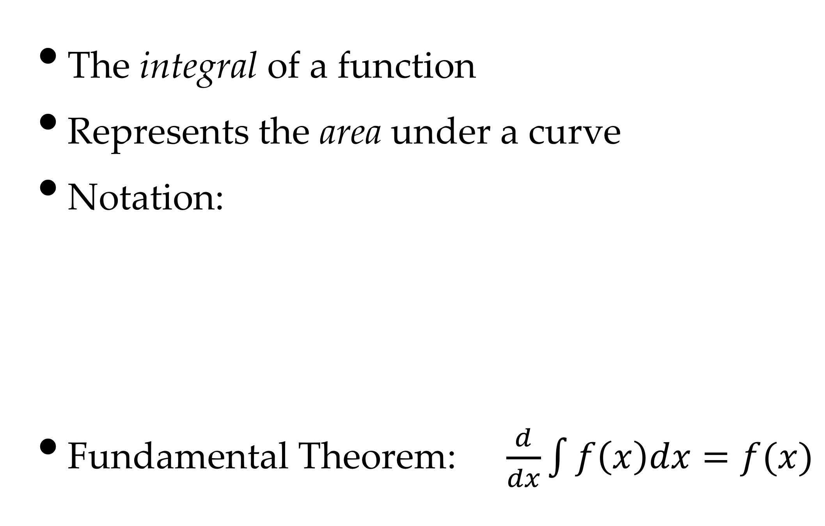

Integral Calculus
The integral of a function
Represents the area under a curve
Notation:
Fundamental Theorem: $\frac{d}{dx}\int{f\left(x\right)dx=f(x)}$
$$dx$$

Slide 9
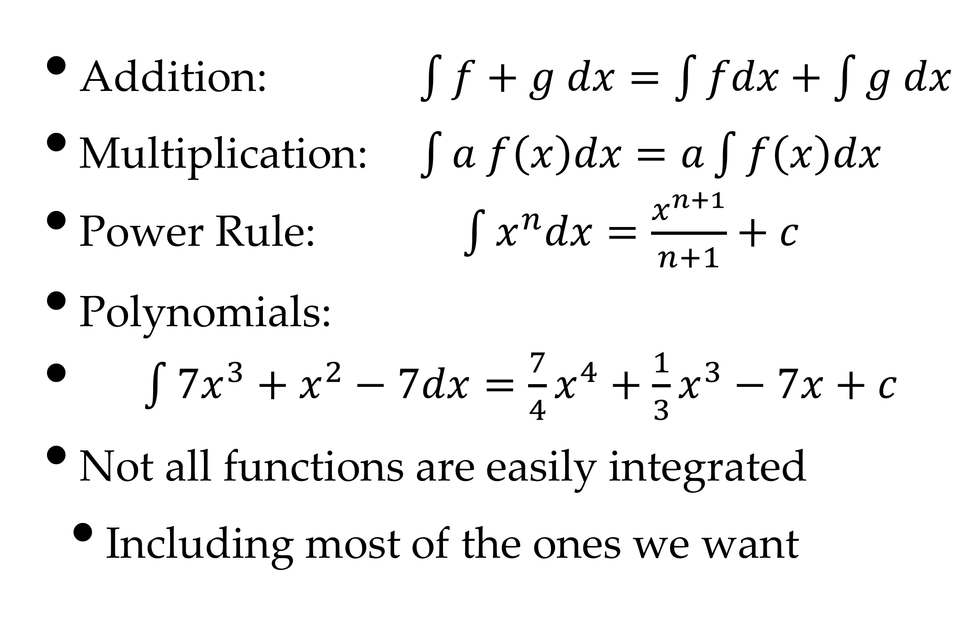
Rules of Integration
Addition: $\int{f+g dx=\int{fdx+\int{g dx}}}$
Multiplication: $\int{a f\left(x\right)dx=a\int{f\left(x\right)dx}}$
Power Rule: $\int{x^{n}dx=\frac{x^{n+1}}{n+1}+c}$
Polynomials:
$\int{7x^{3}+x^{2}−7dx=\frac{7}{4}x^{4}+\frac{1}{3}x^{3}−7x+c}$
Not all functions are easily integrated
Including most of the ones we want

Slide 10

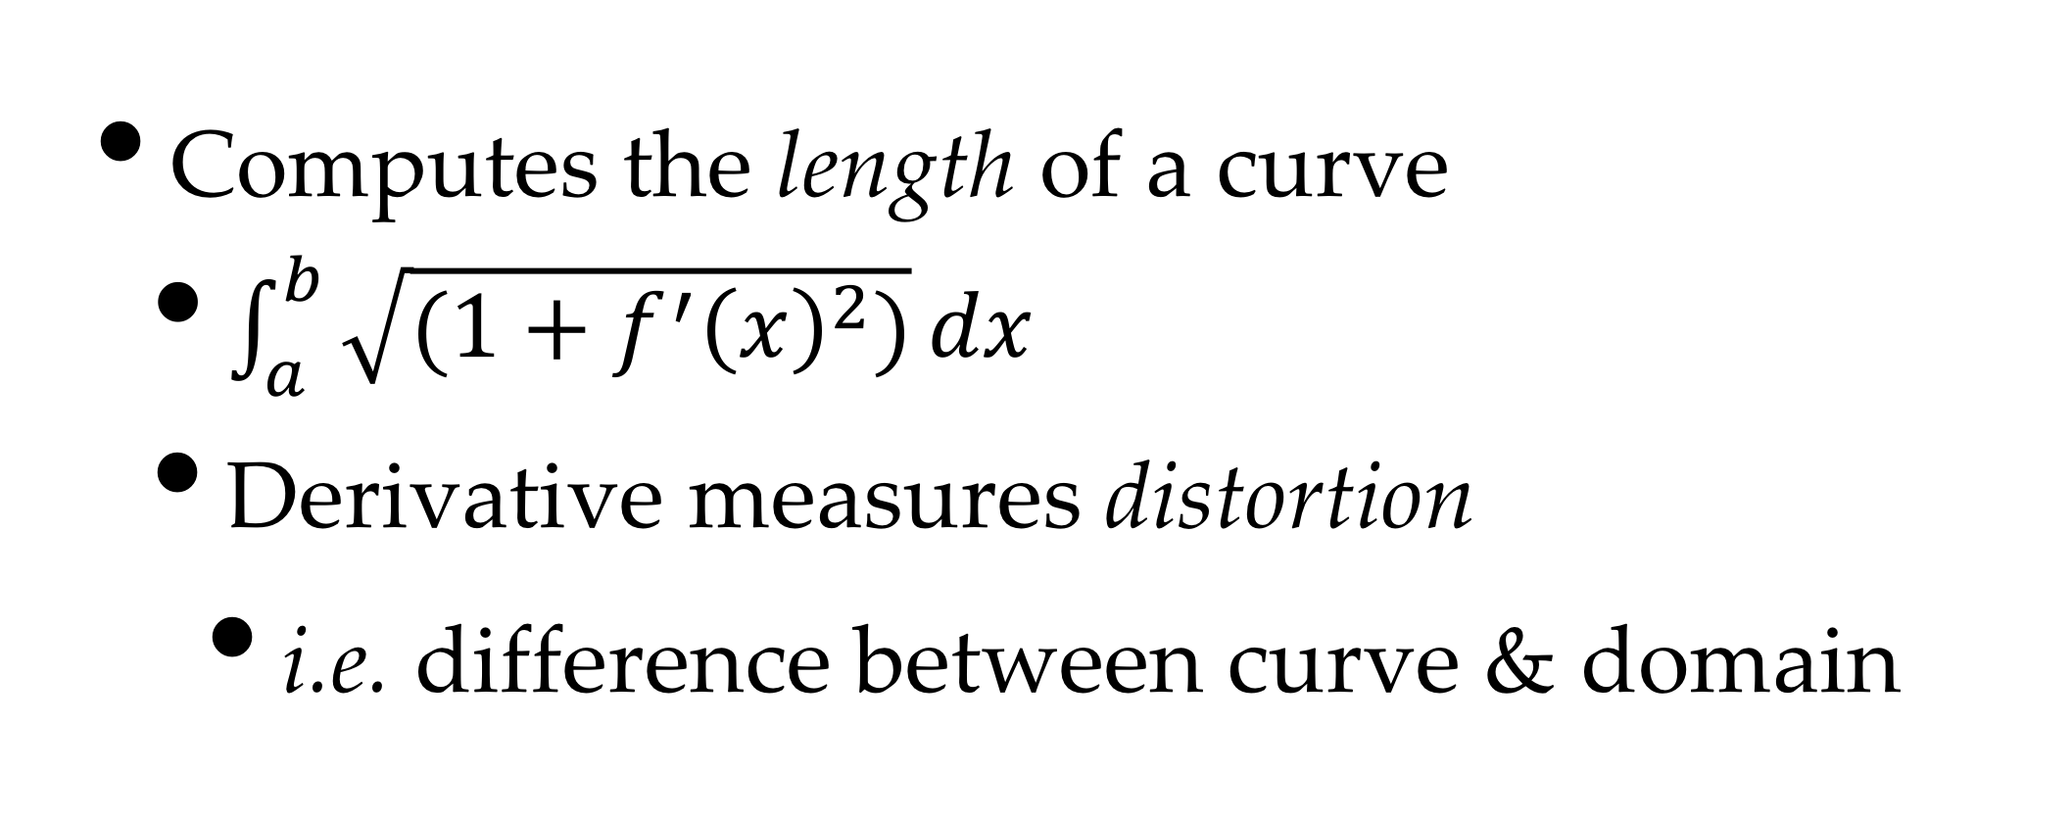
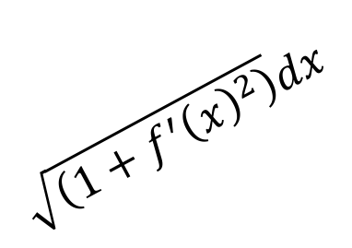

Arc-length Integral
$$\sqrt{\left(1+f^{′}{\left(x\right)}^{2}\right)}dx$$
$$f^{′}\left(x\right)dx$$
$$dx$$
Computes the length of a curve
$\int_{a}^{b}{\sqrt{(1+f^{′}{\left(x\right)}^{2})}}dx$
Derivative measures distortion
i.e. difference between curve & domain

Slide 11
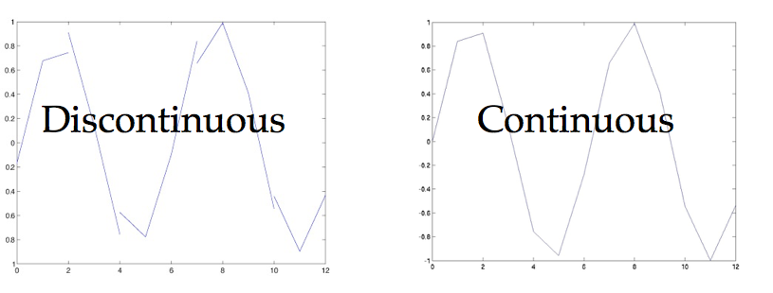
Continuity
A function f(x) is continuous at a if:
Also known as C⁰ continuous

Slide 12
Numerical Calculus
Most of our functions will not be integrable
We will approximate them numerically
There are a number of methods:
Taylor Series
Numerical Integration
Table Lookup

Slide 13
Taylor Series
For any function f(x)
We choose an easy value for a.
For example, look at cosine, with a=0
Many functions converge slowly

Slide 14
Numerical Integration
We just go back to our summation:
And choose a small
The rest is standard numerical computation

Slide 15
Table Lookup
A lot of computations are reused
e.g., sin, cos, logarithm
And we may not need high accuracy
So store a lookup table
an array with (e.g.) 1024 values
Then just take the closest value
This runs a lot faster

Slide 16


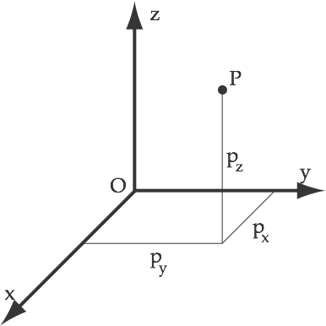


Cartesian Coordinates
A point p is a set of coordinates
distance parallel to x
distance parallel to y
distance parallel to z
relative to the origin O
Vectors & points use the same mathematics
Only the semantics are different

Slide 17
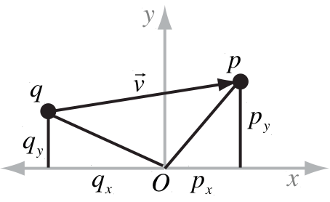
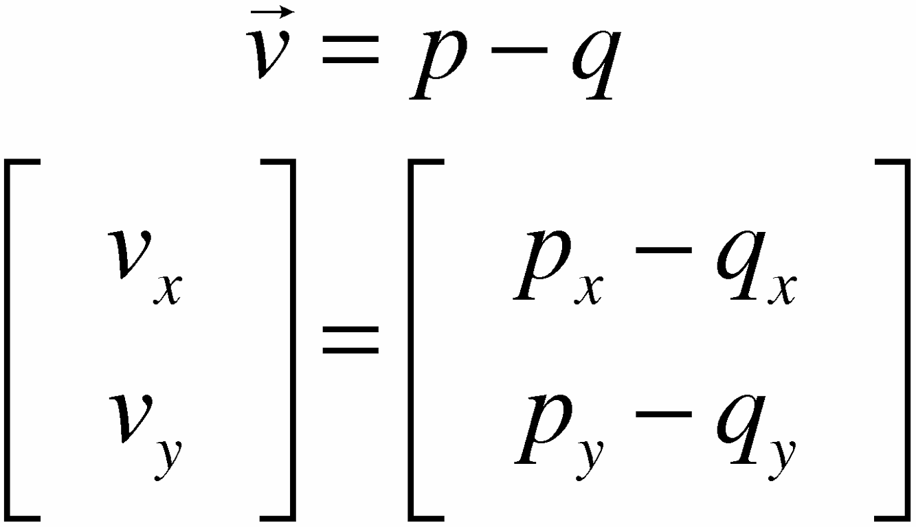
Vectors
A vector measures direction and distance between two points
Obtained by subtracting tail q from head p

Slide 18
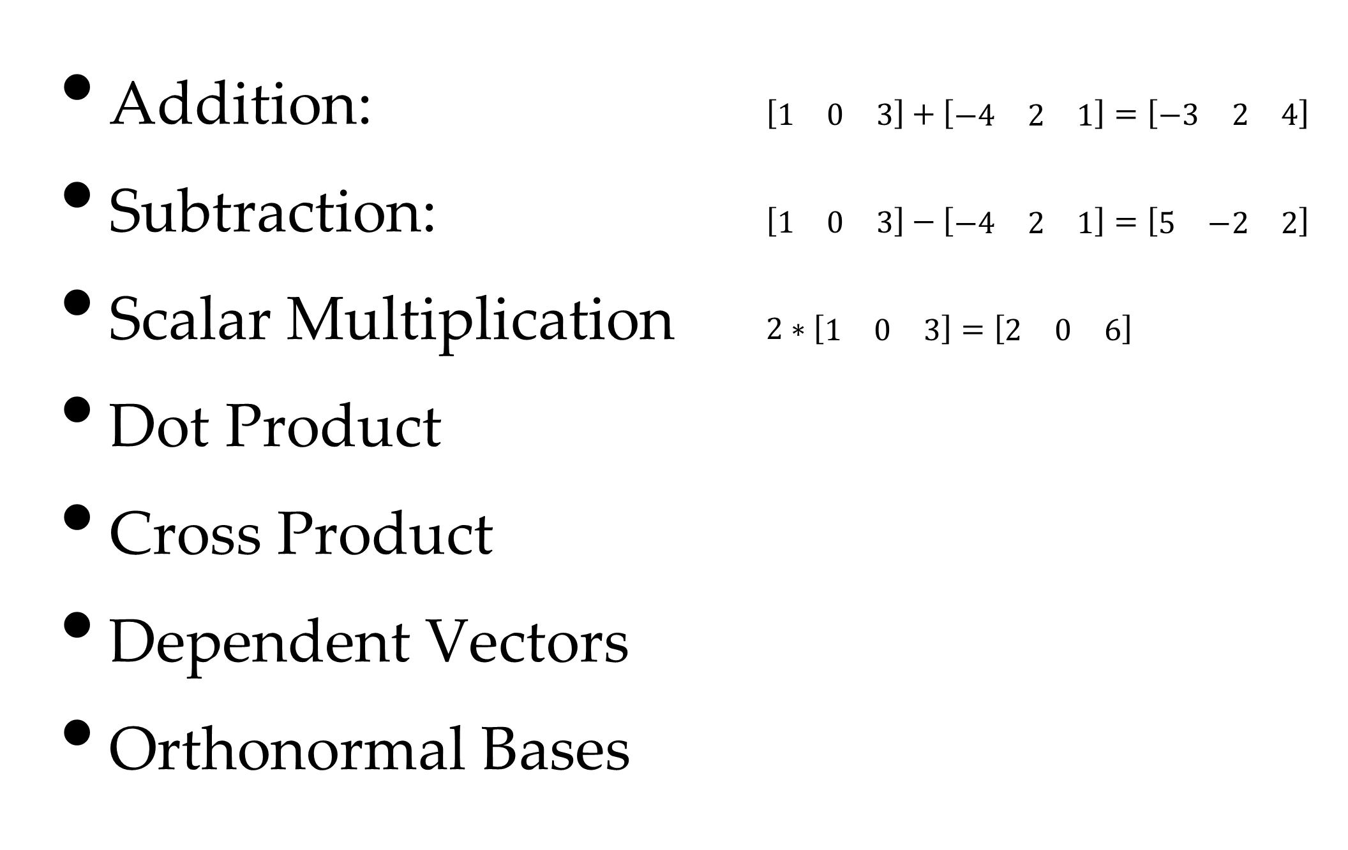
Operations
Addition: $\left[\begin{matrix}1 & 0 & 3\end{matrix}\right]+\left[\begin{matrix}−4 & 2 & 1\end{matrix}\right]=\left[\begin{matrix}−3 & 2 & 4\end{matrix}\right]$
Subtraction: $\left[\begin{matrix}1 & 0 & 3\end{matrix}\right]−\left[\begin{matrix}−4 & 2 & 1\end{matrix}\right]=\left[\begin{matrix}5 & −2 & 2\end{matrix}\right]$
Scalar Multiplication $2∗\left[\begin{matrix}1 & 0 & 3\end{matrix}\right]=\left[\begin{matrix}2 & 0 & 6\end{matrix}\right]$
Dot Product
Cross Product
Dependent Vectors
Orthonormal Bases

Slide 19
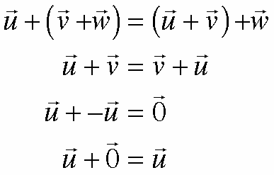
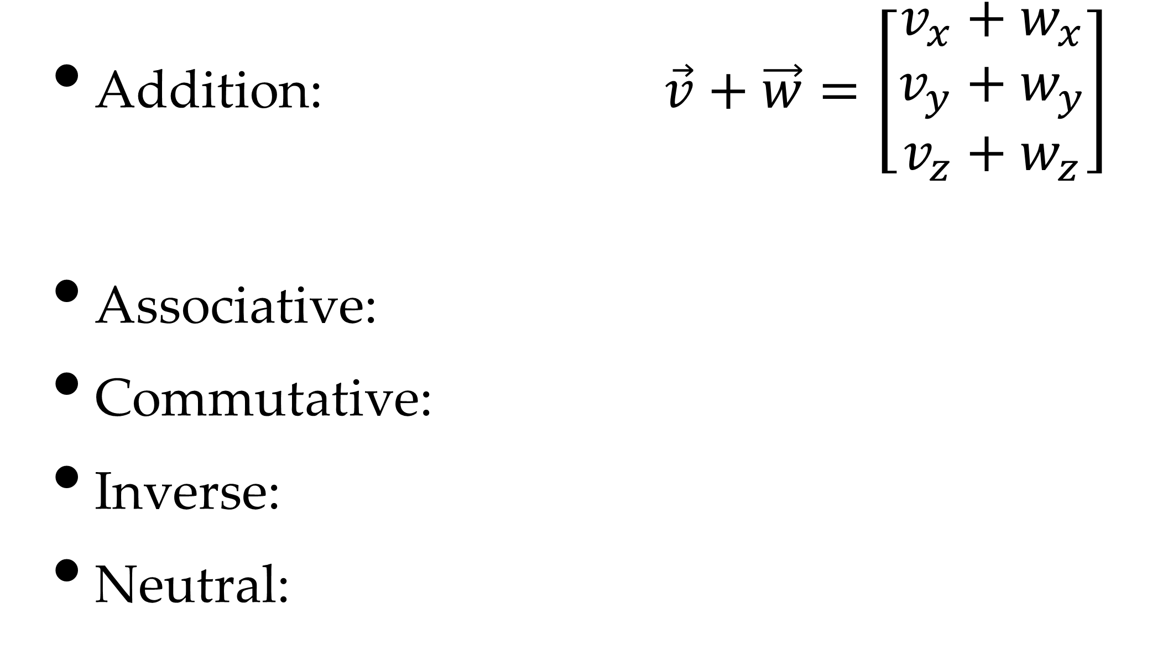
Addition / Subtraction
Addition: $\vec{v}+\vec{w}=\left[\begin{matrix}v_{x}+w_{x} \\ v_{y}+w_{y} \\ v_{z}+w_{z}\end{matrix}\right]$
Associative:
Commutative:
Inverse:
Neutral:

Slide 20
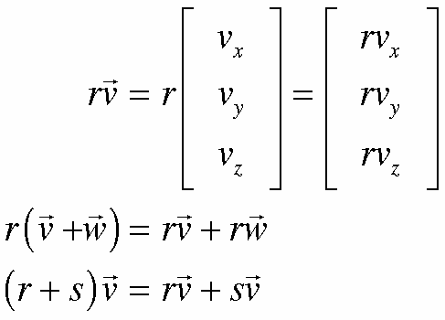
Scalar Multiplication
Multiply each coordinate
distributive

Slide 21
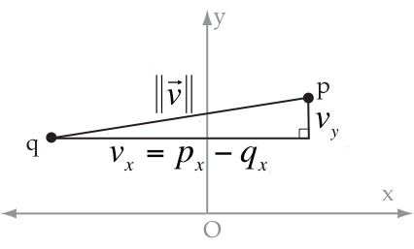




Vector Length (Magnitude)
Using Pythagoras
Scalar multiplication:
Triangle Inequality:

Slide 22
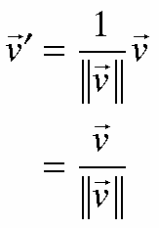
Normalized Vectors
A normalized vector has length of 1
Multiply vector by inverse of length:

Slide 23
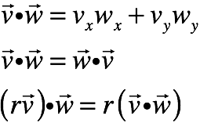
Dot Product
Also called scalar or inner product:
Computes a scalar from two vectors:
commutative
distributive
VERY useful

Slide 24



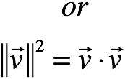
Short-cut for Length

Slide 25
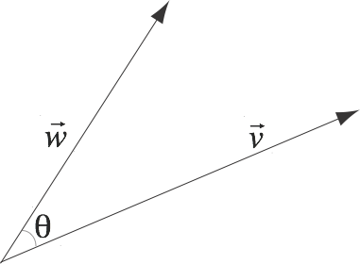
Angle Between Vectors
What’s the angle between two vectors?

Slide 26
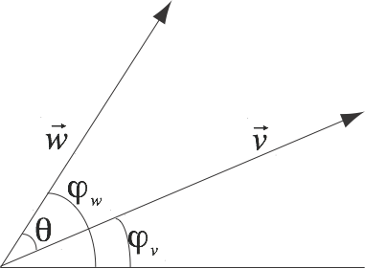
First Step

Slide 27
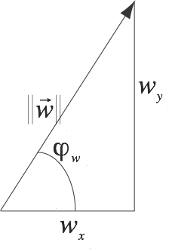
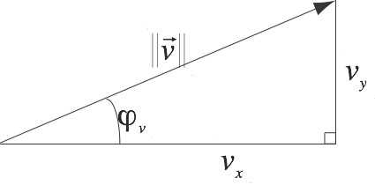
Sines & Cosines

Slide 28
Dot Product Form

Slide 29

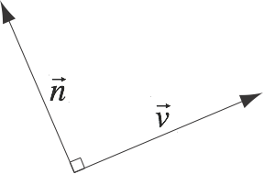

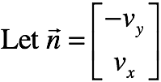

Normal Vectors
A normal vector is perpendicular to v

Slide 30
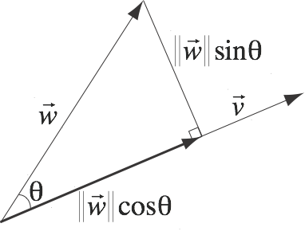
Projection

Slide 31

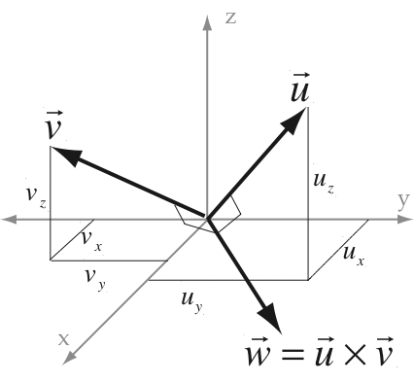
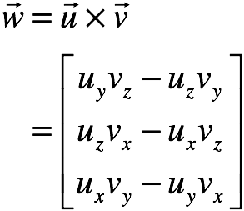
Cross-Product
Computes perpendicular to
in a right-hand system
Extremely useful!!

Slide 32
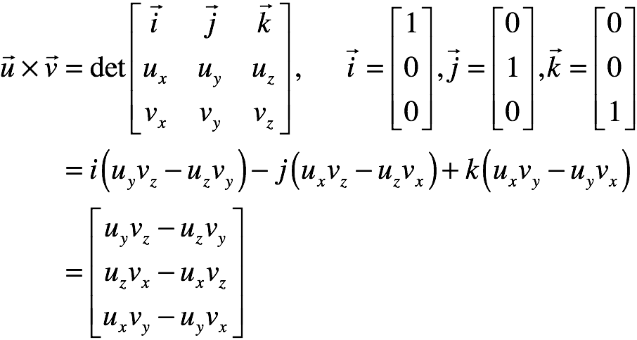
Alternate Form
Can also be written as a determinant

Slide 33
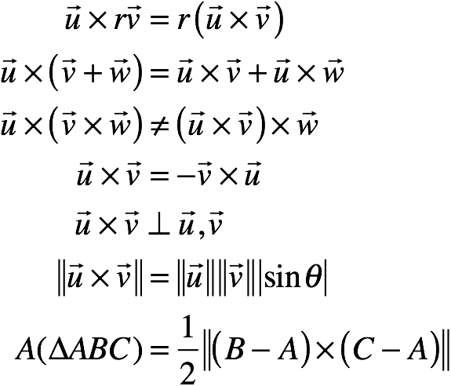
Properties
Distributive
NOT associative
anti-commutative
Normal to u and v
Related to sine of θ
Area of triangle in 2D

Slide 34
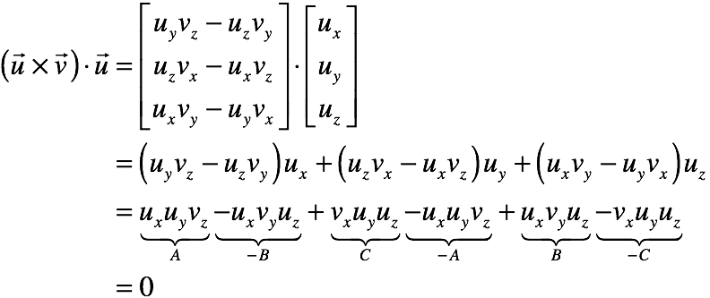
Perpendicularity

Slide 35
Lines in 3-D
A bit trickier than in 2-D
Explicit form: y, z depend on x
Implicit form: x, y, z satisfy equations
Normal form: doesn’t exist
Parametric form: x, y, z depend on t

Slide 36
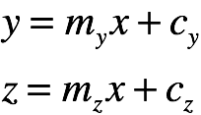
Explicit Form
y, z are functions of x:
Might as well use parametric form
Still doesn’t work for vertical lines

Slide 37
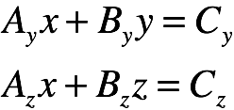
Implicit Form
Two equations:
Again, parametric is easier

Slide 38
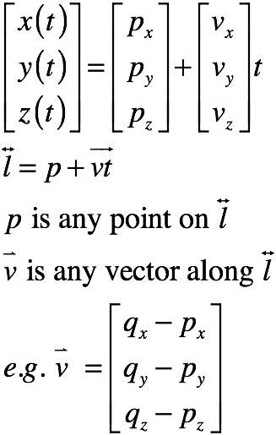
Parametric Form
Same as in 2-D
defined by:
a point p
a vector v

Slide 39
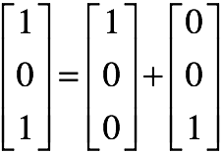
Dependent Vectors
Dependent vectors depend on each other
I.e. they are redundant
you don’t need all of them

Slide 40
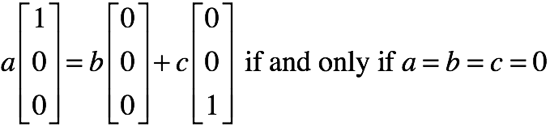
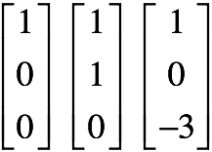
Independent Vectors
Vectors that are not dependent
A basis is a set of 3 independent 3-D vectors

Slide 41
Orthonormal Basis
A normal basis is a basis of unit vectors
An orthogonal basis is a basis of mutually perpendicular vectors
An orthonormal basis is a basis of mutually perpendicular unit vectors
I.e. a set of axes for a coordinate system

Slide 42
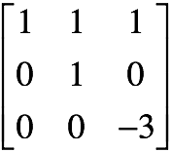
Matrices
Rectangular arrays of numbers
we will always use square ones
And we can define operations with them

Slide 43
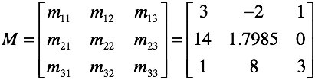
Notation
Matrices are always in square brackets
The entries are indexed by row & column

Slide 44
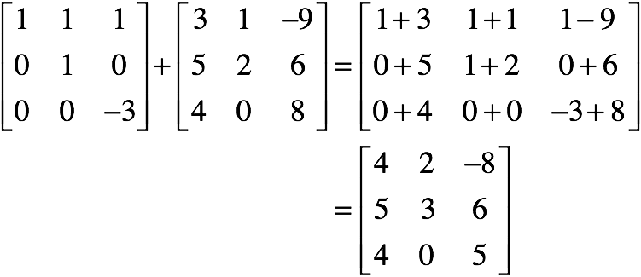
Matrix Addition
Like vectors, just add the elements

Slide 45
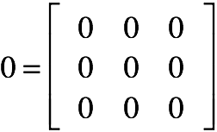
Additive Identity
There is a zero matrix
adding it to a matrix does nothing

Slide 46
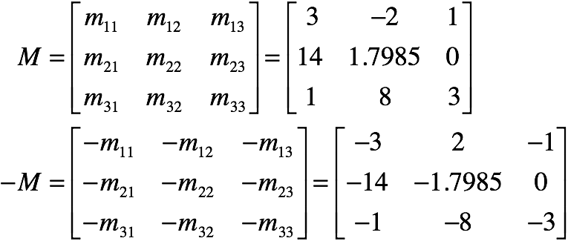

Additive Inverse
The negative of a matrix

Slide 47
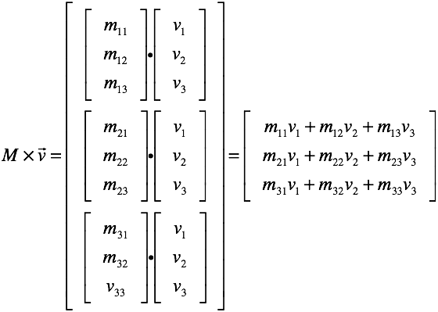
Matrix-Vector Multiplication
For each row of matrix
compute dot product with vector
gives one coordinate of result

Slide 48
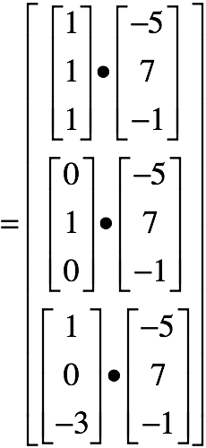
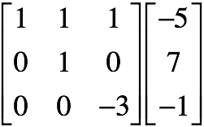

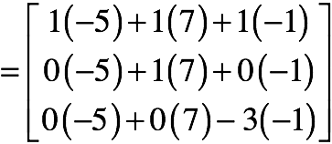
Example

Slide 49
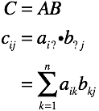
Matrix Multiplication
Similar to what we’ve just seen
Take a row i of A and a column j of B
Put their dot product at their intersection

Slide 50




Matrix Multiplication (2x2)

Slide 51




The Other Way Round

Slide 52


Oops . . .
Like subtraction, the order matters
worse, we don’t get the opposite result

Slide 53

Multiplicative Identity
The identity matrix
multiplying by it does nothing

Slide 54

Matrix Division
Can we divide by a matrix?
Yes, if we multiply by the inverse
the equivalent of 1/x
hard to calculate in general
easy for the ones we will use
exists only for square matrices

Slide 55

Matrix Transpose
Flips a matrix along it’s diagonal
Useful for calculating inverses

