Slide 1

Reusable Metadata Authoring Pipeline
KoboToolbox → SSSOM → schema.org/SOSO JSON-LD
DAVID AMADI

Slide 2






The problem: two metadata languages that don't talk
KoboToolbox captures dataset metadata in its own field structure. Schema.org / Science-on-Schema.org is what catalogs and OHDSI tools expect. A crosswalk must translate — reliably, repeatably, without inventing facts.
The analogy: the raw Kobo JSON is one language, Schema.org is another, and the SSSOM file is the translation dictionary and instruction sheet between them.
{ }
SSSOM crosswalk
Kobo JSON
Schema.org / SOSO
source language
translation dictionary + rulebook
target language
Hand-mapping is brittle
AI alone hallucinates
Catalogs need consistency
Re-mapping each record by hand duplicates effort, drifts, and breaks.
LLMs invent JSONPaths and Schema.org properties that don't exist
Every record from a form maps the same way, auditably.
2/10

Slide 3
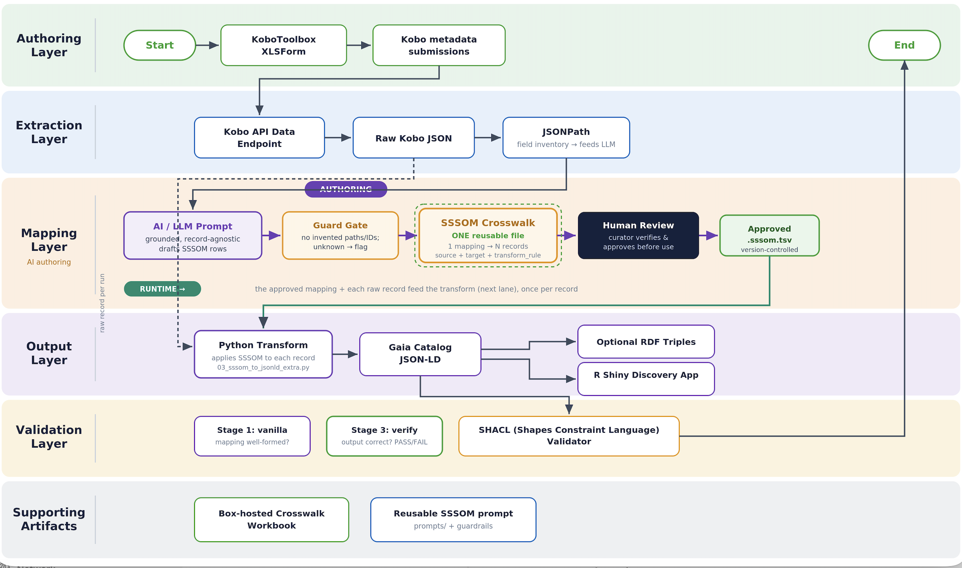
The workflow

Slide 4


Anatomy of the SSSOM mapping file
A single .sssom.tsv contains a YAML-style header and a tab-separated mapping table.
Part A: YAML header
Part B: mapping rows — 13 columns in 4 families
Declares namespaces, extension columns, mapping-set identity, title, description, and the mapping-file licence.
Semantic decision
Human labels
Executable instructions
Categories & provenance
subject_id
predicate_id
object_id
confidence
subject_label
object_label
comment
source_jsonpath
target_jsonpath
transform_rule
subject_category
object_category
mapping_justification
# curie_map:
# schema: https://schema.org/
# skos: .../skos/core#
# extension_definitions:
# - source_jsonpath
# mapping_set_title: "…"
Current prompt = 13 confirmed TSV columns. Proposed extension = property_decision_rationale for property-choice reasoning. Every field row must use subject_category = owl:ObjectProperty — any other value is silently skipped by the transformer.
YAML caution quote titles/descriptions when punctuation appears.
Example mapping row
kobo:license → schema:license | owl:ObjectProperty | $.datasets[*]['dublin_core_group/license'] → $.license | license_code_to_uri
AI-assisted SSSOM mapping workflow · KoboToolbox → Schema.org / Science-on-Schema.org JSON-LD
4/10

Slide 5


How each row is derived
Read from the source, write to the target — the gap between them names the transform.
WHERE FROM
WHERE TO
HOW
WHY
source_jsonpath
target_jsonpath
transform_rule
comment
$.datasets[*] + the exact Kobo key (+ [*] for a group)
$ + the Schema.org property you chose
same shape→string · code→URI · group→object array
human reasoning + any hidden sub-fields
Two real rows from record 136
string (direct copy)
$.datasets[*]['dublin_core_group/title'] → $.name
Kobo title is the Schema.org Dataset name.
license_code_to_uri (transform)
$.datasets[*]['dublin_core_group/license'] = "cc_by" → https://creativecommons.org/licenses/by/4.0/
Code expanded via the profile's license map, not copied literally.
AI-assisted SSSOM mapping workflow · KoboToolbox → Schema.org / Science-on-Schema.org JSON-LD
5/10

Slide 6





Next: one reusable SSSOM for many records
Move from a separate mapping file per record to a single form-level mapping reused across every submission.
Today — one file per record
Next — one reusable form mapping
record_136 → sssom_136 → output_136
record_217 → sssom_217 → output_217
record_26 → sssom_26 → output_26
record_136 ┐
record_217 ┼→ reusable_form.sssom.tsv → many outputs
record_26 ┘
Same 24 rules duplicated; files drift; a fix must be repeated everywhere.
One mapping covers the whole form; new records need no new file.
No drift
One fix, everywhere
Conditional logic
One source of truth for the form's rules.
Correct a rule once; every record benefits.
Vector vs raster handled by conditions, not separate files.
AI-assisted SSSOM mapping workflow · KoboToolbox → Schema.org / Science-on-Schema.org JSON-LD
8/10

Slide 7
Results: one mapping, three records
The same file run across vector and raster records — verified clean.
Record
Type
keys
varMeasured
creativeWorkStatus
Verify
136
vector (polygon)
26
11
draft
PASS
26
vector (point)
24
12
— (absent)
PASS
217
raster
23
1
published
PASS
One mapping produced valid JSON-LD for vector AND raster.
Reusable SSSOM mapping · KoboToolbox → Schema.org / Science-on-Schema.org JSON-LD
8/15

