Slide 1

Reusable Metadata Authoring Pipeline
KoboToolbox → SSSOM → Schema.org/SOSA JSON-LD
DAVID AMADI

Slide 2






The problem: two metadata languages that don't talk
KoboToolbox captures dataset metadata in its own field structure. Schema.org / Science-on-Schema.org is what catalogs and OHDSI tools expect. A crosswalk must translate — reliably, repeatably, without inventing facts.
The analogy: the raw Kobo JSON is one language, Schema.org is another, and the SSSOM file is the translation dictionary and instruction sheet between them.
{ }
SSSOM crosswalk
Kobo JSON
Schema.org / SOSO
source language
translation dictionary + rulebook
target language
Hand-mapping is brittle
AI alone hallucinates
Catalogs need consistency
Re-mapping each record by hand duplicates effort, drifts, and breaks.
LLMs invent JSONPaths and Schema.org properties that don't exist
Every record from a form maps the same way, auditably.
2/8

Slide 3
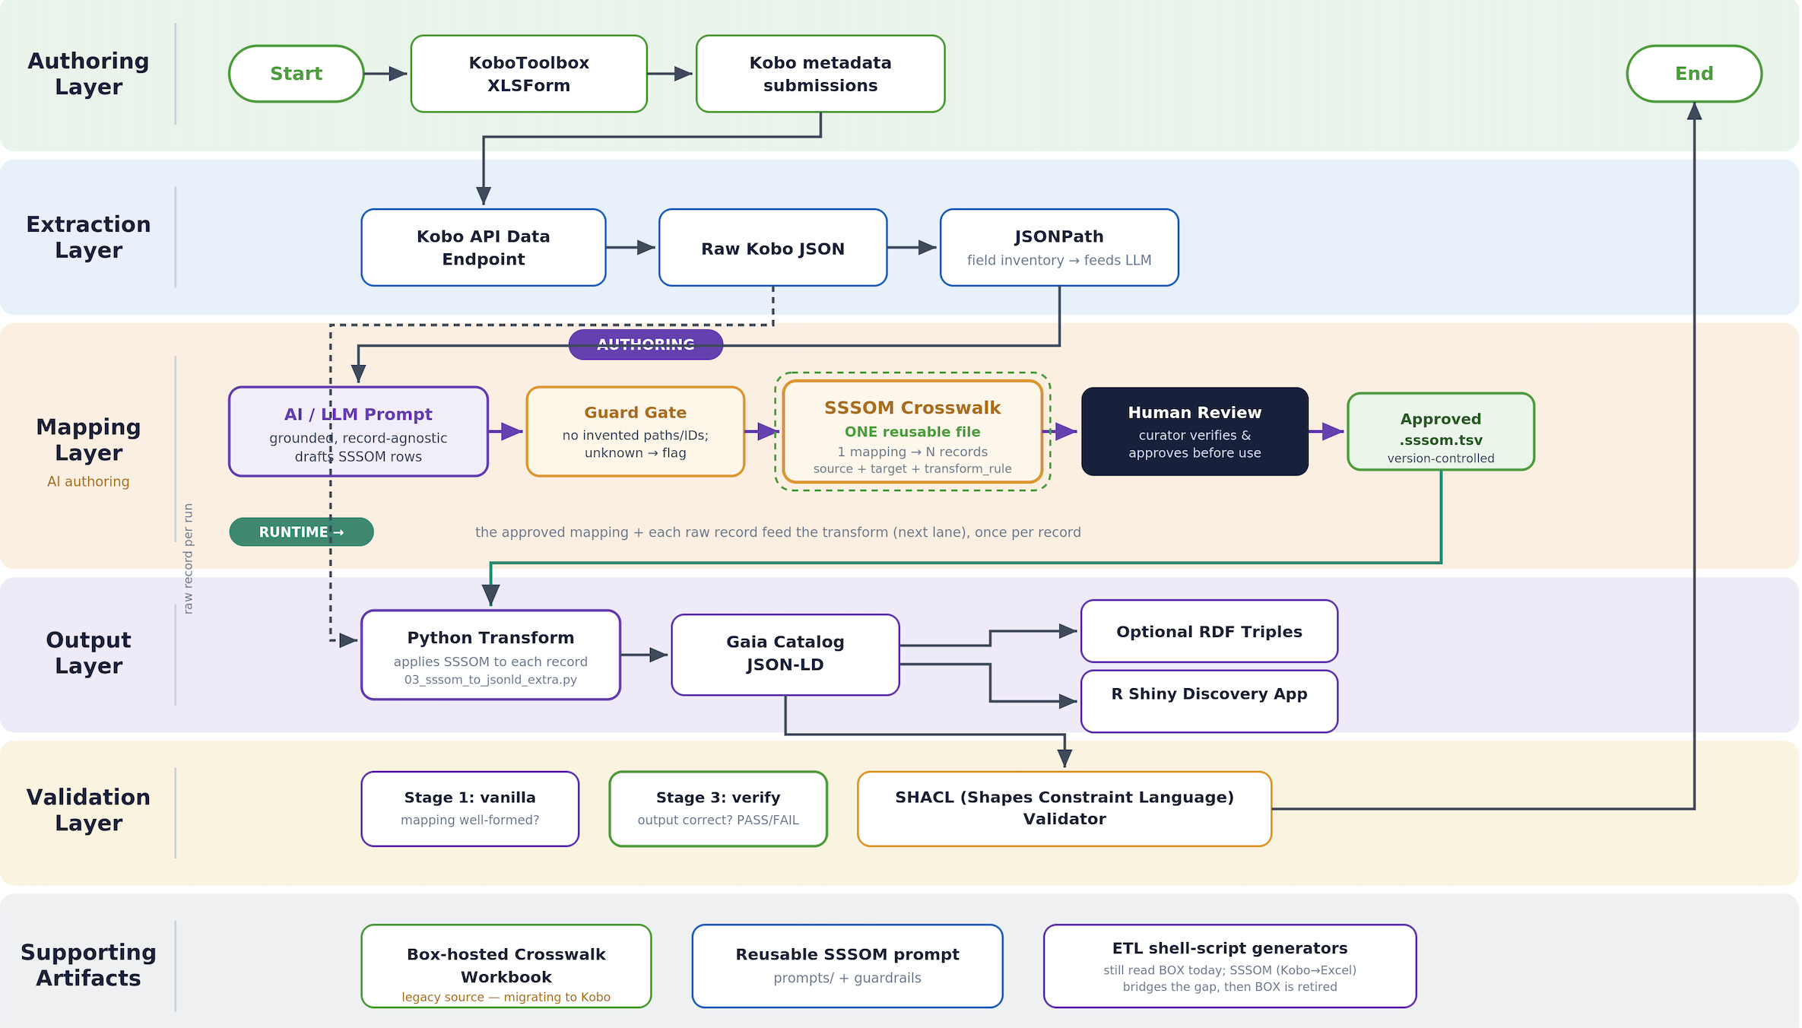
The workflow

Slide 4
SSSOM Mapping at a Glance
A three-column table uses JSONPaths to create a map between two JSON files — a source and a target.
i
JSONPath is a way of expressing where an element sits in a JSON file.
The table maps a source JSON to a target JSON.
Source JSON
The 3-Column Table (SSSOM)
Target JSON
(e.g., KoboToolbox export)
(e.g., Schema.org JSON-LD)
{
"datasets": [{
"id": "136",
"title": "PM2.5",
"description":
"Air quality",
"license": "cc_by",
"keywords": ["air"],
"spatial": {"extent":
{"bbox":[-80.5,
25.7]}},
"contacts": [{"name":
"Jane Doe"}]
}]
}
1. source_jsonpath where the data comes from | 2. relationship source-to-target match | 3. target_jsonpath where the data goes
$.datasets[*].id | one-to-one | $.@id
$.datasets[*].title | one-to-one | $.name
$.datasets[*].description | one-to-one | $.description
$.datasets[*].license | one-to-one | $.license
$.datasets[*].keywords[*] | one-to-many | $.keywords[*]
$.datasets[*].contacts[*].name | one-to-many | $.creator[*].name
{
"@context":"schema.org",
"@id": "136",
"@type": "Dataset",
"name": "PM2.5",
"description":
"Air quality",
"license":".../by/4.0/",
"keywords": ["air"],
"spatialCoverage":{...},
"creator": [{"@type":
"Person","name":
"Jane Doe"}]
}
(...more rows as needed)
In the real SSSOM file…
the predicate shows the relationship,
e.g. one-to-one =
skos:exactMatch
Paths use bracketed Kobo keys.
Notes:
In short: the table is a map. The Python reads the map and builds the target JSON-LD from the source JSON.
One-to-one: Each source maps to one target…

Slide 5


Anatomy of the SSSOM mapping file
A single .sssom.tsv contains a YAML-style header and a tab-separated mapping table.
Part A: YAML header
Part B: mapping rows — 13 columns in 4 families
Declares namespaces, extension columns, mapping-set identity, title, description, and the mapping-file licence.
Semantic decision
Human labels
Executable instructions
Categories & provenance
subject_id
predicate_id
object_id
confidence
subject_label
object_label
comment
source_jsonpath
target_jsonpath
transform_rule
subject_category
object_category
mapping_justification
# curie_map:
# schema: https://schema.org/
# skos: .../skos/core#
# extension_definitions:
# - source_jsonpath
# mapping_set_title: "…"
Current prompt = 13 confirmed TSV columns. Proposed extension = property_decision_rationale for property-choice reasoning. Every field row must use subject_category = owl:ObjectProperty — any other value is silently skipped by the transformer.
YAML caution quote titles/descriptions when punctuation appears.
Example mapping row
kobo:license → schema:license | owl:ObjectProperty | $.datasets[*]['dublin_core_group/license'] → $.license | license_code_to_uri
AI-assisted SSSOM mapping workflow · KoboToolbox → Schema.org / Science-on-Schema.org JSON-LD
5/8

Slide 6


How each row is derived
Read from the source, write to the target — the gap between them names the transform.
WHERE FROM
WHERE TO
HOW
WHY
source_jsonpath
target_jsonpath
transform_rule
comment
$.datasets[*] + the exact Kobo key (+ [*] for a group)
$ + the Schema.org property you chose
same shape→string · code→URI · group→object array
human reasoning + any hidden sub-fields
Two real rows from record 136
string (direct copy)
$.datasets[*]['dublin_core_group/title'] → $.name
Kobo title is the Schema.org Dataset name.
license_code_to_uri (transform)
$.datasets[*]['dublin_core_group/license'] = "cc_by" → https://creativecommons.org/licenses/by/4.0/
Code expanded via the profile's license map, not copied literally.
AI-assisted SSSOM mapping workflow · KoboToolbox → Schema.org / Science-on-Schema.org JSON-LD
6/8

Slide 7





Next: one reusable SSSOM for many records
Move from a separate mapping file per record to a single form-level mapping reused across every submission.
Today — one file per record
Next — one reusable form mapping
record_136 → sssom_136 → output_136
record_217 → sssom_217 → output_217
record_26 → sssom_26 → output_26
record_136 ┐
record_217 ┼→ reusable_form.sssom.tsv → many outputs
record_26 ┘
The same rules are duplicated; files drift; a fix must be repeated everywhere.
One mapping covers the whole form; new records need no new file.
No drift
One fix, everywhere
Conditional logic
One source of truth for the form's rules.
Correct a rule once; every record benefits.
Vector vs raster handled by conditions, not separate files.
AI-assisted SSSOM mapping workflow · KoboToolbox → Schema.org / Science-on-Schema.org JSON-LD
7/8

Slide 8
Results: one mapping, three records
The same file run across vector and raster records — verified clean.
Record
Type
keys
varMeasured
creativeWorkStatus
Verify
136
vector (polygon)
26
11
draft
PASS
26
vector (point)
24
12
— (absent)
PASS
217
raster
23
1
published
PASS
One mapping produced valid JSON-LD for 2 vector AND 1 raster kobo form.
Reusable SSSOM mapping · KoboToolbox → Schema.org / Science-on-Schema.org JSON-LD
8/8
Notes:
Record 26 has no publication status or DOI — correctly absent, not an error. Record 217 (raster) carries fewer measured variables — expected for band data.

