Slide 1

G2M insight for Cab Investment firm
Company Name: XYZ
Location: US
Date: 21-07-2023

Slide 2

Agenda
Executive Summary
Problem Statement
Approach
EDA
EDA Summary
Hypothesis Testing
Recommendations

Slide 3
Summary:
XYZ is a private firm in US. Due to remarkable growth in the Cab Industry in last few years and multiple key players in the market, it is planning for an investment in Cab industry.
XYZ is interested in using your actionable insights to help them identify the right company to make their investment.
Cab companies:
Yellow cab
Pink Cab

Slide 4
Data Preparation:
There are 4 datasets:
Cab_Data.csv : this file contains transaction details for 2 cab companies.
Transaction_ID.csv : this dataset contains transaction data including payment mode.
Customer_ID.csv : this file contains unique customer details with identification numbers.
City.csv : this file contains list of US cities and population with the number of cab users.

Slide 5
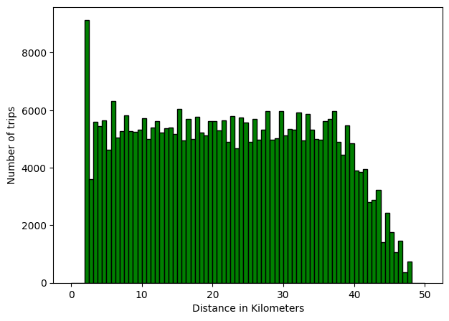
Distribution of Kilometres travelled
From the above graph we can derive that cab rides ranges between distance of 2 to 48 kms. Also count of long-distance rides drastically decreases after a ride distance of 40 kms.

Slide 6
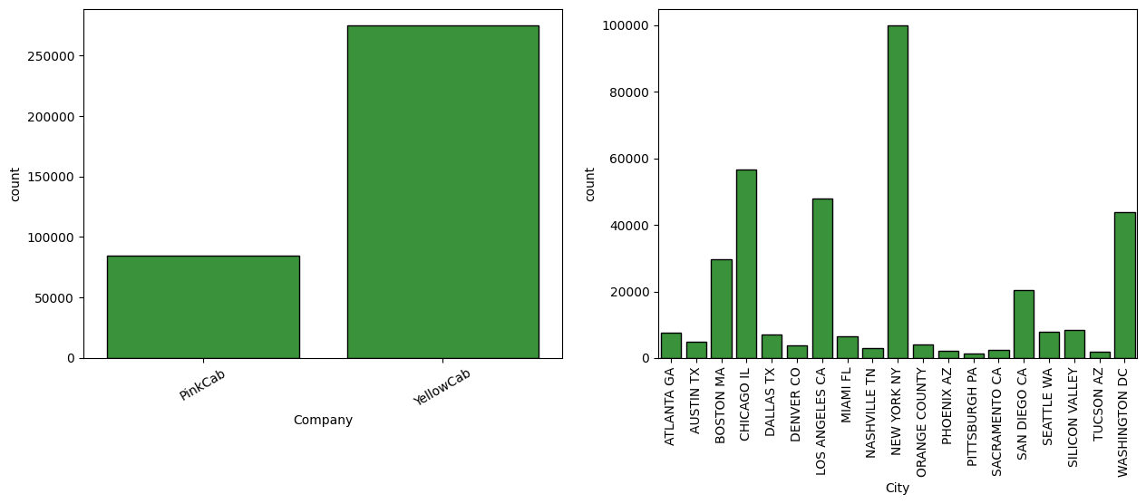
Count of pink cab rides are about 80000 and yellow cab rides is over 2.5 lakhs.
Also, the city with the largest number of cab rides is New York.

Slide 7
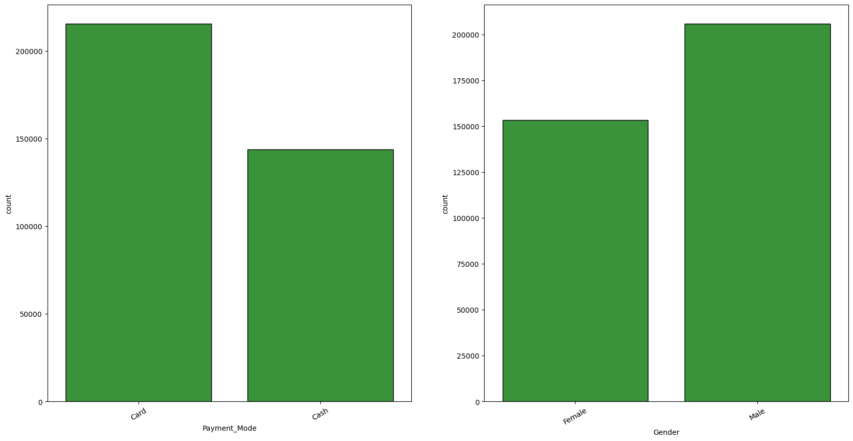
Number of card payments is over 2 lakhs whereas cash transactions are about 1.5 lakhs.
Number of Male passengers is over 2 lakhs, greater than Female passengers by about 50 thousand.

Slide 8
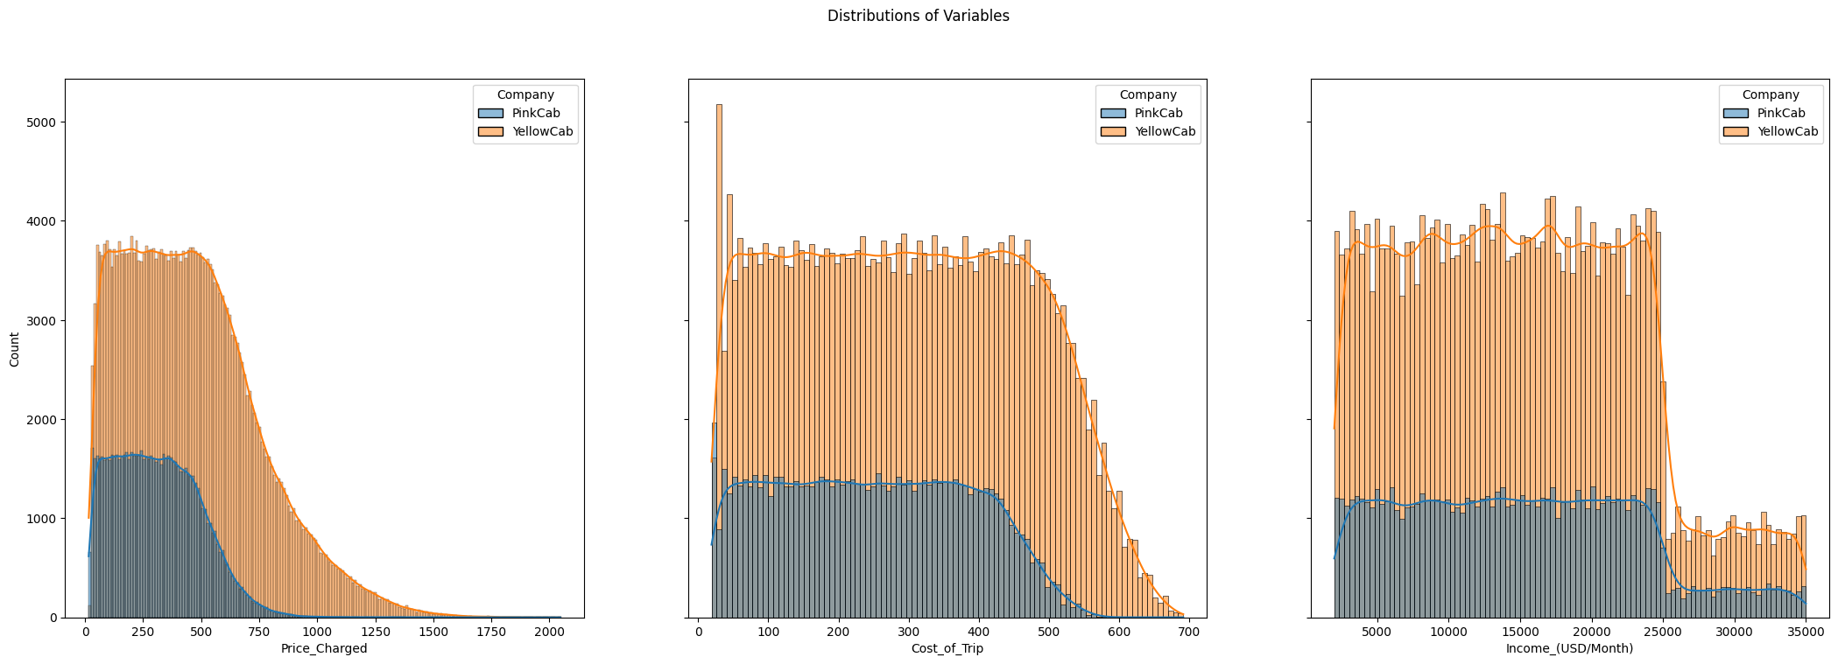
Price charged in Yellow cabs is higher than price charged in red cabs. Cost of trips in Yellow cabs is higher than price charged in red cabs.

Slide 9
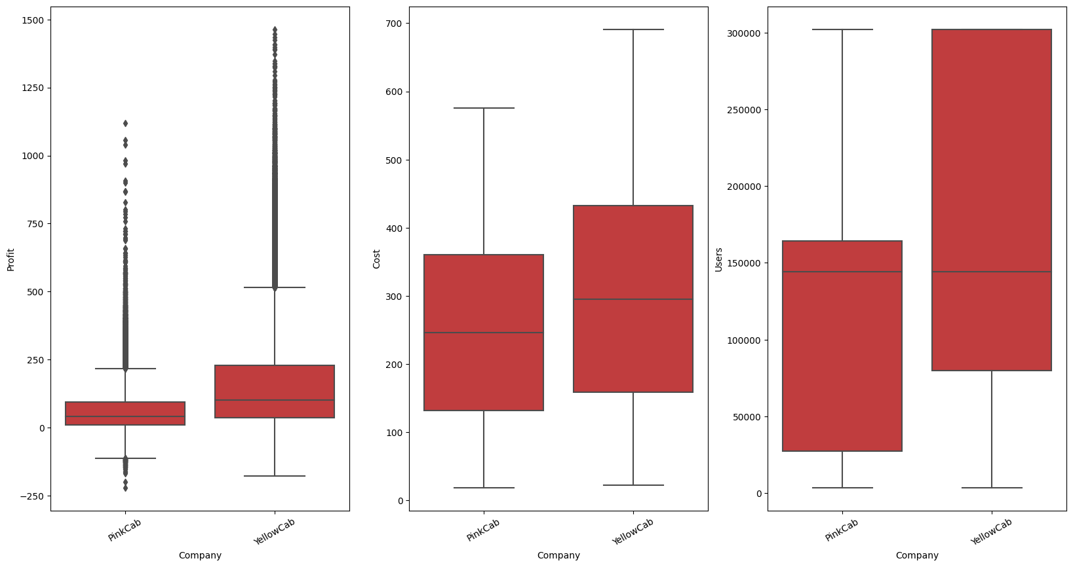
Yellow cabs have a higher profit margin than pink cabs. Mean cost in yellow cabs is higher than mean cost in pink cabs.

Slide 10
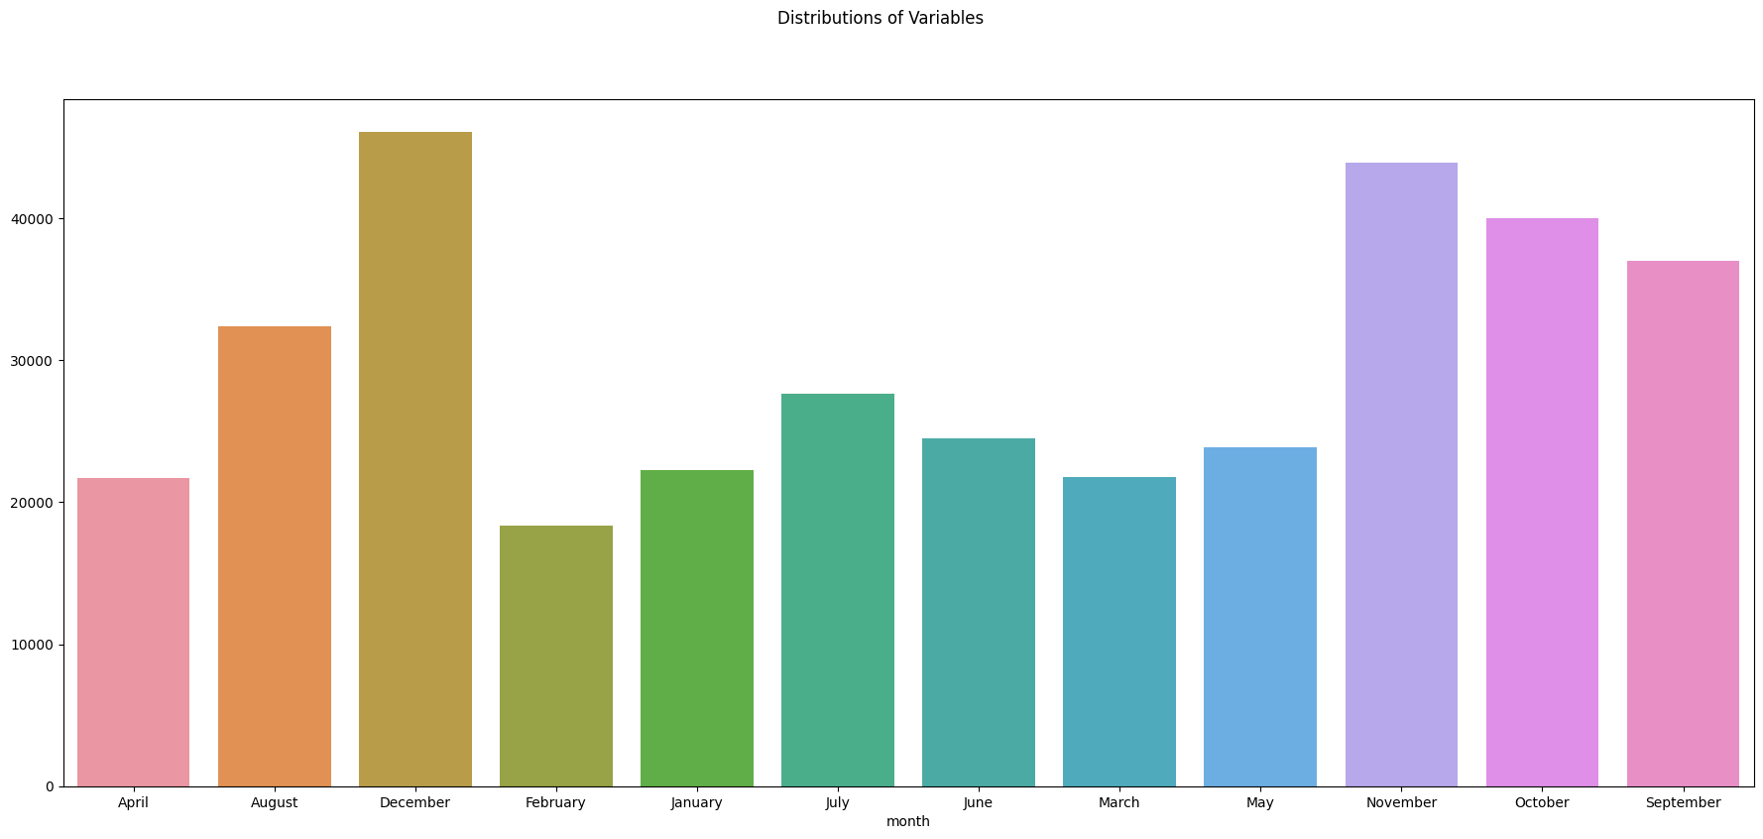
December has the highest number of cab users while in the month of February we can observe least number of cab users.

Slide 11
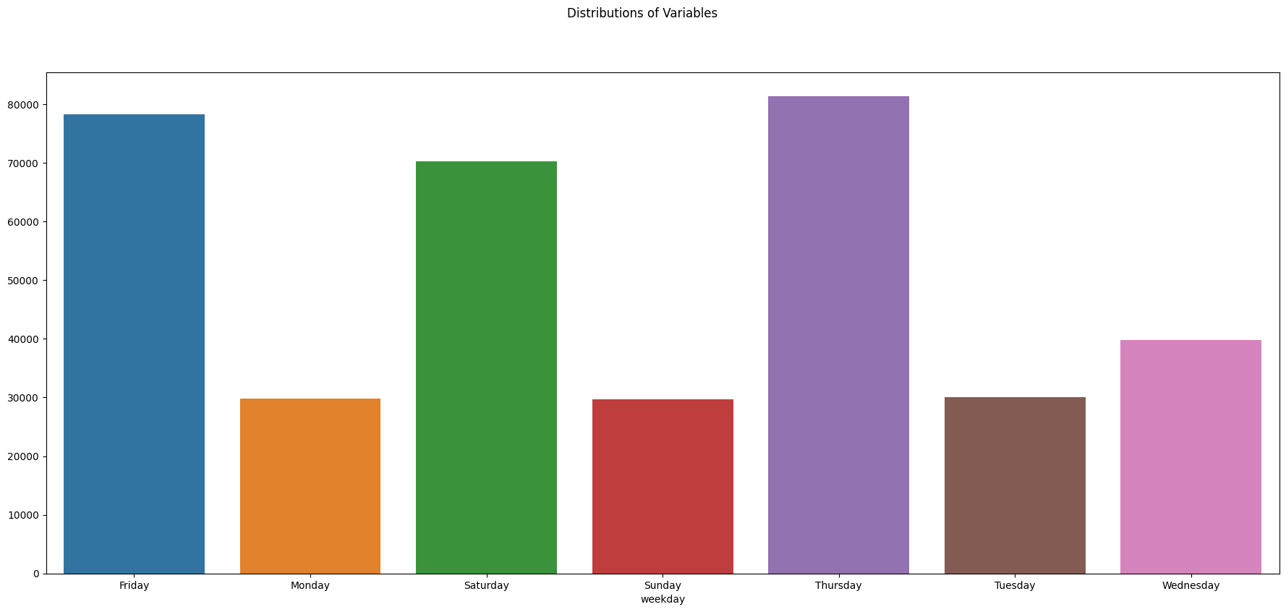
Thursday seems to be the busiest day for cab companies while Tuesday, Sunday and Monday seem to be least busiest days.

Slide 12
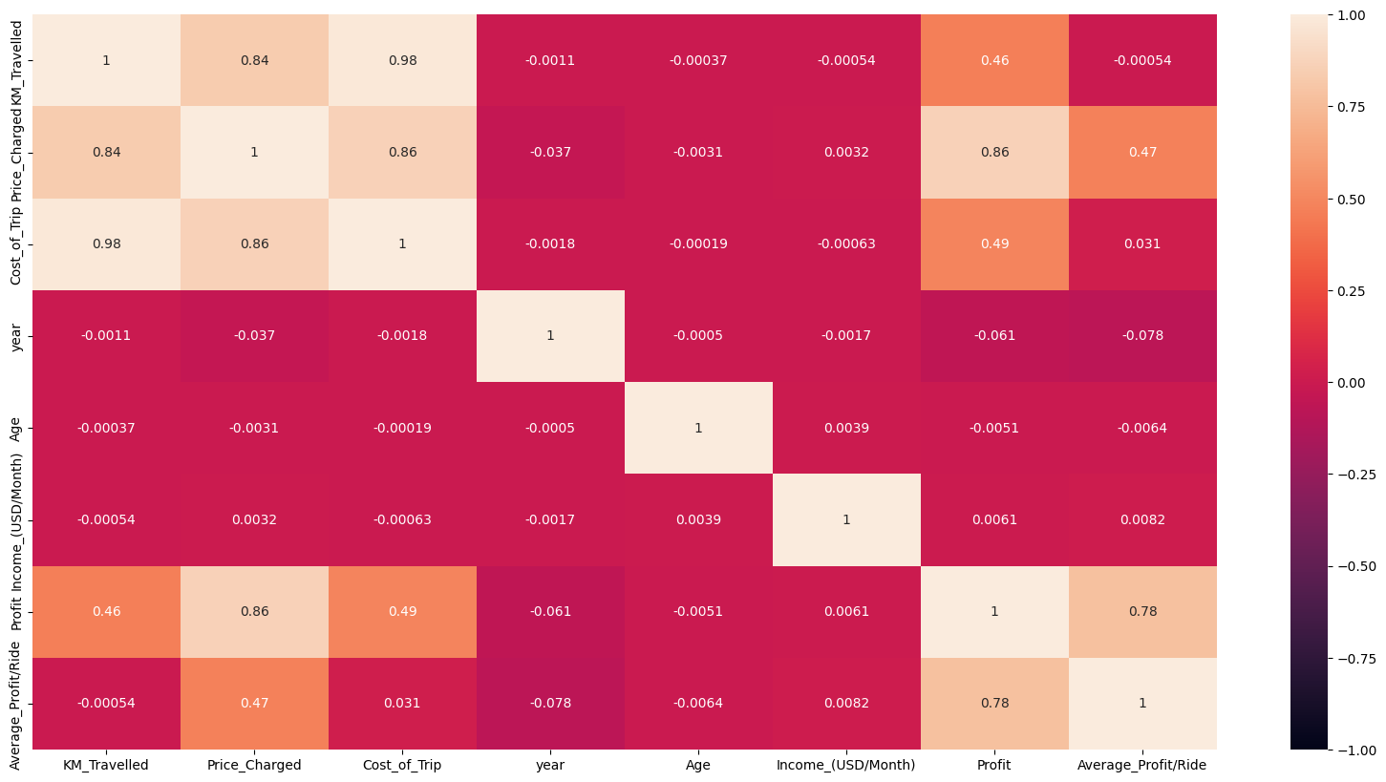
There seems to be positive correlation between Profit and Price Charged

Slide 13
Observations of One-Way ANOVA Analysis:
There is difference in Profit Margin for Male and Female users
There is difference in Profit Margin for Pink Cab company and Yellow Cab company.
There is no evidence to say that there is any difference in profit margin when different payment modes are concerned.

Slide 14
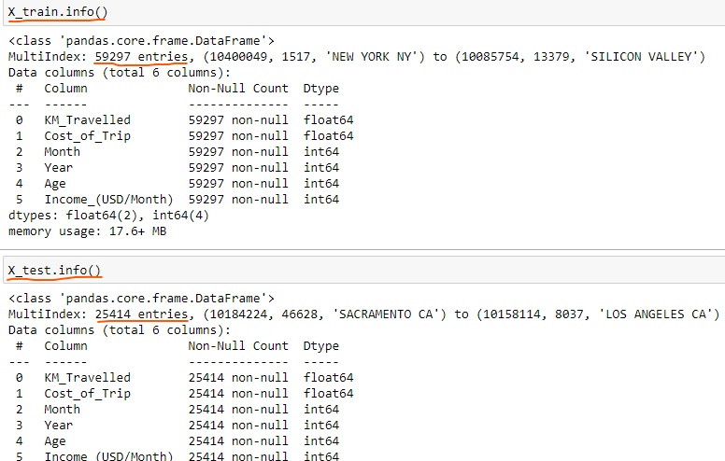
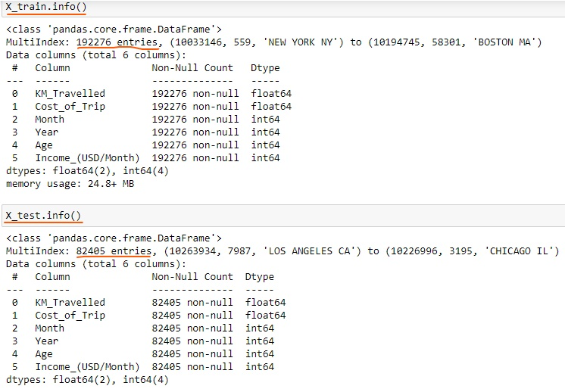
Model1: Linear Regression
Linear Regression is a method for predicting target value and attempts to model the linear relationship between target and one or more predictors.
In our dataset, Price Charge is the target value, and all the other variables are predictors.
Splitting the data into a training set (75%), and test set (25%).
Yellow Cab
Pink Cab

Slide 15
Model2: Decision Tree
Decision tree builds regression models in the form of a tree structure. It breaks down a dataset into smaller and smaller subsets while at the same time an associated decision tree is incrementally developed.
The final result is a tree with decision nodes and leaf nodes.
The topmost decision node in a tree which corresponds to the best predictor for the target value (Price Charged).
Model3: Random Forest
A Random Forest operates by constructing several Decision trees.
A prediction from the Random Forest is an average of the predictions produced by the Decision trees in the forest.

Slide 16
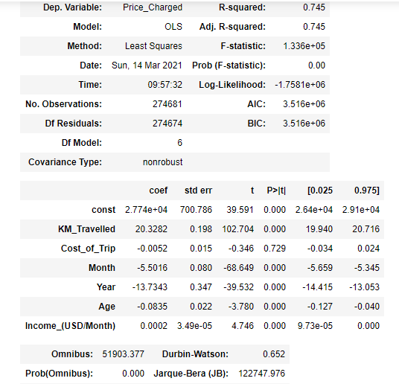
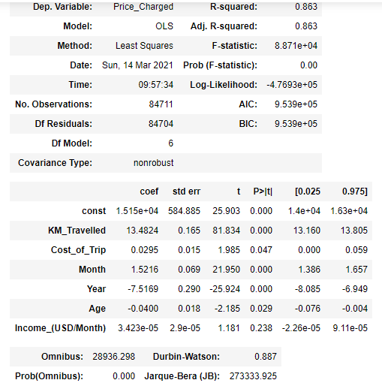
Base Model:
Yellow Cab
Pink Cab
As per Base Model:
Cost of Trip, Month, Year, Age, Income are significant variable for Yellow Cab which are the best predictors for Price Charged.
Cost_of_Trip, Year, Age, Income are significant variable for Pink Cab which are the best predictors for Price Charged. Month is not considered significant.

Slide 17
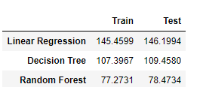
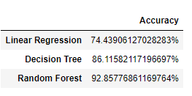
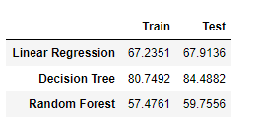
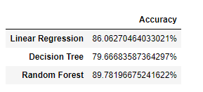
Best Fit Model: RMSE Value & Accuracy
RMSE or root mean square error measures the error which is Prediction values – Actual values.
Lower the RMSE value the better is the Model.
RMSE values & Accuracy for Yellow Cab
RMSE values & Accuracy for Pink Cab
As per the above RMSE data and Accuracy, Random Forest Model is the best fit model for further deployment.
Interpreting Random Forest Model: Cost of Trip, Month, Year, Age, Income are the best predictors for Price Charged.

Slide 18
Recommendation
Transaction per year: For Yellow Cab Transaction per year from 2016 to 2018 is almost double than Pink Cab.
Margin per Gender: For Yellow Cab there is difference in Margin between Male and Female Customers due to which Female Customer percentage is higher in Yellow Cab in comparison to Pink Cab.
Profit Margin: For Yellow Cab the Profit Margin is higher per year from 2016 to 2018 in comparison to Pink Cab.
Margin per Age: In Yellow Cab there is difference in Margin for people older than 50 yrs, whereas in Pink Cab there is no difference in Margin of all age group.
Yellow Cab decreases Margins with the increase in Transaction, hence for Yellow Cab the travel frequency during the Month of December which is the holiday season is 3 times more than Pink Cab.
Customers for Yellow Cab is highest in New York City which has the highest Cab Users of 28%.
On the basis of the above points, Yellow Cab is recommended for investment.

Slide 19
Thank You

