Slide 1

Password project

Slide 2
The idea
What are you planning to implement?
We want to implement an app where you can check if your password is one of the 200 most commonly used in some country, and if so which countries. We also want the app to tell how a specific country ranks password security wise based on the 200 passwords by summing the password cracking time for each country.
why are you interested in doing that?
- A firm’s perspective
- A hackers perspective
- The entertainment value of bad passwords
which data sources you will use to populate the app (or how you will generate synthetic data if you are planning to do that)?
We use a dataset from Kaggle. We will generate additional attributes from the data as needed, e.g. the average cracking time for each country.

Slide 3
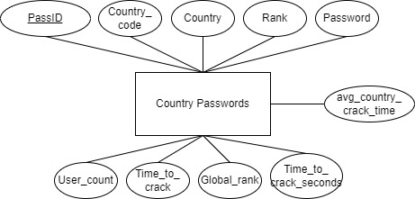
E/R diagram
Keeping it simple
One dataset, one entity
We add our own attributes

Slide 4
The website
Core functions:
Graphs
Sort by country
Sort by password strength
Search for password

