Slide 1
Machine Translation Project – Ndyuka & Backtranslation
By Group 5 – Yifan Hu, Steinar Grässel, Daan Brugmans

Slide 2
Project Outline
Machine Translation for Ndyuka
Creole in Suriname + French Guyana
From Ndyuka to Chinese & German
Research focus: backtranslation
Translate from target to source to gain more sentence pairs
High-resource vs. Low-resource
Research question: What is the change in performance for our Ndyuka to Chinese/German machine translation systems when backtranslated sentence pairs are added to the training data?
Three models/pipelines are considered:
SMT for Ndyuka → Chinese
SMT for Ndyuka → German
NMT for Ndyuka → Chinese + German
Notes:
- We work on machine translation for Ndyuka, a creole in Suriname and French Guyana
- We translate into Chinese and German
- Our research focuses on using backtranslation: translating from target to source language to gain more sentence pairs
- High-resource vs. low-resource
- Research question: What is the change in performance for our Ndyuka to Chinese/German machine translation systems when backtranslated sentence pairs are added to the training data?
- Three models/pipelines are considered:
1. SMT for Ndyuka --> Chinese
2. SMT for Ndyuka --> German
3. NMT for Ndyuka --> German + Chinese

Slide 3
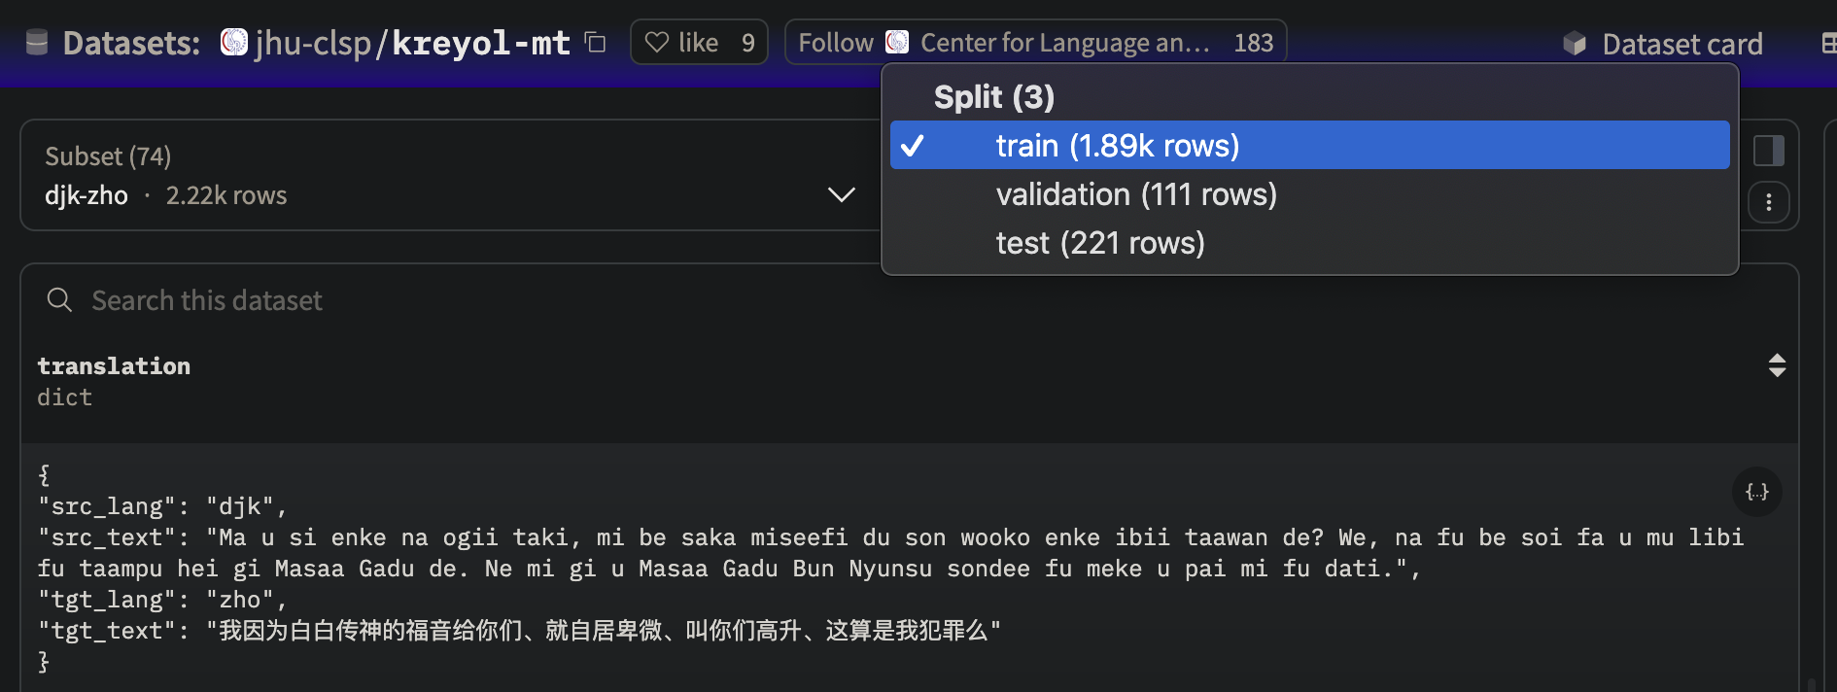
SMT Ndyuka → Chinese: Dataset
Notes:
Simply talk about Chinese dataset, just to show how small it is

Slide 4
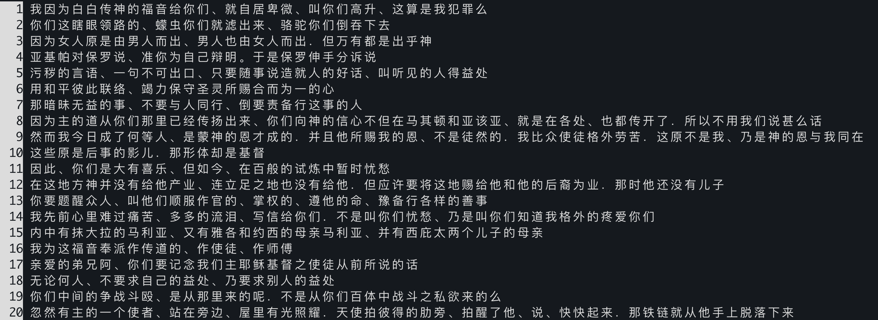
SMT Ndyuka → Chinese: Dataset (More examples)
Weird archaic sentences (either poor translation or religious wording?)
Notes:
Show some examples. It is weired generally, and wording, style are pretty old

Slide 5
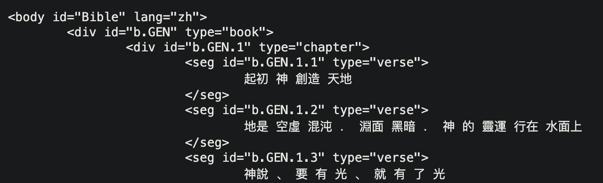
SMT Ndyuka → Chinese: Extra data
https://github.com/christos-c/bible-corpus
xml format in Traditional Chinese
Used from n-gram LM model & extra data for backtranslation
But why?
It is relatively large -> 677919 words count
It is from Bible -> The original text is also from Bible
It is already segmented!!!
Notes:
Show extra data. It is from Bible, and it is segmented
(less than one minuter until here)

Slide 6
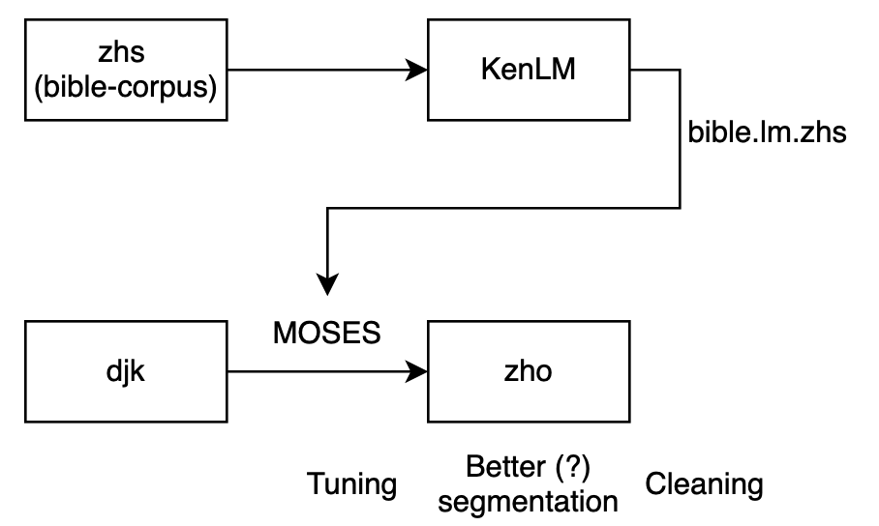
SMT Ndyuka → Chinese: Pipeline
Notes:
Pipeline for baseline. Note: KenLM was compiled by ourselves as at that time, the thing was still not available on Futurum. It is a 5 gram model with bible-corpus.

Slide 7
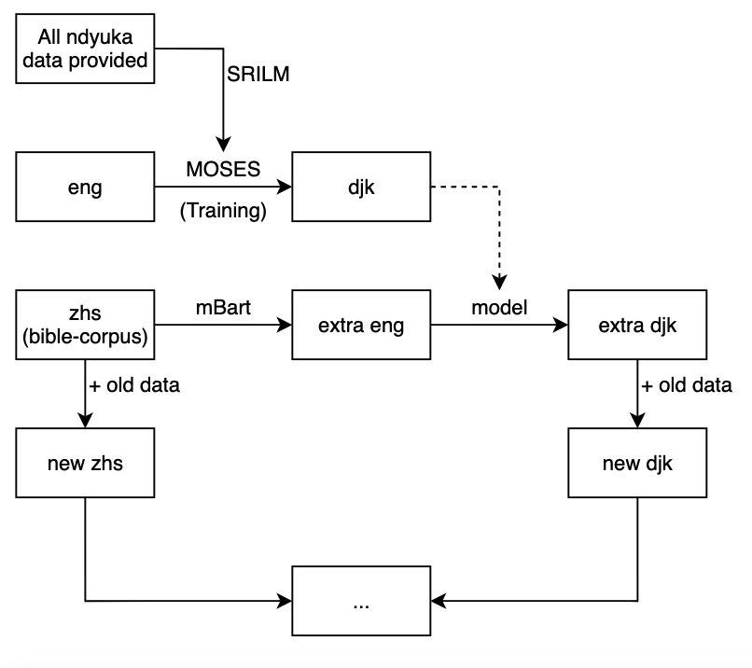
SMT Ndyuka → Chinese: Pipeline
This is the pipeline for creating data for backtranslation
The new Chinese and Ndyuka data will then go through the same process as the previous one
Notes:
Some pipeline for new data. mBart is the original one. In total there are more than 32k of sentences.
N-gram model was trained with SRILM this time, just because it was available, and I was working on server, don’t want to compile again (and I don’t have the permission to install dependencies)
(less than two min here)

Slide 8
SMT Ndyuka → Chinese: Result
Baseline: cleaned + tuning (BLEU 2.17)
Cleaning itself might not so helpful in this case (1.98 vs. 1.93)
Segmentation does matter
$ multi-bleu.perl ../../corpora/zho-djk/might_better_seg/test.tk.zho < test.out.zho
BLEU = 0.89, 13.4/2.0/0.4/0.1 (BP=1.000, ratio=2.545, hyp_len=10766, ref_len=4231)
Back translation (cleaned + tuning): BLEU 2.45
Notes:
Talking about result, briefly, not important, probably just read the slide

Slide 9

SMT Ndyuka → Chinese: Does it work (for Chinese)?
Maybe
Improvement about 0.3, but with 31k of extra sentence, taking the whole weekend (8h for zhs to eng on UPPMAX with GPU, plus some other hours to train and test
Am I good at doing translation?
Will the quality of original data affact?
(as we still need segmentation for traditional method)
If segementation matters, can we get rid of it? -> alignment issue
Is BLEU score reliable?
Is the processing correct?
Same data, same commands, eng to djk scored only 0.61, but djk to eng got above 10
Garbage in, garbage out
???
Notes:
Issues/future works, this might take some times, try to finish by 3 min

Slide 10
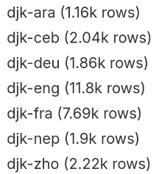
SMT Ndyuka → German
Pipeline essentially analogous to Ndyuka → Chinese
Baseline generated with a ready-to-use German LM (from CMU Sphinx)
BLEU: 1.19
Backtranslation uses Nduyka LM trained with ~12k sentences from the Ndyuka ↔ English data in the Kreyol-MT dataset
Assumption: This pairing is the biggest one for Ndyuka, and will encompass most sentences within the smaller other pairings
Translate 1640 (size of original training data) randomly chosen verses from ~31k bible verses in German bible corpus
Enhancing training data with 1640 additional training pairs leads to BLEU: 1.35
Notes:
Issues/future works, this might take some times, try to finish by 3 min

Slide 11
SMT Ndyuka → German
Lean into domain-specificity: Train a German “Bible-LM” using the ~31k verses
BLEU with Bible-LM: 3.00
BLEU with Bible-LM & aditional data from backtranslation: 3.49
Pending ideas & thoughts
Check if using the (tiny) validation set makes a difference
Supplement Bible-LM with out-of-domain data (~31k lines is not a lot)
Linguistic analysis
Nduyka exhibits reduplication:
wanten wanten → alsobald alsobald
sete sete → dieser ist dieser
Notes:
Issues/future works, this might take some times, try to finish by 3 min

Slide 12
NMT Ndyuka → Chinese + German
NMT from the ground up infeasible
However, authors of creole dataset also published model
Multilingual neural model
Baseline metrics:
German: 16.2 BLEU, 43 ChrF
Chinese: not yet obtained
Continue finetuning of NN on dataset of backtranslations
PEFT/LoRA?
Use same resources for backtranslating as SMT models
Results are to follow
Notes:
- NMT from the ground up infeasible
- However, the authors of the creole dataset also published a model
- Multilingual for sources and targets
- Baseline metrics:
- German: 0.16 BLEU, 43 ChrF
- Chinese: not yet obtained
- Continue finetuning of NN on dataset of backtranslations (PEFT/LoRA?)
- Use same resources for backtranslating as SMT models
- Results are to follow

Slide 13
Machine Translation Project – Ndyuka & Backtranslation
By Group 5 – Yifan Hu, Steinar Grässel, Daan Brugmans

