Slide 1
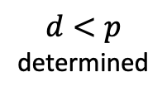
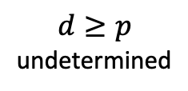
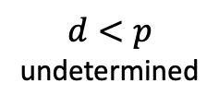
$$d≥p$$
undetermined
$$d<p$$
determined
$$d<p$$
undetermined
r₁
r₁
r₁
r₀
r₀
r₀
k - d
k = d
k - d
k = p
k - d
k = p

Slide 2
k = d
k < d
undetermined
determined
undetermined
r₁
z
r₀
0
1
2
0
1
2
0
1
2
k - d
k
k - d
k
k - d
k
time

