Slide 1

Extraction of expiration dates using image processing
Daniel Simons and Stephen Creighton

Slide 2
Introduction
Project explanation
01
Design and development
02
Results and conclusions
03

Slide 3
Explanation
This projects aim was to create an image processing program which analyses and extracts the expiry date from lids located on the milk brand Mooju
We choose this project as we thought there was a good use case for extraction expiry dates from time sensitive products such as milk
We used image processing techniques such as transformations and feature extraction to extract the text and once extracted saved the text to a new image

Slide 4
Design – Initial Idea
Our initial idea was quite different to the idea we carried out.
Our first idea was to extract text and digitize the text to the screen from orange juice bottles
This idea would have been a handy use case for people who are visually impaired this way the text could be read from the screen
Unfortunately this approach had many issues
The main issue was that reading text from an image without machine learning proved to be very difficult, we attempted a solution with template matching but this had its flaws as templates of letter and numbers would only work with the image is was taken from
We then researched into the font used for sell by dates but this caused many issues as the font (dot font) was varied in how it was printed

Slide 5

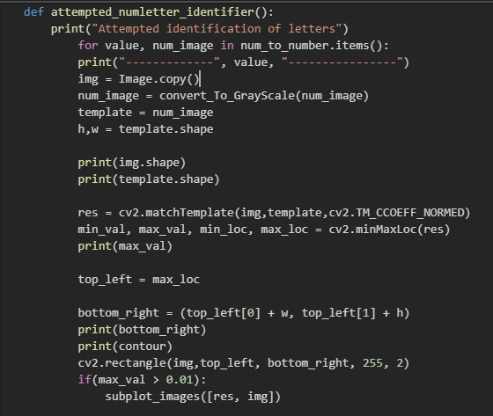
Initial Idea

Slide 6
Design – Planned Idea
With these issues in mind we changed the focus of our idea
We decided to extract text from the image and present it to the screen rather than trying to calculate what the text actually was
Text extraction from an image is almost impossible without knowing what font is used and or from a 3 dimensional object
We changed the type of product used to Mooju as it presented a better surface to extract the text from

Slide 7
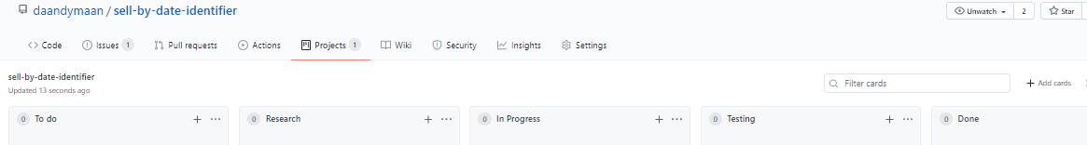
Design- Planning phase
We collaborated as a team and planned out the steps we would need to take
We used GitHubs project management system to display tasks we needed to complete and to share our solutions to issues we had
We sourced images of Mooju bottle lids we could use to test our program

Slide 8
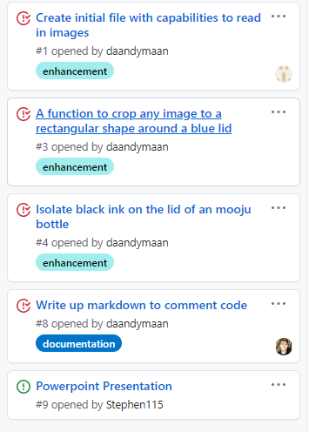
Tasks decided

Slide 9
Implementation
Our solution to this image al steps processing problem was broken down into four logic
The first step is to read in the image of the Mooju lids by user input
The second step is to find the lid of the image and then crop the image accordingly
The third step is extract the black text from the bottle lid
The final step is to find the area of the text and crop the image accordingly

Slide 10
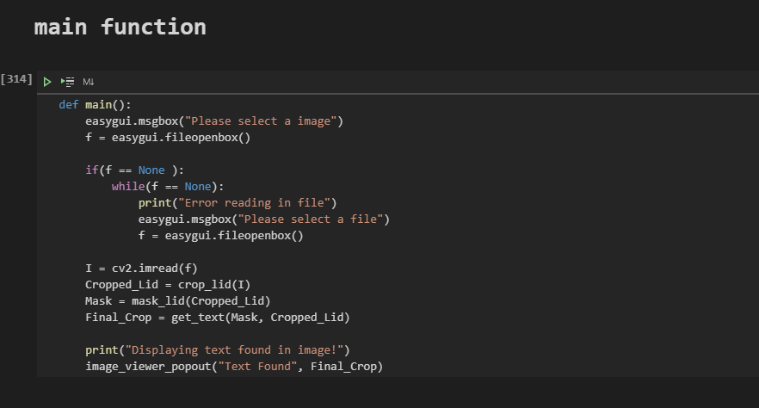

Slide 11
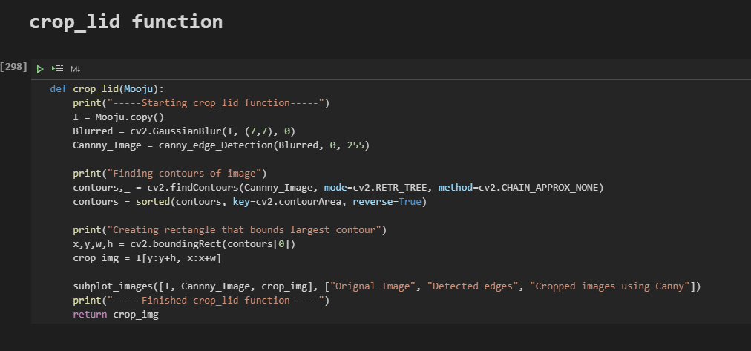

Slide 12
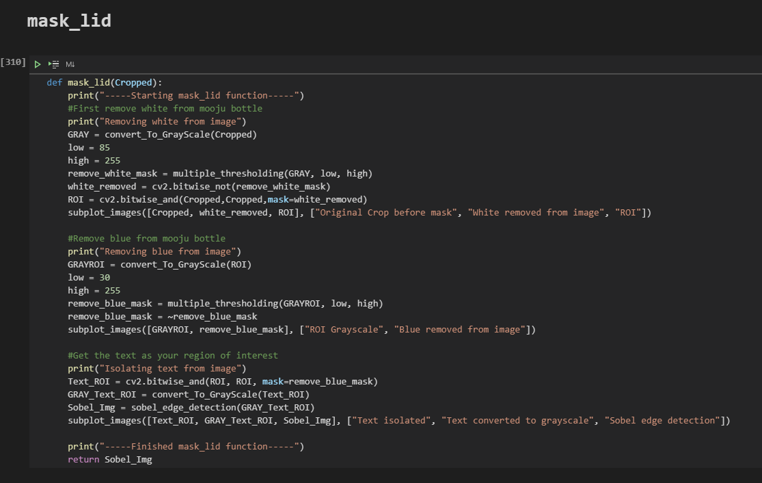

Slide 13
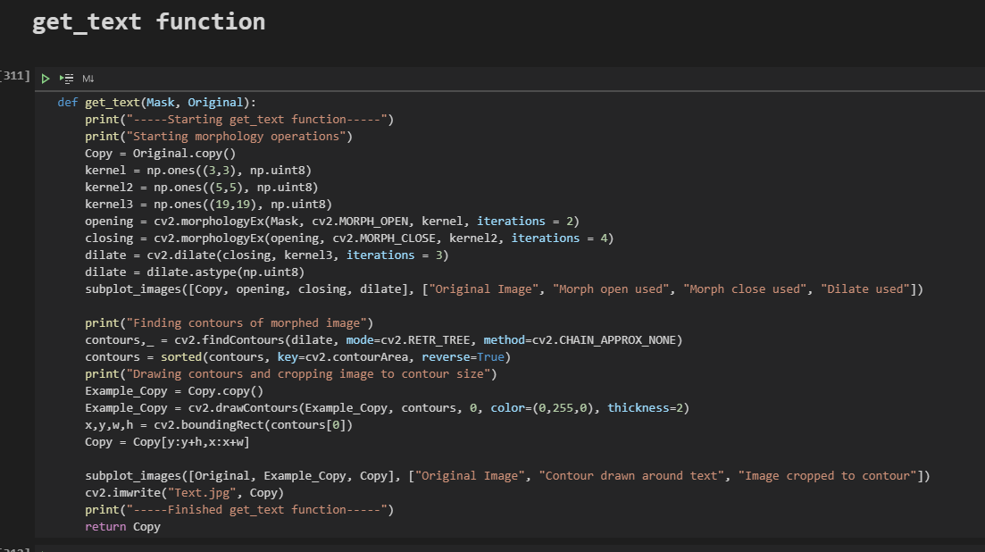

Slide 14
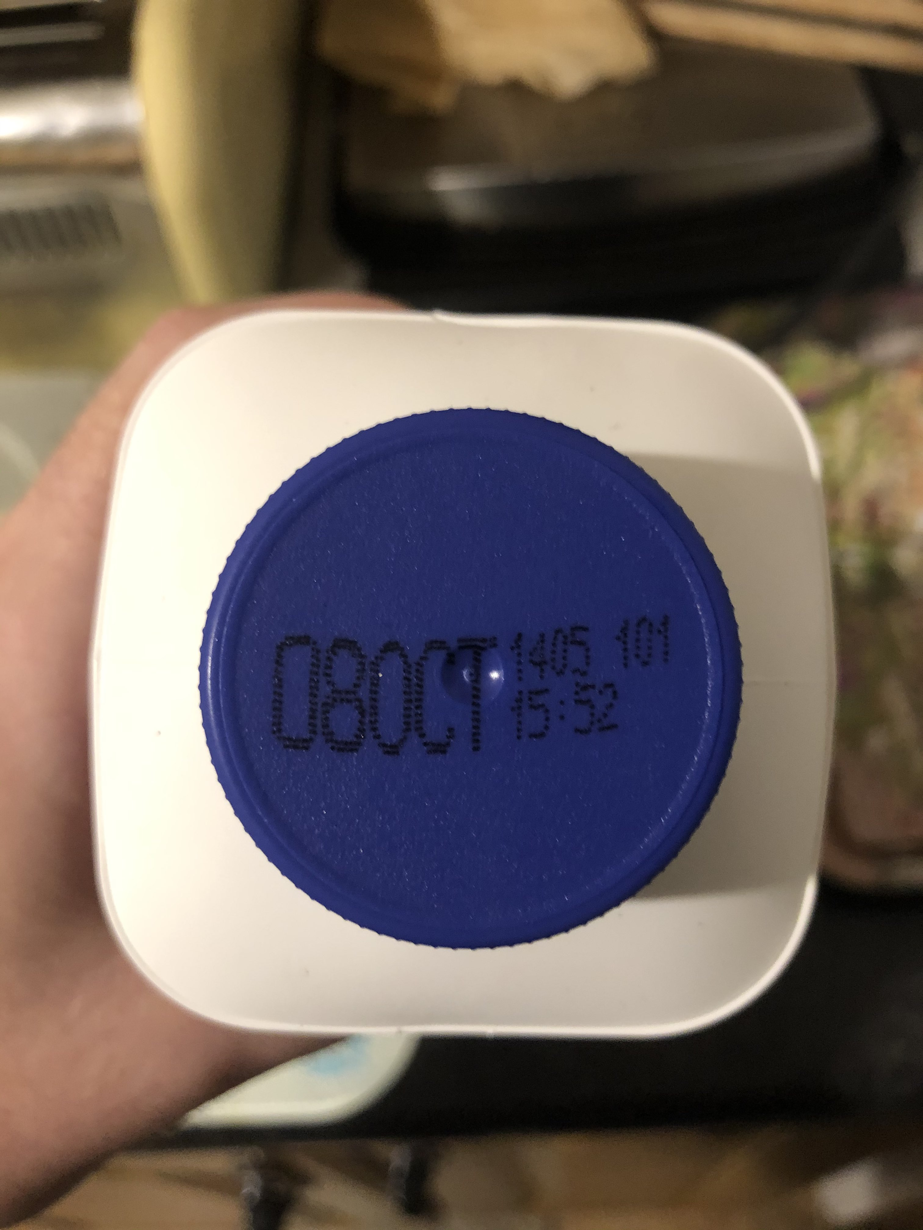
Results

Slide 15
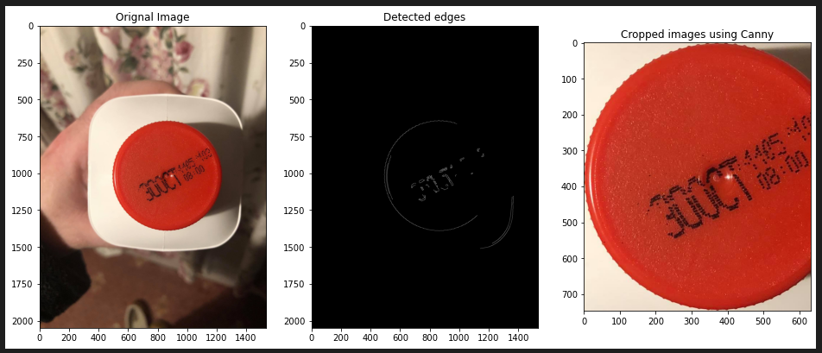

Slide 16
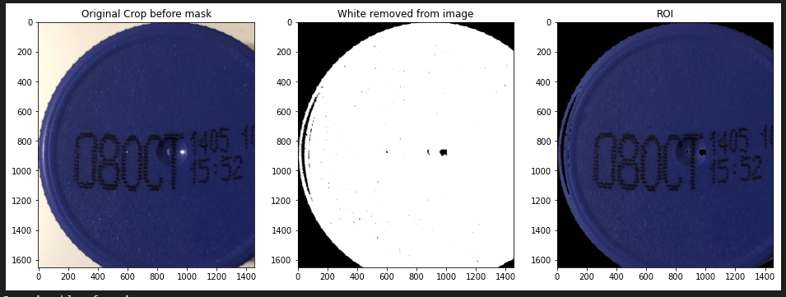

Slide 17
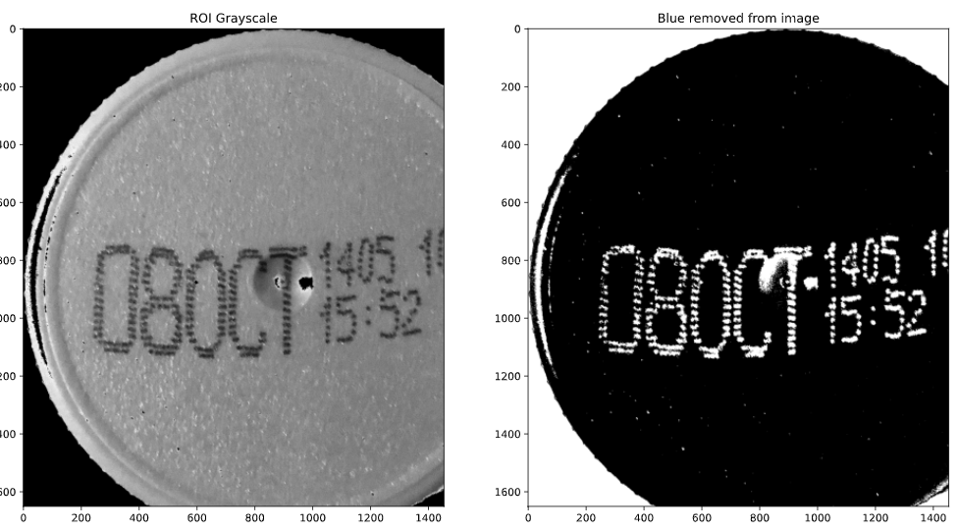

Slide 18
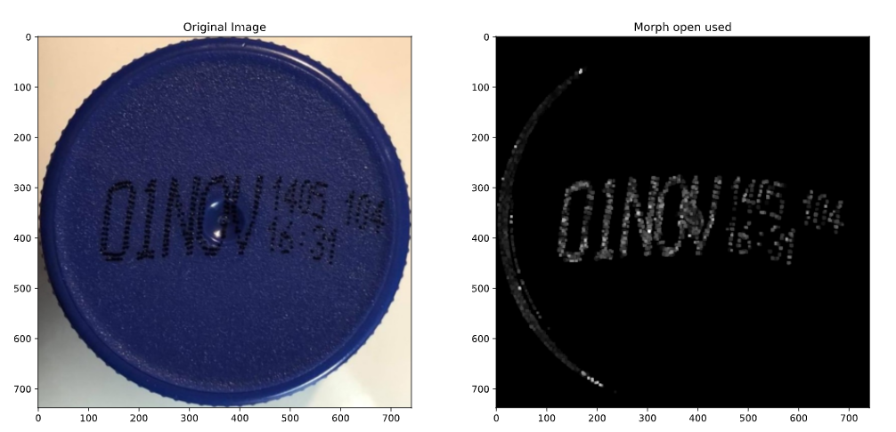

Slide 19
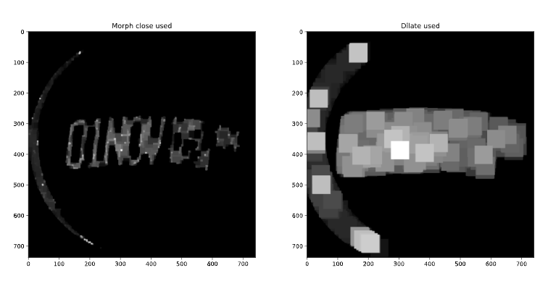

Slide 20
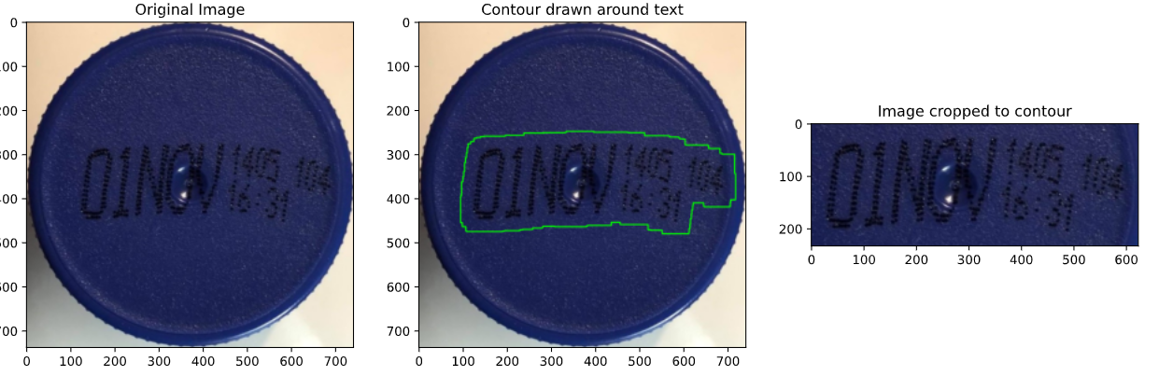

Slide 21
Conclusions
It is difficult to read text from an image without the use of machine learning
Image processing can only go as far as matching characters with templates taken from the image
Image processing with opencv does give you the tools to crop the image and display the area of text

