Slide 1

RakshaCall
Real-Time Scam-Call Protection Assistant
Protecting people during the scam call — not only after the money is already gone.
HACKDAY 1.0 · Tech for a Better Tomorrow
Live demo: aayushpatilcodes-dot.github.io/RakshaCall-/

Slide 2

PARTICIPANT / TEAM DETAILS
Team: daanialmirza
Daanial Baig
Team Leader
+91 90041 22132
Aayush Patil
Team Member
+91 88790 95131
RakshaCall — HACKDAY 1.0
2

Slide 3






THE PROBLEM
Scam calls manipulate people in real time
Fraudsters posing as police, CBI, customs, or bank officials keep victims on a call for hours — using fear and urgency to make them act before they can think.
~₹3,000+ Cr
Authority impersonation
Urgency & threats
estimated lost to "digital arrest" impersonation
scams in India in 2025 alone
Fake police / CBI / RBI / customs officer
"Act now or be arrested"
Isolation
Forced surveillance
Existing defenses — bank fraud monitoring, telecom SIM-binding — all act AFTER the money has already moved.
"Don't hang up, don't tell anyone"
"Keep your camera on"
Credential extraction
Financial extraction
Nothing protects the person while it is happening.
OTP, PIN, password
"Transfer funds for verification"
RakshaCall — HACKDAY 1.0
3

Slide 4
OUR INSIGHT
Every defense works after. We work during.
TODAY
RAKSHACALL
Bank & telecom fraud tools act AFTER
Protects the person WHILE it happens
— Money has already left the account
— Analyzes the conversation live, as it unfolds
— Fraud alert arrives after the transfer
— Warns the moment a scam pattern is recognized
— Victim discovers it only afterward
— Gives a clear action before any money moves
RakshaCall — HACKDAY 1.0
4

Slide 5





HOW IT WORKS
From live conversation to a plain-language warning
Input
Local Detection
Risk Score
Warning
Trusted Contact
Simulated call stream, pasted transcript, or live mic
8 weighted scam-signal categories, on-device
0–100, combining stacked-tactic co-occurrence
Plain-language explanation + recommended action
One-tap simulated check-in alert
Runs entirely client-side, in the browser — no server, no database, no paid API. Detection cannot fail from a network outage because it never makes a network call.
RakshaCall — HACKDAY 1.0
5

Slide 6


THE DETECTION ENGINE
Eight scam-signal categories, weighted and combined
Authority
Urgency
Threat
Isolation
CBI, RBI, police, customs
"Immediately", "within the hour"
Arrest, warrant, legal action
"Don't hang up / tell anyone"
Surveillance
Credentials
Financial
Remote Access
"Keep your camera on"
OTP, PIN, password
Transfer money, processing fee
AnyDesk, TeamViewer installs
Deterministic, not a black box. Weighted category scores + a co-occurrence bonus when tactics stack (as real scams do) — every verdict traces back to the exact phrases matched, so the warning can explain "why" in plain language.
RakshaCall — HACKDAY 1.0
6

Slide 7
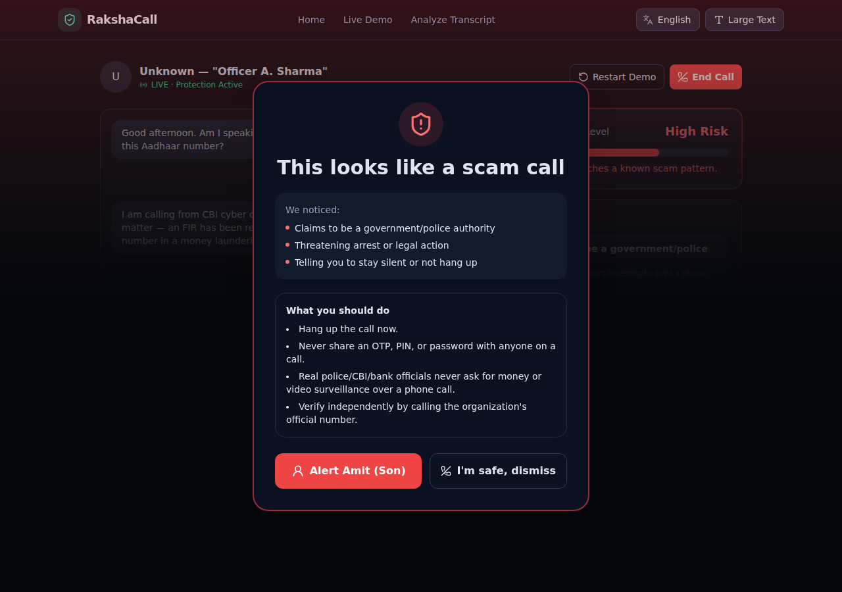
SEE IT IN ACTION
Risk climbs live — the warning fires automatically
Fake "Digital Arrest" scenario
• Caller claims to be a CBI officer
• Threatens arrest, demands secrecy
• Forces the camera to stay on
• Risk meter climbs live as each line streams in
• Full-screen warning fires the moment risk crosses HIGH
RakshaCall — HACKDAY 1.0
7

Slide 8
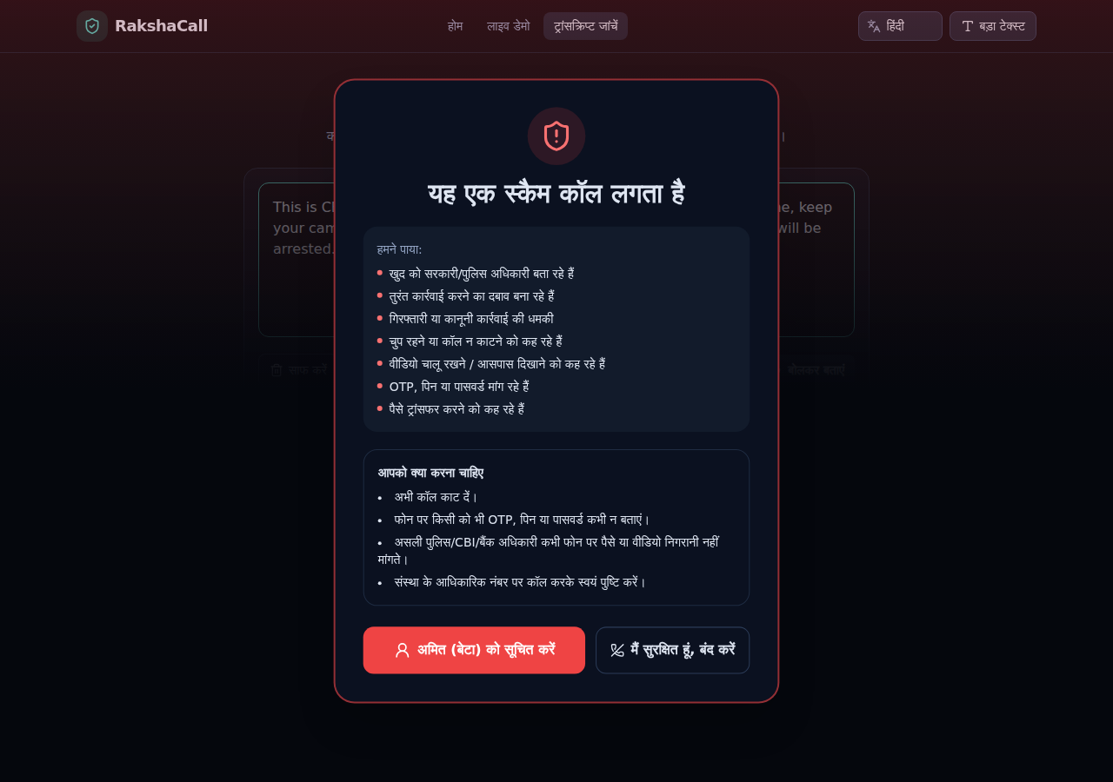


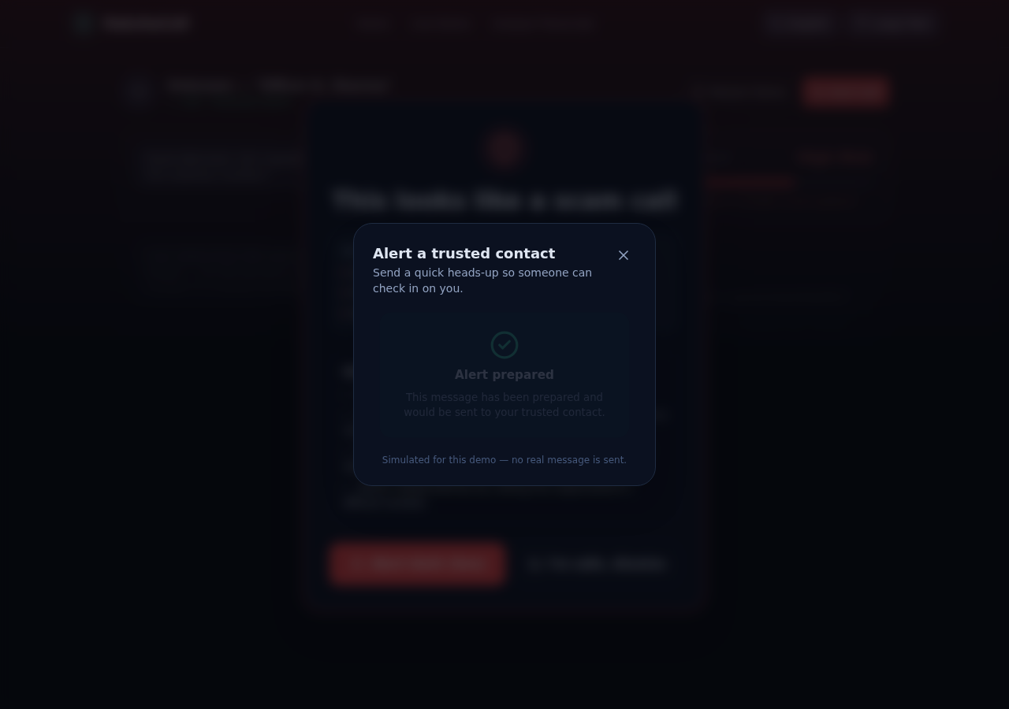
DESIGNED FOR THE MOST VULNERABLE USERS
Understandable in two seconds — even for elderly, low-tech-literacy users
Vernacular language
Full English / Hindi / Marathi translation — not just labels
Large-text mode
One-tap accessibility toggle across the whole app
Calm, not panic
Plain-language warnings; MEDIUM risk asks a question, HIGH gives clear steps
One-tap safety net
Simulated "alert a trusted contact" — no typing required
RakshaCall — HACKDAY 1.0
8

Slide 9


100% FREE STACK
Zero paid APIs, zero credit card, zero cloud bill
React 19 + TypeScript + Vite + Tailwind
FREE · NO CARD
Frontend — fully static, no backend needed
Local deterministic rules engine
FREE · NO CARD
Detection — no LLM API, cannot fail from an outage
Browser-native Web Speech API
FREE · NO CARD
Optional live mic input — built into Chromium, no key
In-memory state + localStorage
FREE · NO CARD
No database — preference-only, never conversation data
GitHub Pages + GitHub Actions
FREE · NO CARD
Hosting — free, tied to the repo, auto-deploys on push
RakshaCall — HACKDAY 1.0
9

Slide 10
WHAT'S REAL VS. WHAT'S NEXT
We're upfront about scope — that's part of the pitch
TODAY — Working MVP
ROADMAP — Post-Hackathon
• Simulated live call stream + pasted transcript
• Native Android companion app (foreground mic service)
• Optional browser mic (Web Speech API)
• OS-level call-screening integration (InCallService)
• Fully local, deterministic detection engine
• Optional on-device NLP layer for paraphrased scams
• Simulated trusted-contact alert (clearly labeled)
• Real trusted-contact delivery (SMS / push)
• No real telecom / phone-call interception
• Telecom & bank partnerships for broader reach
RakshaCall — HACKDAY 1.0
10

Slide 11



WHY RAKSHACALL
Built against the rubric, not just the demo
Problem & Impact
A real, high-loss, under-served threat — protection at the moment of manipulation, not after
Innovation
The only layer that acts during the scam, where every existing defense acts only after
Technical Implementation
Real-time hybrid architecture, a tested rules engine, and honest reliability design
Feasibility & Scalability
Zero-cost today; a clear, named path to native Android integration tomorrow
Live Demo: aayushpatilcodes-dot.github.io/RakshaCall-/
GitHub: github.com/aayushpatilcodes-dot/RakshaCall-
Thank you —
questions welcome

