Slide 1
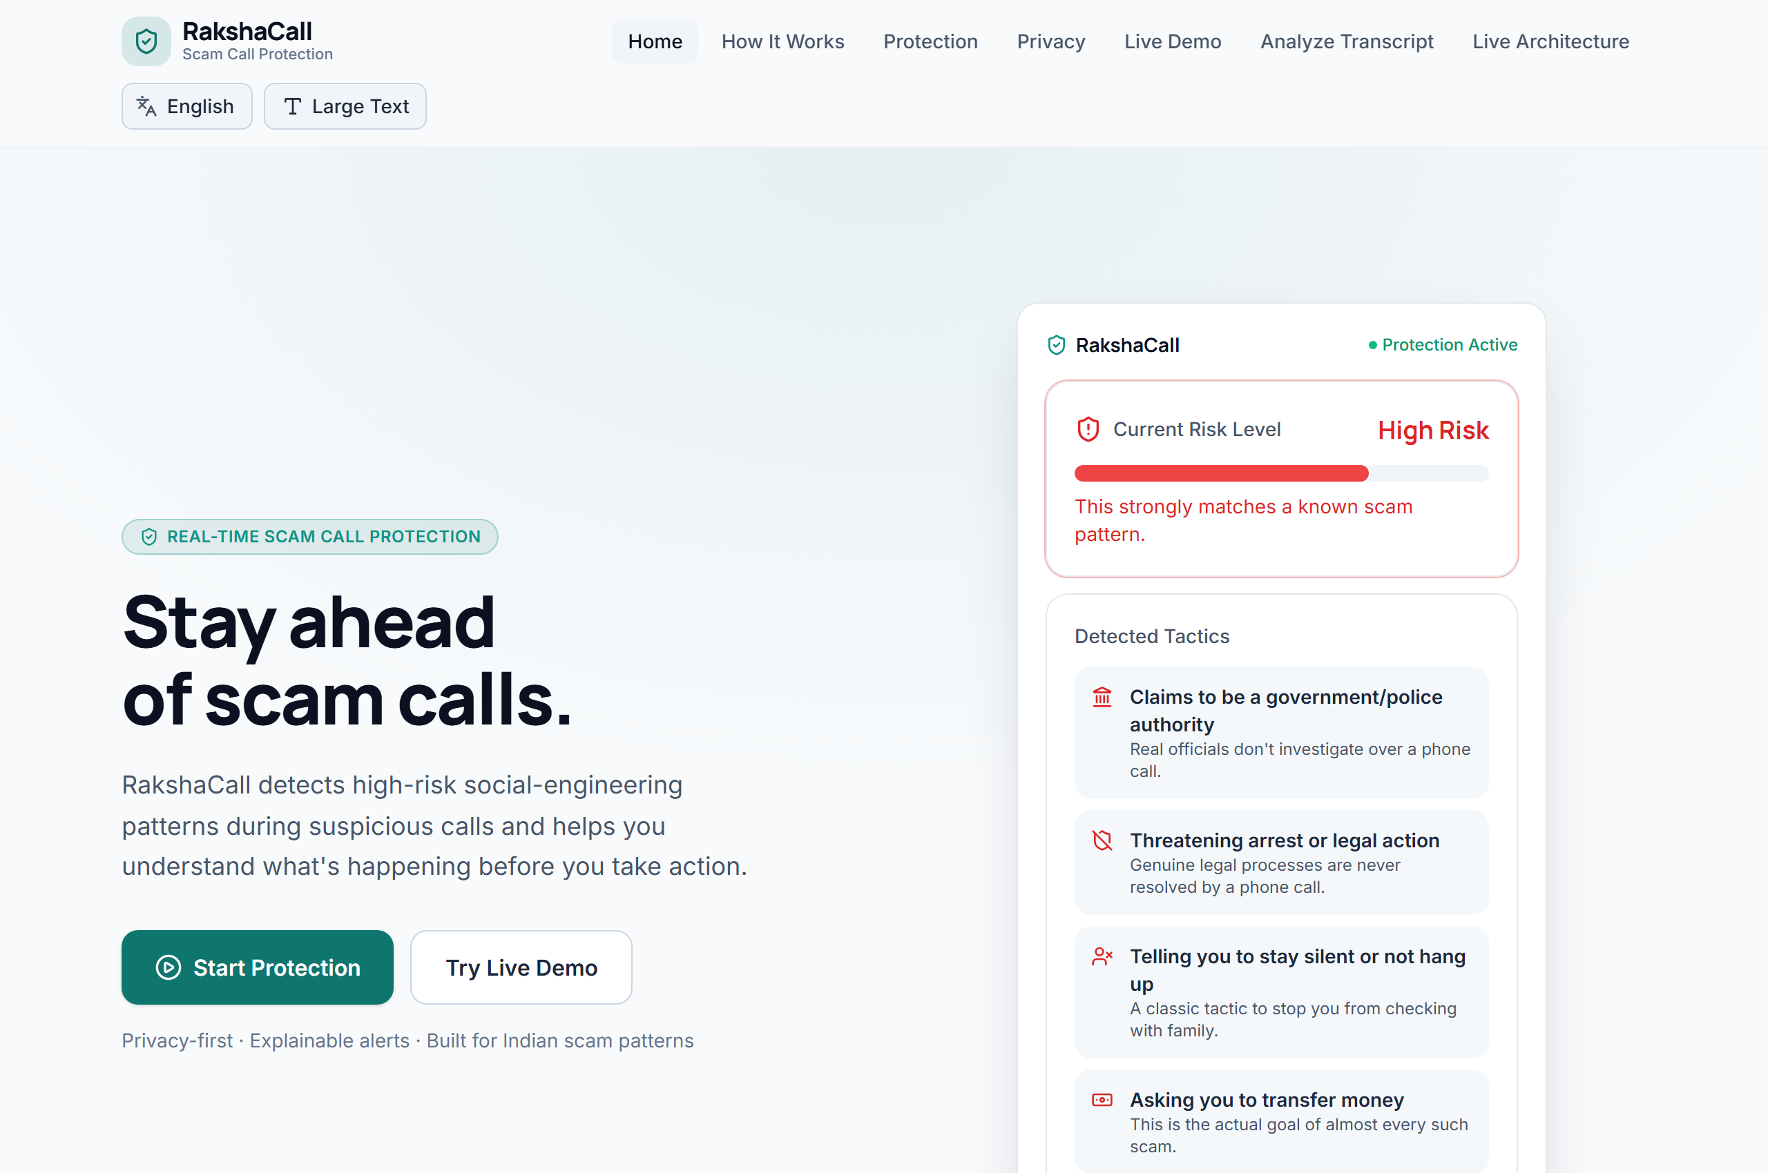
HACKDAY 1.0 · TECH FOR A BETTER TOMORROW
RakshaCall 🛡️
Real-Time Scam-Call Protection Assistant
Detect. Explain. Warn. Protect.
Protecting citizens from high-pressure social engineering, digital arrest, and financial extortion while the call is happening — not after funds are lost.
TEAM: daanialmirza
• Daanial Baig (Team Leader) | +91 90041 22132
• Aayush Patil (Team Member) | +91 88790 95131
🚀 Live Demo: daanialmirza5.github.io/RakshaCall/
RakshaCall · HACKDAY 1.0 · Real-Time Scam-Call Protection
1 / 7

Slide 2
THE THREAT LANDSCAPE
Scam Calls Manipulate People in Real Time
Scammers don't just steal data — they psychologically coerce victims before they realize what is happening.
THE ANATOMY OF A PSYCHOLOGICAL SCAM CALL
SCAMMER ➔ Authority Impersonation ➔ Urgency & Threats ➔ Isolation ➔ OTP / Money / Remote Access ➔ VICTIM
🚨 Predatory Modalities
• Digital Arrest: Fake CBI/Police video surveillance
• Fake Bank KYC: Urgent account block threats
• Customs / Courier: Seized illegal parcels
• SIM Deactivation: Immediate telecom shutoff
• Task / Investment: Upfront deposit extortion
⚡ Psychological Traps
• Enforced Secrecy: 'Do not tell family or police'
• High-Stress Panic: 'Transfer in 10 mins or arrest'
• Credential Extraction: OTPs, PINs, Passwords
• Targeted Victims: Seniors & non-technical citizens
• ~₹3,000+ Cr estimated lost to Digital Arrest in 2025 alone
❌ Why Defenses Fail
• Bank Fraud Alerts: Trigger AFTER money is moved
• Telecom Filters: Block spam numbers, not live voices
• Cybercrime Portals: Report incidents days later
• Zero Real-Time Guidance: Victim is alone during call
• 👉 Need protection DURING the manipulation!
RakshaCall · HACKDAY 1.0 · Real-Time Scam-Call Protection
2 / 7

Slide 3
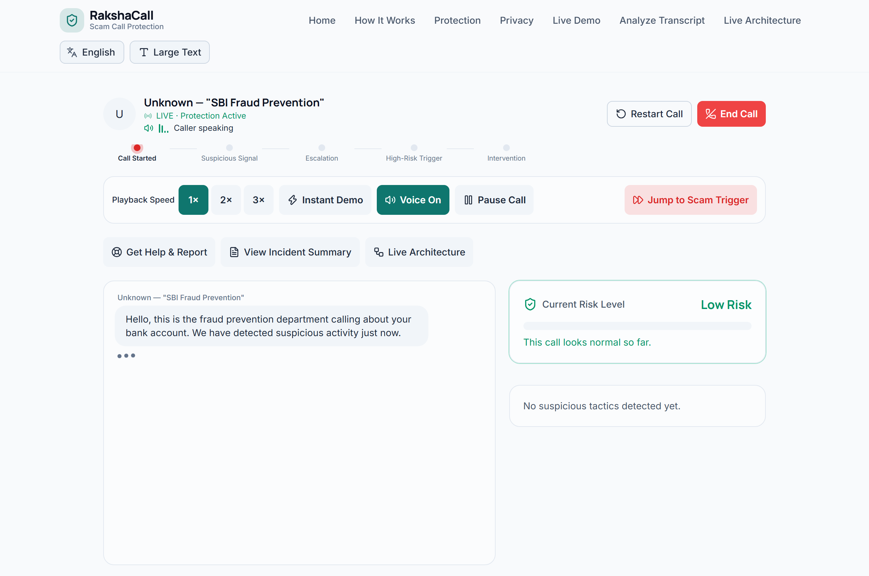
THE REAL-TIME DEFENSE ASSISTANT
Meet RakshaCall
A conversational safety assistant that detects scam tactics and protects citizens while the conversation is happening.
CONVERSATION ➔ DETECT ➔ ASSESS RISK ➔ WARN ➔ PROTECT ➔ HELP
🛡️ Real-Time Detection: Continuous stream evaluation of dialogue as words are spoken
🔎 Explainable Tactics: Clear classification across 8 social-engineering vector categories
🚨 Risk Escalation: Dynamic progressive threat scoring (0–100) across Low, Med, High
🛑 Safety Intervention: Full-screen actionable takeover: STOP · DO NOT SHARE · DISCONNECT
👨‍👩‍👧 Trusted Contact Check-In: One-tap emergency check-in alert to family or guardians
🇮🇳 Indian Scam Aware: Native recognition of English, Hinglish, Hindi, and Marathi
RakshaCall · HACKDAY 1.0 · Real-Time Scam-Call Protection
3 / 7

Slide 4
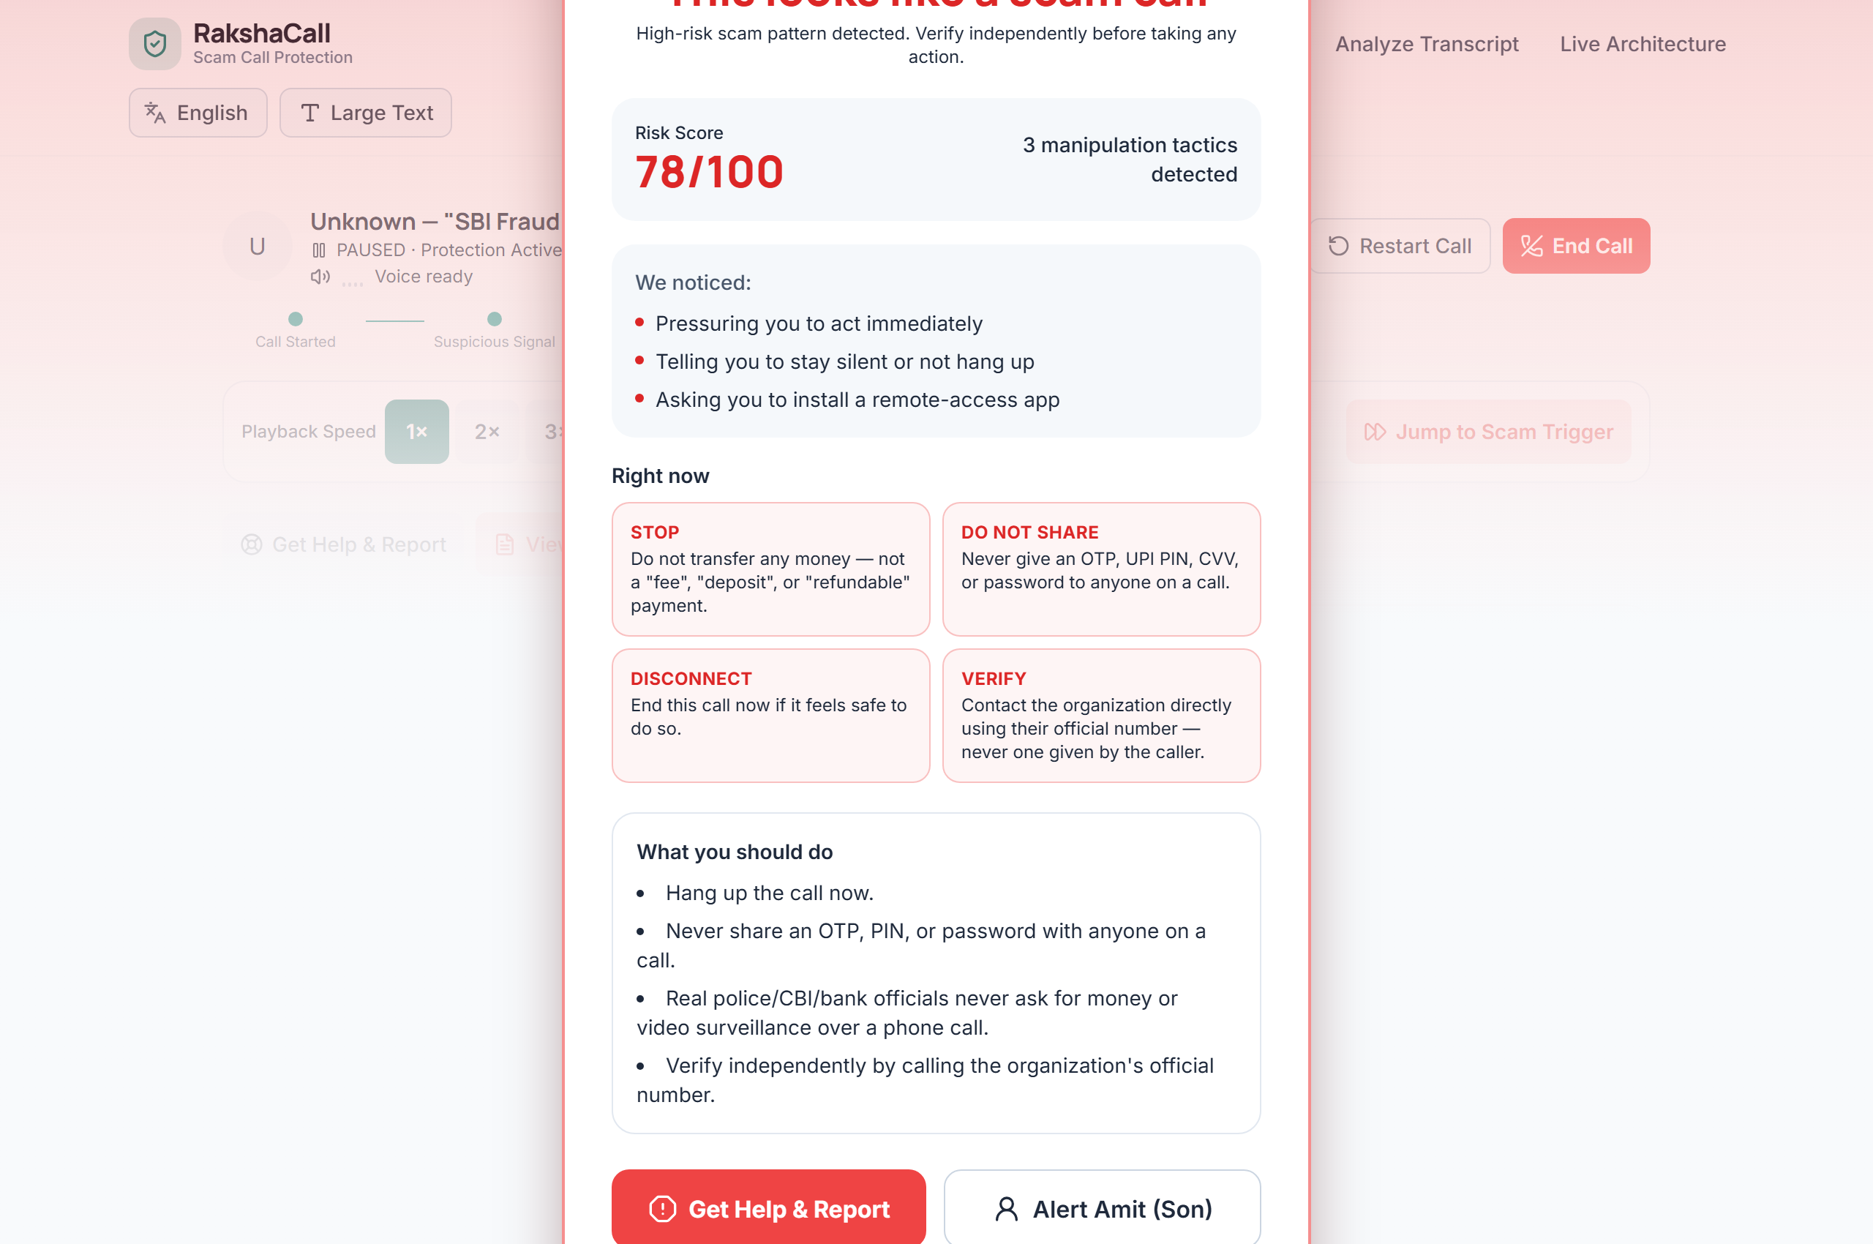
DETERMINISTIC & EXPLAINABLE ENGINE
From Conversation to Protection
Zero black-box AI, zero cloud latency, and 100% on-device privacy.
1. Input
Call Stream
Mic Audio
Pasted Text
2. Normalize
Unicode
Transliteration
Case & Spacing
3. Signals
8 Multi-Vector
Scam Tactic
Categories
4. Scoring
Co-occurrence
Boost & Math
Weights (0–100)
5. Classifier
LOW (0–24)
MEDIUM (25–54)
HIGH (55–100)
6. Action
Screen Takeover
Trusted Alert
1930 Helpline
🎯 8 Observable Social-Engineering Categories
• Authority Impersonation: CBI, Police, Customs, RBI officials
• Urgency & Threat: Immediate arrest, bank account blocking
• Isolation & Secrecy: 'Do not hang up, do not tell family'
• Financial Demand: 'Refundable verification fees', penalties
• OTP & Credential Harvesting: UPI PIN, CVV, OTP requests
• Remote Access: AnyDesk, TeamViewer, QuickSupport requests
RakshaCall · HACKDAY 1.0 · Real-Time Scam-Call Protection
4 / 7

Slide 5
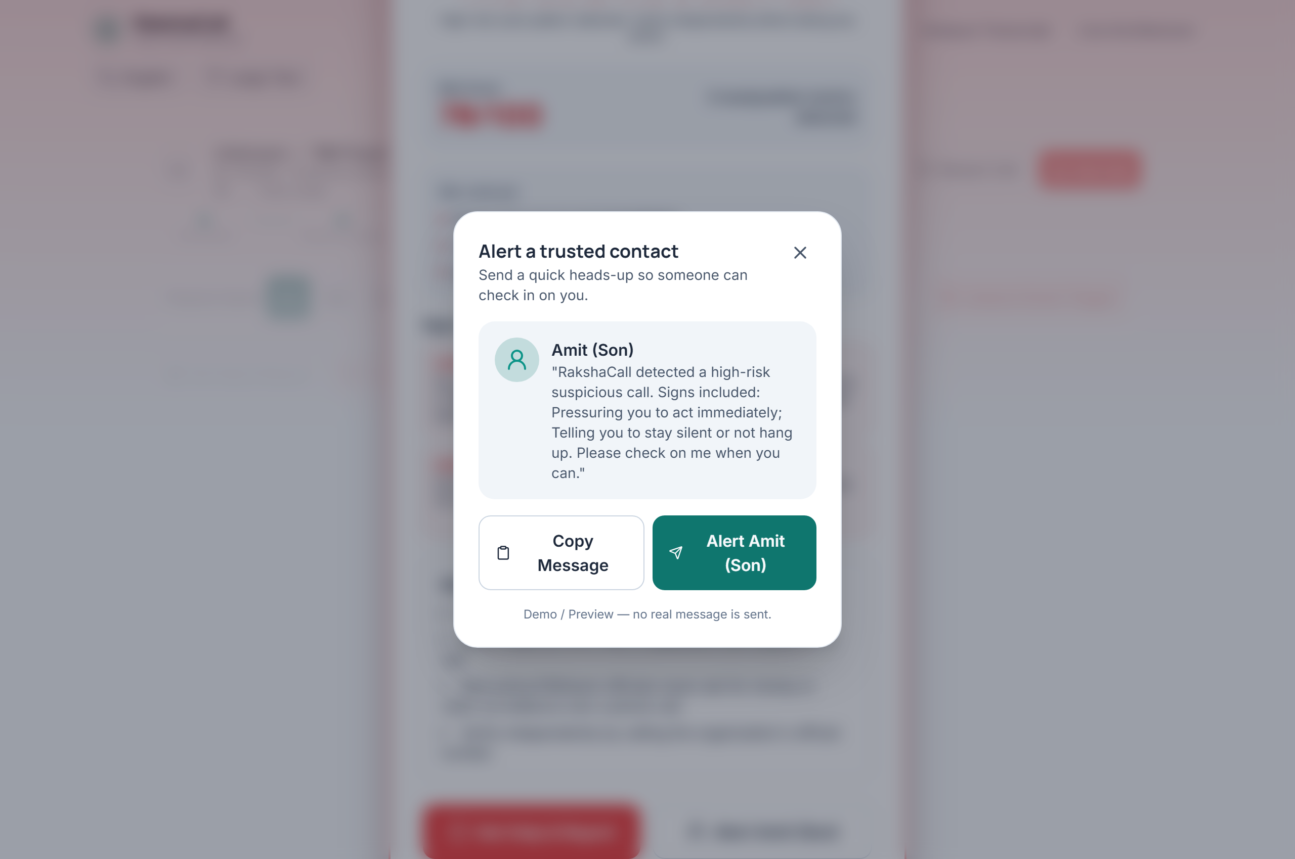
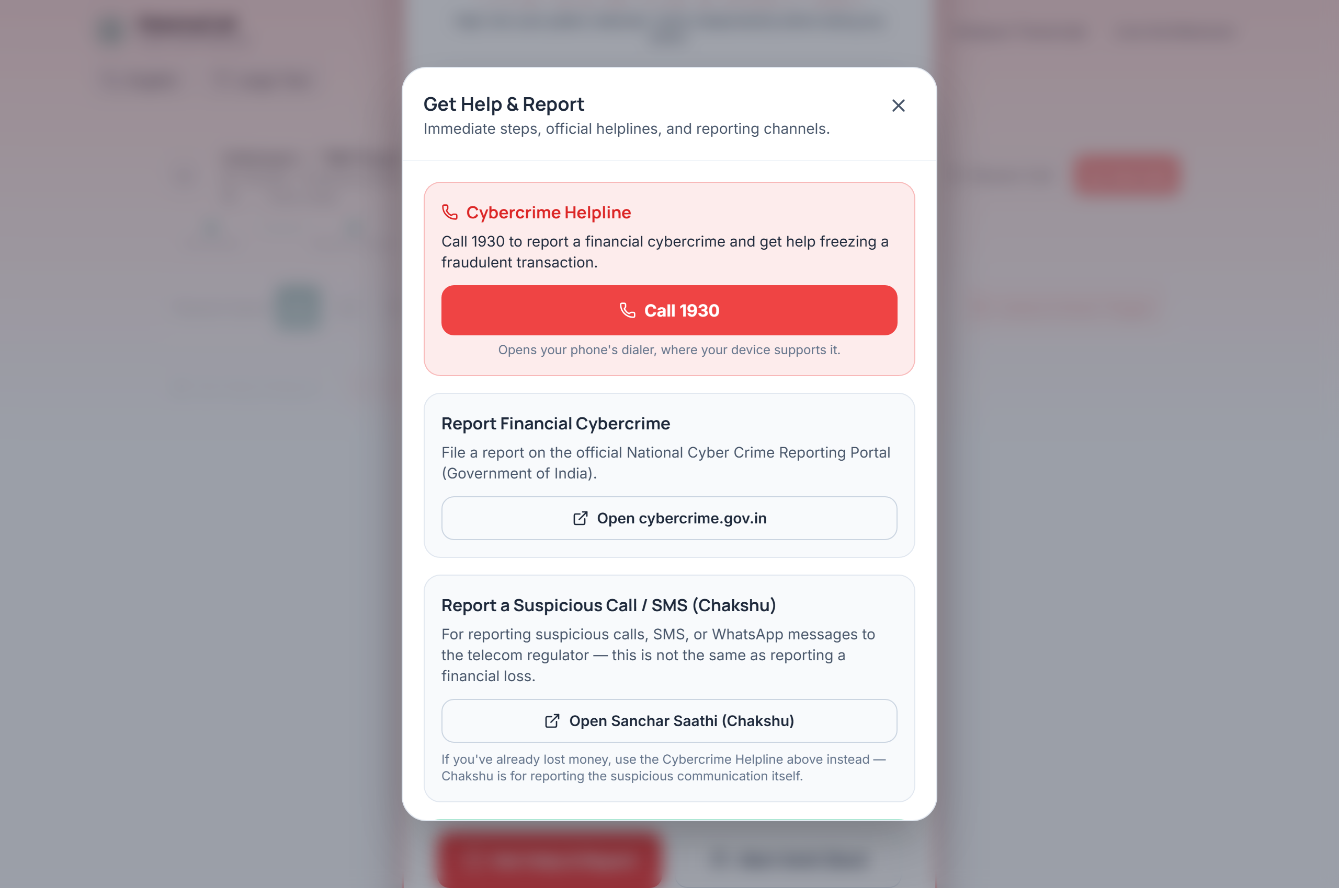
IMMEDIATE SAFETY DIRECTIVES
When Risk Becomes High, RakshaCall Acts
Breaking the psychological manipulation loop with four unambiguous citizen commands.
🛑 STOP
Do not transfer any money or pay verification fees.
🔒 DO NOT SHARE
Never disclose OTPs, PINs, CVVs, or passwords.
📞 DISCONNECT
Immediately hang up the suspicious call.
🔍 VERIFY
Independently contact official numbers directly.
RakshaCall · HACKDAY 1.0 · Real-Time Scam-Call Protection
5 / 7

Slide 6
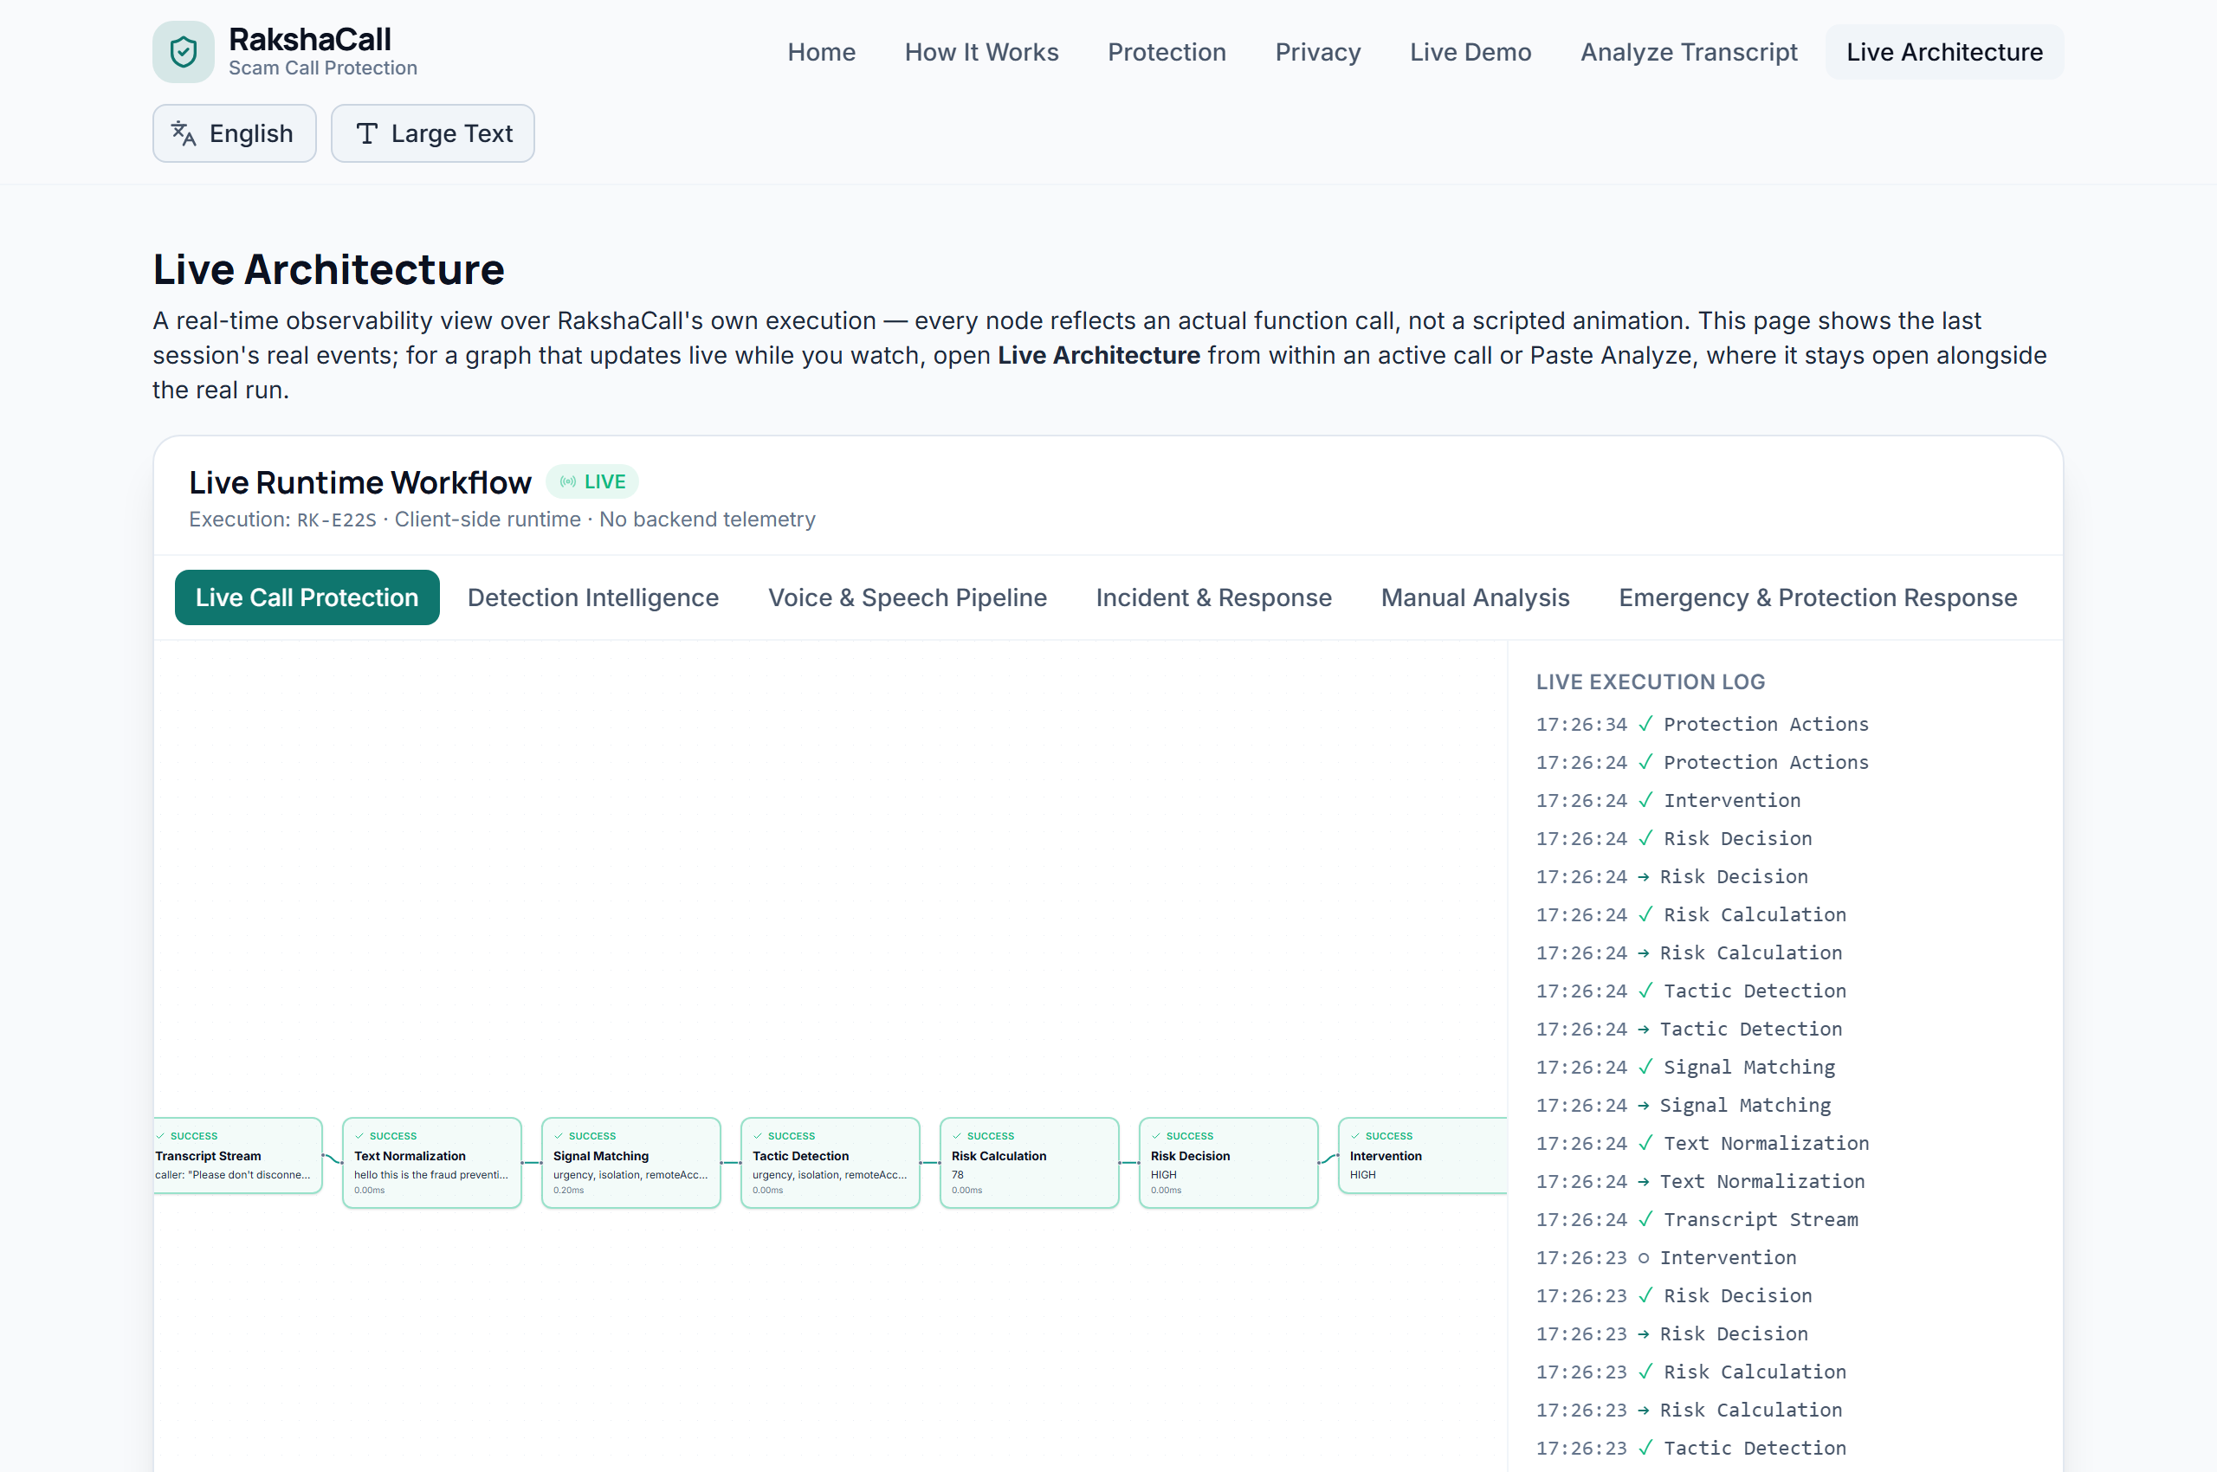
RUNTIME OBSERVABILITY FOR JUDGES & ENGINEERS
See What RakshaCall Is Doing — Live
A dedicated technical observatory providing live visibility into internal function execution without cluttering citizen UX.
🔬 Browser-Native Cross-Tab Synchronization
• Real Execution Graph: Reflects actual function calls, state transitions, and timestamps — not an animation.
• BroadcastChannel Pub/Sub: Runs in a separate tab or side-by-side window, synchronizing live with the active call session.
• 7 Observable Workflows:
1. Live Call Protection (stream orchestration)
2. Detection Intelligence (regex/math matrix)
3. Voice & Speech Activity (TTS synthesis)
4. Incident & Response (forensics builder)
5. Manual Analysis (pasted text engine)
6. Emergency Response (action triggers)
7. Session Lifecycle (state reset & tear-down)
• Node-Level Inspections: Status (running/success), execution duration, inputs, and extracted quotes.
RakshaCall · HACKDAY 1.0 · Real-Time Scam-Call Protection
6 / 7

Slide 7
IMPACT, DELIVERABLES & LIVE ACCESS
RakshaCall — From Detection to Action
Protecting citizens during the scam call — when intervention matters most.
🌟 Core Hackathon Value
✓ Solves the 'Golden Hour' Dilemma: Intervenes before money leaves the victim's account.
✓ 100% Privacy-Preserving: Zero audio/text leaves the user's browser. Zero backend.
✓ Zero Cost & Zero API Dependencies: Immune to cloud outages, subscription costs, or API keys.
✓ Explainable & Transparent: Every risk score points to exact phrases and tactic categories.
✓ Multilingual Indian Context: Supports English, Hinglish, Hindi, and Marathi code-mixing.
✓ 203/203 Vitest Suite Passed: Production-tested reliability and complete CI/CD automation.
🚀 Verified Live Resources
• Live Application Demo:
https://daanialmirza5.github.io/RakshaCall/
• Live Runtime Observatory:
https://daanialmirza5.github.io/RakshaCall/#/observatory
• Open Source Repository:
https://github.com/daanialmirza5/RakshaCall
• Verified Demo Video:
docs/demo/RakshaCall-Demo.mp4
TEAM: daanialmirza · HACKDAY 1.0
Daanial Baig & Aayush Patil
RakshaCall · HACKDAY 1.0 · Real-Time Scam-Call Protection
7 / 7

