Slide 1

TRIBHUVAN UNIVERSITY
Institute of Engineering
Pulchowk, Lalitpur
Project Report Presentation
on
AN ADAPTIVE OVERCURRENT PROTECTION SCHEME FOR DUAL-SETTING
DIRECTIONAL RECLOSER AND FUSE COORDINATION IN UNBALANCED
DISTRIBUTION NETWORKS WITH DISTRIBUTED GENERATION
Submitted To
Department of Electrical Engineering
Pulchowk, Lalitpur
Submitted By
Jhala Nath Kafle
081MSPSE009
OCTOBER, 2026
Notes:
Good afternoon. I am Jhala Nath Kafle, roll number 081 MSPSE 009. My project is on dual-setting directional recloser and fuse coordination in distribution networks with distributed generation.

Slide 2
Abstract
IEEE 13-node feeder, 4.16 kV, with a 4.05 MVA synchronous DG at node 692, in DIgSILENT PowerFactory
A DG changes the magnitude and the direction of the fault current, so conventional recloser–fuse (fuse-saving) coordination can be lost.
The study implements a dual-setting directional recloser (DSDR): the mid-line recloser gets independent forward and reverse settings.
The work uses unbalanced load flow, short-circuit studies for LG, LL, LLG and LLL faults, manufacturer-based relay and fuse curves, and an EMT simulation.
With the DG, a conventional recloser keeps coordination in 24 of 39 fault cells; the DSDR alone in 25.
The DSDR with a revision of the fuse sizes keeps 38 of 39 cells; the remaining LG fault at node 692 is limited by the delayed dial range.
Core message: the dual setting restores the coordination between the grid and the DG, but only together with the fuse revision.
2
Notes:
A DG can break recloser-fuse coordination. I implemented a dual-setting directional recloser on the IEEE 13-node feeder. With the DG, coordination holds in 24 of 39 cells; with the DSDR and revised fuses, in 38 of 39.

Slide 3
Presentation Roadmap
Chapter I
Introduction, problem statement, objectives, scope and limitation
Chapter II
Literature review, research gap and positioning of the project
Chapter III
Methodology: test system, flowchart, formulation and protection settings
Chapter IV
Results and discussion: coordination without DG and with DG; DG penetration; the DSDR; EMT check
Chapter V
Conclusion, recommendation and future scope
References
Method, test feeder and device sources
3
Notes:
I will go through the introduction, literature, methodology, results and conclusion.

Slide 4
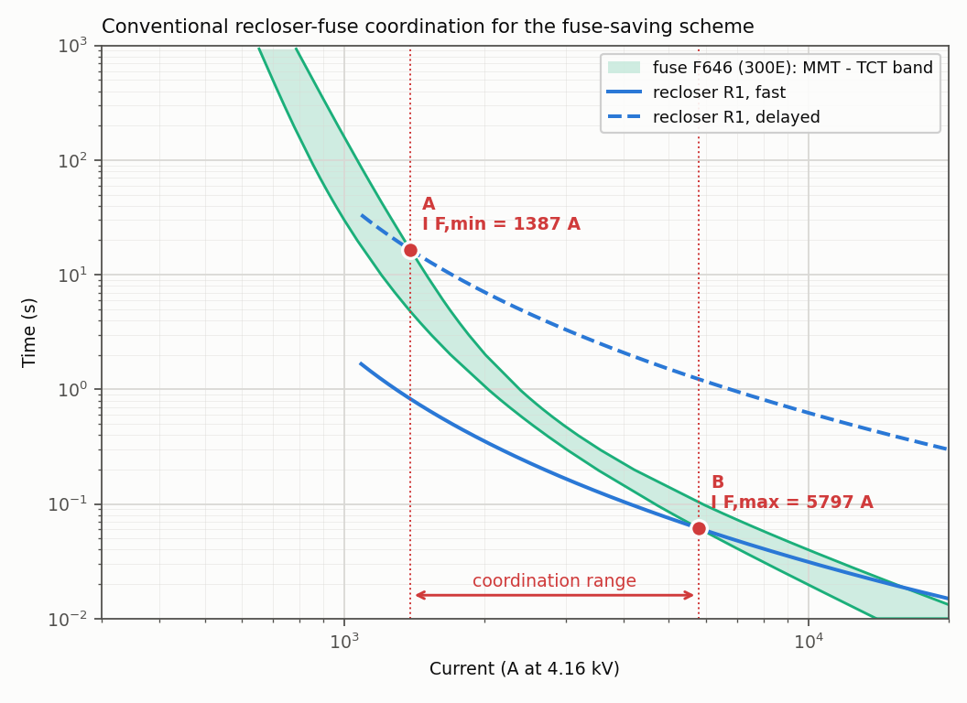
Chapter I: Background and Problem
Fuse saving: the recloser trips on its fast curve before the lateral fuse melts; its delayed curve lets the fuse clear a permanent fault.
Coordination holds only while the recloser and the fuse carry the same current.
With a DG the fuse carries grid + DG current; the recloser only the grid share.
A mid-line recloser can see current in the reverse direction.
The fuse can melt before the fast trip: fuse saving is lost.
Conventional recloser–fuse coordination (R1 and fuse F646)
Fast curve below the fuse band, delayed curve above it.
Problem focus: can independent forward and reverse settings of the mid-line recloser restore the recloser–fuse coordination when a DG is connected?
4
Notes:
The recloser trips fast to save the fuse on a temporary fault. That works only while both carry the same current. With a DG the fuse carries more current than the recloser, and it can melt first.

Slide 5
Chapter I: Objectives and Study Scope
General Objective
To build and validate a DIgSILENT PowerFactory implementation of the dual-setting directional recloser (DSDR) coordination method on the IEEE 13-node feeder, with and without distributed generation.
Specific Objectives
1. To build and verify the IEEE 13-node feeder with its recloser and fuse protection.
2. To perform unbalanced load-flow and short-circuit studies for LG, LL, LLG and LLL faults.
3. To calculate the recloser pickups, time dials and fuse coefficients.
4. To establish the coordination without DG, and with a 4.05 MVA synchronous DG at node 692.
5. To design the DSDR settings of R2 and classify the resulting coordination.
6. To verify the reclosing sequence in the time domain (EMT simulation).
7. To study the effect of the DG penetration level from 0 to 100 %.
Scope: IEEE 13-node feeder; 12 fault locations × 4 fault types = 39 cells; one DG location (692); zero-margin criterion CTI > 0.
5
Notes:
The general objective is to build and validate the DSDR method on the IEEE 13-node feeder in PowerFactory. There are seven specific objectives, from building the model to the DG penetration study.

Slide 6
Chapter I: Limitations of the Study
Settings not specified by the method. R2's plug and dial settings, the fuse sizes and the source impedance are not given, so they were defined in this study and are listed.
1
R2 is not directional in the library. The CDG34 model has no direction element: the forward and reverse groups are separate relay units and the direction is assigned from the fault location.
2
Zero-margin criterion. Coordination is held when the fuse does not start to melt before the fast trip; no breaker time or safety factor is added.
3
One DG location and one machine type. A synchronous DG at node 692 only; the penetration study keeps the settings of the design without DG.
4
Reading the results: the cell counts apply to these settings and to the zero-margin criterion.
6
Notes:
These are the limits of the study. The method does not fix the R2 settings, the fuse sizes or the source, so I defined them. The library relay is not directional, so the direction is assigned from the fault location. Coordination uses a zero-margin criterion. There is one DG location.

Slide 7
Chapter II: Literature Positioning and Gap
Literature stream | Representative sources | Relevance and remaining gap
Recloser–fuse coordination with DG | Naiem et al. [3] | Classifies when coordination holds or is lost with DG; fixed, single settings.
Dual-setting directional recloser | Yousaf et al. [1] | The method implemented here; R2 settings and fuse sizes are not fully specified.
Relay characteristics | Benmouyal et al. [2]; GE Multilin [4] | Inverse-time equations; the method uses a generic curve, real relays have fixed curves and dial ranges.
Test feeder and benchmark | Kersting [5]; Kersting & Shirek [7]; Yousaf et al. [6] | IEEE 13-node data and short-circuit benchmark used to validate the model.
Gap addressed: an independent PowerFactory implementation of the DSDR method with manufacturer-based curves, real dial ranges and standard fuse sizes.
7
Notes:
The literature covers coordination with DG, the DSDR method, relay curves and the test feeder. The gap is an independent implementation with real relay curves, dial ranges and fuse sizes.

Slide 8
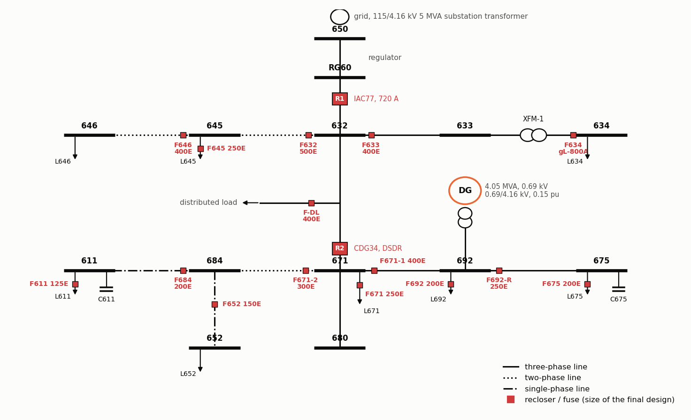
Chapter III: Study System and Inputs
Item | Methodological definition
Test system | IEEE 13-node feeder, 4.16 kV, unbalanced
Source | 115 kV grid, 5 MVA substation transformer
DG | 4.05 MVA synchronous machine at node 692
R1 (feeder head) | GE IAC77B801A, extremely inverse
R2 (line 632–671) | GE/Alstom CDG34 – becomes the DSDR
Fuses | A055C, E-rated, on the laterals
Studies | Unbalanced load flow, short circuit, EMT
Parameters of the synchronous DG
Parameter | Value | Parameter | Value
Rating Sn | 4.05 MVA | Xd | 1.4 pu
Voltage Un | 0.69 kV | X'd | 0.231 pu
Step-up transformer | 0.69 / 4.16 kV | X''d | 0.118 pu
Transformer reactance xT | 0.15 pu | Starting time M = 2H | 1.5 s
Operating point | 3.24 MW | Stator resistance Ra | 0.0014 pu
IEEE 13-node feeder with reclosers R1, R2, fuses and the DG
8
Notes:
Study carried out in A 4.16 kV feeder with a 4.05 MVA synchronous DG at node 692. R1 is at the feeder head, R2 is on line 632 to 671, and fuses protect the laterals.

Slide 9
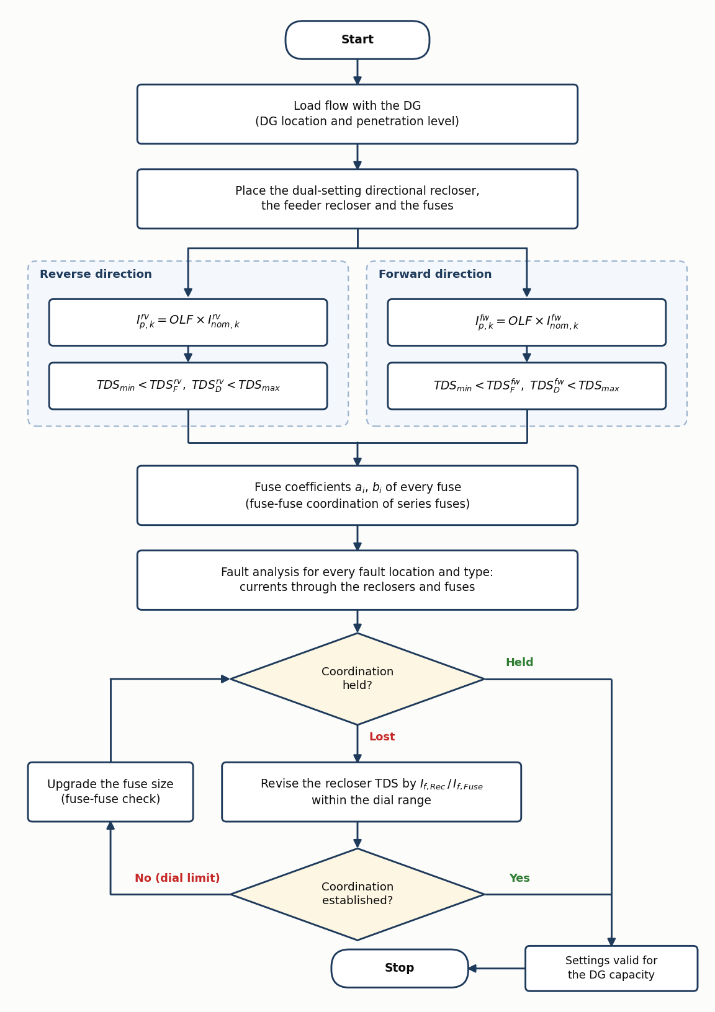
Chapter III: Overall Methodology Flowchart
Stage A: conventional scheme without DG; pickup I_p = 1.25 × I_nom; fuses sized and checked.
Stage B: the same settings with the DG connected; all 39 cells classified.
Stage C: R2 as a DSDR; reverse pickup from the reverse load current; forward and reverse dials.
If coordination is lost: revise the time dial; at the dial limit, upgrade the fuse size.
Check: the fuse must not start to melt before the fast trip, and must clear before the delayed trip.
9
Notes:
Load flow determines branch currents, and recloser pickups are set at 1.25× current. R2 uses separate forward/reverse settings for grid and DG. Fuses are sized, then faults are checked. If coordination fails, the time dial is adjusted first, followed by increasing the fuse rating if necessary.

Slide 10
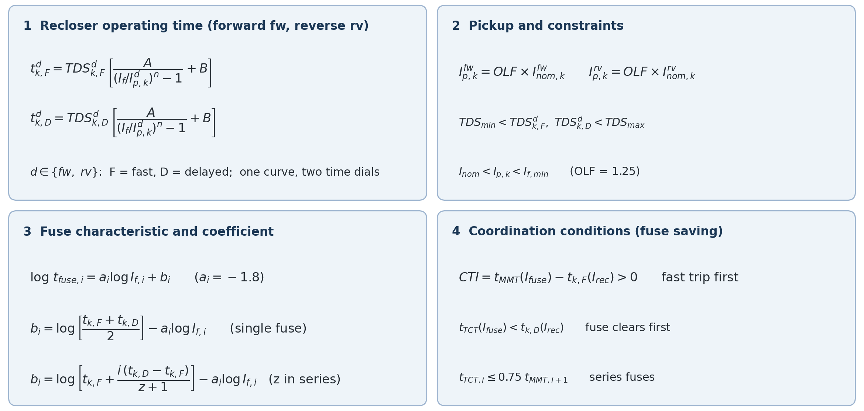
Chapter III: Mathematical Formulation of the Method
10
Notes:
These are the method's equations: the recloser curve, the pickup, the fuse line and the coordination conditions.

Slide 11
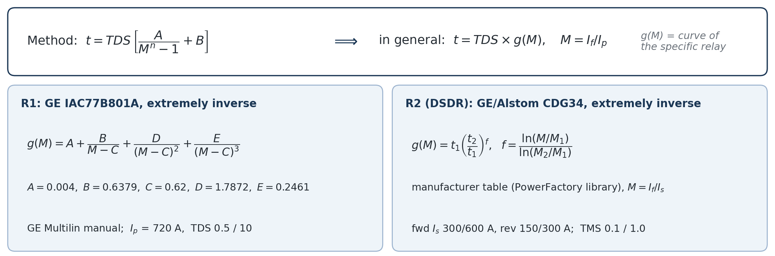
Chapter III: Formulation Used for the Operating Times
The method fixes the structure t = TDS × g(M), with M = I_f / I_p; the constants A, B and n describe only a generic curve.
So g(M) is taken from the manufacturer of each relay: the IAC extremely inverse equation for R1, the CDG34 table for R2.
Check: R1 gives 0.096 / 1.926 s at 4219 A, against 0.097 / 1.932 s in the reference paper.
11
Notes:
I kept the method's structure and used each manufacturer's curve: the GE IAC equation for R1 and the CDG34 table for R2. R1 reproduces the paper's worked example.

Slide 12
Chapter III: Protection Settings
Device | Characteristic | Pickup / plug (fast / delayed) | Dial (fast / delayed)
R1 (feeder head) | GE IAC extremely inverse | 720 A | TDS 0.5 / 10
R2 forward (grid current) | CDG34 | 300 / 600 A | TMS 0.1 / 1.0
R2 reverse (DG current) | CDG34, CT 500/5 | 150 / 300 A | TMS 0.1 / 1.0
Load current through R2: +470 A without DG, −252 A (reversed) with the DG → reverse pickup 1.25 × 252 = 315 A.
A dial revision could not help: R1 and R2 are already at the ends of their dial ranges.
Fuse revision: F632 → 500E; F633, F646, F-DL, F671-1 → 400E; F692-R → 250E.
TDS (IAC relay) and TMS (CDG34 relay) are the manufacturers' names for the same thing: the dial that scales the curve.
12
Notes:
R1 picks up at 720 amperes. R2 has a forward group of 300 and 600 amperes and a new reverse group of 150 and 300. The dials were at their limits, so the fuses were revised.

Slide 13
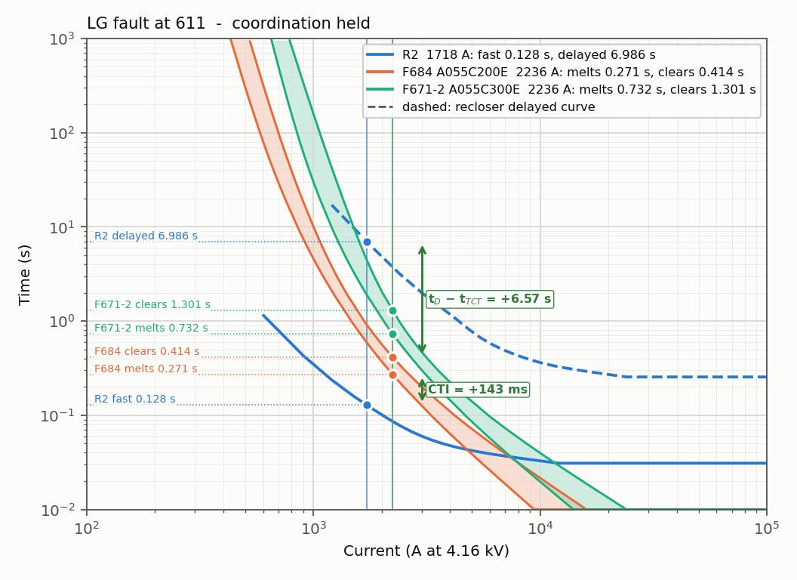
Chapter IV: Base Case Without DG
Quantity | Result
Feeder-head fault level | 4.73 kA
Agreement with the IEEE benchmark | within about 2 %
Cells held, starting fuse sizes | 35 of 39
Cells held, after F692-R → 200E | 39 of 39
R2's fast curve is below the fuses and its delayed curve above them.
Without DG the conventional scheme works.
LG fault at 611: R2 fast 0.128 s < F684 melts 0.271 s – coordination held
13
Notes:
Without DG, 35 of 39 cells are coordinated, and all 39 after one fuse change.

Slide 14
Chapter IV: Branch Currents and Fault Levels – Side by Side
Branch | I nom (A) study | I nom (A) paper | If,min (kA) study | If,min (kA) paper | If,max (kA) IEEE [7] | If,max (kA) study | If,max (kA) paper | Study vs IEEE | Paper vs IEEE
RG60–632 | 587.7 | 587.1 | 1.07 | 1.24 | 4.80 | 4.74 | 5.41 | -1.3 % | +12.7 %
632–633 | 81.0 | 81.1 | 0.76 | 0.72 | 4.15 | 4.10 | 6.73 | -1.1 % | +62.2 %
632–645 | 143.1 | 143.3 | 0.73 | 0.93 | 3.41 | 3.42 | 4.25 | +0.2 % | +24.6 %
632–671 | 470.0 | 478.2 | 0.88 | 1.08 | 3.35 | 3.39 | 4.52 | +1.2 % | +34.9 %
XFM1-HV side | 81.0 | 81.1 | 0.08 | 0.73 | – | 1.81 | 6.48 | – | –
XFM1-LV side | 706.4 | 704.7 | 0.71 | 0.59 | – | 15.67 | 18.76 | – | –
645–646 | 66.1 | 64.9 | 0.73 | 0.84 | 3.05 | 3.11 | 3.64 | +2.0 % | +19.3 %
671–692 | 229.7 | 229.3 | 0.74 | 0.78 | 3.35 | 3.39 | 3.69 | +1.2 % | +10.1 %
671–684 | 71.1 | 70.9 | 0.66 | 0.69 | 2.62 | 2.66 | 3.47 | +1.3 % | +32.4 %
671–680 | 0.0 | 0.0 | 0.64 | 0.59 | 2.91 | 2.93 | 6.25 | +0.7 % | +114.8 %
692–675 | 205.9 | 205.9 | 0.74 | 0.71 | 3.12 | 3.15 | 7.83 | +1.0 % | +151.0 %
684–611 | 71.1 | 70.8 | 0.68 | 0.63 | 1.85 | 1.86 | 1.93 | +0.4 % | +4.3 %
684–652 | 63.0 | 63.1 | 0.66 | 0.66 | 1.79 | 1.87 | 2.67 | +4.7 % | +49.2 %
IEEE benchmark: [7] W. H. Kersting and G. Shirek, “Short circuit analysis of IEEE test feeders,” IEEE PES T&D, 2012 (maximum fault current, DG out). Paper: reference [1], Table II.
Rated currents agree with the paper within 2 %. If,max: this study is within 2 % of the IEEE benchmark at 10 of 11 nodes (largest 4.7 %); the paper is 4 % to 151 % higher. If,min on the 4.16 kV lines: 0.64 to 1.07 kA here, 0.59 to 1.24 kA in the paper.
14
Notes:
Rated currents agree with the paper within 2 per cent. My fault levels match the IEEE benchmark within 2 per cent; the paper's fault levels are higher.

Slide 15
Chapter IV: Fuse Coefficients – Side by Side
Fuse | If (A) | t fast (s) | t delayed (s) | b (this study) | b (paper, Table III) | Difference
F632 | 3418 | 0.133 | 2.67 | 6.35 | 6.38 | -0.03
F633 | 4102 | 0.1 | 2.008 | 6.53 | 6.83 | -0.30
F634 | 15671 | 0.439 | 8.772 | 8.33 | 8.32 | +0.01
F645 | 3418 | 0.133 | 2.67 | 6.62 | 6.65 | -0.03
F646 | 3112 | 0.156 | 3.115 | 6.62 | 6.67 | -0.05
F-DL | 3946 | 0.106 | 2.13 | 6.52 | 6.54 | -0.02
F671 | 3390 | 0.054 | 1.601 | 6.27 | 6.08 | +0.19
F671-1 | 3390 | 0.054 | 1.601 | 6.00 | 5.85 | +0.15
F692 | 3390 | 0.054 | 1.601 | 6.39 | 6.13 | +0.26
F692-R | 3151 | 0.057 | 1.829 | 6.27 | 6.14 | +0.13
F675 | 3151 | 0.057 | 1.829 | 6.44 | 6.19 | +0.25
F671-2 | 2655 | 0.069 | 2.572 | 6.01 | 5.87 | +0.14
F684 | 1857 | 0.113 | 5.778 | 6.35 | 6.15 | +0.20
F611 | 1857 | 0.113 | 5.778 | 6.52 | 6.19 | +0.33
F652 | 1874 | 0.112 | 5.66 | 6.47 | 6.17 | +0.30
Fuse line: log t = a log I + b, with a = −1.8. The coefficients agree within 0.33 for all 15 fuses.
15
Notes:
The fuse coefficients agree with the paper's Table three within 0.33.

Slide 16
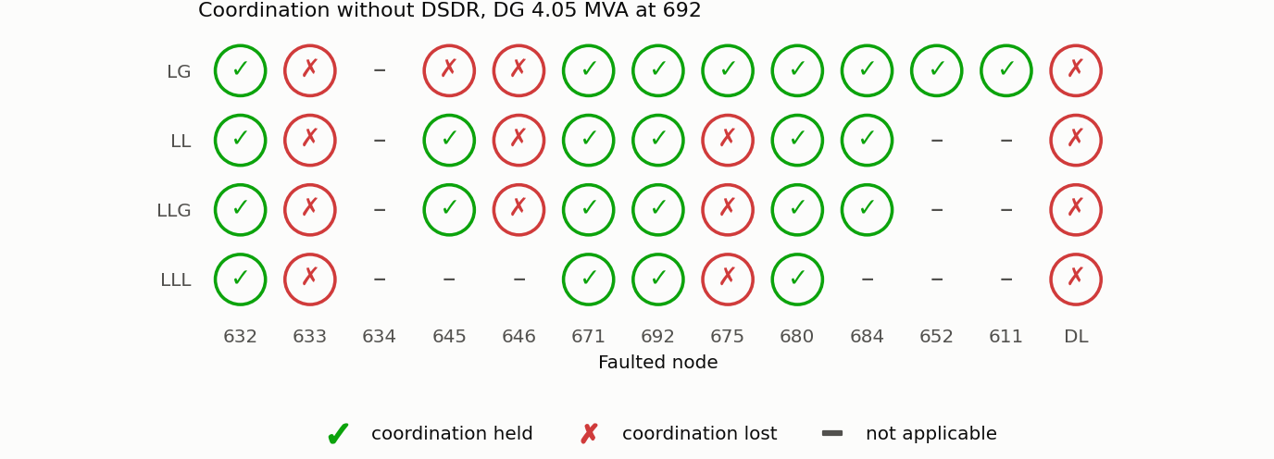
Chapter IV: DG Connected, Conventional R2
Metric | Value
Cells held | 24 of 39
Cells lost | 15
Lost at nodes | 633, 645, 646, DL, 675
Example: three-phase fault near 632 | R2 trips 0.121 s; fuse melts 0.039 s
Coordination status with DG, conventional R2
Green: held. Red: lost.
The fuse carries grid + DG current and melts before the fast trip.
For some LG faults the single-setting R2 does not pick up the reverse DG current.
16
Notes:
With the DG and the same settings, only 24 of 39 cells hold coordination. The fuse melts before the fast trip.

Slide 17
Chapter IV: Coordination with DG – Side by Side
This study – coordination held in 24 of 39 cells
Fault | 632 | 633 | 634 | 645 | 646 | 671 | 692 | 675 | 680 | 684 | 652 | 611 | DL
LG | ✓ | × | – | × | × | ✓ | ✓ | ✓ | ✓ | ✓ | ✓ | ✓ | ×
LL | ✓ | × | – | ✓ | × | ✓ | ✓ | × | ✓ | ✓ | – | – | ×
LLG | ✓ | × | – | ✓ | × | ✓ | ✓ | × | ✓ | ✓ | – | – | ×
LLL | ✓ | × | – | – | – | ✓ | ✓ | × | ✓ | – | – | – | ×
Reference paper [1], Fig. 14 – coordination held in 30 of 39 cells
Fault | 632 | 633 | 634 | 645 | 646 | 671 | 692 | 675 | 680 | 684 | 652 | 611 | DL
LG | ✓ | ✓ | – | × | ✓ | ✓ | ✓ | ✓ | ✓ | ✓ | ✓ | ✓ | ✓
LL | ✓ | ✓ | – | × | × | ✓ | ✓ | ✓ | ✓ | ✓ | – | – | ✓
LLG | ✓ | × | – | × | × | ✓ | ✓ | × | ✓ | ✓ | – | – | ✓
LLL | ✓ | × | – | – | – | ✓ | ✓ | × | ✓ | – | – | – | ✓
Agree in 29 of 39 cells (22 held in both, 7 lost in both). Differ in 10: 8 lost only here (4 of them at DL), 2 lost only in the paper (645). With the DSDR: 38 of 39 here, 39 of 39 in the paper.
17
Notes:
I hold coordination on 24 cell while paper in 30. We agree in 29 of 39 cells.

Slide 18
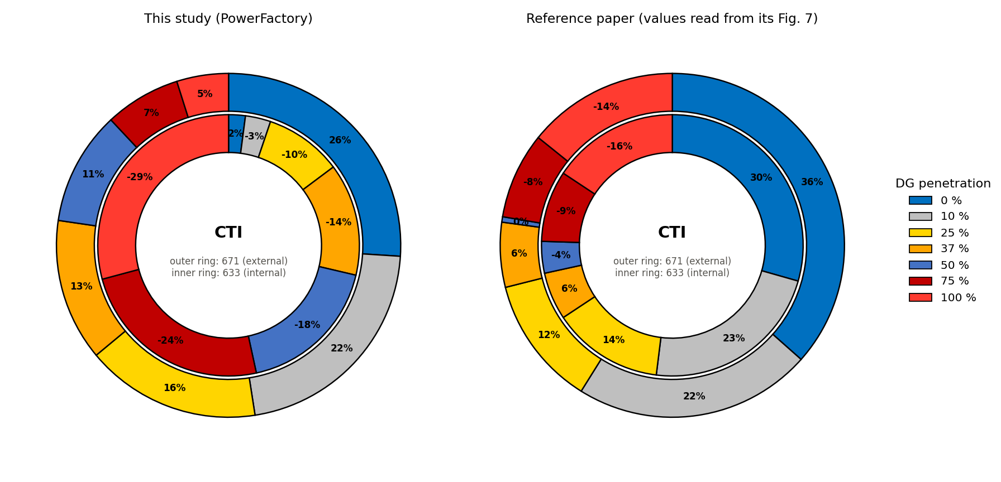
Chapter IV: Effect of the DG Penetration Level – Side by Side
DG (%) | Node 633 study | Node 633 paper | Node 671 study | Node 671 paper
0 | +2.1 | +30 | +26.0 | +36
10 | −3.1 | +23 | +21.5 | +22
25 | −9.6 | +14 | +16.4 | +12
37 | −13.9 | +6 | +13.4 | +6
50 | −17.9 | −4 | +10.7 | 0
75 | −24.2 | −9 | +7.1 | −8
100 | −29.2 | −16 | +4.9 | −14
This study (left) and the reference paper (right)
Share of the CTI at each penetration level (%). Paper: values read from Fig. 7 of [1].
Outer ring: node 671. Inner ring: node 633.
This study, in time: CTI at 633 from +4 ms to −51 ms; at 671 from +403 ms to +75 ms.
The fuse carries grid + DG current, the recloser only the grid share.
Same trend in both: the CTI falls steadily as the DG penetration rises. Node 633 turns negative from 10 % here and from 50 % in the paper, because the starting margin here is only +4 ms.
18
Notes:
As the DG grows from 0 to 100 per cent, the CTI falls: at 633 from plus 4 to minus 51 milliseconds. The paper shows the same trend. This is why an adaptive setting is needed.

Slide 19
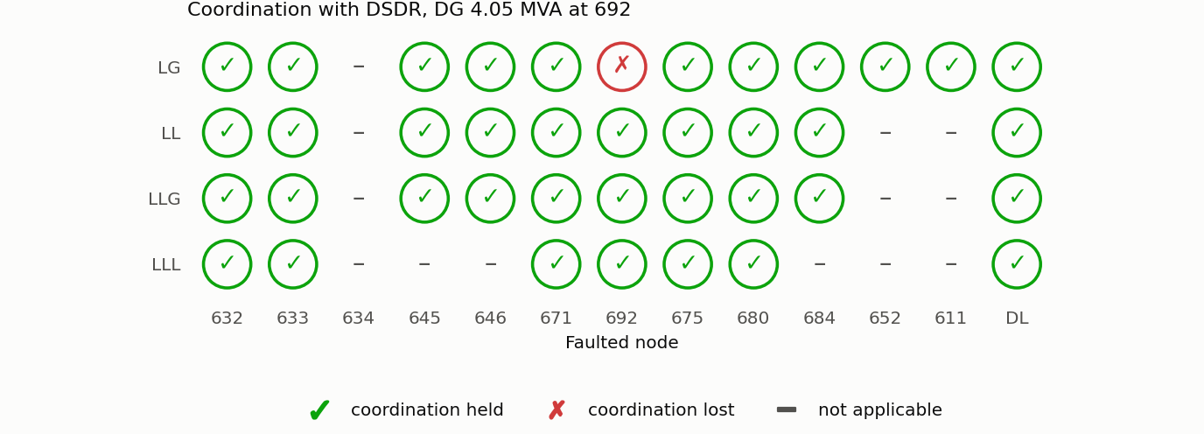
Chapter IV: With the DSDR
Scheme (DG connected) | Cells held
Conventional R2, original fuses | 24
DSDR, original fuses | 25
Conventional R2, revised fuses | 31
DSDR, revised fuses | 38 of 39
Coordination status with the DSDR and revised fuses
Only one cell remains lost.
The dual setting itself restores 7 cells: all faults at 633 and the LG faults at 645, 646 and DL.
Still lost: LG fault at 692 – R2's delayed dial is already at its maximum.
19
Notes:
With the DSDR and revised fuses, 38 of 39 cells hold coordination. The dual setting alone restores seven cells. Only the LG fault at 692 stays lost, at R2's dial limit.

Slide 20
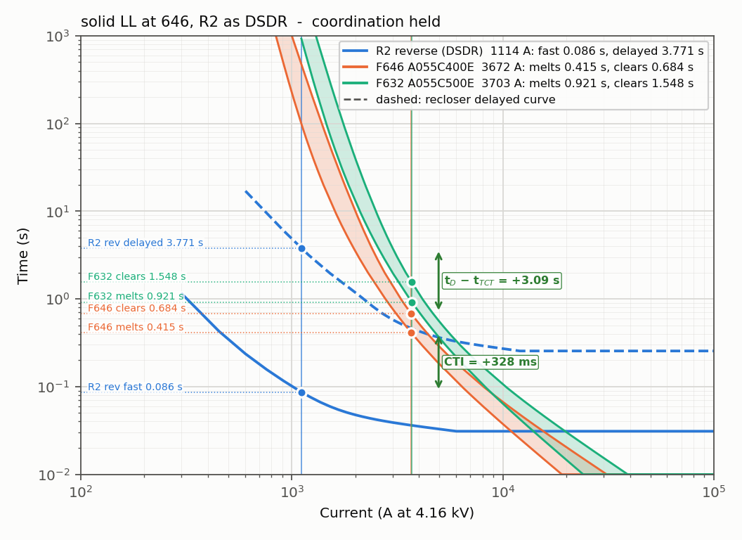
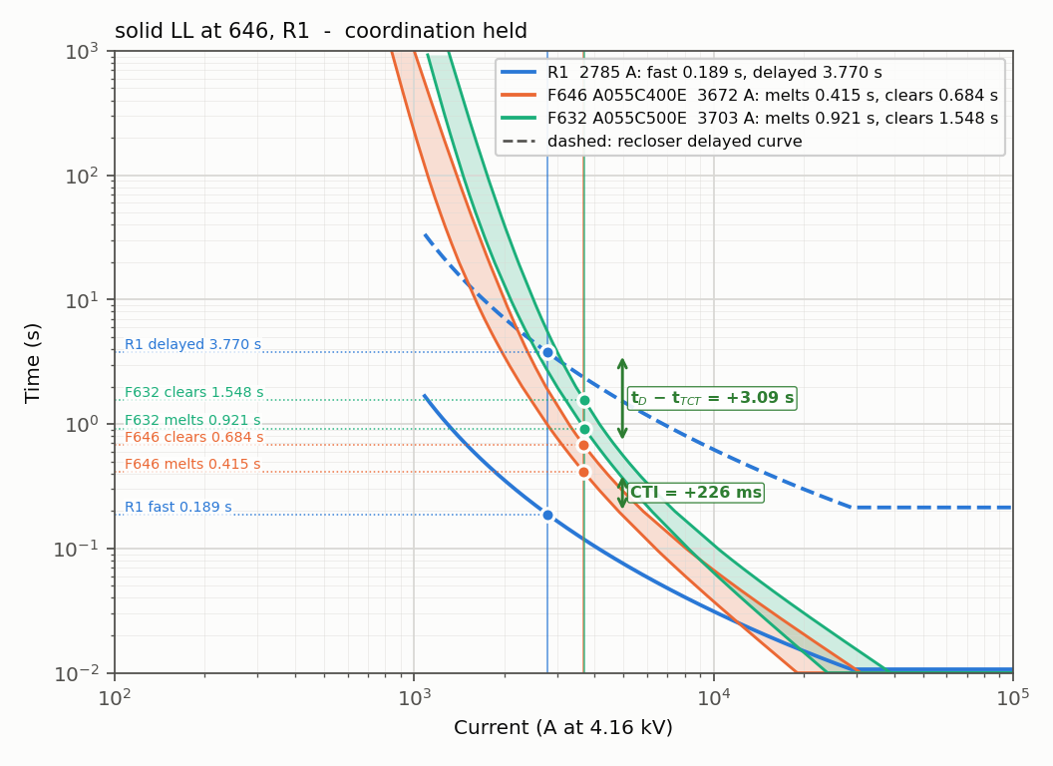
Chapter IV: TCC with the DSDR – Bolted LL Fault at 646
R2 reverse group (DG share, 1114 A): fast trip 0.086 s
R1 (grid share, 2785 A): fast trip 0.189 s
Device | Current | Operates at | Result
R2, reverse group | 1114 A (DG share) | 0.086 s | trips first
R1 | 2785 A (grid share) | 0.189 s | trips second
Fuse F646 (400E) | 3672 A (grid + DG) | starts to melt at 0.415 s | saved, CTI = +226 ms
20
Notes:
For a line-to-line fault at 646, R2 trips in 0.086 seconds on its reverse group and R1 in 0.189. The fuse would melt at 0.415, so it is saved.

Slide 21
Chapter IV: Operating Times with the DSDR – Side by Side
This study (times in s)
Reference paper [1], Table IV (times in s)
Node | Fault | R1 fast | R1 delayed | R2 fast | R2 delayed | Fuse melts
632 | LLL | 0.081 | 1.627 | 0.051 | 1.416 | –
633 | LLL | 0.106 | 2.111 | 0.060 | 2.001 | 0.149
645 | LL | 0.155 | 3.095 | 0.075 | 3.002 | 0.613
646 | LL | 0.189 | 3.770 | 0.086 | 3.771 | 0.415
DL | LLL | 0.106 | 2.123 | 0.048 | 1.213 | 0.121
671 | LLL | 0.134 | 2.677 | 0.054 | 1.600 | –
692 | LLL | 0.134 | 2.677 | 0.054 | 1.600 | 0.525
675 | LLL | 0.158 | 3.152 | 0.059 | 1.941 | 0.065
684 | LL | 0.222 | 4.437 | 0.072 | 2.813 | 0.148
680 | LLL | 0.188 | 3.761 | 0.066 | 2.381 | –
611 | LG | 0.435 | 8.709 | 0.128 | 6.986 | 0.271
652 | LG | 0.446 | 8.919 | 0.123 | 6.570 | 0.138
Node | Fault | R1 fast | R1 delayed | R2 fast | R2 delayed | Fuse melts
632 | LLL | 0.07 | 1.398 | 0.045 | 0.514 | –
633 | LLL | 0.094 | 1.88 | 0.052 | 0.706 | 0.163
645 | LL | 0.105 | 2.095 | 0.087 | 1.659 | 0.276
646 | LL | 0.128 | 2.555 | 0.103 | 2.046 | 0.181
DL | LLL | 0.087 | 1.733 | 0.076 | 1.402 | 0.248
671 | LLL | 0.105 | 2.091 | 0.068 | 1.113 | –
692 | LLL | 0.115 | 2.307 | 0.072 | 1.258 | 0.175
675 | LLL | 0.121 | 2.414 | 0.074 | 1.332 | 0.185
684 | LL | 0.125 | 2.507 | 0.075 | 1.394 | 0.205
680 | LLL | 0.137 | 2.747 | 0.079 | 1.555 | –
611 | LG | 0.326 | 6.523 | 0.146 | 4.385 | 0.417
652 | LG | 0.676 | 13.525 | 0.143 | 9.37 | 0.233
Same behaviour in both: the fuse melts after the fast trip; R1 delayed = 20 × R1 fast (dials 0.5 / 10). R1 is slower here in most rows because the fault levels follow the IEEE benchmark; R2's settings are not published in the paper.
21
Notes:
My operating times next to the paper's Table four. In both, the fuse melts after the fast trip in every row.

Slide 22
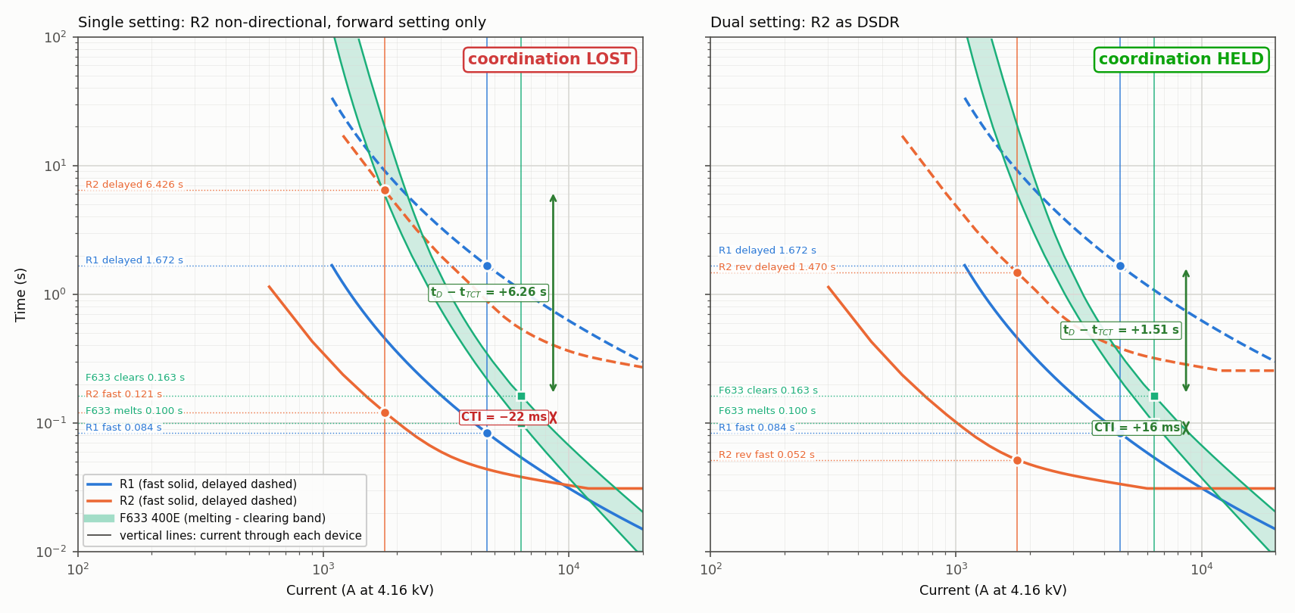
Chapter IV: Single versus Dual Setting
Quantity | Single setting | Dual setting (DSDR)
Current through R2 | 1777 A, reverse | 1777 A, reverse
R2 setting used | Forward: plug 300 / 600 A | Reverse: plug 150 / 300 A
R2 fast trip | 0.121 s | 0.052 s
F633 (400E) starts to melt | 0.100 s | 0.100 s
Fuse saving | LOST | HELD
22
Notes:
Same fault, same current. With the single setting R2 trips in 0.121 seconds: coordination is lost. With the reverse group, 0.052 seconds: coordination is held.

Slide 23
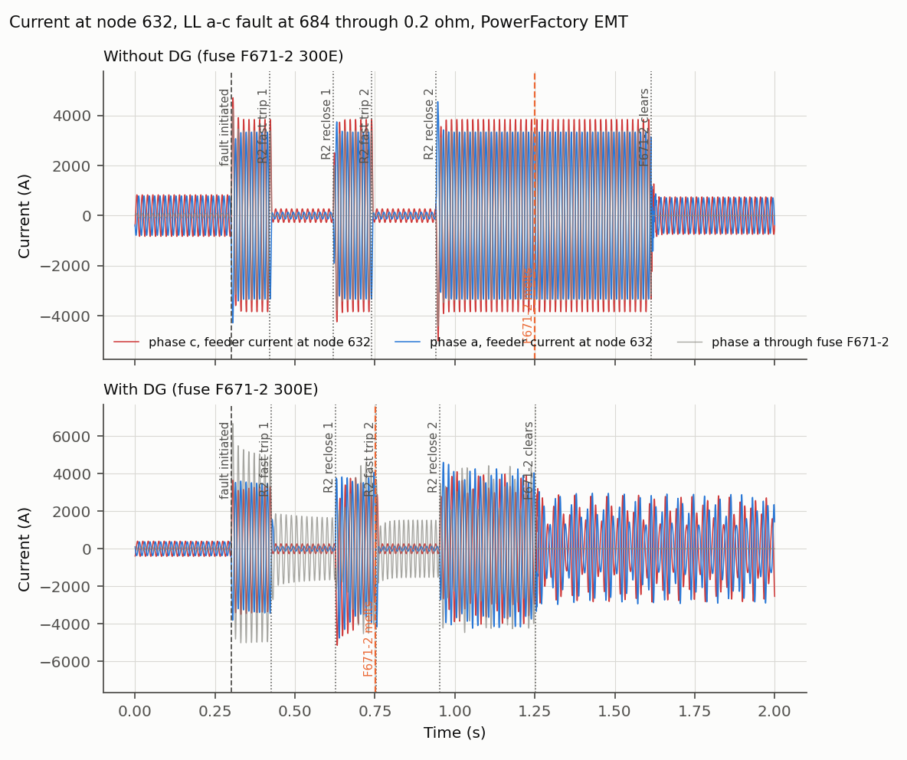
Chapter IV: Time-Domain (EMT) Verification
Event | Without DG | With DG
Fuse F671-2 melts | 1.248 s | 0.752 s
Fuse F671-2 clears | 1.613 s | 1.253 s
Fuse saving | works | lost
LL fault (a–c) at 684 through 0.2 Ω, conventional settings.
With the DG the fuse carries more current, and the DG keeps feeding the fault while R2 is open.
Current at node 632: without DG (top), with DG (bottom)
23
Notes:
The EMT run confirms it in time. Without DG the fuse survives the two fast. With DG it melts during the second shot.

Slide 24
Chapter IV: Summary and Comparison
Stage | This study (of 39) | Reference paper [1]
No DG, starting fuse sizes | 35 | –
No DG, after the fuse revision | 39 | –
DG connected, conventional R2 | 24 | 30
DG connected, original fuses, R2 as DSDR | 25 | –
DG connected, revised fuses, conventional R2 | 31 | –
DG connected, revised fuses, R2 as DSDR | 38 | 39
Same trend as the reference paper. The counts differ because the model is validated against the IEEE short-circuit benchmark (feeder head 4.73 kA) and uses real dial ranges.
24
Notes:
In summary: 24 cells with a conventional recloser, 25 with the DSDR alone, 31 with the fuse revision alone, and 38 with both holds coordination. The paper reports 30 and 39.

Slide 25
Chapter V: Conclusion and Future Scope
Conclusion
The DSDR method was implemented on the IEEE 13-node feeder in DIgSILENT PowerFactory; the model meets the IEEE benchmark within about 2 %.
Without DG: 35 of 39 cells with the starting fuses, 39 of 39 after the fuse revision.
With the DG, a conventional R2 keeps only 24 of 39 cells: the fuse carries grid + DG current and melts before the fast trip.
DSDR alone: 25; fuse revision alone: 31; DSDR with the fuse revision: 38 of 39 (zero-margin criterion).
The DSDR is necessary but not sufficient: it needs the fuse revision; the LG fault at 692 is limited by R2's delayed dial.
Recommendation and Future Scope
Extend the study to the IEEE 34-node feeder and to inverter-based DG.
Model an explicit directional element for R2, and change the setting group with the state of the DG.
Use a recloser with a wider dial range to recover the remaining cell.
25
Notes:
To conclude: the DSDR with the fuse revision raises coordination from 24 to 38 of 39 cells. It is necessary but not sufficient: it needs the fuse revision. Future work includes the 34-node feeder, a true directional element and inverter-based DG.

Slide 26
References
[1] M. Yousaf, A. Jalilian, K. M. Muttaqi, and D. Sutanto, “An adaptive overcurrent protection scheme for dual-setting directional recloser and fuse coordination in unbalanced distribution networks with distributed generation,” IEEE Trans. Ind. Appl., vol. 58, no. 2, pp. 1831–1842, 2022.
[2] G. Benmouyal et al., “IEEE standard inverse-time characteristic equations for overcurrent relays,” IEEE Trans. Power Del., vol. 14, no. 3, pp. 868–872, 1999.
[3] A. Naiem, Y. Hegazy, A. Abdelaziz, and M. Elsharkawy, “A classification technique for recloser-fuse coordination in distribution systems with distributed generation,” IEEE Trans. Power Del., vol. 27, no. 1, pp. 176–185, 2012.
[4] GE Multilin, 735/737 Feeder Protection Relay – Instruction Manual (GEK-106291F), 2010.
[5] W. H. Kersting, “Radial distribution test feeders,” IEEE Trans. Power Syst., vol. 6, no. 3, pp. 975–985, 1991.
[6] M. Yousaf, K. M. Muttaqi, and D. Sutanto, “Overcurrent protection scheme for the IEEE 13-node benchmark test feeder with improved selectivity,” in Proc. IEEE PES General Meeting, 2020.
[7] W. H. Kersting and G. Shirek, “Short circuit analysis of IEEE test feeders,” in Proc. IEEE PES T&D, 2012.
[8] DIgSILENT GmbH, PowerFactory 2021 User Manual, Gomaringen, Germany, 2021.
26
Notes:
These are the main references.

Slide 27
Thank You
Questions and Discussion
27
Notes:
Thank you. I am happy to take your questions.

