Slide 1
Magic Dungeon
Суворова Дарья
Мещанов Михаил

Slide 2
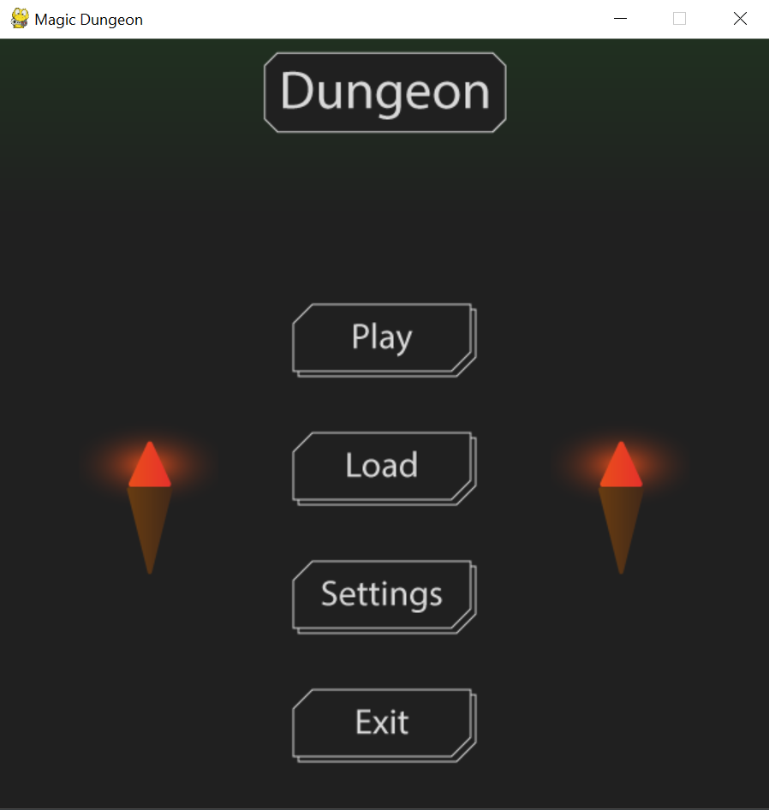
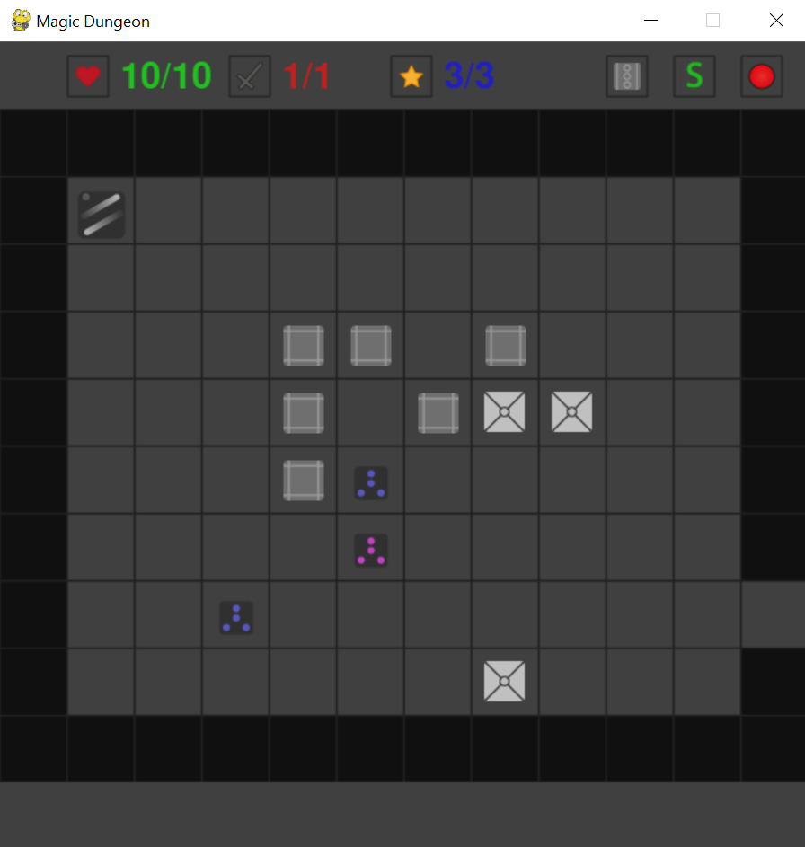
Введение

Slide 3
Примененные технологии
pygame
sqlite2
os
sys

Slide 4
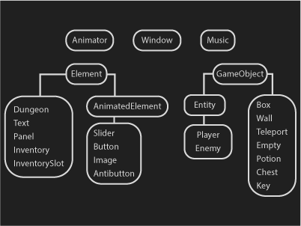
Структура кода

Slide 5
База данных dungeonBase.db
Users
user_name
room_num
Rooms
id
Number
Entities
hit_points
action_points
damage
posX
posY
Enter_posX
Enter_posY
Exit_posX
exit_posY
user
room_id
color
hit_points
posX
posY
max_hit_points
max_action_points
max_gamage
experience
max_experience
max_hit_points
action_points
max_action_points
damage
max_gamage
id
Types_of_objects
id
Objects
Inventory
id
type
user
used
Name
id
type
posX
posY
room_id
inside
color

