Slide 1
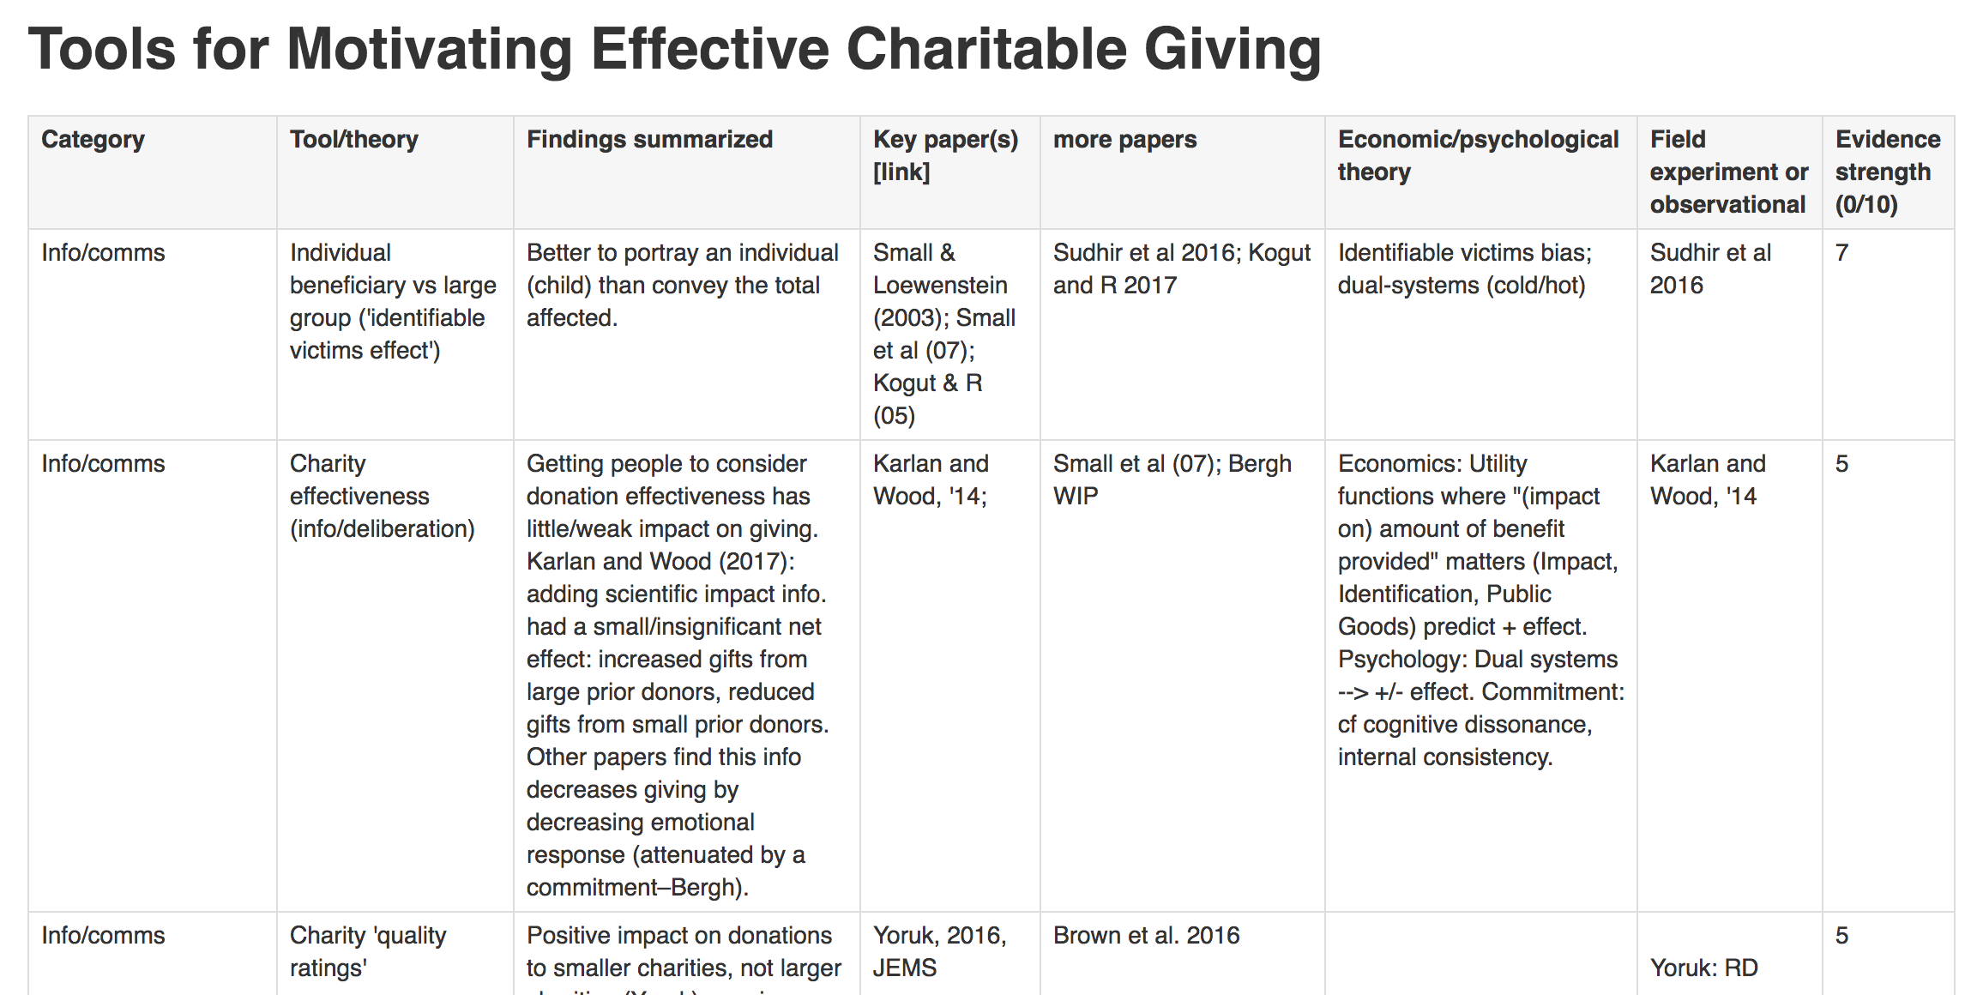
Evidence: how to get donors to give i. to more effective charities, ii. more to effective charities
Dr. David Reinstein, Economics, University of Exeter
innovationsinfundraising.org

Slide 2
Critical issues for effective giving research
The ASK: little vs big guys
Exposure to asks? Crowd-out of asks?
When and how can effectiveness matter? → Responses to…
Ask ⨉ (Mission, Impact, Effectiveness) ⨉ Presentation of info
Notes:
(emotional, statistical,...)

Slide 3
“Expenditure Substitution”?
Does a typical "promo for Cancer Research UK" cause more or less giving to Against Malaria?
Field evidence (isolated asks) → mixed, weak, non-EA
vs.
Lab and proximate asks → Strong crowding-out
Notes:
SKIP THIS SLIDE FOR TIME
Field: 0 or less than complete, largely non-EA setting
→ Effective to ask people to "choose effective charity *instead of* brand-X"?
Still an open question:- Field: Mixed but weak evidence; points to "between zero and complete" crowding- Lab and "proximate" asks finds strong crowding-out

Slide 4

Effectiveness information
1. Freedom from Hunger direct mail study, scientific impact info
→ +/- giving for larger/smaller (prior) donors; small net effect
2. (Non-EA) Charity ratings:
→ strong + evidence, at least for small charities
CW: Careful in encouraging evaluation
← empathy, self-justifying beliefs (but see ‘commitments')
Notes:
Also seems to swap emotional/personal info for the scientific info, and also may be specific to pro-anti university bias
efficiency deliberation may switch off sympathy/system-one, enable self-justifying beliefs\pdfnote{But Bergh finds this is mediated/eliminated by asking for a yes/no commitment after image, before analytical information}\pdfnote{Information may enable self-justification for self-interest (Fong and O-G, 2010 suggests this but net affect unclear)}

Slide 5

Identifiable victims (bias)
Strong, replicated evidence
Notes:
Small & Loewenstein (03); Small et al (07); Kogut and R (05); Sudhir ea; Caveats: does not raise more in joint evaluation (Kogut \& R, 05); mediated by social distance (Ein Gar and L, '12)}

Slide 6
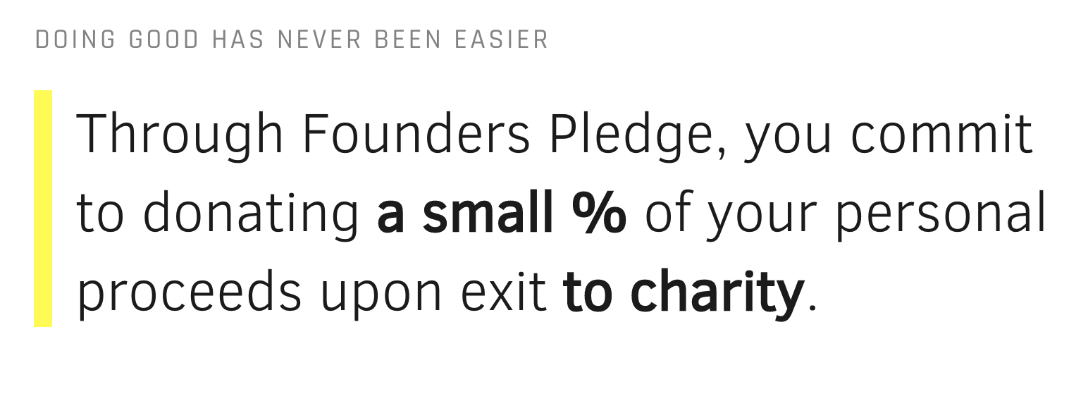

😐
:| “Low-ball”
Small %,
maybe too small anchor
:) 😀
Social, recognition, influence
← strong evidence

Slide 7
Entrepreneurs make a commitment to give IF they have success
Supported by
1. “Give if You Win” (Kellner, Reinstein, Riener 2017)
→ giveifyouwin.org project
2. “Give more tomorrow” (Breman, 2011)

Slide 8
Positive framing
…how much good we can achieve
…not about the mistakes and ineffectiveness of some parts…
Mixed evidence on positive vs negative framing
Positive mood→ generosity (to lab subjects),
but people respond to “loss conditions” and injustices
Notes:
Very mixed evidence; some find negative images/messages reduce donations, others find the opposite, or find this is mediated by congruency of image/message, and temporal framing. Isen & Noonberg (1979). Dyck & Coldevin (1992). (Chang ea, '09).

Slide 9
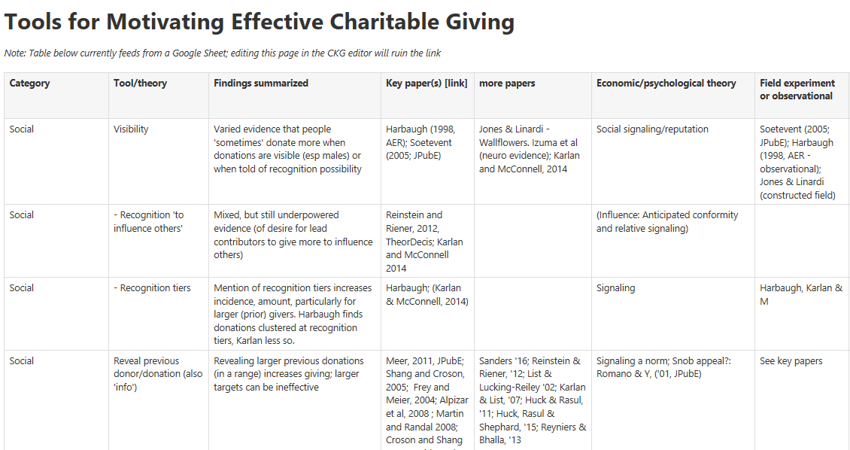
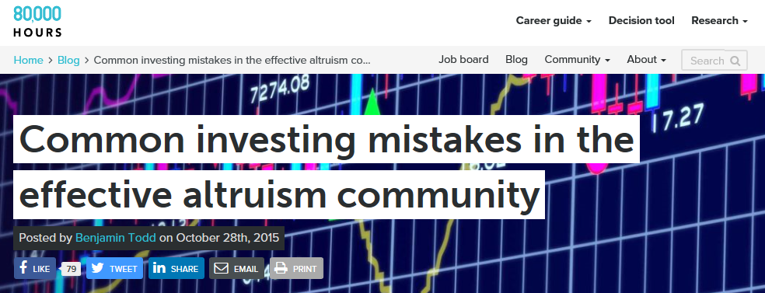

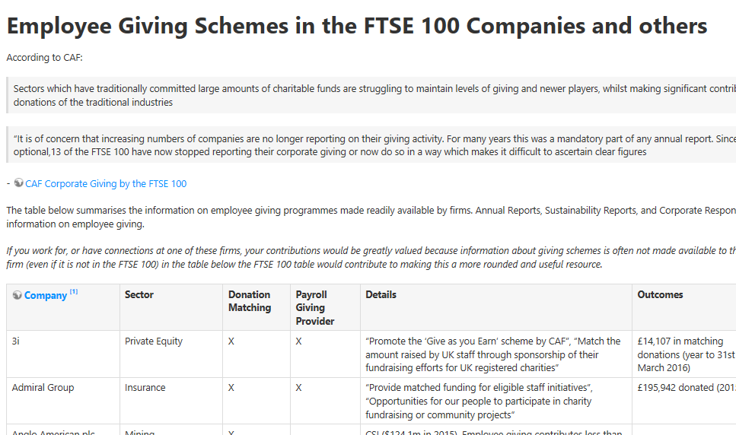

Innovations in Fundraising Wiki

