Slide 1
DHCP, NAT and DNS

Slide 2
Introducing DHCPv4
Dynamic Host Configuration Protocol (DHCP) is a network management protocol used to automate the process of configuring devices on IP networks, thus allowing them to use network services such as DNS, NTP, and any communication protocol based on UDP or TCP.
A DHCP server dynamically assigns an IP address and other network configuration parameters to each device on a network so they can communicate with other IP networks.
DHCP is an enhancement of an older protocol called BOOTP.

Slide 3
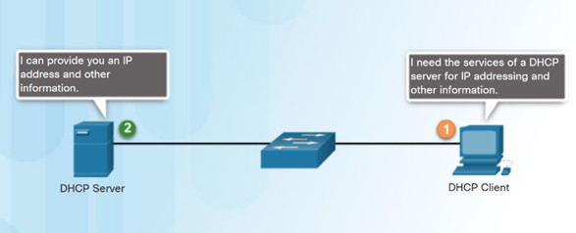
DHCPv4 assigns IPv4 addresses and other network configuration information dynamically.
A dedicated DHCPv4 server is scalable and relatively easy to manage.
A Cisco router can be configured to provide DHCPv4 services in a small network.

Slide 4
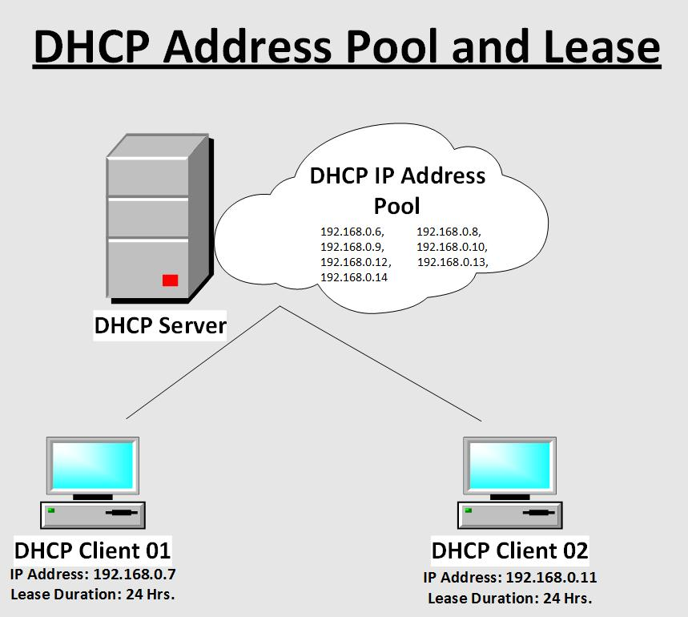

Slide 5
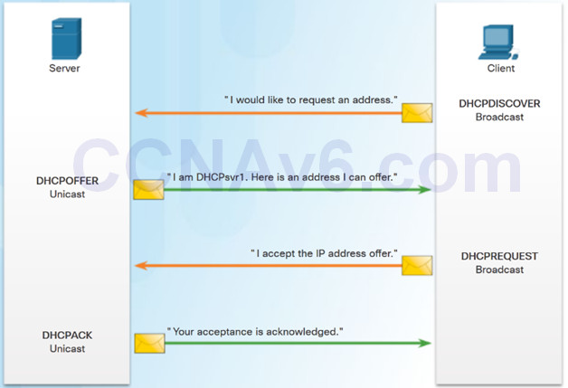
DHCPv4 Operation
Four step process for a client to obtain a lease:
DHCP Discover (DHCPDISCOVER) – client uses Layer 2 and Layer 3 broadcast addresses to find a DHCP server.
DHCP Offer (DHCPOFFER) – DHCPv4 server sends the binding DHCPOFFER message to the requesting client as a unicast.
DHCP Request (DHCPREQUEST) – the client sends back a broadcast DHCPREQUEST in response to the servers offer.
DHCP Acknowledgment (DHCPACK) – the server replies with a unicast DHCPACK message.

Slide 6
Configuration Data Sent by DHCP Server and Key Values
The basic flow is that a DHCP server hands out configuration data, based on the administrator’s policy, to a requesting client. Common network parameters (sometimes referred to as “DHCP Options“) requested include subnet mask, router, domain name server, hostname and domain name.
The DHCP service brings three key values:
Operation tasks are reduced: the network administrator no longer needs to manually configure each client before it can use the network
The IP addressing plan is optimized: addresses no longer being used are freed up and made available to new clients connecting
User mobility is easily managed: the administrator doesn’t need to manually reconfigure a client when its network access point changes.

Slide 7
DHCP Lease Time Management
The IP address information assigned by DHCP is only valid for a limited period of time, and is known as a DHCP lease time.
When the lease expires, the client can no longer use the IP address and has to stop all communication with the IP network unless he requests to extend the lease “rent” via the DHCP lease renewal cycle.
To avoid impacts of the DHCP server not being available at the end of the lease time, clients generally start renewing their lease halfway through the lease period. This renewal process ensures robust IP address allocation to devices.
Any device asking for a new IP version 4 address at arrival on the network and not receiving an answer will use automatic private internet protocol addressing (APIPA) to select an address. These addresses are in the network range 169.254.0.0/16.

Slide 8
NAT (Network Address Translation)

Slide 9
NAT (Network Address Translation)
What's a Private IP address?
A private IP address is an IP address that's reserved for internal use behind a router or other Network Address Translation (NAT) device, apart from the public. Private IP addresses are in contrast to public IP addresses, which are public and can't be used within a home or business network. Sometimes a private IP address is also referred to as a local IP address.
How you connect to the world.
You're public IP address is the IP address that someone on the other end of your Internet activity would see. That's the only reason it's known as a public IP address.

Slide 10
Why Private IP Addresses Are Used
Instead of having devices inside a home or business network each use a public IP address, of which there's a limited supply, private IP addresses provide an entirely separate set of addresses that allow access on a network but without taking up a public IP address space.
For example, most routers in homes and businesses across the globe have the IP address of 192.168.1.1, and assign 192.168.1.2, 192.168.1.3, ... to the various devices that connect to it (using DHCP).
It doesn't matter how many routers use the 192.168.1.1 address, or how many dozens or hundreds of devices inside that network share IP addresses with users of other networks because they aren't communicating with each other directly. Instead, the devices in a network use the router to translate requests through the public IP address, which can communicate with other public IP addresses and eventually to other local networks.

Slide 11
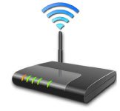
Public and Private. Working together to get you connected.
In theory, your computer must have its own unique IP address so that it will only receive the information that is meant for you.
However, that's not how it works out, because of one major exception—network computers that are linked to a router and share the same public IP address.
Yes. If you have a router, you have a private IP address.
Reserved for private networks.
The organizations that distribute IP addresses to the world reserves a range of IP addresses for private networks.
192.168.0.0 - 192.168.255.255 (65,536 IP addresses)
172.16.0.0 - 172.31.255.255 (1,048,576 IP addresses)
10.0.0.0 - 10.255.255.255 (16,777,216 IP addresses)

Slide 12
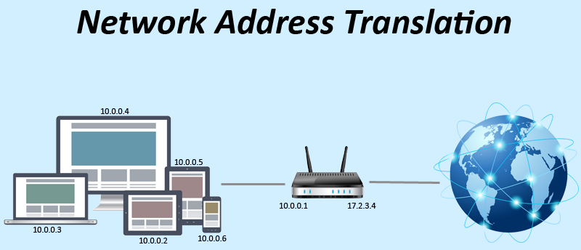

Slide 13
Your simple home network, with its router at the centre and computers connected to it—wired or wireless—classifies as one of those networks.
Your router—once it makes its Internet connection through your Internet Service Provider—sends Internet activity to any computer connected to your router, and is the basis of a networking innovation called a Network Address Translation (NAT).
NAT is a process in which your router changes your private IP Address into a public one so that it can send your traffic over the Internet, keeping track of the changes in the process.
When the information comes back to your router, it reverses the change—from a real IP address into a private one—and forwards the traffic back to your computer.
In other words, the router connects to the other devices (usually desktops, laptops and tablets).

Slide 14
That's the point: Your private address is just for your router, your network and you.
The private address ranges in a network don't have to be synchronized with the rest of the world and Internet.
As a matter of fact, the private address range can be used by more than one address. A network administrator using these private addresses has more room for subnetting, and many more assignable addresses.
These blocks of addresses can be used by a private network. Even if your neighbor is using the exact same addresses, it won't cause a problem, because that's HIS or HER network, not yours.

Slide 15
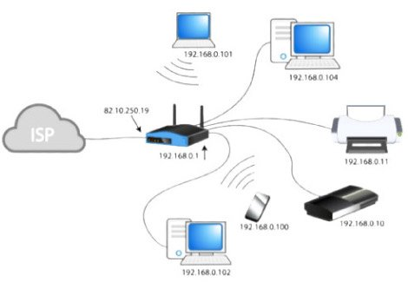
You see, these private addresses are known as non-routable addresses. The networking on the Internet routes Internet activity connected to your public IP address only, not your private IP.

Slide 16
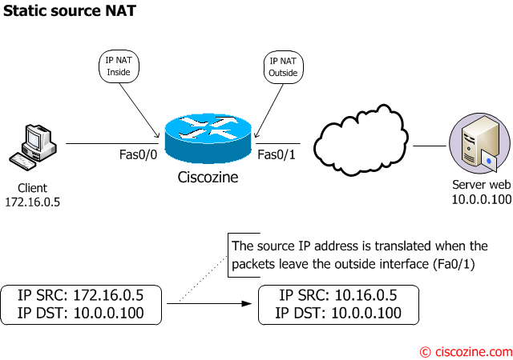
https://www.ciscozine.com/nat-and-pat-a-complete-explanation/

Slide 17
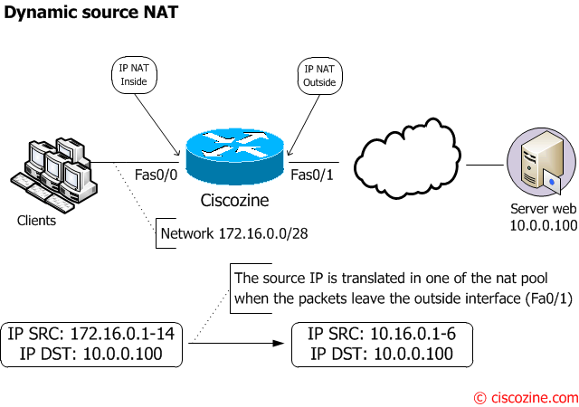

Slide 18
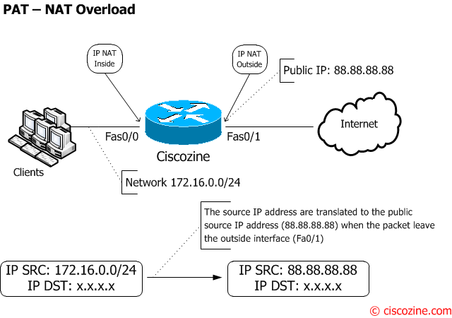

Slide 19
DNS (Domain Name System)

Slide 20
The networks which are running on TCP/IP protocol suite use IP Address (IPv4 Address or IPv6 Address), as the addressing mechanism.
IP address uniquely identifies a TCP/IP device in the network. However, it is difficult for the humans to remember IP Addresses for all the computers they want to communicate.
Think about difficulty in remembering the IP Addresses of 1000s of web sites we use, if we do not have the option to use their names.
Humans prefer to use names instead of IP Addresses. Hence we need a system to map human readable names to corresponding IP Addresses.

Slide 21
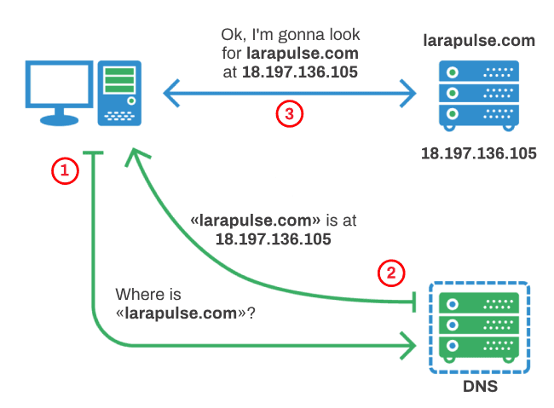

Slide 22
