Slide 1
Exercise 2-1
Implement authenticated perfect links using digital signature primitive

Slide 2
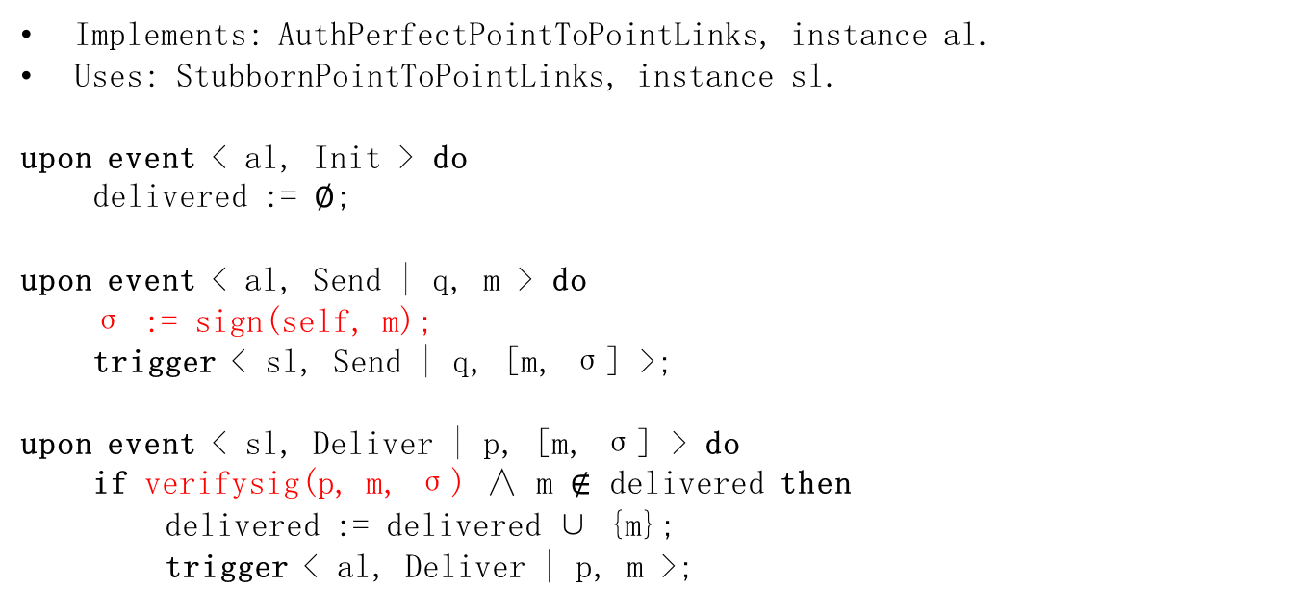
Algorithm
Implements: AuthPerfectPointToPointLinks, instance al.
Uses: StubbornPointToPointLinks, instance sl.
upon event < al, Init > do
delivered := ∅;
upon event < al, Send | q, m > do
σ := sign(self, m);
trigger < sl, Send | q, [m, σ] >;
upon event < sl, Deliver | p, [m, σ] > do
if verifysig(p, m, σ) ∧ m $∉$ delivered then
delivered := delivered ∪ {m};
trigger < al, Deliver | p, m >;

Slide 3
Exercise 2-2
What happens if the assumption for Δ is not held? Which properties of leader election module are violated? Give an example.
Accuracy is violated.
LE2. Accuracy: If a process is leader, then all previously elected leaders have crashed.

Slide 4

Example
2Δ
2Δ
p1
p2
p3
heartbeat_
request
heartbeat_
reply
heartbeat_
request
heartbeat_
reply
p1 :
leader = p1
p1 :
leader = p1
leader = p1
detected = {p3}
detected = {p3}
p2:
leader = p2
detected ={p1}
p2:
leader = p2
detected ={p1}

Slide 5
Exercise 2-3
If we would prefer p2 to be the leader (though it may crash), give an eventual leader detection algorithm that additionally ensures
If p2 does not crash, then eventually p2 is elected as the leader by every correct process.

Slide 6
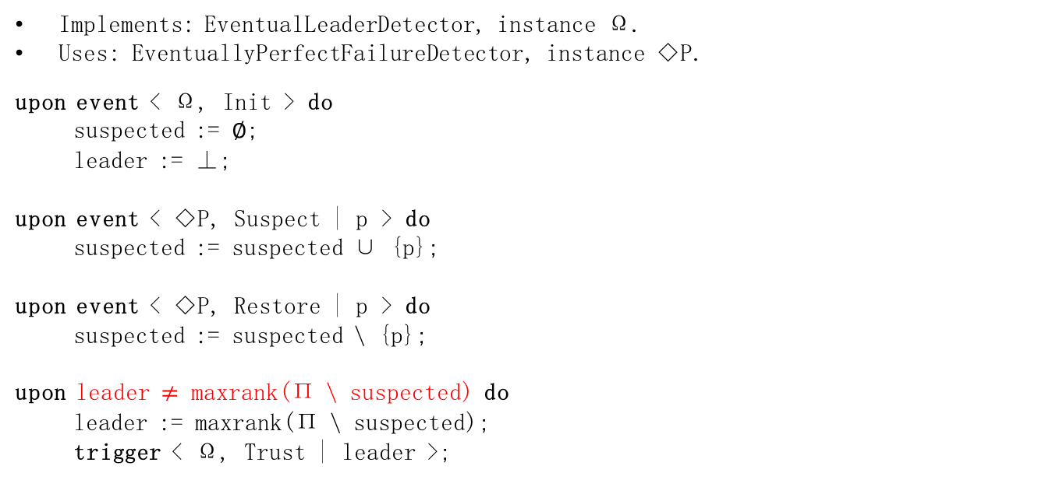
Algorithm: Monarchical Eventual Leader Detection
Implements: EventualLeaderDetector, instance Ω.
Uses: EventuallyPerfectFailureDetector, instance ◇P.
upon event < Ω, Init > do
suspected := ∅;
leader := ⊥;
upon event < ◇P, Suspect | p > do
suspected := suspected ∪ {p};
upon event < ◇P, Restore | p > do
suspected := suspected \ {p};
upon leader $≠$ maxrank(Π \ suspected) do
leader := maxrank(Π \ suspected);
trigger < Ω, Trust | leader >;

Slide 7
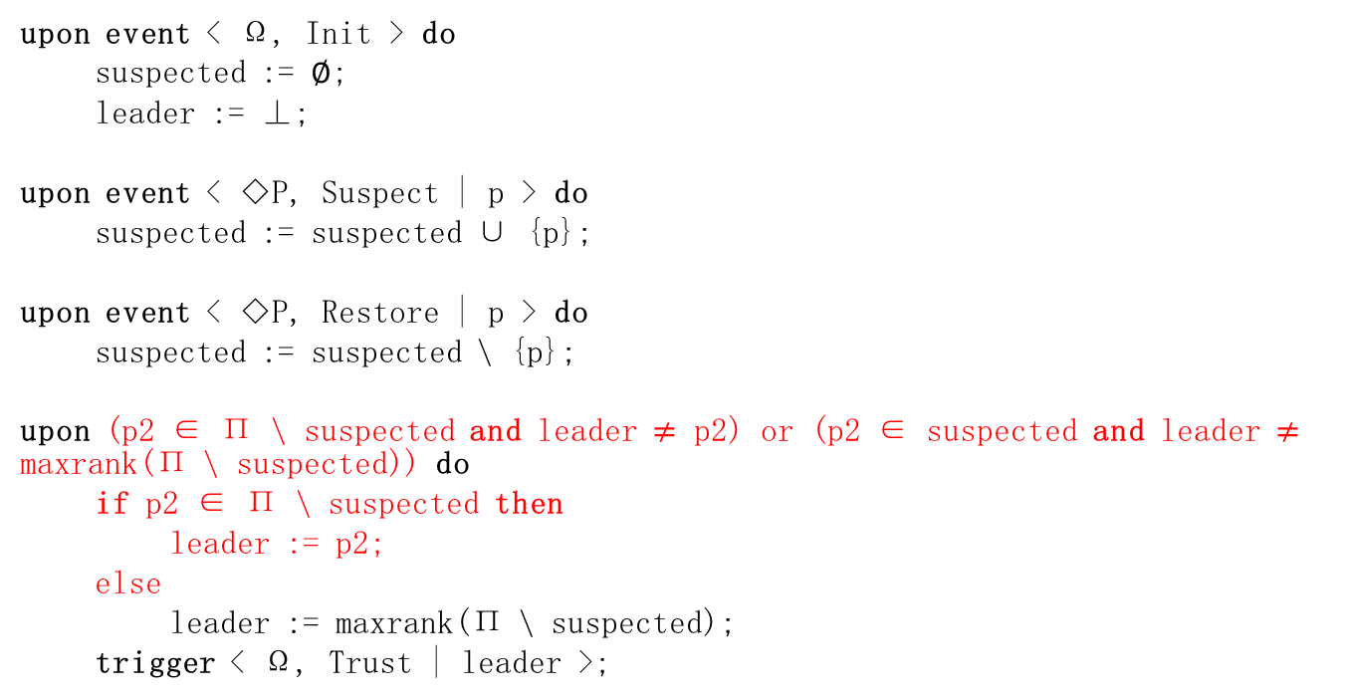
Algorithm - 1
upon event < Ω, Init > do
suspected := ∅;
leader := ⊥;
upon event < ◇P, Suspect | p > do
suspected := suspected ∪ {p};
upon event < ◇P, Restore | p > do
suspected := suspected \ {p};
upon (p2 ∈ Π \ suspected and leader $≠$ p2) or (p2 ∈ suspected and leader $≠$ maxrank(Π \ suspected)) do
if p2 ∈ Π \ suspected then
leader := p2;
else
leader := maxrank(Π \ suspected);
trigger < Ω, Trust | leader >;

Slide 8
Algorithm - 2
maxrank’(S) = p2, if p2 ∈ S;
maxrank(S), otherwise.

