Slide 1
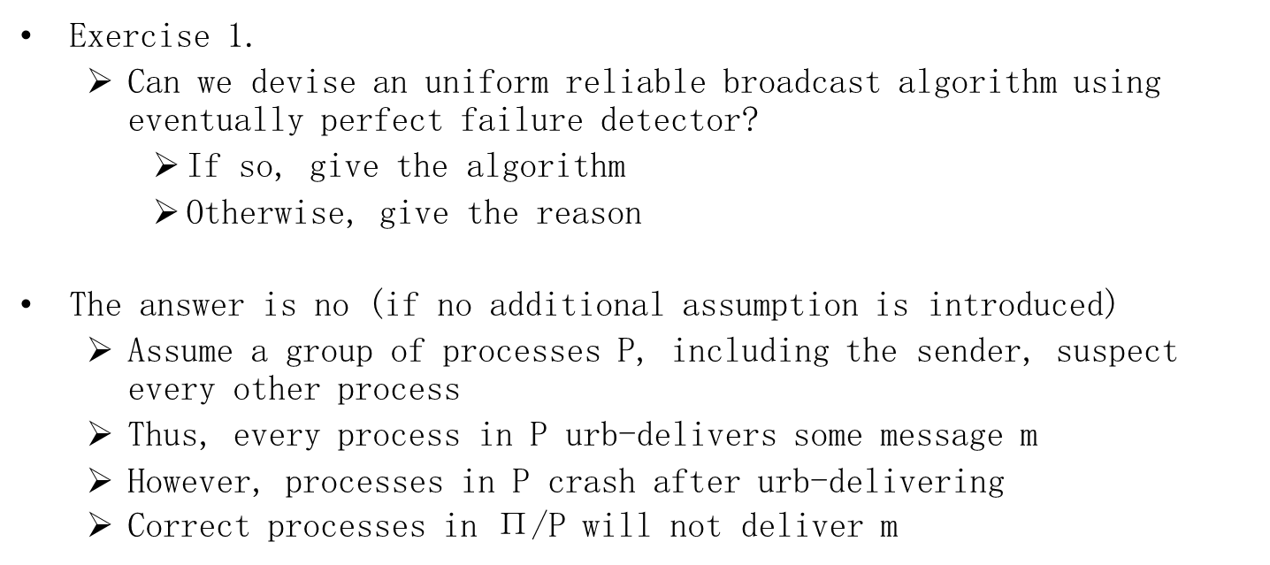
Exercises
Exercise 1.
Can we devise an uniform reliable broadcast algorithm using eventually perfect failure detector?
If so, give the algorithm
Otherwise, give the reason
The answer is no (if no additional assumption is introduced)
Assume a group of processes P, including the sender, suspect every other process
Thus, every process in P urb-delivers some message m
However, processes in P crash after urb-delivering
Correct processes in $\text{Π}\text{/}\text{P}$ will not deliver m

Slide 2
Exercises
Exercise 2.
Can we devise a broadcast algorithm that does not ensure the causal delivery property but only its non-uniform variant:
no correct process p delivers a message m2 unless p has already delivered every message m1 such that m1 → m2?
This does not make much sense:
To differ from “uniform” variant, a faulty process p should be allowed to violate causality
But p does not self-destruct, i.e., p will follow the algorithm
So it might as well be correct
p violates even the nonuniform variant

