Slide 1
Distributed Algorithms: Real-World Applications
刘盛云

Slide 2
Exam
开卷考试：可以携带任何纸质资料
不可使用手机、笔记本电脑等电子设备,不可传阅资料
2025年1月9日 15:50-17:50
陈瑞球楼204、308
判断题
基本概念和性质
算法和论述题
Broadcast
Register
Consensus (variants)

Slide 3

Distributed storage systems
Google File System, Apache HDFS, Ceph, ...
Configuration management (Consensus)
Paxos, Zookeeper, Etcd
Client
Metadata store
(Register)
Data store
(Register)
Data store
(Register)
Data store
(Register)

Slide 4
Distributed storage systems
Configuration management module
Full-fledged SMR (group membership, consensus)
N = 5, typically
Metadata store
Another level of indirection
“All problems in computer science can be solved by another level of indirection.”--- David Wheeler
E.g., Ceph
Data store
Register (shared memory)
3-way replication, n = 3
Usually a single writer
Rack Awareness

Slide 5
Message patterns
query
Read(A)/write(A), with config number
Client
Config.
management
Config: A -> R1
Metadata
Data store (R1)
reply
reply
read/write
query
Client
reconfiguration
Config.
management
Config: A -> R2
reject
Data store
new config number

Slide 6
Large-scale database systems
Google Spanner, PingCAP TiDB, WeChat PaxosStore...
Span over multiple continents
Use Paxos or Raft as a building block
Tablet
Tablet
Paxos
Paxos
replica
leader
replica
replica
leader
replica
…
US East
US West
US Central

Slide 7
Large-scale database systems
Scalability, availability and high performance
Each tablet is managed by a Paxos group
Tablet: a bag of (key:string, timestamp:int64) → string
3 to 5 replicas
Data placement can be specified
May across continents
Among tablets, using two-phase commit for ACID
Atomicity, Consistency, Isolation and Durability

Slide 8
Large-scale database systems
read(A)
read(B)
write(A)
lock
commit
Client
Tablet A
write-lock(A)
Tablet B
read-lock(A)
lock
abort
Client
Tablet A
reject
Tablet B
read-lock(A)

Slide 9
Blockchains
A chain of blocks (i.e., State Machine Replication)
Each block contains
a cryptographic hash of the previous block
transaction data tx
Each block is decided by a consensus instance
tx
tx
tx
T
T
T
i
+
1
i
+
2
i
B
=
H
(
B
,
T
B
=
H
(
B
,
T
,
X
)
B
=
H
(
B
,
T
,
)
X
)
i
i
-
1
i
i
+
1
i
i
+
1
i
+
1
i
+
2
i
+
1
i
+
2
i
+
2

Slide 10

Blockchains
Permissioned Blockchains
Designated participants
Use PBFT, HotStuff, Tendermint, ...

Slide 11
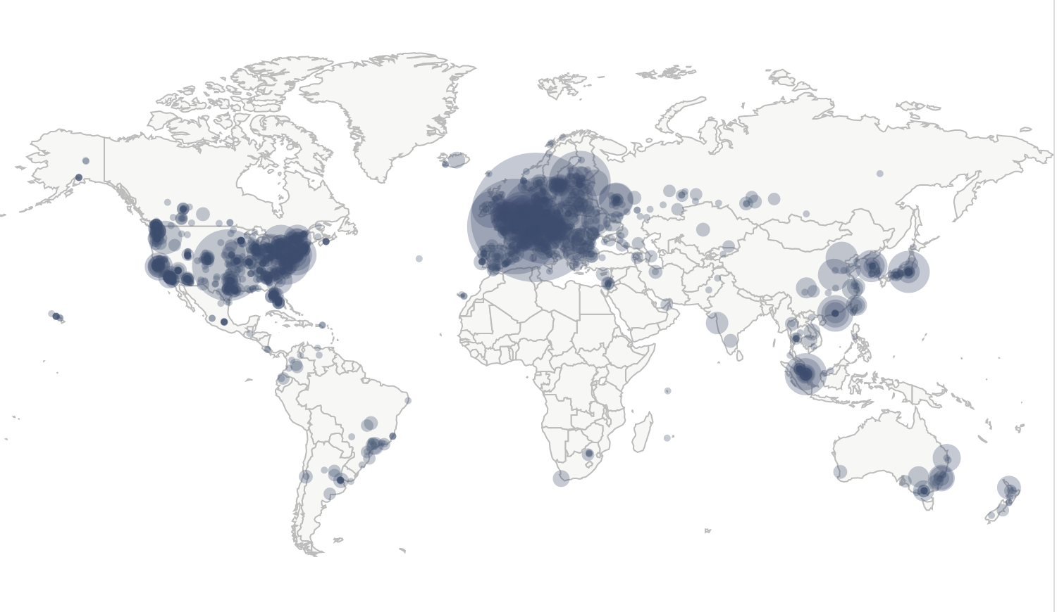
Blockchains
Permissionless Blockchains
Everyone can participate (including you)
Use Proof-of-X (e.g., Proof-of-Work) to defend against Sybil attacks
Bitcoin nodes distribution: 14593 nodes

Slide 12
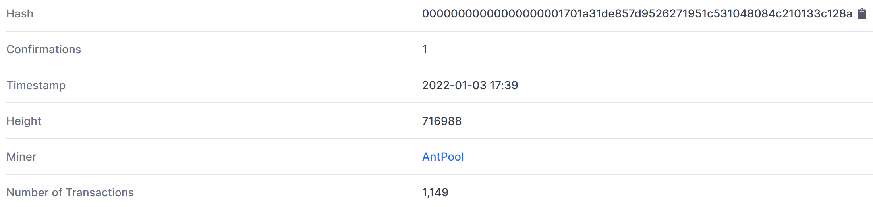
Proof-of-Work
Miner: solve hash puzzle
Honest miners always extend the longest chain
Recommended confirmation: 6 blocks (around 1 hour)
B
=
H
(
B
,
T
,
X
) < target
i
i
-
1
i
i

Slide 13

PoW：example
10 mins
10 mins
Alice
0.5 BTC
Alice 0.5 BTC
Bob 0.5 BTC
Charlie 0.5 BTC
0
Alice 0.5 BTC
1
Adversary
1 BTC
Bob 0.5 BTC
Balance：
Adversary 0 BTC
Alice 0 BTC
Bob 0.5 BTC
Charlie 0.5 BTC
Bob 0.5 BTC
Charlie 0.5 BTC
Bob
0.5 BTC
Charlie 0.5 BTC
2
Bob 0.5 BTC
Charlie 0.5 BTC

Slide 14
Proof-of-Work
Throughput
Bitcoin ~ 7txs/s
Ethereum ~ 15txs/s
…
VISA ~ 10,000txs/s
Confirmation times:
Bitcoin/Ethereum hour(s)
VISA second(s)
Not eco-friendly

Slide 15
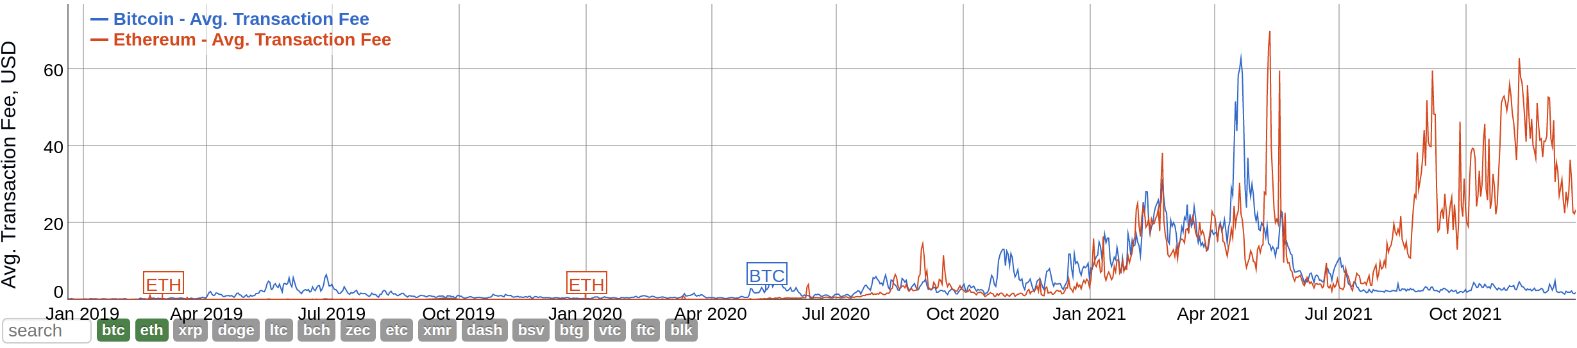
Proof-of-Work: Transaction fee

Slide 16
Permissionless variants
Blockchain trilemma: decentralization, security, scalability
Idea: use verifiable random function (VRF) to select a committee
Probability: proportional to the resources each user owns
Select a committee for each vote, block or period
Run a BFT protocol within the committee
Algorand, Dfinity (Proof-of-Stake)
Filecoin (Proof-of-Storage)
...

Slide 17
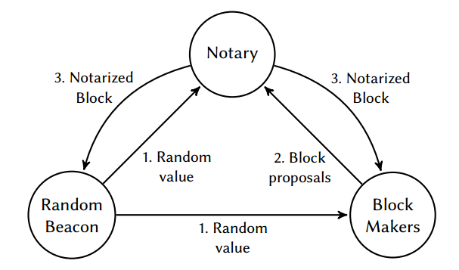
Dfinity

Slide 18
The Stack
State Machine Replication
(Blockchain)
group membership
utrb
nbac
Consensus
Register
Broadcast
FailureDedector
(timing assumption)
Quorum
PerfectLink

Slide 19
谢谢！

