Slide 1
Distributed Algorithms Broadcast communication – Part I
刘盛云

Slide 2
Outline
Last course
Distributed Computation
Abstracting Processes
Cryptographic Abstractions
Abstracting Communication
Timing Assumptions
Abstracting time

Slide 3
Outline
This course
Crash-tolerant broadcast
Reliable broadcast primitives
Causal-order broadcast primitives

Slide 4
Broadcast abstractions
Broadcast: an information dissemination method
When more than two processes need to operate in a coordinated manner
E.g., shared register, consensus, multi-party computation
A process sends a message within a group of processes Π, such that
processes in Π agree on the messages they deliver

Slide 5

Broadcast abstractions
Π
s
Message m
This course: Best-effort broadcast -> regular broadcast -> uniform broadcast

Slide 6
Best-effort broadcast
Name: BestEffortBroadcast, instance beb.
Request: < beb, Broadcast | m >: Broadcasts a message m to all processes.
Indication: < beb, Deliver | p, m >: Delivers a message m broadcast by process p.
Properties:
BEB1. Validity: If a correct process broadcasts a message m, then every correct process eventually delivers m.
BEB2. No duplication: No message is delivered more than once.
BEB3. No creation: If a process delivers a message m with sender s, then m was previously broadcast by process s.

Slide 7
bebBroadcast
bebDeliver
bebBroadcast
p1
m
p2
bebDeliver
m
bebDeliver
p3

Slide 8
bebBroadcast
bebDeliver
crash
bebBroadcast
bebBroadcast
p1
m
m1
bebDeliver
p2
bebDeliver
m
m1
p3
bebDeliver

Slide 9
Basic broadcast
Implements: BestEffortBroadcast, instance beb.
Uses: PerfectPointToPointLinks, instance pl.
upon event < beb, Broadcast | m > do
forall q ∈ Π do
trigger < pl, Send | q, m >;
upon event < pl, Deliver | p, m > do
trigger < beb, Deliver | p, m >;

Slide 10
Correctness and performance
The no creation and no duplication properties follow directly from the corresponding properties of perfect links.
Validity is derived from the reliable delivery property and the fact that the sender sends the message to every other process.
Performance. A single communication step, O(N) messages.

Slide 11
(Regular) Reliable Broadcast
Name: ReliableBroadcast, instance rb.
Request: < rb, Broadcast | m >: Broadcasts a message m to all processes.
Indication: < rb, Deliver | p, m >: Delivers a message m broadcast by process p.
Properties:
RB1–RB3: Same as properties BEB1–BEB3 in best-effort broadcast.
RB4. Agreement: If a message m is delivered by some correct process, then m is eventually delivered by every correct process.

Slide 12
rbBroadcast?
rbDeliver
crash
rbBroadcast
rbBroadcast
p1
m
m1
rbDeliver
p2
rbDeliver
m
m1
p3
rbDeliver

Slide 13
rbBroadcast
rbDeliver
crash
rbBroadcast
rbBroadcast
p1
m
m1
rbDeliver
p2
rbDeliver
m
m1
p3
rbDeliver
rbDeliver

Slide 14
rbBroadcast
rbDeliver
crash
rbBroadcast
rbBroadcast
p1
m
m1
p2
rbDeliver
m
p3
rbDeliver

Slide 15
rbBroadcast
rbDeliver
crash
rbBroadcast
rbBroadcast
p1
m
m1
rbDeliver
p2
rbDeliver
m
m1
p3
rbDeliver

Slide 16
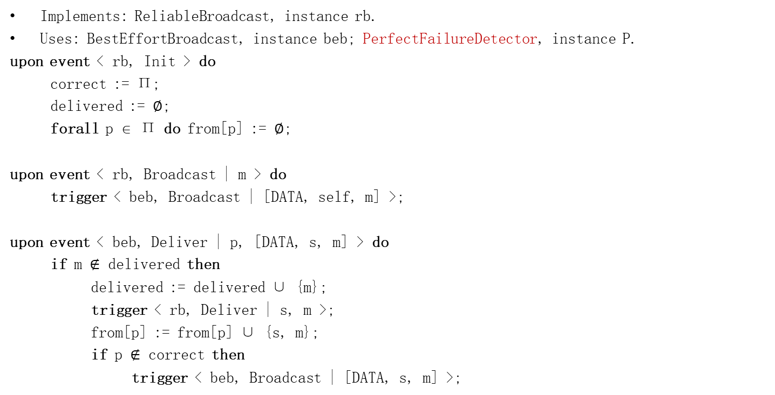
Lazy Reliable Broadcast
Implements: ReliableBroadcast, instance rb.
Uses: BestEffortBroadcast, instance beb; PerfectFailureDetector, instance P.
upon event < rb, Init > do
correct := Π;
delivered := ∅;
forall p ∈ Π do from[p] := ∅;
upon event < rb, Broadcast | m > do
trigger < beb, Broadcast | [DATA, self, m] >;
upon event < beb, Deliver | p, [DATA, s, m] > do
if m $∉$ delivered then
delivered := delivered ∪ {m};
trigger < rb, Deliver | s, m >;
from[p] := from[p] ∪ {s, m};
if p $∉$ correct then
trigger < beb, Broadcast | [DATA, s, m] >;
upon event < P, Crash | p > do
correct := correct \ {p};
forall {s, m} ∈ from[p] do
trigger < beb, Broadcast | [DATA, s, m] >;

Slide 17
Lazy Reliable Broadcast
Performance.
Best case: if the initial sender does not crash
a single communication step and O(N) messages
Worst case: if the processes crash in sequence
O(N) steps and O(N²) messages

Slide 18
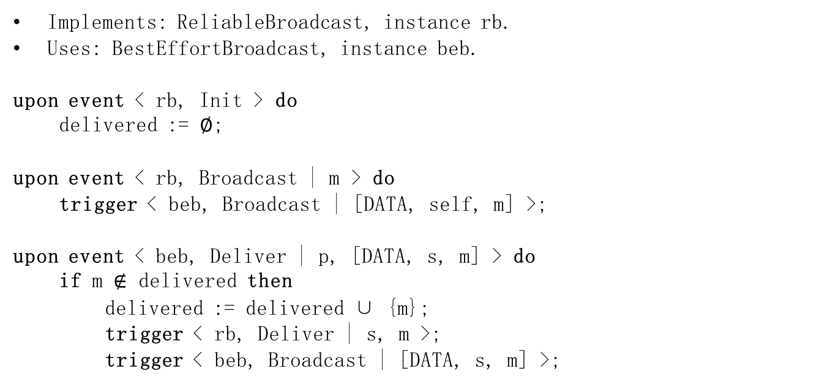
Eager Reliable Broadcast
Implements: ReliableBroadcast, instance rb.
Uses: BestEffortBroadcast, instance beb.
upon event < rb, Init > do
delivered := ∅;
upon event < rb, Broadcast | m > do
trigger < beb, Broadcast | [DATA, self, m] >;
upon event < beb, Deliver | p, [DATA, s, m] > do
if m $∉$ delivered then
delivered := delivered ∪ {m};
trigger < rb, Deliver | s, m >;
trigger < beb, Broadcast | [DATA, s, m] >;

Slide 19
Eager Reliable Broadcast
Performance.
Best case
A single communication step and O(N²) messages
Worst case: the processes crash in sequence
O(N) steps and O(N²) messages

Slide 20
(Regular) Reliable Broadcast
rbDeliver
crash
rbBroadcast
rbBroadcast
p1
m1
m
m1
rbDeliver
bebBroadcast
p2
rbDeliver
m1
m
m1
rbDeliver
p3
rbDeliver

Slide 21
Uniform reliable broadcast
Name: UniformReliableBroadcast, instance urb.
Request: < urb, Broadcast | m >: Broadcasts a message m to all processes.
Indication: < urb, Deliver | p, m >: Delivers a message m broadcast by process p.
Properties:
URB1–URB3: Same as properties RB1–RB3 in (regular) reliable broadcast.
URB4: Uniform agreement: If a message m is delivered by some process (whether correct or faulty), then m is eventually delivered by every correct process.

Slide 22
urbBroadcast?
urbDeliver
crash
urbBroadcast
urbBroadcast
p1
m
m1
urbDeliver
p2
urbDeliver
m
m1
p3
urbDeliver

Slide 23
urbBroadcast
urbDeliver
crash
urbBroadcast
urbBroadcast
p1
m
m1
p2
urbDeliver
m
m1
p3
urbDeliver

Slide 24
urbBroadcast
urbDeliver
crash
urbBroadcast
urbBroadcast
p1
m
m1
urbDeliver
p2
urbDeliver
m
m1
p3
urbDeliver
urbDeliver

Slide 25
All-Ack Uniform Reliable Broadcast
Implements: UniformReliableBroadcast, instance urb.
Uses: BestEffortBroadcast, instance beb; PerfectFailureDetector, instance P.
upon event < urb, Init > do
delivered := ∅;
pending := ∅;
correct := Π;
forall m do ack[m] := ∅;
upon event < urb, Broadcast | m > do
pending := pending ∪ {(self, m)};
trigger < beb, Broadcast | [DATA, self, m] >;

Slide 26
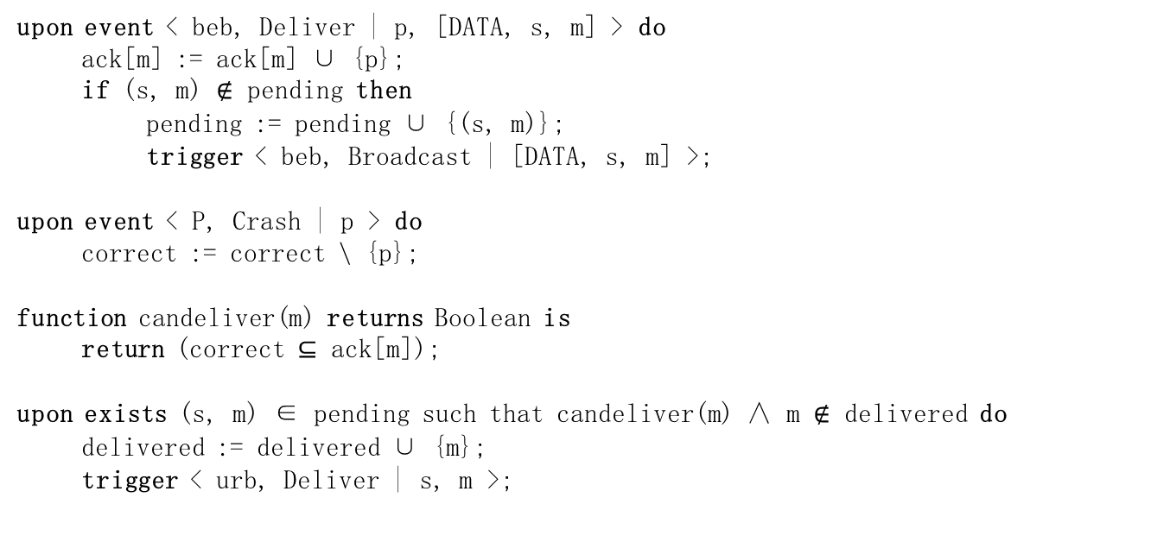
All-Ack Uniform Reliable Broadcast
upon event < beb, Deliver | p, [DATA, s, m] > do
ack[m] := ack[m] ∪ {p};
if (s, m) $∉$ pending then
pending := pending ∪ {(s, m)};
trigger < beb, Broadcast | [DATA, s, m] >;
upon event < P, Crash | p > do
correct := correct \ {p};
function candeliver(m) returns Boolean is
return (correct ⊆ ack[m]);
upon exists (s, m) ∈ pending such that candeliver(m) ∧ m $∉$ delivered do
delivered := delivered ∪ {m};
trigger < urb, Deliver | s, m >;

Slide 27
All-Ack Uniform Reliable Broadcast
bebBroadcast
urbDeliver
p1
m
m
urbDeliver
p2
m
m
urbDeliver
p3

Slide 28
All-Ack Uniform Reliable Broadcast
bebBroadcast
FD suspicion
urbDeliver
p1
m
m
m
p2
m
m
p3
urbDeliver

Slide 29
All-Ack Uniform Reliable Broadcast
Performance.
Best case
two communication steps and O(N²) messages
Worst case
N+1 steps and O(N²) messages
One step more to deliver a message than its regular counterpart

Slide 30
Exercises
Exercise 3.1.
Can we devise an uniform reliable broadcast algorithm using eventually perfect failure detector?
If so, give the algorithm
Otherwise, give the reason

Slide 31
Outline
This course
Crash-tolerant broadcast
Reliable broadcast primitives
Causal-order broadcast primitives

Slide 32
Why causal order?
Two messages broadcast by the same process might not be delivered in order
A message m1 that causes a message m2 might be delivered by some process after m2
Example
A comment on Facebook appears before the photo?
Might happen even with (uniform) reliable broadcast
Causal broadcast alleviates the need for the application to deal with such dependencies

Slide 33
Applications requiring causal relationship
Payment services
A: 100 -> 0
B: 0 -> 100
transfer(A, B, 100)
p1
B: 100 -> 0
C: 0 -> 100
transfer(B, C, 100)
p2
Causality is violated!
p3
B: 0 -> -100?

Slide 34


Applications requiring causal relationship
Social networks
upload a picture
p1
thumb!
p2
Causality is violated!
p3
Thumb for nothing?

Slide 35
Happened-before relationship [Lam78]
In an asynchronous distributed system
Event a “happened before” event b (we write a → b) iff
Local order:
both a and b occur at the same process p, and
event a precedes b according to p’s local clock, OR
Communication order:
a is a send event containing message m, whereas
b is a receive event for m, OR
Transitivity:
there is event c, such that a → c and c → b
If a → b and b → a:
a and b are concurrent events (we write a || b)

Slide 36
Happened-before with local clocks?
1
2
3
4
p1
1
2
3
4
p2
1
2
3
p3

Slide 37
Happened-before
Can we simulate a global clock?
Local clocks won’t do it
Logical clocks (Lamport’s clocks)
Vector clocks

Slide 38
Logical clocks
Each process p maintains its own event counter cnt(p)
p increments cnt(p) with every step
p includes cnt(p) in every message it sends
upon q receives a message from p
cnt(q) := max(cnt(q), cnt(p)) + 1

Slide 39
Logical clocks
Logical clocks: if a → b then lc(a) < lc(b)
Issue: same logical time for different events
1
2
3
6
p1
2
4
5
6
p2
p3
1
2
3

Slide 40
Logical clocks
Logical clocks enforce partial order among events
Concurrent events may have the same or different logical time
Enforcing total order
Use process IDs as tiebreakers

Slide 41
Logical clocks
1.1
2.1
3.1
6.1
p1
2.2
4.2
5.2
6.2
p2
p3
1.3
2.3
3.3

Slide 42
Still some issues?
Logical clocks cannot convey causal relation
i.e., lc(a) < lc(b) does not imply a → b
Solution
Vector clocks

Slide 43
Vector clocks
Each process pi maintains a vector of counters
Initially, VC_{i}[j] = 0, for every j ∈ 1..n
pi increments VC_{i}[i] with every step
pi includes VC_{i}[] in every message it sends
Upon pj receives a message from pi
VC_{j}[k] := max(VC_{j}[k], VC_{i}[k]), for every k
VC_{j}[j] := VC_{j}[j] + 1

Slide 44
Vector clocks (vc)
(1,0,0)
(2,0,0)
(3,0,0)
(4,3,3)
p1
(1,1,0)
(1,2,3)
(2,4,3)
p2
(1,3,3)
p3
(0,0,1)
(0,0,2)
(0,0,3)

Slide 45
Causal precedence
Let m1 and m2 be any two messages, m1 causally precedes m2 iff
FIFO order
Some process pi broadcasts m1 before broadcasting m2
Message order
Some process pi delivers m1 and then broadcasts m2
Transitivity: there is a message m3 such that
m1 causally precedes m3 and
m3 causally precedes m2

Slide 46
Causal precedence?
m1 causally precedes m2 iff
< crbBroadcast, m1> → < crbBroadcast, m2>?
“Happens before” was defined on the channel level so not entirely suitable here

Slide 47
Happened-before v2
a → b
Local order:
both a and b occur at the same process p, and
event a precedes b according to p’s local clock
Communication order:
a is a broadcast event containing message m, whereas
b is a delivery event for m
Transitivity:
there is event c, such that a → c and c → b
Then: m1 causally precedes m2 iff
< crbBroadcast, m1> → < crbBroadcast, m2>

Slide 48
Causal-order (reliable) broadcast
Name: CausalOrderReliableBroadcast, instance crb.
Request: < crb, Broadcast | m >: Broadcasts a message m to all processes.
Indication: < crb, Deliver | p, m >: Delivers a message m broadcast by process p.
Properties:
CRB1–CRB4. Same as properties RB1–RB4 in (regular) reliable broadcast.
CRB5. Causal delivery: For any message m1 that causally precedes a message m2, i.e., m1 → m2, no process delivers m2 unless it has already delivered m1.

Slide 49
crbBroadcast?
crbDeliver(m1)
crbBroadcast
crbBroadcast
p1
m1
m2
crbDeliver(m2)
p2
crbDeliver(m1)
m2
m1
crbDeliver(m2)
p3
crbDeliver(m1)

Slide 50
crbBroadcast?
crbDeliver(m1)
crbBroadcast
crbBroadcast
p1
m1
m2
crbDeliver(m2)
p2
crbDeliver(m1)
m2
m1
p3
crbDeliver(m2)

Slide 51
crbBroadcast?
crbDeliver(m1)
crbBroadcast
p1
m1
m2
crbDeliver(m2)
p2
crbDeliver(m1)
crbBroadcast
m2
m1
p3
crbDeliver(m2)

Slide 52
Causal-order uniform (reliable) broadcast
Name: CausalOrderUniformReliableBroadcast, instance curb.
Request: < curb, Broadcast | m >: Broadcasts a message m to all processes.
Indication: < curb, Deliver | p, m >: Delivers a message m broadcast by process p.
Properties:
CURB1–CURB4. Same as properties URB1–URB4 in uniform reliable broadcast.
CURB5. Same as property CRB5 in causal-order broadcast.

Slide 53

No-Waiting Causal-Order Broadcast
Implements: CausalOrderReliableBroadcast, instance crb.
Uses: ReliableBroadcast, instance rb.
upon event < crb, Init > do
delivered := ∅;
past := [];
upon event < crb, Broadcast | m > do
trigger < rb, Broadcast | [DATA, past, m] >;
append(past, (self, m));
upon event < rb, Deliver | p, [DATA, mpast, m] > do
if m $∉$ delivered then
forall (s, n) ∈ mpast do
if n $∉$ delivered then
trigger < crb, Deliver | s, n >;
delivered := delivered ∪ {n};
if (s, n) $∉$ past then
append(past, (s, n));
trigger < crb, Deliver | p, m >;
delivered := delivered ∪ {m};
if (p, m) $∉$ past then
append(past, (p, m));

Slide 54
crbBroadcast
crbDeliver(m1)
crbBroadcast
crbBroadcast
p1
m2(m1)
m1
crbDeliver(m2)
p2
crbDeliver(m1)
m2(m1)
m1
p3
crbDeliver(m1)
crbDeliver(m2)

Slide 55
crbBroadcast
crbDeliver(m1)
crbBroadcast
p1
m1
m2(m1)
crbDeliver(m2)
p2
crbDeliver(m1)
crbBroadcast
m1
p3
m2(m1)
crbDeliver(m1)
crbDeliver(m2)

Slide 56
Performance
No additional communication steps compared to reliable broadcast algorithm
But, message size grows linearly with time
“past” may become extremely large
Truncate “past” (with the help of perfect FD)

Slide 57

Garbage-Collection of Causal Past
Uses: PerfectFailureDetector, instance P.
upon event < crb, Init > do
delivered := ∅;
past := [];
correct := Π;
forall m do ack[m] := ∅;
upon event < P, Crash | p > do
correct := correct \ {p};
upon exists m ∈ delivered such that self $∉$ ack[m] do
ack[m] := ack[m] ∪ {self};
trigger < rb, Broadcast | [ACK, m] >;
upon event < rb, Deliver | p, [ACK , m] > do
ack[m] := ack[m] ∪ {p};
upon correct ⊆ ack[m] do
remove(past, (*, m));

Slide 58
How can we totally remove “past”?
Use (a variant of) vector clocks

Slide 59
Waiting Causal Broadcast
Implements: CausalOrderReliableBroadcast, instance crb.
Uses: ReliableBroadcast, instance rb.
upon event < crb, Init > do
V := [0]^{N};
lsn := 0;
pending := ∅;
upon event < crb, Broadcast | m > do
W := V;
W[rank(self)] := lsn;
lsn := lsn + 1;
trigger < rb, Broadcast | [DATA, W, m] >;
upon event < rb, Deliver | p, [DATA, W, m] > do
pending := pending ∪ {(p, W, m)};
while exists (p’, W’, m’) ∈ pending such that W’ ≤ V do
pending := pending \ {(p’, W’, m’)};
V[rank(p’)] := V[rank(p’)] + 1;
trigger < crb, Deliver | p’, m’ >;

Slide 60
crbBroadcast
crbDeliver(m1)
p1
m2 (1,0,0)
m1
crbDeliver(m2)
p2
crbDeliver(m1)
m1 (0,0,0)
m2 (1,0,0)
p3
crbDeliver(m1)
crbDeliver(m2)

Slide 61
crbBroadcast
crbDeliver(m1)
p1
m1
(1,0,0)
crbDeliver(m2)
p2
crbDeliver(m1)
m2
m1
(0,0,0)
(1,0,0)
p3
crbDeliver(m1)
crbDeliver(m2)

Slide 62
Performance
No additional communication steps compared to reliable broadcast algorithm
O(n) message size: vector clocks

Slide 63
How do we get the Uniform Reliable Causal Order Broadcast?
Simply replace rbBroadcast with urbBroadcast

Slide 64
Exercise
Exercise 3.2.
Can we devise a broadcast algorithm that does not ensure the causal delivery property but only its non-uniform variant:
no correct process p delivers a message m2 unless p has already delivered every message m1 such that m1 → m2?

