Slide 1
Distributed Algorithms Quorum and Byzantine broadcast
刘盛云

Slide 2
Outline
Last course
Crash-tolerant broadcast
Reliable broadcast primitives
Causal-order broadcast primitives

Slide 3
Outline
This course
Quorum
Majority-Ack Uniform Reliable Broadcast
Byzantine-tolerant broadcast
Consistent broadcast primitives
Reliable broadcast primitives
高能预警！
高能预警！
高能预警！
开始了！ 开始了！ 核能预警！
核能预警！

Slide 4
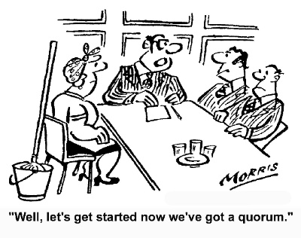
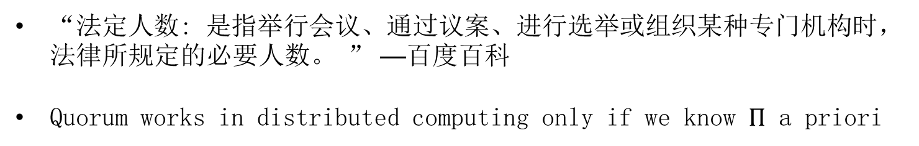
Quorum
“A quorum is the minimum number of members of a deliberative assembly necessary to conduct the business of that group.” —Wiki
Derived from Latin quorum: “of whom”
“法定人数: 是指举行会议、通过议案、进行选举或组织某种专门机构时，法律所规定的必要人数。 ” —百度百科
Quorum works in distributed computing only if we know $Π$ a priori

Slide 5
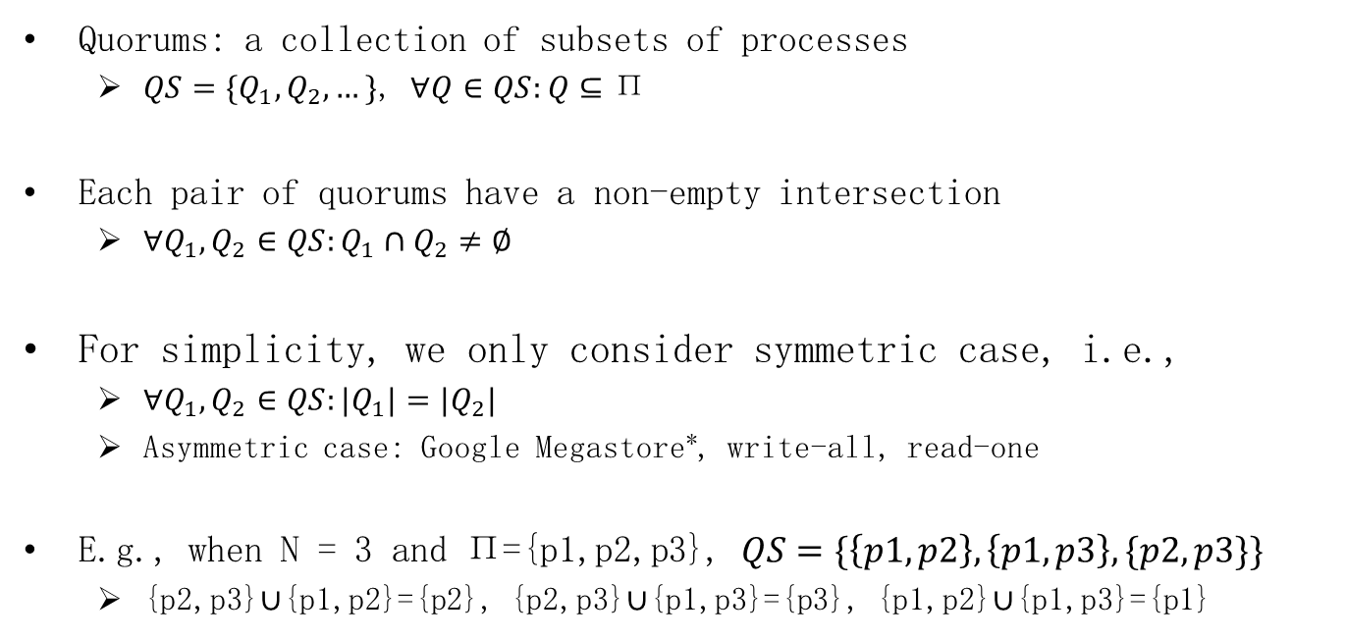
Quorum system in distributed computing
Quorums: a collection of subsets of processes
$QS=\{Q_{1},Q_{2},…\}$, $∀Q∈QS:Q⊆\text{Π}$
Each pair of quorums have a non-empty intersection
$∀Q_{1},Q_{2}∈QS:Q_{1}∩Q_{2}≠∅$
For simplicity, we only consider symmetric case, i.e.,
$∀Q_{1},Q_{2}∈QS:{|Q}_{1}|=|Q_{2}|$
Asymmetric case: Google Megastore*, write-all, read-one
E.g., when N = 3 and $\text{Π}\text{=\{}\text{p}\text{1,}\text{p}\text{2,}\text{p}\text{3\}}$, $QS=\{\left\{p1,p2\right\},\left\{p1,p3\right\},\{p2,p3\}\}$
{p2,p3}$∪${p1,p2}={p2}, {p2,p3}$∪${p1,p3}={p3}, {p1,p2}$∪${p1,p3}={p1}
* Jason Baker et al. Megastore: Providing Scalable, Highly Available Storage for Interactive Services. Proceedings of the Conference on Innovative Data system Research (CIDR) (2011), pp. 223-234.

Slide 6




Symmetric quorum system
Quorum is a key abstraction for ensuring consistency (safety)
Any quorum can make progress despite failures of other processes
p1
p1
p1
p2
p1
p2
p3
p2
p3
p3
p2
Step1:
transfer(A, B, 100)
Step2:
transfer(B, C, 100)
Step3:
transfer(C, D, 100)
quorum = $\{p2,p3\}$
quorum = $\left\{p1,p2\right\}$
quorum = $\left\{p1,p3\right\}$

Slide 7
Safety and liveness
Safety: a quorum must be any majority of processes
Otherwise, split-brain problem may occur
Liveness: even if a minority of processes fail, there is always a quorum that contains only correct processes
Thus can proceed, i.e., ensuring liveness
Account: A = 100
p1
p3
transfer(A, B, 100)
transfer(A, C, 100)
p2
p4

Slide 8

Safety and liveness: combined
Assume there are $f$ crash faults
Liveness: $N−f$ processes can make progress (quorum size)
Safety:
$2\left(N−f\right)>N⇒$ // any two quorums intersect in one correct process
$N>2f⇒$
$N≥2f+1$

Slide 9


Byzantine quorum system
Consider Byzantine faults,
$∀Q_{1},Q_{2}∈QS:{|Q}_{1}∩Q_{2}|=f+1$
$f$ is the number of Byzantine processes
p1
p1
p2
p2
p3
p2
p3
Step1:
transfer(A, B, 100)
Step2:
transfer(A, C, 100)

Slide 10

Safety and liveness: combined
Assume there are $f$ Byzantine faults
Liveness: $N−f$ processes can make progress (quorum size)
Safety:
$2\left(N−f\right)>N+f⇒$ // any two quorums intersect in one correct process
$N>3f⇒$
$N≥3f+1$

Slide 11
Outline
Last course
Quorum
Majority-Ack Uniform Reliable Broadcast
Byzantine-tolerant broadcast
Reliable broadcast primitives

Slide 12
Uniform reliable broadcast
Name: UniformReliableBroadcast, instance urb.
Request: < urb, Broadcast | m >: Broadcasts a message m to all processes.
Indication: < urb, Deliver | p, m >: Delivers a message m broadcast by process p.
Properties:
URB1. Validity: If a correct process broadcasts a message m, then every correct process eventually delivers m.
URB2. No duplication: No message is delivered more than once.
URB3. No creation: If a process delivers a message m with sender s, then m was previously broadcast by process s.
URB4: Uniform agreement: If a message m is delivered by some process (whether correct or faulty), then m is eventually delivered by every correct process.

Slide 13
Uniform reliable broadcast
Can we implement urb without Perfect failure detector?
Assume a majority of correct processes, i.e., N > 2f
Using quorum

Slide 14
Majority-Ack Uniform Reliable Broadcast
Implements: UniformReliableBroadcast, instance urb.
Uses: BestEffortBroadcast, instance beb.
upon event < urb, Init > do
delivered := ∅;
pending := ∅;
forall m do ack[m] := ∅;
upon event < urb, Broadcast | m > do
pending := pending ∪ {(self, m)};
trigger < beb, Broadcast | [DATA, self, m] >;

Slide 15
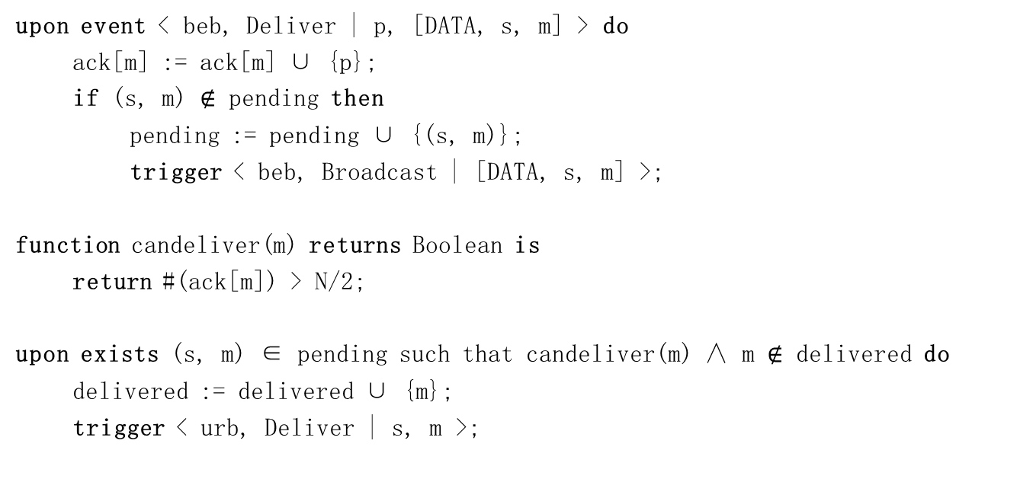
Majority-Ack Uniform Reliable Broadcast
upon event < beb, Deliver | p, [DATA, s, m] > do
ack[m] := ack[m] ∪ {p};
if (s, m) $∉$ pending then
pending := pending ∪ {(s, m)};
trigger < beb, Broadcast | [DATA, s, m] >;
function candeliver(m) returns Boolean is
return #(ack[m]) > N/2;
upon exists (s, m) ∈ pending such that candeliver(m) ∧ m $∉$ delivered do
delivered := delivered ∪ {m};
trigger < urb, Deliver | s, m >;
a majority of correct processes

Slide 16
Majority-Ack Uniform Reliable Broadcast
bebBroadcast
urbDeliver
p1
m
m
urbDeliver
p2
m
m
urbDeliver
p3

Slide 17
Correctness
Validity: if the sender is correct, then
Every correct process delivers a DATA message
Every correct process broadcasts a DATA message
Every correct process delivers more than N/2 DATA messages
Since a majority of processes are correct
No duplication, no creation
Straightforward

Slide 18
Correctness
Uniform agreement
Assume N = 2f + 1
Suppose a correct process p1 somehow urb-delivers m
p1 must have received at least f + 1 DATA messages for m
At least one of these are from correct process
DATA message of this correct process is also delivered by the rest f correct processes,
which then broadcast DATA messages
Every correct process urb-delivers m
Since f + 1 correct processes have sent a DATA message

Slide 19
Majority-Ack Uniform Reliable Broadcast
Performance.
Best case
two communication steps and O(N²) messages
Worst case
N/2+2 steps and O(N²) messages

Slide 20
Outline
This course
Quorum
Majority-Ack Uniform Reliable Broadcast
Byzantine-tolerant broadcast
Consistent broadcast primitives
Reliable broadcast primitives

Slide 21
Broadcast abstractions
Π
s
Message m’
Message m
Deliver m’
Deliver m
Every single instance of a broadcast in the Byzantine model defined as an abstraction of its own.
One instance only serves to reach agreement on a single message.

Slide 22
Byzantine Broadcast primitive
Name: ByzantineConsistentBroadcast, instance bcb, with sender s.
Request: < bcb, Broadcast | m >: Broadcasts a message m to all processes. Executed only by process s.
Indication: < bcb, Deliver | p, m >: Delivers a message m broadcast by process p.
Properties:
BCB1. Validity: If a correct process p broadcasts a message m, then every correct process eventually delivers m.
BCB2. No duplication: Every correct process delivers at most one message.
BCB3. Integrity: If some correct process delivers a message m with sender p and process p is correct, then m was previously broadcast by p.
BCB4. Consistency: If some correct process delivers a message m and another correct process delivers a message m’, then m = m’.

Slide 23
Assumptions
Assume
Asynchronous system
Number of faulty processes f < N/3
No FD (Byzantine FDs tend to be tricky to implement)
Why f < N/3?

Slide 24



f < N/3 Lower bound (sketch)
Assume N = 3f
Show that Byzantine consistent broadcast (w/o FD) is impossible
bcbroadcast(m)
$$f$$
bcbdeliver(m)
$$f$$
bcbdeliver(m)
bcbdeliver(m)
$$f$$

Slide 25



f < N/3 Lower bound (sketch)
Assume N = 3f
Show that Byzantine consistent broadcast (w/o FD) is impossible
bcbroadcast(m’)
$$f$$
bcbdeliver(m’)
$$f$$
$$f$$
bcbdeliver(m’)
bcbdeliver(m’)

Slide 26



f < N/3 Lower bound (sketch)
Assume N = 3f
Show that Byzantine consistent broadcast (w/o FD) is impossible
bcbroadcast(m)
bcbroadcast(m’)
$$f$$
bcbdeliver(m)
bcbdeliver(m’)
$$f$$
bcbdeliver(m)
bcbdeliver(m)
Consistency is violated!
$$f$$
bcbdeliver(m’)
bcbdeliver(m’)

Slide 27
Cryptographic Abstractions
Message Authentication Codes (MAC)
Every pair of processes shares a symmetric key
Symmetric key is known only to a sender and a receiver
MAC = authenticate(p=sender, q=receiver, message)
Only the sender p can invoke authenticate to generate a MAC for process q (and only for q)
verifyauth(q=receiver, sender, message, MAC)
Evaluates to true/false
verifyauth can only be invoked by a process q to tell if a message was sent by p
Its of no use to process r different from p and q
E.g., TLS uses the Hash-Based Message Authentication Code (HMAC) algorithm

Slide 28
Cryptographic Abstractions
Digital signature scheme
Associates a public-key/private-key pair with each process
Private key remains secret to other processes
σ = sign(sender, message)
Using private key of the sender
verifysig(sender, message, σ)
Can be invoked by any process
Using the public key of the sender

Slide 29
Authenticated Echo Broadcast
Implements: ByzantineConsistentBroadcast, instance bcb, with sender s.
Uses: AuthPerfectPointToPointLinks, instance al.
upon event < bcb, Init > do
sentecho := FALSE;
delivered := FALSE;
echos := [⊥]^{N};
upon event < bcb, Broadcast | m > do
forall q ∈ Π do
trigger < al, Send | q, [SEND, m] >;
upon event < al, Deliver | p, [SEND, m] > such that p = s and sentecho = FALSE do
sentecho := TRUE;
forall q ∈ Π do
trigger < al, Send | q, [ECHO, m] >;

Slide 30
Authenticated Echo Broadcast
upon event < al, Deliver | p, [ECHO, m] > do
if echos[p] = ⊥ then
echos[p] := m;
upon exists m ≠ ⊥ such that #{p ∈ Π | echos[p] = m} > (N+f)/2 and delivered = FALSE do
delivered := TRUE;
trigger < bcb, Deliver | s, m >;

Slide 31
Correctness
Validity: if the sender is correct, then
Every correct process receives an SEND message
Every correct process sends an ECHO message
Every correct process delivers at least N - f of them
Since N − f > (N + f)/2, every correct process also delivers the message m contained in the ECHO messages.
No duplication, Integrity
Straightforward

Slide 32
Correctness
Consistency: in order for a correct process p to deliver some m
it needs to receive more than (N + f)/2 ECHO messages containing m.
Any two such sets in at least f+1 processes
At least one of these is correct and does not ECHO two different messages

Slide 33
Performance
Time complexity
2 message delays
Message complexity
O(N²)

Slide 34
Do signatures help
circumvent the lower bound for f （f < N/3）?

Slide 35
Signed Echo Broadcast
Improve on message complexity
Tradeoff
Assume digital signatures

Slide 36
Signed Echo Broadcast
Implements: ByzantineConsistentBroadcast, instance bcb, with sender s.
Uses: AuthPerfectPointToPointLinks, instance al.
upon event < bcb, Init > do
sentecho := FALSE;
sentfinal := FALSE;
delivered := FALSE;
echos := [⊥]^{N};
Σ := [⊥]^{N};
upon event < bcb, Broadcast | m > do // only process s
forall q ∈ Π do
trigger < al, Send | q, [SEND, m] >;
upon event < al, Deliver | p, [SEND, m] > such that p = s and sentecho = FALSE do
sentecho := TRUE;
σ := sign(self, [ECHO, m]) ;
trigger < al, Send | s, [ECHO, m, σ] >;

Slide 37
Signed Echo Broadcast
upon event < al, Deliver | p, [ECHO, m, σ] > do // only process s
if echos[p] = ⊥ ∧ verifysig(p, [ECHO, m, σ]) then
echos[p] := m;
Σ[p] := σ;
upon exists m ≠ ⊥ such that #{p ∈ Π | echos[p] = m} > (N+f)/2 and sentfinal = FALSE do
sentfinal := TRUE;
forall q ∈ Π do
trigger < al, Send | q, [FINAL, m, Σ] >;
upon event < al, Deliver | p, [FINAL, m, Σ] > do
if #{q ∈ Π | Σ[q] ≠ ⊥ ∧ verifysig(q, [ECHO, m, Σ[q]])} > (N+f)/2 and delivered = FALSE do
delivered := TRUE;
trigger < bcb, Deliver | s, m >;

Slide 38
Sample Execution
crash
bcbBroadcast
p1
SEND
ECHO
FINAL
p2
bcbDeliver
SEND
ECHO
p3
p4

Slide 39
Performance
Time complexity
3 message delays
Message complexity
O(N)

Slide 40
Exercise 4.1
Give a bcbBroadcast algorithm
With O(N) messages
Without signatures, but using MACs!
Assume N >5f.
What is the complexity?

Slide 41
Outline
Last course
Quorum
Majority-Ack Uniform Reliable Broadcast
Byzantine-tolerant broadcast
Consistent broadcast primitives
Reliable broadcast primitives

Slide 42
Reliable Broadcast?
crash
bcbBroadcast
p1
SEND
ECHO
FINAL
p2
bcbDeliver
SEND
ECHO
p3
p4

Slide 43
Byzantine reliable broadcast
Name: ByzantineReliableBroadcast, instance brb, with sender s.
Request: < brb, Broadcast | m >: Broadcasts a message m to all processes. Executed only by process s.
Indication: < brb, Deliver | p, m >: Delivers a message m broadcast by process p.
Properties:
BRB1–BRB4: Same as properties BCB1–BCB4 in Byzantine consistent broadcast.
BRB5. Totality: If some message is delivered by any correct process, every correct process eventually delivers a message.

Slide 44
Authenticated Double-Echo Broadcast
A.k.a, Bracha broadcast
Assumptions
f < N/3
Asynchronous model

Slide 45
Authenticated Double-Echo Broadcast
Implements: ByzantineReliableBroadcast, instance brb, with sender s.
Uses: AuthPerfectPointToPointLinks, instance al.
upon event < brb, Init > do
sentecho := FALSE;
sentready := FALSE;
delivered := FALSE;
echos := [⊥]^{N};
readys := [⊥]^{N};
upon event < brb, Broadcast | m > do
forall q ∈ Π do
trigger < al, Send | q, [SEND, m] >;
upon event < al, Deliver | p, [SEND , m] such that p = s and sentecho = FALSE do
sentecho := TRUE;
forall q ∈ Π do
trigger < al, Send | q, [ECHO, m] >;

Slide 46
Authenticated Double-Echo Broadcast
upon event < al, Deliver | p, [ECHO , m] > do
if echos[p] = ⊥ then
echos[p] := m;
upon exists m ≠ ⊥ such that #{p ∈ Π | echos[p] = m} > (N+f)/2 and sentready = FALSE do
sentready := TRUE;
forall q ∈ Π do
trigger < al, Send | q, [READY, m] >;
upon event < al, Deliver | p, [READY, m] > do
if readys[p] = ⊥ then
readys[p] := m;
upon exists m ≠ ⊥ such that #{p ∈ Π | readys[p] = m} > f and sentready = FALSE do
sentready := TRUE;
forall q ∈ Π do
trigger < al, Send | q, [READY, m] >;
upon exists m ≠ ⊥ such that #{p ∈ Π | readys[p] = m} > 2f and delivered = FALSE do
delivered := TRUE;
trigger < brb, Deliver | s, m >;

Slide 47
Sample Execution
brbBroadcast
p1
brbDeliver
p2
brbDeliver
p3
bcbDeliver
p4
SEND
ECHO
READY

Slide 48
The amplification step
Assume N = 3f + 1
Suppose a correct process p1 somehow brb-delivers m
p1 must have received N - f = 2f + 1 READY messages with m
At least f + 1 of these are from correct processes
READY messages of these f+1 processes are also delivered by the rest f correct processes,
which then send READY messages (Ampl. step)
Every correct process brbdelivers m
Since 2f + 1 correct processes have sent a READY message containing m.

Slide 49
Correctness (guidelines)
Consistency
By “Echo” algorithm consistency, no correct process will send a message different from m in READY
Totality
Amplification step is crucial
Yet, cannot amplify ECHOs
Need the third “round”
Benign or honest process: if a process is correct or has crashed
i.e., faithfully following the algorithm
Uniform totality: If some message is delivered by any benign process, every correct process eventually delivers a message.
Bracha’s algorithm is still correct

Slide 50
Performance
Time complexity
3 message delays
Message complexity
O(N²)

Slide 51
Exercise 4.2
Give a brbBroadcast algorithm
Using digital signatures
What is the complexity?
Totality or uniform totality?

