Slide 1
Distributed Algorithms Shared memory
刘盛云

Slide 2
Outline
Last course
Quorum
Majority-Ack Uniform Reliable Broadcast
Byzantine-tolerant broadcast
Consistent broadcast primitives
Reliable broadcast primitives

Slide 3
Outline
This course
Shared memory
regular and atomic (1,N) register

Slide 4
Overview
Shared memory or registers:
encapsulate data storage functionality accessible by read and write operations
store values
key-value store, such as Redis or RocksDB
resemble those provided by multiprocessor machines at the hardware level
though, are implemented in message-passing systems

Slide 5
Registers (specification)
Registers store values
2 operations
Write(v)
x := v
Return ACK
Read()
Return x
Write(v)
ACK
x := v
x
Read
x

Slide 6
Registers (assumptions)
We assume that the initial value of a register is ⊥
x = ⊥
Convention: the initial value has been written by some process before the register is used
Well-formed clients
No process invokes 2 (read/write) operations concurrently
At most one operation per client can be pending (invoked but not complete)

Slide 7
Registers (execution)
Write operation for register r
Request event: < r, Write | v >
Indication event: < r, WriteReturn >
Read operation for register r
Request event: < r, Read >
Indication event: < r, ReadReturn | v >
v: return value
Write
WriteReturn
Read
ReadReturn

Slide 8
Sequential operations
Sequential operations op1 and op2
If indication of op1 precedes request of op2,
Or indication of op2 precedes request of op1
op1
P1
P2
op2
t₁
t₂
timestamp

Slide 9
Concurrent operations
Concurrent operations op1 and op2
If neither indication of op1 precedes request of op2
Nor indication of op2 precedes request of op1
op1
P1
P2
op2
t₁
t₂
timestamp

Slide 10
Properties
Liveness
Wait-freedom
Every operation invoked by a correct process must eventually complete
Safety
If there is no concurrent write
every read operation returns the value written by the last write operation
If there are concurrent writes
Safe, regular, atomic semantics

Slide 11
Sequential execution
R() → 5
R() → 6
P1
W(5)
W(6)
P2

Slide 12
Concurrent execution
R1() → ?
R2() → ?
R3() → ?
P1
W(5)
W(6)
P2

Slide 13
Execution with failures
R() → ?
P1
crash
W(5)
W(6)
P2

Slide 14
Register semantics
Safe, Regular, Atomic
All strongly consistent in absence of read/write concurrency
Differ in requirements on a value returned by a read concurrent with a write
Safe semantics
Assume single writer
A read() not concurrent with a write must return the last value written
A read() concurrent with a write may return any value

Slide 15
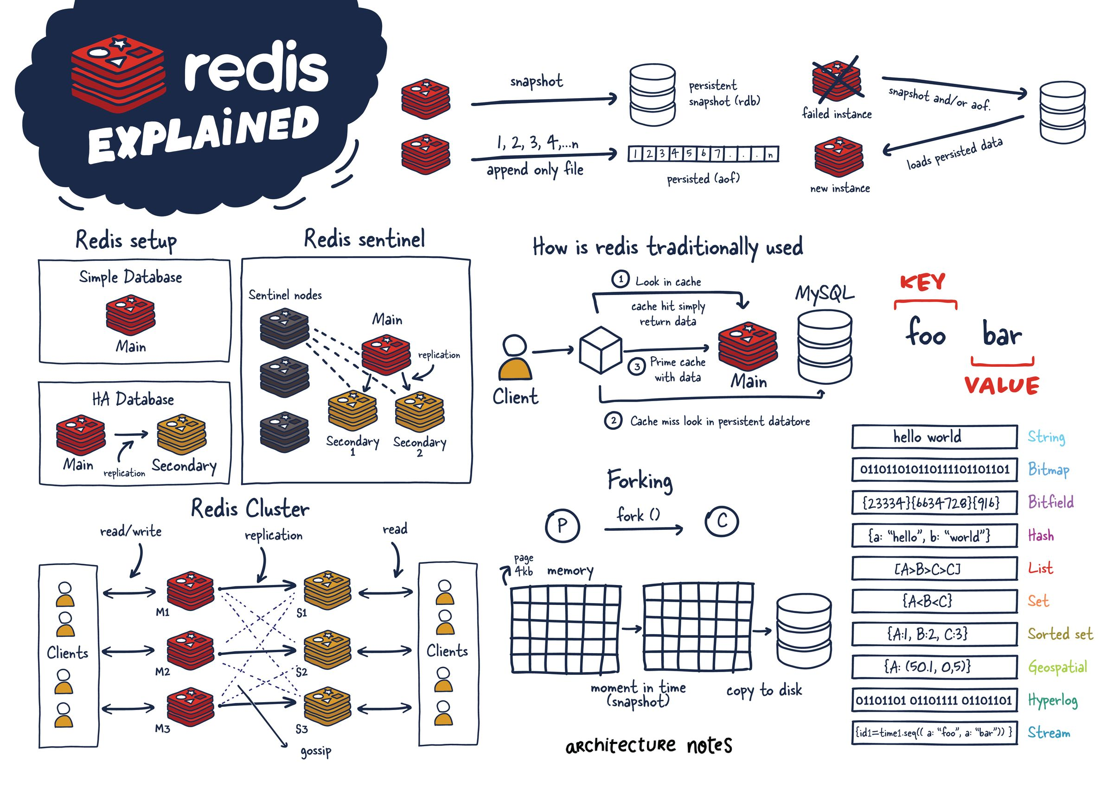
Redis key-value store

Slide 16
Regular register
A single writer
Read() returns:
the last value written if it is not concurrent with any write()
Otherwise, either
the last value written, or
any value concurrently written, i.e., the input parameter of some concurrent Write()

Slide 17
Execution
R1()
R2()
R3()
P1
W(5)
W(6)
P2

Slide 18
Execution 1
R1() → 5
R2() →0
R3() → 25
P1
W(5)
W(6)
P2

Slide 19
Execution 2
R1() → 6
R2() → 5
R3() → 6
P1
W(5)
W(6)
P2

Slide 20
Execution 3
R1() → 5
R2() -> 6
R3() → 5
P1
W(5)
W(6)
P2

Slide 21
Execution 4
R() → 5
P1
crash
W(5)
W(6)
P2

Slide 22
Execution 5
R() → 6
P1
crash
W(5)
W(6)
P2

Slide 23
Correct semantics
Execution 1: safe register
Execution 2: ?
Executions 3; 4; 5: regular register

Slide 24
Regular register algorithms
Setup
Simple algorithm with failure detectors
A tight asynchronous lower bound
Algorithm without failure detectors

Slide 25
Implementing a register: Setup
From message passing to shared memory
Implementing the register boils down to implementing Read() and Write() operations at every process

Slide 26
Implementing a register: Setup
Before returning a Read() value,
the process must communicate with other processes
Before performing a Write(),
i.e., returning the corresponding ACK
the process must communicate with other processes
We assume
reliable point-to-point channels
every process pi holds a copy of the register value vi

Slide 27
A simplistic algorithm
Basic idea
one process, say p1, holds the value of the register
P1 "plays" a centralized data repository
Think of, say, Dropbox or Github
Algorithm is simplistic since we additionally assume that p1 does not fail

Slide 28
A simplistic algorithm
At every process pi：
read()
send [R] to p1
wait to receive [v] from p1
return v
write(v) at writer
send [W,v] to p1
wait to receive [ACK] from p1
return ACK
At p1:
Init: v1 := ⊥
upon receive [R] from pi
send [v1] to pi
upon receive [W,v] from pi
v1 := v
send [ACK] to pi

Slide 29
What if?
p1 might crash?
then the register is not live (wait-free)
Only if p1 is always correct
then the register is regular and wait-free

Slide 30
Regular register algorithms
Setup
Simple algorithm with failure detectors
A tight asynchronous lower bound
Algorithm without failure detectors

Slide 31
(1, N) regular register
Name: (1, N)-RegularRegister, instance onrr.
Request:
< onrr, Read >: Invokes a read operation on the register.
< onrr, Write | v >: Invokes a write operation with value v on the register.
Indication:
< onrr, ReadReturn | v >: Completes a read operation on the register with return value v.
< onrr, WriteReturn >: Completes a write operation on the register.
Properties:
ONRR1. Termination: If a correct process invokes an operation, then the operation eventually completes.
ONRR2. Validity: A read that is not concurrent with a write returns the last value written; a read that is concurrent with a write returns the last value written or the value concurrently written.

Slide 32
Read-One Write-All
Implements: (1, N)-RegularRegister, instance onrr.
Uses: BestEffortBroadcast, instance beb; PerfectPointToPointLinks, instance pl; PerfectFailureDetector, instance P.
upon event < onrr, Init > do
val := ⊥;
correct := Π;
writeset := ∅;
upon event < P , Crash | p > do
correct := correct \ {p};
upon event < onrr, Read > do
trigger < onrr, ReadReturn | val >;
upon event < onrr, Write | v > do
trigger < beb, Broadcast | [WRITE, v] >;
upon event < beb, Deliver | q, [WRITE, v] > do
val := v;
trigger < pl, Send | q, ACK >;
upon event < pl, Deliver | p, ACK > do
writeset := writeset ∪ {p};
upon correct ⊆ writeset do
writeset := ∅;
trigger < onrr, WriteReturn >;

Slide 33
Correctness (wait-freedom)
read()
Local
write()
Strong completeness property of P + reliable channels

Slide 34
Regularity proof (sketch)
(a) If there is no concurrent write operation, a Read() returns the last value written
Assume a write(x) completes and no other Write() is invoked.
By the accuracy property of P
the value of the register at all processes that did not crash is x.
Any subsequent read() invocation by some process pj returns the value of pj,
i.e., x, which is the last written value

Slide 35
Regularity proof (sketch)
(b) else, a Read() must return some value concurrently written or the last value written
Let x be the value returned by a read()
by the properties of the reliable channels
x is the value of the register at some process.
This value does necessarily come from the last or a concurrent write().

Slide 36
What if?
We do not have a perfect FD / synchrony?
Can we still implement an algorithm that tolerates any number of (crash) failures?

Slide 37
Regular register algorithms
Setup
Simple algorithm with failure detectors
A tight asynchronous lower bound
Algorithm without failure detectors

Slide 38
Lower bound
Theorem: any* wait-free asynchronous implementation of a regular register requires a majority of correct processes
*assuming at least 1 writer and 1 reader distinct from each other

Slide 39


f<n/2 Lower bound (sketch)
Assume n=2f
Show that regular register implementation is impossible
Write (1)
$$f$$
$$f$$

Slide 40


f<n/2 Lower bound (sketch)
Assume n=2f
Show that regular register implementation is impossible
$$f$$
Read()→0
$$f$$

Slide 41


f<n/2 Lower bound (sketch)
Assume n=2f
Show that regular register implementation is impossible
Write (1)
$$f$$
Read()→0
$$f$$

Slide 42
Regular register algorithms
Setup
Simple algorithm with failure detectors
A tight asynchronous lower bound
Algorithm without failure detectors

Slide 43
The majority algorithm
Dijkstra award (2011)
Assumptions
p1 is the writer and any process can be reader
A majority of the processes is correct (the rest can crash)
Reliable channels
Idea
Writer p1 maintains a timestamp wts (logical clock)
Every process pi maintains
a local copies of the register value val and timestamp ts
as well as a read timestamp rid
Write to majority, read from majority

Slide 44
Majority Voting Regular Register (Write)
Implements: (1, N)-RegularRegister, instance onrr.
Uses: BestEffortBroadcast, instance beb; PerfectPointToPointLinks, instance pl.
upon event < onrr, Init > do
(ts, val) := (0, ⊥);
wts := 0;
rid := 0;
acks := 0;
readlist := [⊥]^{N};
upon event < onrr, Write | v > do
wts := wts + 1;
acks := 0;
trigger < beb, Broadcast | [WRITE, wts, v] >;
upon event < beb, Deliver | p, [WRITE, ts', v'] > do
if ts' > ts then
(ts, val) := (ts', v');
trigger < pl, Send | p, [ACK, ts'] >;
upon event < pl, Deliver | q, [ACK, ts'] such that ts' = wts do
acks := acks + 1;
if acks > N/2 then
trigger < onrr, WriteReturn >;

Slide 45
Majority Voting Regular Register (Read)
upon event < onrr, Read > do
rid := rid + 1;
readlist := [⊥]^{N};
trigger < beb, Broadcast | [READ, rid] >;
upon event < beb, Deliver | p, [READ, r] > do
trigger < pl, Send | p, [VALUE, r, ts, val] >;
upon event < pl, Deliver | q, [VALUE, r, ts', v'] > such that r = rid do
readlist[q] := (ts', v');
if #(readlist) > N/2 then
v := highestval(readlist);
readlist := [⊥]^{N};
trigger < onrr, ReadReturn | v >;

Slide 46
Correctness (sketch)
Liveness (wait-freedom), by
Reliable channels
Majority correct assumption
Regularity (no read/write concurrency case)
Non-empty majority intersection (Quorum, remember?)
Last complete write wrote to majority
Read reads from majority
There is 1 process in the intersection!
This process holds the last value written which has the highest timestamp

Slide 47
Correctness (sketch)
Regularity (read/write concurrency case)
No older value than the Last Completely Written One (LCWO) will be returned by read
Some of the concurrent writes (with a higher timestamp than the LCWO) might be returned, yet this is ok

Slide 48
Performance
One communication round-trip (two steps)
O(N) message complexity per operation

Slide 49
Exercise 5.1
What happens if a process that receives a write [W] message (with a timestamp and a value) updates its value and timestamp, without checking if it actually has an older timestamp?
Which properties are violated?
Give an example

Slide 50
Exercise 5.2
Explain why a timestamp is needed in the “majority algorithm” (w/o FDs), but not in the “Read-One Write-All” algorithm (with FDs).

Slide 51
Atomic registers
Atomicity (Linearizability)
Strong consistency even when there is read/write concurrency and failures
Atomic (linearizable) execution is equivalent to a sequential and failure-free execution

Slide 52
Atomicity (Linearizability)
Every complete operation
appears to be executed at some instant between its request and indication events
Every failed (write) operation
appears to be either complete or not to have been invoked at all

Slide 53
Online exercise: consistency semantics
Safe:
Regular:
Atomic:
Put linearization points in each atomic execution

Slide 54
Execution 1
R1() → 5
R2() → 0
R3() → 25
P1
W(5)
W(6)
P2

Slide 55
Execution 2
R1() → 5
R2() → 6
R3() → 5
P1
W(5)
W(6)
P2

Slide 56
Execution 3
R1() → 5
R2() → 5
R3() → 5
P1
W(5)
W(6)
P2

Slide 57
Execution 4
R1() → 5
R2() → 6
R3() → 6
P1
W(5)
W(6)
P2

Slide 58
Execution 5
R() → 5
P1
crash
W(5)
W(6)
P2

Slide 59
Execution 6
R() → 5
R() → 6
P1
P1
crash
W(5)
W(5)
W(6)
P2
P2

Slide 60
Execution 7
R() → 6
R() → 5
P1
P1
crash
W(5)
W(5)
W(6)
P2
P2

Slide 61
Regular vs Atomic
With one writer and no failed Write()
for a regular register to be atomic, two successive Read() (possibly by different readers) must not overlap the same Write()
The regular register might in this case allow the first Read() to obtain the new value and the second Read() to obtain the old value
This is called new-old inversion

Slide 62
(1, N) atomic register
Module: (1,N)-AtomicRegister, instance onar.
Request:
< onar, Read >: Invokes a read operation on the register.
< onar, Write | v >: Invokes a write operation with value v on the register.
Indication:
< onar, ReadReturn | v >: Completes a read operation on the register with return value v.
< onar, WriteReturn >: Completes a write operation on the register.
Properties:
ONAR1–ONAR2: Same as properties ONRR1–ONRR2 of a (1, N) regular register.
ONAR3. Ordering: If a read returns a value v and a subsequent read returns a value w, then the write of w does not precede the write of v.

Slide 63
Making regular algorithm atomic
We start from read-one write-all regular algorithm with FDs
Assumptions (stay the same)
Any process might fail by crashing
Perfect failure detector P
Reliable channels

Slide 64
Atomicity: Can we put linearization points?
R1() → 5
R2() → 6
P1
v1 = 5
v1 = 6
W(5)
W(6)
P2
R3() -> 5
P3
v3 = 5

Slide 65
How to fix the issue?
Regular algorithm
Write globally, read locally
Fix (idea)
Read globally…

Slide 66
Does this really work?
R() -> 6
P1
W(5)
W(6)
P2
crash
R() -> 5
P3

Slide 67
Idea
If a read succeeds, every (correct) process should be aware of it.
Impose the read value (or write-back) globally

Slide 68
Read-Impose Write-All
Implements: (1,N)-AtomicRegister, instance onar.
Uses: BestEffortBroadcast, instance beb; PerfectPointToPointLinks, instance pl; PerfectFailureDetector, instance P.
upon event < onar, Init > do
(ts, val) := (0, ⊥);
correct := Π;
writeset := ∅;
readval := ⊥;
reading := FALSE;
upon event < P, Crash | p > do
correct := correct \ {p};
upon event < onar, Read > do
reading := TRUE;
readval := val;
trigger < beb, Broadcast | [WRITE, ts, val] >;

Slide 69
Read-Impose Write-All
upon event < onar, Write | v > do
trigger < beb, Broadcast | [WRITE, ts + 1, v] >;
upon event < beb, Deliver | p, [WRITE, ts', v'] > do
if ts' > ts then
(ts, val) := (ts', v');
trigger < pl, Send | p, [ACK] >;
upon event < pl, Deliver | p, [ACK] > do
writeset := writeset ∪ {p};
upon correct ⊆ writeset do
writeset := ∅;
if reading = TRUE then
reading := FALSE;
trigger < onar, ReadReturn | readval >;
else
trigger < onar, WriteReturn >;

Slide 70
Correctness
Up to now, we are fairly comfortable that the algorithm is regular and wait-free
How to prove atomicity?
➔ prove that there is no new-old inversion!
Once regularity is already shown (i.e., on top of regularity)

Slide 71
Correctness
No new-old inversion
Assume by contradiction that a complete read rd1 that precedes rd2 returns a newer value than rd2
rd1 timestamp T1, rd2 timestamp T2
Show this is impossible
Assume rd1 invoked by pi and rd2 by pj
Once rd1 completes ➔ value vj at pj has the timestamp at least T1
Hence rd2 by pj cannot later return a value with T2 < T1

Slide 72
Performance
Two communication steps
Message complexity: O(N)

Slide 73
Getting rid of FDs
Assumptions
Correct majorities
Asynchronous system
No FD
Idea
Extend regular SWMR (“majority algorithm”) with
Write-back phase at readers
Wait for majority of responses everywhere

Slide 74
Read-Impose Write-Majority (Read)
Implements: (1,N)-AtomicRegister, instance onar.
Uses: BestEffortBroadcast, instance beb; PerfectPointToPointLinks, instance pl.
upon event < onar, Init > do
(ts, val) := (0, ⊥);
wts := 0;
rid := 0;
acks := 0;
readlist := [⊥]^{N};
readval := ⊥;
reading := FALSE;
upon event < onar, Read > do
rid := rid + 1;
acks := 0;
readlist := [⊥]^{N};
reading := TRUE;
trigger < beb, Broadcast | [READ, rid] >;

Slide 75
Read-Impose Write-Majority (Read)
upon event < beb, Deliver | p, [READ, r] > do
trigger < pl, Send | p, [VALUE, r, ts, val] >;
upon event < pl, Deliver | q, [VALUE, r, ts', v’] > such that r = rid do
readlist[q] := (ts', v');
if #(readlist) > N/2 then
(maxts, readval) := highest(readlist);
readlist := [⊥]^{N};
trigger < beb, Broadcast | [WRITE, rid, maxts, readval] >;

Slide 76
Read-Impose Write-Majority (Write)
upon event < onar, Write | v > do
rid := rid + 1;
wts := wts + 1;
acks := 0;
trigger < beb, Broadcast | [WRITE, rid, wts, v] > ;
upon event < beb, Deliver | p, [WRITE, r, ts', v'] > do
if ts' > ts then
(ts, val) := (ts', v');
trigger < pl, Send | p, [ACK, r] >;

Slide 77
Read-Impose Write-Majority (Write)
upon event < pl, Deliver | q, [ACK, r] > such that r = rid do
acks := acks + 1;
if acks > N/2 then
acks := 0;
if reading = TRUE then
reading := FALSE;
trigger < onar, ReadReturn | readval >;
else
trigger < onar, WriteReturn >;

Slide 78
Correctness
Again, no new-old inversion (sketch)
Assume by contradiction that a complete read rd1 that precedes rd2 returns a newer value than rd2
rd1 timestamp T1, rd2 timestamp T2
Show this is impossible
Assume rd1 invoked by pi and rd2 by pj
Once rd1 completes ➔ pi wrote to a majority ➔ a majority of processes has timestamp at least T1
pj reads from a majority of processes, one returns at least T1
Hence rd2 by pj cannot later return a value with T2 < T1

Slide 79
Performance
Every write requires two communication steps
Every read requires four communication steps
Message complexity: O(N)

Slide 80
Exercise 5.3
Give an algorithm that implements a (1,1) atomic register
w/o FDs
That is more efficient than the (1,N) “Read-Impose Write-Majority” algorithm

Slide 81
Multiple writers
Writers need to synchronize their timestamps
Idea
Increment the highest timestamp seen
Use writer ids as timestamp tiebreakers

Slide 82
MWMR specification
NNAR2: Atomicity:
Every read operation returns the value that was written most recently in a hypothetical execution
Every failed operation appears to be complete or does not appear to have been invoked at all
Every complete operation appears to have been executed at some instant between its invocation and its completion.

Slide 83
Read-Impose Write-Consult-All
Implements: (N,N)-AtomicRegister, instance nnar.
Uses: BestEffortBroadcast, instance beb; PerfectPointToPointLinks, instance pl; PerfectFailureDetector, instance P.
upon event < nnar, Init > do
(ts, wr, val) := (0, 0, ⊥);
correct := Π;
writeset := ∅;
readval := ⊥;
reading := FALSE;
upon event < P, Crash | p > do
correct := correct \ {p};
upon event < nnar, Read > do
reading := TRUE;
readval := val;
trigger < beb, Broadcast | [WRITE, ts, wr, val] >;

Slide 84
Read-Impose Write-Consult-All
upon event < nnar, Write | v > do
trigger < beb, Broadcast | [WRITE, ts + 1, rank(self), v] >;
upon event < beb, Deliver | p, [WRITE, ts', wr', v'] > do
if ts’> ts ∨ (ts'= ts ∧ wr'> wr) then
(ts, wr, val) := (ts', wr', v');
trigger < pl, Send | p, [ACK] >;
upon event< pl, Deliver | p, [ACK] > do
writeset := writeset ∪ {p};
upon correct ⊆ writeset do
writeset := ∅;
if reading = TRUE then
reading := FALSE;
trigger < nnar, ReadReturn | readval >;
else
trigger < nnar, WriteReturn >;

Slide 85
Getting rid of FDs
Assumptions
Correct majorities
Asynchronous system
No FD
Wait for majority of responses everywhere

