Slide 1
Distributed Algorithms Consensus - part II
刘盛云

Slide 2
Outline
Last course
Consensus I， II and III
Paxos/Synod

Slide 3
Outline
This course
FLP impossibility result
Randomized Consensus

Slide 4
The FLP impossibility result
Probably one of the most important and fundamental results in distributed computing
And surprising results also…
Asynchronous deterministic consensus with n≥2 processes is impossible even with one (crash) faulty process
Michael J. Fischer, Nancy A. Lynch, and Michael S. Paterson for "Impossibility of Distributed Consensus with One Faulty Process," Journal of the ACM, 32(2):374-382, April 1985.

Slide 5
Simplify the problem
To strengthen the lower bound
Assume binary consensus
the domain of proposal/decision values is {0,1}
Even this is impossible…

Slide 6
Uniform consensus
Name: Consensus, instance uc.
Request: < uc, Propose | v >: Proposes value v for consensus.
Indication: < uc, Decide | v >: Outputs a decided value v of consensus.
Properties:
C1. Termination: Every correct process eventually decides some value.
C2. Validity: If a process decides v, then v was proposed by some process.
C3. Integrity: No process decides twice.
C4. Uniform Agreement: No two processes decide differently.

Slide 7
Recall
Configuration C be a vector of individual process states
C=(S1, S2, … Sn)
The execution captures the evolution of the global state
C0, s1, C1, s2, C2….
Where sk is a step taken by some process
A configuration is a global state
Not accessible to processes!

Slide 8
Notation
(p,m) occurs
Process p delivers m
(p,m) is a receive event
We say (p,m) is enabled
when m is in a channel to p and p is correct
We focus on receive events since their ordering (scheduling) fully determines the execution in the deterministic world!

Slide 9
Executions, configurations, scheduler
Observation: In deterministic asynchronous algorithm the configuration at the end of an execution is fully determined by
The initial values and
Scheduler actions
a configuration C' is reachable in an execution ex if the respective global state of C' can be induced by appending, to ex, scheduler actions

Slide 10
Fair Executions
An execution is fair if for every (p,m), if (p,m) is enabled then it eventually occurs
When (p,m) occurs?
Eventually
When exactly?: depends on the asynchronous scheduler

Slide 11
Consensus Configuration Valency
A configuration C is
Univalent, if in all possible executions (that extend C), in all reachable configurations the same value is decided
i.e., the outcome of consensus is predictable from C
0-valent, if this value is 0
1-valent, if this value is 1
Otherwise, the configuration is bivalent
i.e., the outcome of consensus is unpredictable from C

Slide 12
FLP idea
1) Show that there is a bivalent initial configuration
2) Starting from a bivalent configuration, show that there always exists a path that reaches another bivalent configuration

Slide 13
Bivalent Initialization Lemma (BIL)
There is a bivalent initial configuration
i.e., the consensus decision value cannot always be determined from the inputs (proposals) only.
Proof idea:
Assume, by contradiction, all initial configurations are univalent
Use the fact that 1 process might fail
Show contradiction
NB: No contradiction if no processes fail!
Think of a simple asynchronous consensus algorithm (w/o process failures)

Slide 14
BIL Proof
0 0 0 … 0
1 1 1 … 1
0 0 0 … 1
0 0 0 … 1 1
0 1 1 … 1 1
…
0
0/1
0/1
1
0/1
…
There are two adjanced initial configurations C and C' such that
C is 0-valent and C' is 1-valent
C and C' differ only in input of 1 process, say pi

Slide 15
BIL Proof (continued)
Assume 2 executions ex and ex'
ex starts from C
ex' starts from C’
pi fails upon initialization in both ex and ex’
Other than initial config ex and ex' are identical
No process other than pi (i.e., no correct process) can distinguish ex from ex’
Should decide the same in both executions
But in C they decide 0 and in C' they decide 1
A contradiction

Slide 16
Extension lemma
BIL -> there is a bivalent initial configuration
NB: BIL holds for n≥2 only
Extension lemma
Show that from any bivalent configuration C we can always reach another bivalent configuration C’
Even in fair executions

Slide 17
Notation
C →_{p,m} C'
event (p,m) in configuration C leads to C’
C ⇒ C'
Exists a sequence C → C1 → C2 → … → C’
C ⇒_{-p,m} C'
Exists such a sequence in which (p,m) does not occur

Slide 18
Extension lemma
For any bivalent configuration C and any process p, and (p,m) enabled in C, there are configurations C' and C”, s.t.
C ⇒ _{-p,m} C', and // C might be equal to C’
C' →_{p,m} C”, and
C” is bivalent
C
(-p,m)
C’
(p,m)
C’’

Slide 19
Extension Lemma
C
A bivalent configuration C
The set C' of configurations that can
be reached without (p,m)
extension by (p,m)
C’0
C’106
C’1
The set C" of configurations that can be reached from those from C' with (p,m)
C’2
C’’0
C’’2
C’’106
C’’1

Slide 20
Extension lemma
Restated Claim
Set C" contains a bivalent configuration
Proof
By contradiction. That is, suppose C" has univalent configurations
There are configurations C”0 and C”1 in C", and C'0 and C'1 in C' such that
C”0 is 0-valent, C”1 is 1-valent
C'0 →_{p,m} C”0
C'1 →_{p,m} C”1
C'0 →_{q,m'} C'1
C
(q,m’)
C’0
C’1
(p,m)
C’’0
C’’1
(p,m)

Slide 21
Why?
C
(p,m)
Say this config in C’’ is 0-valent
C’0
(p,m)
(q,m’)
C’’0
C’1
(p,m)
1-valent
C’’1
(p,m)
1-valent

Slide 22
Extension Lemma
C
Case 1: q≠p
Case 2: q=p
Case 1
(q,m') is enabled in C"0,
C"0 →_{q,m’} C"1
Valency changes contradiction
C’0
(p,m)
(q,m’)
C’’0
0-valent
C’1
(p,m)
C’’1
1-valent

Slide 23
Extension Lemma
C
Case 2: q=p
Only events at a single process p
p might be as well faulty and here it acts as a “decider”
What if no one hears from p?
C’0
(p,m)
(q,m’)
C’’0
0-valent
C’1
(p,m)
C’’1
1-valent

Slide 24
Extension Lemma
C
Case 2: q=p
Consider some execution ex in which p fails upon C'0
There is a schedule S such that C'0 + S yields some univalent configuration C^{final}
in which some correct process decides X
If p is not faulty but silent, the same thing happens as in ex, C^{final} can be reached
C’0
(p,m)
(q,m’)
C’’0
0-valent
C’1
(p,m)
S
C’’1
1-valent
C^{final}

Slide 25
Extension Lemma
C
Case 2: q=p
If C^{final} is 1-valent,
C^{final} →_{p,m} C’^{final} is 1-valent
C"0 ⇒_{S} C’^{final} is 0-valent
If C^{final} is 0-valent,
C^{final} →_{q,m’} →_{p,m} C’^{final} is 0-valent
C"1 ⇒_{S} C’^{final} is 1-valent
A contradiction!
C’0
(p,m)
(q,m’)
C’’0
0-valent
C’1
(p,m)
S
C’’1
1-valent
C^{final}

Slide 26
Summing up: FLP
Bivalent Initialization Lemma
There is a bivalent (failure free) initial configuration
Extension lemma
From any bivalent failure free configuration C we can always reach another bivalent failure free configuration C’
Hence, consensus never terminates
FLP does not hold with
Timing assumptions (failure detectors, synchrony)
No possible failures
Randomization

Slide 27
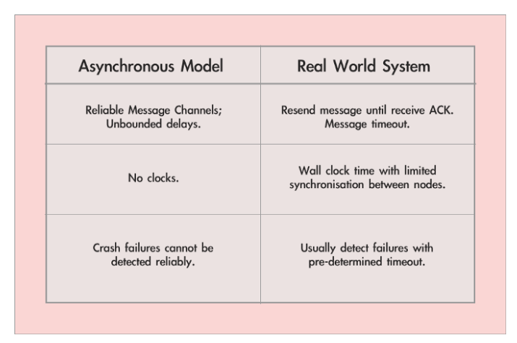
FLP vs. real world

Slide 28
Circumventing FLP
Failure detectors
We saw this
P, ◊P, Ω failure detectors
Probabilistic guarantees
Consensus properties hold probabilistically
FLP impossibility result holds for deterministic algorithms

Slide 29
Randomized consensus
Name: RandomizedConsensus, instance rc.
Request: < rc, Propose | v >: Proposes value v for consensus.
Indication: < rc, Decide | v >: Outputs a decided value v of consensus.
Properties:
RC1. Probabilistic termination: With probability 1, every correct process eventually decides some value.
C2. Validity: If a process decides v, then v was proposed by some process.
C3. Integrity: No process decides twice.
C4. Agreement: No two (correct) processes decide differently.

Slide 30
Extension
We extend our (deterministic) model as follows
1) every process has access to a source of randomness (called a coin)
2) the local computation part in every step of a process may now additionally depend on the output of the coin
picks a random element from a finite set according to a fixed probability distribution
We consider random elements with uniform distribution
We say that the algorithm flips (or tosses) a coin in this case

Slide 31
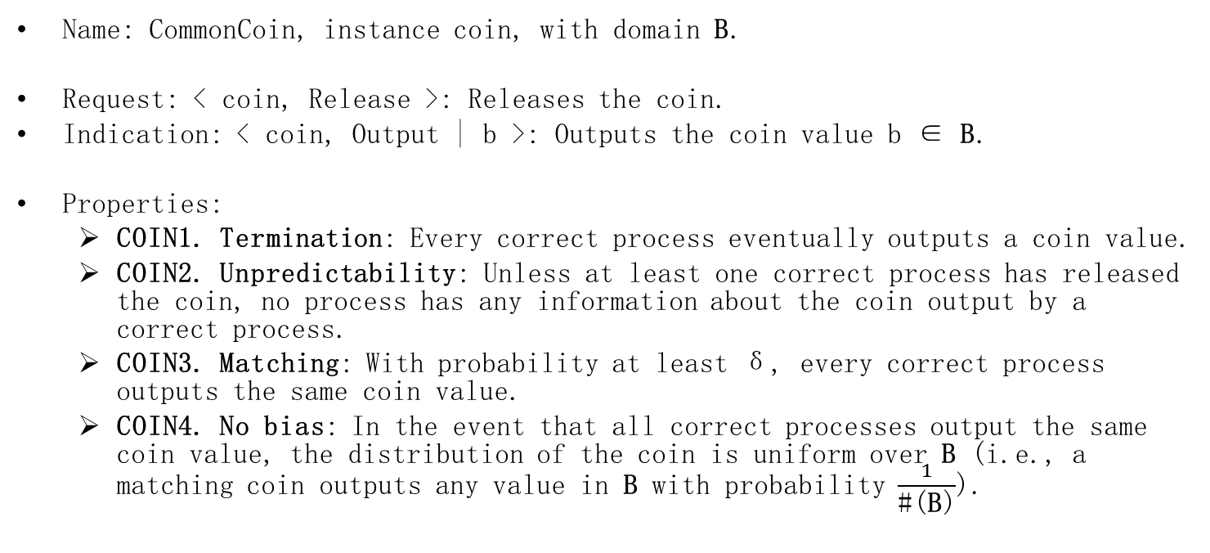
Common coin
Name: CommonCoin, instance coin, with domain B.
Request: < coin, Release >: Releases the coin.
Indication: < coin, Output | b >: Outputs the coin value b ∈ B.
Properties:
COIN1. Termination: Every correct process eventually outputs a coin value.
COIN2. Unpredictability: Unless at least one correct process has released the coin, no process has any information about the coin output by a correct process.
COIN3. Matching: With probability at least δ, every correct process outputs the same coin value.
COIN4. No bias: In the event that all correct processes output the same coin value, the distribution of the coin is uniform over B (i.e., a matching coin outputs any value in B with probability $\frac{1}{\text{\#(}\text{B}\text{)}}$).

Slide 32
Possible common coin implementations
Local Toss
Beacon (δ=1)
Threshold signature scheme (δ=1)
Many others…

Slide 33
Local Toss algorithm (Common Coin)
Upon releasing the coin, every process simply
selects a value c at random from D according to the uniform distribution, and
outputs c.
If the domain is one bit then this realizes a δ=2^{-N+1} matching common coin
Probability that every process selects the same c∈{0,1} is 2^{-N}

Slide 34
Beacon algorithm (Common Coin)
Small cheat: external process
Not really distributed
An external trusted process, called the beacon, periodically:
chooses an unpredictable random value
When an algorithm accesses a sequence of common coins
for the k-th coin, every process receives the k-th random value from the beacon and outputs it
This coin matches always (δ=1).

Slide 35
Randomized binary consensus
Domain for proposal/decision values is {0,1}
Correct majority assumption
Round-based algorithm
In every round, processes try to ensure that the same value is proposed by a majority of the processes
If there is no such value, the processes resort to the coin
coin selects a proposal for the next round
Probability that the processes agree might depend on δ
unless all (initial) proposals are the same
The algorithm terminates eventually with probability 1

Slide 36
Randomized binary consensus
In each round (2 phases)
every correct process proposes a value by sending it to all processes with a best-effort broadcast
Then it receives proposals from a majority of process
If all proposals from majority are the same
This proposal is propagated in the 2nd phase
Else
The process propagates ⊥ in the 2nd phase
Invariant:
If 2 processes propagate v1,v2 ≠ ⊥ in the 2nd phase then v1 = v2 = v

Slide 37
Randomized binary consensus
2nd phase
After a process receives a majority of phase 2 msgs
it checks if all are equal to v
If yes: process decides v and reliable-broadcasts the decision
Else if v≠ ⊥ exists:
adopt v as the proposal in the next round
Else
adopt the outcome of a coin as the proposal in the next round

Slide 38
Randomized Binary Consensus
Implements: RandomizedConsensus, instance rc, with domain {0, 1}.
Uses: BestEffortBroadcast, instance beb; ReliableBroadcast, instance rb; CommonCoin.
upon event < rc, Init > do
round := 0;
phase := 0;
proposal := ⊥;
decision := ⊥;
val := [⊥]^{N};
upon event < rc, Propose | v > do
proposal := v;
round := 1;
phase := 1;
trigger < beb, Broadcast | [PHASE-1, round, proposal] >;
upon event < beb, Deliver | p, [PHASE-1, r, v] > such that phase = 1 ∧ r = round do
val[p] := v;

Slide 39
Randomized Binary Consensus
upon #(val) > N/2 ∧ phase = 1 ∧ decision = ⊥ do
if exists v ≠ ⊥ such that #{p ∈ Π | val[p] = v} > N/2 then
proposal := v;
else
proposal := ⊥;
val := [⊥]^{N};
phase := 2;
trigger < beb, Broadcast | [ PHASE-2, round, proposal] >;

Slide 40
Randomized Binary Consensus
upon event < beb, Deliver | p, [PHASE-2, r, v] > such that phase = 2 ∧ r = round do
val[p] := v;
upon #(val) ≥ N − f ∧ phase = 2 ∧ decision = ⊥ do
phase := 0;
Initialize a new instance coin.round of CommonCoin with domain {0, 1};
trigger < coin.round, Release >;

Slide 41
Randomized Binary Consensus
upon event < coin.round, Output | c > do
if exists v ≠ ⊥ such that #{p ∈ Π | val[p] = v} > f then
decision := v ;
trigger < rb, Broadcast | [DECIDED, decision] >;
else
if exists p ∈ Π , w ≠ ⊥ such that val[p] = w then
proposal := w;
else
proposal := c;
val := [⊥]^{N};
round := round + 1;
phase := 1;
trigger < beb, Broadcast | [PHASE-1, round, proposal] >;
upon event < rb, Deliver | p, [DECIDED, v] > do
decision := v;
trigger < rc, Decide | decision >;

Slide 42
Correctness
Validity
If all proposals are the same then no process ever changes the proposal to coin outcome and the proposal value is the only possible decision value
Otherwise (both 0 and 1 are proposed), the decision value is anyway either 0 or 1
Agreement
By majority intersection: If two processes send a PHASE-2 message in the same round and both messages contain a proposal different from ⊥ then the two proposals are equal to some value v.

Slide 43
Correctness: Termination
Algorithm terminates as soon as all correct processes start a round with the same proposal
By coin matching, there is a positive probability δ that the common coin outputs the same value to all processes and this value is a uniformly chosen random bit.
If all correct processes start a round with the same proposal
then every correct process receives only PHASE-2 messages containing v, consequently broadcasts a DECIDED message with v in the same round

Slide 44
Performance
Every round
2 message delays
O(n²) messages
How many rounds
With probability 0, infinite
Expected number of rounds?
Proportional to 1/δ

Slide 45
Randomized multivalued consensus
From binary to multivalued
Can we just use the coin with larger domain?
What happens to Validity?

Slide 46
Randomized Multivalued consensus (Asynchronous Common Subset, ACS)
Implements: Randomized Multivalued Consensus, instance rmc.
Uses: ReliableBroadcast (rb), n instances; RandomizedBinaryConsensus (rc), n instances.
upon event < rmc, init > do
proposal := ⊥;
delivered := [⊥]^{N};
proposed := [FALSE]^{N};
upon event < rmc, Propose | v > such that proposal = ⊥ do
proposal := v;
trigger < rb, Broadcast | v >;
upon event < rb, Deliver | p, m > do
delivered[p] := m;
if proposed[p] = FALSE then
proposed[p] := TRUE;
trigger < rc.p, Propose | 1 >;

Slide 47

Randomized Multi-value consensus
upon event < rc.p, Decide | v > do
if v = 1 then
decidedone := decidedone ∪ {p};
if #decidedone ≥ N-f then
for $∀$ p : proposed[p] = FALSE do
proposed[p] := TRUE;
trigger < rc.p, Propose | 0 >;
decided := decided ∪ {p};
if #decided = n then
s := maxrank(decidedone);
trigger < rmc, Decide | delivered[s] >;
or trigger < rmc, Decide | {∪delivered[s] | $∀$ s ∈ decidedone } >;

