Slide 1
Distributed Algorithms Consensus – Part III
刘盛云

Slide 2
Outline
Last course
FLP impossibility result
Randomized Consensus

Slide 3
Outline
This course
Byzantine consensus: PBFT, HotStuff

Slide 4
Byzantine consensus (the origins)
Marshall C. Pease, Robert E. Shostak, Leslie Lamport: Reaching Agreement in the Presence of Faults. J.ACM 27 (2): 228-234 (1980)
Dijkstra prize
Leslie Lamport, Robert E. Shostak, Marshall C. Pease: The Byzantine Generals Problem. ACM TOPLAS 4 (3): 382-401 (1982)

Slide 5
Consensus
Name: Consensus, instance c.
Request: < c, Propose | v >: Proposes value v for consensus.
Indication: < c, Decide | v >: Outputs a decided value v of consensus.
Properties:
C1. Termination: Every correct process eventually decides some value.
C2. Validity: If a process decides v, then v was proposed by some process.
C3. Integrity: No process decides twice.
C4. Agreement: No two correct processes decide differently.

Slide 6
Validity variants in the Byzantine world
(Strong validity) If all correct processes propose v, then no correct process decides a value other than v
(Weak validity) If all processes are correct and propose the same value v, then no correct process decides a value different from v; furthermore, if all processes are correct and some process decides v, then v was proposed by some process.

Slide 7
Cryptographic Abstractions
Digital signature scheme
Associates a public-key/private-key pair with each process
Private key remains secret to other processes
σ = sign(sender, message)
Using private key of the sender
verifysig(sender, message, σ)
Can be invoked by any process
Using the public key of the sender

Slide 8


Byzantine fault：equivocation
The Byzantine leader sends inconsistent requests to correct processes
propose（req1 | req2 ）
f
_{Leader}
_{req1}
_{req2}
decide（req1 ）
f
_{process 0}
decide（req2）
f
_{process 1}

Slide 9




f < N/3 Lower bound (sketch)
Assume N = 3f
Show that Byzantine consistent broadcast (w/o FD) is impossible
bcbroadcast(m)
bcbroadcast(m’)
$$f$$
bcbdeliver(m)
bcbdeliver(m’)
$$f$$
bcbdeliver(m)
bcbdeliver(m)
Consistency is violated!
$$f$$
bcbdeliver(m’)
bcbdeliver(m’)

Slide 10
PBFT
PBFT（Practical Byzantine Fault Tolerance）
Roughly, Paxos in Byzantine model
Actually, Viewstamped Replication in Byzantine model
Paxos：READ phase + IMPOSE phase
Miguel Castro and Barbara Liskov: Practical Byzantine fault tolerance. Usenix OSDI: 173–186 (1999).

Slide 11
Message pattern of Paxos/Synod
2. How to ensure S1 selects the highest round
C
request
C
reply
S1
S1
S1
S1
S1
1. When to enter a new round
S2
S2
S2
3. How to transfer the estimate to the next round
.
.
.
.
.
.
.
.
.
READ
GATHER
IMPOSE
Sn
ACK
Sn
Sn
Read phase
Impose phase
PBFT uses digital signatures!

Slide 12
Problems in the Byzantine world
3. How to transfer the estimate to the next round
_{req1}
_{impose}
_{req2}
_{leader}
_{BYZ}
_{leader}
_{process 1}
_{decide(req1)}
_{round++}
_{process 1}
_{[sig0,sig1,sig2] for req1}
_{process 2}
_{req1}
_{process 2}
_{update}
_{estimate}
_{process 3}
_{new leader}
_{process 3}
_{Indistinguishable!}
_{leader}
First round all-to-all
estimate is unique
Second round all-to-all
estimate can be transferred to the next round
_{process 1}
_{process 2}
_{process 3}
_{decide}
_{update}
_{estimate}

Slide 13
Problems in the Byzantine world
2. How to ensure S1 (the new leader) selects the highest round
The new leader broadcasts 2f+1 GATHER messages，such that other processes can verify the proposal imposed (i.e., replay selection procedure)
_{req1}
_{impose}
_{read}
_{leader}
_{process 1}
_{process 2}
_{process 3}
_{gather}

Slide 14
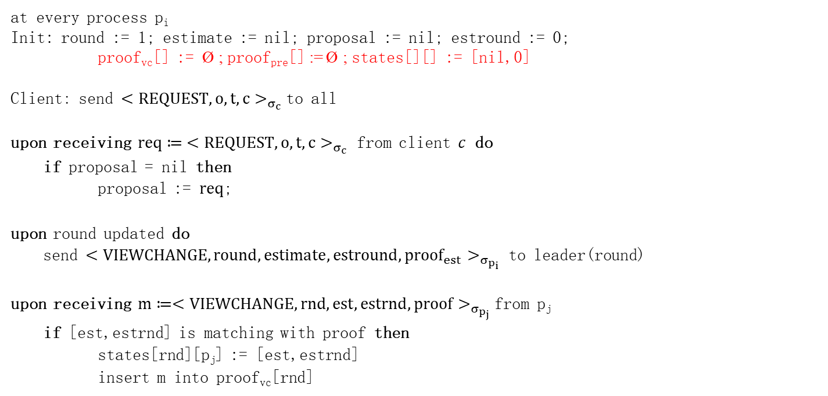
PBFT （omit signature sign/verify）
at every process p_{i}
Init: round := 1; estimate := nil; proposal := nil; estround := 0;
proof_{vc}[] := Ø ; proof_{pre}[] := Ø ; states[][] := [nil,0]
Client： send ${<REQUEST,o,t,c>}_{σ_{c}}$to all
upon receiving $req≔{ <REQUEST,o,t,c>}_{σ_{c}}$ from client $c$ do
if proposal = nil then
proposal := $req$;
upon round updated do
send ${<VIEWCHANGE,round, estimate,estround,{proof}_{est}>}_{σ_{p_{i}}}$ to leader(round)
upon receiving ${m≔<VIEWCHANGE,rnd, est,estrnd,proof>}_{σ_{p_{j}}}$from p_{j}
if [est,estrnd] is matching with proof then
states[rnd][p_{j}] := [est,estrnd]
insert m into proof_{vc}[rnd]
_{leader}
_{process 1}
_{process 2}
_{process 3}

Slide 15
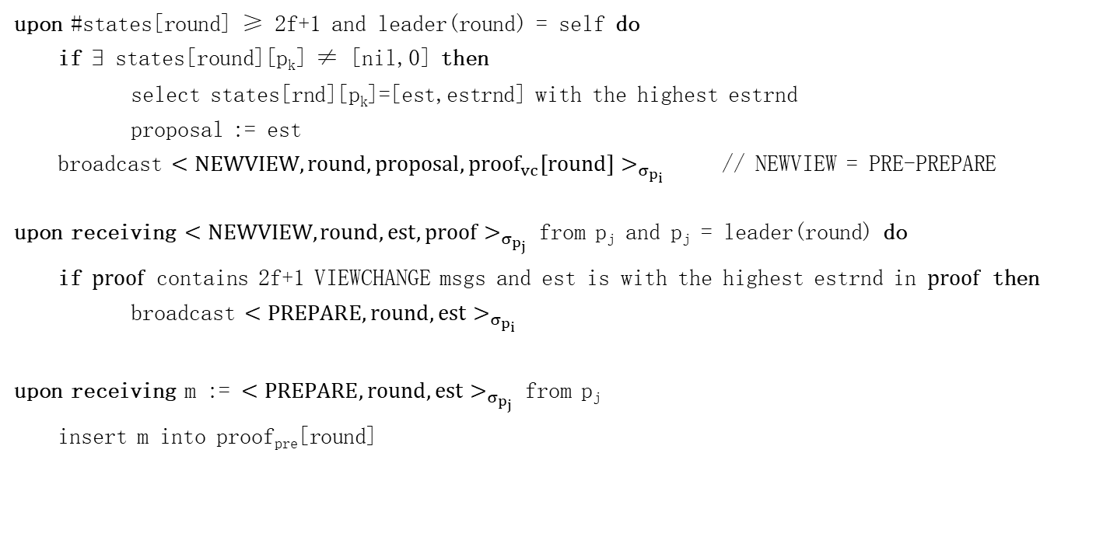
PBFT
_{leader}
upon #states[round] ≥ 2f+1 and leader(round) = self do
if ∃ states[round][p_{k}] ≠ [nil,0] then
select states[rnd][p_{k}]=[est,estrnd] with the highest estrnd
proposal := est
broadcast ${<NEWVIEW,round,proposal,{proof}_{vc}[round]>}_{σ_{p_{i}}}$ // NEWVIEW = PRE-PREPARE
upon receiving ${<NEWVIEW,round,est,proof>}_{σ_{p_{j}}}$ from p_{j} and p_{j} = leader(round) do
if $proof$ contains 2f+1 VIEWCHANGE msgs and est is with the highest estrnd in $proof$ then
broadcast ${<PREPARE,round,est>}_{σ_{p_{i}}}$
upon receiving m := ${<PREPARE,round,est>}_{σ_{p_{j}}}$ from p_{j}
insert m into proof_{pre}[round]
_{process 1}
_{process 2}
_{process 3}

Slide 16

PBFT
upon #proof_{pre}[round] ≥ 2f+1 and proof_{pre}[round] contains 2f+1 matching est do
estimate := est;
estround := round;
broadcast ${<COMMIT,round,estimate>}_{σ_{p_{j}}}$
upon receiving ${<COMMIT,round,v>}_{σ_{∗}}$ from 2f+1 processes do
decide(v)
END OF PBFT CONSENSUS
_{leader}
_{process 1}
_{process 2}
_{process 3}

Slide 17

PBFT
Verify execution result
upon decide(v) do
r := execute v.o // v.o is the operation
send ${<REPLY,v.t,r>}_{σ_{\text{p}\text{i}}}$ to v.c // v.t is the timestamp; v.c is the client
upon receiving ${<REPLY,v.t,r>}_{σ_{∗}}$ with matching r from f+1 processes do
accept r

Slide 18
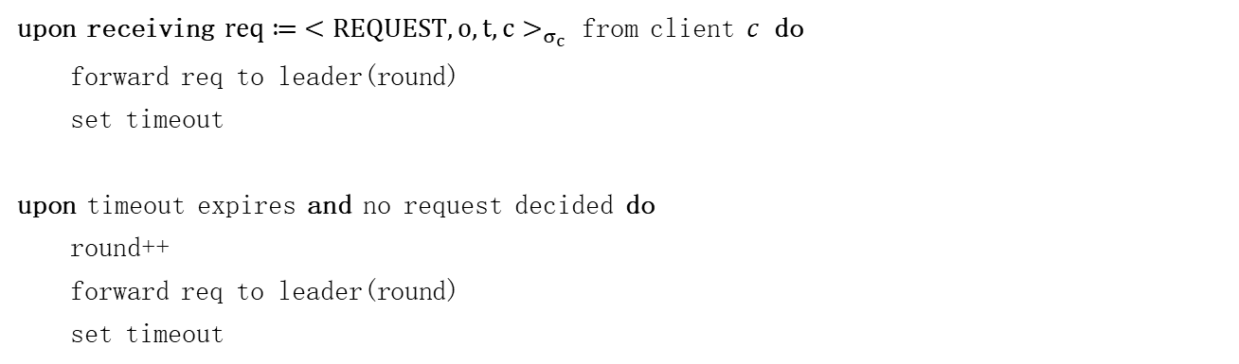
Enter a new round
// Paxos/Synod
upon leader(round) ∈ suspected
round++
1. When to enter a new round
Heartbeat mechanism is not working in the Byzantine world
upon receiving $req≔{ <REQUEST,o,t,c>}_{σ_{c}}$ from client $c$ do
forward req to leader(round)
set timeout
upon timeout expires and no request decided do
round++
forward req to leader(round)
set timeout

Slide 19
Performance
Message complexity
best case: O(n²)
However, communication complexity is O(n³)
The new leader broadcasts NEWVIEW message to O(n) processes
Each NEWVIEW message contains O(n) VIEWCHANGE messages
Each VIEWCHANGE message contains O(n) PREPARE messages

Slide 20
HotStuff
Still a leader-based protocol
In partially synchronous model
Its variant (DiemBFT) is used in Diem project
Facebook pilots
Maofan Yin, Dahlia Malkhi, Michael K. Reiter, Guy Golan Gueta, and Ittai Abraham: HotStuff: BFT Consensus with Linearity and Responsiveness. ACM PODC: 347–356 (2019).

Slide 21
HotStuff
HotStuff has the following features：
Rotate the leader-role proactively
Linear view change：O(n)
optimistic responsiveness
New leader needs to wait just for the first n − f responses to guarantee that it can create a proposal that will make progress.
General idea
The leader takes charge of message dissemination/aggregation
Using (n, 2f+1) threshold signature to combine 2f+1 signature shares
O(n²) -> O(n)
Using a lock to prevent forwarding VIEWCHANGE messages (in PBFT)
Similar to Tendermint

Slide 22
Locking mechanism
New leader in PBFT broadcasts 2f+1 VIEWCHANGE messages，such that other processes can verify the proposal imposed (i.e., replay selection procedure)
O(n³) communication complexity
Processes in HotStuff lock the estimate，thus each process can verify, on its own, whether a proposal is valid
Trade-off：one more round of message exchanges (compared to PBFT)
Otherwise, livelock problem
_{VIEWCHANGE}
_{forward 2f+1 VIEWCHANGE}
_{leader}
_{process 1}
_{process 2}
_{process 3}

Slide 23
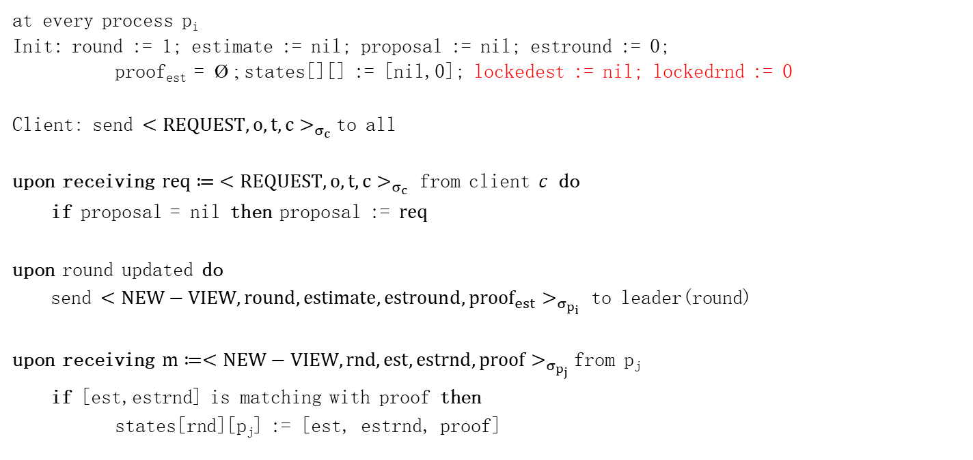
Hotstuff （omit signature operations）
at every process p_{i}
Init: round := 1; estimate := nil; proposal := nil; estround := 0;
proof_{est} = Ø ; states[][] := [nil,0]； lockedest := nil; lockedrnd := 0
Client： send ${<REQUEST,o,t,c>}_{σ_{c}}$to all
upon receiving $req≔{ <REQUEST,o,t,c>}_{σ_{c}}$ from client $c$ do
if proposal = nil then proposal := $req$
upon round updated do
send ${<NEW−VIEW,round, estimate,estround,{proof}_{est}>}_{σ_{p_{i}}}$ to leader(round)
upon receiving ${m≔<NEW−VIEW,rnd,est,estrnd,proof>}_{σ_{p_{j}}}$from p_{j}
if [est,estrnd] is matching with proof then
states[rnd][p_{j}] := [est, estrnd, proof]
_{leader}
_{process 1}
_{process 2}
_{process 3}
threshold signature：O（1） space complexity

Slide 24
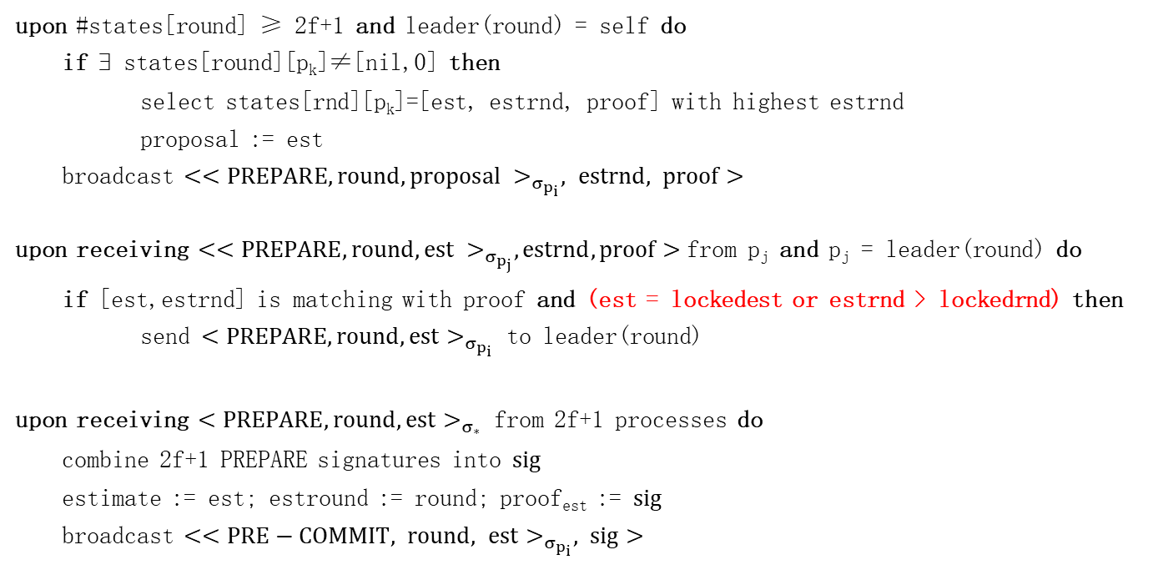
HotStuff
upon #states[round] ≥ 2f+1 and leader(round) = self do
if ∃ states[round][p_{k}]≠[nil,0] then
select states[rnd][p_{k}]=[est, estrnd, proof] with highest estrnd
proposal := est
broadcast ${<<PREPARE,round,proposal >}_{σ_{p_{i}}}, estrnd, proof>$
upon receiving ${<<PREPARE,round,est >}_{σ_{p_{j}}},estrnd, proof>$from p_{j} and p_{j} = leader(round) do
if [est,estrnd] is matching with proof and (est = lockedest or estrnd > lockedrnd) then
send ${<PREPARE,round,est>}_{σ_{p_{i}}}$ to leader(round)
upon receiving ${<PREPARE,round,est>}_{σ_{∗}}$ from 2f+1 processes do
combine 2f+1 PREPARE signatures into $sig$
estimate := est; estround := round; proof_{est} := $sig$
broadcast $<{<PRE−COMMIT, round, est>}_{σ_{p_{i}}}, sig>$
_{leader}
_{process 1}
_{process 2}
_{process 3}

Slide 25
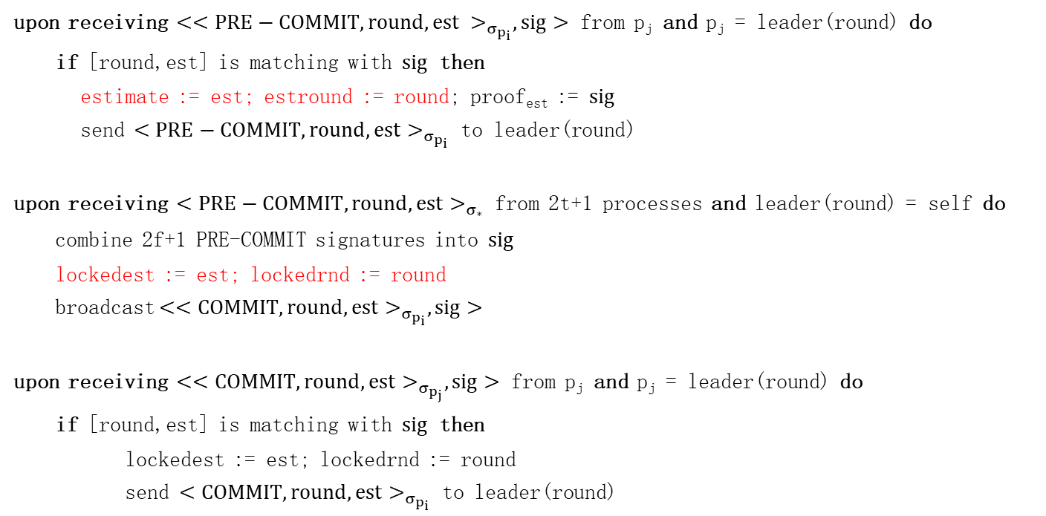
HotStuff
upon receiving ${<<PRE−COMMIT,round,est >}_{σ_{p_{i}}},sig>$ from p_{j} and p_{j} = leader(round) do
if [round,est] is matching with $sig$ then
estimate := est; estround := round; proof_{est} := $sig$
send ${<PRE−COMMIT,round,est>}_{σ_{p_{i}}}$ to leader(round)
upon receiving ${<PRE−COMMIT,round,est>}_{σ_{∗}}$ from 2t+1 processes and leader(round) = self do
combine 2f+1 PRE-COMMIT signatures into $sig$
lockedest := est; lockedrnd := round
broadcast${<<COMMIT,round,est>}_{σ_{p_{i}}},sig>$
upon receiving ${<<COMMIT,round,est>}_{σ_{p_{j}}},sig>$ from p_{j} and p_{j} = leader(round) do
if [round,est] is matching with $sig$ then
lockedest := est; lockedrnd := round
send ${<COMMIT,round,est>}_{σ_{p_{i}}}$ to leader(round)
_{leader}
_{process 1}
_{process 2}
_{process 3}

Slide 26

HotStuff
upon receiving ${<COMMIT,round,est>}_{σ_{∗}}$ from 2f+1 processes and self=leader(round) do
combine 2t+1 COMMIT signatures into $sig$
broadcast ${<<DECIDE,round,est>}_{σ_{p_{j}}},sig>$
decide(est)
upon receiving ${<<DECIDE,round,est>}_{σ_{p_{j}}},sig>$ from p_{j} and p_{j} = leader(round) do
if [round,est] is matching with $sig$ then
decide(est)
END OF HOTSTUFF CONSENSUS
_{leader}
_{process 1}
_{process 2}
_{process 3}

Slide 27
Performance
Message complexity
best case: O(n)
Communication complexity
best case: O(n)

Slide 28
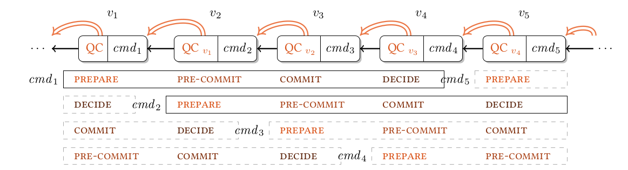
Pipelining

