Slide 1
Distributed Algorithms Consensus variants
刘盛云

Slide 2
Outline
Last course
Byzantine consensus: PBFT, HotStuff

Slide 3
Outline
This course
Consensus variants
Terminating Reliable Broadcast
Group Membership
Non-Blocking Atomic Commit

Slide 4
(Uniform) Reliable Broadcast
deliver(m)
p1
broadcast(m)
p2
crash
deliver(m)
p3

Slide 5
(Uniform) Reliable Broadcast
?
p1
broadcast(m)
p2
crash
p3
?

Slide 6
Terminating reliable broadcast
Like reliable broadcast…
A communication primitive used to disseminate a message among a set of processes in a reliable way
Unlike reliable broadcast…
A correct process has to deliver a message
TRB is strictly stronger than (uniform) reliable broadcast

Slide 7
Terminating reliable broadcast
deliver(m)
p1
broadcast(m)
p2
crash
deliver(m)
p3

Slide 8
Terminating reliable broadcast
deliver(△)
p1
broadcast(m)
p2
crash
deliver(△)
p3

Slide 9
Terminating reliable broadcast
Like with (uniform) reliable broadcast…
correct processes in TRB agree on the set of messages they deliver
every correct process in TRB delivers every message delivered by any process
Unlike (uniform) reliable broadcast…
TRB is defined with a designated broadcaster (source)
Like Byzantine consistent broadcast and Byzantine reliable broadcast
src known to all processes in advance
every correct process delivers a message, even if the broadcaster crashes

Slide 10
Terminating reliable broadcast
Defined for a specific broadcaster process
pi = src (known by all processes)
Process src is supposed to broadcast a message m∈Μ (distinct from △)
△ = Source Failure
△ ∉ Μ
The other processes need to deliver a message
m if src is correct
but may deliver △ if src crashes

Slide 11
Uniform Terminating Reliable Broadcast
Name: UniformTerminatingReliableBroadcast, instance utrb, with sender s.
Request: < utrb, Broadcast | m >: Broadcasts a message m to all processes. Executed only by process src.
Indication: < utrb, Deliver | src, m >: Delivers a message m broadcast by process src or the symbol △.
Properties:
UTRB1. Validity: If a correct process src broadcasts a message m, then src eventually delivers m.
UTRB2. Termination: Every correct process eventually delivers exactly one message.
UTRB3. Integrity: If a correct process delivers some message m, then m was either previously broadcast by process src or it holds m = △.
UTRB4. Uniform Agreement: If any process delivers a message m, then every correct process eventually delivers m.

Slide 12
Consensus-Based UTRB
Implements: UniformTerminatingReliableBroadcast, instance utrb, with sender src.
Uses: BestEffortBroadcast, instance beb; UniformConsensus, instance uc; PerfectFailureDetector, instance P.
upon event < utrb, Init > do
proposal := ⊥ ;
upon event < utrb, Broadcast | m > do
trigger < beb, Broadcast | m >;
upon event < beb, Deliver | src, m > do
if proposal = ⊥ then
proposal := m;
trigger < uc, Propose | proposal >;
upon event < P, Crash | p > do
if p = src ∧ proposal = ⊥ then
proposal := △;
trigger < uc, Propose | proposal >;
upon event < uc, Decide | decided > do
trigger < utrb, Deliver | src, decided >;

Slide 13
Example
trbDeliver(m)
propose(m)
decide(m)
p1
trbBroadcast(m)
trbDeliver(m)
propose(m)
decide(m)
p2
CONS
trbDeliver(m)
p3
propose(m)
decide(m)

Slide 14
Example
crash,p2
trbDeliver(m)
propose(△)
p1
decide(m)
trbBroadcast(m)
p2
CONS
trbDeliver(m)
p3
propose(m)
decide(m)

Slide 15
Example
trbDeliver(△)
crash,p2
propose(△)
p1
decide(△)
trbBroadcast(m)
p2
CONS
trbDeliver(△)
p3
propose(△)
decide(△)

Slide 16
Correctness (utrb)
Integrity
No other value is proposed to consensus, the property follows by consensus Validity

Slide 17
Correctness (utrb)
Validity
Since src is correct, by bebBroadcast Validity
Every correct process delivers m
By Strong accuracy P
no process changes proposal to △
Hence, every process proposes m to consensus
m is the only possible decision
src trbDelivers m

Slide 18
Correctness (utrb)
Uniform Agreement
By Consensus Uniform Agreement
Termination
By bebBroadcast No Duplication and strong completeness of P
Every process proposes to consensus (exactly once)
Consensus Termination, Integrity

Slide 19
Is P necessary for utrb?
What is the weakest failure detector for utrb?
Exercise 9.1
Prove that P is the weakest failure detector to implement utrb
Hint: Try to implement P assuming utrb (and reliable channels)
This would mean that P and utrb are equivalent in a system with reliable channels

Slide 20
Group membership
In some distributed applications, processes need to know which processes are participating in the computation and which are not
Failure detectors?
provide such information
however, that information is not coordinated even if the failure detector is perfect

Slide 21
Perfect Failure Detector (P)
crashed={p2}
crashed={p2,p3}
p1
crash
p2
crash
p3
crashed={p3}
crashed={p2,p3}
crashed={}
p4

Slide 22
Group membership
V1 = {p1,p4}
p1
crash
p2
crash
p3
p4
V1 = {p1,p4}

Slide 23
Group membership
Fault Tolerance focus
Group membership abstraction to coordinate the information about crashes
More generally,
A group membership abstraction can also typically be used to coordinate the processes joining and leaving explicitly the set of processes (i.e., without crashes)

Slide 24
Group membership
Like with a failure detector
the processes are informed about failures
we say that the processes install views
Like with a perfect failure detector P
the processes have accurate knowledge about failures
Unlike with a perfect failure detector P
the information about failures are coordinated
the processes install the same sequence of views

Slide 25
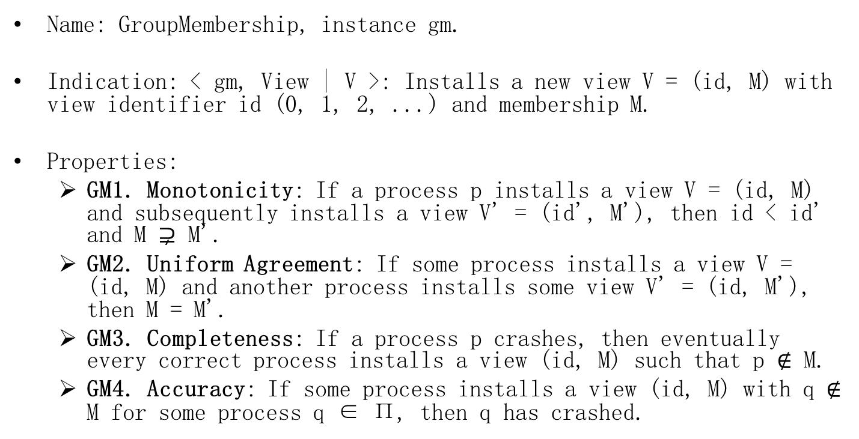
Interface and properties
Name: GroupMembership, instance gm.
Indication: < gm, View | V >: Installs a new view V = (id, M) with view identifier id (0, 1, 2, ...) and membership M.
Properties:
GM1. Monotonicity: If a process p installs a view V = (id, M) and subsequently installs a view V' = (id', M'), then id < id' and M $⊋$ M'.
GM2. Uniform Agreement: If some process installs a view V = (id, M) and another process installs some view V' = (id, M'), then M = M'.
GM3. Completeness: If a process p crashes, then eventually every correct process installs a view (id, M) such that p $∉$ M.
GM4. Accuracy: If some process installs a view (id, M) with q $∉$ M for some process q ∈ Π, then q has crashed.

Slide 26

Consensus-Based Group Membership
Implements: GroupMembership, instance gm.
Uses: UniformConsensus (multiple instance); PerfectFailureDetector, instance P.
upon event < gm, Init > do
(id, M) := (0, Π);
correct := Π;
wait := FALSE;
trigger < gm, View | (id, M ) >;
upon event < P, Crash | p > do
correct := correct \ {p};
upon correct $⊊$ M ∧ wait = FALSE do
id := id + 1;
wait := TRUE;
Initialize a new instance uc.id;
trigger < uc.id, Propose | correct >;
upon event < uc.i, Decide | M' > such that i = id do
M := M';
wait := FALSE;
trigger < gm, View | (id, M) >;

Slide 27
Example
propose(1, {p1,p2,p4}) → (1,{p1,p2,p4})
p1
crash
propose(2,{p1,p4}) → (2,{p1,p4})
p2
crash
p3
propose(1,{p1,p3,p4}) → (1,{p1,p2,p4})
p4
propose(2,{p1,p4}) → (2,{p1,p4})

Slide 28
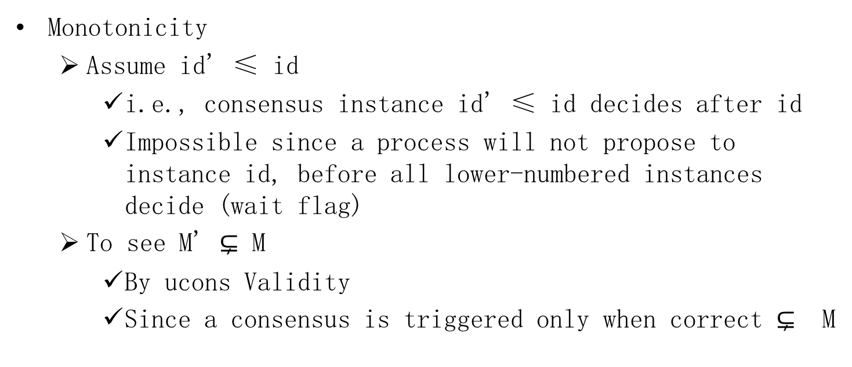
Correctness (gm)
Monotonicity
Assume id' ≤ id
i.e., consensus instance id' ≤ id decides after id
Impossible since a process will not propose to instance id, before all lower-numbered instances decide (wait flag)
To see M' $⊊$ M
By ucons Validity
Since a consensus is triggered only when correct $⊊$ M

Slide 29
Correctness (gm)
Agreement
By ucons Uniform Agreement
Completeness
By strong completeness of P all correct processes suspect p eventually
Once all correct processes suspect p, a member set without p will be proposed by all
By ucons Validity a view without p is installed
Accuracy
By Strong Accuracy of P

Slide 30
Group membership vs. P?
P is clearly sufficient for gm
Is it necessary?
Exercise 9.2
Can you implement P using gm?

Slide 31
Non-blocking Atomic Commit (NBAC)
An agreement problem
Used in database transactions

Slide 32
Transactions
A transaction is an atomic program describing a sequence of accesses to shared and distributed information
Jim Gray, late 1970s….
A transaction can be terminated either by committing or aborting

Slide 33
Transaction example
begin.transaction
Alice.withdraw(¥1000)
Bob.deposit(¥1000)
end.transaction

Slide 34
Transaction example 2
begin.transaction
EasternAirline.book(Shanghai, Beijing)
AirChina.book(Beijing, Shanghai)
end.transaction
Either both instructions are executed (tx commits) or neither of them is (tx aborts)
A transaction may abort due to
Concurrency, and/or
Failures

Slide 35
ACID properties
Atomicity:
a transaction either performs entirely or none at all
Consistency:
a transaction transforms a consistent state into another consistent state
Isolation:
a transaction appears to be executed in isolation
Durability:
the effects of a transaction that commits are permanent

Slide 36
NBAC
A consensus variant used to reach decision on whether to abort/commit a tx
More precisely
A variant of binary consensus
Decision biased towards 0

Slide 37
NBAC
As in binary consensus
every process has an initial value 0 (no) or 1 (yes) and must decide on a final value 0 (abort) or 1 (commit)
Unlike consensus
the processes here seek to decide 1 but every process has a veto right
i.e., there is a bias towards deciding 0

Slide 38
NBAC
Name: NonBlockingAtomicCommit, instance nbac.
Request: < nbac, Propose | v >: Proposes value v = COMMIT or v = ABORT for
the commit.
Indication: < nbac, Decide | v >: Outputs the decided value for the commit.
Properties:
NBAC1. Termination: Every correct process eventually decides some value.
NBAC2. Abort-Validity: A process can only decide A BORT if some process proposes A BORT or a process crashes.
NBAC3. Commit-Validity: A process can only decide C OMMIT if no process proposes ABORT.
NBAC4. Integrity: No process decides twice.
NBAC5. Uniform Agreement: No two processes decide differently.

Slide 39
NBAC
decide(1)
propose(1)
p1
decide(1)
propose(1)
p2
decide(1)
propose(1)
p3

Slide 40
NBAC
decide(0)
propose(0)
p1
decide(0)
propose(1)
p2
decide(0)
propose(1)
p3

Slide 41
NBAC
decide(0/1)
propose(1)
p1
propose(1)
p2
decide(0/1)
propose(1)
p3

Slide 42
NBAC?
propose(1)
p1
propose(0)
p2
propose(1)
p3

Slide 43
Atomic Commit (AC)
NBAC1, NBAC3 and NBAC4
Might violate termination (i.e., might block)
Databases: standard textbook implementation of AC
2-phase commit (2PC)

Slide 44
2-phase commit
decide(1)
propose(1)
p1
decide(1)
propose(1)
p2
decide(1)
propose(1)
p3

Slide 45
2-phase commit
decide(0)
propose(1)
p1
decide(0)
propose(0)
0
p2
decide(0)
propose(1)
p3

Slide 46
2-phase commit
decide(0)
propose(1)
p1
propose(0)
p2
decide(0)
propose(1)
p3

Slide 47
2-phase commit
propose(1)
p1
propose(0)
0
?
p2
propose(1)
p3
?

Slide 48
Consensus-based NBAC
Implements: NonBlockingAtomicCommit, instance nbac.
Uses: BestEffortBroadcast, instance beb; UniformConsensus, instance uc; PerfectFailureDetector, instance P.
upon event < nbac, Init > do
voted := ∅;
proposed := FALSE;
upon event < P, Crash | p > do
if proposed = FALSE then
trigger < uc, Propose | ABORT >;
proposed := TRUE;
upon event < nbac, Propose | v > do
trigger < beb, Broadcast | v >;
upon event < beb, Deliver | p, v > do
if v = ABORT ∧ proposed = FALSE then
trigger < uc, Propose | ABORT >;
proposed := TRUE;
else
voted := voted ∪ {p};
if voted = Π ∧ proposed = FALSE then
trigger < uc, Propose | COMMIT >;
proposed := TRUE;
upon event < uc, Decide | decided > do
trigger < nbac, Decide | decided >;

Slide 49
NBAC
decide(1)
propose(1)
U
C
O
N
S
1
1
p1
decide(1)
propose(1)
1
1
p2
decide(1)
propose(1)
p3
1
1

Slide 50
NBAC
decide(0)
propose(0)
U
C
O
N
S
0
0
p1
decide(0)
propose(1)
0
0
p2
decide(0)
propose(1)
p3
0
0

Slide 51
NBAC
propose(1)
decide(1)
U
C
O
N
S
p1
1
1
propose(1)
p2
decide(1)
propose(1)
p3
1
1

Slide 52
NBAC
(crash,p2)
propose(1)
U
C
O
N
S
decide(1)
p1
0
1
propose(1)
p2
decide(1)
propose(1)
p3
1
1

Slide 53
NBAC
(crash,p2)
decide(0)
propose(1)
U
C
O
N
S
p1
0
0
propose(1)
p2
decide(0)
propose(1)
p3
1
0

Slide 54
Correctness (nbac)
Agreement
By ucons Agreement
Termination
Either
Some process crashes and, by Strong completeness of P, all correct propose to ucons, or
No process crashes and by beb Validity, all correct propose to ucons
By Termination of ucons, every correct process eventually decides

Slide 55
Correctness (nbac)
Commit Validity
1 can only be decided if all processes propose 1
By algorithm, 1 is proposed to ucons only if all propose 1
Abort Validity
0 can only be decided if some process fails or proposes 0
By contradiction
Assume all are correct and propose 1, yet some process decides 0
Then all propose 1 to ucons
Since 0 is decided, it is a decision of ucons
Violation of ucons Validity (a contradiction)

