Slide 1

Modeling Obesity Prevalence A Stochastic Approach for the U.S. Population
MS Presentation
Palma Daawin
Department of Statistics, Miami University

Slide 2
Outline
Introduction
Objectives
Data
Obesity ,Stochastic Mortality ,Cohort Effect Literature
Methods
Results & Analysis
Conclusion

Slide 3
Introduction- Consequences of Obesity
Obese individuals are vulnerable to death –causing diseases such as
Coronary heart disease
high blood pressure
stroke
type 2 diabetes
cancer
sleep apnea
gallstones
Osteoarthritis (Weight, 2015).

Slide 4

Introduction
About one third of the U.S. adults are obese. Center for Disease Control (CDC)
About 300,000 annual deaths due to obesity in the U.S. Alison at al. (1999)
Olshansky et al. (2005) forecasted a decline in U.S life expectancy in the 21st century due to the effect of obesity on longevity
Life/health insurance firms include obesity as a major risk factor in their ratemaking, life and health insurance product pricing
Good eating habits and physical exercise can reduce the health care bill
and relieve Obama Care , Trump Care .Biggest problem Facing President Trump?

Slide 5
Objectives
Learn from cohort estimation in stochastic mortality models and provide alternatives to ANOVA models.
Build and implement stochastic models for estimating cohort effect and obesity prevalence.
Use some evaluation methods to assess the proposed model/methods
Explore tools for forecasting obesity prevalence
Notes:
Using Age –Group Data in different age bins

Slide 6
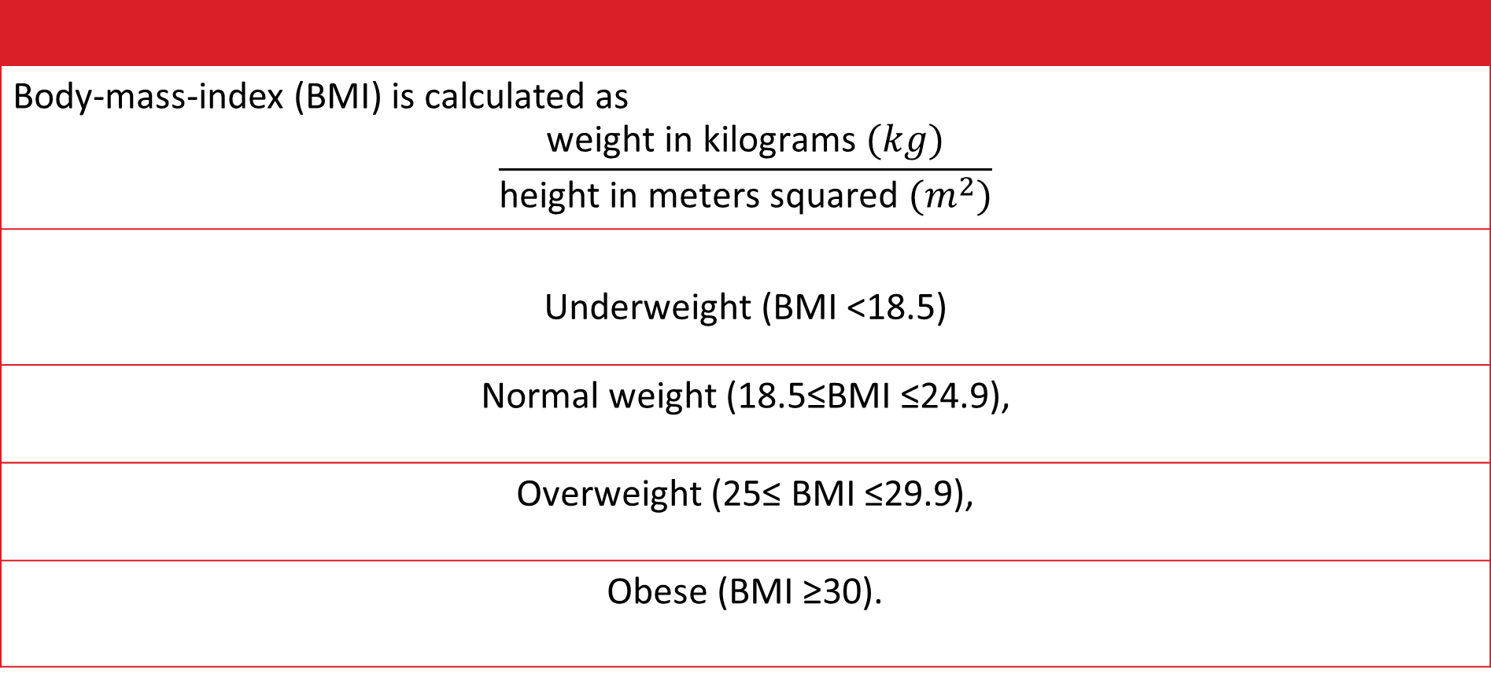
Body Mass Index (BMI)
Body-mass-index (BMI) is calculated as $$\frac{\text{weight} \text{in} \text{kilograms} (kg)}{\text{height} \text{in} \text{meters} \text{squared}{ (m}^{2})}$$
Underweight (BMI <18.5)
Normal weight (18.5≤BMI ≤24.9),
Overweight (25≤ BMI ≤29.9),
Obese (BMI ≥30).

Slide 7
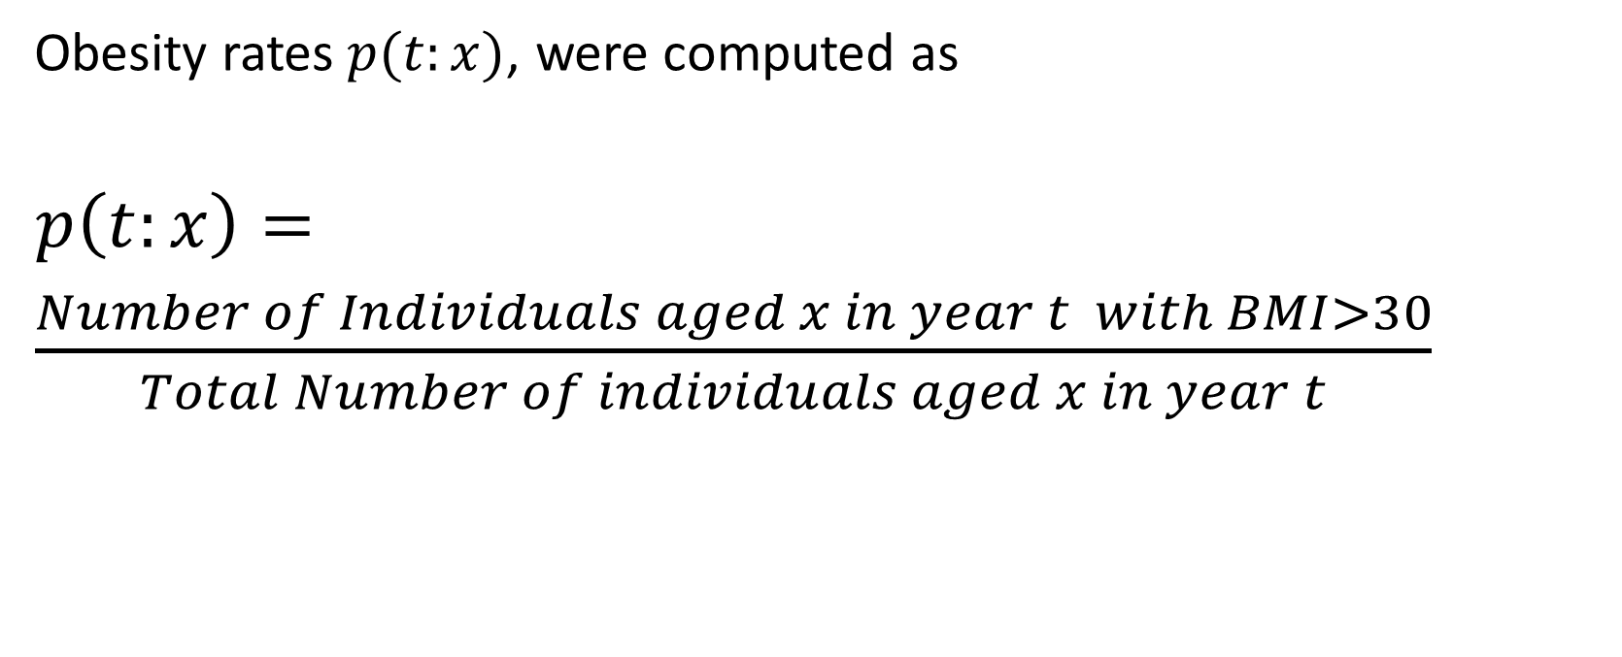
Obesity
Obesity rates$p(t:x)$, were computed as
$p\left(t:x\right)=$
$\frac{Number of Individuals aged x in year t with BMI>30}{Total Number of individuals aged x in year t}$

Slide 8
Data
Age | BRFSS [2006] | BRFSS [2007] | BRFSS [2008] | BRFSS [2009] | BRFSS [2010] | BRFSS [2011] | BRFSS [2012]
[23] | 0.1729702 | 0.2093023 | 0.2025316 | 0.2135981 | 0.1990262 | 0.1811757 | 0.1783061
[24] | 0.1938776 | 0.2167617 | 0.2273622 | 0.2178649 | 0.2319187 | 0.1905896 | 0.1812325
[25] | 0.2041925 | 0.2194369 | 0.2298695 | 0.2415934 | 0.2412607 | 0.1952014 | 0.1943987
[26] | 0.2120335 | 0.2378609 | 0.2452050 | 0.2416165 | 0.2560570 | 0.2228346 | 0.2246661
[27] | 0.2172800 | 0.2307461 | 0.2526278 | 0.2674881 | 0.2612077 | 0.2286801 | 0.2130841
[28] | 0.2316865 | 0.2541317 | 0.2523608 | 0.2543676 | 0.2626923 | 0.2200051 | 0.2308872
[29] | 0.2346003 | 0.2580487 | 0.2502765 | 0.2637028 | 0.2866988 | 0.2616693 | 0.2526010
[30] | 0.2290323 | 0.2602978 | 0.2386831 | 0.2773723 | 0.2697704 | 0.2531703 | 0.252070
[31] | 0.2502254 | 0.2601358 | 0.2537764 | 0.2682927 | 0.2618683 | 0.2443492 | 0.2550172
[32] | 0.2602324 | 0.2727905 | 0.2743136 | 0.2747570 | 0.2843354 | 0.2755319 | 0.2742607
KEY facts
Behavioral Risk Factor Surveillance System (BRFSS)
28 years from 1988 -2015
Average of 330 Variables
300,000 annual records
Total training data used is 6.1 million (1988 -2012)
1.2 million test data 2013-2015
Alternative Data: National Health and Nutrition Examination Survey (NHANES)
Notes:
Table 1 Extract Age-Period Contingency table for obesity. Age (rows) and period (columns) Obesity (BMI>30) rates
In this study obesity rates are computed using data from the Behavioral Risk Factor Surveillance System (BRFSS) survey
6 million + records from individuals from 1988 to 2012 .

Slide 9
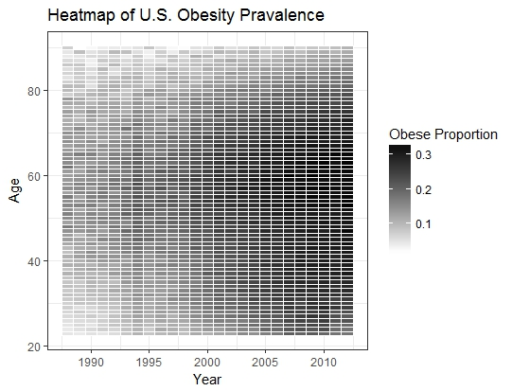
Summed on Entity ID for Bar Chart

Slide 10
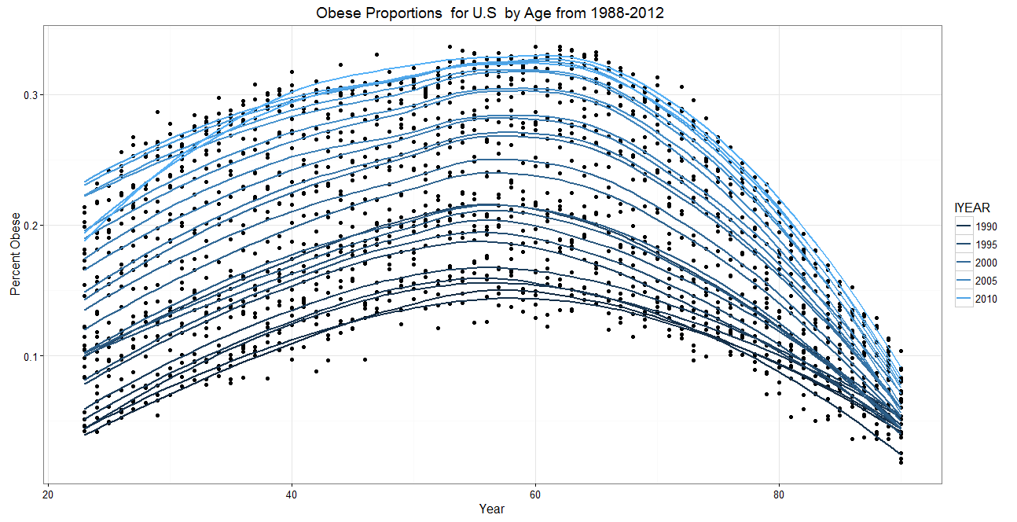
Visualizing Obesity Prevalence
Summed on Entity ID for Bar Chart

Slide 11
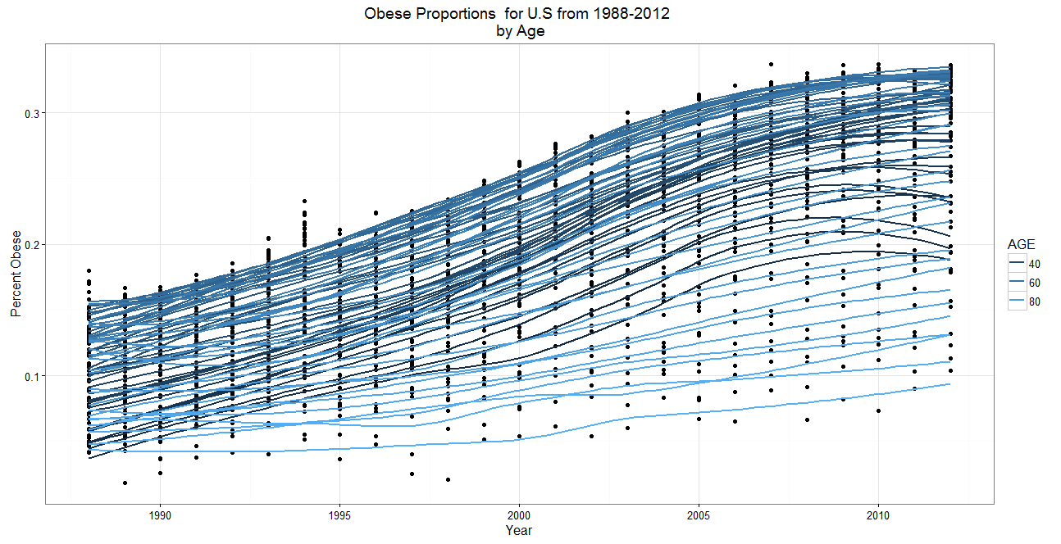
Visualizing Obesity Prevalence
Summed on Entity ID for Bar Chart

Slide 12
Cohort (Generation) Effect
 | Cohort = Period(t) – Age (x)
Epidemiology | Events having general environmental occurrence or health epidemic. Thus the obvious experience of an age specific exposure that is caused by a general occurrence.
Other Definitions | An occurrence , peculiar and associated with a specific age group that affects their generation into the future and is generally evident in the members of that cohort. Thus a unique occurrence that achieves a structural effect in the way and life expectancy or characteristic of members of that group. Sociologist usually associate cohort effect to the full environmental influence of a specific group of individuals born in the same period.
Notes:
Ryder (1965) we impede on temporal analysis when we don’t model/capture all the know variations in the data

Slide 13
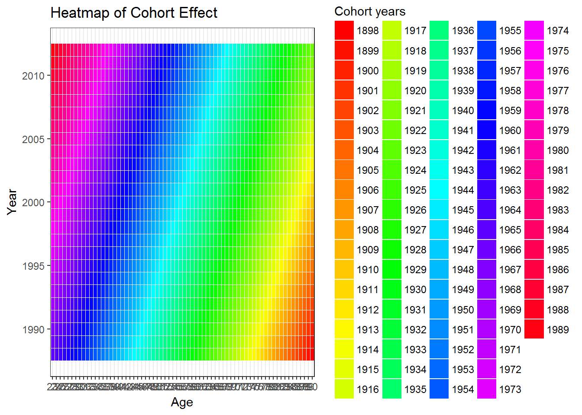
Visualizing the Cohort Effect

Slide 14
Stochastic Approach in Mortality Models
Component | Definition
What is Mortality ? | Mortality refers to the instantaneous death rate for a defined group of individuals.
Why is Mortality? | Social Security , Pension and Retirement Funds , Life Insurance . Obesity relates more to health insurance in the short term , but has implications for mortality
Stochastic Model ? | • probabilistic assumptions for individual terms of probabilities of death ,survival, • independence hypothesis among random lifetimes • alternative mortality, survival scenarios in order to deal with systematic deviations.
Notes:
Conversely, a stochastic approach to actuarial calculations requires focusing on random variables and related probability distributions
(Annamaria Olivieri , Ermanno Pitacco,2006)

Slide 15
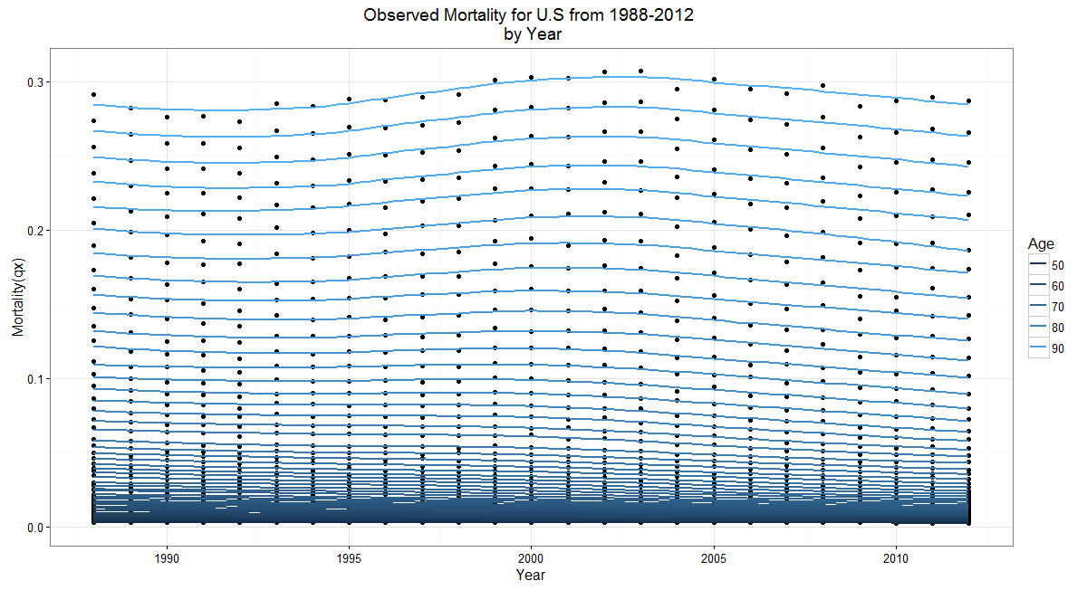
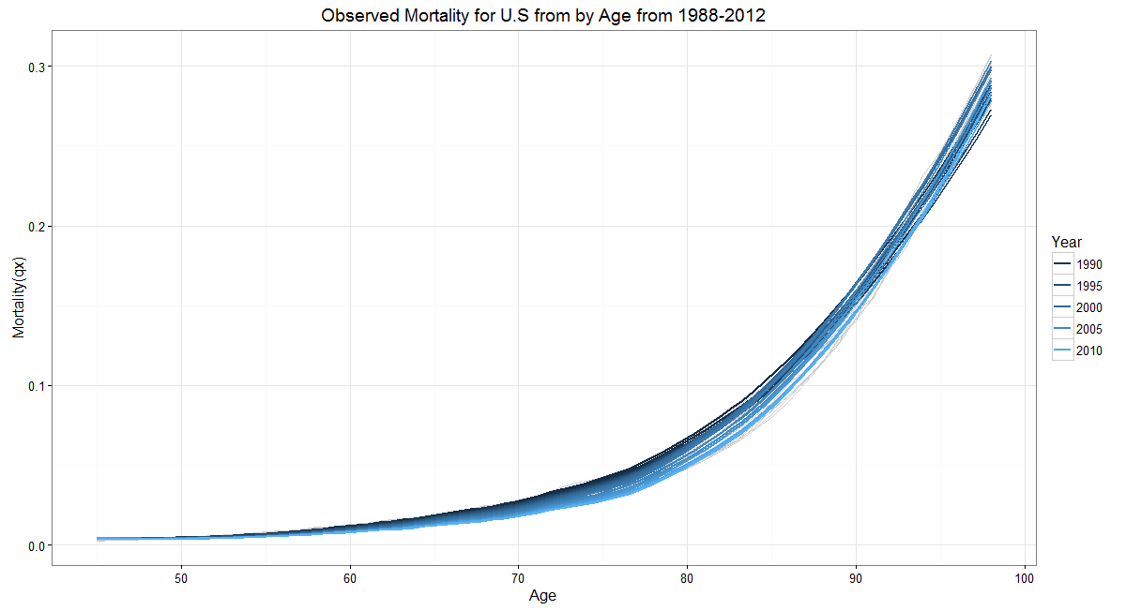
Visualizing Mortality
Notes:
Less Variability , more close distribution

Slide 16
Similarities Mortality & Obesity
Random response following a distribution
Age, Period and Cohort Relationship
Probabilities
Interested in Counts of success/failure of an event

Slide 17
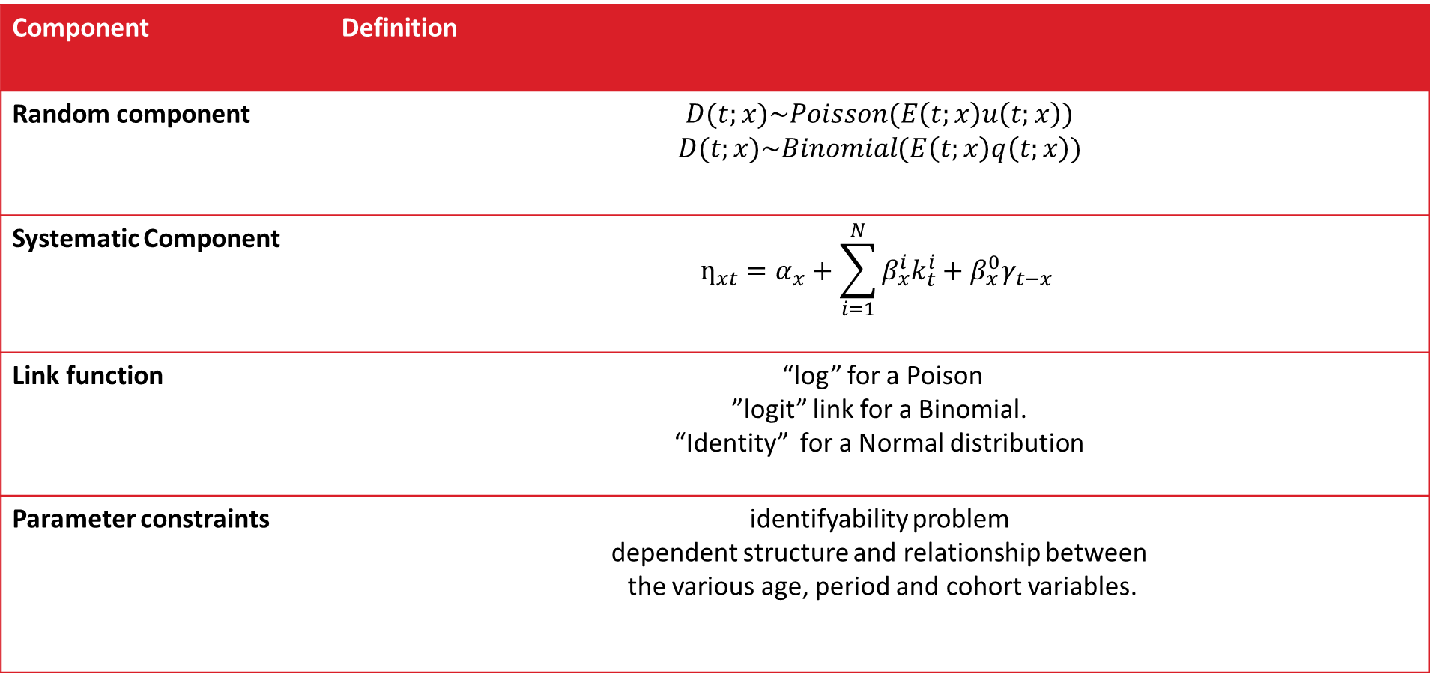
Background to Stochastic Mortality Models
Component | Definition
Random component | $D(t;x)\sim Poisson(E\left(t;x\right)u\left(t;x\right))$ $$D(t;x)\sim Binomial(E\left(t;x\right)q\left(t;x\right))$$
Systematic Component | $$ƞ_{xt}=α_{x}+\sum_{i=1}^{N}{β_{x}^{i}k_{t}^{i}}+β_{x}^{0}γ_{t−x}$$
Link function | “log” for a Poison ”logit” link for a Binomial. “Identity” for a Normal distribution
Parameter constraints | identifyability problem dependent structure and relationship between the various age, period and cohort variables.
Notes:
Link function: These associates the random and systematic components to each other. the canonical link function that can be assumed.
Systematic Component : Hunt and Blake (2015) expressed as a link predictor $ƞ_{xt}$

Slide 18
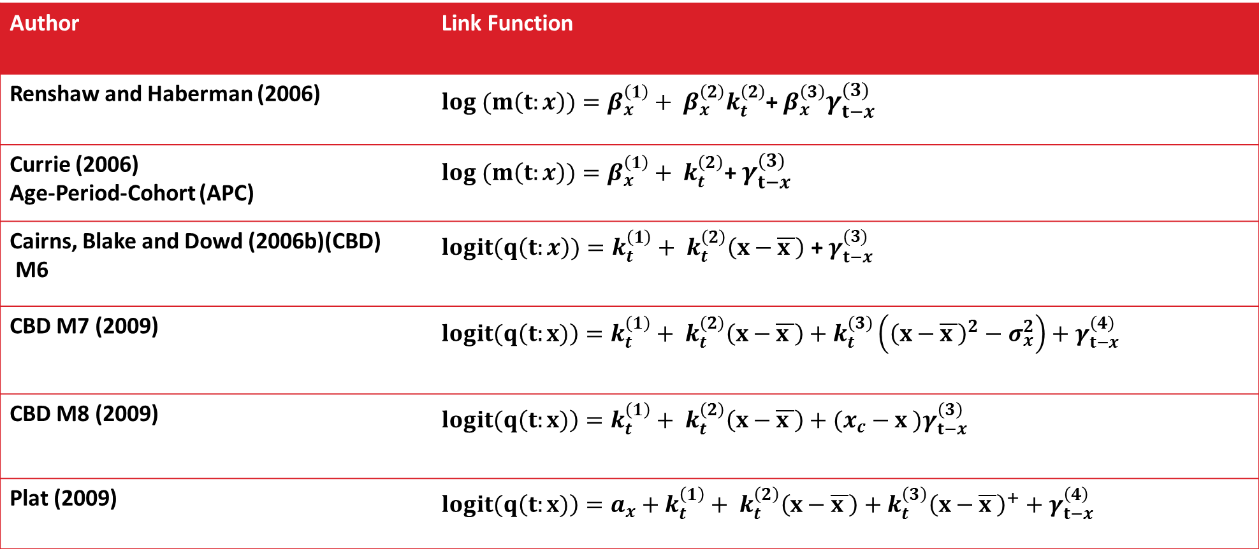
Background to Cohort Effect-Mortality Models
Author | Link Function
Renshaw and Haberman (2006) | $log (m\left(t:x\right))=β_{x}^{\left(1\right)}+ β_{x}^{\left(2\right)}k_{t}^{\left(2\right)}$+ $β_{x}^{\left(3\right)}γ_{t−x}^{(3)}$
Currie (2006) Age-Period-Cohort (APC) | $$log (m\left(t:x\right))=β_{x}^{\left(1\right)}+ k_{t}^{\left(2\right)}\text{+ }γ_{t−x}^{(3)}$$
Cairns, Blake and Dowd (2006b)(CBD) M6 | $logit(q\left(t:x\right))=k_{t}^{\left(1\right)}+ k_{t}^{\left(2\right)}\left(x−\overline{x }\right)$ + $γ_{t−x}^{(3)}$
CBD M7 (2009) | $$logit(q\left(t:x)\right)=k_{t}^{\left(1\right)}+ k_{t}^{\left(2\right)}\left(x−\overline{x }\right)+k_{t}^{\left(3\right)}\left({\left(x−\overline{x }\right)}^{2}−σ_{x}^{2}\right)+γ_{t−x}^{\left(4\right)}$$
CBD M8 (2009) | $$logit(q\left(t:x)\right)=k_{t}^{\left(1\right)}+ k_{t}^{\left(2\right)}\left(x−\overline{x }\right)+{(x_{c}−x )γ}_{t−x}^{\left(3\right)}$$
Plat (2009) | $$logit(q\left(t:x)\right)=a_{x}+k_{t}^{\left(1\right)}+ k_{t}^{\left(2\right)}\left(x−\overline{x }\right)+k_{t}^{\left(3\right)}{\left(x−\overline{x }\right)}^{+}+γ_{t−x}^{\left(4\right)}$$

Slide 19
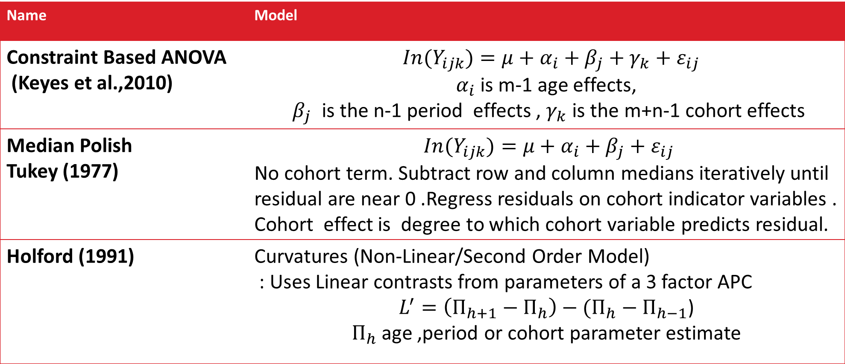
Statistical methods for obesity prevalence
Name | Model
Constraint Based ANOVA (Keyes et al.,2010) | $${ In(Y}_{ijk})=μ+α_{i}+β_{j}+γ_{k}+ε_{ij}$$ $α_{i}$ is m-1 age effects, $β_{j}$ is the n-1 period effects , $γ_{k}$ is the m+n-1 cohort effects
Median Polish Tukey (1977) | $${ In(Y}_{ijk})=μ+α_{i}+β_{j}+ε_{ij}$$ No cohort term. Subtract row and column medians iteratively until residual are near 0 .Regress residuals on cohort indicator variables . Cohort effect is degree to which cohort variable predicts residual.
Holford (1991) | Curvatures (Non-Linear/Second Order Model) : Uses Linear contrasts from parameters of a 3 factor APC $L^{′}=\left(П_{h+1}−П_{h}\right)−(П_{h}−П_{h−1}$) $П_{h}$ age ,period or cohort parameter estimate
Notes:
Found in literature

Slide 20
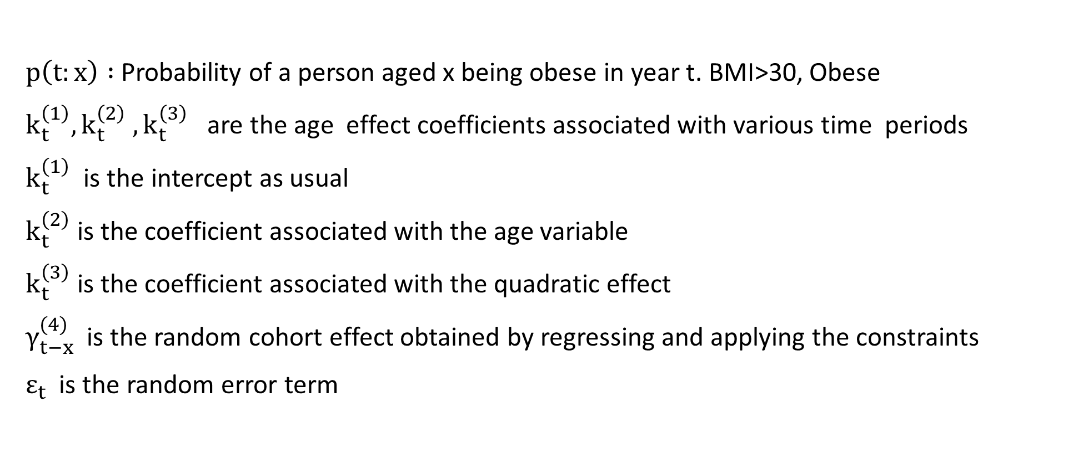
Proposed Model Statement
$$p\left(t:x\right)=k_{t}^{\left(1\right)}+ k_{t}^{\left(2\right)}\left(x−\overline{x }\right)+k_{t}^{\left(3\right)}\left({\left(x−\overline{x }\right)}^{2}−σ_{x}^{2}\right)+γ_{t−x}^{(4)}+ε_{t}$$
$p\left(t:x\right) :$Probability of a person aged x being obese in year t. BMI>30, Obese
$k_{t}^{\left(1\right)}, k_{t}^{\left(2\right)} , k_{t}^{\left(3\right)}$ are the age effect coefficients associated with various time periods
$k_{t}^{\left(1\right)}$ is the intercept as usual
$k_{t}^{\left(2\right)}$is the coefficient associated with the age variable
$k_{t}^{\left(3\right)}$is the coefficient associated with the quadratic effect
$γ_{t−x}^{(4)}$is the random cohort effect obtained by regressing and applying the constraints
$ε_{t}$ is the random error term

Slide 21
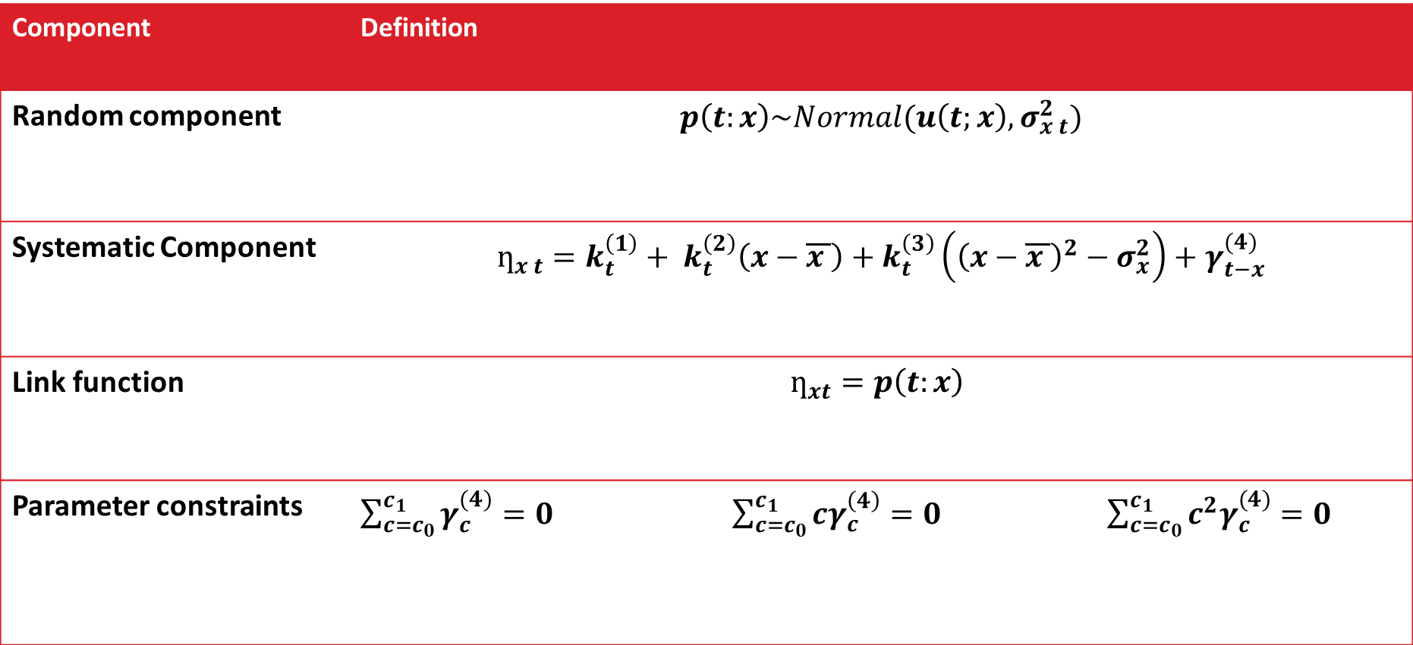
Proposed Stochastic Model
Component | Definition
Random component | $$p\left(t:x\right)\sim Normal(u\left(t;x\right),σ_{x t}^{2})$$
Systematic Component | $$ƞ_{x t}=k_{t}^{\left(1\right)}+ k_{t}^{\left(2\right)}\left(x−\overline{x }\right)+k_{t}^{\left(3\right)}\left({\left(x−\overline{x }\right)}^{2}−σ_{x}^{2}\right)+γ_{t−x}^{(4)}$$
Link function | $$ƞ_{xt}=p\left(t:x\right)$$
Parameter constraints | $\sum_{c=c_{0}}^{c_{1}}{γ_{c}^{(4)}}=0$ $\sum_{c=c_{0}}^{c_{1}}{{cγ}_{c}^{\left(4\right)}}=0$ $\sum_{c=c_{0}}^{c_{1}}{{c^{2}γ}_{c}^{(4)}}=0$
Notes:
Link function
These associates the random and systematic components to each other the canonical link function “Identity” for a Normal distribution

Slide 22
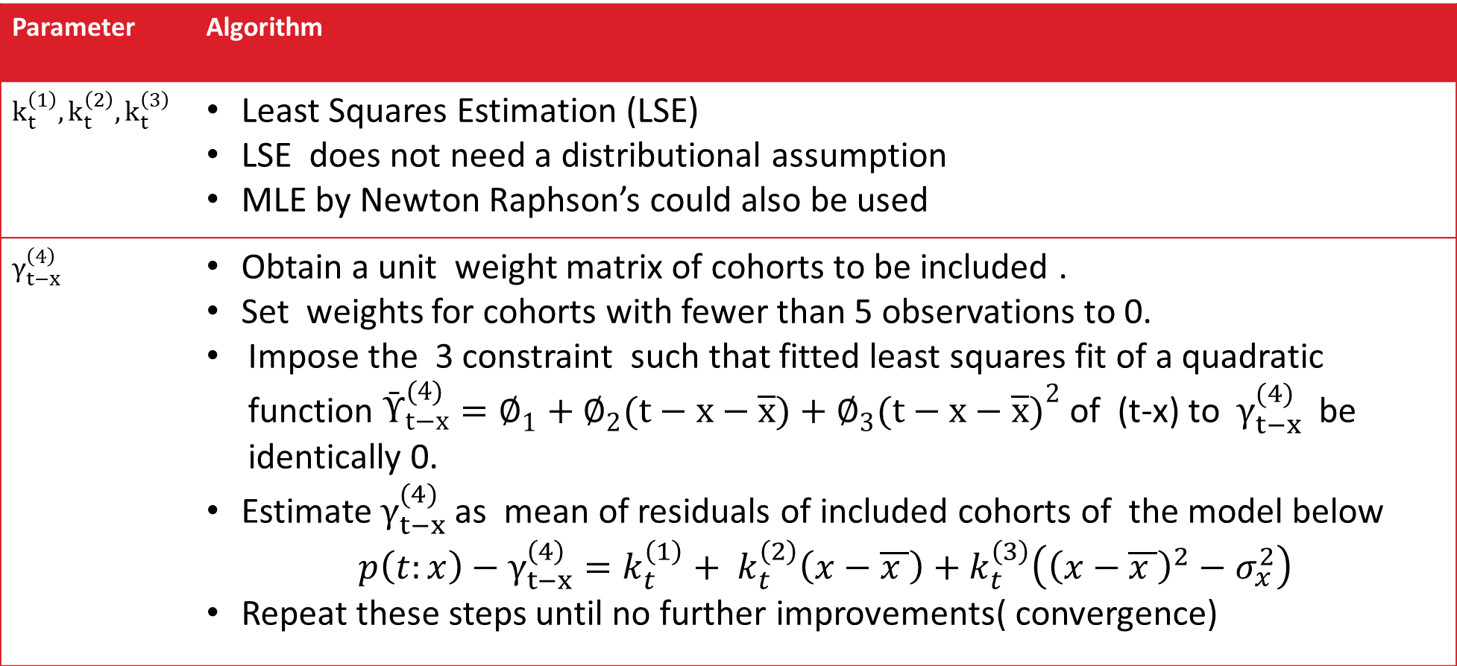
Parameter Estimation
Parameter | Algorithm
$$k_{t}^{\left(1\right)},k_{t}^{\left(2\right)},k_{t}^{\left(3\right)}$$ | Least Squares Estimation (LSE) LSE does not need a distributional assumption MLE by Newton Raphson’s could also be used
$$γ_{t−x}^{\left(4\right)}$$ | Obtain a unit weight matrix of cohorts to be included . Set weights for cohorts with fewer than 5 observations to 0. Impose the 3 constraint such that fitted least squares fit of a quadratic function $Ῡ_{t−x}^{(4)}=∅_{1}+∅_{2}(t−x−\overline{x})+∅_{3}{(t−x−\overline{x})}^{2}$ of (t-x) to $γ_{t−x}^{(4)}$ be identically 0. Estimate $γ_{t−x}^{(4)}$ as mean of residuals of included cohorts of the model below $$p\left(t:x\right)−γ_{t−x}^{\left(4\right)}=k_{t}^{\left(1\right)}+ k_{t}^{\left(2\right)}\left(x−\overline{x }\right)+k_{t}^{\left(3\right)}\left({\left(x−\overline{x }\right)}^{2}−σ_{x}^{2}\right)$$ Repeat these steps until no further improvements( convergence)

Slide 23
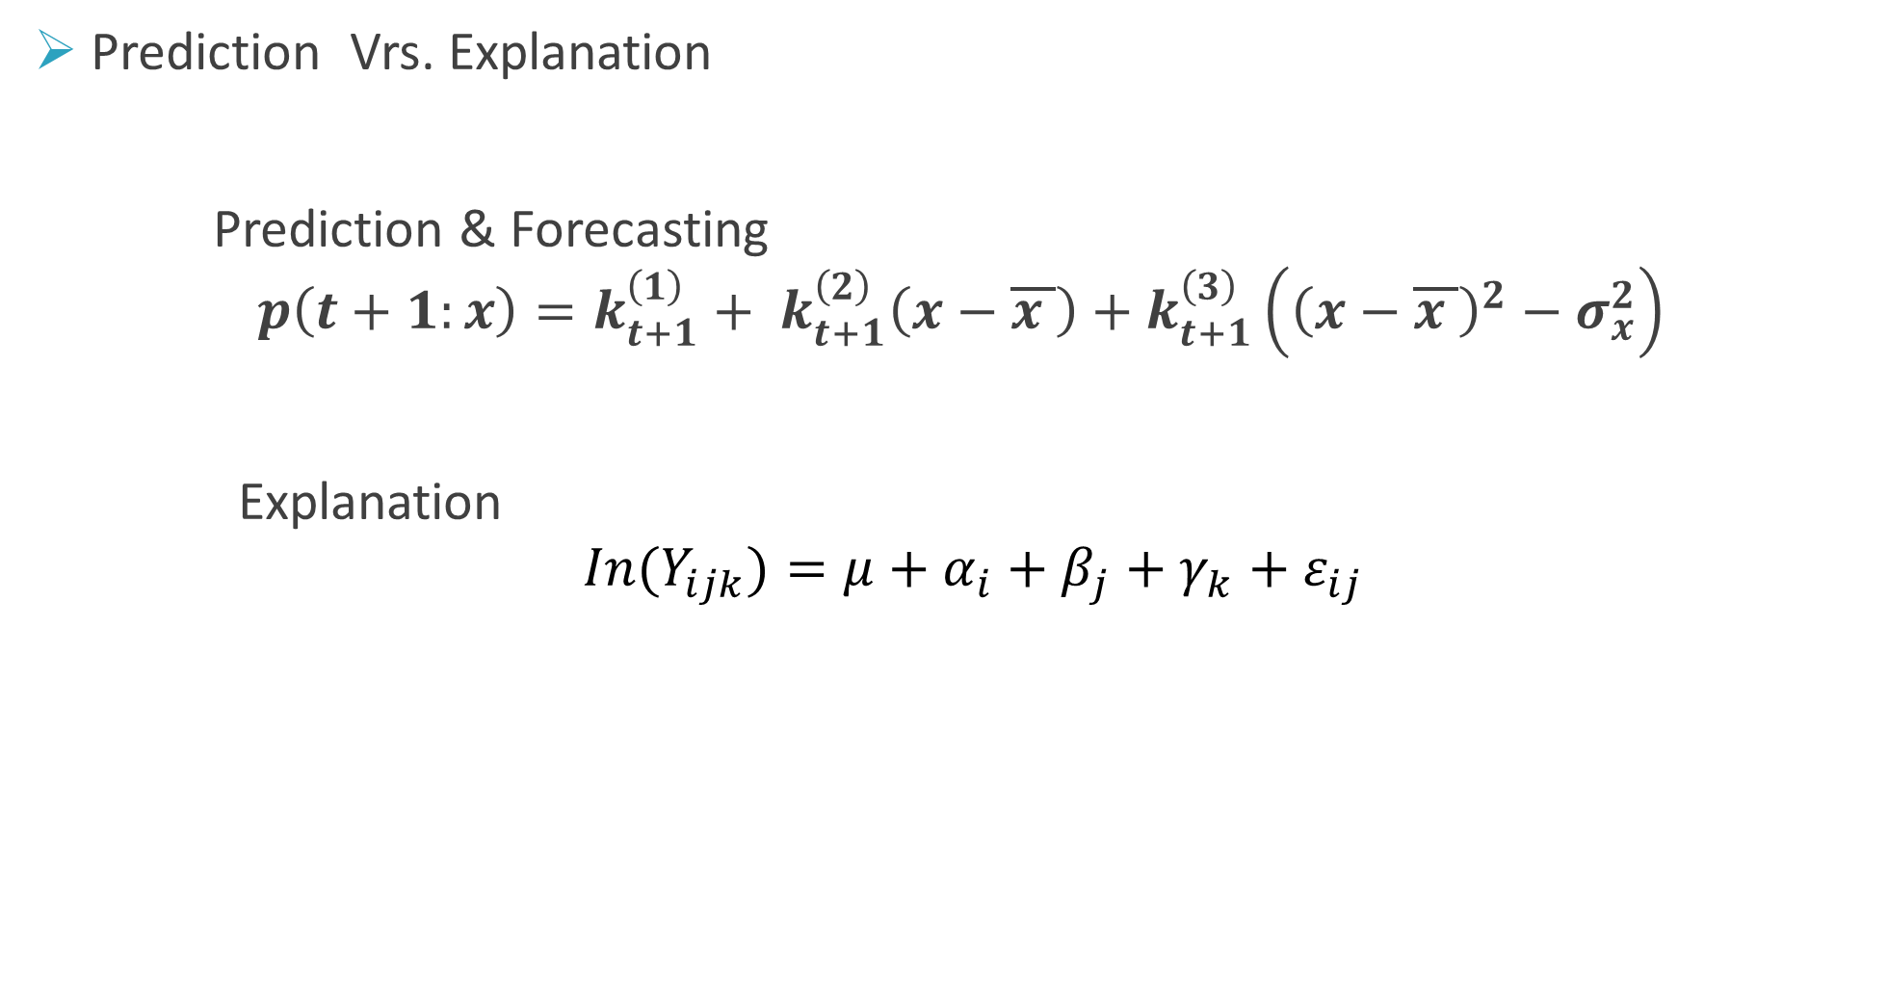
Differences - Stochastic model and Other Statistical methods for obesity prevalence
Prediction Vrs. Explanation
Prediction & Forecasting
$$p\left(t+1:x\right)=k_{t+1}^{\left(1\right)}+ k_{t+1}^{\left(2\right)}\left(x−\overline{x }\right)+k_{t+1}^{\left(3\right)}\left({\left(x−\overline{x }\right)}^{2}−σ_{x}^{2}\right)$$
Explanation
$${ In(Y}_{ijk})=μ+α_{i}+β_{j}+γ_{k}+ε_{ij}$$

Slide 24
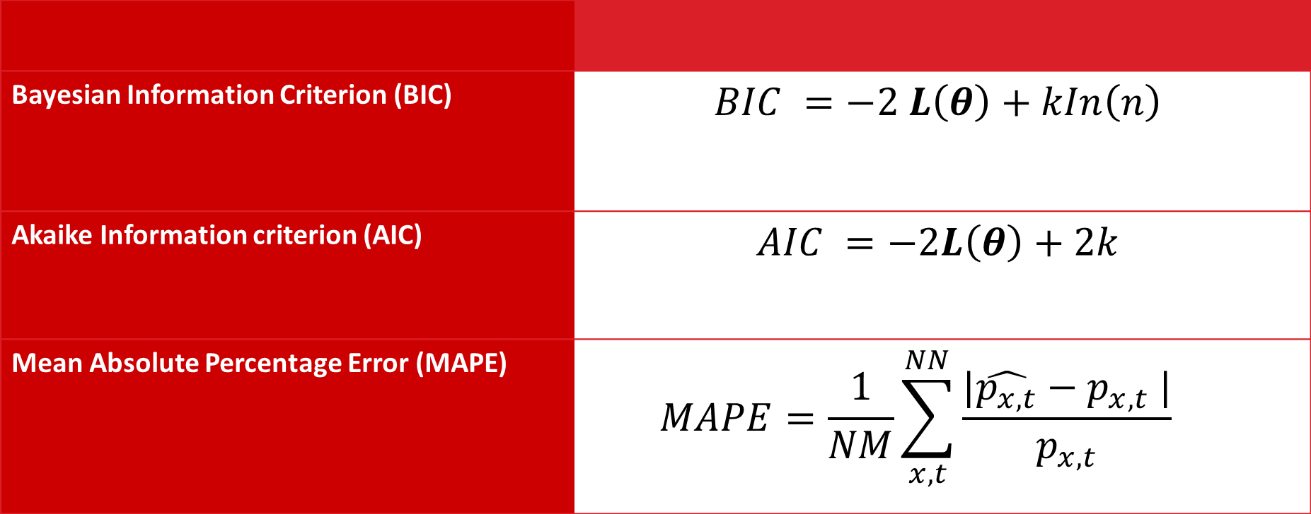
Goodness of fit and Model Evaluation
Bayesian Information Criterion (BIC) | $$BIC =−2 L\left(θ\right)+kIn\left(n\right)$$
Akaike Information criterion (AIC) | $$AIC =−2L\left(θ\right)+2k$$
Mean Absolute Percentage Error (MAPE) | $$MAPE=\frac{1}{NM}\sum_{x,t}^{NN}{\frac{|\hat{p_{x,t}}−p_{x,t} |}{p_{x,t}} }$$

Slide 25
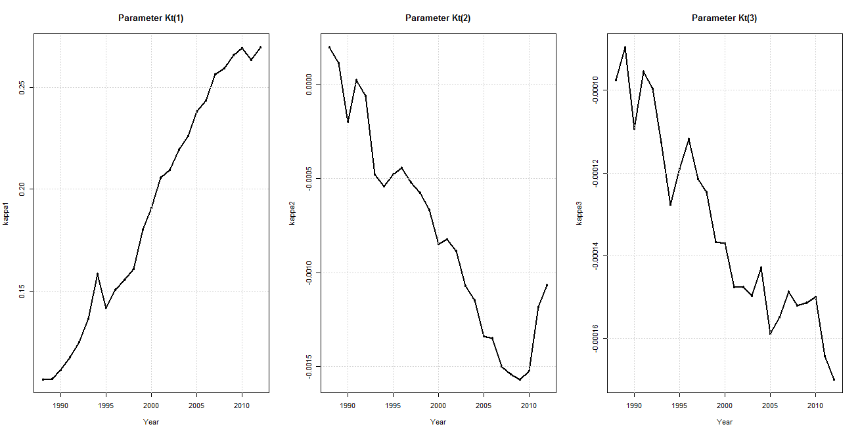



Results – Parameter Estimates
$$p\left(t:x\right)=k_{t}^{\left(1\right)}+ k_{t}^{\left(2\right)}\left(x−\overline{x }\right)+k_{t}^{\left(3\right)}\left({\left(x−\overline{x }\right)}^{2}−σ_{x}^{2}\right)+γ_{t−x}^{(4)}$$
$$k_{t}^{\left(1\right)}$$
$$k_{t}^{\left(2\right)}$$
$$k_{t}^{\left(3\right)}$$

Slide 26
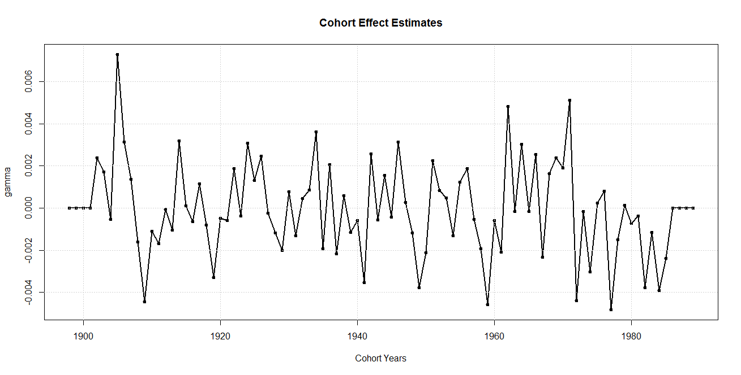

Results - Cohort effect estimates
$$p\left(t:x\right)=k_{t}^{\left(1\right)}+ k_{t}^{\left(2\right)}\left(x−\overline{x }\right)+k_{t}^{\left(3\right)}\left({\left(x−\overline{x }\right)}^{2}−σ_{x}^{2}\right)+γ_{t−x}^{(4)}$$
$(γ_{t−x}^{(4)}$)
Notes:
Constraints ensure that cohort effect fluctuates around 0.

Slide 27
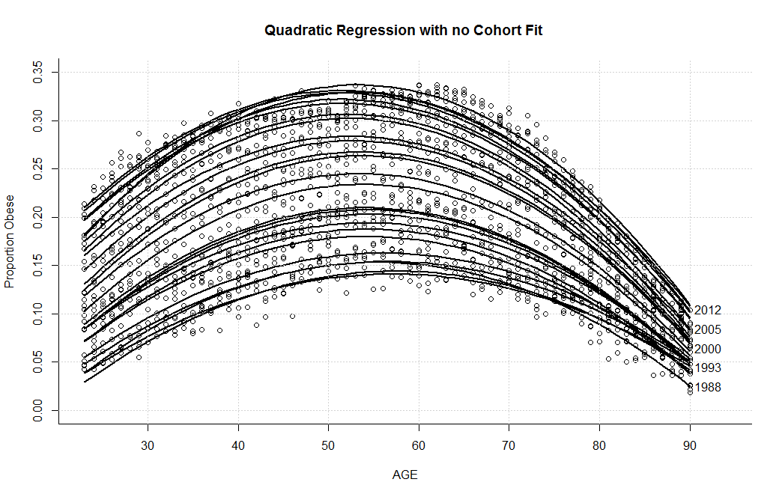
Fitted Graphs from quadratic regression without cohort effect
$$p\left(t:x\right)=k_{t}^{\left(1\right)}+ k_{t}^{\left(2\right)}\left(x−\overline{x }\right)+k_{t}^{\left(3\right)}\left({\left(x−\overline{x }\right)}^{2}−σ_{x}^{2}\right)+ε_{t}$$

Slide 28
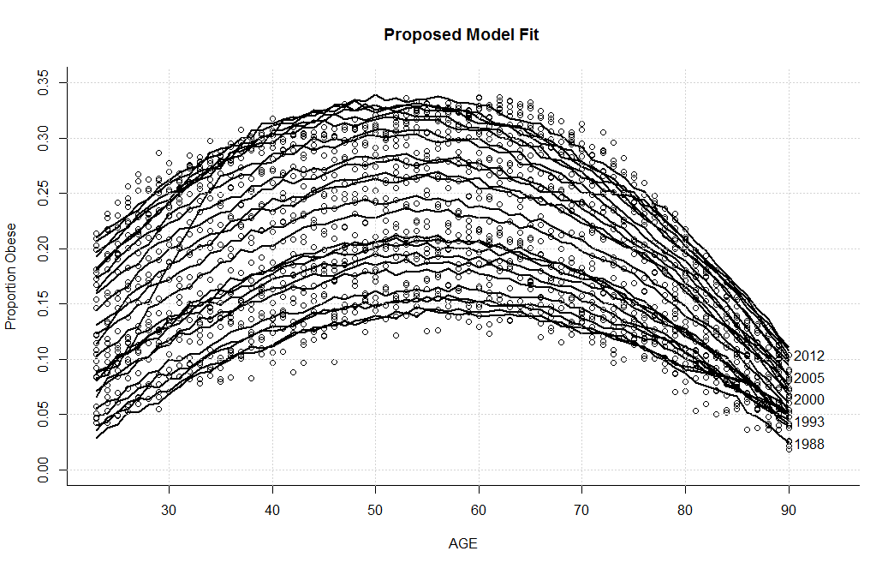
Fitted values of the proposed model
$$p\left(t:x\right)=k_{t}^{\left(1\right)}+ k_{t}^{\left(2\right)}\left(x−\overline{x }\right)+k_{t}^{\left(3\right)}\left({\left(x−\overline{x }\right)}^{2}−σ_{x}^{2}\right)+γ_{t−x}^{(4)}+ε_{t}$$

Slide 29
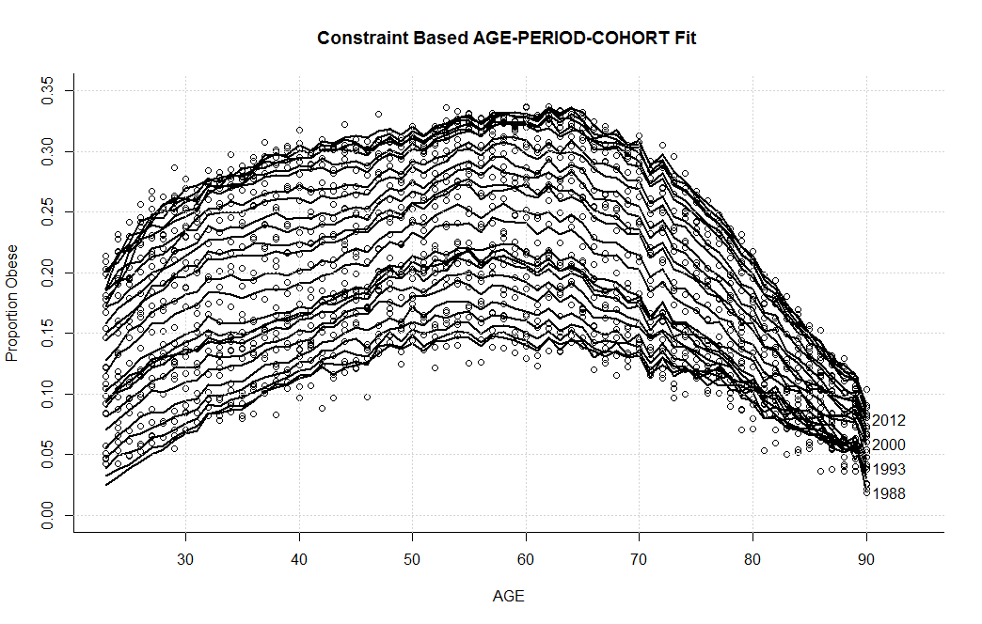
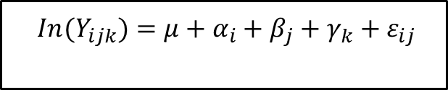
Fitted values from the Constraint Based APC
$${ In(Y}_{ijk})=μ+α_{i}+β_{j}+γ_{k}+ε_{ij}$$

Slide 30
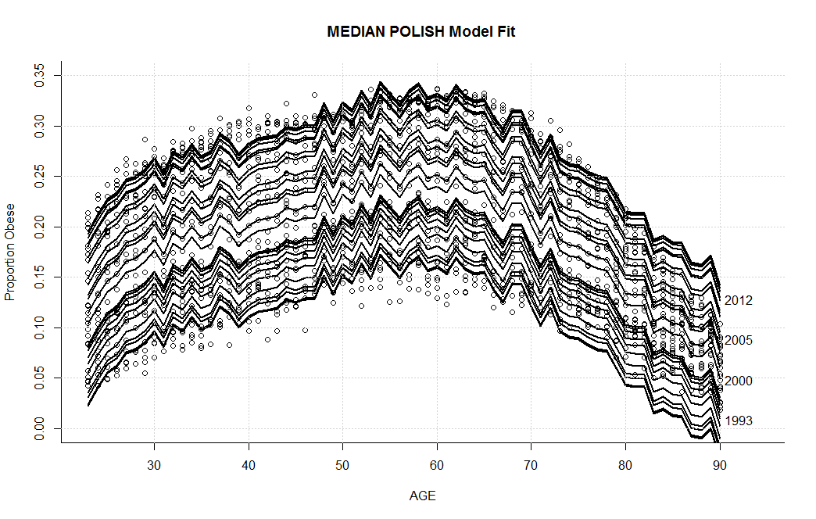
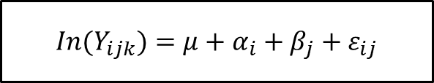
Fitted values from the Median Polish Approach
$${ In(Y}_{ijk})=μ+α_{i}+β_{j}+ε_{ij}$$

Slide 31
Comparison of Models
Statistic | Proposed Model | Constraint-based (APC ANOVA model) | Quadratic Regression (No Cohort)
MAPE | 7.20% | 5.71% | 7.04%
BIC | 1237.00 | 1370.93 | 575.10
AIC | 345.17 | 375.71 | 167.231
Number of Parameters | 164 | 183 | 75
Mean Squared Error(MSE) | 1.871633e-04 | 1.186409e-04 | 1.812762e-04

Slide 32
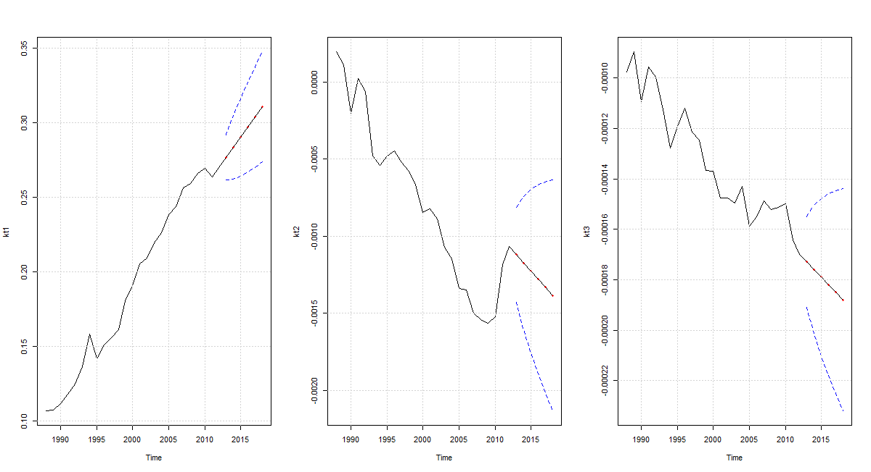




Forecasting Parameters
ARIMA (0,1,0)$eg. k_{t+1}^{\left(1\right)}=u+ k_{t}^{\left(1\right)}$
$$k_{t+i}^{\left(1\right)}$$
$$k_{t+i}^{\left(2\right)}$$
$$k_{t+i}^{\left(3\right)}$$
Notes:
ARIMA(0,1,0)
U- Log term drift in Kt

Slide 33
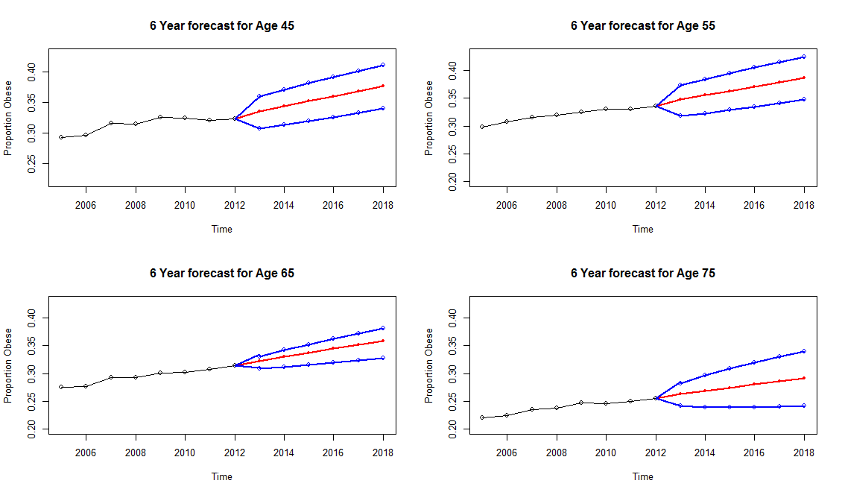
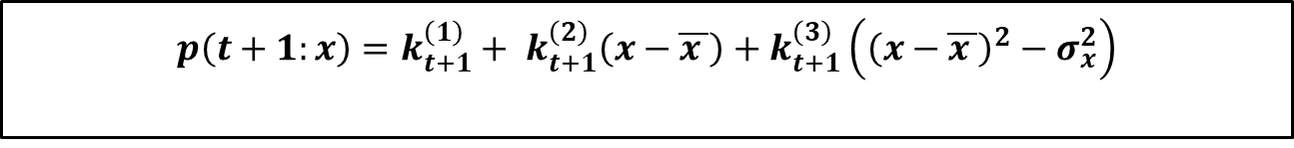
Forecasting and Predicting Obesity prevalence
$$p\left(t+1:x\right)=k_{t+1}^{\left(1\right)}+ k_{t+1}^{\left(2\right)}\left(x−\overline{x }\right)+k_{t+1}^{\left(3\right)}\left({\left(x−\overline{x }\right)}^{2}−σ_{x}^{2}\right)$$
Notes:
Use Time Series to project the coefficients,
Then use the coefficients to predict the future ARIMA(0,1,0)

Slide 34
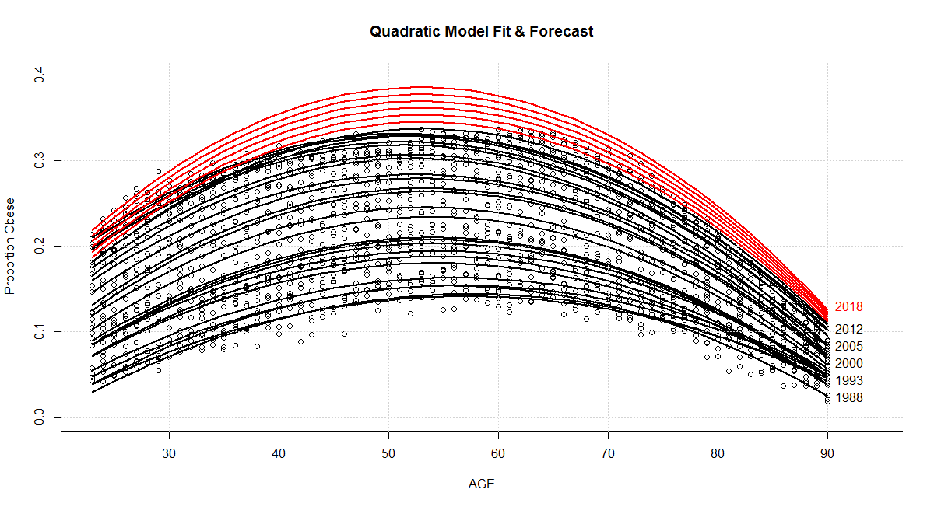
Results of Model Forecast & Predictions
$$p\left(t+1:x\right)=k_{t+1}^{\left(1\right)}+ k_{t+1}^{\left(2\right)}\left(x−\overline{x }\right)+k_{t+1}^{\left(3\right)}\left({\left(x−\overline{x }\right)}^{2}−σ_{x}^{2}\right)$$

Slide 35
Conclusion
Provided an alternative for estimating cohort effect in obesity prevalence.
Developed models for predicting future obesity prevalence , an improvement over use of ANOVA models that are explanatory but limited with prediction.
Obesity prevalence for individual age and years instead of age-bin (2-4,5-9,etc) and year bin (1965-1970, 1971-1975) methods.
Researchers(epidemiologists, medical sociologists), insurance risk analyst ,actuaries can now efficiently forecast obesity , a major health issue.
Like in mortality literature ,this sets the tone for further future studies

Slide 36
References
Allison D B, Fontaine KR, Manson JE, Stevens J, VanItallie TB. (1999). Annual deaths attributable to obesity in the United States.JAMA;282:1530-8.
Cairns, A.J.G., Blake, D., and Dowd, K. (2006b). A Two-Factor Model for Stochastic Mortality with Parameter Uncertainty: Theory and Calibration," Journal of Risk and Insurance, 73: 687-718
Currie, I.D. (2006) .Smoothing and forecasting mortality rates with P-splines, Talk given at the Institute of Actuaries,2006
Holford, T. R. (1992). Analysing the temporal effects of age, period and cohort. Statistical Methods in Medical Research, 1(3), 317–337.
Keyes, K. M., Utz, R. L., Robinson, W., & Li, G. (2010). What is a cohort effect? Comparison of three statistical methods for modeling cohort effects in obesity prevalence in the United States, 1971–2006. Social science & medicine, 70(7), 1100-1108.
Olshansky, S.J., Passaro, D.J., Hershow, R.C., Layden, J., Carnes, B.A., Brody, J., Hayflick, L., Butler, R.N., Allison, D.B. and Ludwig, D.S.(2005). A potential decline in life expectancy in the United States in the 21st century.New England Journal of Medicine, 352(11), pp.1138-1145.
Renshaw, A.E., and Haberman, S. (2006). A cohort-based extension to the Lee-Carter model for mortality reduction factors," Insurance: Mathematics and Economics, 38: 556-570.
Notes:
Plat , Keys et al, holford, Selvin

Slide 37
THE END

