Slide 1









Quantum Computation with Quantum Dots:
Decoherence and Fidelity Limits
K. B. Whaley, UC Berkeley
whaley@socrates.berkeley.edu / www.cchem.berkeley.edu/~kbwgrp
Objectives
Universality of Exchange
Overcoming decoherence limitations to scalable quantum computing realizations
Decoherence prevention, error correction, and fault tolerant computation
Development and simulation of realizable models for QC employing quantum dots
1
2
3
4
5
Objective Approach
Status
Control of decoherence via Subspace or Subsystem selection (DFSs)
Universal, fault tolerant QC on DFS
Optimal design of quantum dot implementations
Numerical Simulation of QC models
Universal QC achieved using 2-body exchange interaction only
Fault tolerant QC demonstrated on DFSs
Explicit gate sequences for some DFSs
Proposal for QC on quantum dots connected with linear support

Slide 2
Research Plan
Quantum Computing with Quantum Dots:
Decoherence and Fidelity Limits
K. B. Whaley, UC Berkeley
Progress on last year’s objectives
- DFS concatenated with QECCs shown to be stable under exchange errors
- fault tolerant quantum computation demonstrated on decoherence free subspaces
and subsystems (DFSs)
- explicit gate sequences derived for QC on DFSs defined by: i) collective decoherence,
and ii) multiple qubit errors
- universal quantum computation shown to be achievable using 2-body
exchange as the only physical interaction
- low decoherence QC scheme using quantum dots connected with linear support
Research plan for the next 12 months
- search for other physical interactions possessing asymptotic universality
- physical realizations of DFSs and computation thereon
- stochastic wave function simulations: QC based on exchange interaction,
QC on quantum dot arrays, minimizing decoherence via DFSs, …
- investigation of spin coherence in quantum dots
Long term objectives
- overcome decoherence limitations to scalable quantum computation
- characterize physical systems for fault tolerant, universal QC with DFS-QECCs
- establish realistic scenarios for scalable qubit registers employing quantum dots

Slide 3

Quantum Computing on Decoherence-Free Subspaces
"Surprise: A New Paradigm For Quantum Computation"
Dave Bacon
University of California Berkeley
Departments of Physics and Chemistry

Slide 4

Cult of Universality
Universal Quantum Computer
 a quantum computer which can be programmed to perform any algorithmic manipulation on quantum information.
U(2)
Set of Universal Quantum Gates
 a set of operations/gates which, acting on the quantum information, can be used to implement (to any desired accuracy) any unitary evolution of the quantum info.
The Royal King and Queen of Universal Quantum Gates
CNOT and 1-qubit rotations
Other methods (TAILOR TO AVAILABLE PHYSICS)???!!!

Slide 5

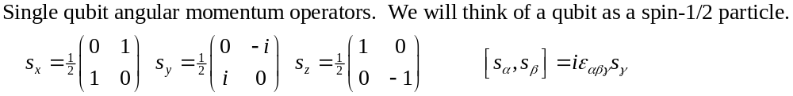
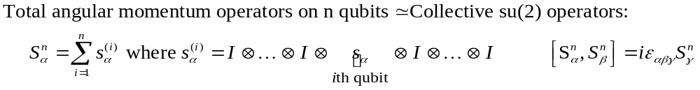
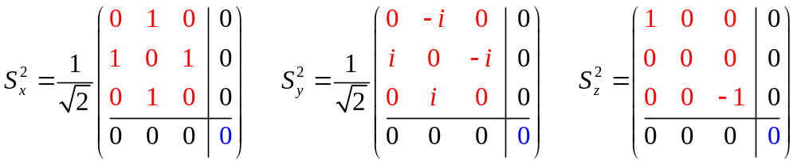
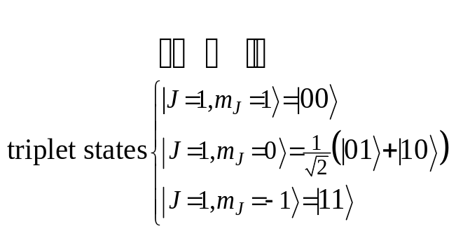
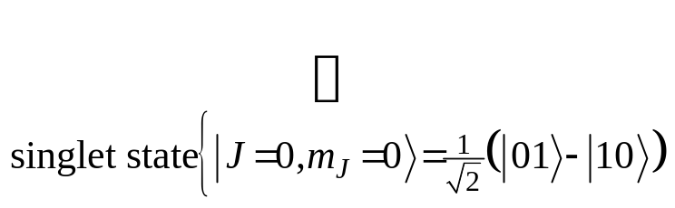
Collective Operations
Intro quantum mechanics: addition of angular momentum for two spin-1/2 particles. •Two spin-1/2 can be combined into a spin-1 triplet and a spin-0 singlet.

Slide 6
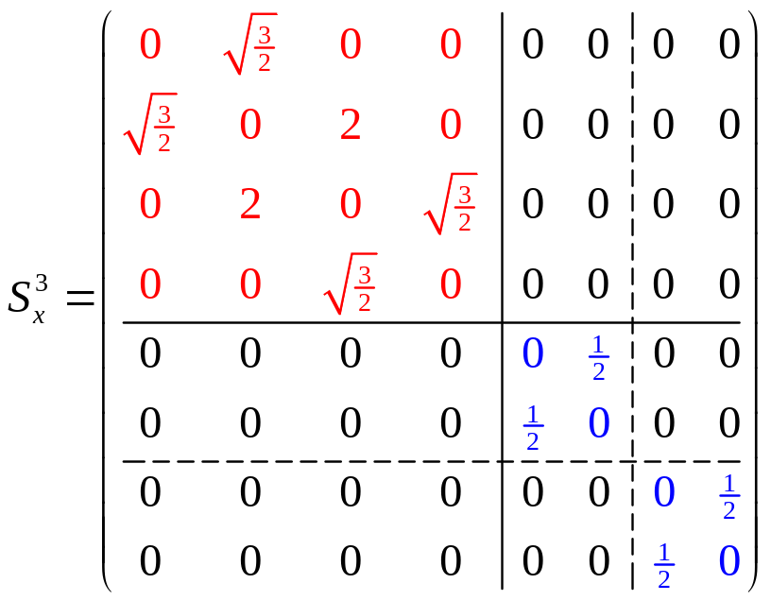
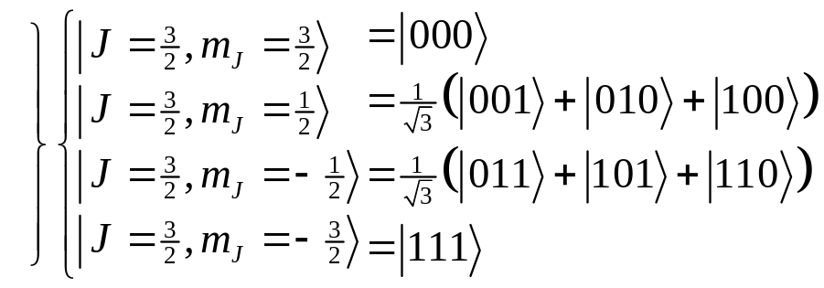
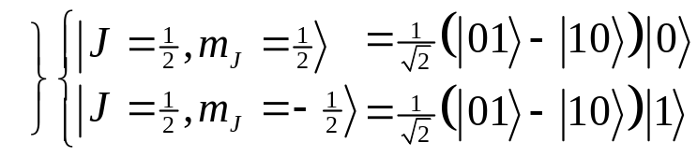
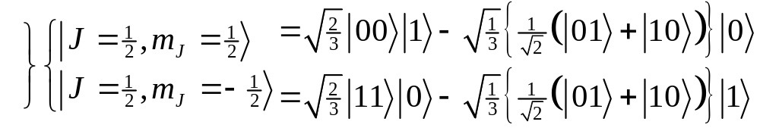
Degeneracy
spin-1 (triplet) plus spin-1/2 can produce either a spin-1/2 or a spin-3/2.
spin-0 (singlet) plus spin-1/2 can produce spin 1/2.
These spin-1/2 states come from combining a spin-0 two qubit state and a spin-1/2 single qubit state
These spin-1/2 states come from combining a spin-1 two qubit state and a spin-1/2 single qubit state
There is a DEGENERACY in the action of the 3 qubit collective su(2) operation!

Slide 7
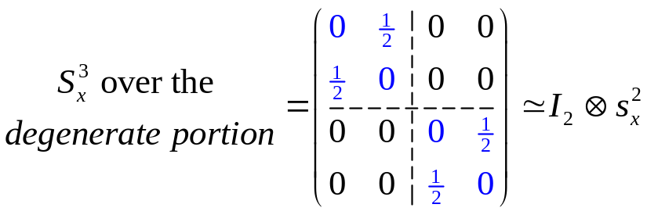
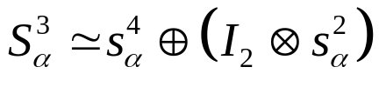
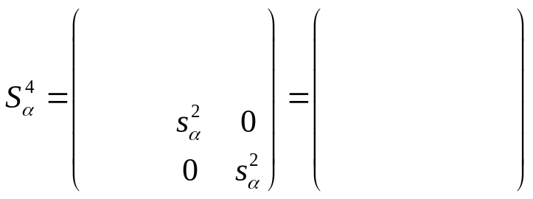
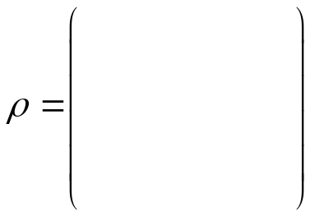



Protection
(KLV) Emanuel Knill, Raymond Laflamme, Lorenza Viola, Phys. Rev. Lett. 84, 2525 (2000)

Slide 8
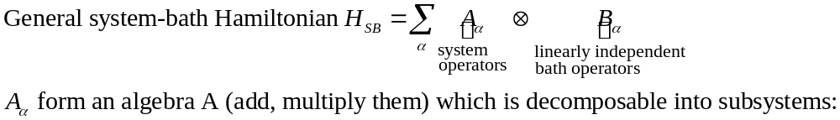
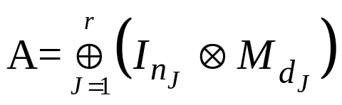


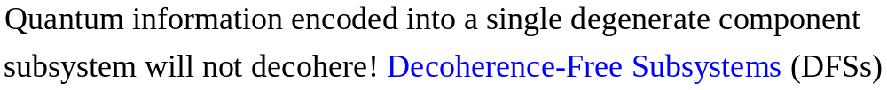
Decoherence-Free
Subsystems (KLV)
“The universe is an enormous direct product of representations of symmetry groups” - Steve Weinberg
(KLV) Emanuel Knill, Raymond Laflamme, Lorenza Viola, Phys. Rev. Lett. 84, 2525 (2000)

Slide 9
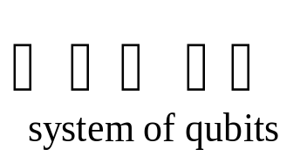
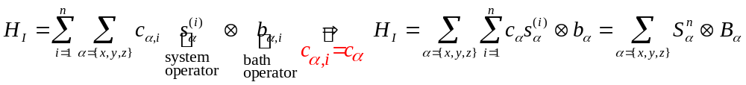
Collective Decoherence
Bath mode with a wavelength much longer than the inner qubit spacing
bath
Acts on i^{th} qubit
system-bath Hamiltonian
Collective decoherence in quantum optics terms is “Dicke subradiance”.
Expect collective decoherence in systems of fixed qubits with small inner qubit spacing.
Promising systems: atoms trapped in a cavity, solid state systems at low temperatures, etc.

Slide 10


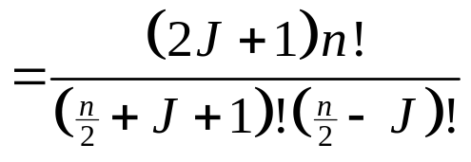


Collective DFSs
1
1
Degeneracy of the n qubit, total angular momentum J collective su(2) operators
= dimension of quantum information which can be encoded into the corresponding DFS.
1
6
1
5
1
4
14
1
3
9
1
2
5
14
The J=0 irreps of su(2) are 1 dimensional Decoherence-Free Subspaces.
1
2
5
1
2
3
4
5
6
7
A nice set of basis states for a (n,J) DFS can be labeled by the path taken when constructing the (n,J) DFS via addition of angular momentum.

Slide 11
DFS History
(Whaley Group Involvement)
1997
Decoherence Free Subspace General Definitions, Collective Decoherence
Robustness to perturbing error processes
Use of DF subspace for concatenation into a Quantum Error Correcting Code (QECC)
Relationship between DF subspace and QECC
Zanardi, Duan and Guo, Lidar et. al.
Viola and Lloyd, Zanardi
Symmetrization/Bang-bang methods
1998
Lidar et. al., PRL 81 (1998), 2594
Bacon et. al., PRA 60 (1999), 1944
Lidar. et. al., PRL 82 (1999) 4556
1999
Existential universality results on DF subspaces/symmetrization methods
Zanardi, Lidar
2000
Subsystem Generalization
Knill, Laflamme, Viola
How do we perform quantum computation on the information of a (n,J) DFS?
Can we do this using only one or two-qubit interactions?

Slide 12
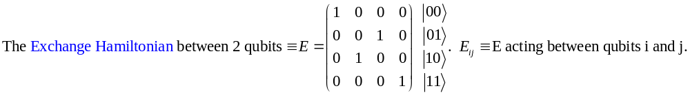
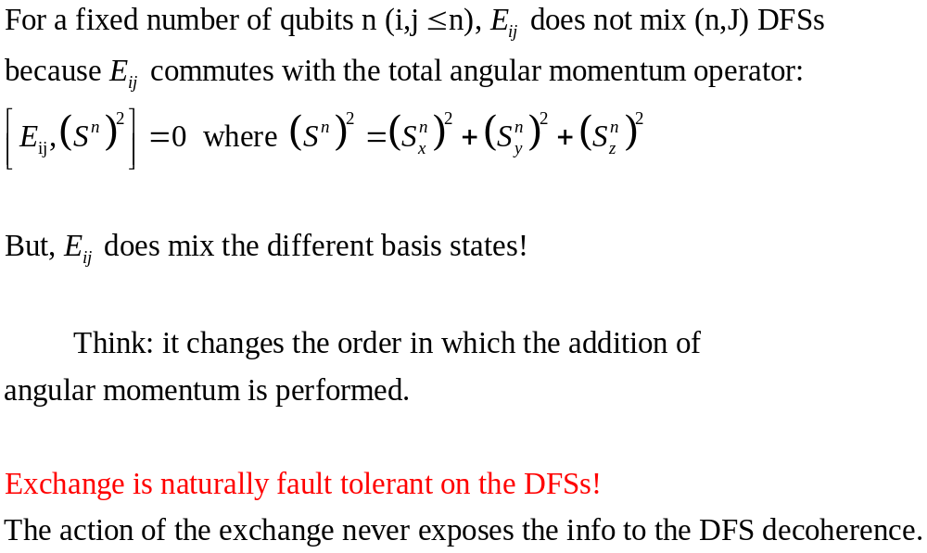

Exchange
1
2
3
4
5

Slide 13
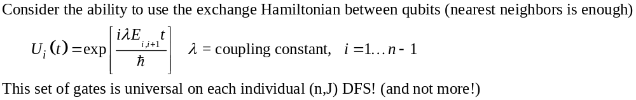
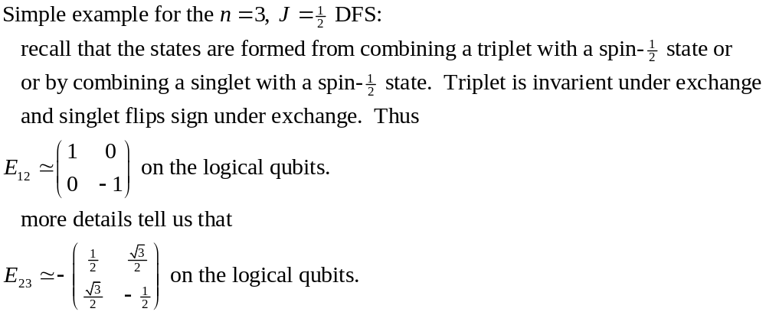
Exchange's Universality
The exchange Hamiltonian is universal on the encoded states of a collective DFS

Slide 14



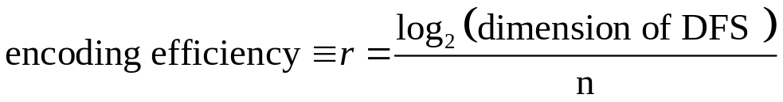
Universality Amazing!
3
1
Can perform su(d)’s on each of the DFSs
encode information into the DFSs and the EXCHANGE interaction can be used to perform any su(d) on each of the su(d)’s for a given n independently!
su(d) means we have a d dimensional Hilbert space (encoded) and we can perform all unitary manipulations on this d dimensional Hilbert space!
2
5
1
9
5
0
1
2
3
4
5
6
The Exchange Hamiltonian is ASYMPTOTICALLY UNIVERSAL

Slide 15
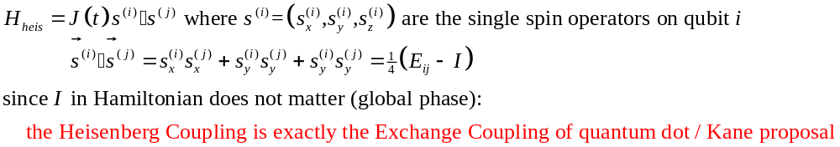
Heisenberg Coupling
A NEW DESIGN FOR QUANTUM COMPUTER ARCHITECTURE
Not necessary to supplement the Heisenberg coupling with single qubit operations!
Heisenberg interaction in quantum dot / Kane proposal are easily tuned using local magnetic fields.
Heisenberg operation is fast (GHz range) and has an on-off ratio of several orders of magnitude.
Encoding into low J DFSs is easily performed using a simple cooling routine: let there be an exchange interaction between alternating neighboring dots and cool the system.

Slide 16
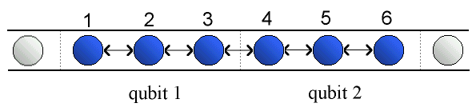
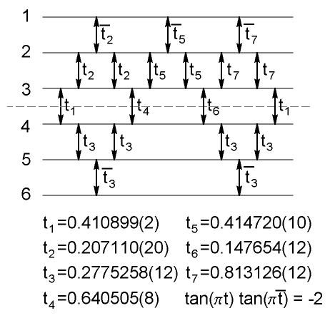

Explicit Gate Construction
exchange gate
i
j
DiVincenzo, Bacon, Kempe, Burkard, Whaley “Universal Quantum Computation with the Exchange Interaction” quant-ph/0005116

Slide 17



What Do I Need
To Quantum Compute?
Hey I found this new quantum system with these crazy interactions. Can I quantum compute?
Many interactions, with a bit of encoding, can be used to do quantum computation.
This question is a simple application of the representation theory of Lie Algebras (take it to your local particle theorist for a quick answer!)
A few more qubits and a few more operations may be required.
The hope, however, is that the requirements for engineering a quantum computer using encoded universal interactions will be simplified.
Controlled-Not and single qubit gates are not the only way to go!
U(2)

Slide 18
Universality and Implementations
Early history of QC: generic set of gates is universal (Lloyd // Deutsch, Barenco, and Ekert)
Nature is not generic:
TM
Nature

Slide 19
DFS Universality Results
Existential Universality
Exchange is universal on collective decoherence decoherence-free subspaces
Exchange is universal on collective decoherence decoherence-free subsystems
Explicit exchange gates for use as a universal quantum computer
DFS concatenated with QECC robust to “exchange errors”.
DFS FT computation on multi-qubit DFSs
Zanardi, Lidar
Bacon, Kempe, Lidar, and Whaley, PRL 85 (2000) 1758.
Kempe, Bacon, Lidar, and Whaley, submitted to PRA, quant-ph/0004064
DiVincenzo, Bacon, Kempe, Burkard, and Whaley, submitted to Nature, quant-ph/0005116
Lidar, Bacon, Kempe, and Whaley, PRA 61 (2000) 052307
Lidar, Bacon, Kempe, Whaley, submitted to PRA, quant-ph/9908064 and quant-ph/0007013

Slide 20


Whaley Group
Members
Professor K. B. Whaley, Department of Chemistry
Postdoc:
Dr. Daniel Lidar (leaving for faculty of University of Toronto)
DFS theory, quantum dot proposal
Graduate Students:
Dave Bacon, Department of Physics DFS theory, Quantum optics DFSs
Julia Kempe, Department of Mathematics DFS theory, quantum information topics
Ken Brown, Department of Chemistry Quantum dots connected by linear support
Simon Myrgren, Departement of Chemistry Trajectory simulations of exchange universality and quantum dot proposal

