Slide 1









Quantum Computation with Quantum Dots:
Decoherence and Fidelity Limits
K. B. Whaley, UC Berkeley
whaley@socrates.berkeley.edu / www.cchem.berkeley.edu/~kbwgrp
Objectives
Universality of Exchange
Overcoming decoherence limitations to scalable quantum computing realizations
Decoherence prevention, error correction, and fault tolerant computation
Development and simulation of realizable models for QC employing quantum dots
1
2
3
4
5
Objective Approach
Status
Control of decoherence via Subspace or Subsystem selection (DFSs)
Universal, fault tolerant QC on DFS
Optimal design of quantum dot implementations
Numerical Simulation of QC models
Universal QC achieved using 2-body exchange interaction only
Fault tolerant QC demonstrated on DFSs
Explicit gate sequences for some DFSs
Proposal for QC on quantum dots connected with linear support

Slide 2
Research Plan
Quantum Computing with Quantum Dots:
Decoherence and Fidelity Limits
K. B. Whaley, UC Berkeley
Progress on last year’s objectives
- DFSs shown to be stable under exchange errors
- fault tolerant quantum computation demonstrated on decoherence free subspaces
and subsystems (DFSs)
- explicit gate sequences derived for QC on DFSs defined by: i) collective decoherence,
and ii) multiple qubit errors
- universal quantum computation shown to be achievable using 2-body
exchange as the only physical interaction
- low decoherence QC scheme using quantum dots connected with linear support
Research plan for the next 12 months
- search for other physical interactions possessing asymptotic universality
- physical realizations of DFSs and computation thereon
- stochastic wave function simulations: QC based on exchange interaction,
QC on quantum dot arrays, minimizing decoherence via DFSs, …
- investigation of spin coherence in quantum dots
Long term objectives
- overcome decoherence limitations to scalable quantum computation
- characterize physical systems for fault tolerant, universal QC with DFS-QECCs
- establish realistic scenarios for scalable qubit registers employing quantum dots

Slide 3

Cult of Universality
Universal Quantum Computer
 a quantum computer which can be programmed to perform any algorithmic manipulation on quantum information.
U(2)
Set of Universal Quantum Gates
 a set of operations/gates which, acting on the quantum information, can be used to implement (to any desired accuracy) any unitary evolution of the quantum info.
The Royal King and Queen of Universal Quantum Gates
CNOT and 1-qubit rotations

Slide 4
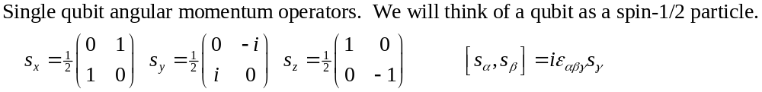
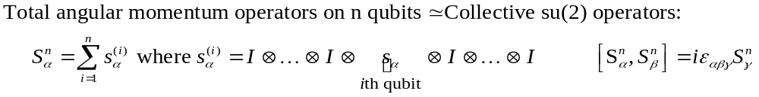
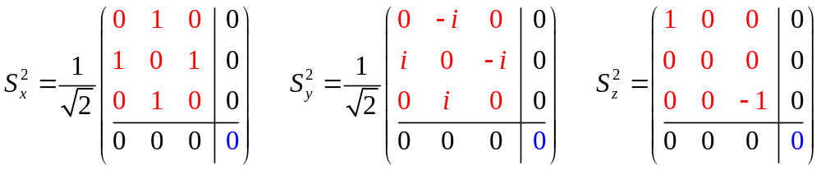
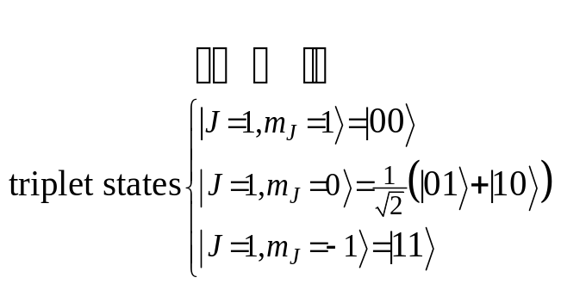
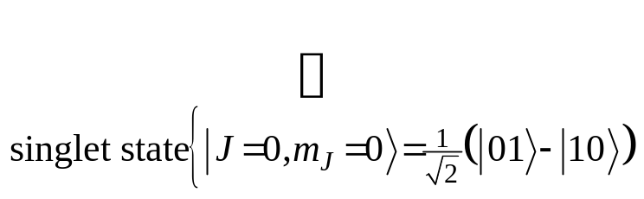
Collective Operations
Intro quantum mechanics: addition of angular momentum for two spin-1/2 particles. •Two spin-1/2 can be combined into a spin-1 triplet and a spin-0 singlet.

Slide 5
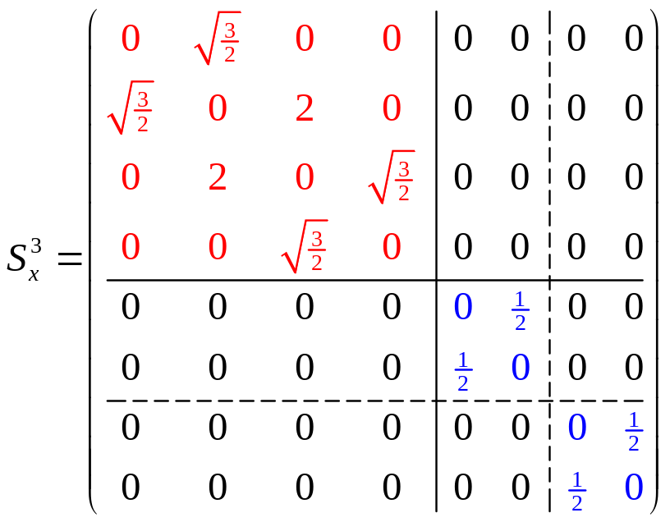
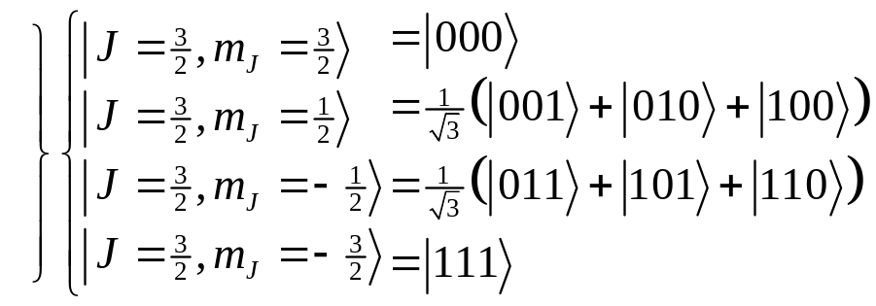
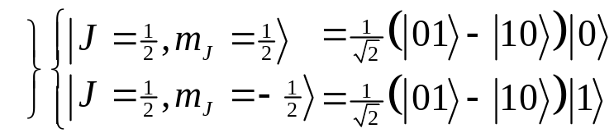
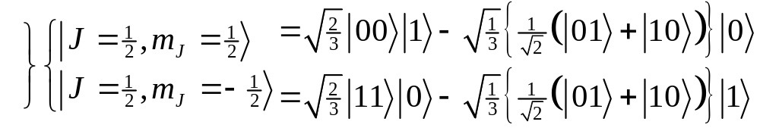
Degeneracy
Something special happens with three particles…
spin-1 (triplet) plus spin-1/2 can produce either a spin-1/2 or a spin-3/2.
spin-0 (singlet) plus spin-1/2 can produce spin 1/2.
These spin-1/2 states come from combining a spin-0 two qubit state and a spin-1/2 single qubit state
These spin-1/2 states come from combining a spin-1 two qubit state and a spin-1/2 single qubit state
There is a DEGENERACY in the action of the 3 qubit collective su(2) operation!

