Slide 1









Quantum Computation with Quantum Dots:
Decoherence and Fidelity Limits
K. B. Whaley, UC Berkeley
whaley@socrates.berkeley.edu / www.cchem.berkeley.edu/~kbwgrp
Objectives
Universality of Exchange
Overcoming decoherence limitations to scalable quantum computing realizations
Decoherence prevention, error correction, and fault tolerant computation
Development and simulation of realizable models for QC employing quantum dots
1
2
3
4
5
Objective Approach
Status
Control of decoherence via Subspace or Subsystem selection (DFSs)
Universal, fault tolerant QC on DFS
Optimal design of quantum dot implementations
Numerical Simulation of QC models
Universal QC achieved using 2-body exchange interaction only
Fault tolerant QC demonstrated on DFSs
Explicit gate sequences for some DFSs
Proposal for QC on quantum dots connected with linear support

Slide 2
Research Plan
Quantum Computing with Quantum Dots:
Decoherence and Fidelity Limits
K. B. Whaley, UC Berkeley
Progress on last year’s objectives
- DFSs shown to be stable under exchange errors
- fault tolerant quantum computation demonstrated on decoherence free subspaces
and subsystems (DFSs)
- explicit gate sequences derived for QC on DFSs defined by: i) collective decoherence,
and ii) multiple qubit errors
- universal quantum computation shown to be achievable using 2-body
exchange as the only physical interaction
- low decoherence QC scheme using quantum dots connected with linear support
Research plan for the next 12 months
- search for other physical interactions possessing asymptotic universality
- physical realizations of DFSs and computation thereon
- stochastic wave function simulations: QC based on exchange interaction,
QC on quantum dot arrays, minimizing decoherence via DFSs, …
- investigation of spin coherence in quantum dots
Long term objectives
- overcome decoherence limitations to scalable quantum computation
- characterize physical systems for fault tolerant, universal QC with DFS-QECCs
- establish realistic scenarios for scalable qubit registers employing quantum dots

Slide 4

Cult of Universality
Universal Quantum Computer
 a quantum computer which can be programmed to perform any algorithmic manipulation on quantum information.
U(2)
Set of Universal Quantum Gates
 a set of operations/gates which, acting on the quantum information, can be used to implement (to any desired accuracy) any unitary evolution of the quantum info.
The Royal King and Queen of Universal Quantum Gates
CNOT and 1-qubit rotations

Slide 5
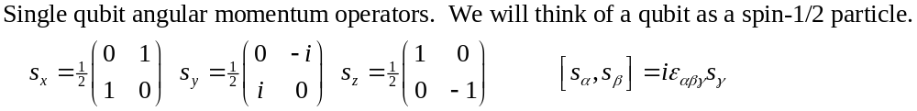
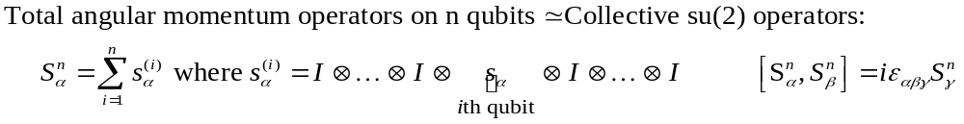
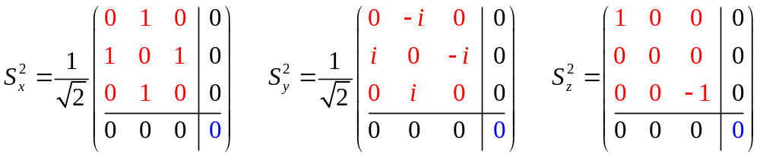
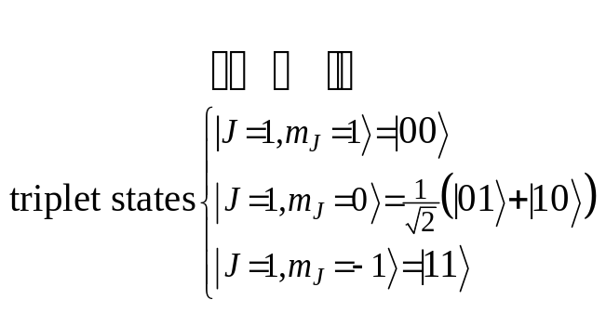
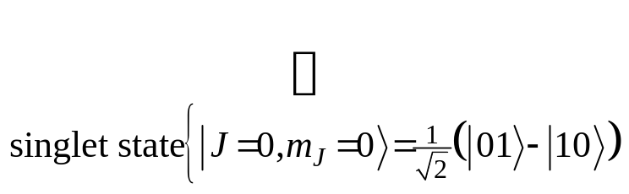
Collective Operations
Intro quantum mechanics: addition of angular momentum for two spin-1/2 particles. •Two spin-1/2 can be combined into a spin-1 triplet and a spin-0 singlet.

Slide 6
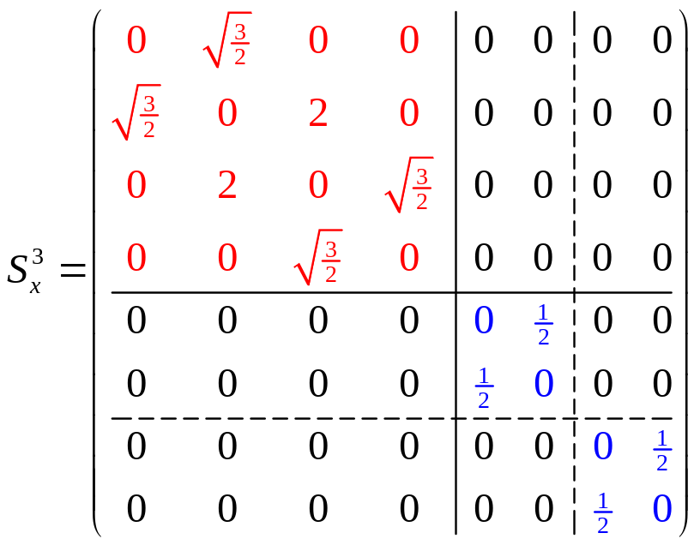
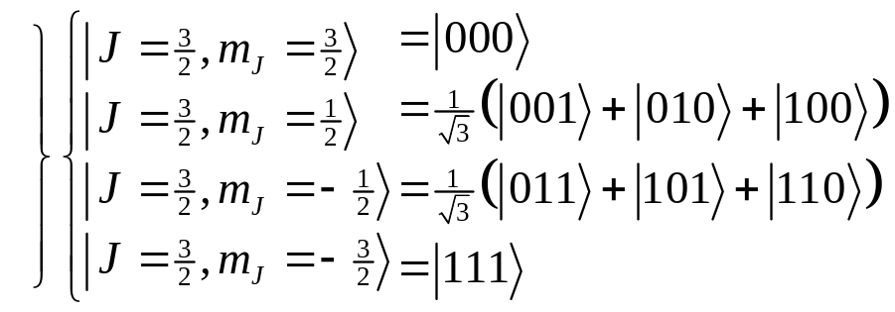
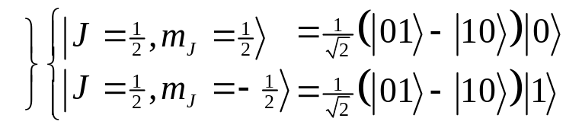
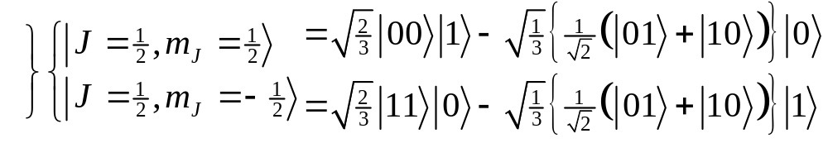
Degeneracy
spin-1 (triplet) plus spin-1/2 can produce either a spin-1/2 or a spin-3/2.
spin-0 (singlet) plus spin-1/2 can produce spin 1/2.
These spin-1/2 states come from combining a spin-0 two qubit state and a spin-1/2 single qubit state
These spin-1/2 states come from combining a spin-1 two qubit state and a spin-1/2 single qubit state
There is a DEGENERACY in the action of the 3 qubit collective su(2) operation!

Slide 7
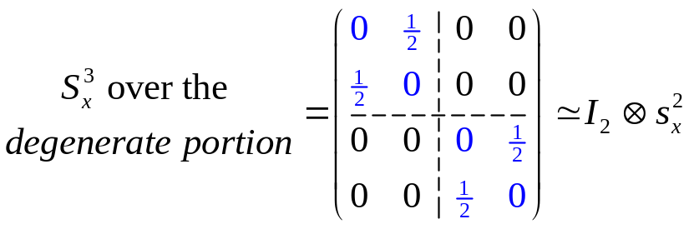
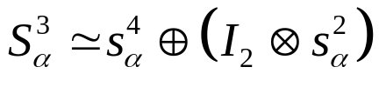
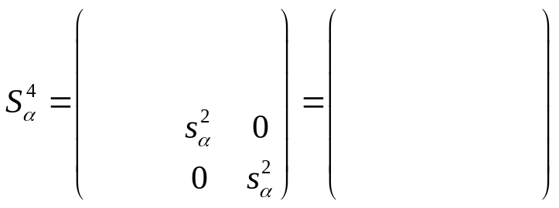
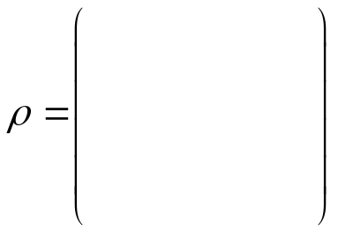



Protection
(KLV) Emanuel Knill, Raymond Laflamme, Lorenza Viola, Phys. Rev. Lett. 84, 2525 (2000)

Slide 8
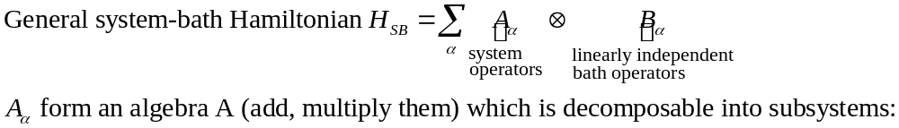
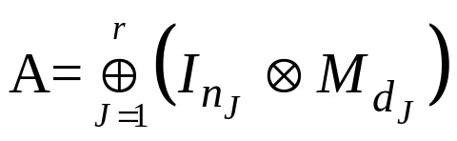


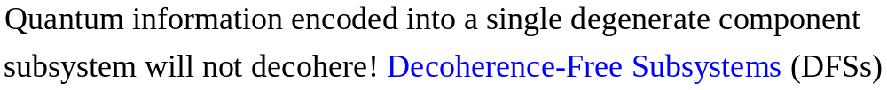
Decoherence-Free
Subsystems (KLV)
“The universe is an enormous direct product of representations of symmetry groups” - Steve Weinberg
(KLV) Emanuel Knill, Raymond Laflamme, Lorenza Viola, Phys. Rev. Lett. 84, 2525 (2000)

Slide 9
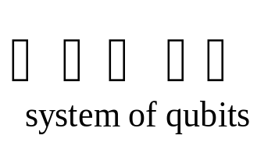
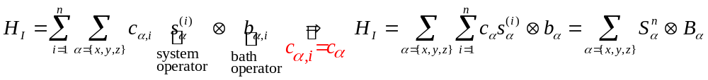
Collective Decoherence
Bath mode with a wavelength much longer than the inner qubit spacing
bath
Acts on i^{th} qubit
system-bath Hamiltonian
Collective decoherence in quantum optics terms is “Dicke subradiance”.
Expect collective decoherence in systems of trapped qubits with small inner qubit spacing.
Promising systems: atoms trapped in a cavity, solid state systems at low temperatures, etc.

Slide 10


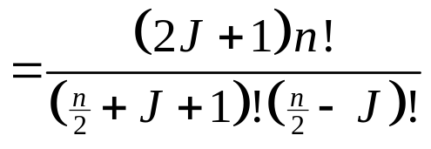


Collective DFSs
1
1
Degeneracy of the n qubit, total angular momentum J collective su(2) operators
= dimension of quantum information which can be encoded into the corresponding DFS.
1
6
1
5
1
4
14
1
3
9
1
2
5
14
The J=0 irreps of su(2) are 1 dimensional Decoherence-Free Subspaces.
1
2
5
1
2
3
4
5
6
7
A nice set of basis states for a (n,J) DFS can be labeled by the path taken when constructing the (n,J) DFS via addition of angular momentum.

Slide 12
How do we perform quantum computation on the information of a (n,J) DFS?
Can we do this using only one or two-qubit interactions?

Slide 20
Whaley Group Members
Professor K. B. Whaley Department of Chemistry
Postdoc: Dr. Daniel Lidar (leaving for faculty of University of Toronto)
Graduate Students:
Physics
Mathematics
Chemistry

