Slide 1
Abstract:
Decoherence-free subspaces and their generalization, decoherence-free subsystems (both refered to as DFSs here), are an alternative to quantum error correction (QEC) for dealing with the problem of performing quantum computation in the presence of a noise inducing environment. Proper encoding of quantum information in a DFS sheilds the information from the effects of decoherence. Here we discuss specific forms of decoherence in which the system couples collectively to the bath. We first induce an analogue of the QEC stabilizers for DFSs and show how this can be used to identify properties of the of DFS. We then show that this allows for fault-tolerant quantum computation on the collective DFSs. The fault tolerant computation on the collective DFS can be performed with one and two-qubit interactions which always preserve the integrity of the quantum information. This natural fault tolerance is possible due to a duality between DFSs and QEC. The results of this study also have immediate consequences for computation using the exchange interaction.

Slide 2
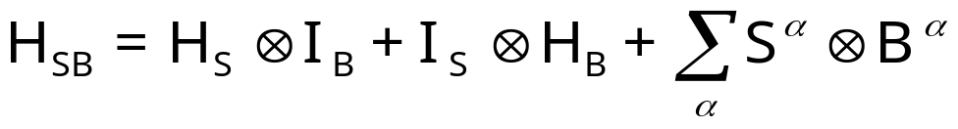
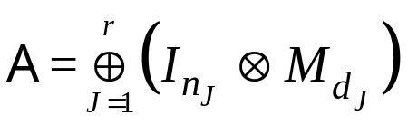


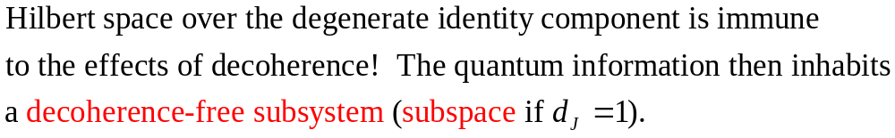
Subspaces and Subsystems:
E. Knill, R. Laflamme and L. Viola,
Phys. Rev. Lett. 84, 2525 (2000)
System
Bath
Interaction causing
DECOHERENCE
System evolution
Bath evolution
Expansion into
system and bath
operators

Slide 3
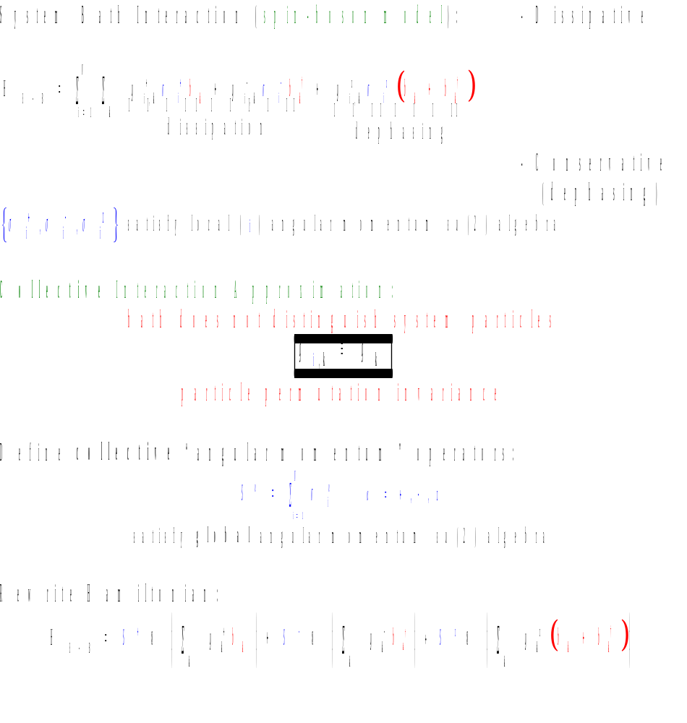



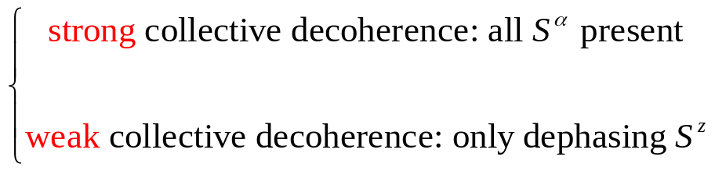
Collective Decoherence:
●
bath boson mode
Δx

Slide 4
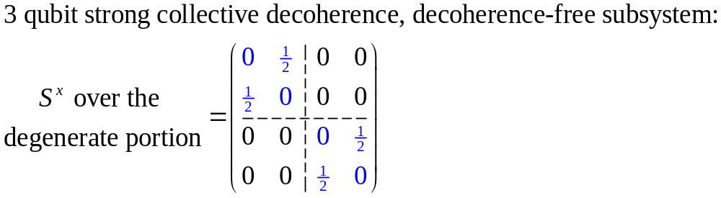
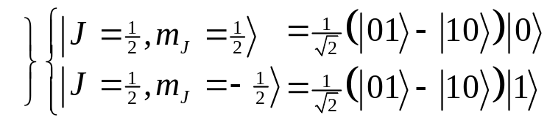
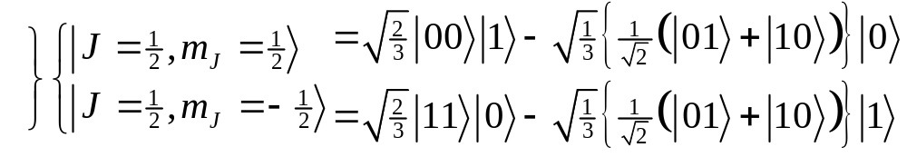

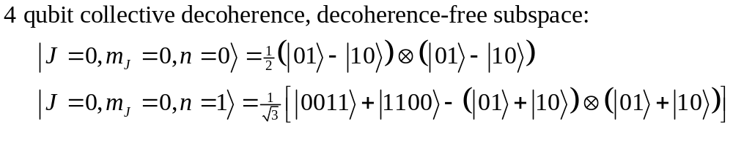
Strong Collective DFS Examples:
Information encoded over the degenerate component will not decohere!
Information encoded over the subspace will not decohere
J
2
1
4
Multiplicity=dimension of DFS
3/2
1
1
1
3
9
1/2
1
2
5
14
1
2
5
14
N
1 2 3 4 5 6 7 8

Slide 5
Weak Collective DFSs

Slide 6
Gates for computation:
Here we first state what fault-tolerance means for DFS and QECC:
(never leaves the DFS versus in QECC at beginning and end)
Also we impose the locality requirement on the operations.
Then we use the commutant to get Exchange.

Slide 7








Results:
3
1
Exchange can be used to perform su(d)’s on each of the DFSs.
Each su(n) can be inacted when the others turned off (independent action on each J irrep)
su(d) means we have a d dimensional Hilbert space (encoded) and we can perform all unitary manipulations on this d dimensional Hilbert space!
2
5
1
9
5
0
1
2
3
4
5
6
Exchange produces fault tolerant quantum computation on collective decoherence-free subsystems!!!

Slide 8
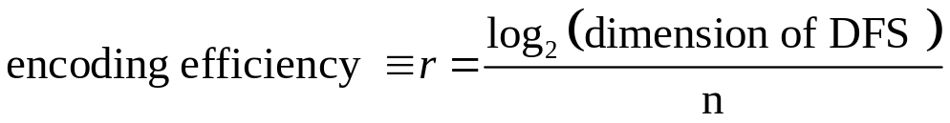
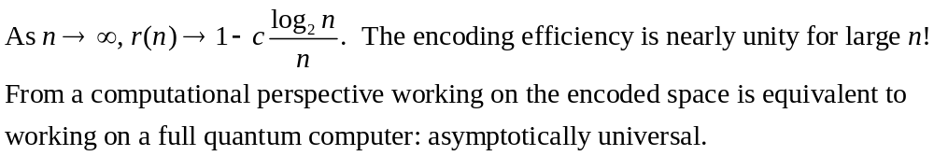
Asymptotic Universality:
The Exchange Hamiltonian is ASYMPTOTICALLY UNIVERSAL
Concatentation

Slide 9
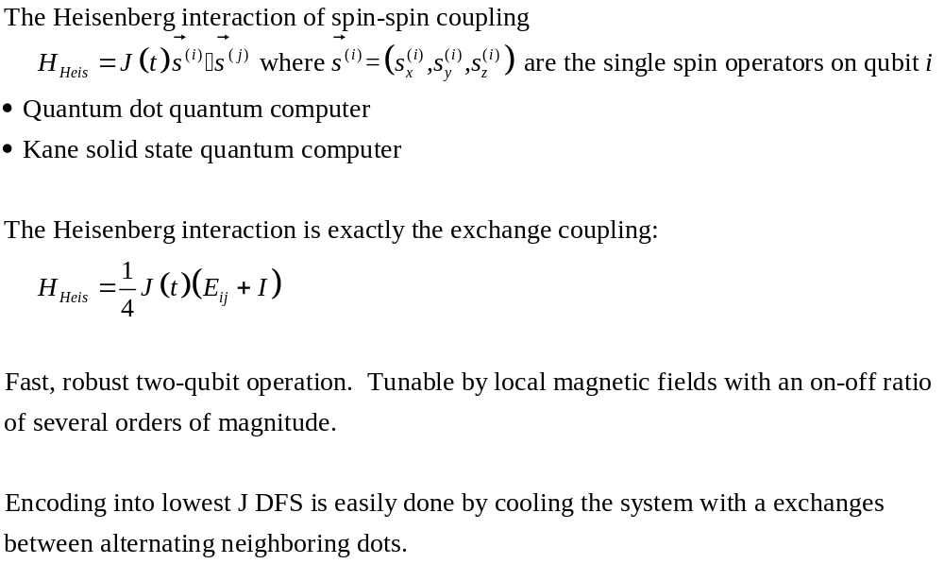
Exchange interactions:
There is no need to supplement the proposals by single qubit gates

Slide 10
QECC versus DFS:
Quantum Error Correcting Decoherence-Free
Code for independent Subsystems for collective
decoherence decoherence
errors local local
error coupling local global
to bath
mode active passive
fault must preserve code between must not leave the code
tolerance gate operations during gate operations
fault must leave codespace natural fault tolerance
tolerance during one and two body provided by the two body
results interactions exchange interaction

Slide 11
Summary and Conlusions:
Mention recent work with DiVincenzo. Mention that similar method
can be used to analyze power of other given interactions. Introduce
this whole philosophy.
Mention Euler angles and 19 gate solution.

Slide 12

Acknowledgements:
We acknowledge funding by the U.S. ARO under
DAAG 55-98-1-0371.
J.K. acknowledges funding
by U.S. NSF DMS-9971169.
References:
Dave Bacon, Julia Kempe, Daniel Lidar, K. B. Whaley, “Universal Fault-Tolerant Computation on Decoherence-Free Subspaces” quant-ph/9909058. (1999)
Julia Kempe, Dave Bacon, Daniel Lidar, K. B. Whaley, “Theory of Decoherence-Free Fault-Tolerant Universal Quantum Computation.” quant-ph/0004064. (2000)
David DiVincenzo, Guido Burkard, Julia Kempe, Dave Bacon, work in progress (2000)

